Slide 1
TDT4258: Low-Level Programming
Assembly Programming
Input/Output devices and handling
Rakesh Kumar
( & Lasse Natvig)
Computer Architecture Lab
Department of Computer Science
Some of the slides are based on other courses around the world: University of Edinburgh, NTNU, etc.

Slide 2
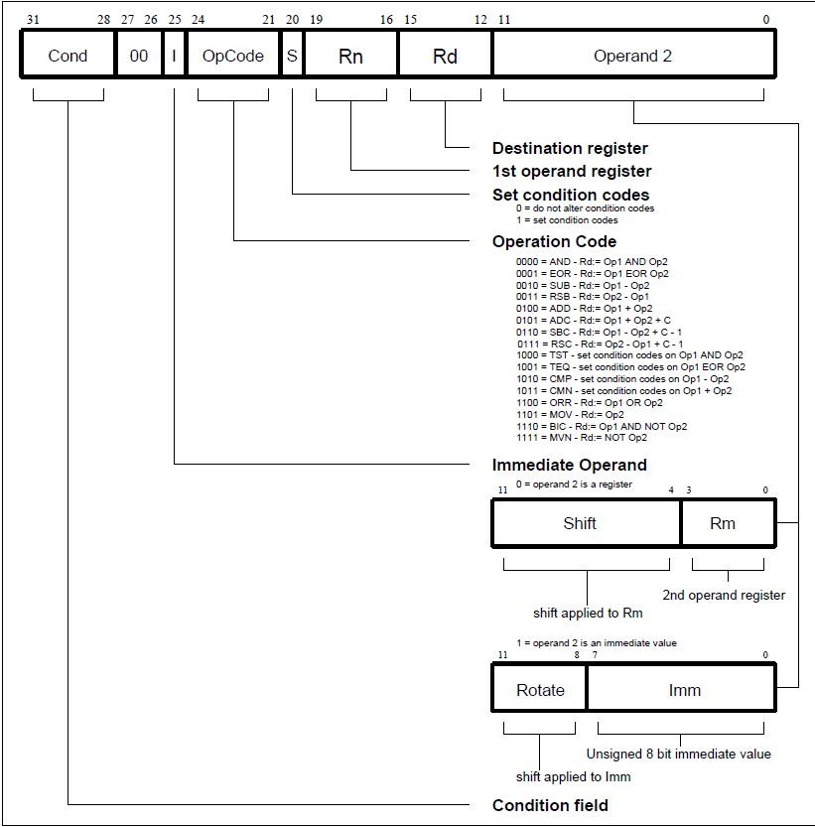
Moving immediate values to registers
For small immediate (8-bits)
  mov r3,#val ; val can be 0 to 255
  mvn r3,#val ; val can be -256 to -1
For larger values
  ldr r3,=val ; val can be any 32-bit value
ldr is a pseudo-op again! But this time, it loads a value instead of an address to the register.

Slide 3
Conditionals in an assembly program
High Level Language Code
Assembly Code
int a = 1;
int b = 2;
int x;
if(a < b) {
x = 1;
} else {
x = 2;
}
Use conditional instructions (CMP, xxxGE, xxxLT)
LDR, STR, B
Branch: B label
.section .text
ldr r0, =vars
ldr r1, [r0]
ldr r2, [r0, #4]
cmp r1, r2
bge else
mov r2, #1
b endif
else:
mov r2, #2
endif:
str r2, [r0, #8]
.section .data
vars:
.word 1 ; a
.word 2 ; b
.word 0 ; x
Evaluates r1 - r2; updates flags, discards the result
Labels: Avoid the need to calculate instruction addresses

Slide 4
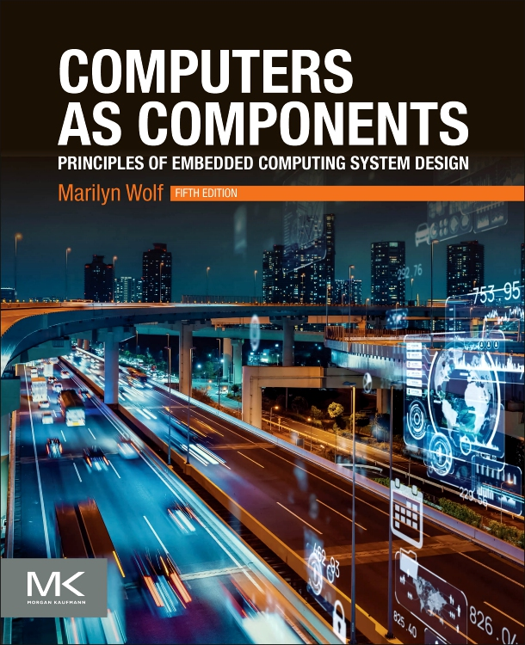
Loops in assembly
High Level Language Code
Assembly Code
.section .text
ldr r0, =vars
ldr r1, [r0]
ldr r2, [r0, #4]
loop: cmp r1, r2
beq end
; loop body
b loop
end:
.section .data
vars:
.word 1 // a
.word 2 // b
int a = 1;
int b = 2;
while(a != b) {
//loop-body
}
Chap.
2.3.3

Slide 5
Loops in assembly
High Level Language Code
Assembly Code
.section .text
ldr r0, =vars
ldr r1, [r0]
ldr r2, [r0, #4]
loop: cmp r1, #0
beq end
cmp r2, #0
beq end
; loop body
b loop
end:
.section .data
vars:
.word 1 // a
.word 2 // b
int a = 1;
int b = 2;
while(a && b) {
//loop-body
}

Slide 6
Function/procedure/method calls
Essential even for a small program
Most ISAs provide some support for such calls
High-level language code
…
foo(a, b);
…
foo(a, b);
…
How to pass these parameters?
void foo(int a, int b) {
…
return;
}
where do we return to?

Slide 7
ARM support for function calls
Jumping to a function: bl label
  bl is “branch and link”
    set r14 (Link Register) to PC+4
    set PC to label
Returning from a function
  Needs to move LR to PC
    E.g. mov r15, r14 will do the trick
  No special instruction
Here, PC is the address of the current instruction being executed, and PC+4 is the next instruction to execute when the call has returned
Notes:
Note: added the text in the box since this is different from what happened on CPUlator in video 2 about pseudo operations

Slide 8
Function call in assembly
High Level Language Code
Assembly Code
add:
add r0, r0, r1
mov r15, r14
main:
mov r0, #5
mov r1, #10
bl add
int add (int a, int b) {
return a+b;
}
main() {
int x=5, y=10;
add(x, y);
}
But wait!
  We never passed the parameters to the callee!
  Neither did the callee return the result.

Slide 9
ARM register convention on function calls
Parameters are passed:
  In registers r0 to r3
  Additional parameters are passed via stack
Values are returned in r0-r1
Callee saved registers: r4-r12
Callee saved registers: r4-r11
  R12 is a (Intra-procedure-call) scratch register according to ARM Procedure Call Standard
    A convention, we are not following all of it to full detail
Special registers:
R15 = PC
R14 = LR (link register)
R13 = SP (Stack Pointer)
R12 = IP (scratch)
Notes:
* Scratch register, use as you like, must be agreement, also with compiler --- w do not go into details for it, updated slide, made a note on the video
* The link also tells us that we can call r0 to r3 for a1 (argument 1), a2 (argument 2) etc., and r4 as v1 (variable 1), r5 as v2 etc… Also on RPi4 symbolic names can be used (TODO: make a slide on all this later, 2026??)

Slide 10
Nested function calls in assembly
R14 = LR (Link Register)
R15 = PC (Program Counter)
High Level Language Code
Assembly Code
addNum:
add r0, r0, r1
mov r15, r14
add:
bl addNum
mov r15, r14
main:
mov r0, #5
mov r1, #10
bl add
int addNum (int a, int b) {
return a+b;
}
int add (int a, int b) {
return addNum(a, b);
}
main() {
int x=5, y=10;
add(a, b);
}
r14
Problem: Overwrites the link register (r14)
Solution: Use stack to saved the return address

Slide 11
Stack
Stack is a region of memory that operates in last-in first-out manner.
Stack Pointer (r13) points to the last occupied position in the stack.
Stack grows downwards from higher address towards lower addresses
Special instructions to access stack:
  push to store data on stack. e.g. push {r4, r5}
  pop to load data from stack. e.g. pop {r2}

Slide 12
Stack examples
R13 = SP (Stack Pointer)
32 bits
32 bits
32
32
20
20
230
SP (r13)
230
SP
#r1
#r1
#r2
#r2
push/pop Example:
push r1
push r2
pop r2
pop r1
load/store Example:
sub r13, r13, #8
str r1, [r13, #4]
str r2, [r13]
add r13, r13, #8
pop order is reverse of push order

Slide 13
Nested function calls using stack
R14 = LR (Link Register)
R15 = PC (Program Counter)
High Level Language Code
Assembly Code
addNum:
add r0, r0, r1
mov r15, r14
add:
push {r14}
bl addNum
pop {r15}
mov r15, r14
main:
push {r14}
mov r0, #5
mov r1, #10
bl add
pop {r15}
int addNum (int a, int b) {
return a+b;
}
int add (int a, int b) {
return addNum(a, b);
}
main() {
int x=5, y=10;
add(a, b);
}
Loads the return address directly to PC

Slide 14
Other uses of stack
Stack is used to save callee-saved register (r4-r12) if they are needed in computations.
Stack can used to pass parameters and return values
  Registers are limited
Stack is also used for the local variables within the function
parameters
(caller context)
return address
local vars
Stack grows

Slide 15
Should an ISA be simple or complex?
ISAs range in complexity
ARM is relatively simple ISA
Simple vs Complex ISA:
High Level Language (HLL) Code: a[0]=b[0]+5;
Assembly Code:
  - Simple (ARM): ldr r3,[r1]
  add r4,r3,5
  str r4,[r2]
- Complex: add [r2],[r1],5
What are the trade-offs?

Slide 16
CISC vs RISC ISA
Complex Instruction Set Computer (CISC)
  register-memory architecture: appeared in early computers, like x86
  Computers programmed in assembly → HLL features as instructions
  Very few registers → operands can be in memory
  Very little memory → variable length instructions to minimize code size
Reduced Instruction Set Computer (RISC)
  Appeared in 80’s: Used in ARM, MIPS, SPARC, RISC-V ISAs
  High-level languages and compilers were already in fashion
  More register, more memory, faster clock → fixed length/format instructions for easy and fast decoding
  load-store architecture

Slide 17
The big picture
CPU-I/O
communication
Compiler, Assembler, Optimizer
C - Code
Assembly Code
CPU
I/O devices
BUS
Memory
H/W

Slide 18

Input/Output (I/O)

Slide 19
I/O devices
Device | Behaviour | Partner | Data Rate (Mbit/sec)
Keyboard | Input | Human | 0.001
Mouse | Input | Human | 0.004
Voice input | Input | Human | 0.26
Laser printer | Output | Human | ^{3.2}
Graphics | Output | Human | 800-8,000
Magnetic disk | Storage | Machine | 800-3,000
Network/LAN | Input or output | Machine | 100-40,000 (40Gbit/sec)
Chap.
3.2

Slide 20
Connecting I/O devices to CPU
I/O
Controller
data
reg
CPU
I/O
device
status
reg
Data register
  For input device: holds data read from the device
  For output device: holds data that needs to be written to the device
Status register: status of read/write operation

Slide 21
Connecting multiple I/O devices
UART
RS 232
modem
I/O interface
USB
printer
CPU
video
monitor
SATA
Serial SCSI
disk
PCIe
802.11
(wi-fi)
I/O controllers
I/O devices

Slide 22
Addressing I/O devices
Memory mapped I/O
  I/O controller registers are mapped to a dedicated portion of memory
  Regular load/store instructions can be used to access I/O devices
  I/O devices eat up some memory space → lesser effective memory
Isolated I/O space
  Other names: I/O mapped I/O, port-mapped I/O, …
  I/O devices are mapped in a separate memory space
  Special instructions to access I/O devices: in, out in x86
A processor can support both modes

Slide 23
Memory mapped I/O example Thumb
DEVICE_BASE = 0x1000
REG1 = 0;
REG2 = 4;
LDR r1, =DEVICE_BASE
LDR r0, [r1, #REG1] // read from reg1
MOV r0, #8
STR r0, [r1, #REG2] // write to reg2
base address of the device.
offsets of the device registers

Slide 24
How to Check I/O status: Is it ready?
Checking I/O status. e.g. mouse or keyboard click
Polling (busy-wait I/O)
  CPU monitors I/O (continuously/regularly) to find if it is ready
  Waste of CPU time especially for event happening infrequently
  CPU reacts fast
Interrupt
  I/O controller interrupts CPU to signal I/O event (device is ready)
  Slow response: CPU needs to finish what it was doing
  Better CPU utilization

Slide 25
Interrupt Interface
I/O
Controller
data
reg
Chap.
3.2
CPU
Interrupt request
Interrupt acknowledge
Data/address
status
reg

Slide 26
What happens on an interrupt?
CPU saves the address of the current instruction
  needs to return to this PC after handling the interrupt
Jump to the interrupt handler
Handle the interrupt
  service the I/O device
  need to preserve registers, just like procedure call
Return to the foreground program
  The one which was execution when the interrupt arrived
  Special instruction to return from interrupt handler
Most of the functionality is similar to procedure call

Slide 27
Connecting multiple I/O devices
Device 1
CPU
Device 2
Interrupt request
CPU must have enough ports for all devices

Slide 28
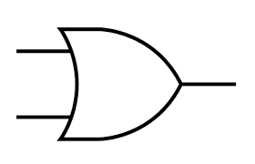
Connecting multiple I/O devices
What if there are more devices than interrupt ports on CPU?
Device 1
CPU
Device 2
Device 3
Device n
CPU needs to poll to check which device triggered the interrupt.

Slide 29
Connecting multiple I/O devices
What if there are more devices than interrupt ports on CPU?
Device 1
CPU
Device 2
Interrupt
Controller
Device 3
Device n
Interrupt Controller arbitrates CPU access among devices

Slide 30
Handling multiple devices
So many devices, so much trouble
How to find interrupt handlers of a device?
What happens if two devices request interrupt at the same time?

Slide 31
Finding the interrupt handler
Approach 1:
  Jump to a predefined address
  Then use cause of interrupt (device id) to branch to a the right handler
Approach 2:
  Directly branch to a specific handler based on interrupting device
  Called vectored interrupts

Slide 32
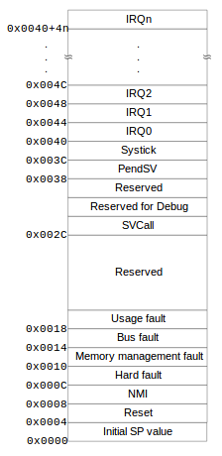
ARM vector interrupt table

Slide 33
Which interrupt to handle first?
Interrupt Priority
Interrupts are assigned priorities
A high priority interrupt is handled before a low priority interrupt
Interrupts can arrive while other interrupts are being handled
  An interrupt with higher priority will interrupt the execution of the lower priority interrupt
  Lower priority interrupts will be ignored while a higher priority interrupt is being handled
  A “priority register” stores the priority of currently executing interrupt
CPU can mask interrupts while doing something important
  E.g. lower priority interrupts are masked while handling higher priority interrupts
Some interrupts are non-maskable (NMI)

Slide 34
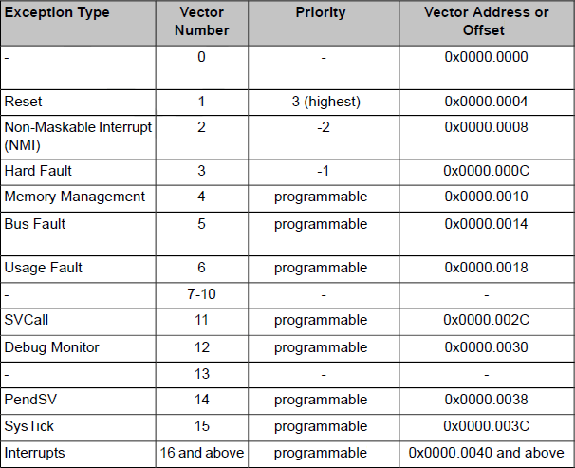
ARM interrupt priority

Slide 35
Summary of interrupt handling
I/O device: Raises interrupt
CPU: Checks pending interrupts every cycle. Acknowledges the highest priority interrupt (higher than of priority register)
I/O device: Sends its interrupt vector number to the CPU on receiving acknowledgement
CPU: Saves state (PC, other registers) and jumps the interrupt handler
Software: Performs required I/O operation. Might need to save additional CPU state.
CPU: Restores the state and PC and returns to execution where it was interrupted

Slide 36
Exceptions and Traps
Similar to interrupts in that they cause CPU to break out of its normal execution path.
Exceptions
  Internal error during program execution
  Caused by invalid conditions during instruction execution e.g. divide by zero, invalid opcode, illegal memory access, …
  Handled in the same way as interrupts
  Like interrupts, exceptions are vectored and prioritized
    ARM vector table we saw had both interrupts and exception handlers
Traps
  Explicitly generated by special instructions (not errors)
  Used to request operating system services
  SWI instruction generates traps in ARM ISA

Slide 37
Interrupts/Exceptions/ Traps
Word of caution: Terminology is not consistent
TDT4258 uses the terminology that we have seen so far (the same is also defined in the text book)
Alternate terminology:
  Exception: Any event that interrupts normal program flow and causes CPU to break out of running program
    This would include all Interrupts, Exception, and Traps of the text book terminology
  Interrupt: External exception generated by I/O devices
    Same as text book definition
  Trap: Internal exception generated by program execution
    Includes both Exception and Traps of text book definition

Slide 38
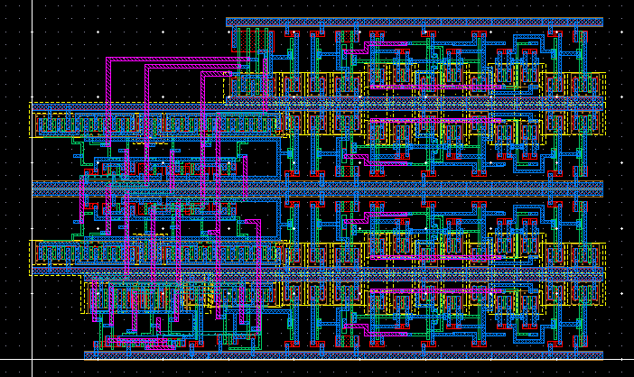
Buses
Chap.
4.3

Slide 39
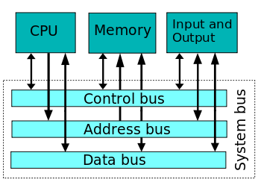
Bus
Double meaning
#1: Collection of wires that run between components like CPU, I/O
#2: The protocol that governs the communication between two devices

Slide 40
Bus Signals
Address bus: n wires that specify an address. Often unidirectional
Data bus: n wires that carry data. Often bidirectional
Control bus: wires to implement bus protocol e.g. read, write, interrupt request, etc. Often bidirectional but most individual wires are unidirectional

Slide 41
How to communicate over bus
Four stage handshake
Device 1 raises enquiry signal
Device 2 acknowledges
- Data transfer happens
One of the devices lowers its signal
Other device terminates operation
Device 1
req
Device 2
ack
data xfer
Device 1
Enq
Device 2
Ack
1
2
3
4
time

Slide 42
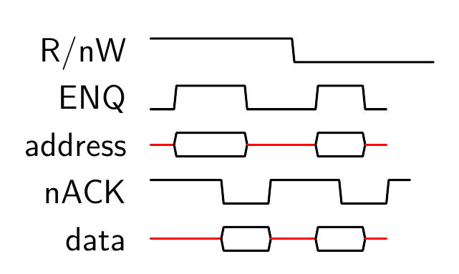
Asynchronous bus read/write
Asynchronous bus: Events can happen at any time.
Active High
Active Low

Slide 43
Synchronous bus read/write
Synchronous bus: Events are synchronized with a clock signal.

Slide 44
Wait States
Slow devices are not able to provide data at next clock cycle
No activity

Slide 45
Burst Transfer
Transfers multiple words in a single request

Slide 46
Direct Memory Access
DMA Controller: A device that manages data transfer between memory and I/O devices without CPU intervention
CPU setup the DMA for bulk data transfer by initializing its registers:
  Address register: Starting address for the data transfer
  Length register: Number of words to be transferred
  Status register: status of the transfer, initiate transfer, etc
DMA controller interrupts CPU when the transfer is done

Slide 47
Direct Memory Access
Parallel computation and data transfer
CPU is free

Slide 48
What does CPU do during DMA?
CPU executes instructions using data from registers and caches
  Caches are small and fast memories inside CPU.
  We will cover caches in next lecture.
CPU does not need buses during DMA if the data in caches is enough to keep it busy
  Otherwise, it needs to wait for DMA to finish
Reducing CPU wait cycles:
  DMA transfers only few words and returns the bus control to CPU
  DMA requests bus control by asserting “Bus request” signal
  CPU gives control to DMA by enabling “Bus grant” signal if it is not using the bus
    Otherwise, DMA needs to wait until CPU finishes its transfer

Slide 49
Bus Hierarchy
CPU
slow device
bridge
memory
slow device
high-speed
device
Separate buses for slow and fast devices
  Cost optimization: slow buses are cheaper than fast buses
Slow and fast buses are connected via a bridge
Allows simple and cheap interface for slow devices
  Slow devices do not benefit from connecting to a fast bus

