Slide 1
NVMe™ Software Drivers: What’s New and What’s Supported?
Scott Lee – Windows; Sudhanshu Jain / Murali Rajgopal – vmware; Jim Harris – SPDK Uma Parepalli, Session chair; Cameron Brett - Organizer
August 06, 2019
Sponsored by NVM Express™ organization, the owner of NVMe™, NVMe-oF™ and NVMe-MI™ standards

Slide 2



Speakers
Scott Lee
Sudhanshu (Suds) Jain
Murali Rajagopal
Jim Harris
Uma Parepalli, Session Chair
Cameron Brett, Organizer

Slide 3

NVMe Driver Ecosystem
Robust drivers available on all major platforms

Slide 4
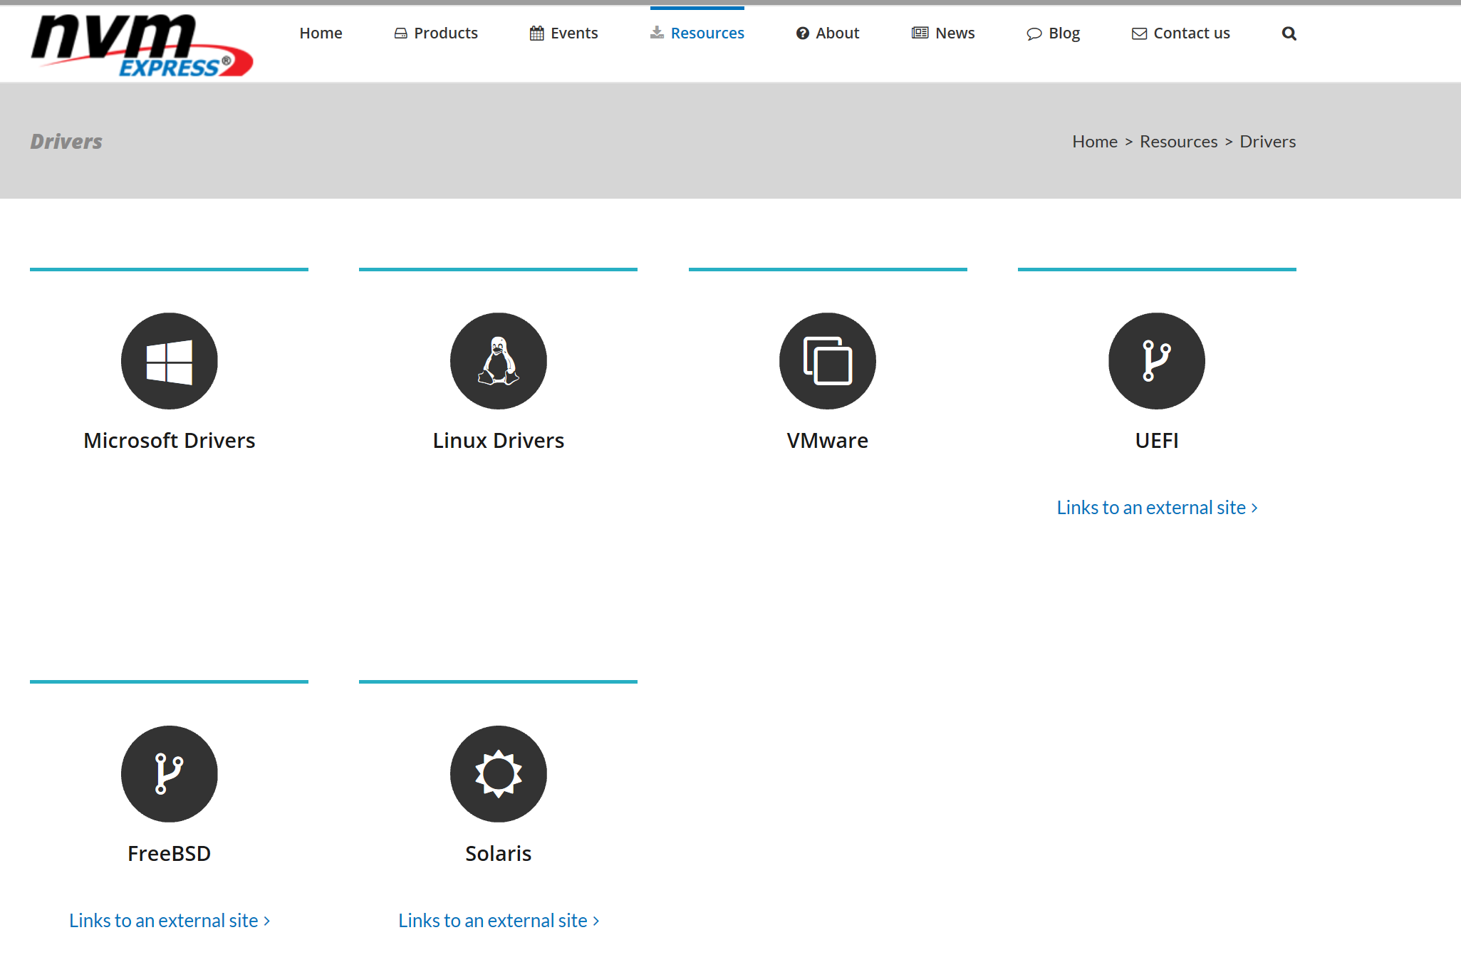
Visit NVM Express Website http://nvmexpress.org for Drivers related resources

Slide 5

UEFI NVMe Drivers – Very stable in 2019
Highly stable UEFI NVMe drivers available on Intel and ARM platforms
NVMe support available from preboot UEFI to booting all major Operating Systems.

Slide 6
Windows Inbox NVMe™ Driver
Scott Lee, Principle Software Engineer Lead, Microsoft

Slide 7
Agenda
New Additions for Windows 10 version 1903, May 2019 Update (19H1)
Windows NVMe™ Diagnostic
New Additions for Next Windows version
Futures

Slide 8
Windows 10 version 1903, May 2019 Update
TP4018/4018a: NVM Set & Endurance Group
Improved diagnostics of NVMe hardware issues
Controller Fatal Status (CFS)
Device Self-Test
Runtime D3 for NVMe™
Host Controlled Thermal Management Feature

Slide 9
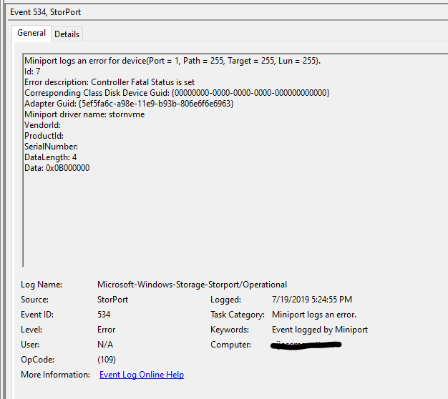
NVMe™ Diagnostic – Controller Fatal Status
Checked when Async Event Notification (AEN), controller reset (e.g. IO timeout), invalid command ID in completion entry or command failure
Storport event 534 in Microsoft-Windows-Storage-Storport/Operational channel

Slide 10
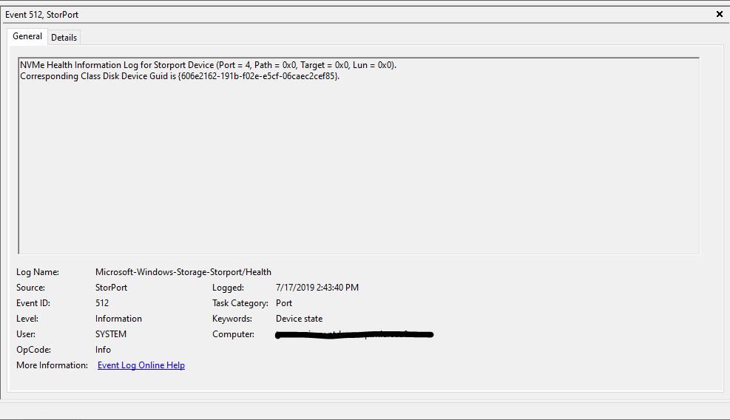
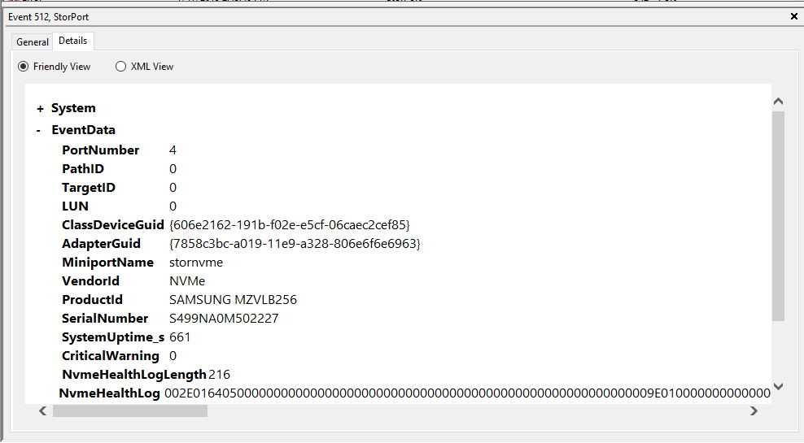
NVMe™ Diagnostic – SMART Log
Regular monitoring and logging of NVMe™ SMART/Health Informational Log
NOTE: expect drive update SMART values asynchronously to the Get Log call
Logs all contents of SMART/Health Information Log
Storport event 512 in Microsoft-Windows-Storage-Storport/Health channel

Slide 11
NVMe™ Diagnostic – AEN
Driver will send Asynchronous Event Request as part of controller initialization
Event logged when AEN indicates a warning or error event
Error Event - Critical warning bit set
Warning Event - Available spare below 2
Warning Event – Percentage used above 95
Storport event 539 for error events in Microsoft-Windows-Storage-Storport/Health channel
Storport event 543 for warning events in Microsoft-Windows-Storage-Storport/Health channel

Slide 12
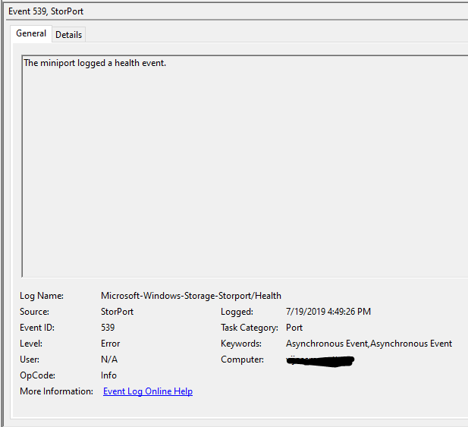
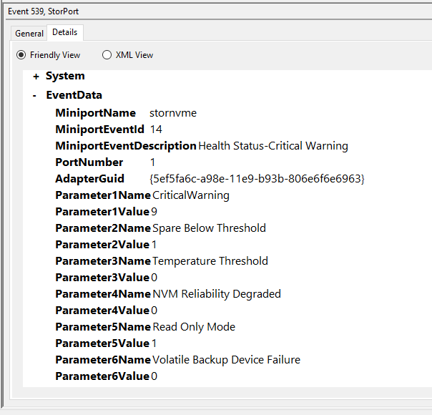
NVMe™ Diagnostic – AEN (cont)
Example AEN Error Event - Critical Failure

Slide 13
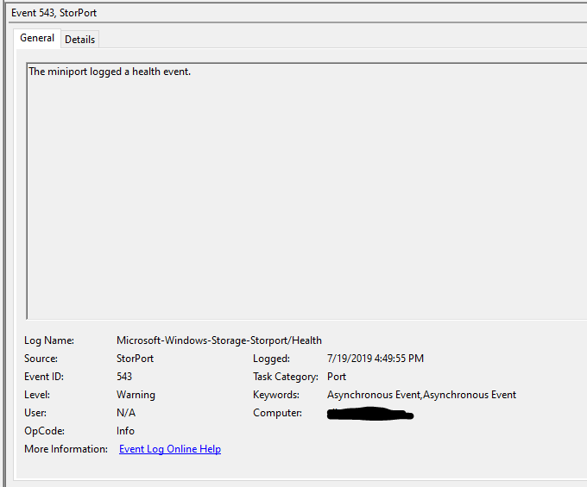
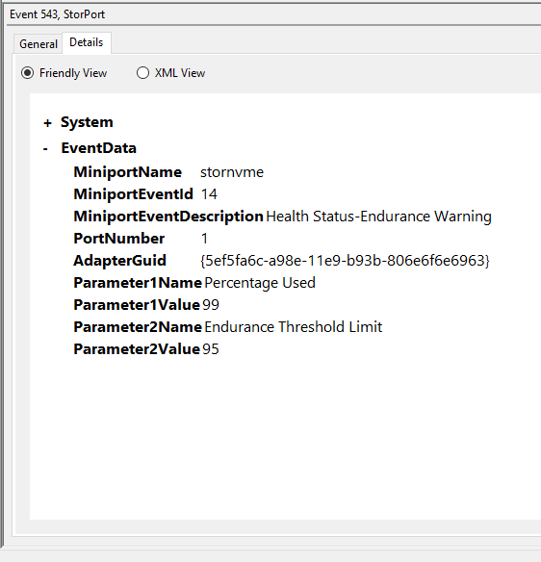
NVMe™ Diagnostic – AEN (cont)
Example AEN Warning Event – Percentage Used Above Threshold

Slide 14
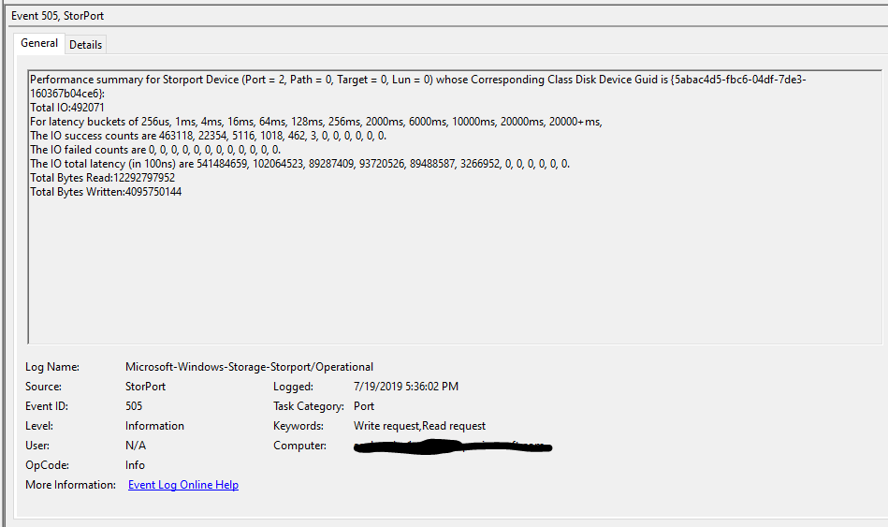
NVMe™ Diagnostic – IO Performance
Classification of IO performance into pre-defined latency buckets
Storport event 505 in Microsoft-Windows-Storage-Storport/Operational channel

Slide 15
NVMe™ Diagnostic – Command Tracing
Support for tracing of NVMe command and response data
Turn on by enabling Miniport and CommandTrace keywords for Microsoft-Windows-Storport ETW provider.
Method 1: Download Windows Performance Toolkit and run following commands in Command Prompt. Use Windows Performance Analyzer to view storport.etl.
xperf -start STORPORT -on Microsoft-Windows-Storport:0x0000200000000080:4 -BufferSize 1024 -MinBuffers 4096 -MaxBuffers 4096
<run test>
xperf -stop STORPORT -d storport.etl
Method 2: Microsoft Message Analyzer.
Add a new Live Trace and specify Microsoft-Windows-Storport as system provider. Configure the provider and select Miniport and CommandTrace keywords.
Start the session and run your test. You should start to see some events.
Stop the session to stop tracing.

Slide 16
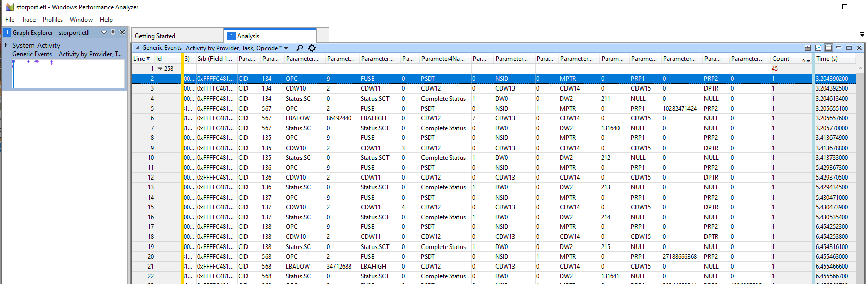
NVMe™ Diagnostic – Command Tracing (cont)
Example output from Windows Performance Analyzer

Slide 17
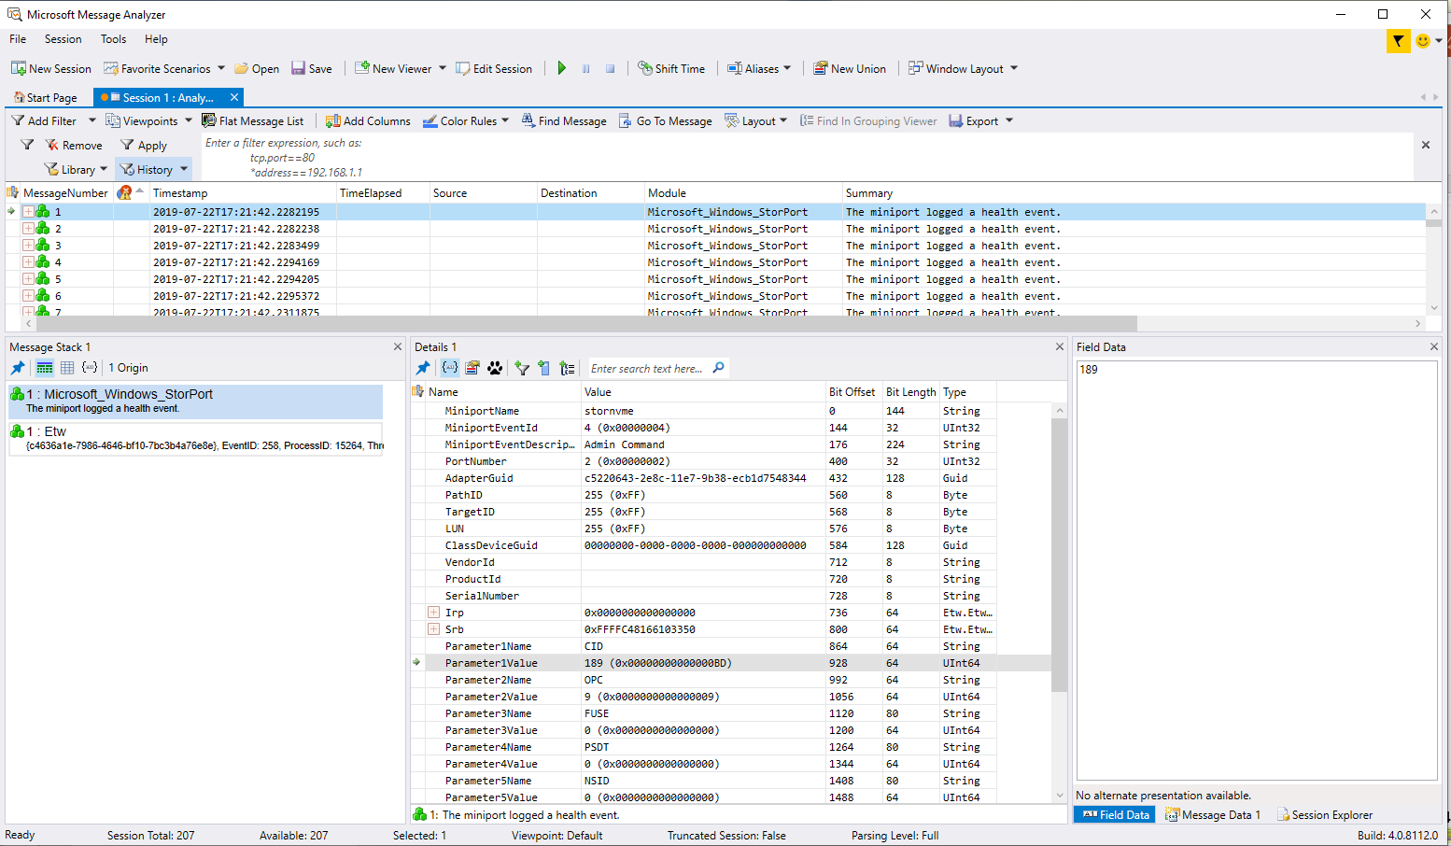
NVMe™ Diagnostic – Command Tracing (cont)
Example output from Microsoft Message Analyzer

Slide 18
Next Windows Version
Development for next Windows version in progress
Non-Operational Power State Config Feature
LED for NVMe™ Devices
ACPI-based: PCIe ® SSD Status LED Management _DSM
PCI-based: Native PCIe Enclosure Management (NPEM)

Slide 19
Futures*
Native NVMe™ Storage Stack
Zoned Namespace (ZNS)
Device Firmware Hang Detection
Runtime Hardware Reset of NVMe Devices
* Not plan of record

Slide 20
vSphere NVMe™ Driver Support
Sudhanshu (Suds) Jain and Murali Rajagopal, VMware

Slide 21
NVMe™ Focus @VMWare
vSphere 6.5
vSphere 6.7
Future Direction
Boot (UEFI)
Firmware Update
End-to-end protection
Deallocate/TRIM/Unmap
4K
SMART, Planned hot-remove
Performance enhancements
Extended CLI
Name space management
Async event error handling
Enhance diagnostic logs
PCIe Native Hot-plug
LED Management
NVMe Over Fabric
Multiple fabric option
Sanitize
Driver
Reduced serialization
Locality improvements
vNVMe Adaption layer
Multiple completion worlds support in NVMe
Optimized stack - Highly parallel execution for single path local NVMe devices
Reach target of 90%+ performance of device spec
Next Generation Storage Stack with ultra-high IOPS
End-to-end NVMe Stack
NVMe Multi-pathing, ANA
Core Stack
NVMe™ 1.0e spec
Hot-plug support
VM orchestration
Performance improvements
Async mode support
unmap support
Rev the specification
Parallel execution @backend
4K Support
Scatter-gather support
Interrupt coalescing
Virtual Devices

Slide 22
NVMe™ Performance Boost
Hardware:
Intel® Xeon® E5-2687W v3 @3.10GHz (10 cores + HT)
64 GB RAM
NVM Express* 1M IOPS @ 4K Reads
Software:
vSphere* 6.0U2 vs. Future prototype
1 VM, 8 VCPU, Windows* 2012, 4 VMDK eager-zeroed
IOMeter:
4K seq reads, 64 OIOs per worker, even distribution of workers to VMDK
vSphere 6.0
vSphere 6.7 with new Plug-in
Notes:
We can do even better than that! We are actively working to evolve the ESXi storage stack to be optimized for local SS devices. This is the stack that is used by VMFS but also VSAN itself to access the local devices.
I am presenting here one example of what we are up to.
Existing ESXi versions are doing pretty well pushing performance out of current generation SSDs. For example, we can push up to 400K IOPS from a single SSD. See the grey bars in the graph here. But as devices are evolving and become faster, we are also evolving our software stack.
The blue bars in the graph show the performance we see with a prototype that is based on a modified version of vSphere plus some additional optimizations we are working on for the future. These are IOPS numbers with an NVMe device that is spec’ed for 1M IOPS. Obviously, you need parallelism in your workload to push this device. With the new stack we can get very close to the theoretical raw performance of the device, with 4K seq reads, 64 outstanding IOs per worker, 8 workers.

Slide 23
(Future) NVMe™ Driver Architecture
vmknvme
ESXi Storage Stack
ESXi Next Generation Storage Stack
Stack Interface 1
Stack Interface 2
SCSI NVMe Translation
NVMe™ Transport Device Driver Framework
CLI
NVMe Core Functionality
NVMe-oF Transport Abstraction
PCIe Transport Driver
RDMA Transport Driver (RoCEv1, RoCEv2, iWarp)
Fibre Channel Transport Driver
Driver Interface

Slide 24
VMware’s NVMe™ Driver Ecosystem
Available as part of base ESXi image from vSphere 6.0 onwards
Faster innovation with async release of VMware NVMe™ driver
VMware Opensource its NVMe Driver to encourage ecosystem to innovate
https://github.com/vmware/nvme
Broad VMware NVMe Driver Ecosystem https://www.vmware.com/resources/compatibility/search.php?deviceCategory=io
Close to 300 third party NVMe devices certified on VMware NVMe driver
Beyond NVMe PCI Driver (Future)
Actively working with broad I/O controller and storage array partners to bring NVMe-oF solutions

Slide 25
Accelerating NVMe™ with SPDK
Jim Harris, Principal Software Engineer, Intel

Slide 26
Notices and disclaimers
Intel technologies’ features and benefits depend on system configuration and may require enabled hardware, software or service activation. Learn more at intel.com, or from the OEM or retailer.
Some results have been estimated or simulated using internal Intel analysis or architecture simulation or modeling, and provided to you for informational purposes. Any differences in your system hardware, software or configuration may affect your actual performance..
Intel processors of the same SKU may vary in frequency or power as a result of natural variability in the production process.
Intel does not control or audit third-party benchmark data or the web sites referenced in this document. You should visit the referenced web site and confirm whether referenced data are accurate.
Optimization Notice: Intel's compilers may or may not optimize to the same degree for non-Intel microprocessors for optimizations that are not unique to Intel microprocessors. These optimizations include SSE2, SSE3, and SSSE3 instruction sets and other optimizations. Intel does not guarantee the availability, functionality, or effectiveness of any optimization on microprocessors not manufactured by Intel. Microprocessor-dependent optimizations in this product are intended for use with Intel microprocessors. Certain optimizations not specific to Intel microarchitecture are reserved for Intel microprocessors. Please refer to the applicable product User and Reference Guides for more information regarding the specific instruction sets covered by this notice. Notice Revision #20110804.
The benchmark results may need to be revised as additional testing is conducted. The results depend on the specific platform configurations and workloads utilized in the testing, and may not be applicable to any particular user's components, computer system or workloads. The results are not necessarily representative of other benchmarks and other benchmark results may show greater or lesser impact from mitigations.
Software and workloads used in performance tests may have been optimized for performance only on Intel microprocessors. Performance tests, such as SYSmark and MobileMark, are measured using specific computer systems, components, software, operations and functions. Any change to any of those factors may cause the results to vary. You should consult other information and performance tests to assist you in fully evaluating your contemplated purchases, including the performance of that product when combined with other products. For more complete information visit www.intel.com/benchmarks.
Results have been estimated or simulated using internal Intel analysis or architecture simulation or modeling, and provided to you for informational purposes. Any differences in your system hardware, software or configuration may affect your actual performance.
Intel technologies' features and benefits depend on system configuration and may require enabled hardware, software or service activation. Performance varies depending on system configuration. No computer system can be absolutely secure. Check with your system manufacturer or retailer or learn more at www.intel.com.
The cost reduction scenarios described are intended to enable you to get a better understanding of how the purchase of a given Intel based product, combined with a number of situation-specific variables, might affect future costs and savings. Circumstances will vary and there may be unaccounted-for costs related to the use and deployment of a given product. Nothing in this document should be interpreted as either a promise of or contract for a given level of costs or cost reduction.
No computer system can be absolutely secure.
© 2019 Intel Corporation. Intel, the Intel logo, Xeon and Xeon logos are trademarks of Intel Corporation in the U.S. and/or other countries.
*Other names and brands may be claimed as the property of others.

Slide 27


Storage Performance Development Kit
User Space Storage Software Stack
Extreme performance (>10M IO/s on one thread)
Block device abstraction and device drivers
Network and virtualization protocols
Resets, timeouts, I/O splitting, volume management
Widely Adopted
Powering major storage systems in production today
C Libraries and Applications
Open Source (GitHub, BSD License)
Active Community (~50 contributors each quarter)
Notes:
Designed for performance!

Slide 28
SPDK Architecture

Slide 29
SPDK and Kernel
SPDK has better performance and efficiency compared to interrupt-driven kernel mode approaches
BUT...
SPDK is not a general-purpose solution
covers some use cases very well – others not at all (or at least not well)
Polled mode design and userspace implementation drove much of the SPDK design

Slide 30
NVMe™ Transport Abstraction
Enables different implementations for different transports
construct/destruct controller
set/get register value
create/delete I/O queue pair
submit request
process completions
NVMe™ Driver
NVMe Transport API
NVMe PCIe Transport
NVMe RDMA Transport
NVMe TCP
Transport

Slide 31
NVMe-oF™ Target
Compute Node
Spec-compliant, fully functional NVMe-oF™ target
No modifications on client/compute node
Supports broad range of storage services – including:
Sharing SSD across multiple clients (Logical Volumes)
At-rest data encryption with crypto offload
SSD pooling/striping
Application
OS Filesystem
OS Block Layer
OS NVMe Driver
Network Fabric
(RDMA, TCP)
SPDK Storage Node
NVMe-oF Target
Logical Volumes
NVMe SSD
NVMe Driver
NVMe SSD
NVMe SSD
NVMe SSD
NVMe SSD

Slide 32
Supported Features
Explicit Queue Pair Allocation
Metadata and Data Protection
Controller Memory Buffer
Timeout Handling
SGL
Asynchronous Attach
AER
NVMe-oF™ Persistent Reservations

Slide 33
NVMe™ /TCP
NVMe™ TP ratified November 2018
SPDK added TCP transport for
NVMe driver
NVMe-oF™ target
Supports alternative TCP stack implementations

Slide 34
Host Block FTL
Host FTL enabling smart data placement
Based on OC2.0 specification
Block FTL support added to bdev nvme module
Long term goal: Zoned Namespace API
With ZNS/OC adapters

Slide 35
NVMe™ Performance: Avoid MMIO
Past: Simple completion queue doorbell batching
Ring doorbell after processing first 3 completions
Recent: Leverage polling
Delay ringing submission queue doorbell until end of poll call
Future: Advanced completion queue batching
Track number of free cq slots
Only ring doorbell when slots are needed
P: 1
P: 1
P: 1
P: 0
P: 0
P: 0
Notes:
Everyone uses first trick. No one does second or third.

Slide 36
SPDK NVMe™ Driver Performance
https://spdk.io/news/2019/05/06/nvme/
System Configuration: 2S Intel(R) Xeon(R) Platinum 8280L (use single thread for testing), 192GB DDR4 Memory, 6x Memory Channels per socket, Fedora 29, Linux kernel 5.0.0-rc+, BIOS: HT enabled, p-states enabled, turbo enabled, SPDK 19.04+, SPDK nvme-perf tool used for benchmarking, numjobs=1, direct=1, 21x Intel P4610 1.6T SSD or 20x Intel P4800X 375GB SSD.
Notes:
CLX Xeon Platinum
21 SSDs attached in all cases
Queue depth 32

Slide 37
Questions?

