Slide 1
SPCNVMe Introduction and Design
Roy Wang
a.k.a. SmokingPC

Slide 2
TOC
NVMe Overview
Important Behavior and Sequence
Admin and I/O Queue
SCSI Translation
Reference

Slide 3
What is SPCNVMe ?
an OpenSource PCIe NVMe driver for Windows Platform
Implemented by Storport Miniport framework
Supported only Win 8+
Maybe I will make it support Win7 when I have free time.... :p
Some information are reversed from windows built-in stornvme.sys.

Slide 4
Overview

Slide 5
Logical View of NVMe system
NVMe Device
Controller
Namespace(NS) 1
Namespace(NS) 2
...... NS 3~127
PCIe

Slide 6
Logical View of NVMe system
NVMe Controller
Admin Queue Pair x1
Device Registers
I/O Queue Pairs xN
I/O Queue Pairs xN
I/O Queue Pairs xN

Slide 7
Commands of NVMe system
Admin Commands
Submit to admin queue
I/O Queue Management(create / delete)
Identify Controller and Namespace
Get LogPage (e.g. SMART infor)
Namespace Management
Firmware Management
Query / Set extra feature of controller
......etc.

Slide 8
Commands of NVMe system
NVM Commands (I/O commands)
Submit to I/O queue
Read data
Write data
Copy and verify
Flush
Write Zero
......etc.

Slide 12
Important Behavior and Sequence

Slide 13
Init Controller
shutdown controller (SHN == 1)
reset controller
Queue create/delete sequence

Slide 14
Admin and I/O Queues

Slide 16
NVMe Queue
Request
Response
Completion Queue
Submittion Queue
NVMe Device

Slide 17
NVMe Queue Concept
All queues are kind of ring buffer structure with doorbell notification .
Submittion Queue
Submit NVME_COMMAND to NVME device
After submit, update doorbell to notification device
Completion Queue
Retrieve command result from NVME device
Device trigger interrupt back to driver for notification
1 SubQ + 1 CplQ ➔ a QueuePair

Slide 18
Ring Buffer concept
Producer / Consumer model
QHead and QTail ptr
Producer updates QTail ptr (write)
Consumer updates QHead ptr (read)
If Head == Tail, queue is full.
Stop pushing entries into queue.

Slide 19
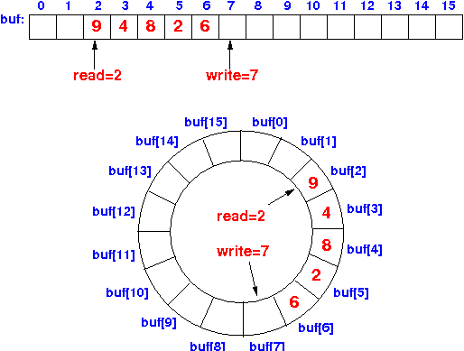
Ring Buffer concept

Slide 20
NVMe Submittion Queue
Each command put into this queue by sequence
Using NVME_COMMAND structure as entry
SubQHead and SubQTail cursor
Sender update SubQTail to indicate “where is latest submitted entry”
NVMe device update SubQHead to indicate “where is latest consumed entry”

Slide 21
How to transmit data with command
To transmit data with commands, sender have to prepare some physical pages to store data
Sender should set PRP field to store these data
Host should prepare these pages to read from/write to NVMe device.
Physical Region Page (PRP)
Scatter Gather List (SGL)

Slide 23
Admin Queue and I/O Queue
SubmitQueue
CompletionQueue
SubQ-0
Admin Q
CplQ-0
SubQ-1
I/O Queue 1
CplQ-1
SubQ-2
I/O Queue 2
CplQ-2
SubQ-3
CplQ-3
…
…
…
…
…
…
SubQ-N
I/O Queue N
CplQ-N

Slide 24
Admin Queue and I/O Queue
Each QueuePair has 1 SubmitQueue and 1 CompletionQueue
Each NVMe device has 1 Admin QueuePair and N I/O QueuePairs.
Admin QueuePair for admin command.
I/O QueuePairs for I/O requests

Slide 26
SCSI Command Translation

Slide 27
SCSI Translation

Slide 29
Reference
NVMe 1.3 spec
https://nvmexpress.org/wp-content/uploads/NVM_Express_Revision_1.3.pdf
Windows StorNVMe driver SCSI Translation Support
https://github.com/MicrosoftDocs/windows-driver-docs/blob/staging/windows-driver-docs-pr/storage/stornvme-scsi-translation-support.md

Slide 30


Slide 31
Appendix

Slide 32
History of SSD
http://www.ssdfans.com/?p=8076
https://zh.m.wikipedia.org/zh-hant/NVM_Express

