Slide 1
SPCNVMe Introduction and Design
Roy Wang
a.k.a. SmokingPC

Slide 2
TOC
NVMe Overview
Important Behavior and Sequence
Admin and I/O Queue
Command and Completion
SCSI Translation
Reference

Slide 3
What is SPCNVMe ?
an OpenSource PCIe NVMe driver for Windows Platform
Implemented by Storport Miniport framework
Supported only Win 8+
Maybe I will make it support Win7 when I have free time.... :p
Some information are reversed from windows built-in stornvme.sys.

Slide 4
Overview

Slide 5
Logical View of NVMe system
A NVMe device has controller and namespaces
Actually NVMe support multiple controller but SpcNVMe doesn’t support it yet.
Each namespace has different format(e.g. block size)
Each namespace can represent one “Disk” in windows view.
NVMe Device
Controller
Namespace(NS) 1
Namespace(NS) 2
...... NS 3~127
PCIe

Slide 6
Logical View of NVMe system
NVMe Device
Admin Queue Pair x1
Device Registers
I/O Queue Pairs xN
I/O Queue Pairs xN
I/O Queue Pairs xN

Slide 7
Logical View of NVMe system
Terms Definition in spec
Host : OS Layer which your driver running
Device : Your NVMe device
Host control / communicate / submit commands to device, get completion and result from device.
Host
(OS Layer)
Haradware Layer
NVME Device

Slide 8
Register Region and QueuePair
For NVMe device, there is one “Global” register region.
Each PCI device has its own i/o address and register address. They are used to communicate with hardware to perform actions you want.
By registers, you can enable(startup)/disable(shutdown) device, check status and other informations are done by registers.
Use QueuePair for communication
Host submit commands to device via SubmissionQueue (SubQueue)
Host retrieve command result from device via CompletionQueue (CplQueue)
1 SubQueue + 1 CplQueue == 1 QueuePair

Slide 9
QueuePairs
In device, 1 QueuePair for admin requests
E.g. register I/O queue, identify controllers and namespaces, query SMART info, setup Interrupt Coalescing…etc.
Multiple I/O QueuePairs for I/O related requests
Minimum 1 I/O QueuePair in each device, max depends on vendors
QueueSize is “How many entries a Queue has?”
Host must register queue size before use them
SubQ size can be different from CplQ size
Of course, it’s better that set same size for them.

Slide 10
Queue and Doorbell
Request
Response
Completion Queue
Submittion Queue
NVMe Device

Slide 11
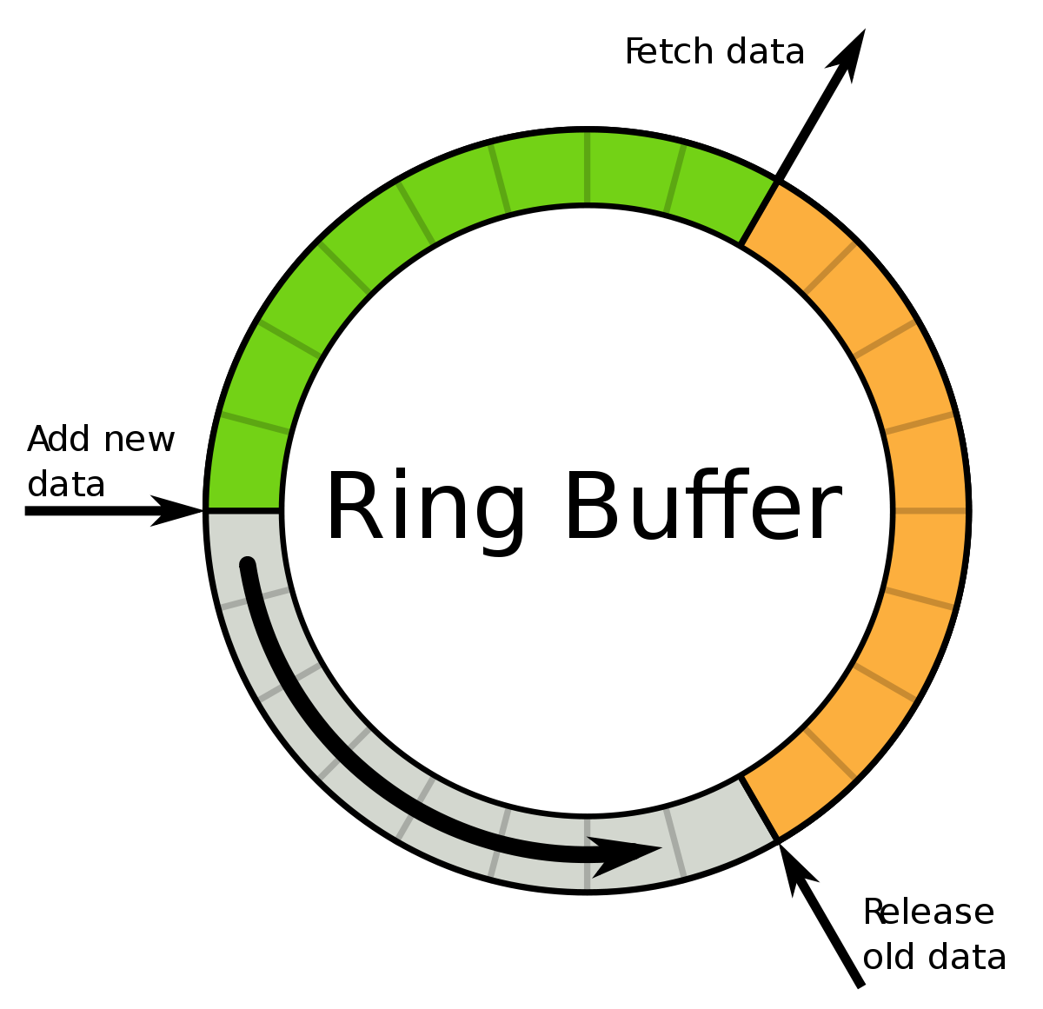
Queue and Doorbell

Slide 12
Queue and Doorbell
Both SubQueue and CplQueue are implemented by ring buffer
Producer / Consumer concept
Doorbell / Interrupt notification
Host should “notify” device when sent new request into SubQueue, and “notify” device when retrieved(picked) results from CplQueue.
Use Doorbells
Device should “notify” host when new result arrived to CplQueue.
Use Interrupts

Slide 13
Queue and Doorbell
Producer : Update index “Tail” and notify consumer
Consumer : Update index “Head” and notify producer
Doorbells are registers for corresponding queue that notify device something(head or tail) changed.
In SubQ, Host should update doorbell to tell device “new SubQ Tail”
In CplQ, Host should update doorbell to tell device “new CplQ Head”

Slide 14
Admin Cmd and I/O Cmd
The NVMe command are defined as 2 group
Admin command : set Interrupt Coalescing, register I/O queue…etc.
I/O command : Read / Write / Verify …etc.

Slide 15
Commands of NVMe system
Admin Commands
Submit to admin queue
I/O Queue Management(create / delete)
Identify Controller and Namespace
Get LogPage (e.g. SMART infor)
Namespace Management
Firmware Management
Query / Set extra feature of controller
......etc.

Slide 16
Commands of NVMe system
NVM Commands (I/O commands)
Submit to I/O queue
Read data
Write data
Copy and verify
Flush
Write Zero
......etc.

Slide 20
Important Behavior and Sequence

Slide 21
Init Controller
shutdown controller (SHN == 1)
reset controller
Queue Register/Unregister sequence

Slide 22
Admin and I/O Queues

Slide 24
NVMe Queue
Request
Response
Completion Queue
Submittion Queue
NVMe Device

Slide 25
NVMe Queue Concept
All queues are kind of ring buffer structure with doorbell notification .
Submittion Queue
Submit NVME_COMMAND to NVME device
After submit, update doorbell to notification device
Completion Queue
Retrieve command result from NVME device
Device trigger interrupt back to driver for notification
1 SubQ + 1 CplQ ➔ a QueuePair

Slide 26
Ring Buffer concept
Producer / Consumer model
QHead and QTail ptr
Producer updates QTail ptr (write)
Consumer updates QHead ptr (read)
If Head == Tail, queue is full.
Stop pushing entries into queue.

Slide 27
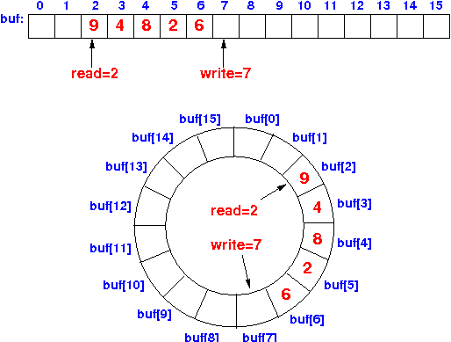
Ring Buffer concept

Slide 28
NVMe Submittion Queue
Each command put into this queue by sequence
Using NVME_COMMAND structure as entry
SubQHead and SubQTail cursor
Sender update SubQTail to indicate “where is latest submitted entry”
NVMe device update SubQHead to indicate “where is latest consumed entry”

Slide 29
How to transmit data with command
To transmit data with commands, sender have to prepare some physical pages to store data
Sender should set PRP field to store these data
Host should prepare these pages to read from/write to NVMe device.
Physical Region Page (PRP)
Scatter Gather List (SGL)

Slide 30
Admin Queue and I/O Queue
SubmitQueue
CompletionQueue
SubQ-0
Admin Q
CplQ-0
SubQ-1
I/O Queue 1
CplQ-1
SubQ-2
I/O Queue 2
CplQ-2
SubQ-3
CplQ-3
…
…
…
…
…
…
SubQ-N
I/O Queue N
CplQ-N

Slide 31
Admin Queue and I/O Queue
Each QueuePair has 1 SubmitQueue and 1 CompletionQueue
Each NVMe device has 1 Admin QueuePair and N I/O QueuePairs.
Admin QueuePair for admin command.
I/O QueuePairs for I/O requests

Slide 33
Command and Completion

Slide 34
NVME Command
Total 64 Bytes, defined in nvme.h struct _NVME_COMMAND
NVMe spec 1.3 Figure11
CDW0 : 4 bytes
NSID : 4 bytes
MPTR : 8 bytes
DPTR (PRP1 and PRP2) : 16 bytes
CDW10 ~ CDW15 : 4 bytes for each

Slide 35
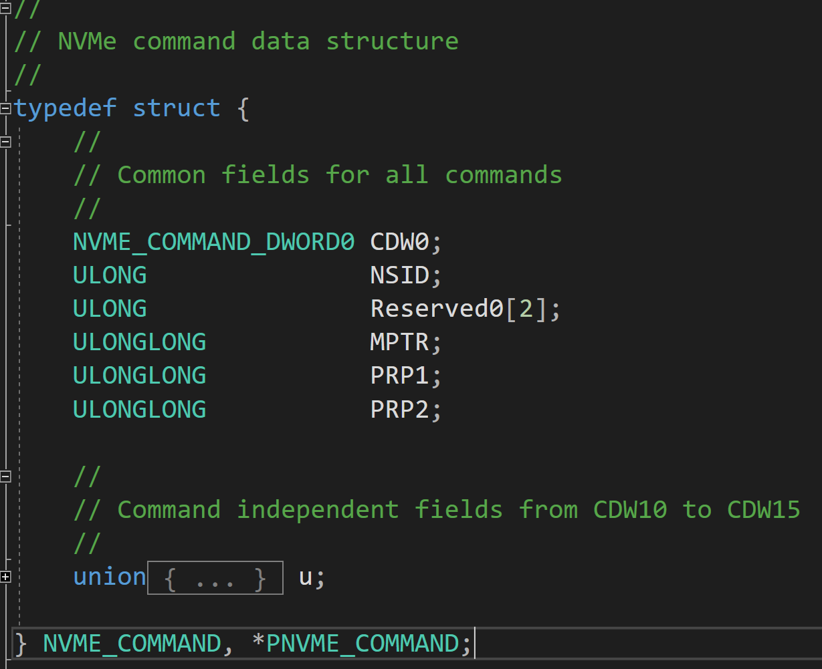
NVME Command
OpCode、Fuse、PSDT、CID
Namespace ID
PRPs
Structures for corresponding command

Slide 36
NVME Command – CDW0
Refer to NVMe 1.3 Figure 10
OpCode : cmd code. Admin and I/O command has different OpCode
E.g. NVME_ADMIN_COMMAND_IDENTIFY == 6
FUSE : fused operation
CID : command id, should be unique in entire device currently processing
PSDT : select DPTR or MPTR to transfer data. Default 00 == DPTR (use PRP)

Slide 37
NVME Command – NSID
Refer to NVMe 1.3 Figure 11
Select Namespace ID that this command applies to.
1-based index id
If cmd doesn’t need NSID, set this field to 0
If apply this command to all namespaces, set this field to 0xFFFFFFFF
Wrong NSID will cause cmd failed.

Slide 38
NVME Command – MPTR and DPTR
Refer to NVMe 1.3 Figure 11
MPTR is reserved for NVMe over Fabric (so I didn’t use)
DPTR is common way to pass data buffer with NVMe command.
I only use PRP, not SGL.
PRP contains PhysicalAddress of data buffer.

Slide 39
NVME Command – PRP (DPTR) rules
In all condition, PRP1 should be DWORD aligned at least. PRP2 should be page aligned.
All following address means “PhysicalAddress”
If buffer doesn’t across page boundary, PRP1 == address of buffer start, and PRP2 == 0
If buffer across one page boundary, PRP1 == address of buffer start, and PRP2 == next page start address
E.g. buffer va=0xffff80a000001730, pa = 0x0000000005942730 length 0xC00. PRP1 == 0x0000000005942730 and PRP2 == 0x0000000005943000

Slide 40
NVME Command – PRP (DPTR) rules
If buffer across 2 or more page boundary, PRP1 is buffer start address, PRP2 is another allocated new PAGE(1 page only). In this page stores address array of following buffer address.
E.g. assum a buffer va=0xffff80a000001730, pa=0x0000000005942730, length=0x1A00.
PRP1 == 0x0000000005942730, PRP2 == another page (assume it is 0x0000000006007000, named PHYSICAL_ADDRESS *prp2_list pointer points to this page).
prp2_list[0]==0x0000000005943000, prp2_list[1]== 0x0000000005944000

Slide 41
NVME Command –

Slide 42
NVME Command –

Slide 43
SCSI Command Translation

Slide 44
SCSI Translation

Slide 46
Reference
NVMe 1.3 spec
https://nvmexpress.org/wp-content/uploads/NVM_Express_Revision_1.3.pdf
Windows StorNVMe driver SCSI Translation Support
https://github.com/MicrosoftDocs/windows-driver-docs/blob/staging/windows-driver-docs-pr/storage/stornvme-scsi-translation-support.md

Slide 47


Slide 48
Appendix

Slide 49
History of SSD
http://www.ssdfans.com/?p=8076
https://zh.m.wikipedia.org/zh-hant/NVM_Express

