Slide 1
SPCNVMe Introduction and NVMe Pricinples
Roy Wang
a.k.a. SmokingPC

Slide 2
TOC
NVMe Overview
Important Behavior and Sequence
Admin Queue and I/O Queues
Command and Completion
Command Translation
Appendix

Slide 3
What is SPCNVMe ?
an OpenSource PCIe NVMe driver for Windows Platform
Implemented by Storport Miniport framework
Supported only Win 8+
Maybe I will make it support Win7 when I have free time.... :p
Some information are assembly reversed from windows built-in stornvme.sys.

Slide 4
What can SPCNVMe do?
I implemented this driver with :
Normal storage features
Firmware download, query, and activate (planned in future)
SED(self encrypted disk) cmds
Windows storage system cmds

Slide 5
Overview and Concept

Slide 6
Logical View of NVMe system
A NVMe device has controller and namespaces
Actually NVMe support multiple controller but SpcNVMe doesn’t support it yet.
Each namespace has different format(e.g. block size)
Each namespace can represent one “Disk” in windows view.
NVMe Device
Namespace(NS) 1
Namespace(NS) 2
...... NS 3~127
PCIe

Slide 7
Logical View of NVMe system
NVMe Device
Admin Queue Pair x1
Device Registers
I/O Queue Pairs xN
I/O Queue Pairs xN
I/O Queue Pairs xN

Slide 8
Logical View of NVMe system
Terms Definition in spec
Host : OS Layer which your driver running
Device : Your NVMe device
Host control / communicate / submit commands to device, get completion and result from device.
Host
(OS Layer)
Haradware Layer
NVME Device

Slide 9
Communication Model and QueuePairs
Notify “new completion arrived”
Request
Response
Notify “new cmd arrived”
Completion Queue
Submittion Queue
Implememnted by RingBuffer, no locks
NVMe Device
Ack “completion received”

Slide 10
Communication Model and QueuePairs
There is NO lock can be used between Host and Device.
Memory of Queues are share memory between Host and Device.
For share memory locking, NVMe implements these Queues as RingBuffer.
There are 2 types of Queue :
Submittion Queue : Host sends commands to Device.
struct NVME_COMMAND array
Completion Queue : Device return the cmd result back to Host.
struct NVME_COMPLETION_ENTRY array
1 SubQueue + 1 CplQueue == 1 QueuePair

Slide 11
Communication Model and QueuePairs
Each NVMe device has one (and only one) Admin QueuePair.
To do I/O on NVMe, there should be one I/O QueuePair at least.
Spec defines max I/O queue is 65536
Actual supported max I/O queue depends on vendor design.
Some device requires SubQ and CplQ of same QueuePair using continuous physical memory
So in SpcNVMe, I always allocate them on continuous physical pages.

Slide 12
Communication Model and QueuePairs
QueueSize is “How many entries a Queue has?”
Host must register queue size before use them
SubQ size can be different from CplQ size. Of course, better to set same size.

Slide 13
Register Region
Use QueuePair for communication
Host submit commands to device via SubmissionQueue (SubQueue)
Host retrieve command result from device via CompletionQueue (CplQueue)
1 SubQueue + 1 CplQueue == 1 QueuePair

Slide 14
PCIe Device BAR0
NVMe device is like other PCI/PCIe devices, there is Bar0 to be mapped during StartupDevice
StorPortGetBusData() can get PCI_COMMON_CONFIG data buffer.
Storport will do it and parse this buffer BEFORE HwFindAdapter
HwFindAdapter() pass it to miniport in PPORT_CONFIGURATION_INFORMATION:: AccessRanges
NVMe CtrlRegister region comes from BAR0 in this parsing result.
Doorbells page address is CtrlRegister+0x1000
BAR0 is usually 4 PAGES long.
DO NOT touch CtrlRegister+0x2000 and CtrlRegister+0x3000, unless you know what you’re doing. Corruption on that two pages will cause MSIX interrupt failure.

Slide 15
PCIe Device BAR0
CtrlRegister
(1 PAGE)
Doorbells
(1 PAGE)
BAR-0 Space
(4 PAGES)
MSIX Table or MSIX-PBA Table
(1 PAGE)
MSIX and MSIX-PBA tables’ sequence depend on device.
MSIX Table or MSIX-PBA Table
(1 PAGE)

Slide 16
NVMe CtrlRegister Region
For NVMe device, there is one “Global” register region.
struct _NVME_CONTROLLER_REGISTERS in nvme.h
enable / disable nvme device
check status
setup and register Admin QueuePair
NVMe capability and version information
……etc.

Slide 17
Doorbell and Interrupt
How does Host tell Device “new command arrived?”
Host should update corresponding “SubQ Doorbell”.
How does Device tell Host “new completion result returned??”
How does Host tell Device “Host popped some results”
Device use Interrupt to notify Host.
Host use “CplQ Doorbell” to notify device.
SubQ and CplQ are RingBuffer implemented, no lock can be used. So it’s necessary to notify each others, to prevent ring overflow and underflow.

Slide 18
Doorbell and Interrupt
SubQ and CplQ are implemented by RinBuffer
Producer and Consumer I/O model
Producer : Update index “Tail” and notify consumer
Consumer : Update index “Head” and notify producer
In Cmd Submit, Host is Producer and Device is Consumer.
In Completion, Device is Producer and Host is Consumer.
Doorbells are registers for corresponding queue that notify device something(head or tail) changed.
In SubQ, Host should update doorbell to tell device “new SubQ Tail”
In CplQ, Host should update doorbell to tell device “new CplQ Head”

Slide 19
Important Behaviors

Slide 20
Init (Startup) NVMe Device
Init PCI/PCIe bus resources
Disable device controller
Setup Admin QueuePair
Enable controller
Setup necessary configs
Identify Controllers
Identify Namespaces
Set Features
Register I/O QueuePairs

Slide 21
Shutdown Device
Set register to notify shutdown
Wait complete
Release Host resources
Disable controller

Slide 22
Disable Device
Set register to disable controller
Wait complete

Slide 23
Reset Device
Disable Device
Init Device

Slide 24
I/O Queue Register
Register CplQ[n] first
Loop until all desired QueuePairs has been registered.
then Register SubQ[n]

Slide 25
Identify Namespaces
NVMe 1.3 and 1.0 are different in this behavior
Query all active namespaces
Iterate returned namespace ids
Query each namespace information by adm cmd

Slide 26
Identify Namespaces
VMWare simulated virtual nvme device only support NVMe v1.0 spec.
NVMe v1.0 doesn’t support “Query All Active Namespace” command.
Only query Namespace ID 1

Slide 27
Set Features (NVMe spec 1.3)
You can skip SetFeatures step if you want it be default.
“MustHave” in Spec (“Mandatory” in SetFeature section)
Arbitration (Round Robin weight of queue processing)
Power Management (How to handle different power state)
Temperature Threshold (Temperature upper/lower limit)
Error Recovery
Number of Queues (ask how many I/O Queues can be registered)
Write Atomicity Normal
Asynchronous Event Configuration (AsyncEvent will tell you what’s wrong)

Slide 28
Set Features (NVMe spec 1.3)
Minimal Implementation
Number of Queues
Host tell Device “how many I/O queues I would like to register” and Device will reply “How many I/O queues MAX I can allow your registration”.
This must be implemented! Not every device has 64 queues…
My Recommended Implementation
Asynchronous Event Configuration
It will reply event data if anything wrong. Replied event carries debug information.

Slide 29
Register I/O Queues
Admin Command
Create I/O Submission Queue
Create I/O Completion Queue
Assign Physical Memory Address of QueueBuffer to PRP
In each QueuePair , always create Completion Queue before Submission Queue !
Device will reject cmd if create SubQ before CplQ

Slide 30
Queue Buffer Contiguous
In CtrlRegister->Cap , CQR field indicates “Registered Queue Buffer should be Physically Contiguous”
Example : register a SubQ with 128 entries, the buffer must be 2 PAGE physically contiguous memory if CAP.CRQ == 1.
SubQ no need to be contiguous with CplQ

Slide 31
Admin Queue and I/O Queues
Communication with NVMe Device

Slide 32
NVMe Queue
Request
Response
Completion Queue
Submittion Queue
NVMe Device

Slide 33
NVMe Queue Concept
All queues are kind of ring buffer structure with doorbell notification .
Submittion Queue
Submit NVME_COMMAND to NVME device
After submit, update doorbell to notification device
Completion Queue
Retrieve command result from NVME device
Device trigger interrupt back to driver for notification
1 SubQ + 1 CplQ ➔ a QueuePair

Slide 34
Ring Buffer concept
Producer / Consumer model
QHead and QTail ptr
Producer updates QTail ptr (write)
Consumer updates QHead ptr (read)
If Head == Tail, queue is full.
Stop pushing entries into queue.

Slide 35

Ring Buffer concept

Slide 36
NVMe Submittion Queue
Each command put into this queue by sequence
Using NVME_COMMAND structure as entry
SubQHead and SubQTail cursor
Sender update SubQTail to indicate “where is latest submitted entry”
NVMe device update SubQHead to indicate “where is latest consumed entry”.
SubQHead comes from CplQ Entry
Each CplQ entry tells Host “when this completion go back, where is latest consumed NVME_COMMAND entry in device”.

Slide 37
How to transmit data with command
To transmit data with commands, sender have to prepare some physical pages to store data
Sender should set PRP field to store these data
You can treat it as “buffer of command”, like calling API.
Host should prepare these pages to read from/write to NVMe device.
Physical Region Page (PRP)
Scatter Gather List (SGL)
SpcNVMe doesn’t use this way.

Slide 38
Admin Queue and I/O Queue
SubmitQueue
CompletionQueue
SubQ-0
Admin QueuePair
CplQ-0
SubQ-1
I/O QueuePair 1
CplQ-1
SubQ-2
I/O QueuePair 2
CplQ-2
SubQ-3
CplQ-3
…
…
…
…
…
…
SubQ-N
I/O QueuePair N
CplQ-N

Slide 39
Admin Queue and I/O Queue
Each QueuePair has 1 SubmitQueue and 1 CompletionQueue
Each NVMe device has 1 Admin QueuePair and N I/O QueuePairs.
Admin QueuePair for admin command.
I/O QueuePairs for I/O requests
Count of I/O QueuePairs depends on device
In implementation, it’s usually treat AdminQpair as QueuePair-0, I/O QPair as QueuePair-1 ~ QueuePair-N

Slide 40
Command and Completion

Slide 41
NVME Command
Total 64 Bytes, defined in nvme.h struct _NVME_COMMAND
NVMe spec 1.3 Figure11
CDW0 : 4 bytes
NSID : 4 bytes
MPTR : 8 bytes
DPTR (PRP1 and PRP2) : 16 bytes
CDW10 ~ CDW15 : 4 bytes for each

Slide 42
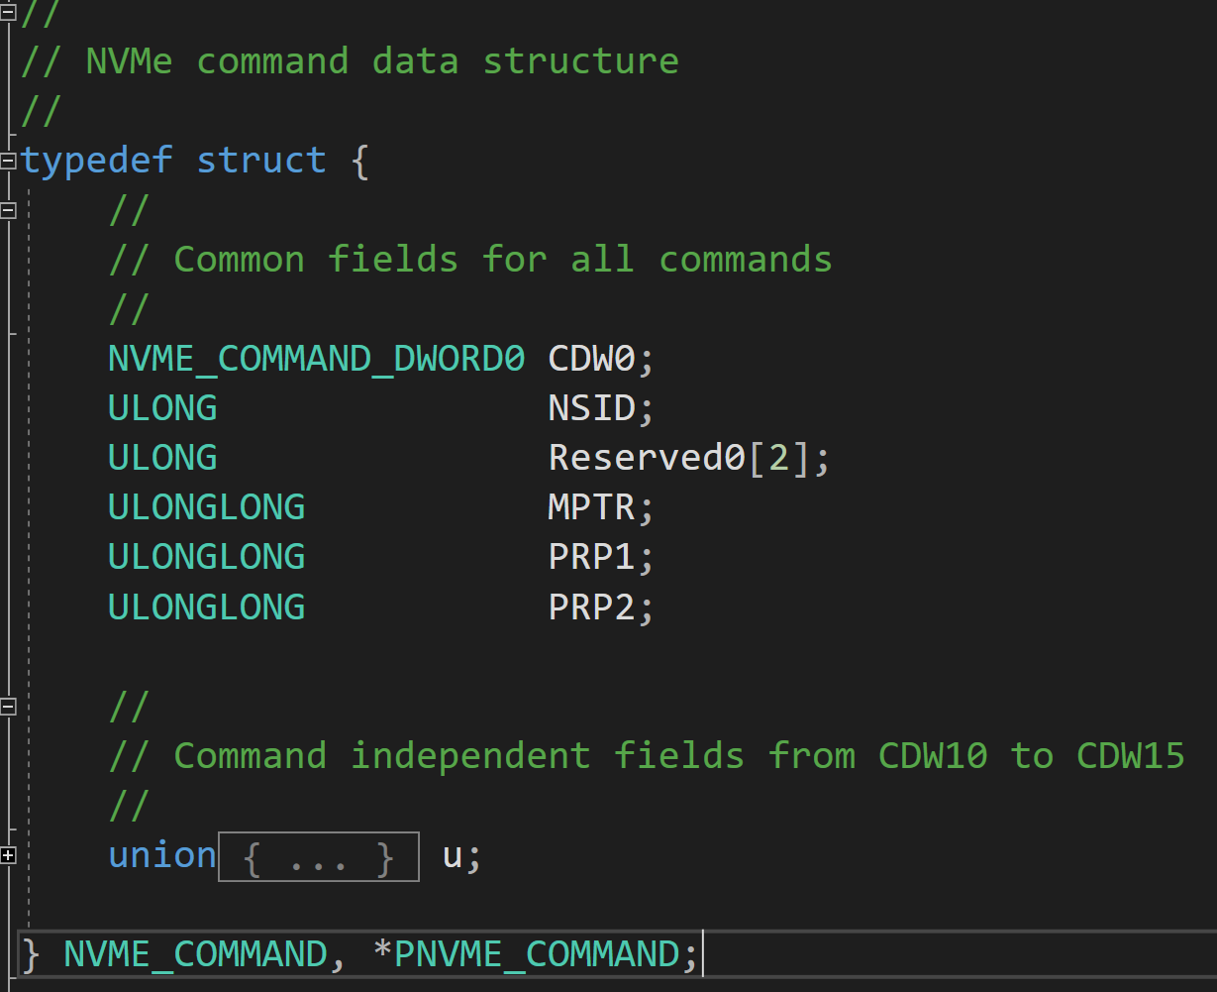
NVME Command
OpCode、Fuse、PSDT、CID
Namespace ID
PRPs
Structures for corresponding command

Slide 43
NVME Command – CDW0
Refer to NVMe 1.3 Figure 10
OpCode : cmd code. Admin and I/O command has different OpCode
E.g. NVME_ADMIN_COMMAND_IDENTIFY == 6
FUSE : fused operation
CID : command id, should be unique in entire device currently processing
PSDT : select DPTR or MPTR to transfer data. Default 00 == DPTR (use PRP)

Slide 44
NVME Command – NSID
Refer to NVMe 1.3 Figure 11
Select Namespace ID that this command applies to.
1-based index id
If cmd doesn’t need NSID, set this field to 0
If apply this command to all namespaces, set this field to 0xFFFFFFFF
Wrong NSID will cause cmd failed.

Slide 45
NVME Command – MPTR and DPTR
Refer to NVMe 1.3 Figure 11
MPTR is reserved for NVMe over Fabric (so I didn’t use)
DPTR is common way to pass data buffer with NVMe command.
I only use PRP, no SGL.
PRP contains PhysicalAddress of data buffer.

Slide 46
NVME Command – PRP (DPTR) rules
VA = 0xffff80a000001730
Length = 0xC00
1st Page PA = 0x0000000005942730
PRP1 = 0x0000000005942730
PRP2 = 0x0000000005943000
2nd Page PA = 0x0000000005943000

Slide 47
NVME Command – PRP (DPTR) rules
In all condition, PRP1 should be DWORD aligned at least. PRP2 should be page aligned.
All following address means “PhysicalAddress”
If buffer doesn’t across page boundary, PRP1 == address of buffer start, and PRP2 == 0
If buffer across one page boundary, PRP1 == address of buffer start, and PRP2 == next page start address
E.g. buffer va= 0xffff80a000001730, pa = 0x0000000005942730 length 0xC00. PRP1 == 0x0000000005942730 and PRP2 == 0x0000000005943000

Slide 48
NVME Command – PRP (DPTR) rules
VA = 0xffff80a000001730
Length = 0x1A00
1st Page PA = 0x0000000005942730
PRP1 = 0x0000000005942730
PRP2 = 0x0000000006007000
2nd Page PA = 0x0000000005943000
[Content of PRP2 page]
PHYSICAL_ADDRESS array
3rd Page PA = 0x0000000005944000
0x0000000005943000
0x0000000005944000

Slide 49
NVME Command – PRP (DPTR) rules
If buffer across 2 or more page boundary, PRP1 is buffer start address, PRP2 is another allocated new PAGE(1 page only). In this page stores address array of following buffer address.
assum a buffer va=0xffff80a000001730, pa=0x0000000005942730, length=0x1A00.
PRP1 == 0x0000000005942730
PRP2 == another page allocated by Host (assume it is 0x0000000006007000, named PHYSICAL_ADDRESS *prp2_list pointer points to this page).
prp2_list[0]==0x0000000005943000, prp2_list[1]== 0x0000000005944000
The page of PHYSICAL_ADDRESS array can be only 1 PAGE long. Unsed elements should be filled by 0 to avoid unexpected issue.

Slide 50
Windows Command Translation

Slide 51
Cmd Translation?
In windows I/O model, storage system are managed and accessed by several different group of commands
SCSI cmd for most requsts
SCSI miniport cmd for Firmware related requests
Storage property cmd for control and telemetry logging
Some SCSI commands are abandoned in Windows.
No need to implement all SCSI command

Slide 52
SCSI Translation Table (Admin Cmd)
SCSI Command | NVMe Command
Format Unit/Sanitize | (Adm) Format NVM
Inquiry | (Adm) Identify
Log Sense | (Adm) Get Features, Get Log Page
Mode Sense (10) | (Adm) Identify, Get Features
Read Capacity | (Adm) Identify
Read Data Buffer(16) | (Adm) Get Log Page
Report LUNs | (Adm) Identify
Security Protocol In / Security Protocol Out | (Adm) Security Receive / Security Send
Start / Stop Unit | (Adm) Set Features, Get Features

Slide 53
SCSI Translation Table (I/O Cmd)
SCSI Command | NVMe Command
Read | Read
Write | Write
Verify | Verify
Synchronize Cache (10) | Flush
Unmap | Dataset Management

Slide 54
Firmware Commands
Miniport IOCTL Command | NVMe Command
FIRMWARE_FUNCTION_GET_INFO (Firmware Query) | Get Log Page
FIRMWARE_FUNCTION_DOWNLOAD (Firmware Download) | Firmware Image Download
FIRMWARE_FUNCTION_ACTIVATE (Firmware Active) | Firmware Commit (Firmware Active in NVMe v1.0)

Slide 55
Firmware Command Translation
Firmware related feature are implemented by SRB_IO_CONTROL structure and IOCTL_SCSI_MINIPORT_FIRMWARE command
Cmd target to disk device, disk.sys forward it to NVMe driver
Another way to implement Firmware related feature is SCSI command WRITE BUFFER
Cmd also target to disk device, and disk.sys also forward it to NVMe driver.
Microsoft recommended way is IOCTL_SCSI_MINIPORT_FIRMWARE

Slide 56
Appendix

Slide 57
About Index and ID
In Spec, You should mention about Index and ID number base
Global QueuePair ID is 0-Based number.
Admin QueuePair treat as QueuePair [0]
I/O QueuePair ID is 1-based. It’s because Admin QueuePair exist.
I/O QueuePair 1 == QueuePair[1], I/O QueuePair 2 == QueuePair[2]……and so on
Controller ID : 0-Based index number
NameSpace ID : 1-Based index number
0 is INVALID_NAMESPACE_ID
0xFFFFFFFF is NOT_SPECIFIC_NSID
In Read/Write cmds, LBA are 0-based
How do you put “256” into 8bit? 0 is meaningless for such command.

Slide 58
About “Number of XXX”
QueueSize of Admin QueuePair and I/O QueuePair
ASQS and ACQS in struct NVME_ADMIN_QUEUE_ATTRIBUTES
QSIZE in register i/o queue cmd.
all of them are 0-Based number
NLB of Read/Write cmd : 0-Based number
Why 0-Based? Same as Read/Write cmd’s LBA

Slide 59
Reference
NVMe 1.3 spec
https://nvmexpress.org/wp-content/uploads/NVM_Express_Revision_1.3.pdf
Windows StorNVMe driver SCSI Translation Support
https://github.com/MicrosoftDocs/windows-driver-docs/blob/staging/windows-driver-docs-pr/storage/stornvme-scsi-translation-support.md

Slide 60
Reference
History of SSD
http://www.ssdfans.com/?p=8076
https://zh.m.wikipedia.org/zh-hant/NVM_Express

Slide 61


