Slide 1

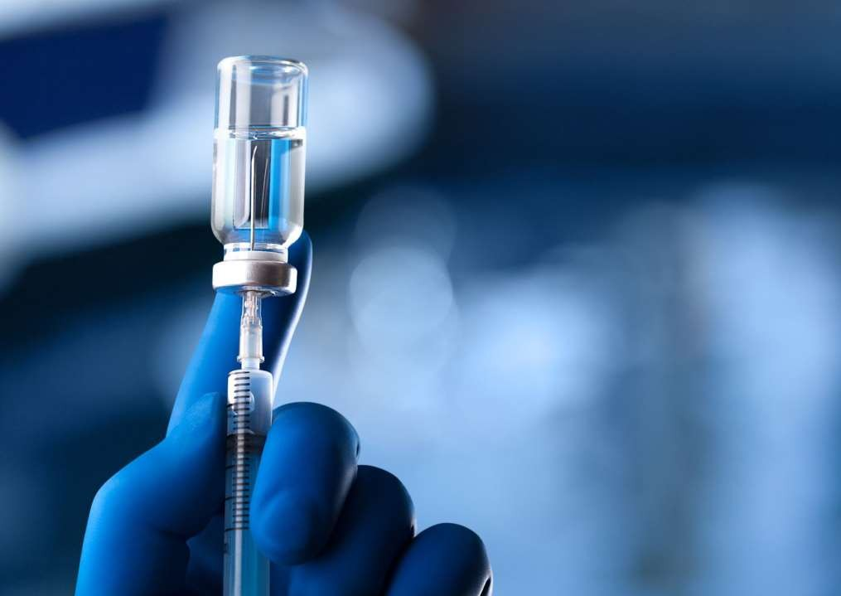
Thyroid Disease classification using ML
Team members:
MYLESHWARAN V
SAKTHI K
SRIKANTH
VIGNESH R

Slide 2


Description
With the vast amount of data and information difficult to deal with, especially in the health system, machine learning algorithms and data mining techniques have an important role in dealing with data. In our study, we used machine learning algorithms with thyroid disease

Slide 3

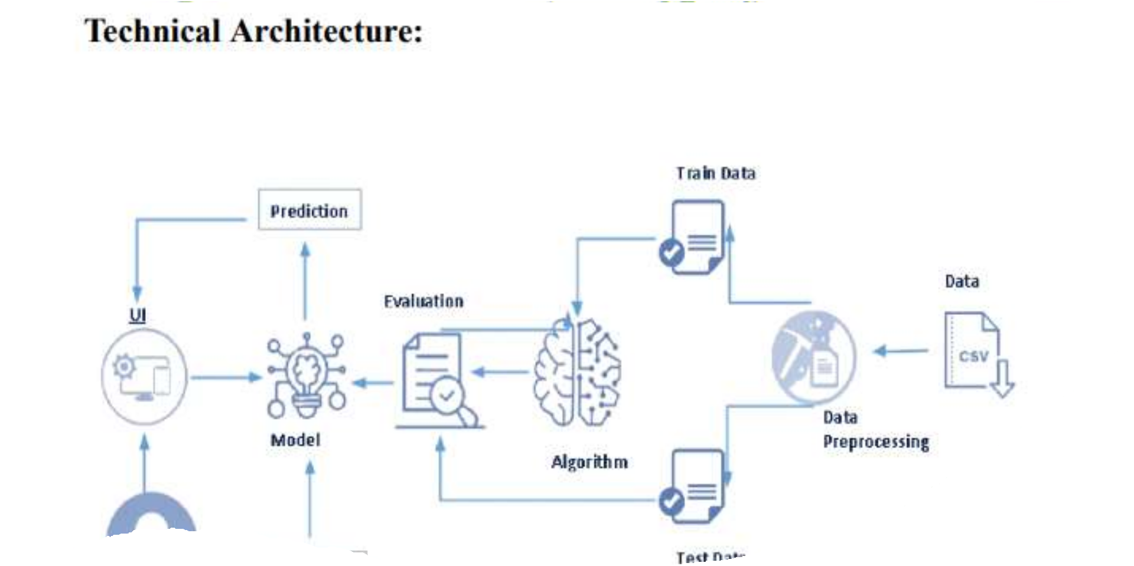



Slide 4




Project Structure: Create the Project folder which contains files as shown below

Slide 5
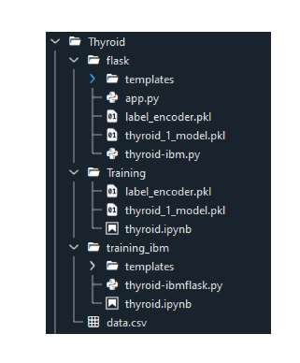
Project Flow: ● The user interacts with the UI to enter the input. ● Entered input is analysed by the model which is integrated. ● Once the model analyses the input the prediction is showcased on the UI To accomplish this, we have to complete all the activities listed below, ● Define Problem / Problem Understanding ○ Specify the business problem ○ Business requirements ○ Literature Survey ○ Social or Business Impact. ● Data Collection & Preparation ○ Collect the dataset ○ Data Preparation ● Exploratory Data Analysis ○ Descriptive statistical ○ Visual Analysis ● Model Building ○ Training the model in multiple algorithms ○ Testing the model
Performance Testing & Hyperparameter Tuning ○ Testing model with multiple evaluation metrics ○ Comparing model accuracy before & after applying hyperparameter tuning ● Model Deployment ○ Save the best model ○ Integrate with Web Framework ● Project Demonstration & Documentation ○ Record explanation Video for project end to end solution ○ Project Documentation-Step by step project development procedure

Slide 6
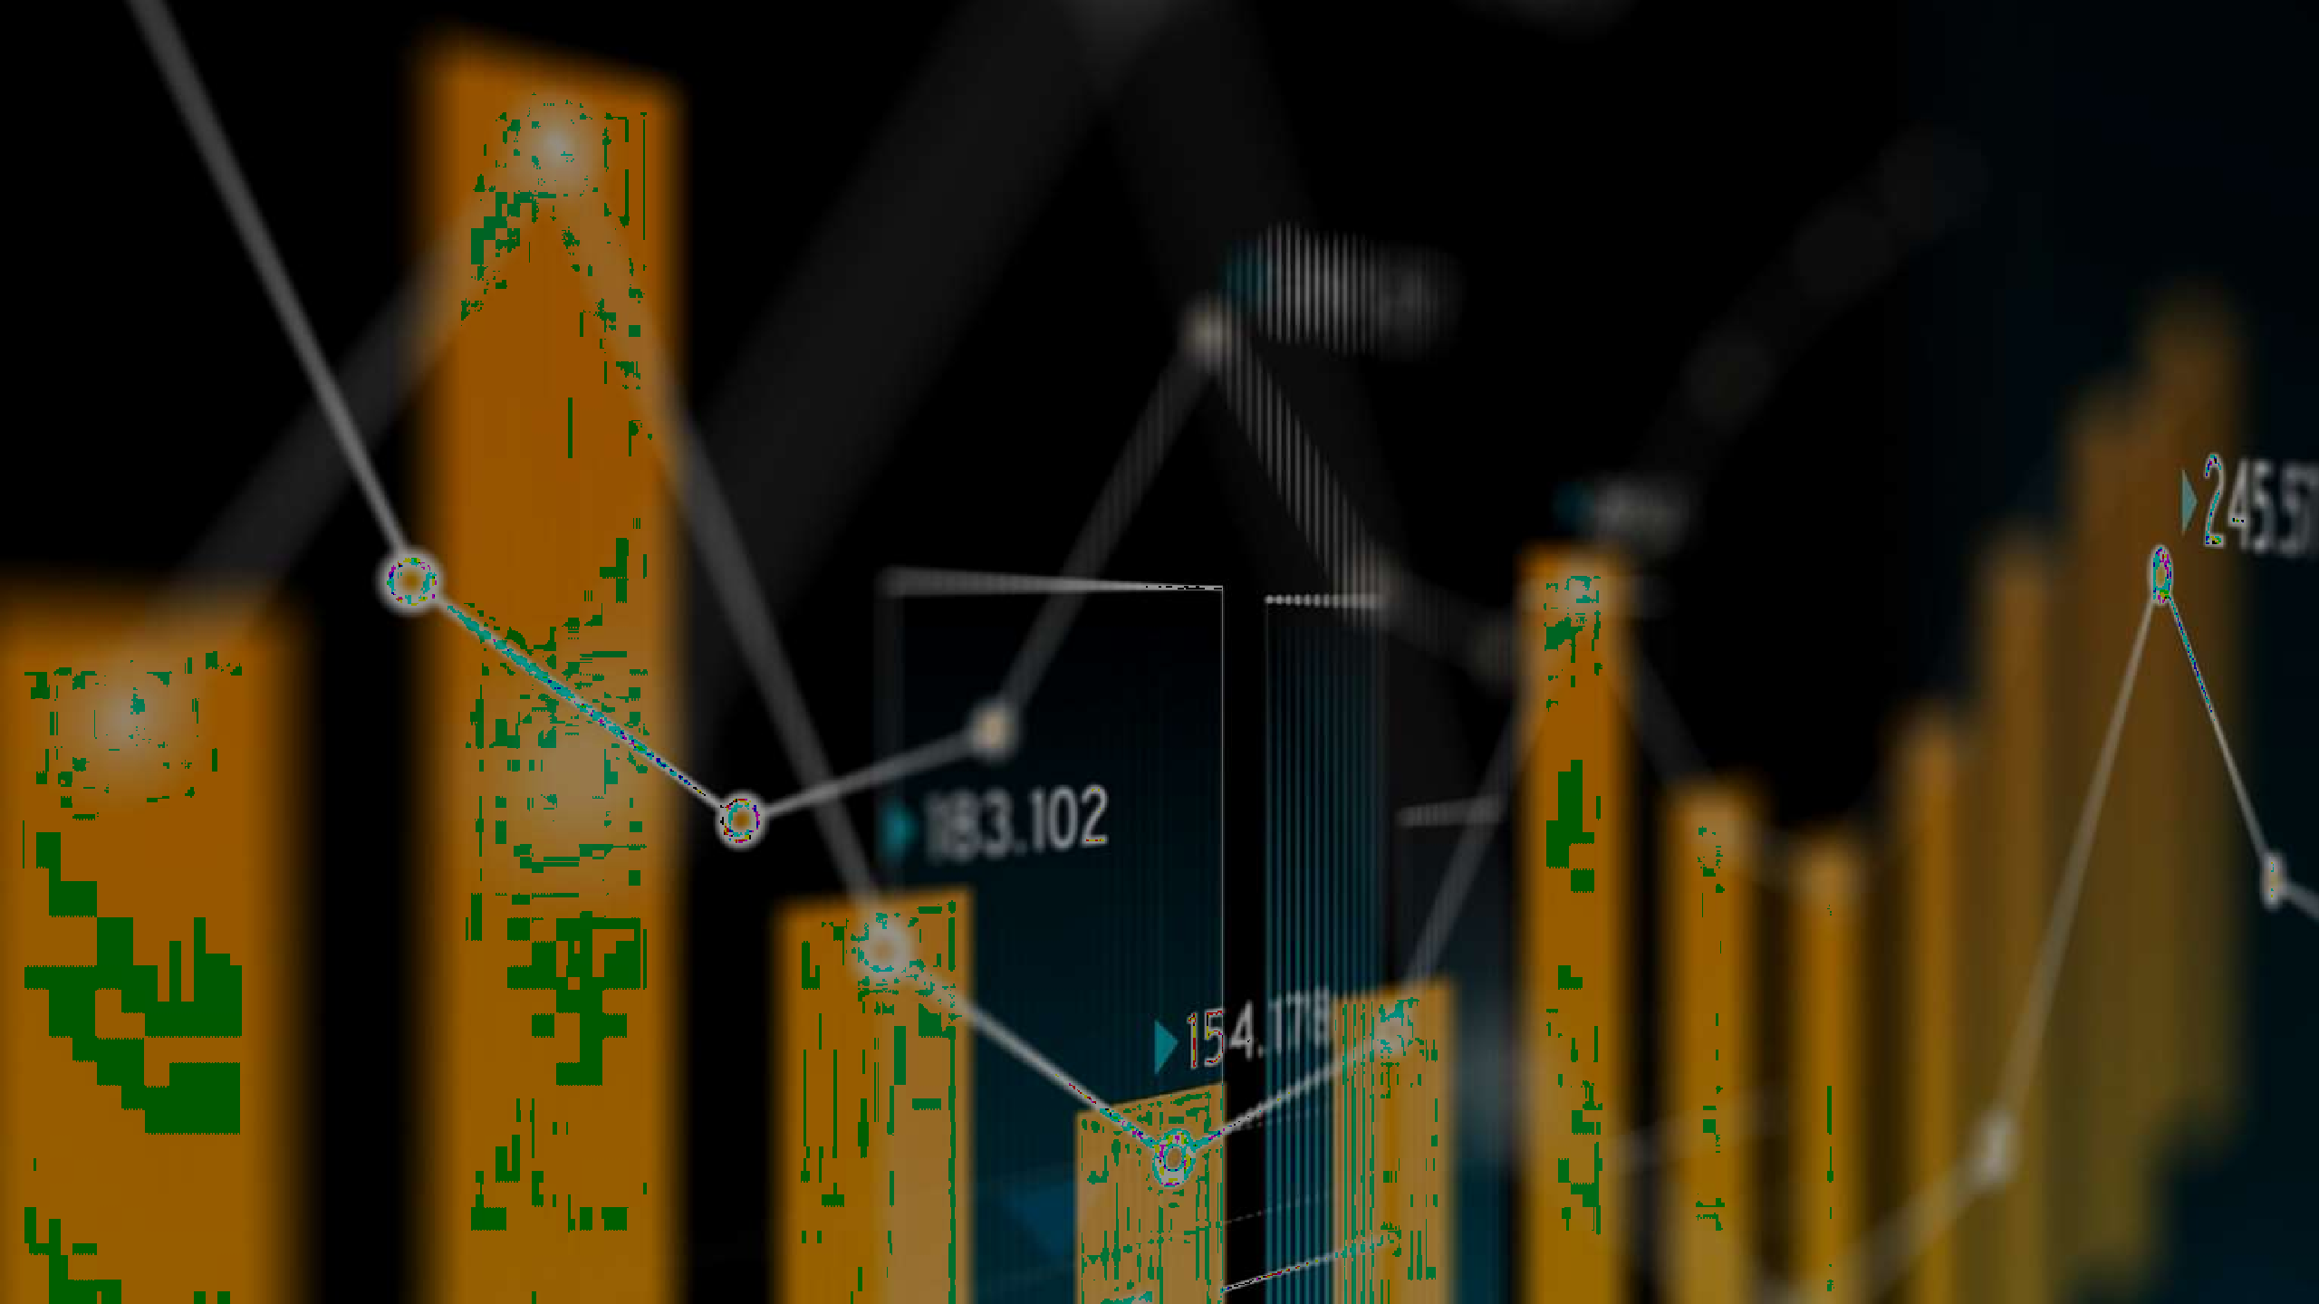
Visual Analysis
Visual analysis Visual analysis is the process of using visual representations, such as charts, plots, and graphs, to explore and understand data. It is a way to quickly identify patterns, trends, and outliers in the data, which can help to gain insights and make informed decisions. Activity 2.1: Checking Correlation. Here, I'm finding the correlation using HeatMap. It visualizes the data in 2-D coloured maps making use of colour variations. It describes the related variables in the form of colours instead of numbers; it will be plotted on both axes. Here, there is no correlation between columns.

Slide 7
Model Deployment
Model Deployment Activity 1:Save the best model Saving the best model after comparing its performance using different evaluation metrics means selecting the model with the highest performance and saving its weights and configuration. This can be useful in avoiding the need to retrain the model every time it is needed and also to be able to use it in the future. Activity 2: Integrate with Web Framework In this section, we will be building a web application that is integrated to the model we built. A UI is provided for the uses where he has to enter the values for predictions. The enter values are given to the saved model and prediction is showcased on the UI. This section has the following tasks • Building HTML Pages • Building server side script Activity 2.1: Building Html Pages: For this project create three HTML files namely • home.html • predict.html • submit.html and save them in the templates folder. Let’s see how our home.html page looks like

Slide 8


Slide 9
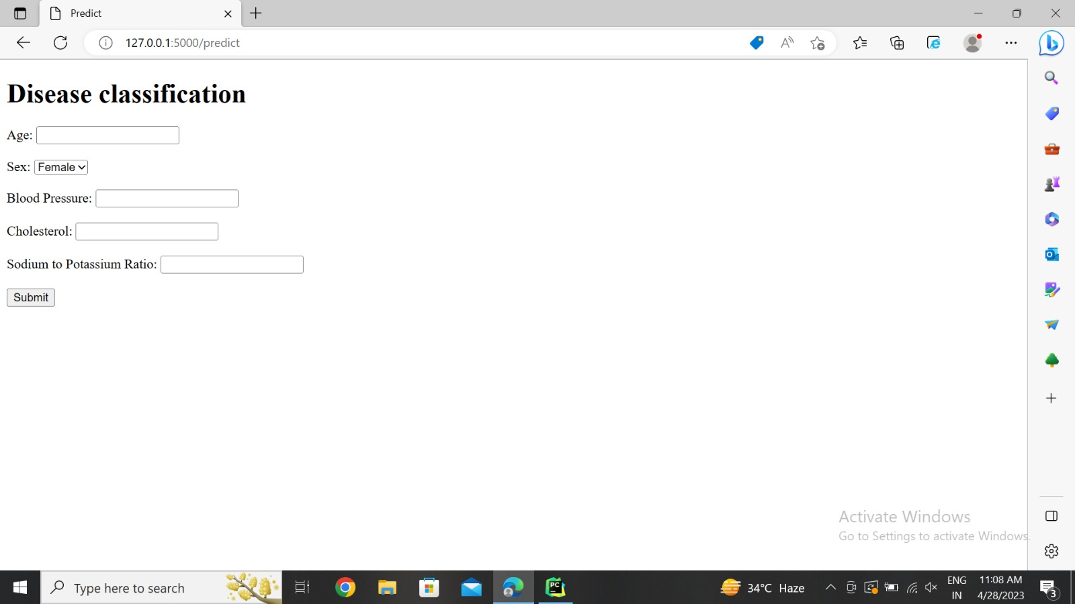

Slide 10


Thank you For Your Attention

