Slide 1
Course Work
Topic: “Call Center Management System Database”
Project Manager
By
Lishchuk K.I.
Smoklien

Slide 2
Problem Formulation
The purpose of the coursework is to develop a database that could manage call center activities. The main goals of which are increasing the level of automation and improving the efficiency of the company's work, as well as providing employee performance reporting.

Slide 3
Steps
01
Subject analysis
05
Data import
02
06
Automatization of business processes
Development of ER model
03
Development of relational model
07
Optimization of queries
04
08
Mult-iuser access
Creation of database

Slide 4
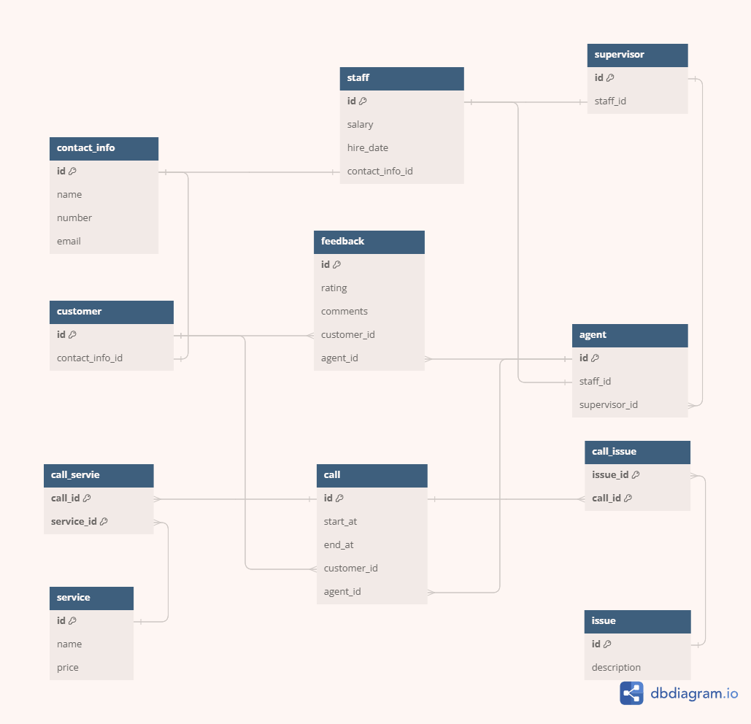
ER Model

Slide 5
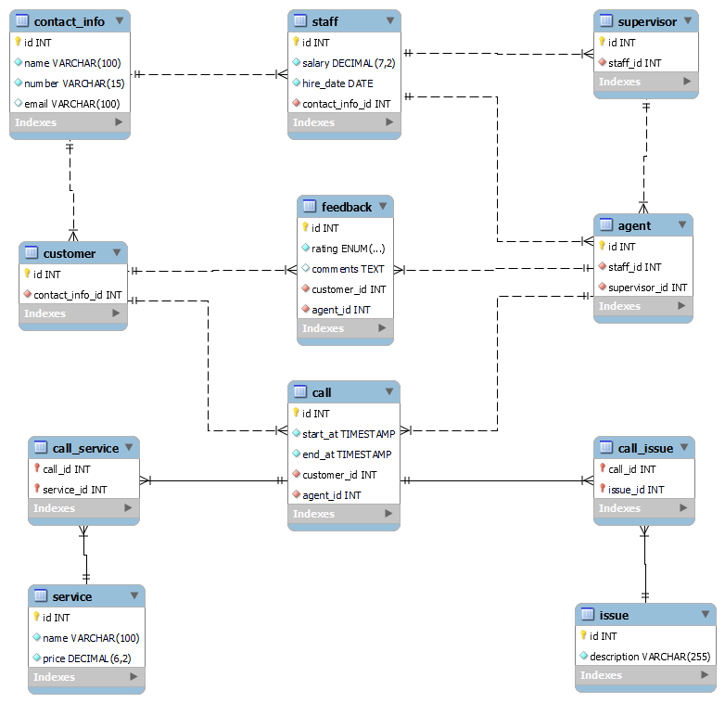
Relational Model

Slide 6
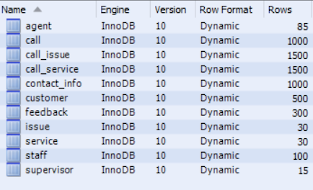
Data Import

Slide 7

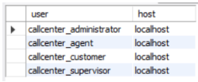
Users
Administrator
Agent
Client
Supervisor

Slide 8
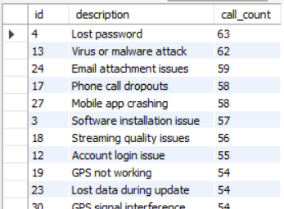
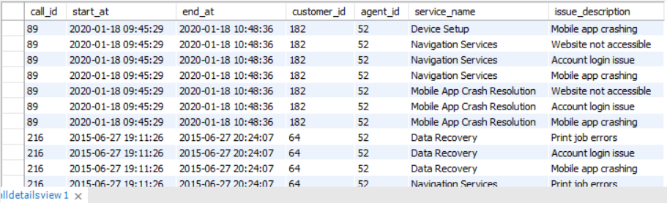
Work with a Database
10 procedures and functions
5 trigger
3 views
20 queries
Procedure “most_common_issues”
View “CallDetailsView”

Slide 9

Conclusion
During this course work, an analysis of the subject environment was carried out, the main tasks and requirements for the call center database were determined. According to the requirements, a database was created to support the activities of the call center. It is capable of automating and improving the efficiency of the call center, as well as reporting on the work of employees.

