Slide 1

Build scalable and reliable JEE apps with AWS
Warsjava workshops 2014’
Adam Smolnik

Slide 2
Agenda
Global AWS Architecture – Multi Regions and AZ
A brief overview of AWS services
Example JEE apps structure walk-through
Exercise 1. – set up EC2
Exercise 2. - scale apps out declaratively with ASG, ELB via AWS console
Exercise 3. – scale digest-service-no-limit up programmatically with Java AWS SDK
Exercise 4. – dissect digest-controller-service interiors and adjust it to your own concept

Slide 3
Goals
Show you - as a Java/JEE developer a handful of new opportunities which has come with the advent of Cloud era
Get you familiar with AWS Services and their rich Java SDK
Bring your attention to new challenges you will face while dealing with Cloud solutions

Slide 4
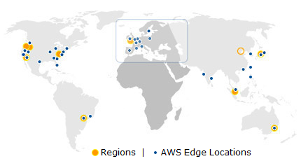
AWS Globality

Slide 5
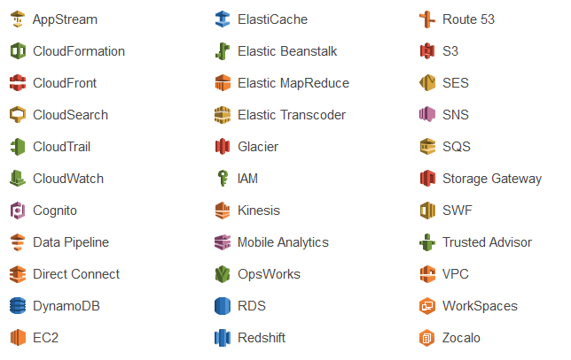
AWS overview
Just call up AWS Console

Slide 6

AWS Console vs. Java SDK
JAVA SDK

Slide 7
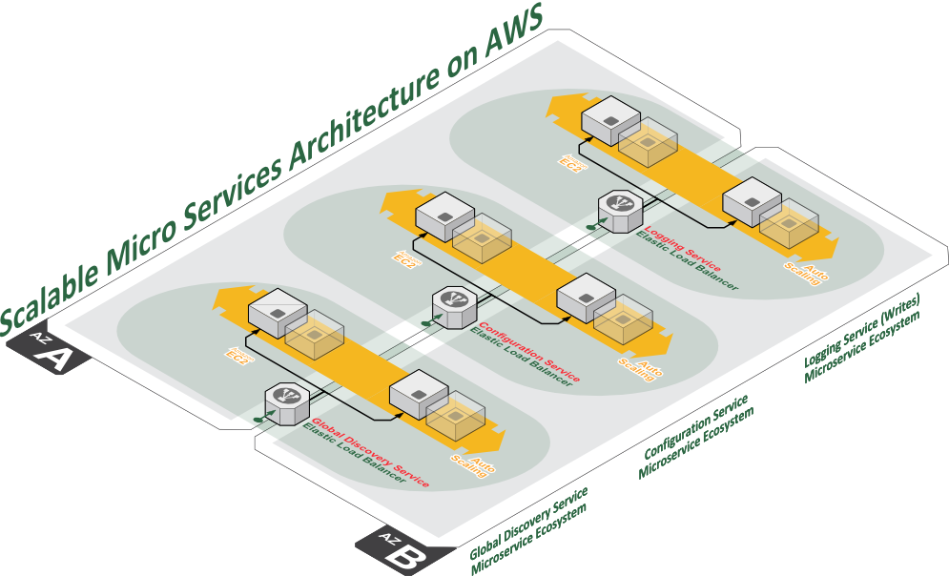

Slide 8
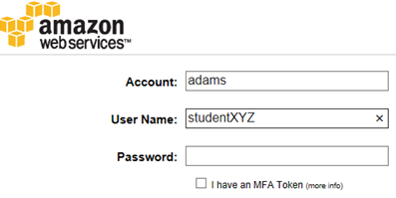
AWS Console
https://adams.signin.aws.amazon.com/console
Account: adams
User Name: studentXYZ e.g. student002
Password: wj!studentXYZ@# e.g. wj!student002@#

Slide 9
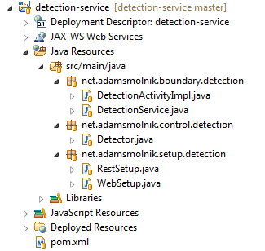
Example JEE 7 Service structure
Entity-Control-Boundary

Slide 10
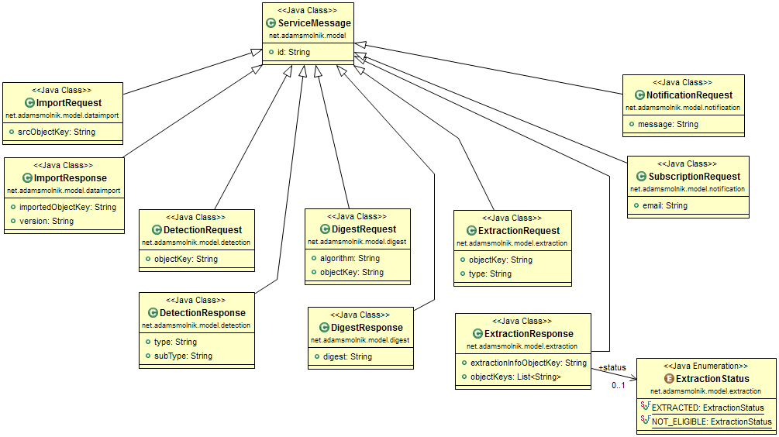
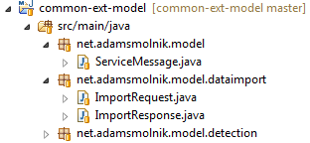
Common external model

Slide 11
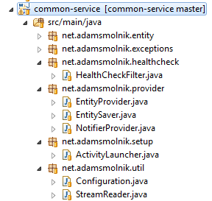
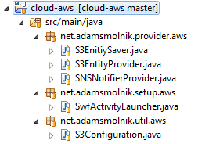
Common service structure
Cloud-agnostic interfaces
Specific cloud provider impl.

Slide 12
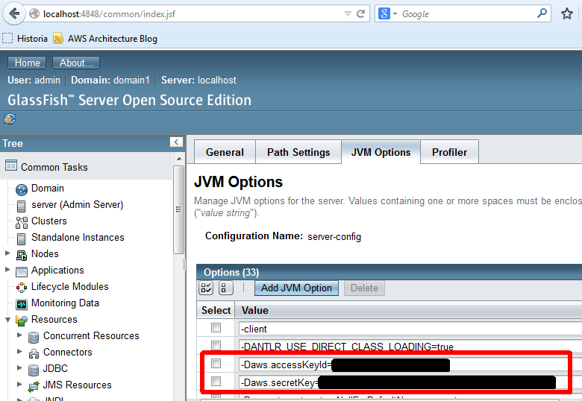
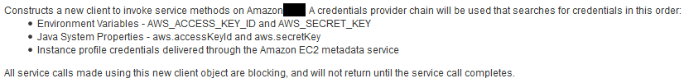
Test locally with GF

Slide 13
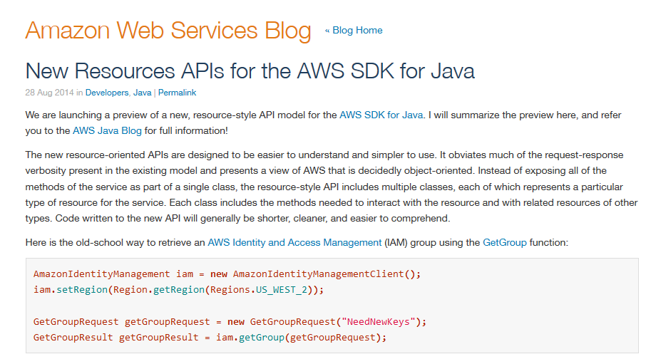
New API for Java is coming soon…

Slide 14
Setbacks happens
Central Maven’s repository issue

Slide 15
Exercise 1. Set up EC2
Goal: Make the EC2 instance work and ready for deployment of apps
Worth to mention here:
Bakery process used by us to bake the right machine instance image
Free tier instances
CPU Credits

Slide 16
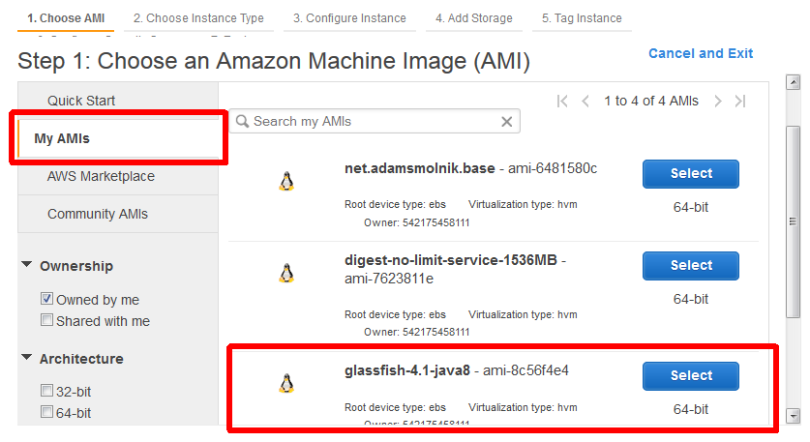
Exercise 1. Step 1

Slide 17
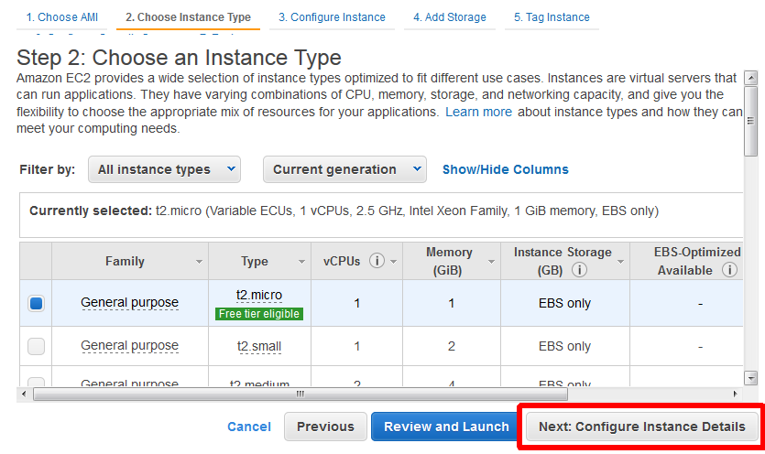
Exercise 1. Step 2

Slide 18
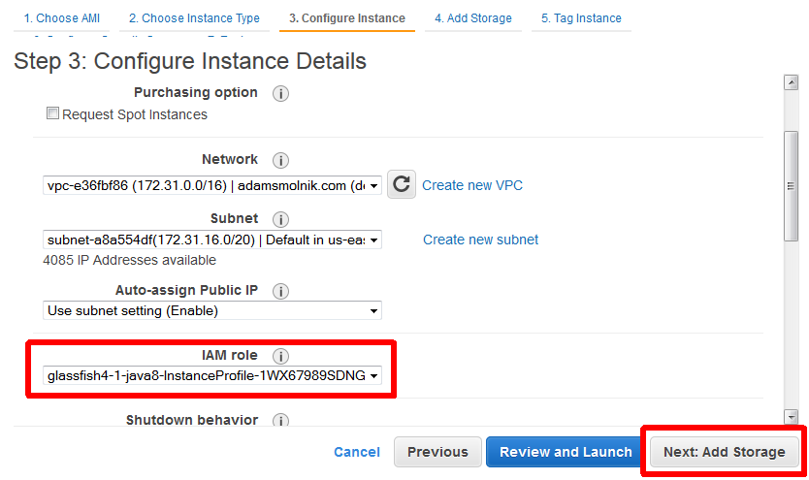
Exercise 1. Step 3

Slide 19
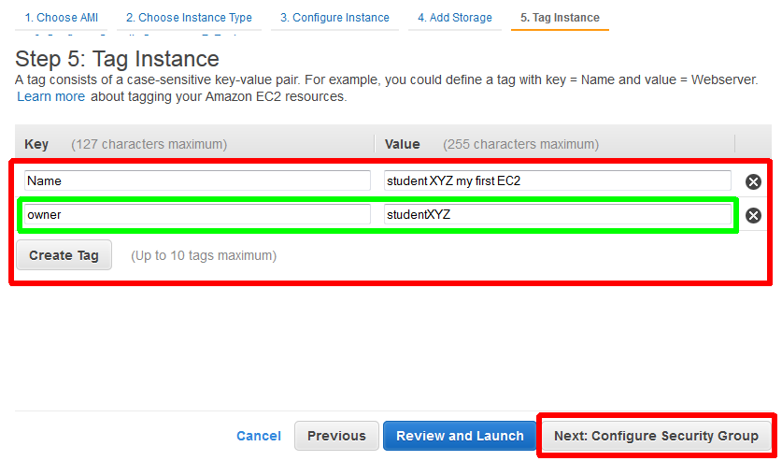
Exercise 1. Step 5

Slide 20
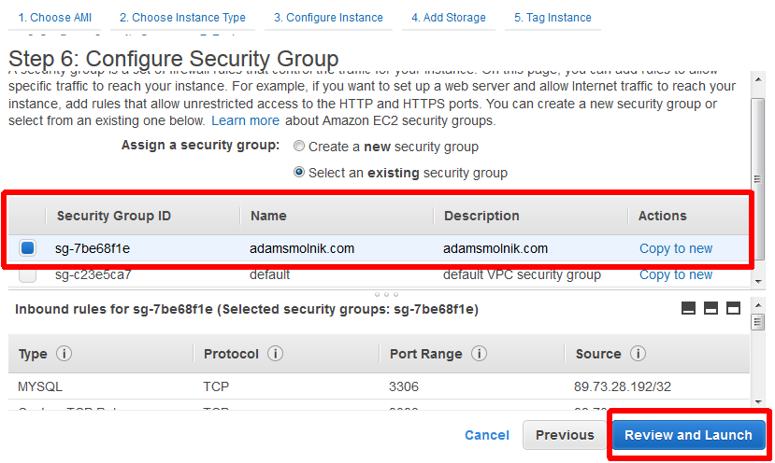
Exercise 1. Step 6

Slide 21
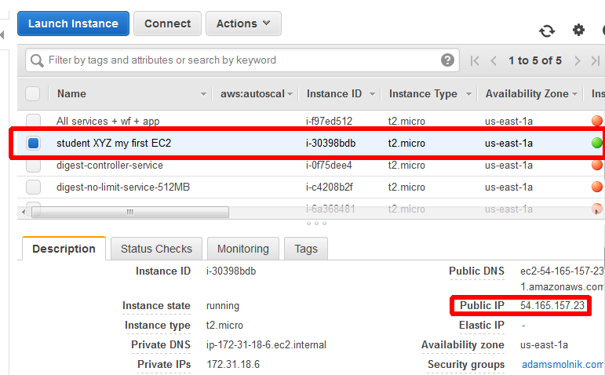
Exercise 1. Outcome

Slide 22
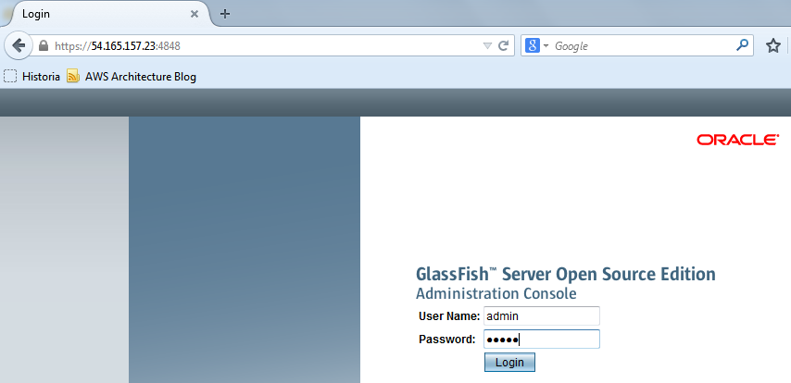
Exercise 1. Try to login

Slide 23
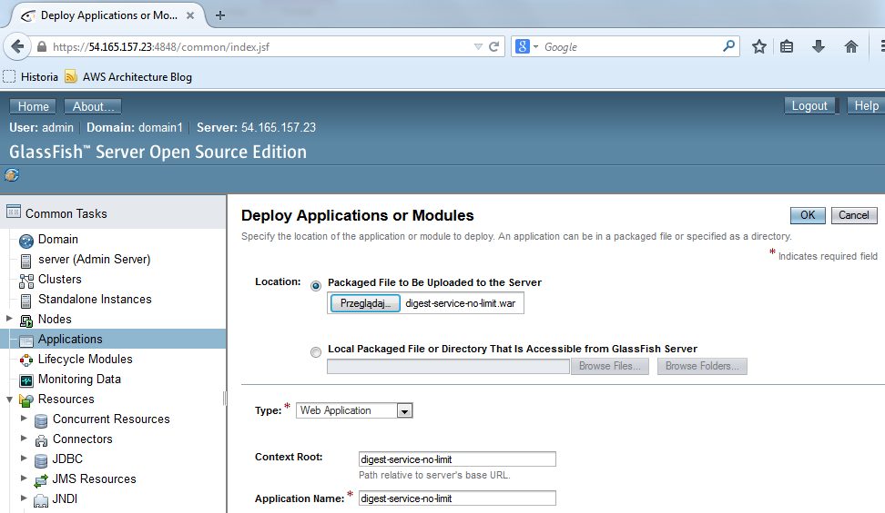
Exercise 1. Deploy a service

Slide 24
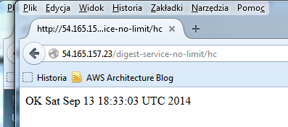
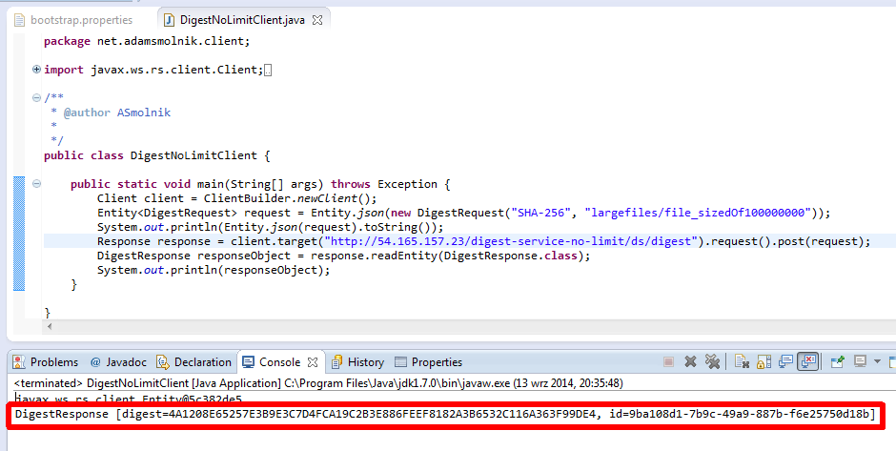
Exercise 1. Call the service

Slide 25
Exercise 2. Scaling out
No programming at all – declarative and out-of-the-box way
Ingredients
Java, JEE, Glassfish, webapp (webservice)
AWS Services: EC2, ELB, ASG, CloudWatch
Expected results
Machines with app(s) are added automatically once a workload threshold is surpassed - without human intervention
Respectively, the number of server instances diminishes in the opposite settings

Slide 26
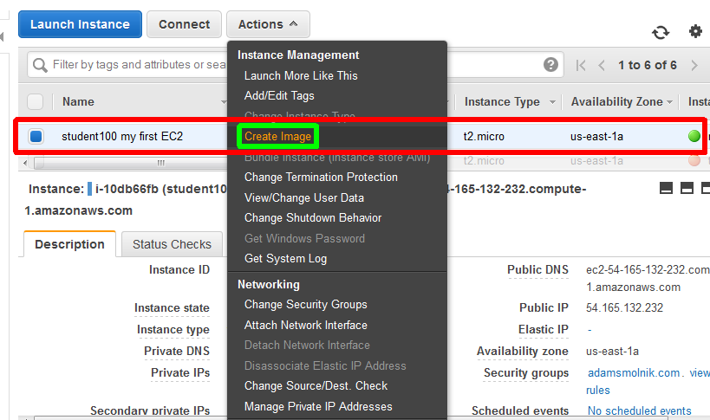
AMI from working instance

Slide 27
Exercise 2. Go ahead
Just proceed and follow me!

Slide 28
Exercise 3. The essence
ServerInstanceBuilder<SetupParamsView, ServerInstance> sib;
…
long size = fetchObjectSize(digestRequest);
if (size <= sizeThreshold) {
return sender.send(basicServiceUrl, digestRequest);
}
SetupParams sp = new SetupParams().withLabel("...");
ServerInstance newInstance = sib.build(sp);
String newServiceUrl = buildServiceUrl(newInstance.getPublicIpAddress());
DigestResponse response = sender.trySending(newServiceUrl, digestRequest);
newInstance.scheduleCleanup(55, TimeUnit.MINUTES);
return response;

Slide 29
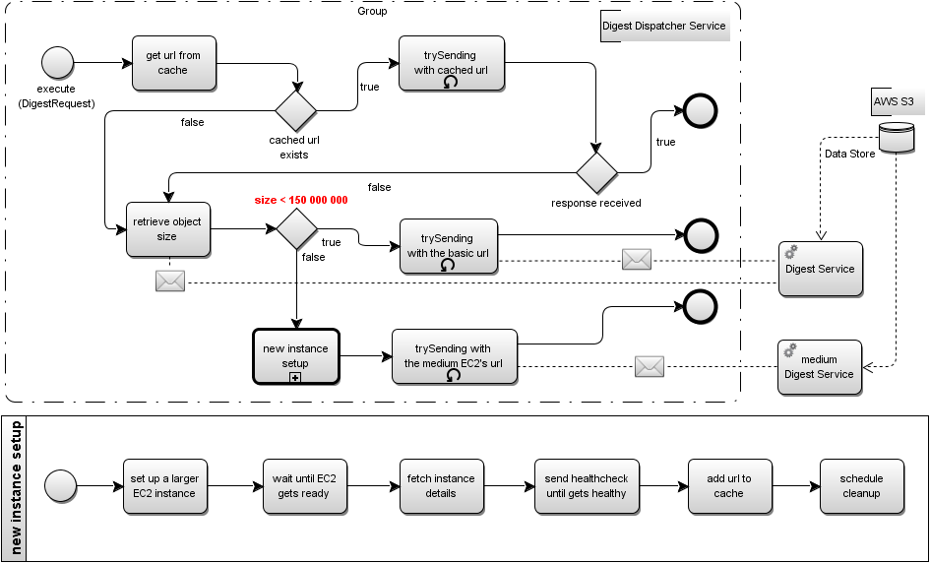
Exercise 3. Flow impl. details

Slide 30









Exercise 3. Components layout
digest-service-elb-743012833.us-east-1.elb.amazonaws.com
digest-no-limit-service-512MB
digest.adamsmolnik.com
studentXYZ-dds-queue-in
true
EC2 instance
net.adamsmolnik.warsjawa/largefiles/
file_sizedOf10000000
studentXYZ-dds-queue-out
exercise-digest-dispatcher-service
retrieves configuration
false
digest-no-limit-service-1536MB
Setup new medium instance
studentXYZ/conf/services
file_sizedOf40000000

Slide 31
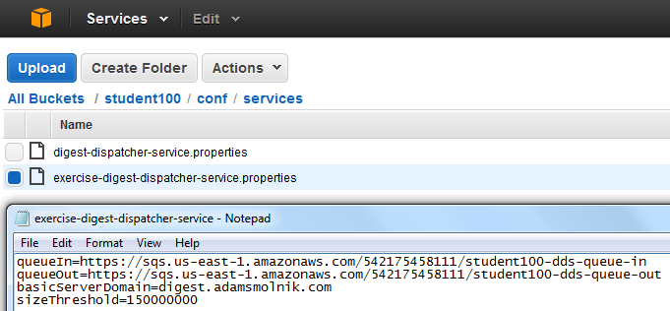
Exercise 3. Check out app’s skeleton
https://github.com/smolnik/exercise-digest-dispatcher-service.git with dependent projects
Or just import the zipped Eclipse project from S3: warsjava-apps/exercise-digest-dispatcher-service
Have a look at S3 configuration file
<dependency>
<groupId>net.adamsmolnik</groupId>
<artifactId>common-ext-model</artifactId>
<version>0.0.1-SNAPSHOT</version>
</dependency>
<dependency>
<groupId>net.adamsmolnik</groupId>
<artifactId>common-service</artifactId>
<version>0.0.1-SNAPSHOT</version>
</dependency>
<dependency>
<groupId>net.adamsmolnik</groupId>
<artifactId>cloud-aws</artifactId>
<version>0.0.1-SNAPSHOT</version>
<scope>runtime</scope>
</dependency>
<dependency>
<groupId>net.adamsmolnik</groupId>
<artifactId>common-controller</artifactId>
<version>0.0.1-SNAPSHOT</version>
</dependency>
<dependency>

Slide 32
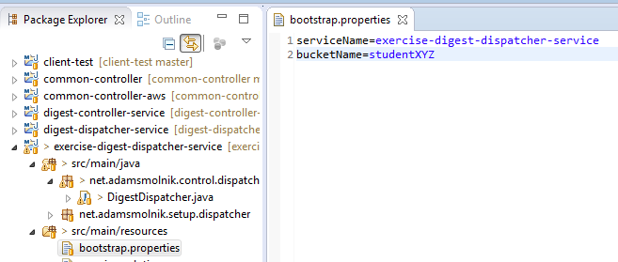
Exercise 3. Replace XYZ->001, 002…
bucketName=studentXYZ
bucketName=student002

Slide 33
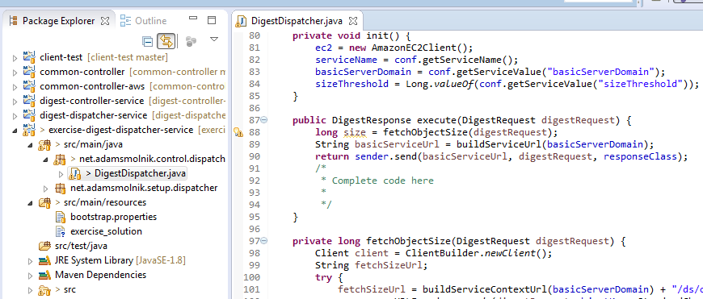
Exercise 3. At last, write code

Slide 34
Exercise 3. Build and deploy

Slide 35
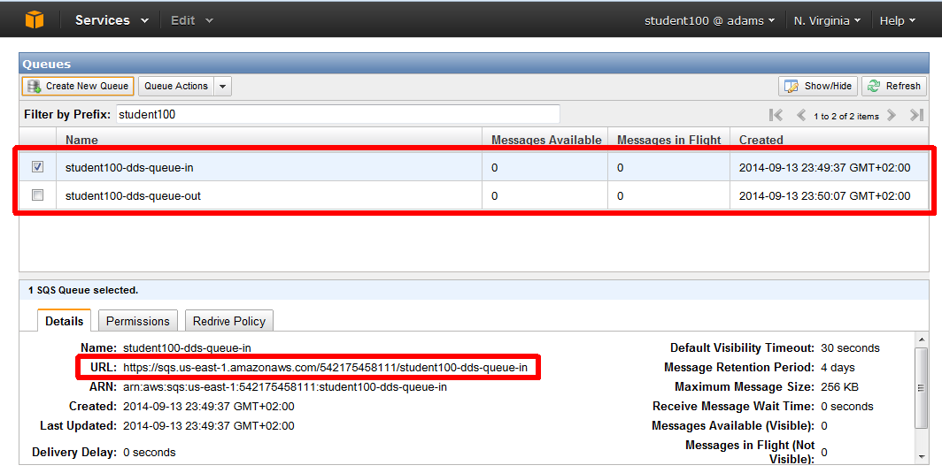
Exercise 3. Create SQS queues

Slide 36
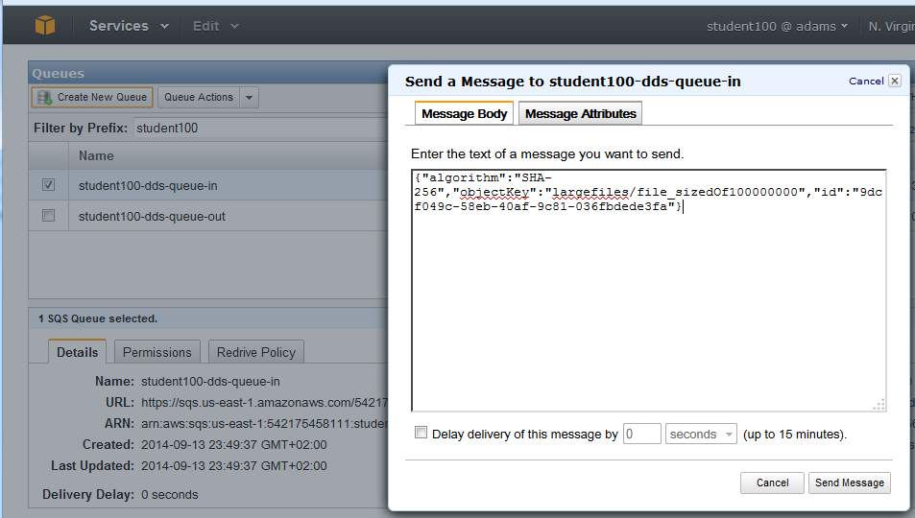
Exercise 3. Fire the flow

Slide 37
Exercise 4. More involved case
FallbackServerInstanceBuilder fsib = ...;
try {
sender.trySending(basicServiceUrl, digestRequest);
} catch (OutOfMemoryError outOfMemoryErrorFromTargetServerMachineInstance) {
try {
FallbackSetupParams fsp = new FallbackSetupParams().withLabel("...");
FallbackServerInstance newMediumFallbackInstance = fsib.build(fsp);
String newMediumServiceUrl = buildServiceUrl(newMediumFallbackInstance.getPublicIpAddress());
DigestResponse response = sender.trySending(newMediumServiceUrl, digestRequest);
newMediumFallbackInstance.scheduleCleanup(55, TimeUnit.MINUTES);
return response;
} catch (OutOfMemoryError outOfMemoryFromMediumTargetServerMachineInstance) {
FallbackSetupParams fsp = new FallbackSetupParams().withLabel("...");
FallbackServerInstance newLargestFallbackInstance = fsib.build(fsp);
String newLargestServiceUrl = buildServiceUrl(newLargestFallbackInstance.getPublicIpAddress());
DigestResponse response = sender.trySending(newLargestServiceUrl, digestRequest);
newLargestFallbackInstance.scheduleCleanup(55, TimeUnit.MINUTES);
return response;
}
}
return response;

Slide 38
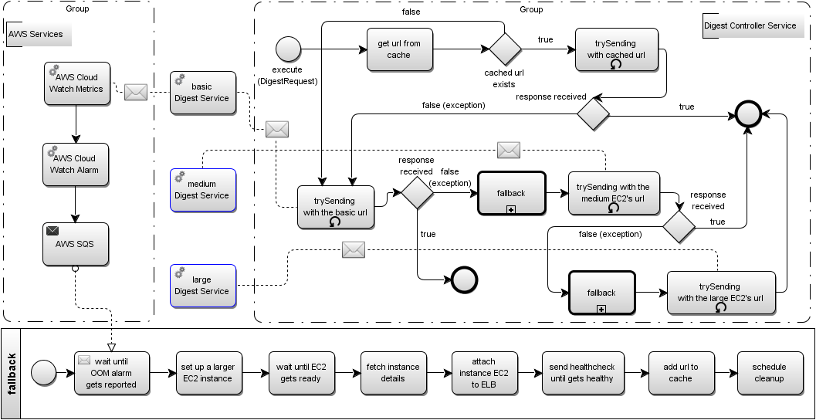
Exercise 4. More complex flow

