Slide 1


http://www.cloudyna.org

Slide 2

Build scalable and reliable JEE apps with AWS
AWS UG Warsaw workshop
Adam Smolnik

Slide 3
Agenda
Signing in AWS Console
Exercise 1. – set up EC2
Exercise 2. - scale apps out declaratively with ASG, ELB via AWS console
Other intriguing cases

Slide 4
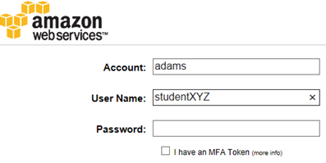
AWS Console
https://adams.signin.aws.amazon.com/console
Account: adams
User Name: studentXYZ e.g. student002
Password: aws!studentXYZ e.g. aws!student002

Slide 5
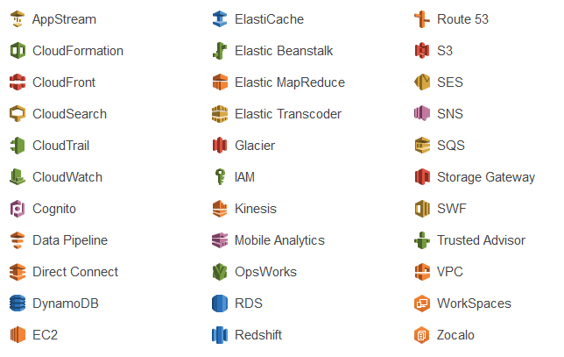
AWS overview
Just call up AWS Console

Slide 6
Bonus
S3:
studentXYZ/bonus/aws_coupon_for_studentXYZ.txt

Slide 7
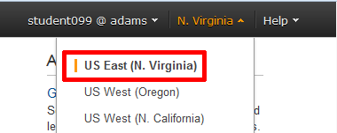
Set the appropriate Region

Slide 8
You say “service”, “web service” or “web app” and you typically think of “jar”, “war” or “ear” file*
*at least in Java’s universe

Slide 9
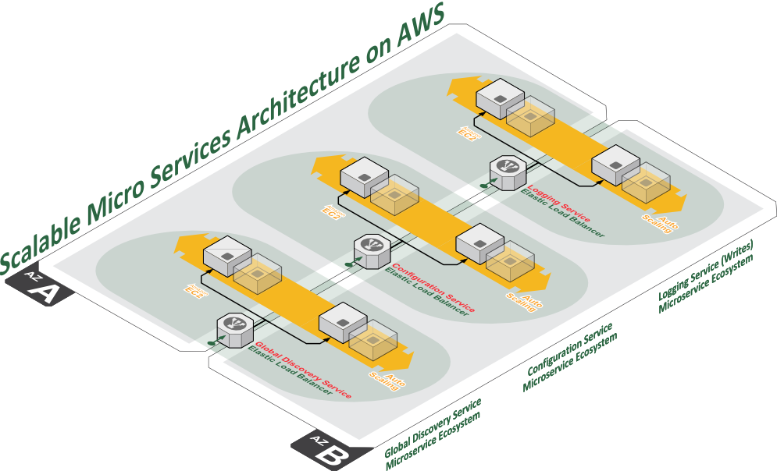
I say “web service” or “web app” and I think of
a set of components making up a new notion of “service” in the Cloud: “war/ear” file + ASG + ELB

Slide 10
Exercise 1. Set up EC2
Goal: Make the EC2 instance work and ready for deployment of apps
Worth to mention here:
Staged bakery process used by us to bake the right machine instance image
Free tier instances
CPU Credits

Slide 11
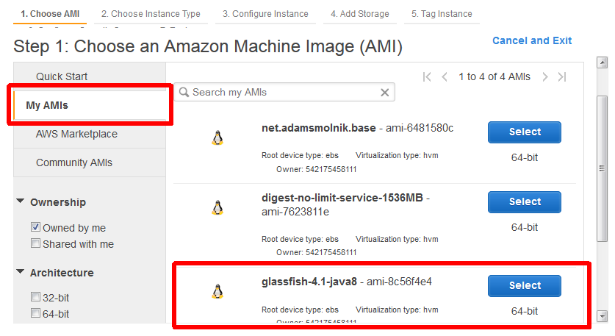
Exercise 1. Step 1

Slide 12
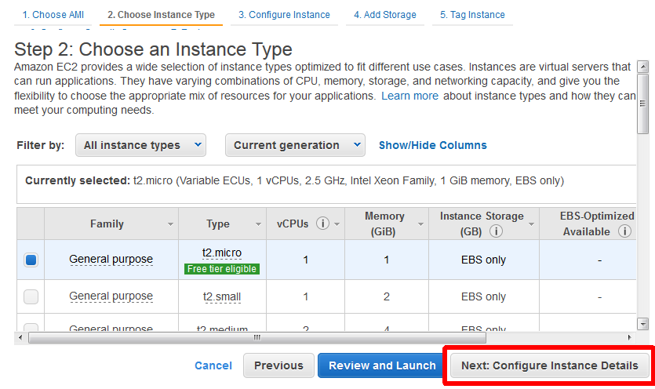
Exercise 1. Step 2

Slide 13
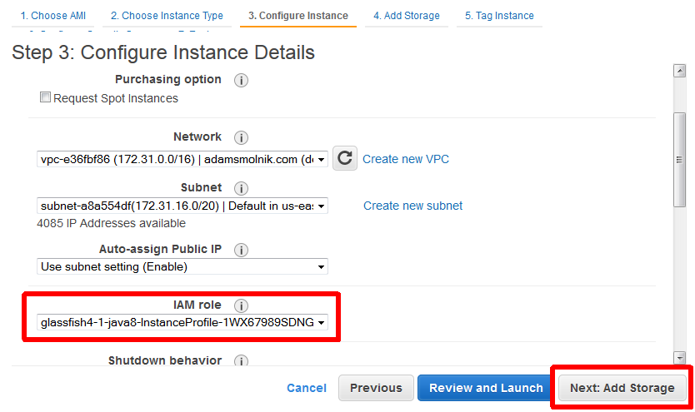
Exercise 1. Step 3

Slide 14
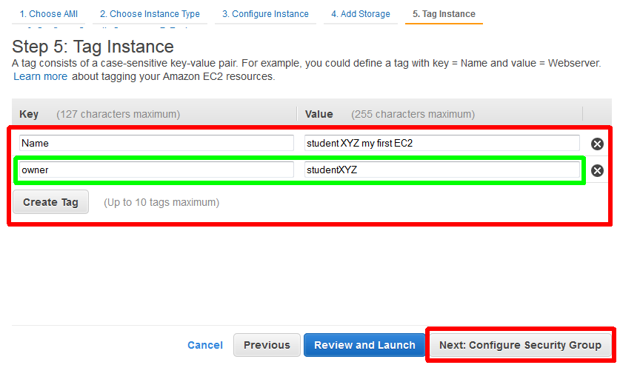
Exercise 1. Step 5

Slide 15
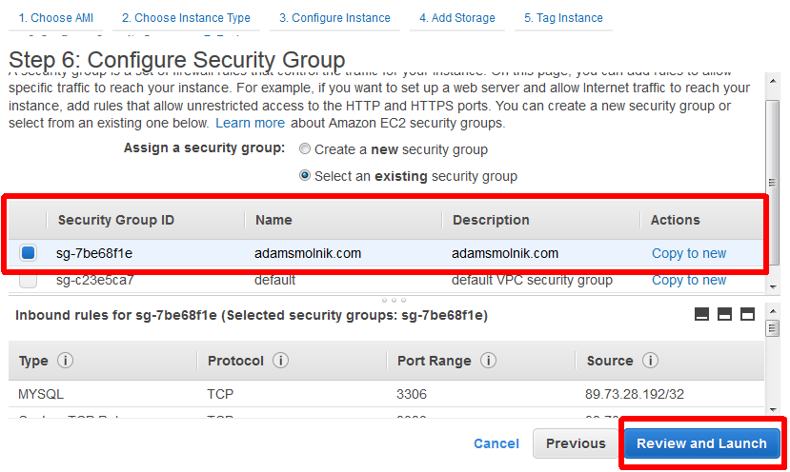
Exercise 1. Step 6

Slide 16
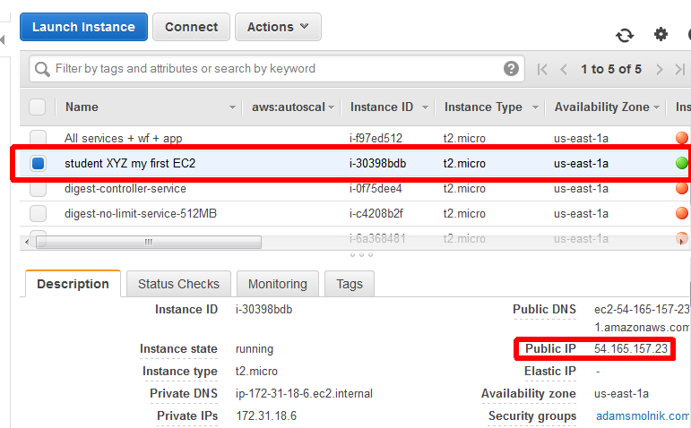
Exercise 1. Outcome

Slide 17
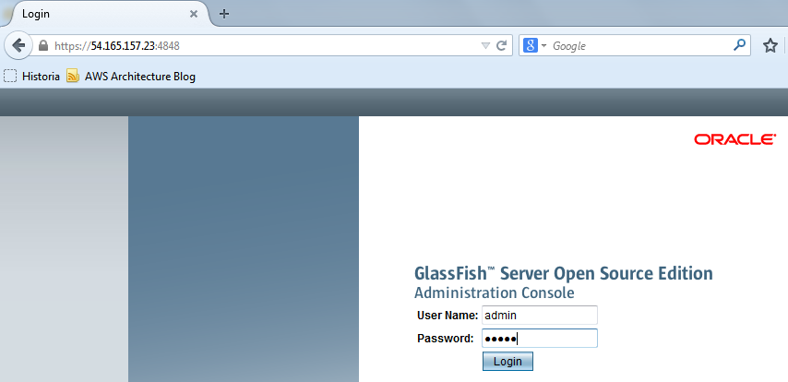
Exercise 1. Try to login

Slide 18
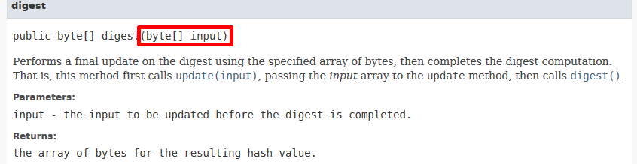
About the sample service
Digest Service has been used to mimic memory- and CPU-intensive consuming work
To recall “Message digests are secure one-way hash functions that take arbitrary-sized data and output a fixed-length hash value”

Slide 19
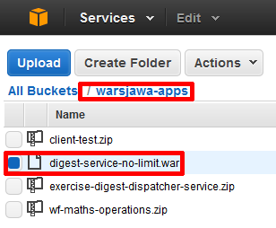
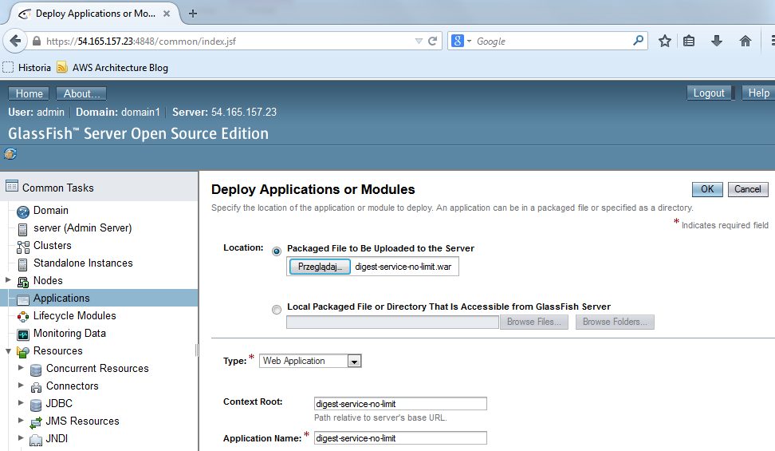
Exercise 1. Deploy a service

Slide 20
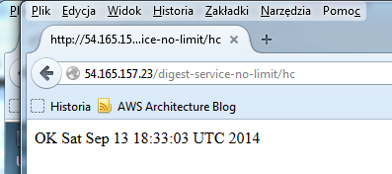
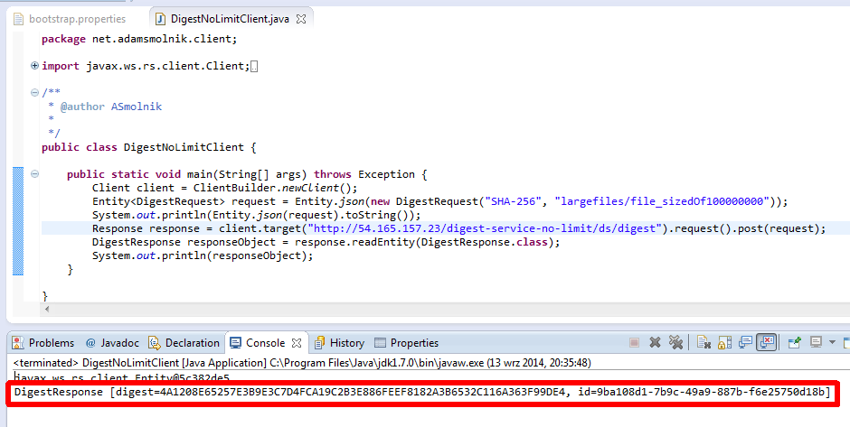
Exercise 1. Call the service
https://github.com/smolnik/client-test.git
Or S3: warsjawa-apps/client-test.zip

Slide 21
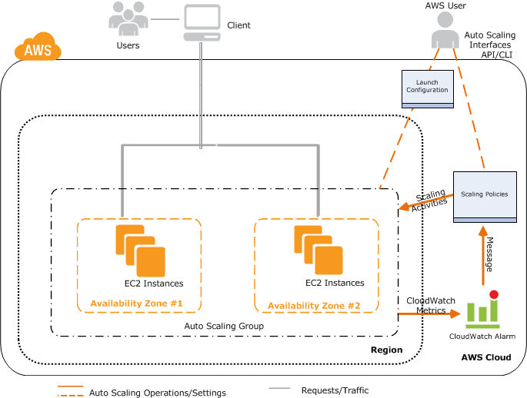
Before going into Exercise 2.

Slide 22







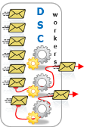



More details on Architecture
AWS cloud
Student001 Logical Environment
student001
Student001’s ELB
Digest Service
Student001’s AMIs
Student001’s
Auto Scaling group
Shared Environment
S3 bucket
…/largefiles/
Student002 Logical Environment
Digest Service Client (DSC)
Amazon Route 53
DSC
workers
Web Digest Service Client
(WDSC)
student002
Student002’s ELB
Digest Service
Student002’s AMIs
Student002’s
Auto Scaling group
Availability Zone

Slide 23
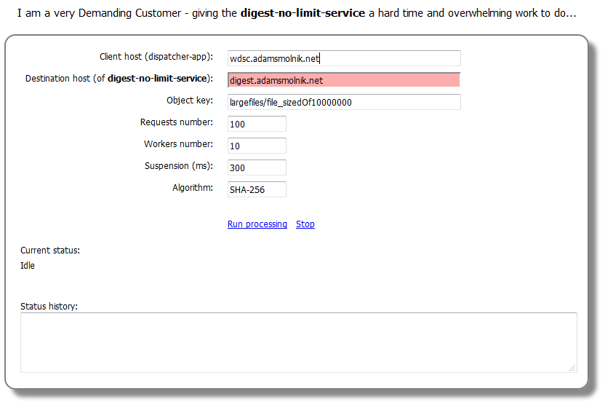


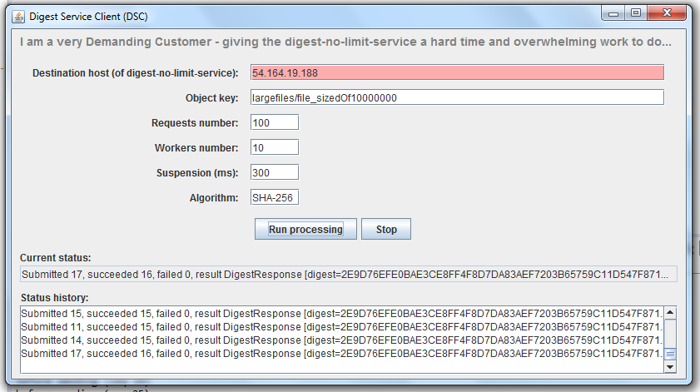
http://wdsc.adamsmolnik.net/webclient
Web Digest Service Client
(WDSC)
S3 bucket
…/largefiles/
DSC
workers
student002
S3: awswarszawa/dcs.zip

Slide 24
Exercise 2. Scaling out
No programming at all – declarative and out-of-the-box approach
Ingredients
Java/JEE, Glassfish, webapp (webservice)
AWS Services: EC2, ELB, ASG, CloudWatch
Expected results:
Machines with app(s) are added automatically as long as a workload threshold is surpassed - without human intervention
Respectively, the number of server instances diminishes in the opposite settings

Slide 25
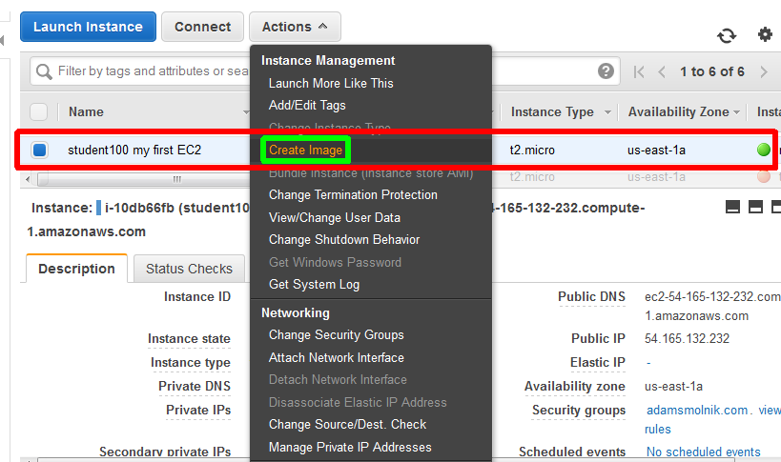
AMI from working instance

Slide 26
Exercise 2. Go ahead
Just proceed and follow me!

Slide 27
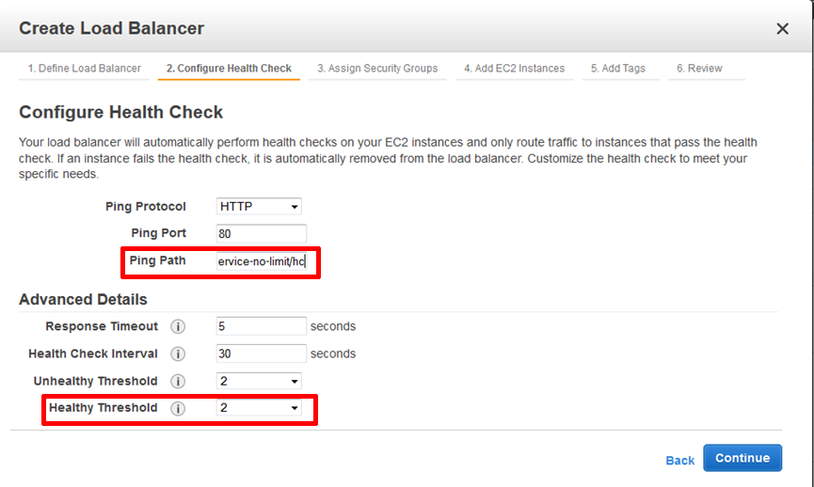
This is where ELB comes into play
/digest-service-no-limit/hc

Slide 28
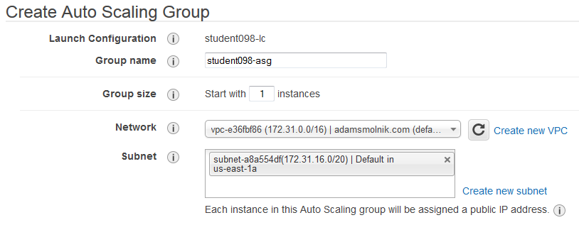
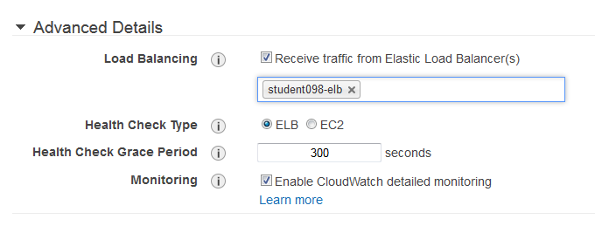
ASG comes in

Slide 29
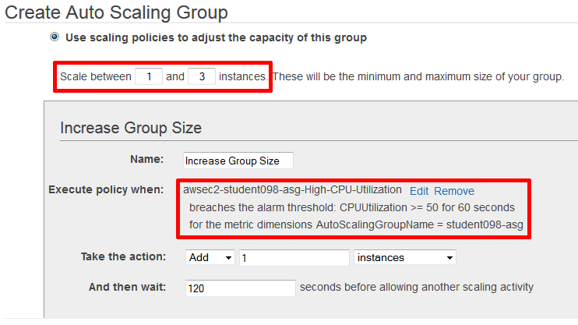
ASG and Alarms

Slide 30
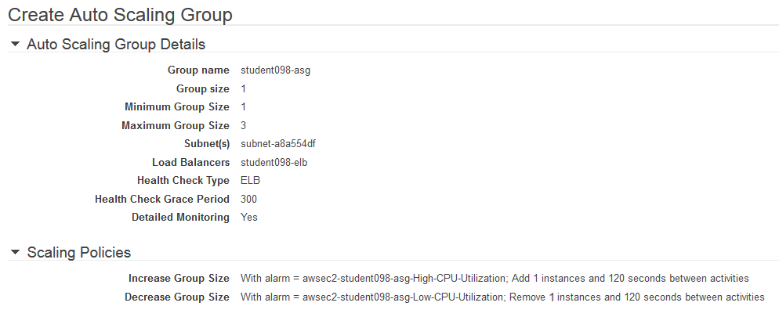
ASG Review

Slide 31
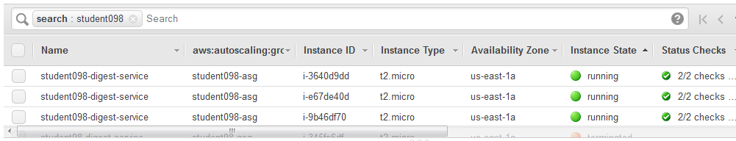
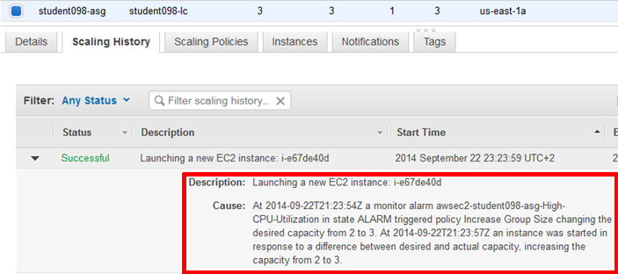
ASG at work

Slide 32
Other applications
ServerInstanceBuilder<SetupParamsView, ServerInstance> sib;
…
long size = fetchObjectSize(digestRequest);
if (size <= sizeThreshold) {
return sender.send(basicServiceUrl, digestRequest);
}
SetupParams sp = new SetupParams().withLabel("...");
ServerInstance newInstance = sib.build(sp);
String newServiceUrl = buildServiceUrl(newInstance.getPublicIpAddress());
DigestResponse response = sender.trySending(newServiceUrl, digestRequest);
newInstance.scheduleCleanup(55, TimeUnit.MINUTES);
return response;

Slide 33
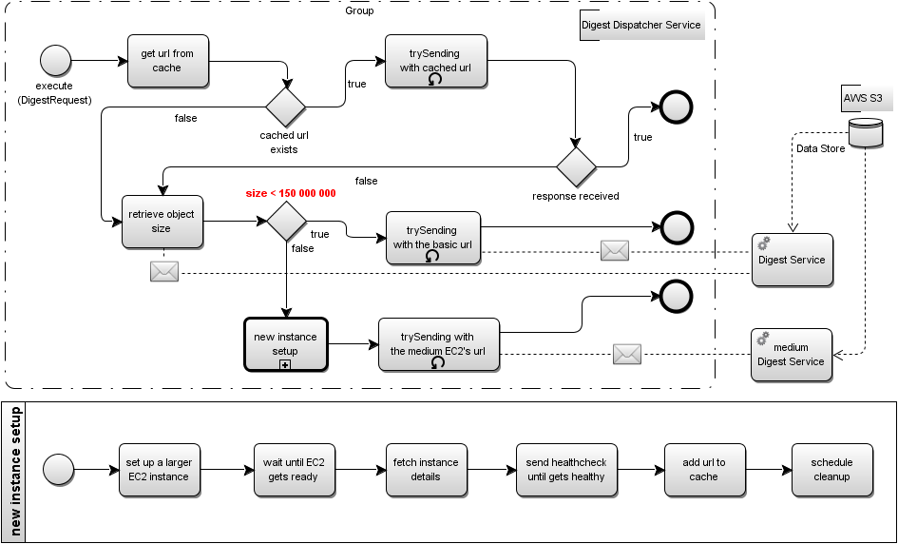
Other applications

Slide 34









Other applications
digest-service-elb-743012833.us-east-1.elb.amazonaws.com
digest-no-limit-service-512MB
digest.adamsmolnik.com
studentXYZ-dds-queue-in
true
EC2 instance
net.adamsmolnik.warsjawa/largefiles/
file_sizedOf10000000
studentXYZ-dds-queue-out
exercise-digest-dispatcher-service
retrieves configuration
false
digest-no-limit-service-1536MB
Setup new medium instance
studentXYZ/conf/services
file_sizedOf40000000

Slide 35
Other applications - cope with OOM
FallbackServerInstanceBuilder fsib = ...;
try {
sender.trySending(basicServiceUrl, digestRequest);
} catch (OutOfMemoryError outOfMemoryErrorFromTargetServerMachineInstance) {
try {
FallbackSetupParams fsp = new FallbackSetupParams().withLabel("...");
FallbackServerInstance newMediumFallbackInstance = fsib.build(fsp);
String newMediumServiceUrl = buildServiceUrl(newMediumFallbackInstance.getPublicIpAddress());
DigestResponse response = sender.trySending(newMediumServiceUrl, digestRequest);
newMediumFallbackInstance.scheduleCleanup(55, TimeUnit.MINUTES);
return response;
} catch (OutOfMemoryError outOfMemoryFromMediumTargetServerMachineInstance) {
FallbackSetupParams fsp = new FallbackSetupParams().withLabel("...");
FallbackServerInstance newLargestFallbackInstance = fsib.build(fsp);
String newLargestServiceUrl = buildServiceUrl(newLargestFallbackInstance.getPublicIpAddress());
DigestResponse response = sender.trySending(newLargestServiceUrl, digestRequest);
newLargestFallbackInstance.scheduleCleanup(55, TimeUnit.MINUTES);
return response;
}
}
return response;

Slide 36
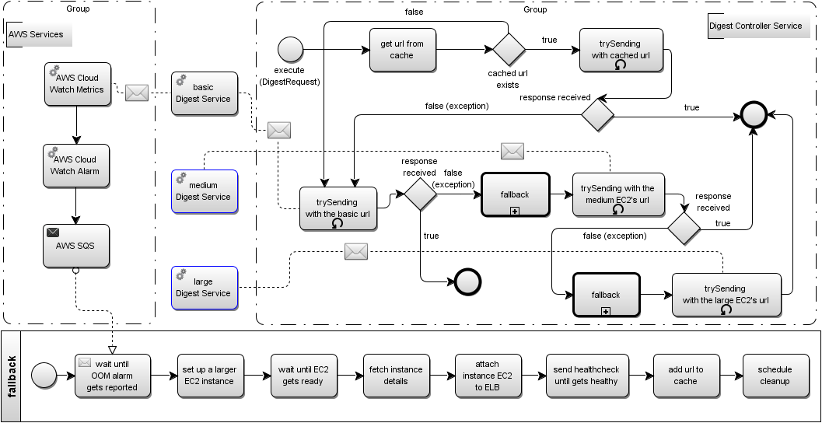
Other applications - cope with OOM

Slide 37
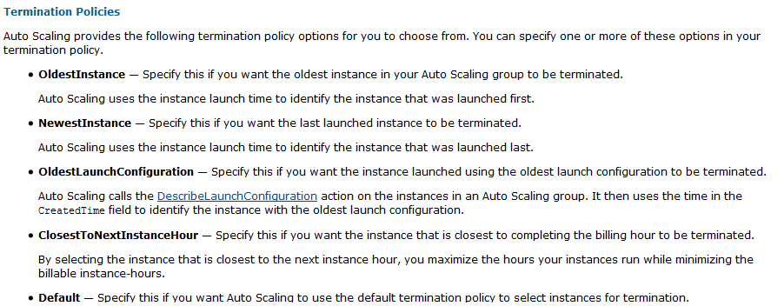
Challenges
Scaling down is extremely tricky…
Our approach: Assassin and Seppuku
Think of a “machine” as sort of a process or thread rather than a stable infrastructure component
Possibility of falling into an infinite loop when launching new EC2 instances
“Turn off the light” once EC2s are idle

Slide 38
http://www.cloudyna.org

