Slide 1

Build scalable and reliable JEE apps with AWS
Warsjava workshops 2014’
Adam Smolnik

Slide 2
Agenda
Global AWS Architecture – Multi Regions and AZ
A brief overview of AWS services
Example JEE apps structure walk-through
Exercise 1. – set up EC2
Exercise 2. - scale apps out declaratively with ASG, ELB via AWS console
Exercise 3. – scale digest-service-no-limit up programmatically with Java AWS SDK
Exercise 4. – dissect digest-controller-service interiors and adjust it to your own concept

Slide 3
Goals
Show you - as a Java/JEE developer a handful of new opportunities which has come with the advent of Cloud era
Get you familiar with AWS Services and their rich Java SDK
Bring your attention to new challenges you will face while dealing with Cloud solutions

Slide 4
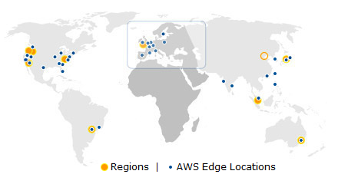
AWS Globality

Slide 5
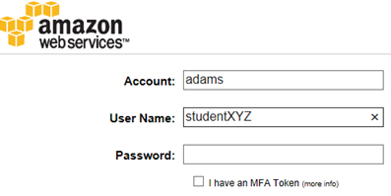
AWS Console
https://adams.signin.aws.amazon.com/console
Account: adams
User Name: studentXYZ e.g. student002
Password: wj!studentXYZ@# e.g. wj!student002@#

Slide 6
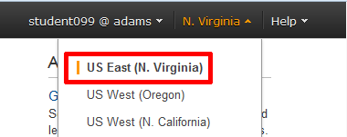
Set the appropriate Region

Slide 7
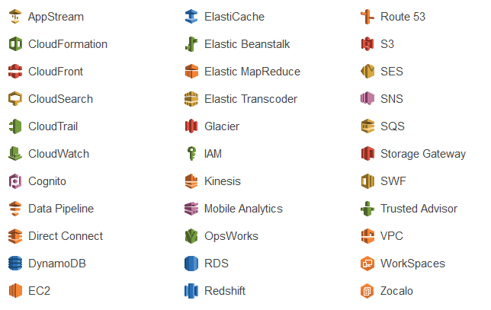
AWS overview
Just call up AWS Console

Slide 8

AWS Console vs. Java SDK
JAVA SDK

Slide 9
You say “service”, “web service” or “web app” and you typically think of “jar”, “war” or “ear” file

Slide 10
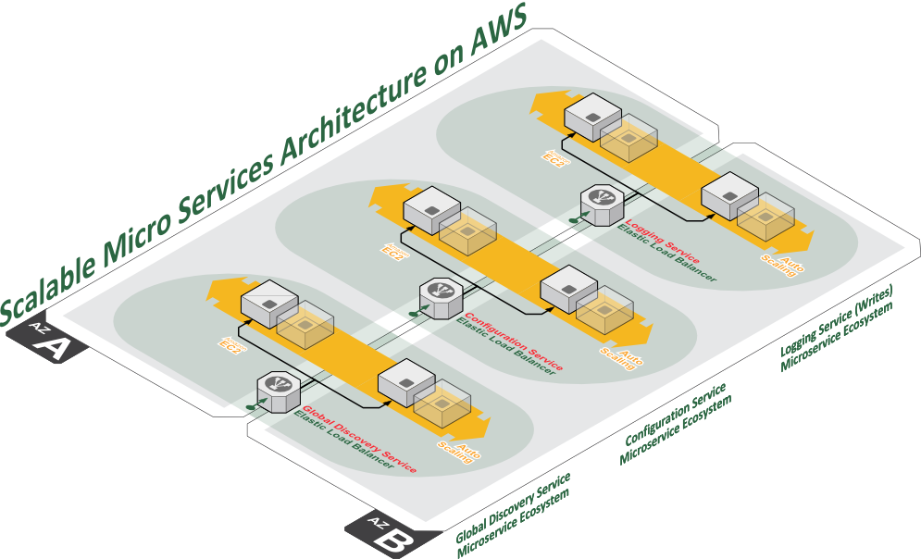
I say “web service” or “web app” and I think of
a set of components making up a new notion of “service” in the Cloud: “war/ear” file + ASG + ELB

Slide 11
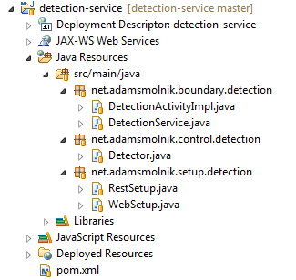
Example JEE 7 Service structure
https://github.com/smolnik?tab=repositories
Entity-Control-Boundary

Slide 12
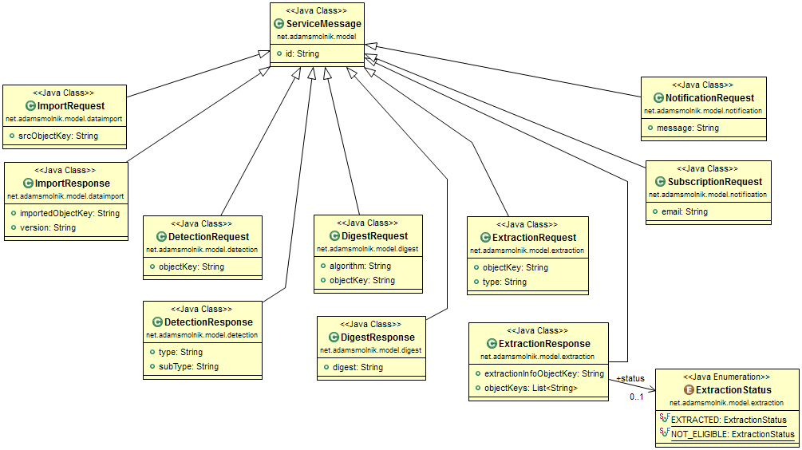
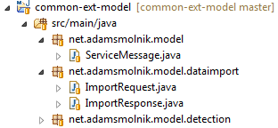
Common external model

Slide 13
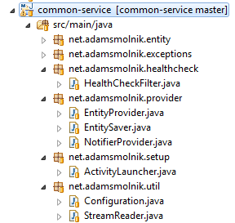
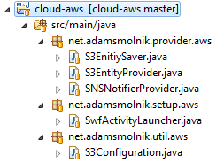
Common service structure
Cloud-agnostic interfaces
Specific cloud provider impl.

Slide 14
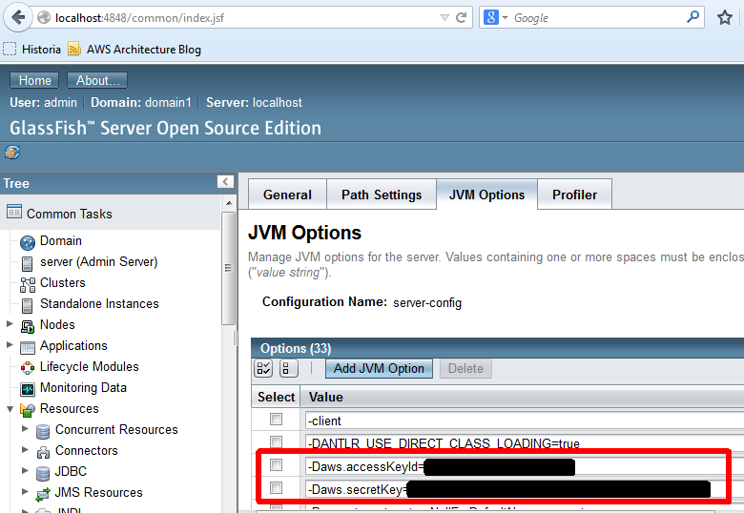
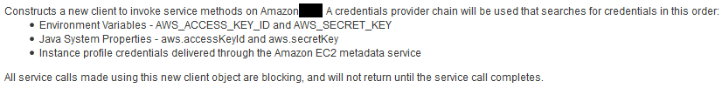
Test locally with GF

Slide 15
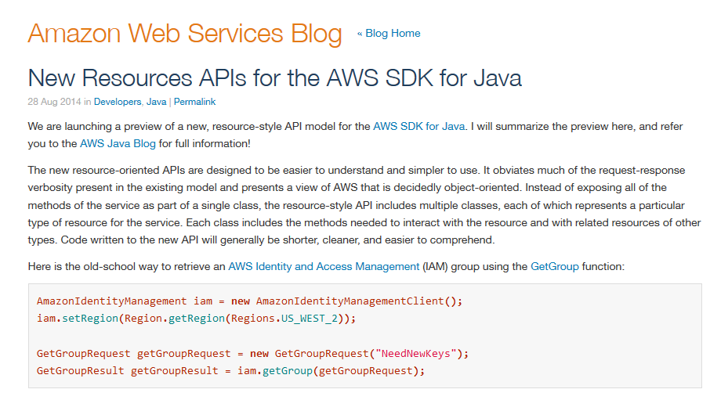
New API for Java is coming soon…

Slide 16
Manifesto: Java Enterprise Edition Cloud API JSR
https://forums.aws.amazon.com/thread.jspa?threadID=161000&tstart=0

Slide 17
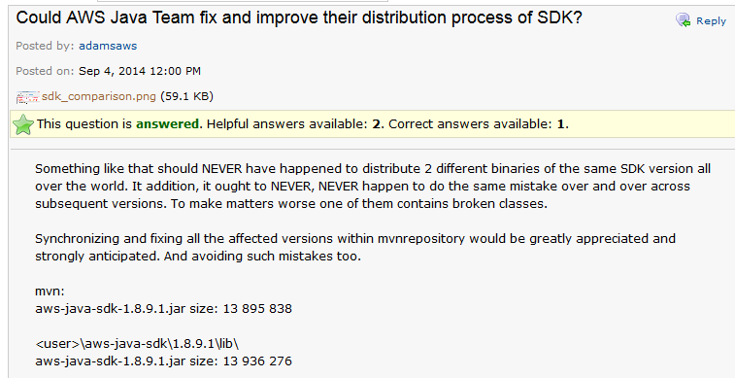
At times setbacks happen
Central Maven’s repository issue
https://forums.aws.amazon.com/thread.jspa?threadID=160097&tstart=0

Slide 18
Exercise 1. Set up EC2
Goal: Make the EC2 instance work and ready for deployment of apps
Worth to mention here:
Staged bakery process used by us to bake the right machine instance image
Free tier instances
CPU Credits

Slide 19
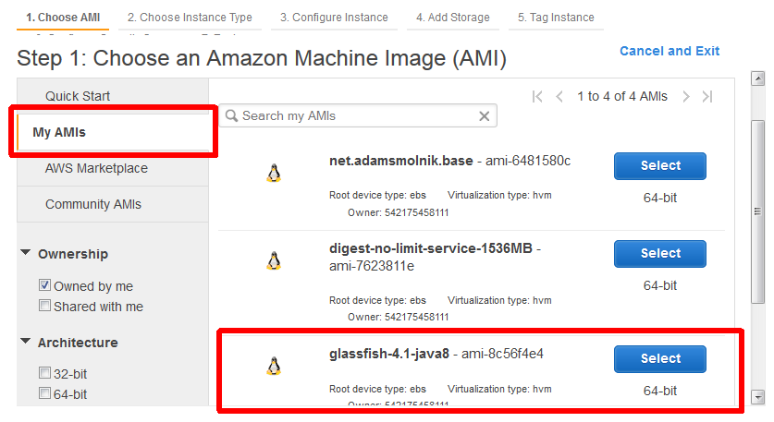
Exercise 1. Step 1

Slide 20
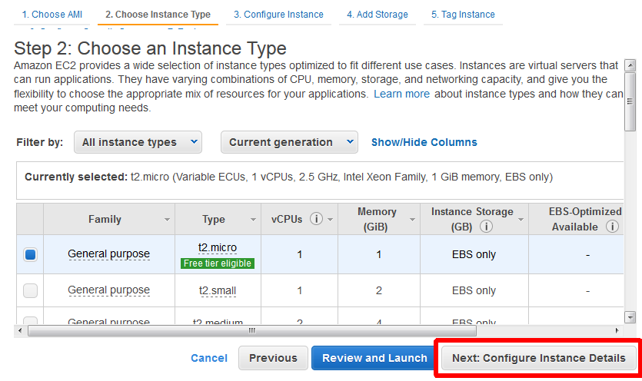
Exercise 1. Step 2

Slide 21
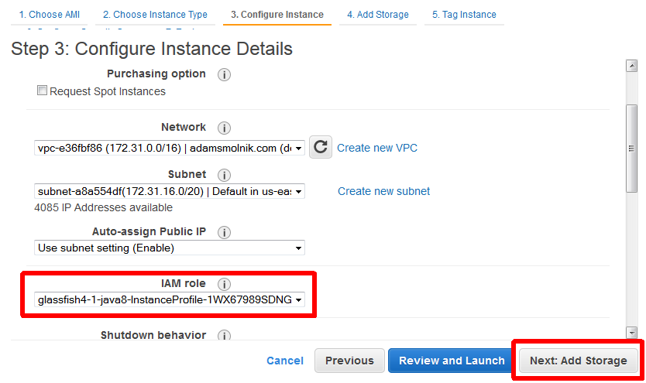
Exercise 1. Step 3

Slide 22
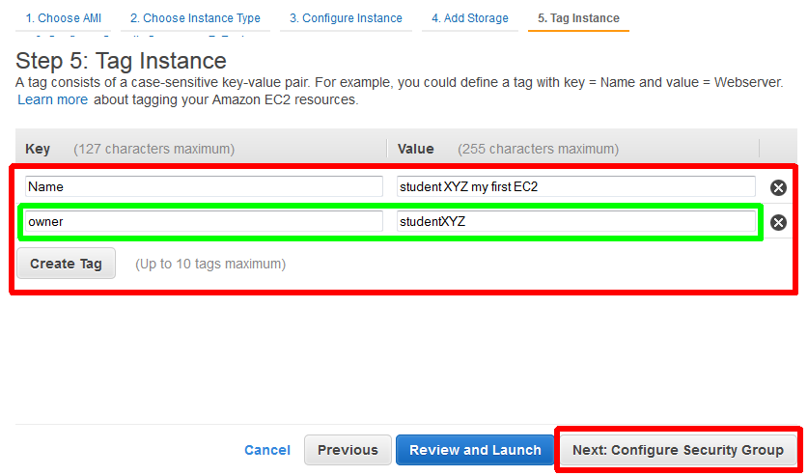
Exercise 1. Step 5

Slide 23
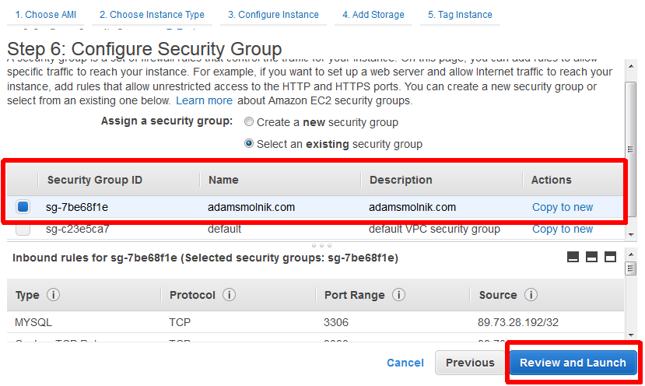
Exercise 1. Step 6

Slide 24
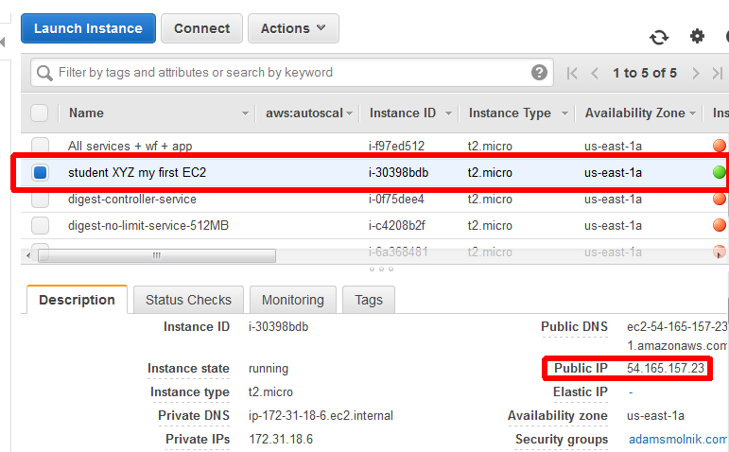
Exercise 1. Outcome

Slide 25
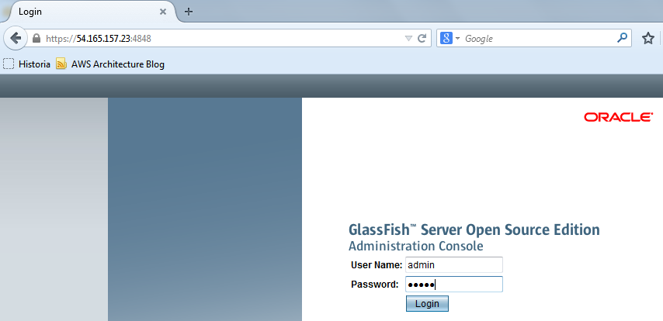
Exercise 1. Try to login

Slide 26
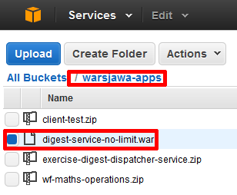
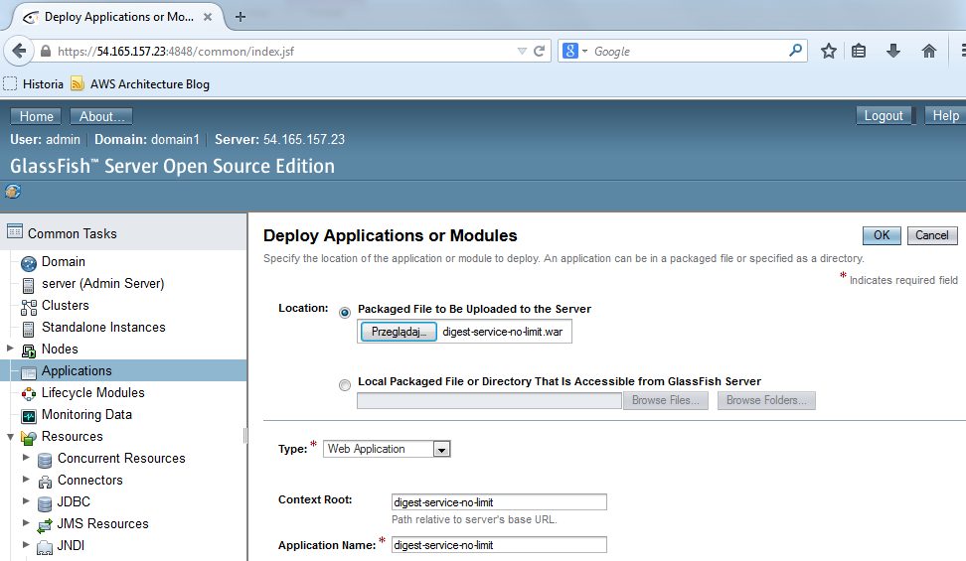
Exercise 1. Deploy a service

Slide 27
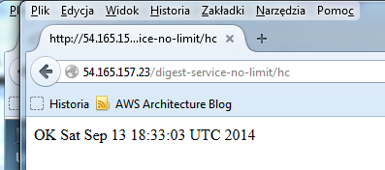
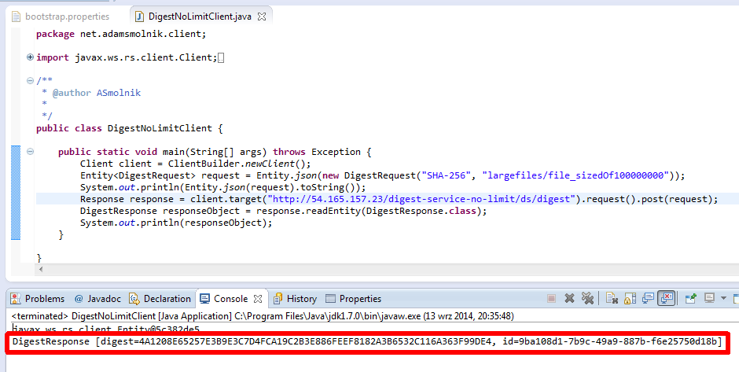
Exercise 1. Call the service
https://github.com/smolnik/client-test.git
Or S3: warsjawa-apps/client-test.zip

Slide 28
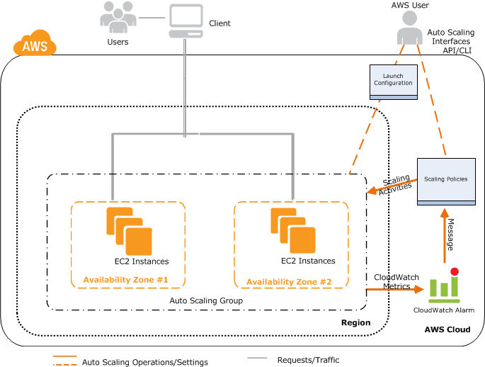
Before going into Exercise 2.

Slide 29
Exercise 2. Scaling out
No programming at all – declarative and out-of-the-box approach
Ingredients
Java, JEE, Glassfish, webapp (webservice)
AWS Services: EC2, ELB, ASG, CloudWatch
Expected results:
Machines with app(s) are added automatically once a workload threshold is surpassed - without human intervention
Respectively, the number of server instances diminishes in the opposite settings

Slide 30
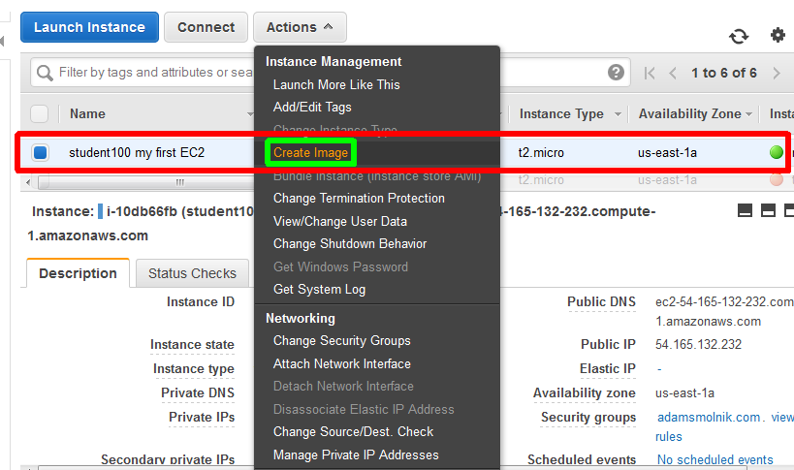
AMI from working instance

Slide 31
Exercise 2. Go ahead
Just proceed and follow me!

Slide 32
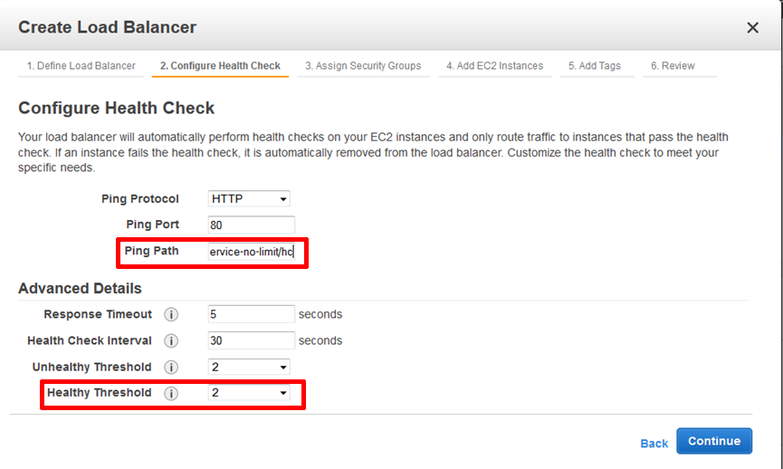
This is where ELB comes into play
/digest-service-no-limit/hc

Slide 33
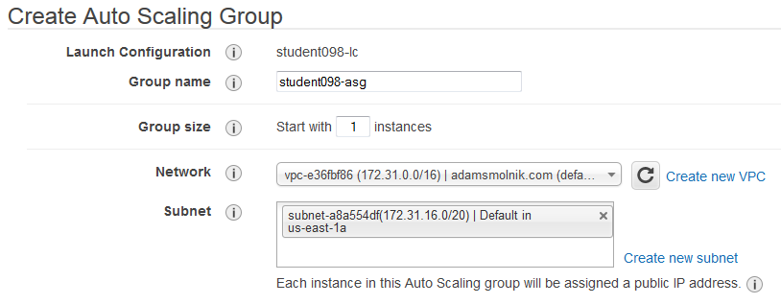
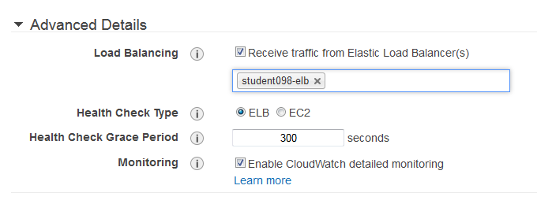
ASG comes in

Slide 34
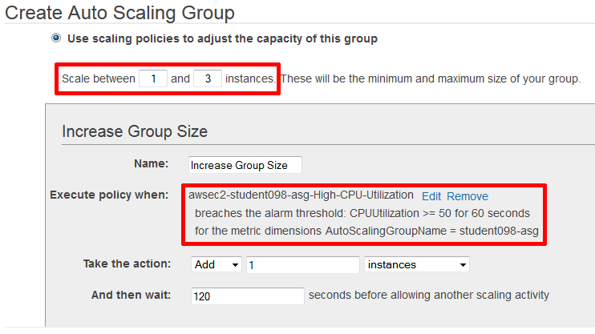
ASG and Alarms

Slide 35
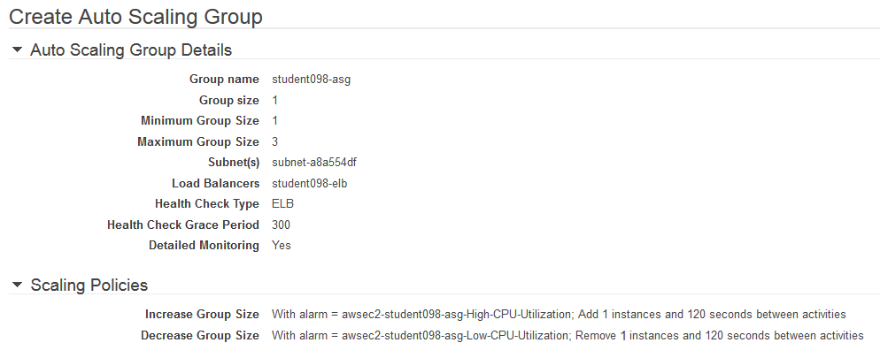
ASG Review

Slide 36
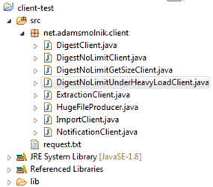
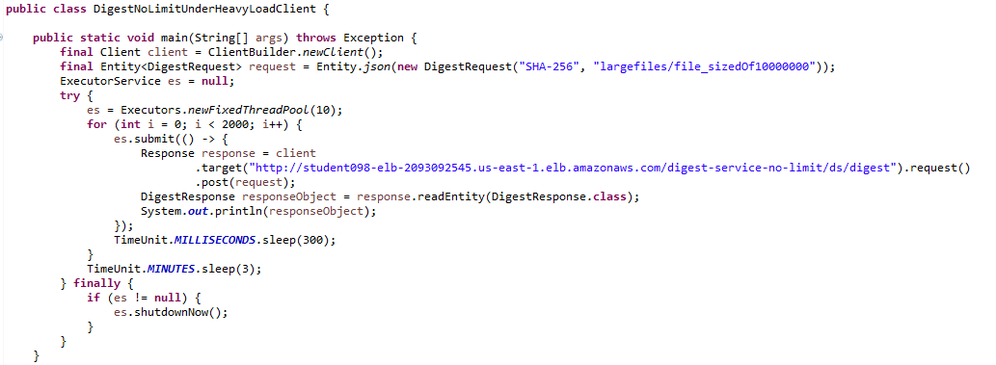
Overload the service

Slide 37
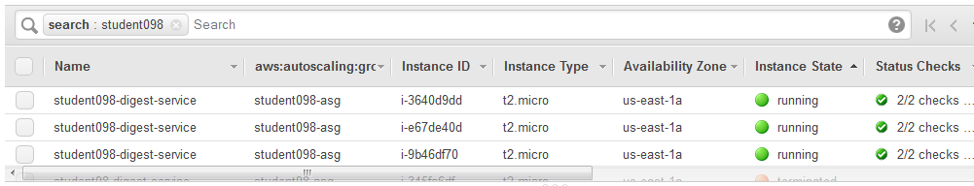
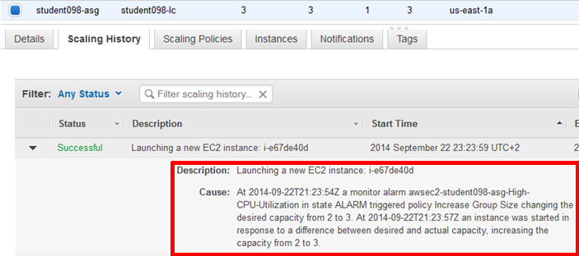
ASG at work

Slide 38
Exercise 3. The essence
ServerInstanceBuilder<SetupParamsView, ServerInstance> sib;
…
long size = fetchObjectSize(digestRequest);
if (size <= sizeThreshold) {
return sender.send(basicServiceUrl, digestRequest);
}
SetupParams sp = new SetupParams().withLabel("...");
ServerInstance newInstance = sib.build(sp);
String newServiceUrl = buildServiceUrl(newInstance.getPublicIpAddress());
DigestResponse response = sender.trySending(newServiceUrl, digestRequest);
newInstance.scheduleCleanup(55, TimeUnit.MINUTES);
return response;

Slide 39
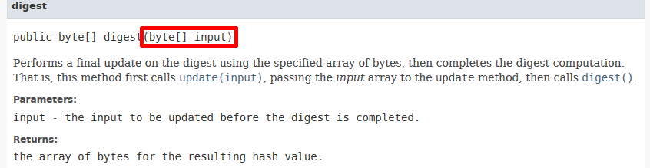
Before turning to Exercise 3.
Digest Service has been used to mimic memory- and CPU-intensive consuming work
To recall “Message digests are secure one-way hash functions that take arbitrary-sized data and output a fixed-length hash value”

Slide 40
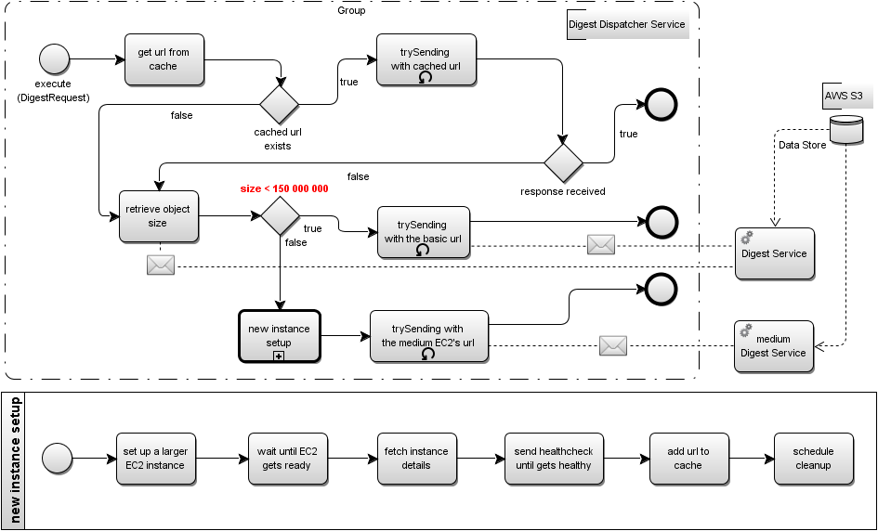
Exercise 3. Flow impl. details

Slide 41









Exercise 3. Components layout
digest-service-elb-743012833.us-east-1.elb.amazonaws.com
digest-no-limit-service-512MB
digest.adamsmolnik.com
studentXYZ-dds-queue-in
true
EC2 instance
net.adamsmolnik.warsjawa/largefiles/
file_sizedOf10000000
studentXYZ-dds-queue-out
exercise-digest-dispatcher-service
retrieves configuration
false
digest-no-limit-service-1536MB
Setup new medium instance
studentXYZ/conf/services
file_sizedOf40000000

Slide 42
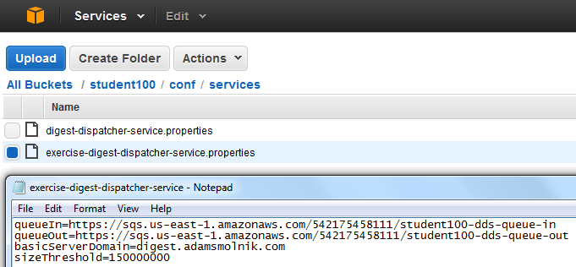
Exercise 3. Check out app’s skeleton
https://github.com/smolnik/exercise-digest-dispatcher-service.git with dependent projects
Or just import the zipped Eclipse project from S3: warsjawa-apps/exercise-digest-dispatcher-service.zip
Have a look at S3 configuration file
<dependency>
<groupId>net.adamsmolnik</groupId>
<artifactId>common-ext-model</artifactId>
<version>0.0.1-SNAPSHOT</version>
</dependency>
<dependency>
<groupId>net.adamsmolnik</groupId>
<artifactId>common-service</artifactId>
<version>0.0.1-SNAPSHOT</version>
</dependency>
<dependency>
<groupId>net.adamsmolnik</groupId>
<artifactId>cloud-aws</artifactId>
<version>0.0.1-SNAPSHOT</version>
<scope>runtime</scope>
</dependency>
<dependency>
<groupId>net.adamsmolnik</groupId>
<artifactId>common-controller</artifactId>
<version>0.0.1-SNAPSHOT</version>
</dependency>
<dependency>

Slide 43
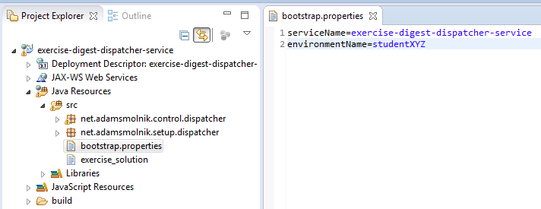
Exercise 3. Replace XYZ->001, 002…
environmentName=studentXYZ
environmentName=student002

Slide 44
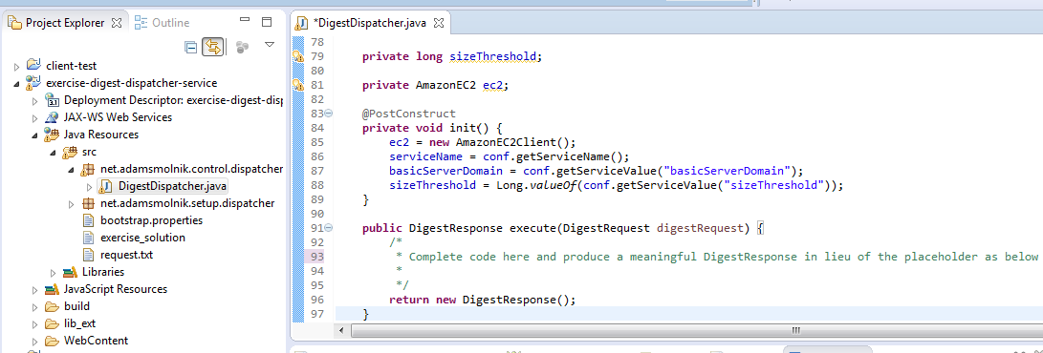
Exercise 3. At last, write code

Slide 45
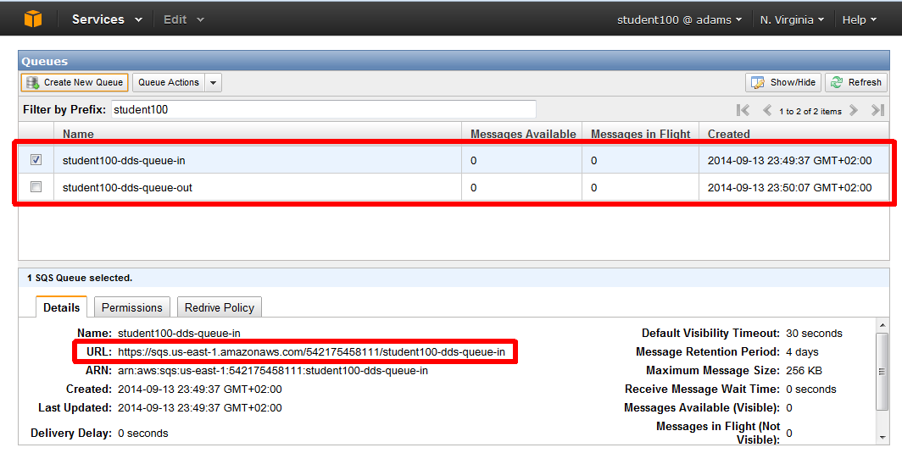
Exercise 3. Create SQS queues

Slide 46
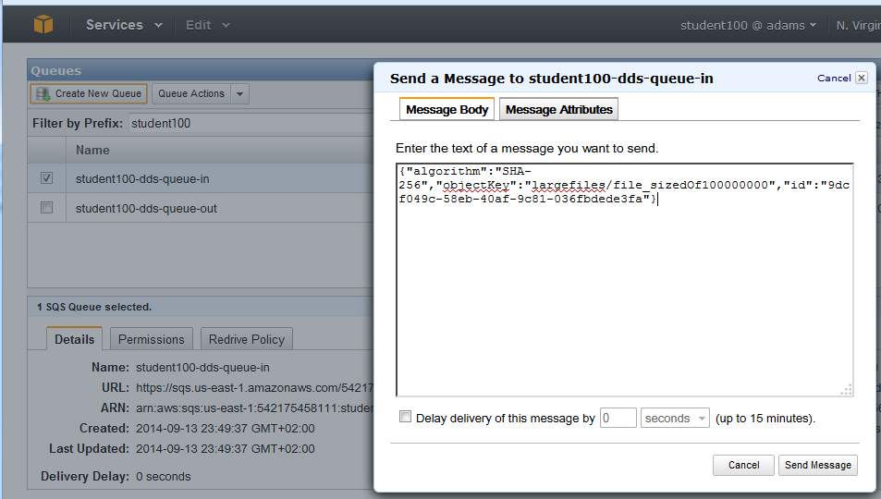
Exercise 3. Fire the flow

Slide 47
Exercise 3. Build and deploy

Slide 48
Exercise 4. More involved case
FallbackServerInstanceBuilder fsib = ...;
try {
sender.trySending(basicServiceUrl, digestRequest);
} catch (OutOfMemoryError outOfMemoryErrorFromTargetServerMachineInstance) {
try {
FallbackSetupParams fsp = new FallbackSetupParams().withLabel("...");
FallbackServerInstance newMediumFallbackInstance = fsib.build(fsp);
String newMediumServiceUrl = buildServiceUrl(newMediumFallbackInstance.getPublicIpAddress());
DigestResponse response = sender.trySending(newMediumServiceUrl, digestRequest);
newMediumFallbackInstance.scheduleCleanup(55, TimeUnit.MINUTES);
return response;
} catch (OutOfMemoryError outOfMemoryFromMediumTargetServerMachineInstance) {
FallbackSetupParams fsp = new FallbackSetupParams().withLabel("...");
FallbackServerInstance newLargestFallbackInstance = fsib.build(fsp);
String newLargestServiceUrl = buildServiceUrl(newLargestFallbackInstance.getPublicIpAddress());
DigestResponse response = sender.trySending(newLargestServiceUrl, digestRequest);
newLargestFallbackInstance.scheduleCleanup(55, TimeUnit.MINUTES);
return response;
}
}
return response;

Slide 49
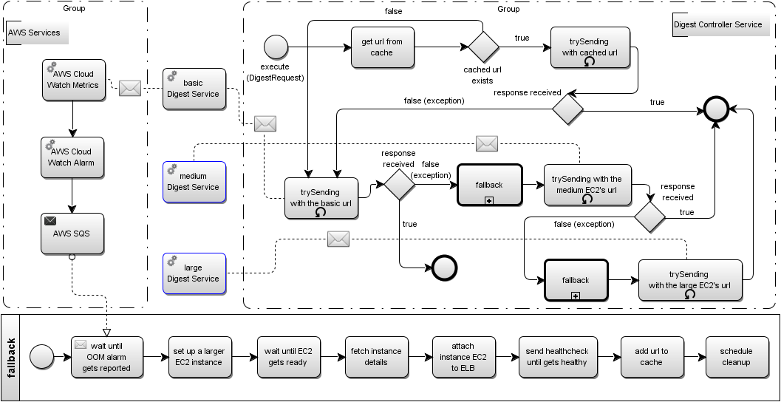
Exercise 4. More complex flow

Slide 50
Exercise 4. Check out app’s code
https://github.com/smolnik/exercise-digest-controller-service.git with dependent projects
Or just import the zipped Eclipse project from S3: warsjawa-apps/exercise-digest-controller-service.zip

Slide 51
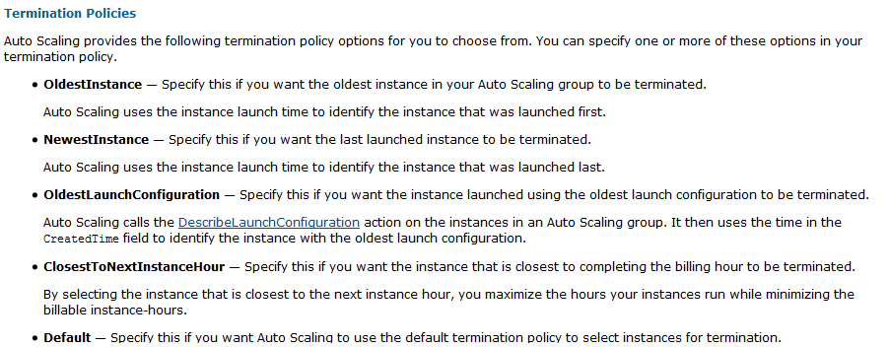
Challenges
Scaling down is extremely tricky…
Our approach: Assassin and Seppuku
Think of a “machine” as sort of a process or thread rather than a stable infrastructure component
Possibility of falling into an infinite loop when launching new EC2 instances
“Turn off the light” once EC2s are idle

