Slide 1
Build workflow in the Cloud
Warsjava workshops 2014’
Adam Smolnik

Slide 2

Agenda
Brief overview of AWS workflow components
Eclipse SDK setup
DataProcessingWorkflow walkthrough
Exercise 1. Sequential workflow
Exercise 2. Parallel workflow
Exercise 3. “Mix of both” workflow
Exercise 4. Mix workflow in real
Exercise 5. Build your own Data Processing flow
AWS SWF’ timeouts and limits

Slide 3

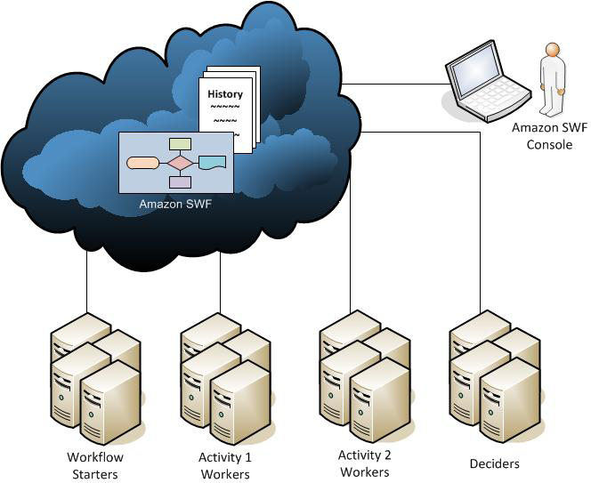



SWF Workflow Architecture
Amazon SWF
Decider
Activity
Worker

Slide 4
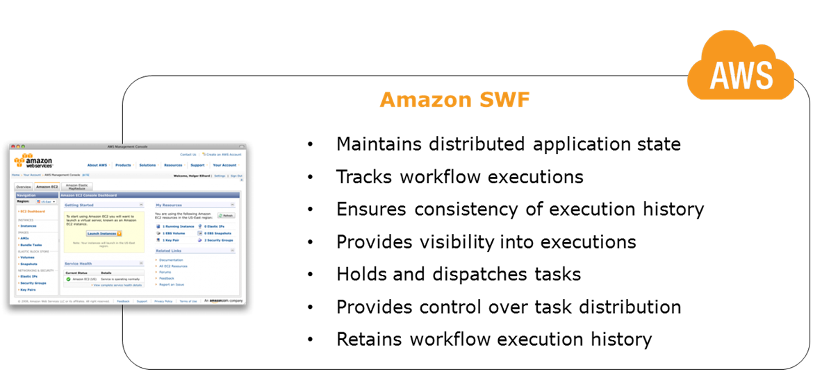
Amazon SWF
A reliable central hub through which data is exchanged between the decider, the activity workers, and other relevant entities such as the person administering the workflow.
Amazon SWF

Slide 5
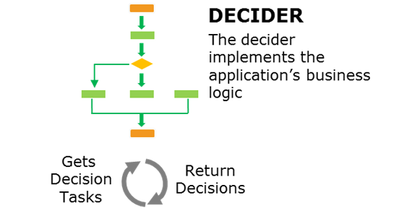
Decider
A decider is an implementation of a workflow's coordination logic. Deciders control the flow of activity tasks in a workflow execution.
Decider
Amazon SWF

Slide 6
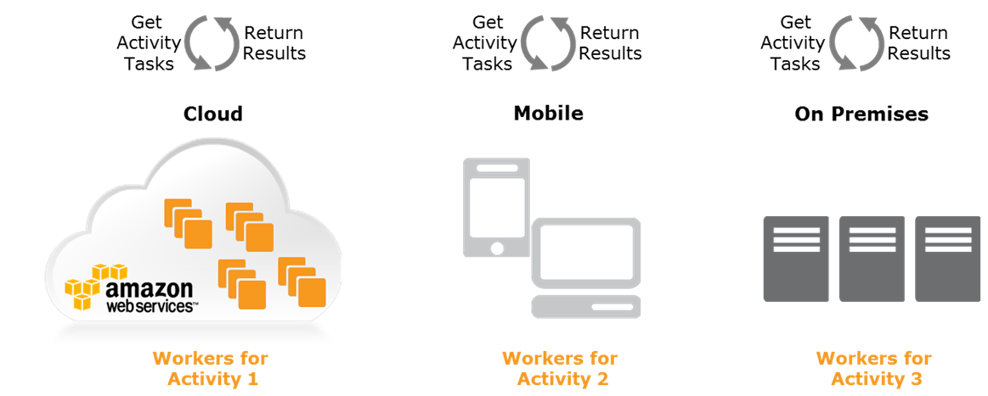
Workers and Activities
An Activity Worker is a process or thread that performs the activity tasks that are part of the workflow.
The Activity Task represents one of the tasks that is identified in the application.
Each Activity Worker polls Amazon SWF for new tasks that are appropriate for that Activity Worker to perform.
Worker
Activity Task
Amazon SWF

Slide 7
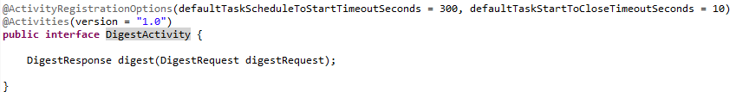

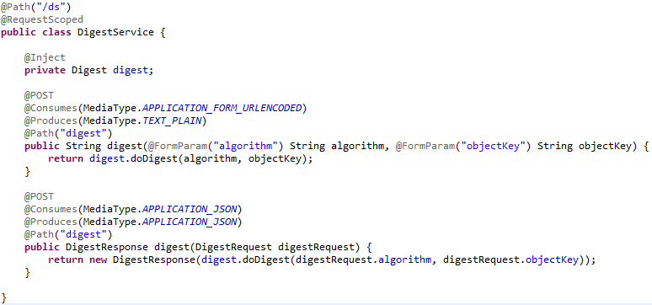
Activities as an Endpoint
Activities can play a role of a regular Endpoint as HTTP, REST, JMS, AMQP one at the Boundary layer
AWS SWF Endpoint invokes core business service Digest
RESTful Endpoint (JAX-RS)

Slide 8
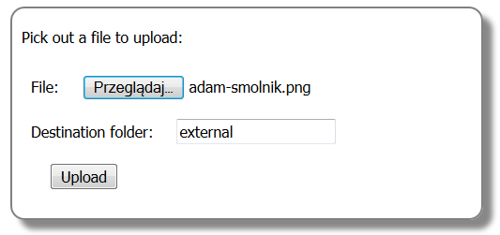
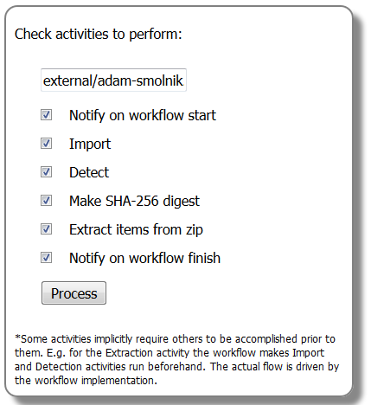
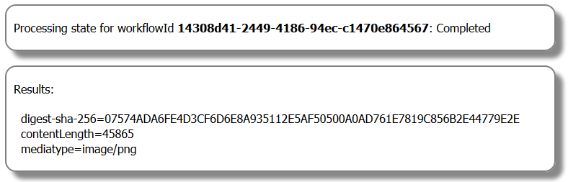
Live cooking: DataProcessingWorkflow
http://wf.adamsmolnik.com/data-uploader/

Slide 9
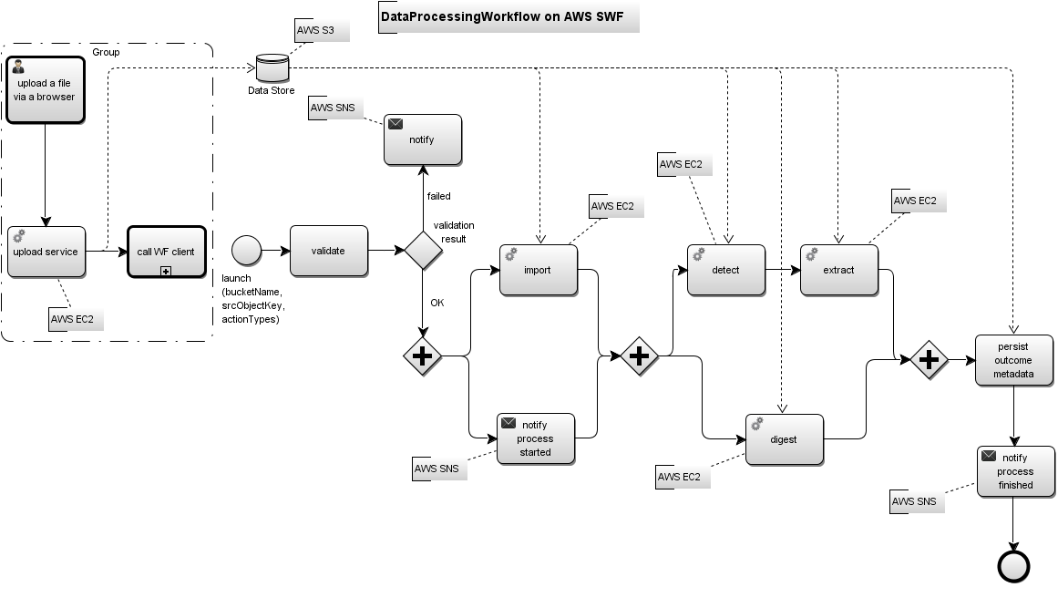
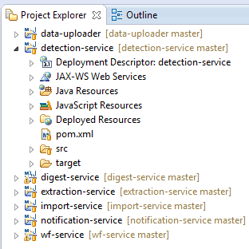
DataProcessingWorkflow layout

Slide 10
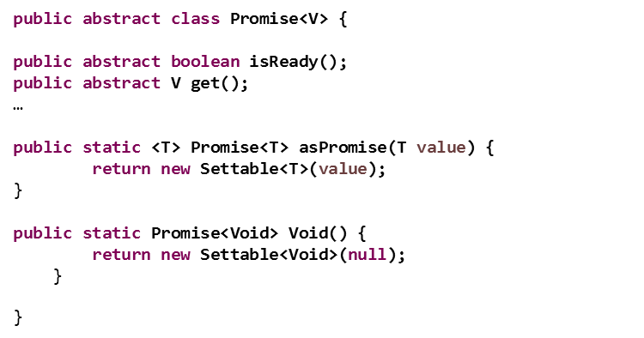
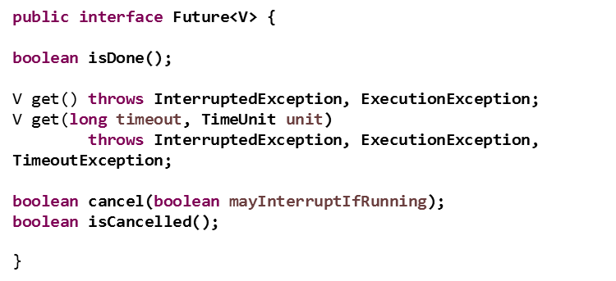
Promise vs. Future

Slide 11
Eclipse Setup
http://docs.aws.amazon.com/amazonswf/latest/awsflowguide/setup.html
Google, just type: swf eclipse setup

Slide 12
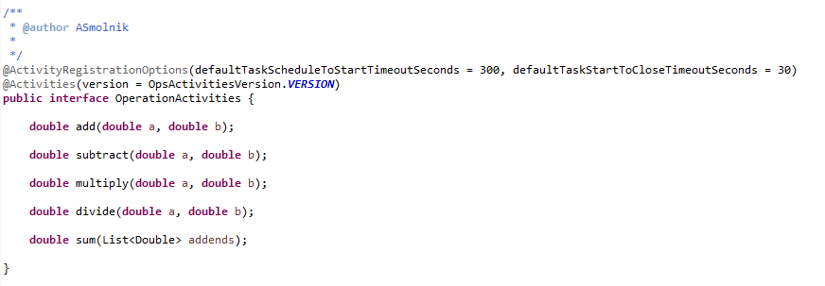
Exercises - Prerequisites
Check out wf-maths-operations from github: https://github.com/smolnik/wf-maths-operations.git or retrieve the Eclipse project from S3: warsjawa-apps/wf-maths-operations.zip
Acquaint with the SWF’s workflow and activities interfaces as well as their implementations
Examine and run PromiseTest

Slide 13
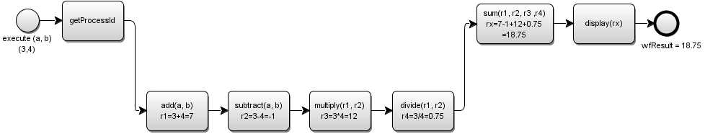
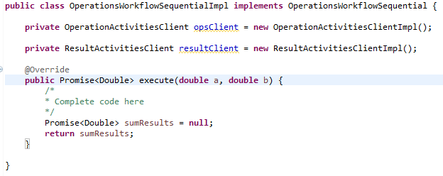
Exercise 1. Sequential workflow
Implement workflow logic as shown in the following diagram and then test the solution with JUnit:

Slide 14
Exercise 1. Solution
Promise<String> processId = Promise.asPromise(ManagementFactory.getRuntimeMXBean().getName());
Promise<Double> addResult = opsClient.add(a, b);
Promise<Double> subtractResult = opsClient.subtract(a, b, addResult);
Promise<Double> multiplResult = opsClient.multiply(a, b, subtractResult);
Promise<Double> divideResult = opsClient.divide(a, b, multiplResult);
List<Promise<Double>> addends = new ArrayList<>();
addends.add(addResult);
addends.add(subtractResult);
addends.add(multiplResult);
addends.add(divideResult);
Promise<List<Double>> addendsAsPromise = Promises.listOfPromisesToPromise(addends);
Promise<Double> sumResults = opsClient.sum(addendsAsPromise);
resultClient.display(Promise.asPromise("wfResult"), sumResults, processId);
return sumResults;

Slide 15
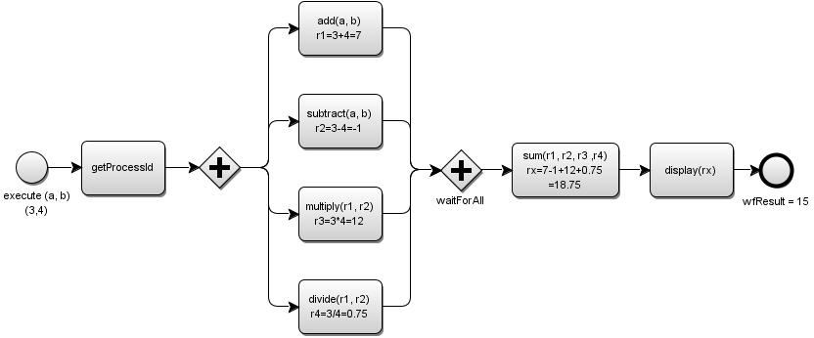
Exercise 2. Parallel workflow
Implement workflow logic as per shown in the following diagram and then test the solution with JUnit:

Slide 16
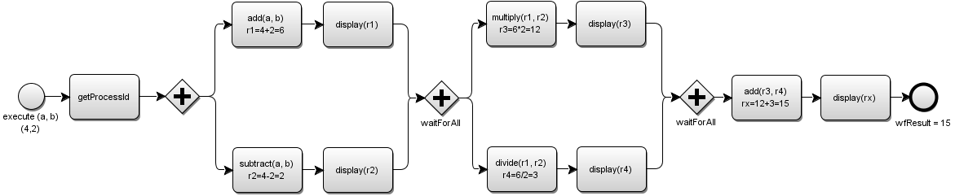
Exercise 3. “Mix of both” workflow
Implement workflow logic as per shown in the following diagram and then test the solution with JUnit:

Slide 17

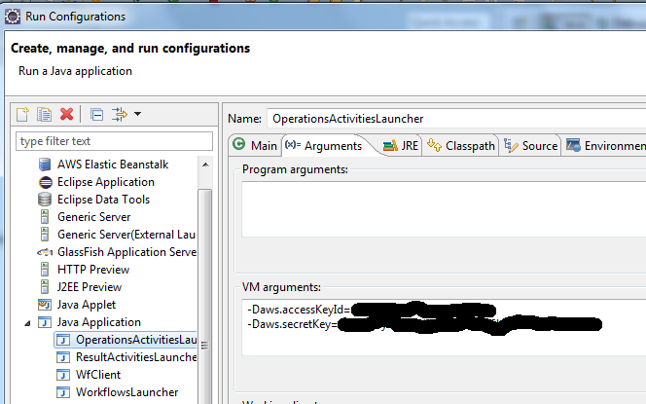
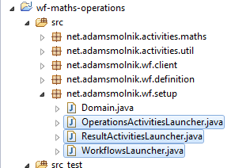
Exercise 4. Mix workflow in action
Run Mix workflow in real AWS settings and examine the steps via AWS SWF console

Slide 18
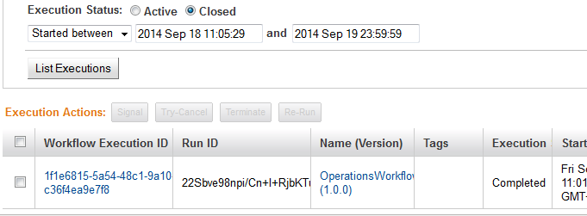
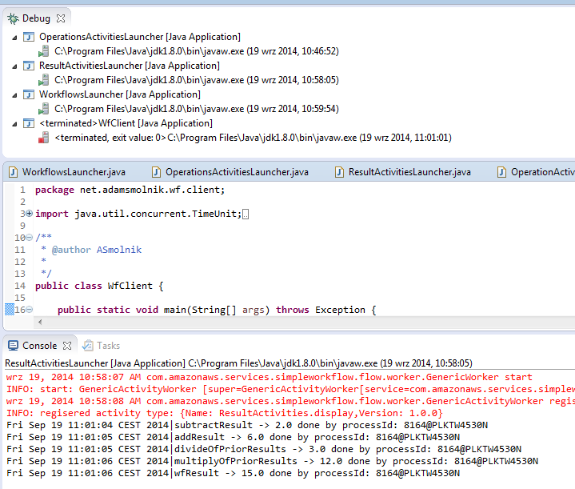
Exercise 4. Outcome

Slide 19
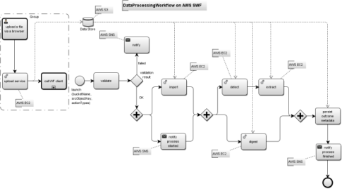
Exercise 5. Build your own Data Processing flow
Build and run your own Data Processing flow using distributed, independent remote services
So, check out exercise-wf-service from github: https://github.com/smolnik/exercise-wf-service.git or retrieve the Eclipse project from s3:
warsjawa-apps/exercise-wf-service.zip
Run your own all-services EC2 instance to provision remote services

Slide 20
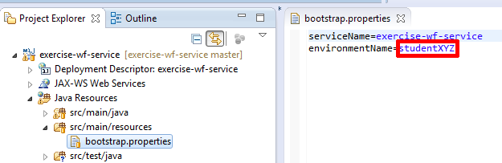
Exercise 5. Build your own Data Processing flow
(Optional) If you’d like to deploy the app into the AWS Cloud, set the param environmentName to value of your account name (e.g. student007)

Slide 21
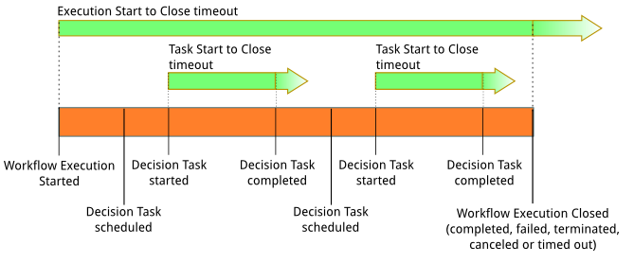
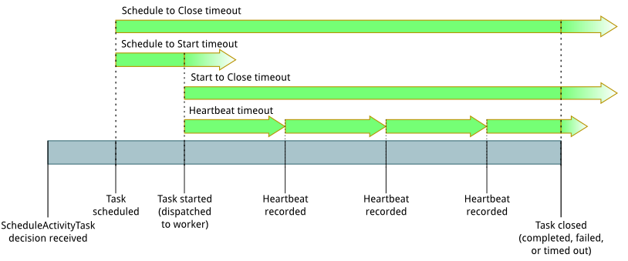
Timeouts

Slide 22
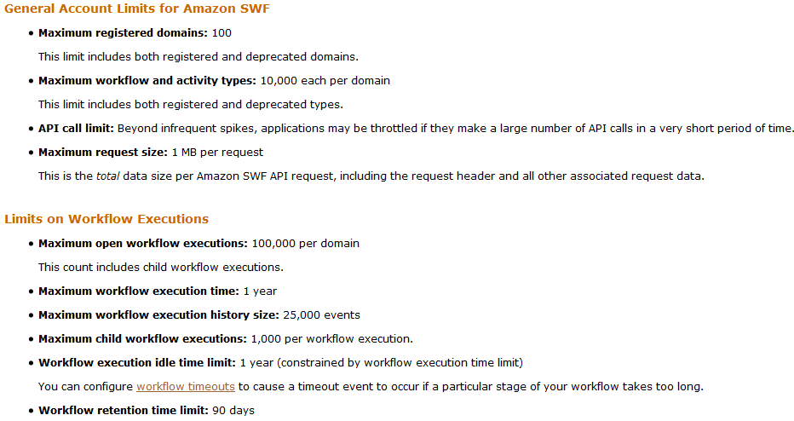
AWS SWF’ limits
http://docs.aws.amazon.com/amazonswf/latest/developerguide/swf-dg-limits.html
and a little bit more…

Slide 23
Worker Extensibility
The GenericWorkflowWorker can be configured with a factory for creating workflow definition factories
You may provide your own implementation of the factories by implementing
WorkflowDefinitionFactory
WorkflowDefinitionFactoryFactory
WorkflowDefinition

