Slide 1
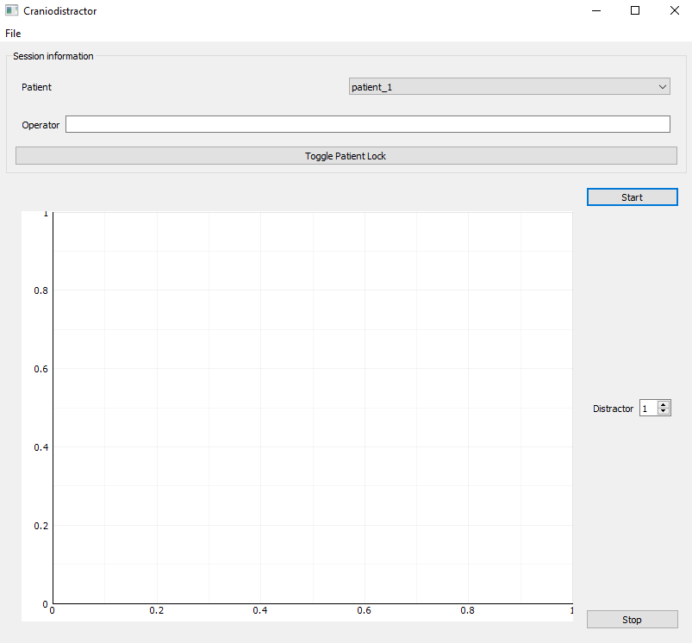
1. Select patient from the dropdown menu
2. Enter operator name
3. (Optional) Disable / Enable changing patient from the dropdown menu
5. Start the measurement
4. Select distractor number
6. Stop the measurement after distraction has been completed

Slide 2
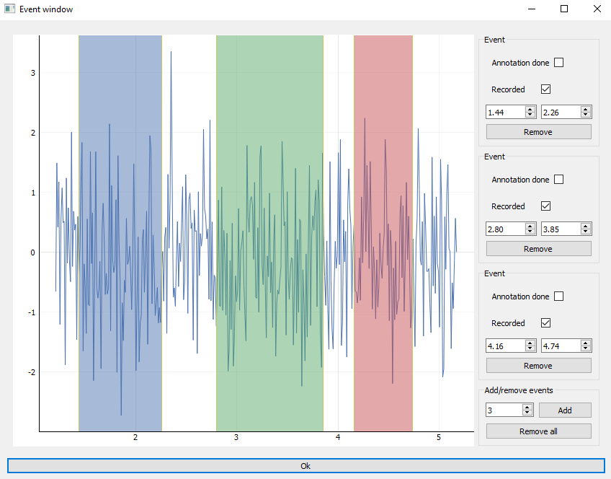
1. Verify that the number of events is correct
2. (Optional) Annotate distraction events by dragging the boundaries and ticking ”Annotation done”
3. Untick ”Recorded” if a distraction was performed but not recorded
4. Click ”Ok”

Slide 3
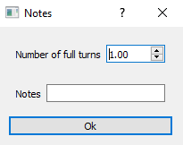
1. Enter number of full turns (1 by default)
2. Write any additional notes regarding the distraction
3. Click ”Ok” to return to the Measurement sequence

