Slide 1


Autonomous Truck Deployment – Impact of Road Construction
June 2025
Present by: Salah Uddin Momtaz
Presented to:

Slide 2
Construction Impact Analysis
Summary
Data: US road construction data (2016-2021)
Critical insights for AV deployment strategy
Identifying high-impact zones and routes
Predict affect of Construction
22.6K
Total Cities Analyzed
5
Self-driving Routes
6.2M
Construction Projects
2.7B
Construction Hours
7.8M
Construction Length
6Yr
Continuous Data

Slide 3
Analysis Methodology
Data Processing Approach
Ingest Kaggle data using API
Get the additional data
Census population, employment
National Road network for freights: to get the road density of cities - generating city size to normalize
Extract features from additional files

Slide 4
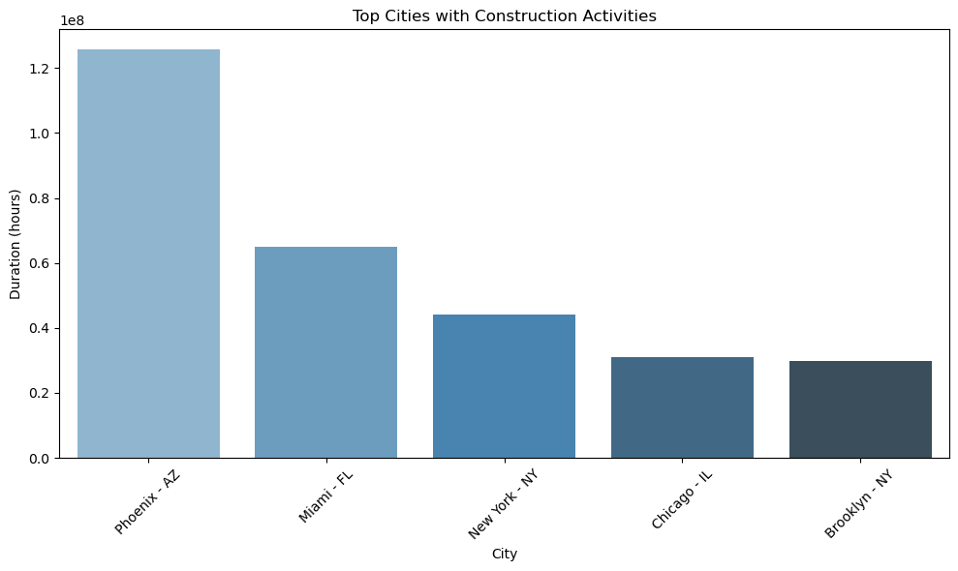
Insight 1: City With Highest Construction Activity
Top 5 Cities
Rank | City | Hours | Site | Avg Duration
1
2
3
4
5

Slide 5
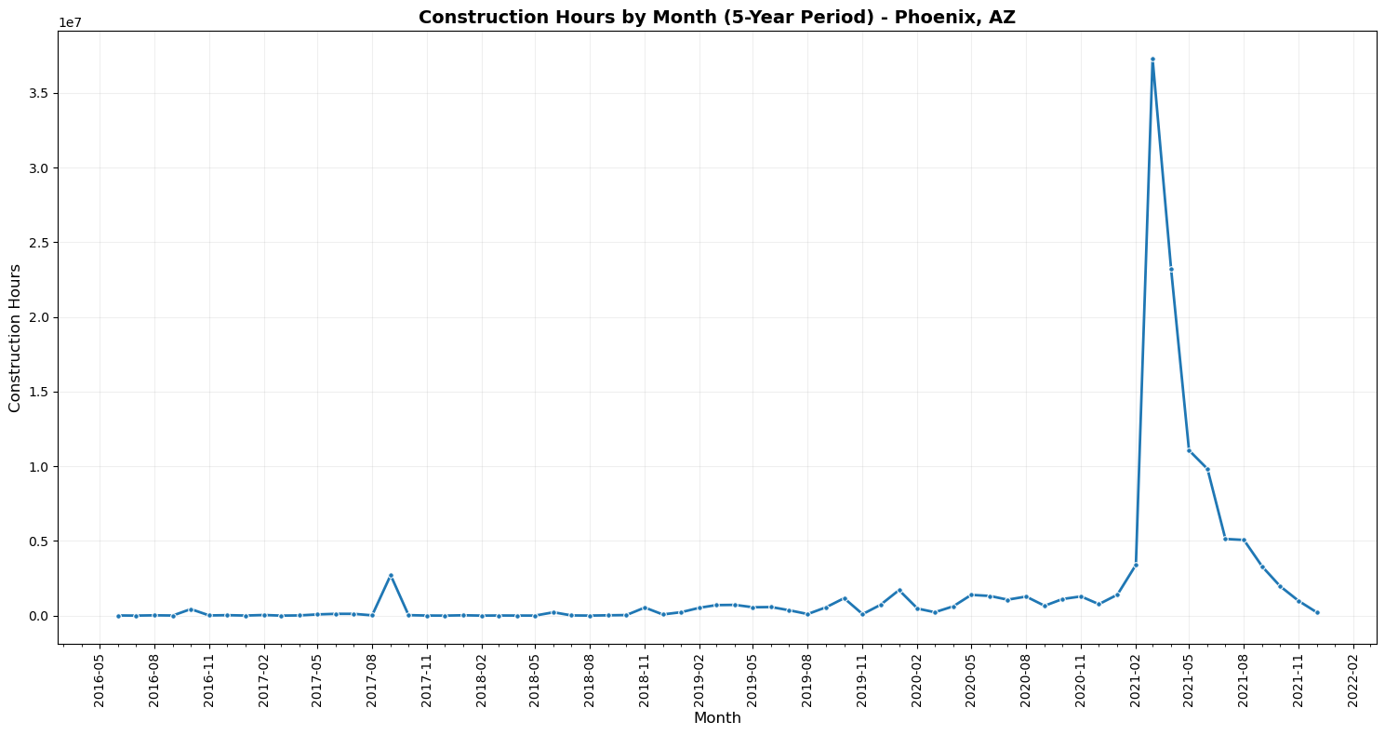
Insight 2: Time Series Trends
During the Month of March 2021 to June 2021 the Construction duration hiked significantly

Slide 6
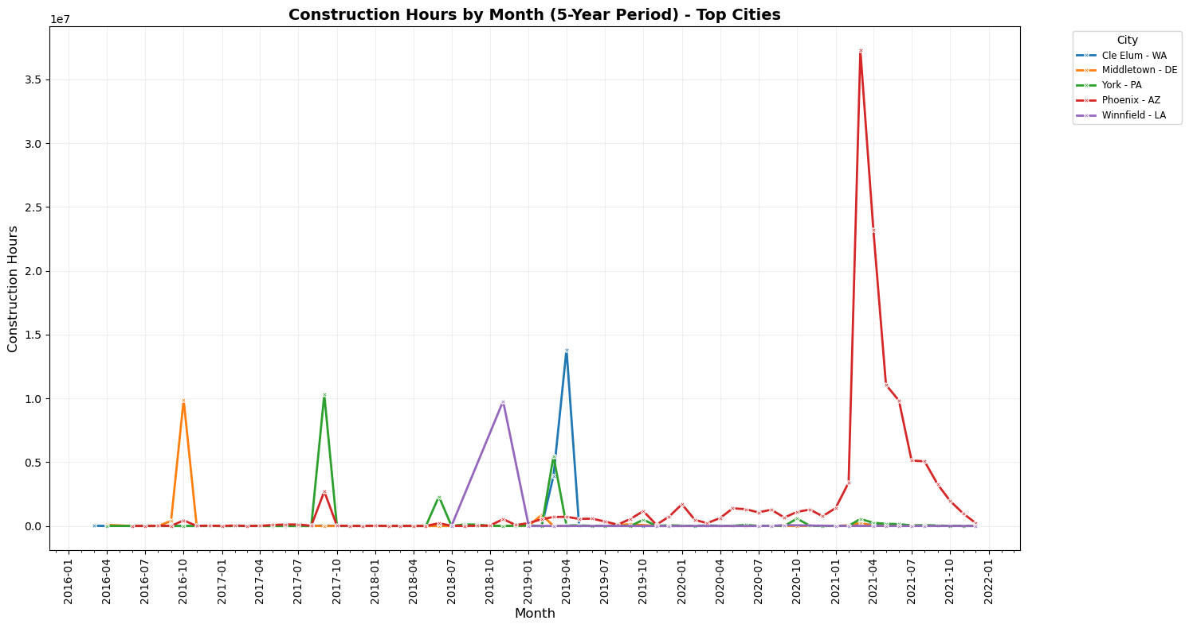
Insight 2: Time Series Trends (Contd.)
Most of the cities with highest construction hours has highest activity in Q3 before Covid, which may have shifted towards Q1 during Covid

Slide 7
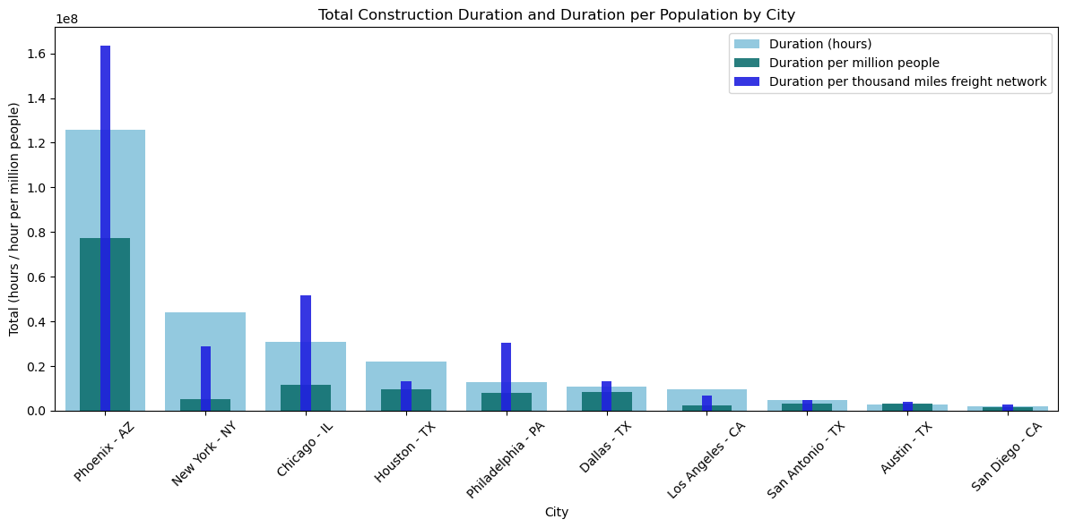
Insight 3: Compare 10 largest US cities
Regardless of the matric we used normalized version of the duration shows city of Phoenix, AZ and Chicago, IL are topmost and third most impactful cities respectively

Slide 8
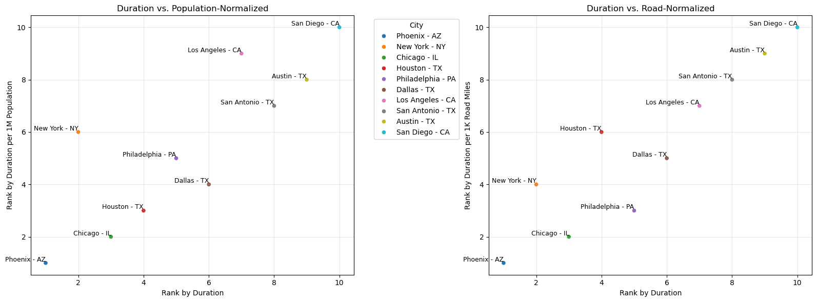
Insight 3: Compare 10 largest US cities
Normalization methodology significantly affects how construction impacts appear across different cities
Freight road length KPI reveals higher impacts in major port cities like NYC, and LA due to their extensive freight infrastructure

Slide 9
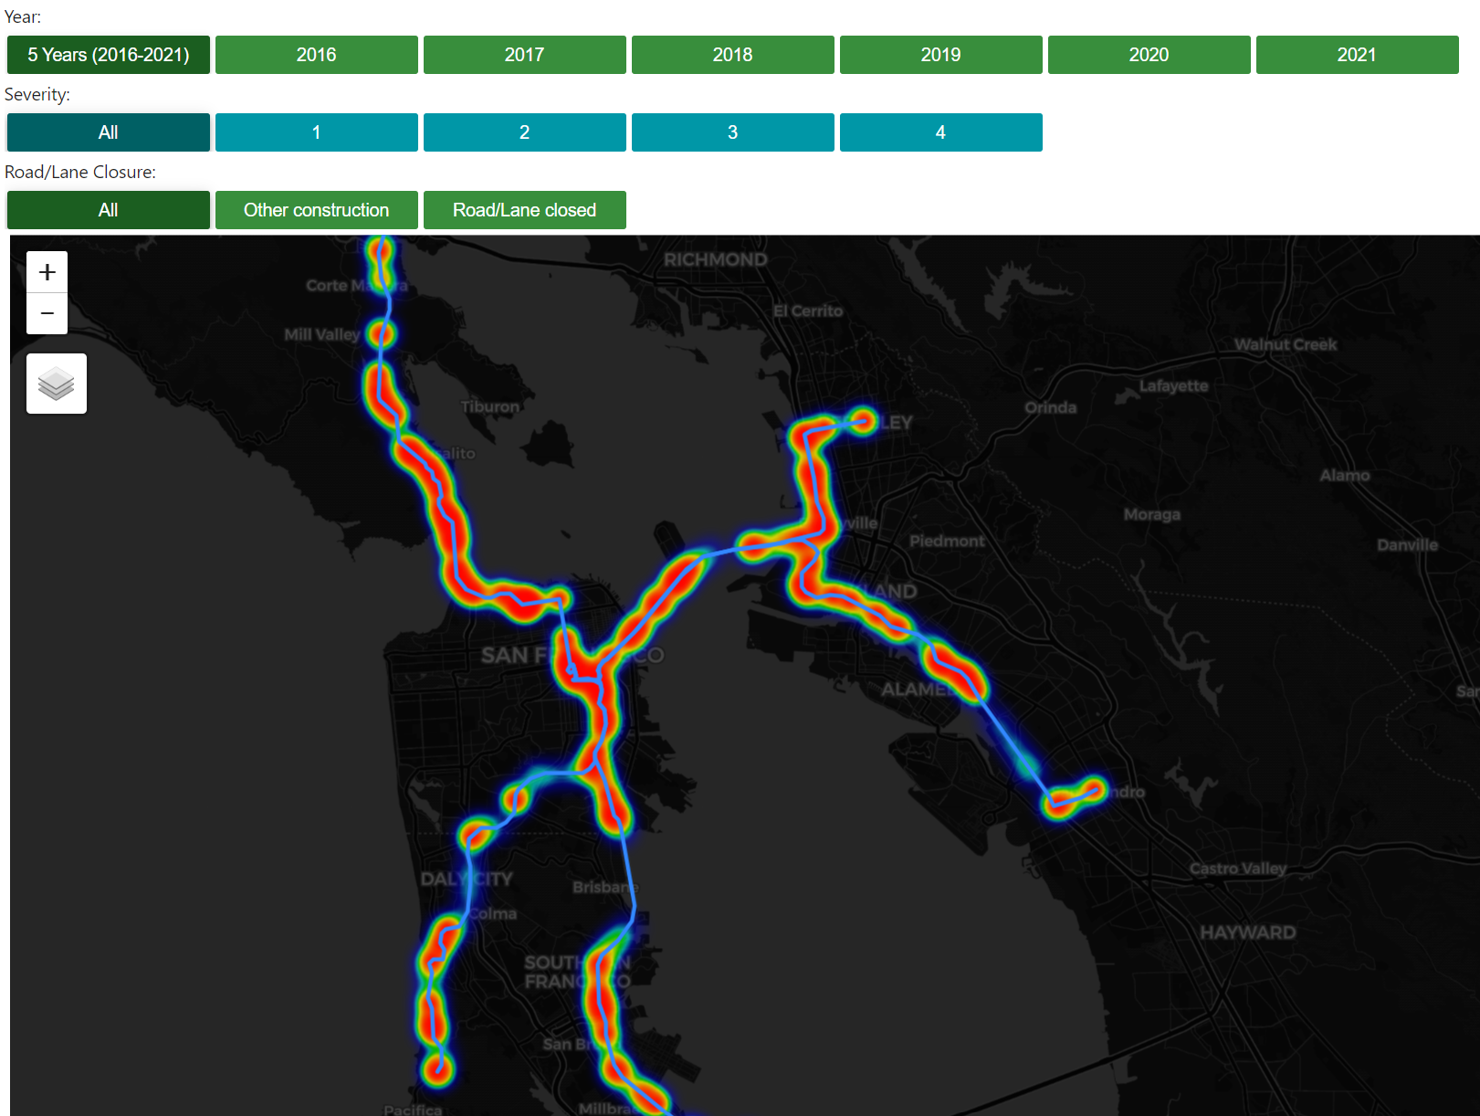
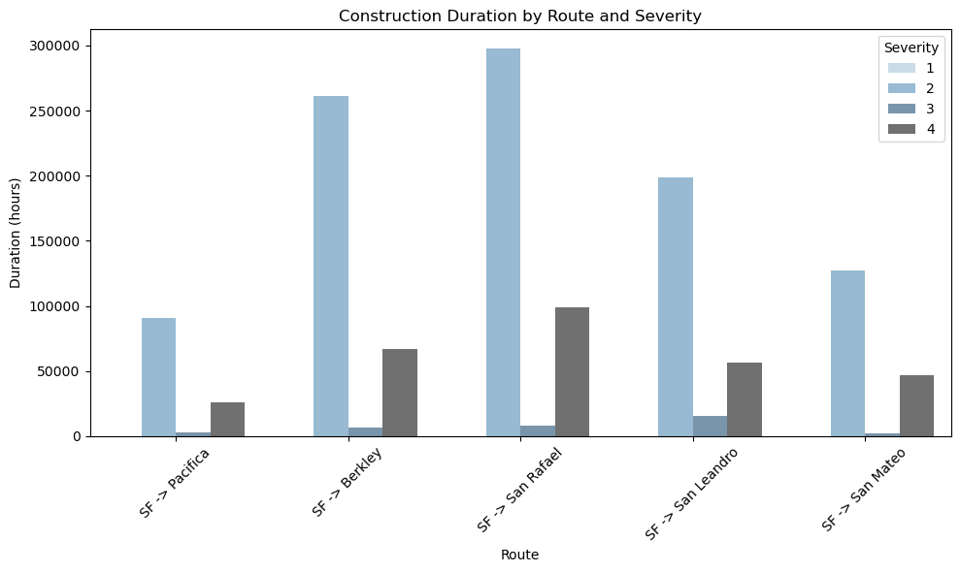
Insight 4: Self-driving Routes’ Risk Assessment
SF -> Pacifica shows no hotspot for Road/Lane closure construction of any severity in any time other than 2019
SF -> Pacifica shows lowest number of construction with higher severity

Slide 10
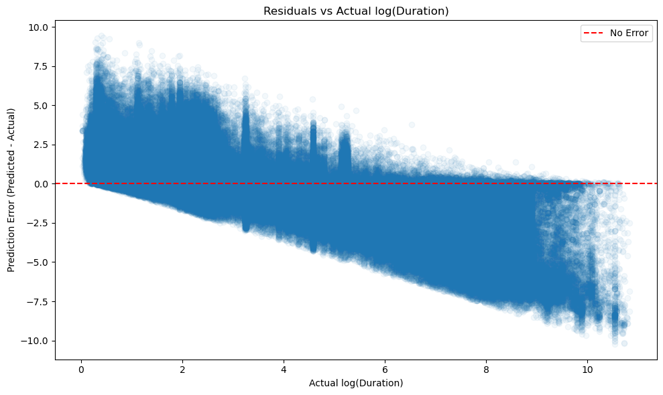
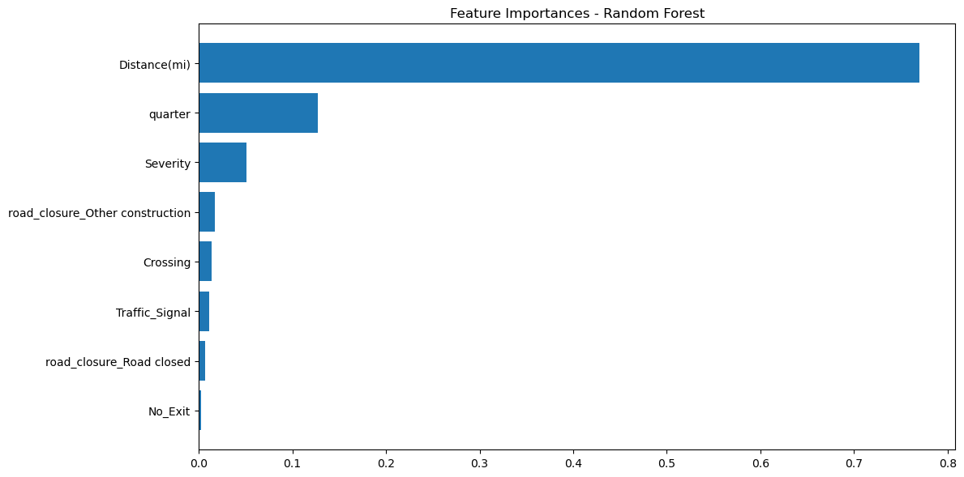
Insight 5: Duration Prediction Model
Log Linear Regression Model
Training, Test data split 80% - 20%
Performs poorly
MAE: 1.645
RMSE: 2.132
R²: 0.076
Shows heavy tails - indication of removing outliers could improve model
Random Forest Regressor
Training, Test data split 80% - 20%
Performs Decently Good
MAE: 1.2344
RMSE: 1.851
R²: 0.303
Distance is very important feature, followed by seasonal effect (Quarter), Severity of construction.
Road Closure is another potential interaction variable.

