Slide 1
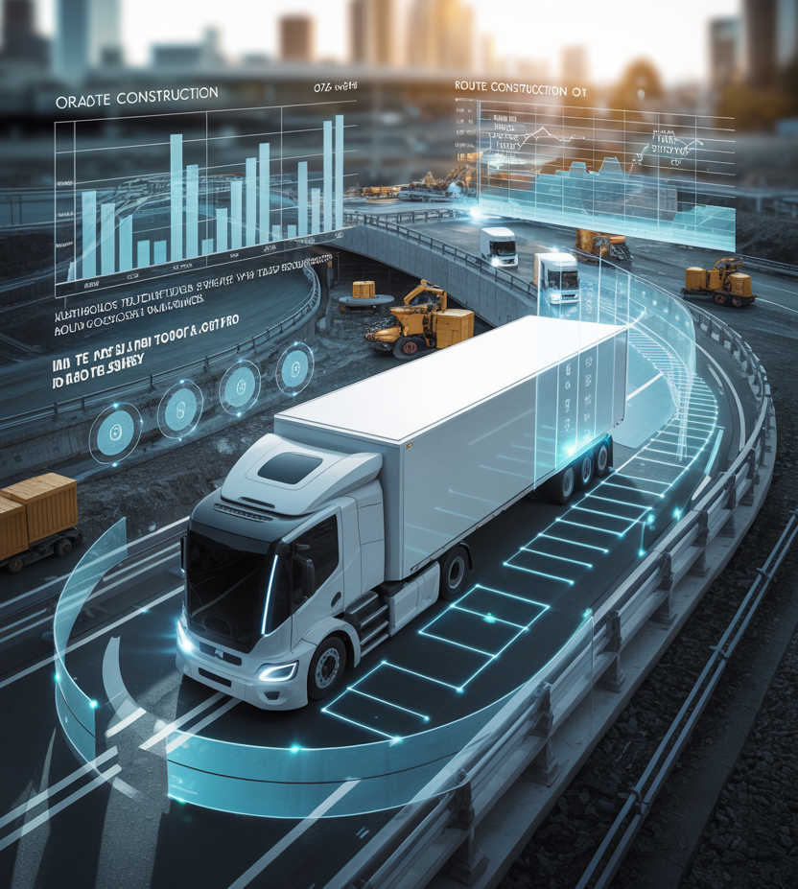

Autonomous Truck Deployment – Impact of Road Construction
June 2025
Present by: Salah Uddin Momtaz
Presented to:

Slide 2






Construction Impact Analysis
Summary
Data: US road construction data (2016-2021)
Critical insights for AV deployment strategy
Identifying high-impact zones and routes
Predict affect of Construction
22.6K
Total Cities Analyzed
5
Self-driving Routes
6.2M
Construction Projects
2.7B
Construction Hours
7.8M
Construction Length
6Yr
Continuous Data

Slide 3
Analysis Methodology
Data Processing Approach
Ingest Kaggle data using API
Get the additional data
Census population, employment
National Road network for freights: to get the road density of cities - generating city size to normalize
Extract features from additional files

Slide 4
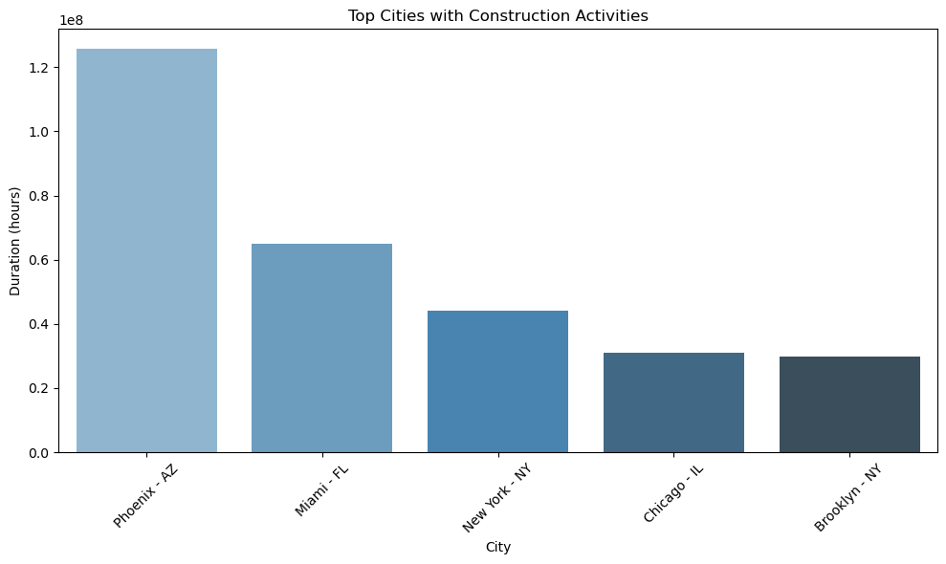
Insight 1: City With Highest Construction Activity
Phoenix has over all higher construction site with shorter activity
NY state has two cities within top 5 cities with active constructions
Top Cities Over 6 years
Year | City | Million Hours | Site | Avg. Distance (miles)
2016 | Middletown, DE | 10.4 | 299 | 0.9
2017 | York, PA | 10.3 | 841 | 1.8
2018 | Winnfield, LA | 9.8 | 461 | 1.9
2019 | Cle Elum, WA | 17.8 | 1,393 | 4.0
2020 | Phoenix, AZ | 11.9 | 34,240 | 0.2
2021 | Phoenix, AZ | 10.3 | 212,356 | 0.2
Phoenix has higher construction site with shorter length
Cle Elum has long stretched sites

Slide 5
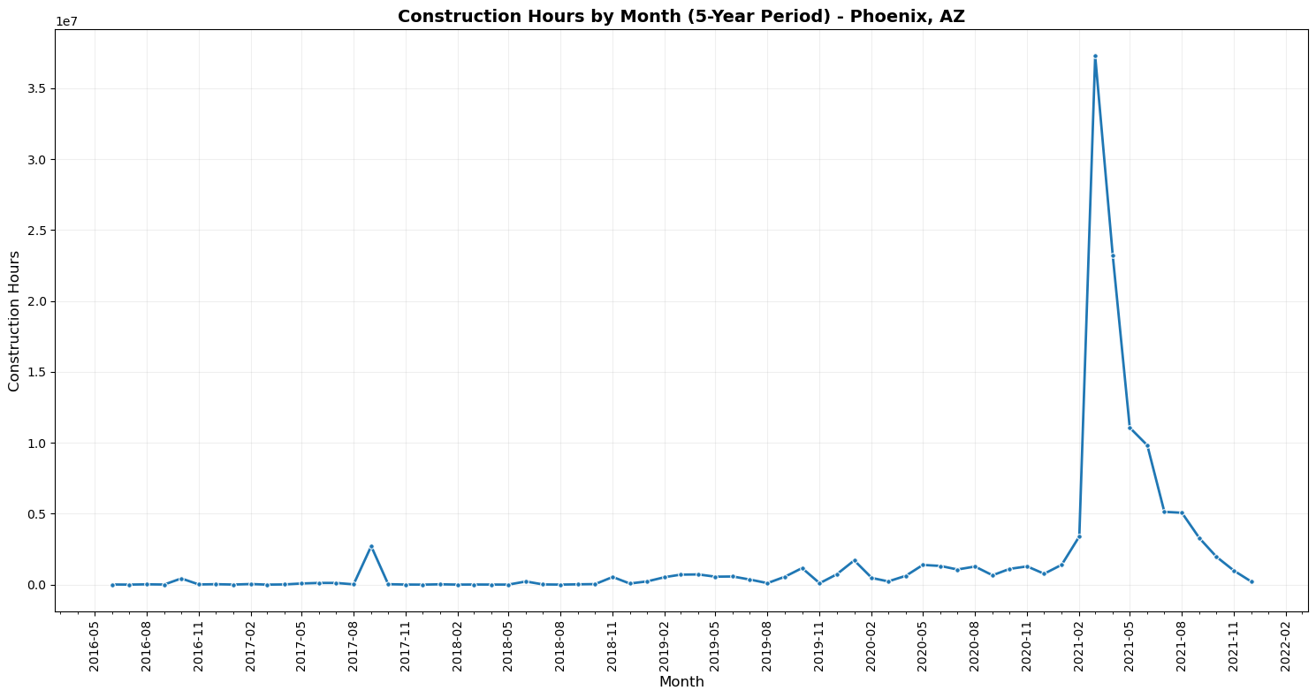
Insight 2: Time Series Trends
During the Month of March 2021 to June 2021 the Construction duration hiked significantly

Slide 6
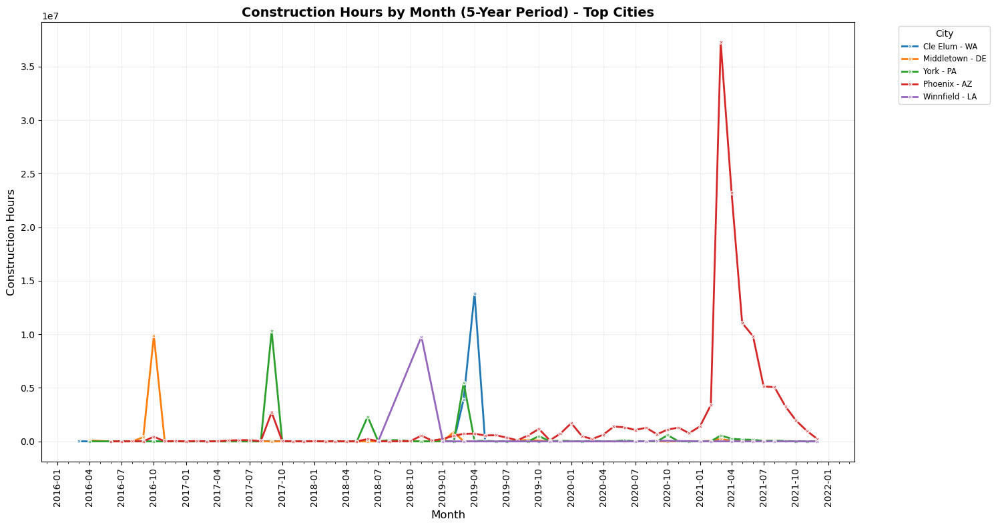
Insight 2: Time Series Trends (Contd.)
Most of the cities with highest construction hours has highest activity in Q3 before Covid, which may have shifted towards Q1 during Covid

Slide 7
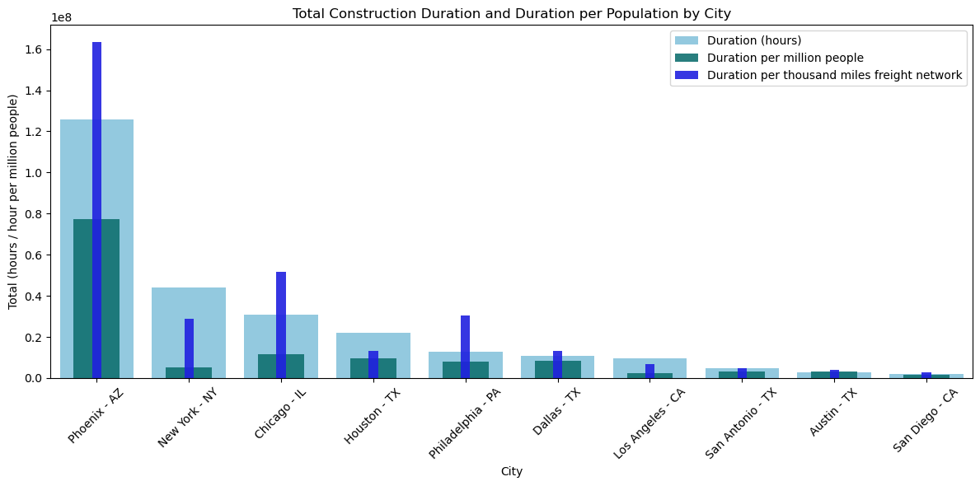
Insight 3: Compare 10 largest US cities
Regardless of the matric we used normalized version of the duration shows city of Phoenix, AZ and Chicago, IL are topmost and third most impactful cities respectively

Slide 8
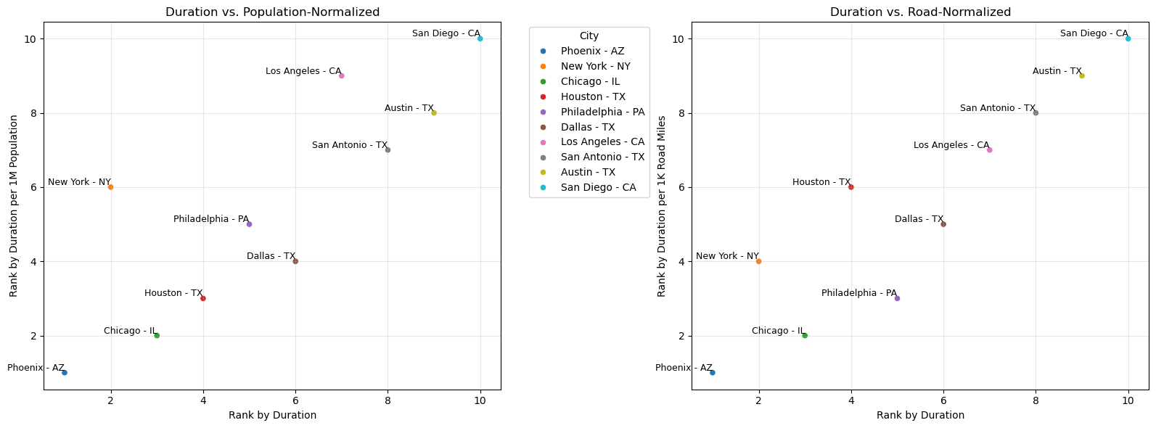
Insight 3: Compare 10 largest US cities
Normalization methodology significantly affects how construction impacts appear across different cities
Freight road length KPI reveals higher impacts in major port cities like NYC, and LA due to their extensive freight infrastructure

Slide 9
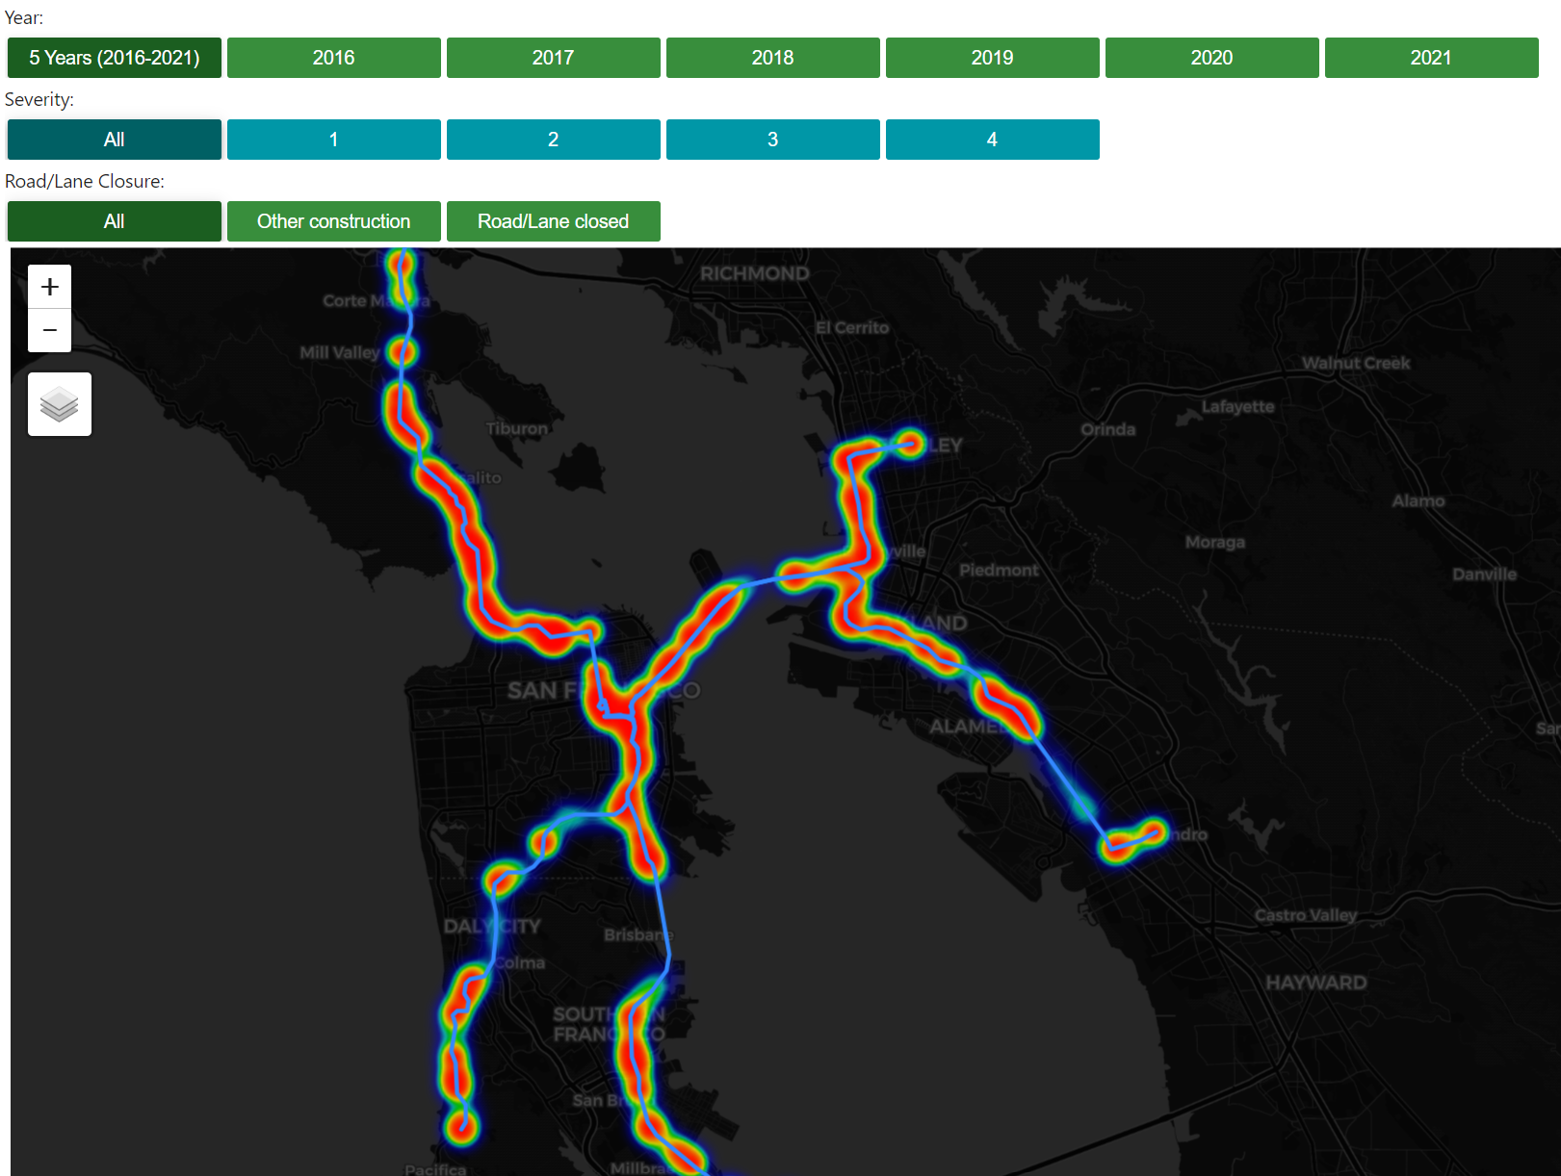
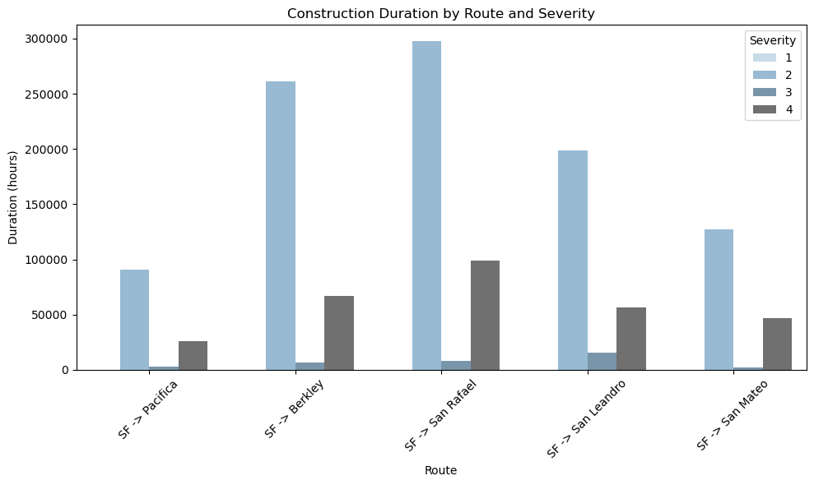
Insight 4: Self-driving Routes’ Risk Assessment
SF -> Pacifica shows no hotspot for Road/Lane closure construction of any severity in any time other than 2019
SF -> Pacifica shows lowest number of construction with higher severity

Slide 10
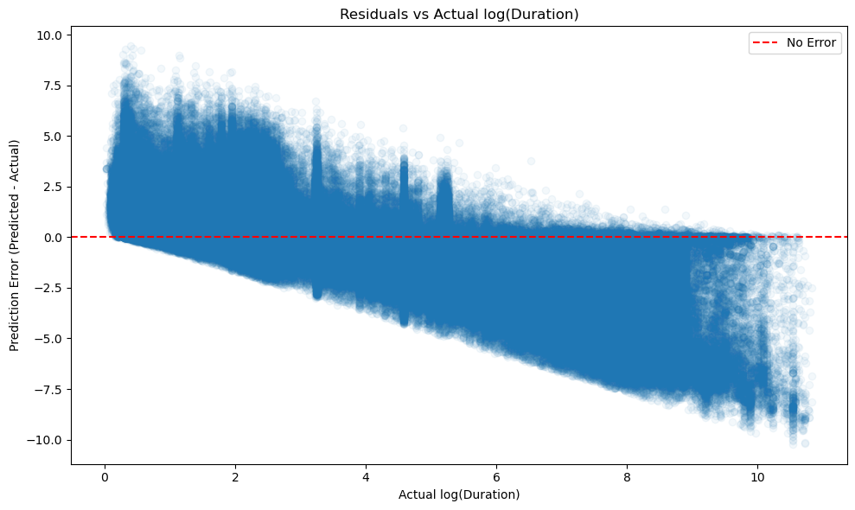
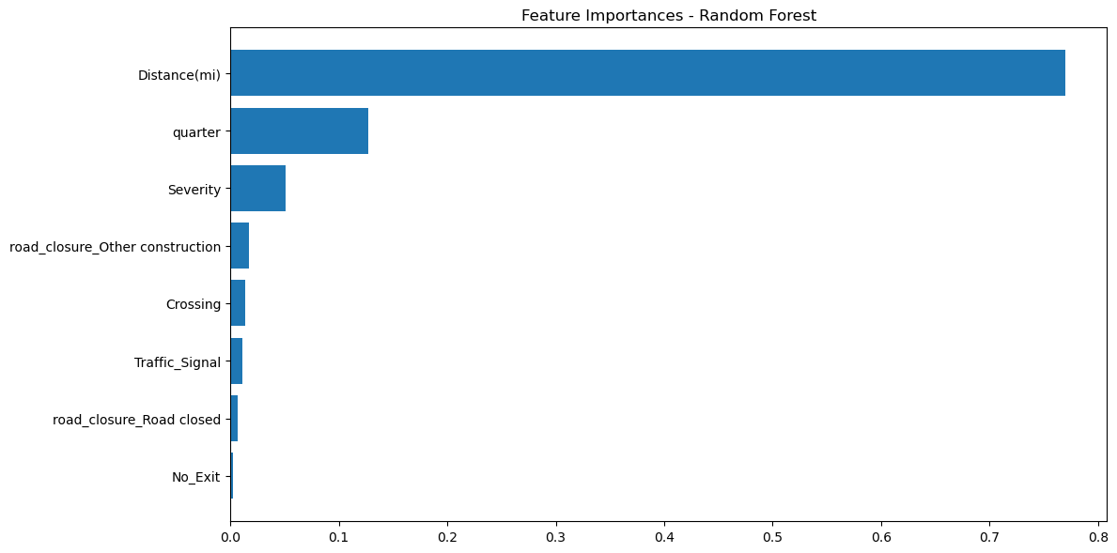
Insight 5: Duration Prediction Model
Log Linear Regression Model
Training, Test data split 80% - 20%
Performs poorly
MAE: 1.645
RMSE: 2.132
R²: 0.076
Shows heavy tails - indication of removing outliers could improve model
Random Forest Regressor
Training, Test data split 80% - 20%
Performs Decently Good
MAE: 1.2344
RMSE: 1.851
R²: 0.303
Distance is very important feature, followed by seasonal effect (Quarter), Severity of construction.
Road Closure is another potential interaction variable.

Slide 11
Overall Summary
Key Findings
Strategic Recommendations
Phoenix, AZ emerges as highest risk city with 212K+ construction sites but shorter duration projects
COVID-19 shifted construction patterns from Q3 to Q1, requiring adaptive route planning
SF → Pacifica route shows minimal construction risk, ideal for initial deployment
Random Forest model achieves over 30% accuracy with distance as primary predictor
Prioritize low-risk routes like SF-Pacifica for initial autonomous deployment
Implement dynamic routing algorithms for high-impact cities like Phoenix and Chicago
Develop seasonal deployment strategies accounting for Q1 construction peaks
Enhance model accuracy by incorporating road closure interaction variables, or using geospatial modeling approach

