Slide 1

CRAFT DEMO – Crowd FUND
Soumya Mondal

Slide 2

About Me
Technical lead having :
12+ years of industry experience
Major skill is java language with microservice and frontend with Angular
Problem solver or solution creator skills
Hobbies :
Reading Novels – Fan of Agatha Christie , Perry Mason.
Listening to music
Soumya Mondal
https://www.linkedin.com/in/soumya-mondal-b4527270/

Slide 3
Portfolio of your work
Lets talk about shiftlogbook various design solutions
Lets talk about POC of create app

Slide 4

Requirements

Slide 5
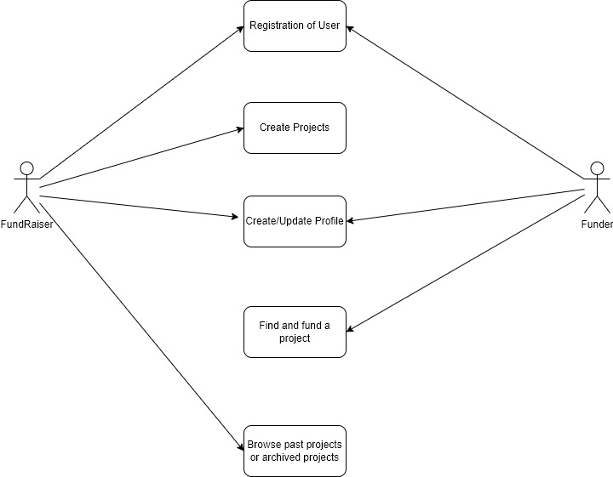
USE CASE DIAGRAM

Slide 6
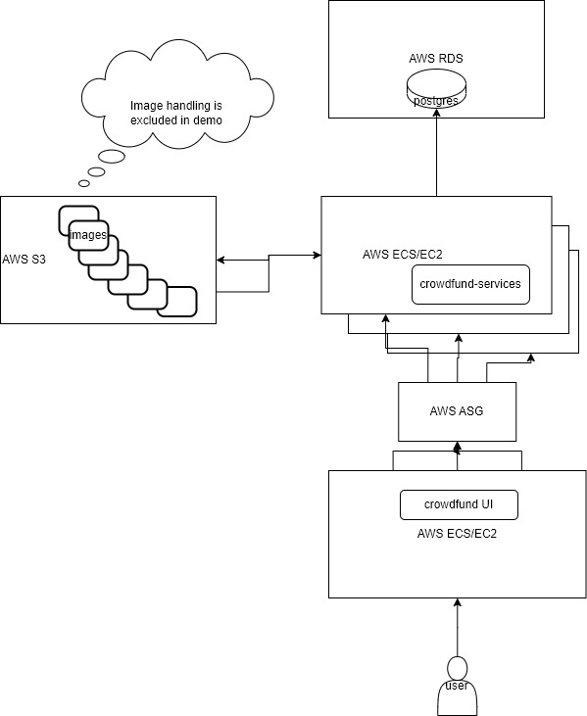
Architecture

Slide 7
Techstacks
Why not no sql ? Pros cons ?
Technologies used : Backend
Java with spring boot framework
Spring data JPA
Database
Postgres as relation database
Flyways for Database migration/dev
Frontend
Angular
Angular Material
bootstrap
Possible Cloud server provider AWS

Slide 8
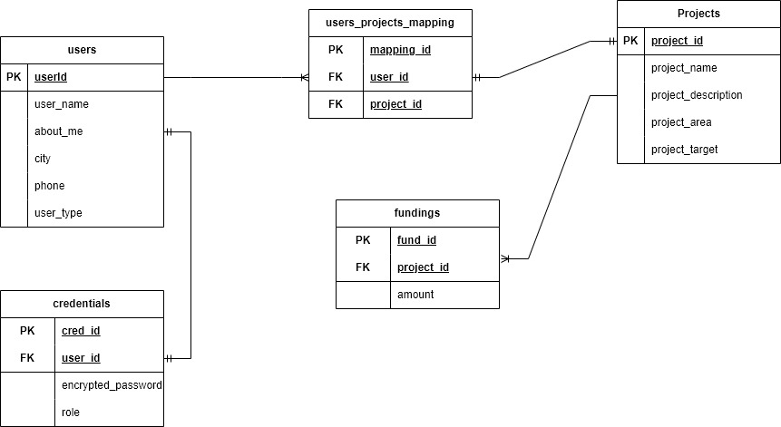
Database tables

Slide 9
DEMO FUNCTIONAL

Slide 10
Database insight and migration /development

Slide 11
JPA insights (entity and repository)

Slide 12
Services layer insights

Slide 13
Swagger,actuator,security,ssl

Slide 14
JUNIT

Slide 15
Show api (postman)

Slide 16
Back End Deployment

Slide 17
Insight of UI

Slide 18
SSL and Security

Slide 19
UI Deployment

Slide 20
Future enhancement
Enhancement of health with Db check by HealthIndicator api
Having functionality of update profile of Funder and Fund raiser(back end is implemented though)
Image of project /profile image and profile handling by AWS S3
Chatting of funder and fundraiser functionality by Db and instant chatting window in UI
Relationship of funder with funds being contributed. For time constraint it has been made simple.
Rating system of Fundraiser by overall collection.
Addition of payment gateway for practical disbursement and addition of bank account/upi etc.
Third party like pingID. azureAD etc for tokenization and authentication
Emailing services from AWS SES or TWILIO sendgrid etc

Slide 21

Large image
Q & A

Slide 22





Thank You
Soumya Mondal
+91 6364077268
s.mondal8@gmail.com
Whitefield, Bangalore

