Slide 1
Multithreading

Slide 2
Multithreading in java is a process of executing multiple threads simultaneously.
Thread is basically a lightweight sub-process, a smallest unit of processing. Multiprocessing and multithreading, both are used to achieve multitasking.
But we use multithreading than multiprocessing because threads share a common memory area. They don't allocate separate memory area so saves memory, and context-switching between the threads takes less time than process.
Java Multithreading is mostly used in games, animation etc.

Slide 3
Advantage of Multithreading
1) It doesn't block the user because threads are independent and you can perform multiple operations at same time.
2) You can perform many operations together so it saves time.
3) Threads are independent so it doesn't affect other threads if exception occur in a single thread.

Slide 4
Multitasking
Multitasking is a process of executing multiple tasks simultaneously. We use multitasking to utilize the CPU. Multitasking can be achieved by two ways:
Process-based Multitasking(Multiprocessing)
Thread-based Multitasking(Multithreading)

Slide 5
Process-based Multitasking (Multiprocessing)
Each process have its own address in memory i.e. each process allocates separate memory area.
Process is heavyweight.
Cost of communication between the process is high.
Switching from one process to another require some time for saving and loading registers, memory maps, updating lists etc.

Slide 6
Thread-based Multitasking (Multithreading)
Threads share the same address space.
Thread is lightweight.
Cost of communication between the thread is low.

Slide 7
What is thread in JAVA
A thread is a lightweight sub process, a smallest unit of processing. It is a separate path of execution.
Threads are independent, if there occurs exception in one thread, it doesn't affect other threads. It shares a common memory area.

Slide 8
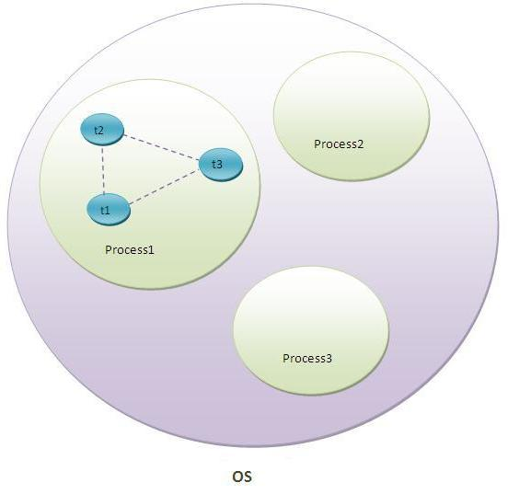
As shown in the above figure, thread is executed inside the process. There is context-switching between the threads. There can be multiple processes inside the OS and one process can have multiple threads.

Slide 9
Life cycle of a Thread (Thread States)
A thread can be in one of the five states. According to sun, there is only 4 states in thread life cycle in java new, runnable, non-runnable and terminated. There is no running state.
But for better understanding the threads, we are explaining it in the 5 states.
The life cycle of the thread in java is controlled by JVM. The java thread states are as follows:
New
Runnable
Running
Non-Runnable (Blocked)
Terminated

Slide 10
1) New
The thread is in new state if you create an instance of Thread class but before the invocation of start() method.
2) Runnable
The thread is in runnable state after invocation of start() method, but the thread scheduler has not selected it to be the running thread.
3) Running
The thread is in running state if the thread scheduler has selected it.
4) Non-Runnable (Blocked)
This is the state when the thread is still alive, but is currently not eligible to run.
5) Terminated
A thread is in terminated or dead state when its run() method exits.

Slide 11
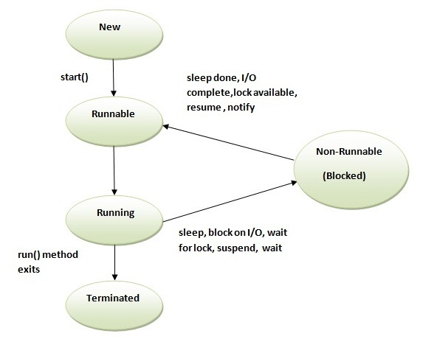

Slide 12
How to create Thread
There are two ways to create a thread:
By extending Thread class
By implementing Runnable interface.

Slide 13
Thread Class
Thread class provide constructors and methods to create and perform operations on a thread. Thread class extends Object class and implements Runnable interface. Commonly used Constructors of Thread class:
Thread()
Thread(String name)
Thread(Runnable r)
Thread(Runnable r,String name)

Slide 14
Commonly used methods of Thread class
public void run(): is used to perform action for a thread.
public void start(): starts the execution of the thread.JVM calls the run() method on the thread.
public void sleep(long miliseconds): Causes the currently executing thread to sleep (temporarily cease execution) for the specified number of milliseconds.
public void join(): waits for a thread to die.
public void join(long miliseconds): waits for a thread to die for the specified miliseconds.
public int getPriority(): returns the priority of the thread.
public int setPriority(int priority): changes the priority of the thread.
public String getName(): returns the name of the thread.
public void setName(String name): changes the name of the thread.
public Thread currentThread(): returns the reference of currently executing thread.
public int getId(): returns the id of the thread.
public Thread.State getState(): returns the state of the thread.
public boolean isAlive(): tests if the thread is alive.
public void yield(): causes the currently executing thread object to temporarily pause and allow other threads to execute.
public void suspend(): is used to suspend the thread(depricated).
public void resume(): is used to resume the suspended thread(depricated).
public void stop(): is used to stop the thread(depricated).
public boolean isDaemon(): tests if the thread is a daemon thread.
public void setDaemon(boolean b): marks the thread as daemon or user thread.
public void interrupt(): interrupts the thread.
public boolean isInterrupted(): tests if the thread has been interrupted.
public static boolean interrupted(): tests if the current thread has been interrupted.

Slide 15
Runnable Interface
The Runnable interface should be implemented by any class whose instances are intended to be executed by a thread. Runnable interface have only one method named run().
public void run(): is used to perform action for a thread.

Slide 16
Sleep method in java
The sleep() method of Thread class is used to sleep a thread for the specified amount of time.
Syntax of sleep() method in java
The Thread class provides two methods for sleeping a thread:
public static void sleep(long miliseconds)throws InterruptedException
public static void sleep(long miliseconds, int nanos)throws InterruptedException

Slide 17
join() method
The join() method waits for a thread to die. In other words, it causes the currently running threads to stop executing until the thread it joins with completes its task.
public void join()throws InterruptedException
public void join(long milliseconds)throws InterruptedException

Slide 18
Naming a thread
The Thread class provides methods to change and get the name of a thread.
public String getName(): is used to return the name of a thread.
public void setName(String name): is used to change the name of a thread.

Slide 19
The currentThread() method
The currentThread() method returns a reference to the currently executing thread object.Syntax of currentThread() method:
public static Thread currentThread(): returns the reference of currently running thread

Slide 20
Priority of a Thread (Thread Priority)
Each thread have a priority. Priorities are represented by a number between 1 and 10. In most cases, thread schedular schedules the threads according to their priority (known as preemptive scheduling). But it is not guaranteed because it depends on JVM specification that which scheduling it chooses.3 constants defiend in Thread class:
public static int MIN_PRIORITY
public static int NORM_PRIORITY
public static int MAX_PRIORITY
Default priority of a thread is 5 (NORM_PRIORITY). The value of MIN_PRIORITY is 1 and the value of MAX_PRIORITY is 10.

Slide 21
Synchronization in Java
Synchronization in java is the capability to control the access of multiple threads to any shared resource.
Java Synchronization is better option where we want to allow only one thread to access the shared resource.

Slide 22
Why use Synchronization
The synchronization is mainly used to
To prevent thread interference.
To prevent consistency problem.

Slide 23
Types of Synchronization
There are two types of synchronization
Process Synchronization
Thread Synchronization

Slide 24
Thread Synchronization
There are two types of thread synchronization mutual exclusive and inter-thread communication.
Mutual Exclusive
Synchronized method.
Synchronized block.
static synchronization.
Cooperation (Inter-thread communication in java)

Slide 25
Mutual Exclusive
Mutual Exclusive helps keep threads from interfering with one another while sharing data. This can be done by three ways in java:
by synchronized method
by synchronized block
by static synchronization

Slide 26
Concept of Lock in Java
Synchronization is built around an internal entity known as the lock or monitor. Every object has an lock associated with it. By convention, a thread that needs consistent access to an object's fields has to acquire the object's lock before accessing them, and then release the lock when it's done with them.
.

Slide 27
Inter-thread communication in Java
Inter-thread communication or Co-operation is all about allowing synchronized threads to communicate with each other.
Cooperation (Inter-thread communication) is a mechanism in which a thread is paused running in its critical section and another thread is allowed to enter (or lock) in the same critical section to be executed.It is implemented by following methods of Object class:
wait()
notify()
notifyAll()

Slide 28
wait() method
Causes current thread to release the lock and wait until either another thread invokes the notify() method or the notifyAll() method for this object, or a specified amount of time has elapsed.
The current thread must own this object's monitor, so it must be called from the synchronized method only otherwise it will throw exception.

Slide 29
notify() method
Wakes up a single thread that is waiting on this object's monitor. If any threads are waiting on this object, one of them is chosen to be awakened. The choice is arbitrary and occurs at the discretion of the implementation. Syntax:
public final void notify()

Slide 30
notifyAll() method
Wakes up all threads that are waiting on this object's monitor. Syntax:
public final void notifyAll()

