Slide 1
Code improvement

Slide 2
When passing variables to subroutine is needed, multi-dimensional array or pointers,
which is better?
consider the cases for a smaller array of size ND*ND*ND
and a large array of size N1*N2*N3*NS*2, respectively

Slide 3
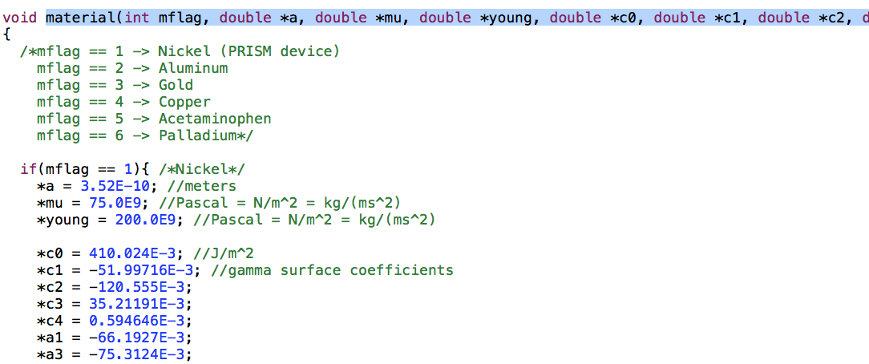
Here several double variables are passed to subroutine as pointer, why not directly pass
double instead?

Slide 4
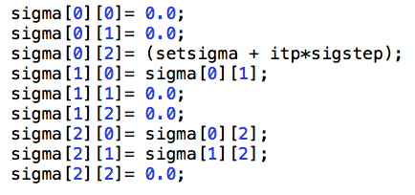
use a 2D array for the convenience of indices, but this leads to memory drawback.
if change it to a 1D vector,
when using it, indices must be calculated, which leads to additional multiplication.
which is better? please check

Slide 5
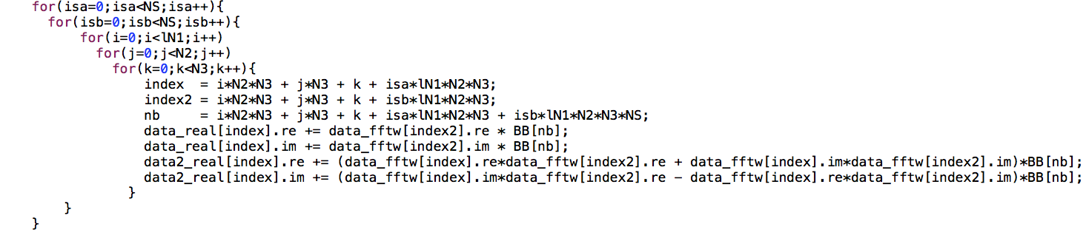
please check if this nested loop can be improved

Slide 6
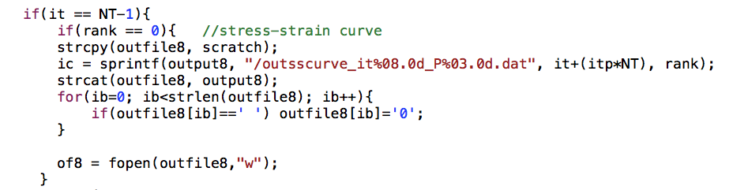
can you make it concise? is “ic” even necessary?

Slide 7
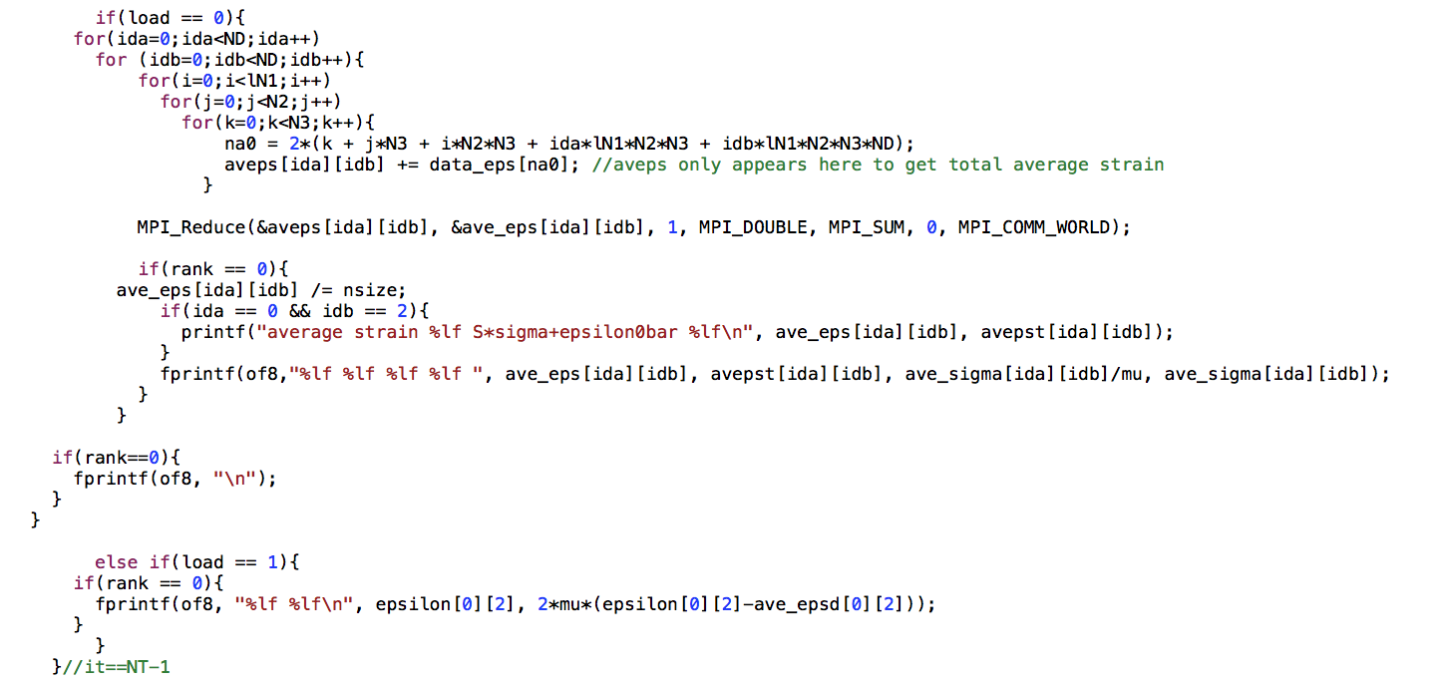
Can this nested loop be imporved?

Slide 8
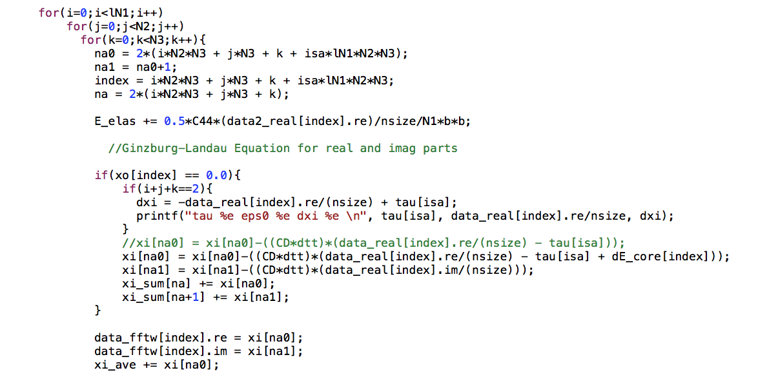
Can this nested loop be imporved?

Slide 9
The code includes a lot of I/O. Instead of output the data using fprintf by N1*N2*N3*NS
times, will use fwrite better?
what’s the time for fprintf and fwrite. (
1st step :open the stress.dat file into your script and
fprintf it using a nested loop and fwrite, respectively)
2nd step: do the above step in slip-gb.c or psxtal.c

Slide 10
For the nested loops in subroutine
“stress” in psxtal.c can it be improved?

Slide 11
For the nested loops in subroutine
“strain” in psxtal.c can it be improved?

Slide 12
For the nested loops in subroutine
“Bmatrix” in psxtal.c can it be improved?

Slide 13
For the nested loops in subroutine
“Fmatrix” in psxtal.c can it be improved?

