Slide 1
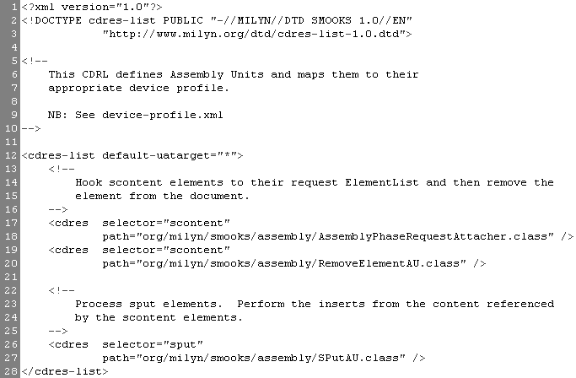
Default Target
“all browsers”
Target this java CDU at instances of the <scontent> element

Slide 2
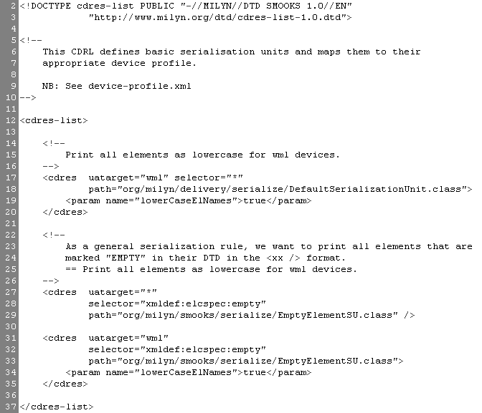
Target this CDU at “wml” profile browsers only
Target this CDU at all elements of content
Supply the CDU instance with the named parameter
(1)
Target this CDU at all browsers
Target this CDU at all elements defined “EMPTY” in the requesting browsers DTD
(2)
Supply the CDU instance with the named parameter
(3)

Slide 3


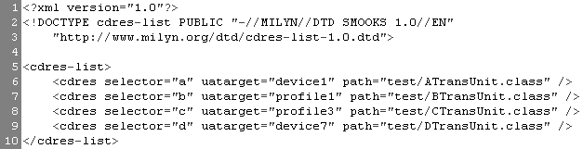
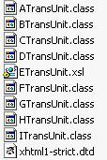
etc

