Slide 1



Maps and Spatial Analysis in R
Steve Mooney
Harborview Injury Prevention & Research Center
SER 2018
They don’t love you like I love you

Slide 2
Agenda
Mapping and intro spatial data in R
Break
Work time
Concepts in spatial analysis

Slide 3
Why Spatial R?
A lot of data, particularly 'secondary' administrative data are spatially located
Digression: My FOIL story

Slide 4
Why Spatial R?
… so it turns out I found a CD in my mailbox with about 2000 Excel files, each of which has a traffic or pedestrian count
This has potential to be interesting data for people doing pedestrian injury work
Esp. if counts are aligned with pre-existing web cameras?
But how do I know? I don't have money to pay for ArcGIS or geographer time

Slide 5
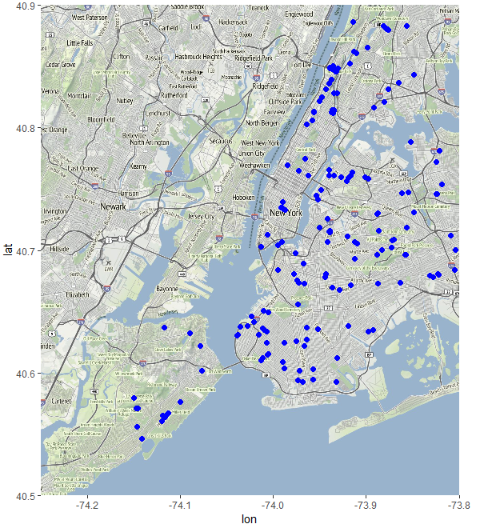
Why Spatial R?

Slide 6
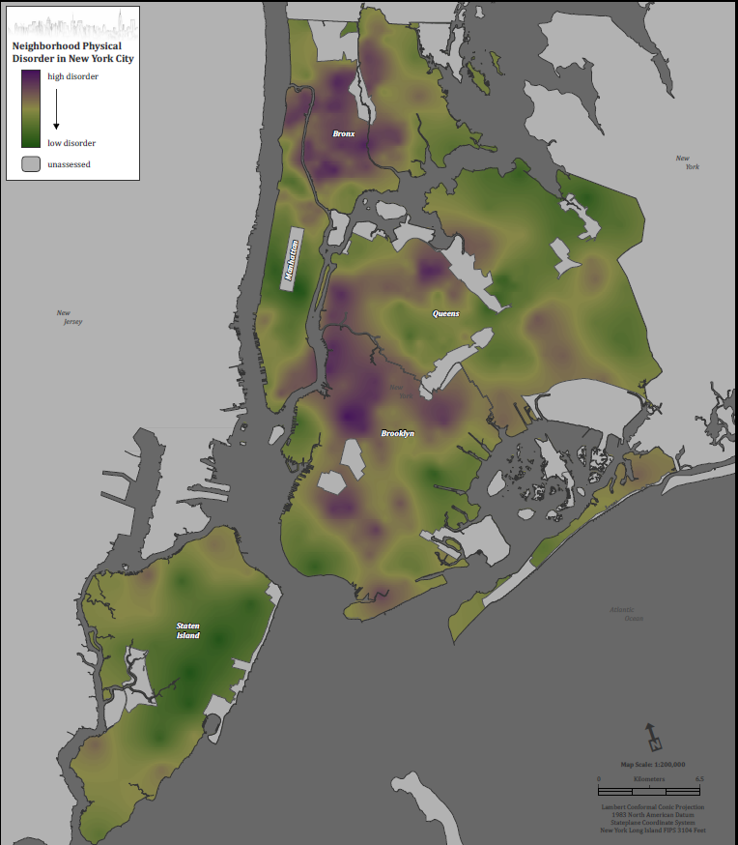
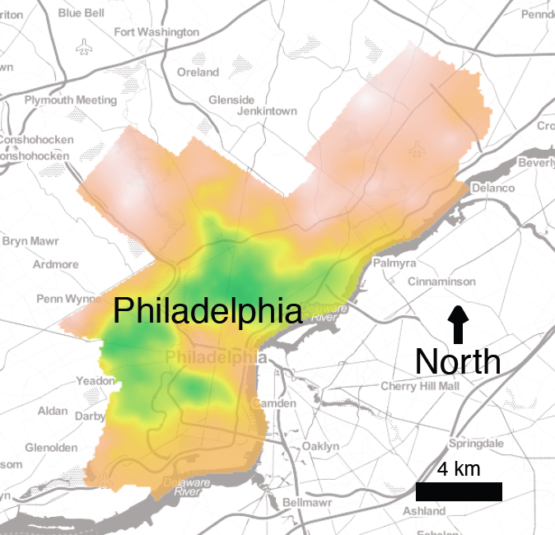
Note: maps are not spatial analysis
Map made in ArcGIS
Map made in R

Slide 7
Note: maps are not spatial analysis
Spatial Analysis for this map: Done in R
Spatial Analysis for this map: Done in R

Slide 8
Maps: why?
Spatial analysis is often well suited to visual communication
It’s important to remember that maps are just a kind of figure – a way of communicating some underlying relationships determined through spatial analysis

Slide 9

So really: why do we use spatial analysis?
Surveillance
Are the spatial patterns to disease incidence?
Infectious disease etiology/vector identification
Can the spatial pattern tell us something about how the disease is being transmitted?
Cluster investigations
Neighborhood influences
etc.

Slide 10

Spatial Epidemiology
Geography is a discipline unto itself
Spatial Epidemiology ought to be its own full semester course (or at least an EPIC course)
So: this lecture is designed to give you a feel for what you might do rather than introduce everything

Slide 11
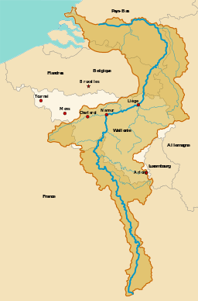
So: let’s play around a little
Install the sp and maps packages
Load the meuse dataset
library(sp)
data(meuse)
Meuse river
(The world’s oldest river?)
Notes:
River age estimation is totally fascinating. The Amazon is postulated to have flowed the other direction as an extension of the Congo before South America and Africa separated? Holy crap!

Slide 12
Getting started
Use str to look at the meuse dataset.
Where are we going to get spatial data out of this data frame?
x and y

Slide 13
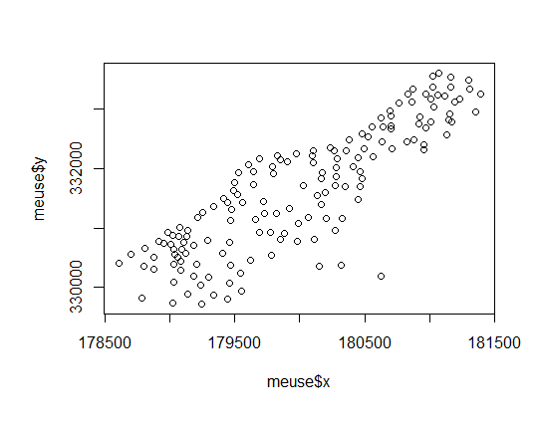
Plotting spatial data
Make a scatterplot of the points. Remember how?
plot(meuse$x, meuse$y)

Slide 14
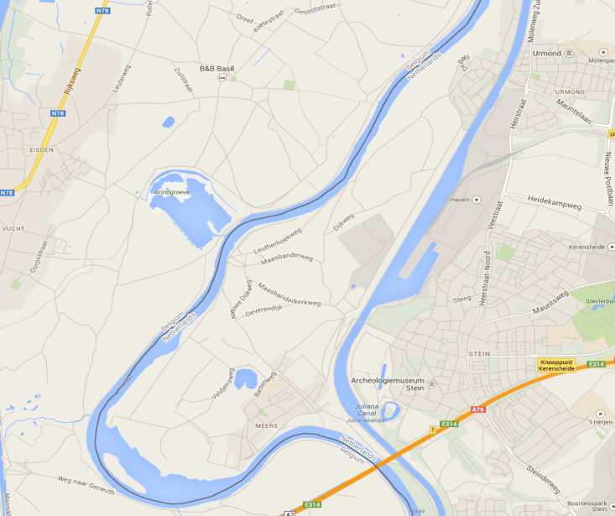
Compare with Google Maps
These don’t really look the same. Why not?
The Google Maps image took me, like, forever to find, because it turns out there’s more than one town named Stein in the Netherlands. Stein => Dutch for Springfield.

Slide 15
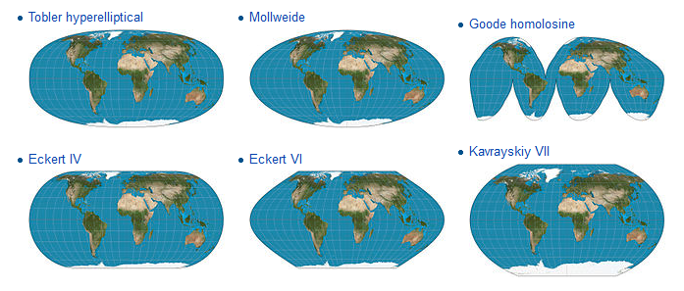
Coordinate systems
All maps need to match date from a ball to a map drawn as plane.
X and Y are defined within in a coordinate system

Slide 16
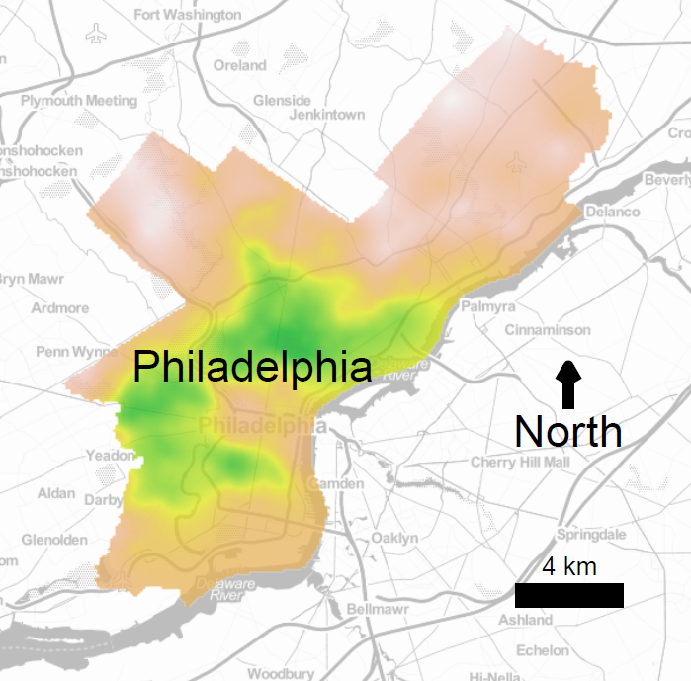
Coordinate systems (more)
Remember this map? Its projection is inconsistent
The lines on the colored overlay don’t align with underlying features
USGS State Plane Coordinate Systems are usually the correct projections for city-scale maps

Slide 17
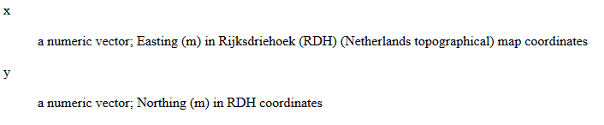
So, back to the meuse dataset
Look up documentation for meuse
?meuse

Slide 18
Spatially aware R objects
meuse is a data frame
Let’s give it coordinates, using a vector or a formula:
coordinates(meuse) <- ~x+y
or
coordinates(meuse) <- c(“x”, “y”)
And a projection:
proj4string(meuse) <- CRS("+init=epsg:28992“)

Slide 19
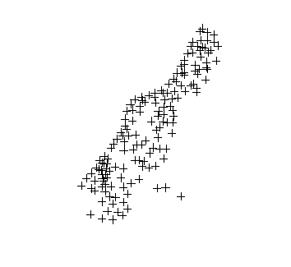
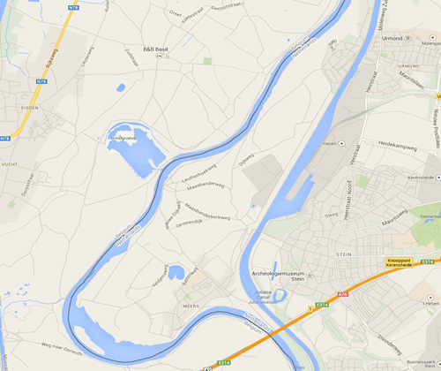
Plot with spatially aware object
Plot as before:
plot(meuse)
The shape looks closer now…

Slide 20
Spatially aware R objects
Okay, now let’s look at the meuse object again:
str(meuse)
WTF?!

Slide 21
Aside: why the sp package, which is generally awesome, makes me angry
Caveat: the following is just my opinion
Quietly changing the underlying type of an object is evil*
For example, try this:
data(meuse)
head(meuse[4])
coordinates(meuse) <- c(“x”, “y”)
head(meuse[4])
* wherein evil is defined as unnecessarily making it possible to make mistakes without knowing it

Slide 22
SpatialPointsDataFrame
S4 object
‘slots’
head(meuse@data)
Use @coords to get back to the x and y values:
plot(meuse@coords[,1], meuse@coords[,2])
Note for plotting: spplot also available:
spplot(meuse)
spplot(meuse, “copper”)
Does this look more like what we might want? Maybe…

Slide 23
Spatial Interpolation
Interpolation is a huge topic, but here's a quick demo of ordinary kriging, a common technique for it:
library(raster)
library(automap)
meuse.extent <- extent(meuse)
lat_vals <- seq(ymin(meuse.extent), ymax(meuse.extent), by=10)
lng_vals <- seq(xmin(meuse.extent), xmax(meuse.extent), by=10)
meuse.grid <- expand.grid(lat=lat_vals, lng=lng_vals)
coordinates(meuse.grid) <- c('lng', 'lat')
krige_result <- autoKrige(copper ~ 1, meuse, meuse.grid)
plot(krige_result)

Slide 24
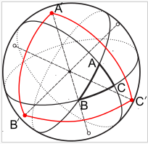
More about spatially aware objects
Consider computing distance between two points or area of a triangle. If distances are long enough, the fact that they’re on a sphere might matter.
Geosphere package is helpful for computing distances
Remember: you can get a PhD in geography. Though we who have or are getting PhDs in epidemiology probably won’t.

Slide 25
Things you can do with spatially aware objects
Creating datasets
E.g. via spatial merge
Spatial statistics
E.g. cases/zip code
Spatial interpolation
E.g. kriging
Etc.
Again, Geography is its own discipline

Slide 26
Geocoding
In a lot of datasets, you have an address and want to do something spatial with it
E.g. you want census data for residential neighborhood
Solution: get (lat, long), from the address then do spatial merge with Census data
Getting (lat,long) from an address is called geocoding
Any guesses as to what reverse geocoding is?

Slide 27
Geocoding with R using ggmap
The easiest way to geocode in R is using the geocode() function in ggmap
Challenge #1: use ggmap to get the (lat, long) of 722 W 168th St in New York.
library(ggmap)
geocode('722 W 168th St, New York, NY')

Slide 28
Challenge #2: compute distance
Compute the distance in meters from Hyatt Regency Miami (Epi Congress 2016) to the Westin in Seattle (SER 2017)
Hint: use geosphere library
library(geosphere)
congress <- geocode(' Hyatt Regency, Miami, FL')
ser <- geocode('Westin Hotel, Seattle, WA')
distm(congress, ser)

Slide 29
Geocoding: a caveat
2 Quick challenges
Use qmap to get a map of Stein, NL at zoom = 12
Now use qmap to get a map of Geleen, NL at zoom = 12.
(Does the curve of the river on the left look familiar?)

Slide 30
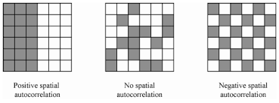
Spatial Autocorrelation
Co-variation of properties within geographic space
Note that perfect mixing is not expected if each cell is independent

Slide 31
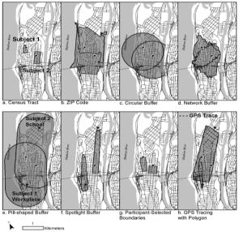
Modifiable Areal Unit Problem
Different spatial unit definitions can result in different findings
Usual recommendation: start from theory

Slide 32
Cluster Detection
Given point data for some phenomenon, are points closer than would be expected by chance?
Note that we are interested in clustering in the population, not in the sample
many sampling strategies (esp. convenience samples) artificially induce clustering.

Slide 33
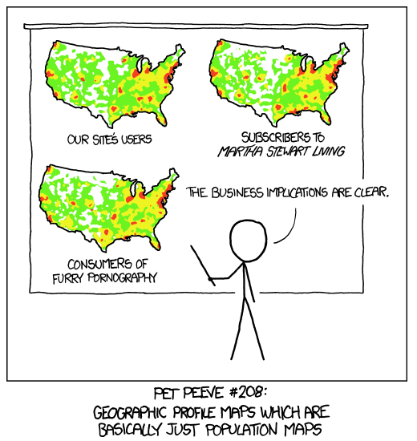
Clustering: think about your denominator, too

Slide 34
Nearest Neighbor Index
Defined as the ratio of the mean distance to the nearest neighbor for all observations to the mean distance that would be expected due to chance alone
Values significantly less than 1 indicate clustering
But: 50 randomly distributed pairs of points would have a very low index, but no real clusters as we'd traditionally think of them

Slide 35
Other cluster detection/analysis methods
Ripley's K function
Kulldorff's scan statistic
Bayesian hierarchical modeling

Slide 36
Two other important spatial techniques
Estimation (actually prediction) at places you didn't observe
Land use regression
Interpolation: Kriging/Kernel density estimation

Slide 37
Land use regression
Basically a 4-step process
Pick sample locations (usually a grid)
Measure outcome and land uses (e.g. population density, proximity to highways) at each sample point
Regress outcome on land uses, use model to predict in unmeasured locations
Check residuals for spatial autocorrelation

Slide 38

Land Use Regression in R
In its most basic forms, LUR ignores spatial covariance, so it does not require custom regression model fitting
lm()
Sorry. I know this is hokey.

Slide 39
Kriging
4-step process
Pick sample points
Sample outcome
Use spatial covariance in outcome to predict at unsampled points
Draw multiple times from posterior distribution of spatial model to get 'conditional realizations' – multiple imputation-like way of including uncertainty in estimates
Universal Kriging essentially integrates LUR and Kriging

Slide 40
Kriging in R
Several packages support kriging
GeoR
kriging
gstat
There are a lot of details in how you fit the model – talk to me if you’re interested in trying it out
Kriged using GeoR

