Slide 1


The Bleeding Edge: magrittr and dplyr
Steve Mooney
Harborview Injury Prevention & Research Center
SER 2018

Slide 2

Magrittr
Named for Rene Magritte, who painted this:
Initially released in 2014 (?) – still pretty new

Slide 3
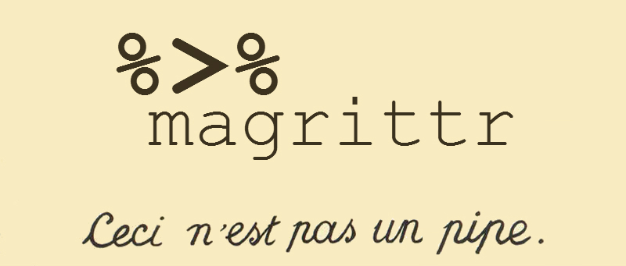
Magrittr

Slide 4
Pipes
Essentially a way to pass the output from one function into another
Minimizes parentheses, and makes code flow more naturally left-to-right
library(magrittr)
data(infert)
infert %>% subset(case==1) %>% nrow
Equivalent to:
nrow(infert[infert$case == 1,])

Slide 5
How pipes work
This looks a little magical, but it's mostly just a syntax layer on top of passing arguments around
By default, the left hand side becomes the first argument of the function on the right hand side…
(… but you can use the . to place it somewhere else)
"Pronounce %>% as then"
infert %>% subset(case==1) %>% lm(parity ~ age, data=.)

Slide 6
Other kinds of pipes
%$% to expose the names of the output of the left hand side to the right hand side:
infert %>% subset(case==1) %$% mean(age)
%<>% to assign the result of the pipe back to the left hand side:
myinfert <- infert
myinfert %<>% subset(case==1)
nrow(myinfert)

Slide 7
Should you use magrittr
Short answer: if you like the pipe paradigm
Longer answer: several things about magrittr, including but not limited to its joke-y name, represent a transition from R development being driven by statisticians to R development being driven by programmers/data scientists
Pipes as a concept dates at least from UNIX
Pipes fit very nicely with accessing and cleaning data from databases, which brings us to…

Slide 8
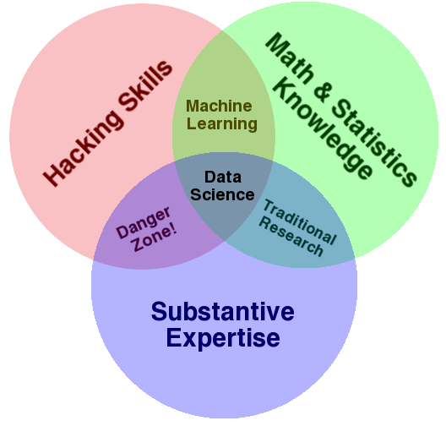
Data Science
Have we all seen this diagram?
Image credit: drewconway.com

Slide 9
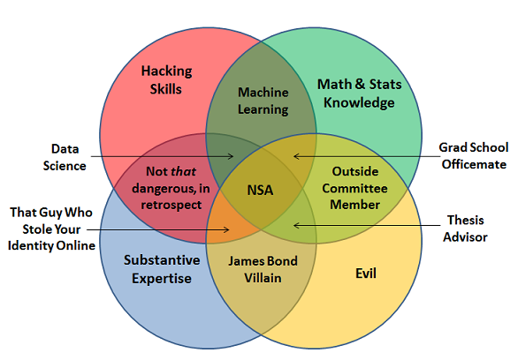
Data Science Diagram Update
Image credit: joelgrus.com

Slide 10
dplyr
Another package making R friendly for Data Science
Abstracts the idea of a table, making database access and certain 'Big Data' things much easier
Try this:
library(dplyr)
data(mtcars)
mtcars %>%
filter(am == 1) %>%
group_by(cyl) %>%
summarise(mean_mpg=mean(mpg))

Slide 11
dplyr 'table verbs'
Filter: keep rows that match (like subset)
Select: pick columns by name
Arrange: re-order
Mutate: add new columns
Summarise: get summary statistics from columns

Slide 12
Working with dplyr
Often want to think in terms of pulling & cleaning data within dplyr:
library(ggplot2)
data(diamonds)
diamonds %>%
group_by(cut, color, clarity) %>%
summarise(total=n(), mean_price=mean(price)) %>%
filter(total > 700)

Slide 13
Learn more
magrittr
Vignette at https://cran.r-project.org/web/packages/magrittr/vignettes/magrittr.html
dplyr
Lots of blog posts with examples
Also: https://github.com/hadley/dplyr

