Slide 1


R Workshop, Part 2 (Data and Packages)
Steve Mooney
Harborview Injury Prevention & Research Center
SER 2018

Slide 2
The data command
data(dataset-name)
Loads a dataset built into R into memory
data(infert)
Note: In real life you will almost never use this
But it's useful for example, so you see it in vignettes, example posts on StackOverflow, etc.

Slide 3
Reading files from disk
Remember this from our walk-through?
dig <- read.csv(
"http://www.columbia.edu/~sjm2186/EPIC_R/dig.csv")
In real life, usually read in data with a read() function, like read.csv, read.table, read.dta

Slide 4
read.table
Most read functions are variations on read.table
Some important parameters to read.table:
file= file name or URL
Use double backslashes in Windows filenames
header=TRUE: first row is column names
stringsAsFactors=FALSE: turn off auto-convert strings to factors

Slide 5
More read.table
Other parameters to know:
sep= spaces, tabs, hard returns (default), or specify
na.strings= how to treat missing values
skip= rows not to read in
nrows= number observations to read in
fill=TRUE if some observations have more variables than others
(otherwise R expects all observations to be equal)

Slide 6
Important variations on read.table
read.csv: reads comma-separated value files
read.delim: reads tab-delimited files
read.fwf: reads fixed-width files

Slide 7

Other read functions
In the foreign package:
read.xport (SAS export files)
read.dta (Stata files, version 12 and lower)
read.spss (SPSS files)
… others
In the sas7bdat package:
read.sas7bdat (SAS sas7bdat files)
In the readstata13 package:
read.dta13 (Stata 13 files)
(we'll talk more about packages later)
American Sign Language for more

Slide 8

How to get data from someone else?
No one clear answer, but…
I usually ask others to export as a .csv…
Unless the file has a ton of columns (10,000ish?), in which case I ask them to export as .dta (even from SAS!)

Slide 9
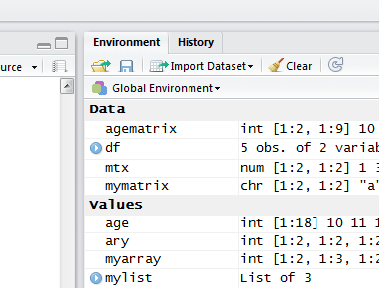
The RStudio import wizard
Really just a code generator for read.table
Loads data frame into your session, but does not put the code in your editor file
So you need to run the import every time you restart RStudio

Slide 10

Aside: Reading from SQL
We don't do this a lot now, but it is my belief that connecting to online databases is going to be more important in the future
If you agree with me, you may want to look into the sqldf package

Slide 11
A note on .RData files
.Rdata files save memory of an R session, not just one data frame
Rdata contains your variable names and data
load() does not return a data frame – it creates variables in memory
It is my opinion that this is not usually what you want
Instead, re-run code to recreate session variables

Slide 12
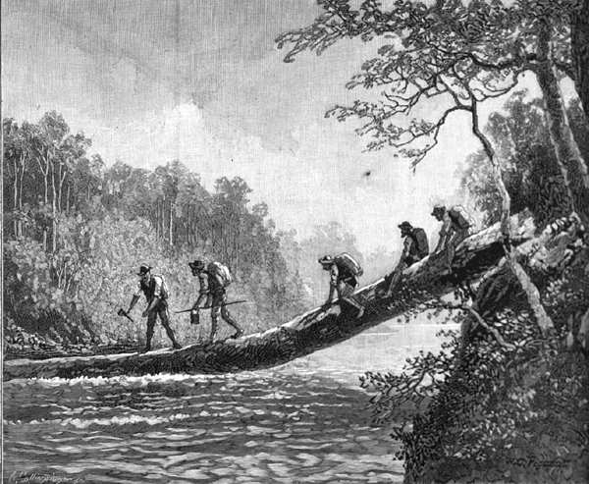
Exploring a data frame
Some common ways to take a first look at your data frame
head(infert)
tail(infert)
str(infert)
rownames(infert)
colnames(infert)
dimnames(infert)
str is useful for all kinds of objects, not just data frames
Note: these all work with matrices, too
Exploring
(eurocentrically)

Slide 13

Working with data frames
Get the dimensions of the data frame:
nrow(infert)
ncol(infert)
length(infert) (why?)
dim(infert)
I assume this picture of generically handsome white guys with ties doing very very important work with data was taken by a window washer

Slide 14
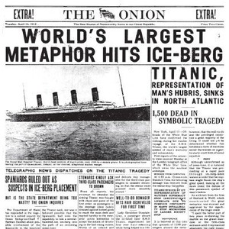
Challenge
Here's a URL for a CSV file with data about survival (or not) of passengers on the Titanic: http://www.columbia.edu/~sjm2186/EPIC_R/titanic.csv
Challenge: read the CSV into R and figure out how many rows of data it has.
My answer:
titanic <- read.csv("http://www.columbia.edu/~sjm2186/EPIC_R/titanic.csv")
nrow(titanic)

Slide 15
Some common operations with data frames
Tabulate the data: table or xtabs
table(infert$case)
xtabs(~case, data=infert)
table(infert$case, infert$parity)
xtabs(~case+parity, data=infert)
Get the proportions in each cell: prop.table, passing in a table (or any matrix)
prop.table(table(infert$case))
prop.table(table(infert$case, infert$parity)) prop.table(table(infert$case, infert$parity), 1)
prop.table(table(infert$case, infert$parity), 2)

Slide 16

Aside on table
Remember that $ indexes a data frame column (or a list item) by name
So, table(infert$case) is just tabulating the vector that is the case column
Intuition test: What do you think
length(table(c(1,2,2,2,2,4)))
will return?
A side table

Slide 17
Reminder: Indexing data frames to get rows
Get rows by position – index is a numeric vector:
infert[1,]
infert[c(1,2),]
infert[1:2,]
infert[2:1,]
A minus before the position index means everything except those positions
infert[-1,]
infert[-(1:244),]

Slide 18
Getting rows by name
If the row index is a character vector, R will try to find rows with those names:
It turns out that infert's row names are (character) numbers. So for infert:
infert["1",]
works just like:
infert[1,]

Slide 19
Indexing data frame rows by name:
… but this is not true in general. See, for example:
data(USArrests)
head(USArrests)
For the USArrests dataset, rownames are state names. So:
USArrests[1,] # works
USArrests["New York",] # works
USArrests["1",] # returns an error

Slide 20
Indexing data frames to get columns
Can also get columns by position, name, or logical:
infert[,1]
infert[,1:2]
infert[,'age']
infert[,c(T,T,F,F,F,F,F,F)]
In my experience, most column indexing is by name using $:
infert$age

Slide 21
Indexing data frames by boolean
In my experience, you frequently want to index rows to filter your data.
The filter logic can usually be a boolean statement:
rows_over_40 <- infert$age > 40
rows_over_40
table(rows_over_40)
infert[rows_over_40,]
infert[infert$age > 40,]

Slide 22
Adding columns to data frames
Maybe you want to create a dichotomous indicator for over 40
Can assign to columns of data frames just like lists:
infert$rows_over_40 <- infert$age > 40
table(infert$rows_over_40)
table(infert$rows_over_40, infert$age)

Slide 23
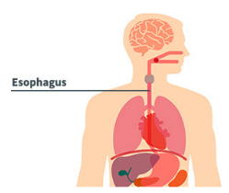
Challenge
There is a dataset built into R called esoph. Load it and get the third column, second row.
My answer:
data(esoph)
esoph[2,3]
(Bonus: self-test # 8)

Slide 24

Caution
Note: when you index to pull out only one column, the result is a vector, but when you index more than one column, the result is a data frame
class(infert[,1])
class(infert[,c(1,5)])

Slide 25
Caution, continued
This is more likely to be a problem when you use code to select columns
grep("ca", colnames(infert))
ca_colnames <- colnames(infert)[grep("ca", colnames(infert))]
ca_colnames
cat_colnames <- colnames(infert)[grep("cat", colnames(infert))]
cat_colnames
class(infert[, ca_colnames])
class(infert[, cat_colnames])

Slide 26
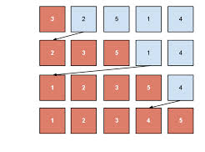
Sorting Data Frames (using order)
The sort() function returns the vector, sorted:
myvec<-c(6,3,2,4,5)
sort(myvec)
The order function returns the order in which a vector would be sorted, e.g.
order(myvec)
It's a little mind-bending, but order is the one you use to sort data frames
This illustrates a sort algorithm known as "insertion sort"

Slide 27
Order in action
Consider: you want to sort infert by age:
ages<-sort(infert$age)
ages
age_order<-order(infert$age)
age_order
infert[ages,]$age # wrong
infert[age_order,]$age # correct
infert[order(infert$age),]$age # correct
age_ordered_infert <- infert[order(infert$age),]
head(age_ordered_infert)

Slide 28

Sorting Data Frames (plyr)
Because order() is confusing, Hadley Wickham (who's done a ton of great stuff for R) added the arrange function to his plyr library (we'll talk more about libraries)
library(plyr)
infert_by_age <- arrange(infert, age)
Hadley, our hero

Slide 29

Aside on attach
You can make R have a default data frame using the attach function:
attach(infert)
order(age)
This is not recommended
Harder to read, reuse code
Easier to make subtle mistakes
But you will sometimes see it in examples
I'm unclear on whether this image is saying I should or I should not…
But: I do know you should NOT use attach().

Slide 30

Challenge
Load the USArrests dataset (built into R) and print out the list of states, sorted by murder arrest rate
My answer:
data(USArrests)
rownames(USArrests[order(USArrests$Murder),])
(Bonus: self-test # 9, review)

Slide 31
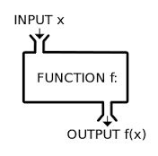
Functions
Formally, a function is a special kind of R object with mode function
Basic form:
returnValue<-functionName(arguments)
It is my belief that being able to write functions is the single best reason to use R
Or at least, being able to write functions can make you hella efficient
Ye Olde Function Machine

Slide 32
Some important built-in functions
We've come across some important ones before:
str(infert) # show the structure of an object
head(infert) # print the start of a vector/data frame
table(infert$age) # print a frequency table
We'll also see a more as we start talking about using R with statistical computation in mind:
fivenum(infert$age) # "five number" summary
summary(infert$age) # generic object summary
t.test(table(infert$age, infert$case)) # run a t-test
lm(case~age, data=infert) # run a linear regression

Slide 33
Turning your code into a function
You can write your own, using the function function(), which returns functions:
mean.ignoreNA <- function(vec) {
return(mean(vec, na.rm=TRUE))
}
This calls the mean() function on the same vector, passing a specific parameter

Slide 34
Packages
Organizations of functions
Some come with R and load every time you start R ('base priority')
e.g. utils, stats, base, graphics,…
Most need to be installed and loaded

Slide 35

'Core R'
Some of what you might think of as "in R" is actually implemented in a 'base Priority' package
e.g. max is in the base package:
max(c(1, 3, 2, 1)) # 3
help(max)
t.test is in the stats package

Slide 36
'User-Defined' Packages
Base packages are maintained by the R core team
A set of people who probably get paid (maybe through grants) to make R better
What comes with your iPhone
User-defined packages provide more specific functionality
Like iPhone Apps, only without the rigorous AppStore validation process.

Slide 37

Some examples of packages
to accomplish specialized tasks
survival, genetics
to manipulate data
plyr, reshape, RecordLinkage
for teaching purposes
CAR, LearnBayes
to extend R's capabilities to new methods
ggplot2, sp, maptools, survey, mitools
to bring together tools folks have found helpful, and want to share
epitools, epicalc, epiR

Slide 38
Working with packages
library() lists packages
Like browsing through your iPhone apps
install.packages("package-name") gets the code from CRAN and copies it to your R library
Like installing from the App Store
library(package) loads the package for this session
Like running an app
Note: checking the checkbox next to a library on RStudio runs library(package) in the console

Slide 39
The library call
Once a package is loaded, functions become available
births <- read.dta('http://www.columbia.edu/~sjm2186/P9489/births.dta')
library(foreign)
births <-
read.dta('http://www.columbia.edu/~sjm2186/P9489/births.dta')
Some packages also make datasets available for load using data() as well
I find it easiest to put my library calls at the top of my code, so all libraries load when I start

Slide 40

Keeping your packages up to date
update.packages() updates all packages
This is usually a good thing
But you want to do it at strategic time points – it usually shouldn't break anything, but you never know

Slide 41

Aside: Contributing to a package
It doesn't happen often, but sometimes you find a problem with a package
e.g. mitools + nnet for multinomial regression
If you can fix the code, submit it back! – even if your fix is ugly, it gives the person who wrote the package a head-start on fixing the issue.

Slide 42
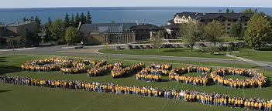
Challenge
Load the 'epitools' package, load the oswego dataset that's built into epitools, and compute the odds ratio for ill, conditional on consuming coffee
(hint: if you get stuck, try ?epitab after you've loaded epitools)
My answer:
library(epitools)
data(oswego)
epitab(oswego$ill, oswego$coffee)
(Bonus: Self-test #10, 11, review)

Slide 43
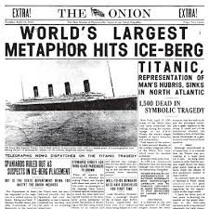
Challenge
Load the titanic survivor dataset from http://www.columbia.edu/~sjm2186/P9489/titanic.csv
Use epitab to compute risk ratios (with confidence intervals) for death for second and third class passengers
I feel like I can never show this headline too many times
My answer:
titanic <- read.csv("http://www.columbia.edu/~sjm2186/P9489/titanic.csv")
epitab(titanic$pclass, !titanic$survived, method="riskratio")
(Bonus: Self-test #10, 11, review)

