Slide 1


R Workshop, Part 3 (Regression & Graphics)
Steve Mooney
Harborview Injury Prevention & Research Center
SER 2018

Slide 2

Review Challenge
Load the USArrests dataset (built into R) and print out the list of states, sorted by assault arrest rate
My answer:
data(USArrests)
rownames(USArrests[order(USArrests$Assault),])
(Bonus: self-test # 13)

Slide 3
Orientation on Regression in R
Use the formula type to specify a model:
y ~ x + z
Where y is the dependent variable and x and z are predictors, e.g.
dig <- read.csv("http://www.columbia.edu/~sjm2186/EPIC_R/dig.csv")
lm(HEARTRTE ~ TRTMT + SEX, data=dig)

Slide 4

Using the model object
lm() (and family) return a model object, which subsequent functions interrogate.
model <- lm(SYSBP ~ DIABP + SEX, data=dig)
str(model)
summary(model)
coef(model)
anova(model)
residuals(model)
predict(model)

Slide 5
More with the model object
Regression diagnostics in the car ('companion for applied regression') package:
library(car)
data(Duncan)
model<-lm(prestige~income, data=Duncan)
qqPlot(model)
infIndexPlot(model)
infIndexPlot(model, "Cook")

Slide 6

Graphical tools for regression
Plot is a generic function for graphing
More details later
plot(Duncan$income, Duncan$prestige)
identify(Duncan$income, Duncan$prestige)
Duncan[c(6, 16),]
abline(model)
plot(model)

Slide 7
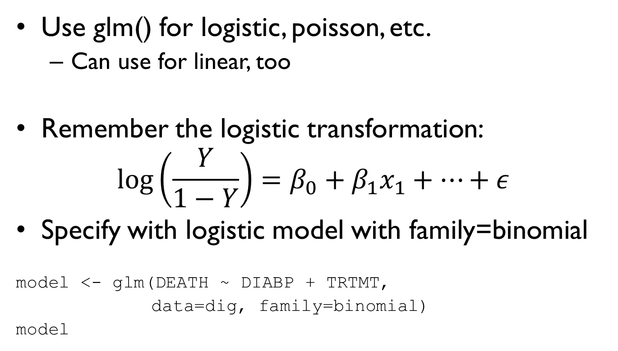
Glm – generalized linear model
Use glm() for logistic, poisson, etc.
Can use for linear, too
Remember the logistic transformation:
$$\log\left(\frac{Y}{1−Y}\right)=β_{0}+β_{1}x_{1}+…+ε$$
Specify with logistic model with family=binomial
model <- glm(DEATH ~ DIABP + TRTMT,
data=dig, family=binomial)
model

Slide 8
Caution!
Glm defaults to assuming a linear outcome, and does not throw a warning if all linear values are 0s and 1s:
model <- glm(DEATH ~ DIABP + TRTMT, data=dig) # wrong, sort of
summary(model)
model <- glm(DEATH ~ DIABP + TRTMT,
data=dig, family=binomial)
summary(model)

Slide 9

Challenge
Load the Duncan dataset (reminder: it's in the car package)
Estimate the average increase in prestige associated with a one-unit increase in education
Q: How many PhDs use academic robes as bathrobes?
My answer:
library(car)
data(Duncan)
model <- lm(prestige~education, data=Duncan)
summary(model)
(Bonus: self-test # 14)

Slide 10

Challenge
Using the Duncan dataset and regression diagnostics, find the occupation that has the largest prestige bump not predicted by education (i.e. has most positive residual)
My answer:
plot(model)
Prestige! Because of 3-year olds

Slide 11
Base Graphics
R has two main flavors of graphics:
'base' graphics
'ggplot', which is increasingly popular
We'll cover base graphics first, then ggplot

Slide 12
Getting started
To plot any object, just wrap it in plot:
plot(Duncan$income)
plot(Duncan$type)
Intuition check: Why were these different?

Slide 13
Histogram
But wouldn’t a histogram be more informative?
hist(Duncan$income)
Can change up the binning using breaks:
hist(Duncan$income, breaks=seq(0,100, 5))

Slide 14
Scatterplot
A scatterplot comparing income (x-axis) to prestige (y-axis):
plot(Duncan$income, Duncan$prestige)
The x-axis is the one whose name is x, or the first argument by default:
plot(Duncan$prestige, Duncan$income)
plot(y=Duncan$prestige, x=Duncan$income)
You can use type= to change the type of plot:
plot(Duncan$income, Duncan$prestige, type="l")

Slide 15
Plot titles
Add a title as another call or in the plot call using main=
title(“Income vs. Prestige”)
plot(Duncan$income, Duncan$prestige, main="Income and Prestige")
Some plots create titles by default, use main="" to suppress it
hist(Duncan$income)
hist(Duncan$income, main="")
title("I decide the title, yo!")

Slide 16
Fiddling
Look at the scatterplot again:
plot(Duncan$income, Duncan$prestige)
Why doesn't income have ticks at 0 and 100 but prestige does?
Fiddle with plot parameters to override labels, default axis ranges, etc:
plot(Duncan$income, Duncan$prestige, xlab="Income", ylab="Prestige", xlim=c(0,100))

Slide 17
More fiddling
Suppose you want to see how education affects the prestige/income relationship by treating jobs as high or low education
First, create a dichotomous variable for education and sanity-check it:
Duncan$high_education <- Duncan$education > 50
table(Duncan$high_education)
plot(Duncan$high_education, Duncan$education)

Slide 18
Adding color
There are different ways to color points by education, but none of them are all that elegant, in my opinion
Here's one option:
Duncan$plot_color <- ifelse(Duncan$high_education, "red", "blue")
plot(Duncan$income, Duncan$prestige, col=Duncan$plot_color)
Spoiler: ggplot makes this more elegant

Slide 19
Bar plot
Okay, now run this code:
plot(Duncan$type, Duncan$income)
Note that we don't get a scatterplot, because type is a factor:
class(Duncan$type)
We can get one by coercing type to be a numeric:
plot(as.numeric(Duncan$type), Duncan$income)

Slide 20
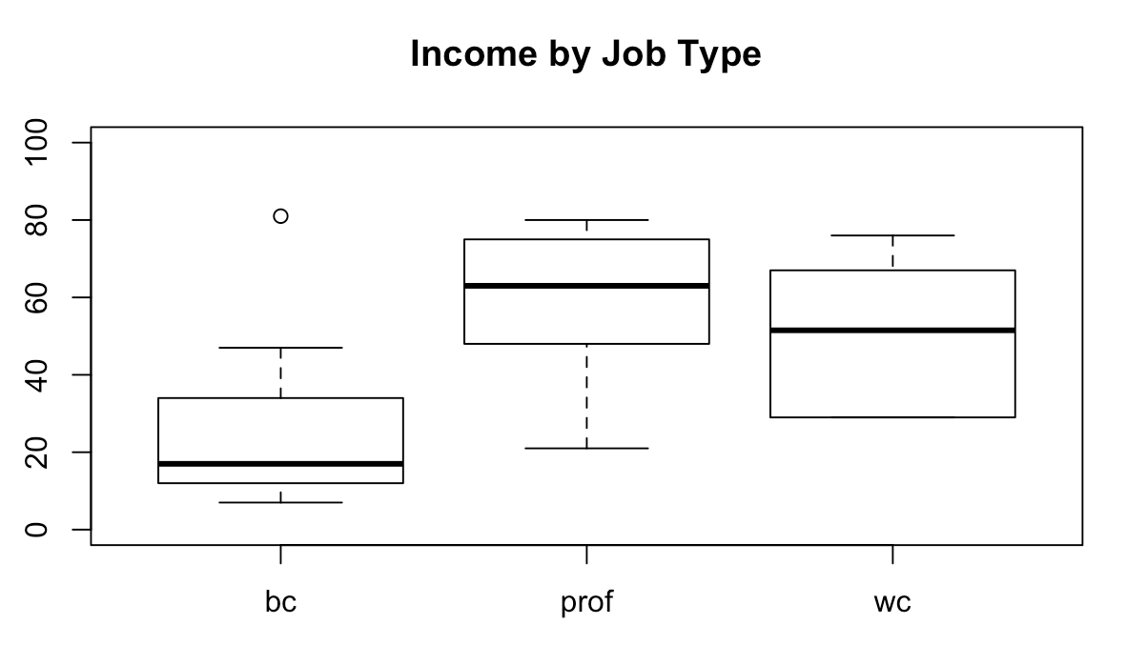
Challenge
Use the Duncan dataset to make a box-and-whiskers plot titled “Income by Job Type” wherein type is on the x axis, income is on the y axis, and the y axis runs from 0 to 100
plot(Duncan$type, Duncan$income, ylim=c(0, 100))
title("Income by Job Type")
(Bonus self-test: #15)

Slide 21
ggplot
ggplot is a whole different beast from base graphics
ggplot is like R itself – some work to get oriented, but powerful once you do
You don't have to know ggplot to be successful using R

Slide 22
Plot income vs. prestige
Load the ggplot2 library
library(ggplot2)
It will be easiest to start using qplot. Qplot mimics plot(), but uses the ggplot layout engine.
qplot(Duncan$income, Duncan$prestige)

Slide 23
ggplot
qplot is the training wheels version of ggplot
ggplot's syntax takes some getting used to. Try this:
ggplot(Duncan) + aes(x=income, y=prestige) + geom_point()
Huh? What are the pluses about?

Slide 24
ggplot syntax
ggplot objects are weird
You execute them (like a command) to draw their plot
But you construct them by adding options to them
Options specify data source, data columns, etc, resulting in code like this:
p <- ggplot(Duncan)
p <- p + aes(x=income, y=prestige, color=high_education)
p + geom_point()
All in one line is also okay:
ggplot(Duncan) + aes(x=income, y=prestige, color=high_education) + geom_point()

Slide 25
Where ggplot shines
In my opinion, it's harder to think about doing simple plots in ggplot
But when I want to do something multi-faceted (e.g. with different colors, sizes, etc.), ggplot makes it really easy
I use it a lot for to understand 3+-way relationships in data

Slide 26
Challenge
Use ggplot to make a scatterplot of prestige vs. income in the Duncan dataset, making size proportional to education and color set by type
My answer:
ggplot(Duncan) +
aes(x=income, y=prestige, color=education, size=type) +
geom_point()
(Bonus self-test: graphics self-test)

