Slide 1
The Lazy Ops Guide to Cert Management

Slide 2



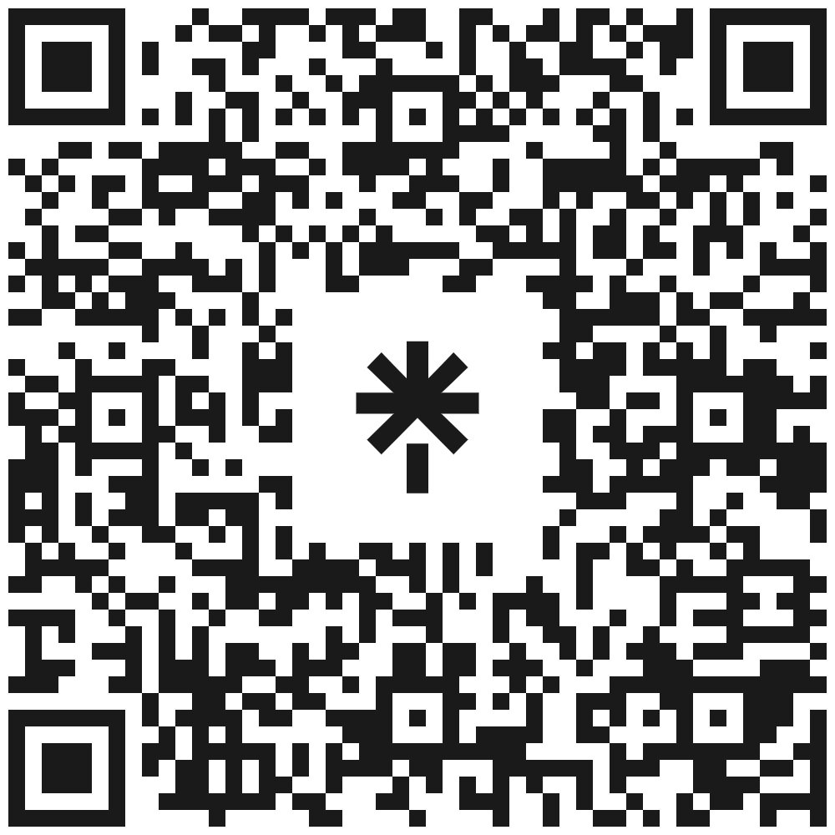




Who Am I?
Simon Lee
simon-john-lee
Simon’s Linktree
smoon_lee
smoon_lee
smoonlee
thebuiltwithcaffeineblog
blog.builtwithcaffeine.cloud

Slide 3
The Back Story: What Do We Know
Why Cert Management Has Always Been Tiresome:
🔁 Short validity periods mean certificates need regular renewal and redeployment.
⚠️ Manual renewal processes often involve human error, downtime, or last-minute scrambles.
🗺️ Scattered certificates across multiple systems and environments — no single source of truth.
❌ Lack of automation leads to poor visibility, missed expirations, and reactive firefighting.
🔐 Complicated tooling around PKI, intermediate chains, and server bindings adds confusion.

Slide 4
The Back Story: What Do We Know
Why It's About to Get Worse:
📉 DigiCert & the CA/Browser Forum are reducing certificate lifetimes industry-wide.
⏳ As of March 2026, max cert life will be just 200 days.
⏳ As of March 2027, max cert life will be just 100 days.
⏳ As of March 2029, max cert life will be just 47 days.
🧠 More frequent renewals = more opportunity for failure, missed deadlines, and outages.
🚨 Teams that don’t automate will be stuck in a loop of constant cert chasing.
source: https://www.digicert.com/blog/tls-certificate-lifetimes-will-officially-reduce-to-47-days

Slide 5
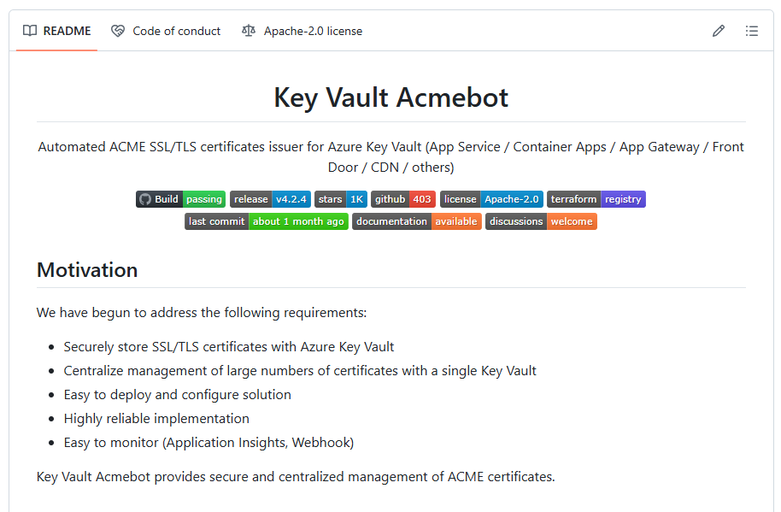
The Solution: Key Vault ACME
Support for ACME v2 compliant Certification Authorities
  Let's Encrypt
  Buypass Go SSL
  ZeroSSL (Requires EAB Credentials)
  Google Trust Services (Requires EAB Credentials)
  SSL.com (Requires EAB Credentials)
  Entrust (Requires EAB Credentials)
Certificates can be used with many Azure services
  Azure App Services (Web Apps / Functions / Containers)
  Azure Container Apps (Include custom DNS suffix)
  Front Door (Standard / Premium)
  Application Gateway v2
  API Management
  SignalR Service (Premium)
  Virtual Machine
https://github.com/shibayan/keyvault-acmebot

Slide 6
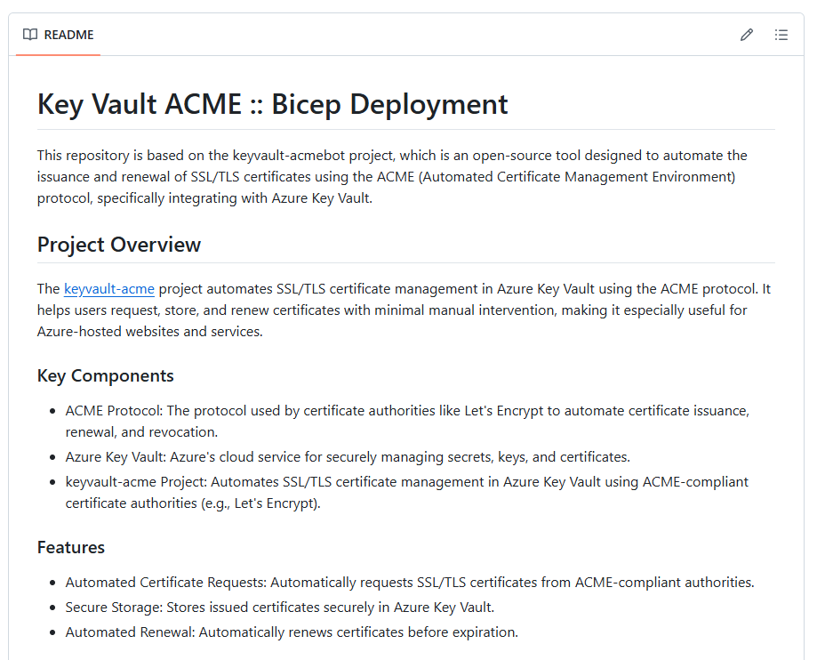
The Solution: IaC Automation
https://github.com/builtwithcaffeine/bwc-keyvault-acme-bicep

Slide 7
The Solution:
https://github.com/builtwithcaffeine/bwc-keyvault-acme-bicep

Slide 8
The Lazy Ops Guide to Cert Management
The Lazy Ops Guide to Cert Management
Demo Time 🥳

