Slide 1
The Lazy Ops Guide to Azure Cert Management
- Simon Lee

Slide 2





Who am I?
Azure Consultant @ Intercept BV
Over 10 Years in Tech
Started in Education
Moved to Private Sector
Moved to the Cloud
Socials:
@smoon_lee
Simon John Lee
@smoonlee
https://blog.builtwithcaffeine.cloud
Notes:
Due to Azure Issues – this is frozen :D – Welcome to 2024 -> https://blog.builtwithcaffeine.cloud

Slide 3
Demystifying Certificate Management
The Real-World Problem:
- Managing TLS/SSL certificates in Azure can be tedious and error-prone.
- It often involves:
  Requesting certs manually.
  Uploading them to Azure services.
  Remembering to renew them (😬).
  Scripting the whole thing if you want some automation.

Slide 4
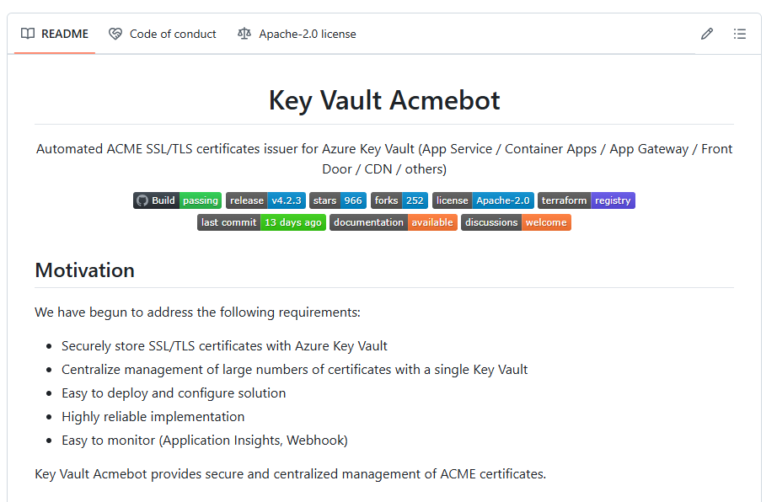
Key Vault ACME
https://github.com/shibayan/keyvault-acmebot
Support for ACME v2 compliant Certification Authorities
  Let's Encrypt
  Buypass Go SSL
  ZeroSSL (Requires EAB Credentials)
  Google Trust Services (Requires EAB Credentials)
  SSL.com (Requires EAB Credentials)
  Entrust (Requires EAB Credentials)
Certificates can be used with many Azure services
  Azure App Services (Web Apps / Functions / Containers)
  Azure Container Apps (Include custom DNS suffix)
  Front Door (Standard / Premium)
  Application Gateway v2
  API Management
  SignalR Service (Premium)
  Virtual Machine
Notes:
Reasons to use this:
- Free
- Cloud Based
- Uses Lets Encrypt Certificates
- Less Management Overhead
- Automated Renewals
- Native Azure Integration
https://github.com/shibayan/keyvault-acmebot

Slide 5
The Fun Part :: Demo Time
Notes:
Machine prep – Install Packages -> Hugo, Git, VSCode, Pwsh7
Configure Git User and Email
Creating GitHub Repo user-group-swa-demo
Create Hugo
Clone Repo
Git Init
Install Hugo
Git Commit
Creating Azure Static Web App
Configure Domain and Cert
Azure DNS / Cert
https://github.com/smoonlee/public-speaking-slide-decks/tree/main/Getting_Started_With_Blogging

Slide 6


Questions?
The Socials
@smoon_lee
Simon John Lee
@smoonlee
https://blog.builtwithcaffine.cloud

