Slide 1
VAIDS-DSML exercise block 10
Jasmin Duvivié

Slide 2
k-means clustering
problem
660 samples of vertebral columns
7 features
no target
we need to group the samples into meaningful clusters
solution
visualize the features to check which is suitable for clustering
set random values as cluster centers
assign samples to clusters based on minimal Euclidian distance
repeat until clusters don’t significantly improve

Slide 3
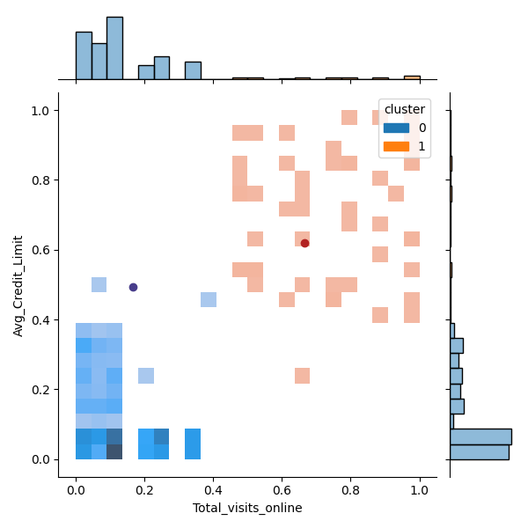
k-means clustering 1st iteration

