Slide 1
VAIDS-DSML exercise block 4
Jasmin Duvivié

Slide 2
knn classification
Problem
we have 1372 samples of banknotes of which we know some features and whether they are real or counterfeit
we have 5 samples of banknotes of which we know the same feature but not whether they are real or counterfeit
Solution
for each of the samples, calculate the Manhattan distance of its features to each known sample’s features
sort the results in an ascending order
take a majority vote of the k closest known samples to classify the unknown samples

Slide 3
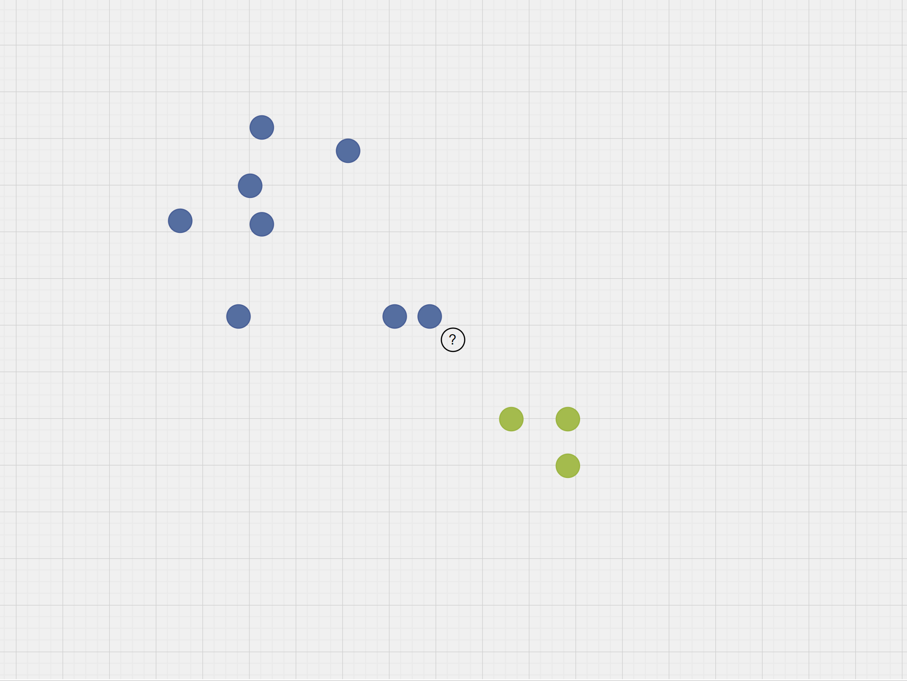
knn classification

Slide 4
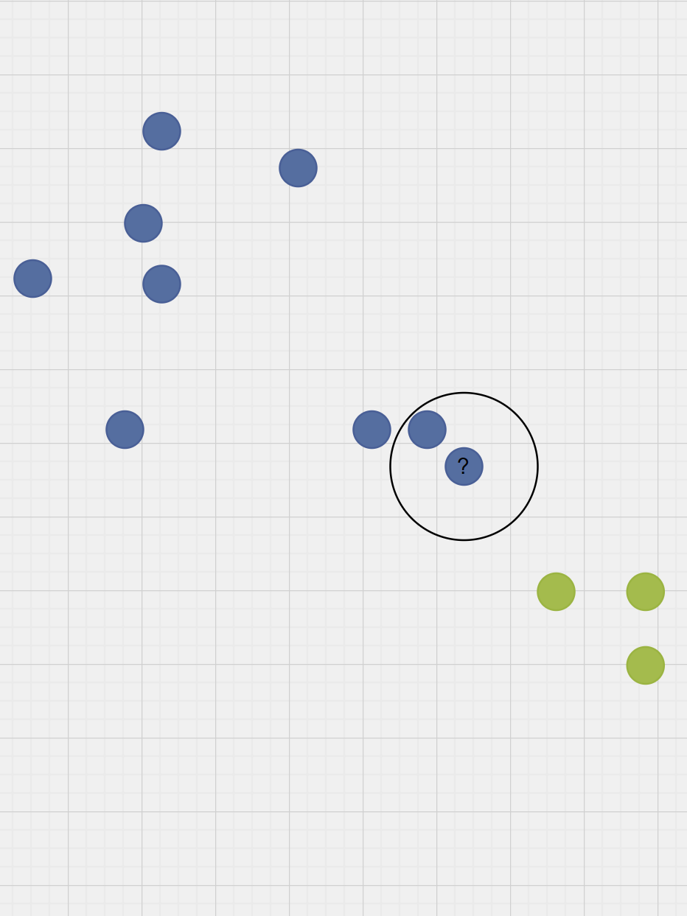


knn classification

Slide 5


knn classification

Slide 6
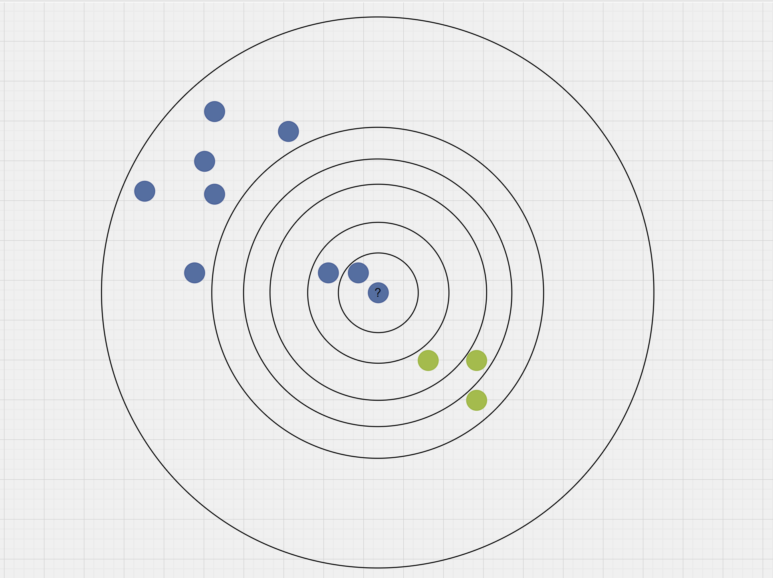
knn classification

