Slide 1
软件工程
UML简介

Slide 2
内容 Contents
UML的目标和特点
UML语言的基本元素
结构建模 （静态结构图）
组件图, 部署图
时序图, 状态图, 活动图

Slide 3
Where are we?
Use Cases
Requirements
Requirements Specification
Conceptual
Models
Contracts
Detail
Design
Design Models
Collaborations
Code
Implementation

Slide 4
UML 的目标
向使用者提供一种可用的, 能有效表达能力强的可视化的建模语言, 以便他们有效的开发和交流有意义的设计模型
提供扩展和细化机制对核心概念进行展开
独立于具体程序设计语言和开发过程
提供一种形式化的基础来理解建模语言

Slide 5
我们为什么需要模型?
Unified Modeling Language
提供解决问题的结构
帮助抽象以管理复杂度
通过实验探索多种解决方案

Slide 6
为什么需要图形化的模型?
图形同时表达内容,结构等等许多信息…
一副图顶得上千字

Slide 7
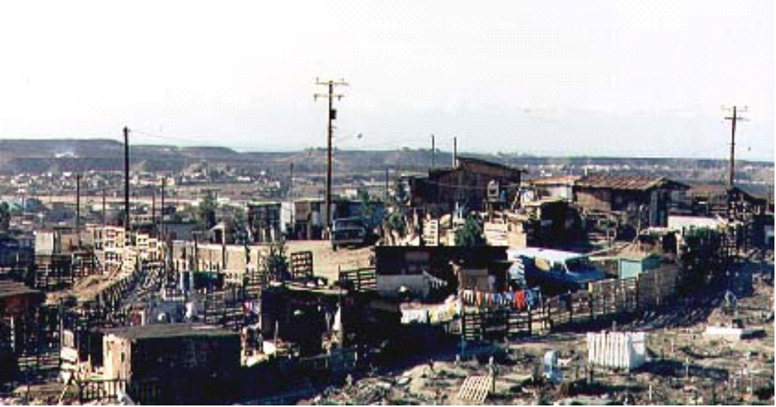
挑战

Slide 8

目标

Slide 9
语言本身
Unified Modeling Language
语言 = 语法 + 语意
  语法Syntax = 语言成分(如单词)构成句子的规则 (e.g., phrases, clauses)‏
  语义Semantics = 语法句子被赋予意义的规则

Slide 10
语言元素
UML 的基本语言元素:
  建模元素(类, 接口, 组件, 用例)‏
  关系 (associations, generalization, dependencies)‏
  图 (类图, 用例图, 交互图interaction diagrams)‏
简单的元素用来构成大的复杂的结构

Slide 11
UML 图的类型
每个 UML 图设计来让开发者和使用者从不同的角度和抽象层次来看待一个软件系统
  用例Use Case
  类Class
  交互Interaction
  状态State
  活动Activity
  物理Physical

Slide 12
用例建模
用例模型= 从系统对外部的用户展现的行为来看系统
用例模型把系统功能划分为对用户和外部系统(行为者)有意义的互动过程(用例)‏
用例图显示行为者和用例的关系

Slide 13
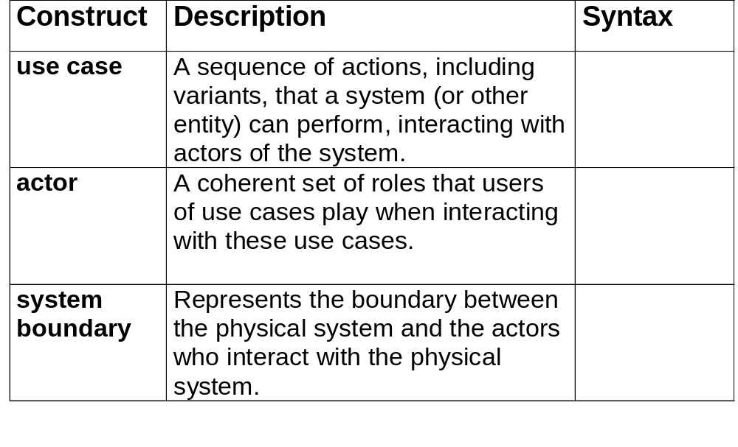
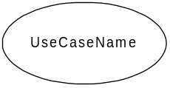
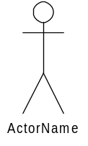

核心元素

Slide 14
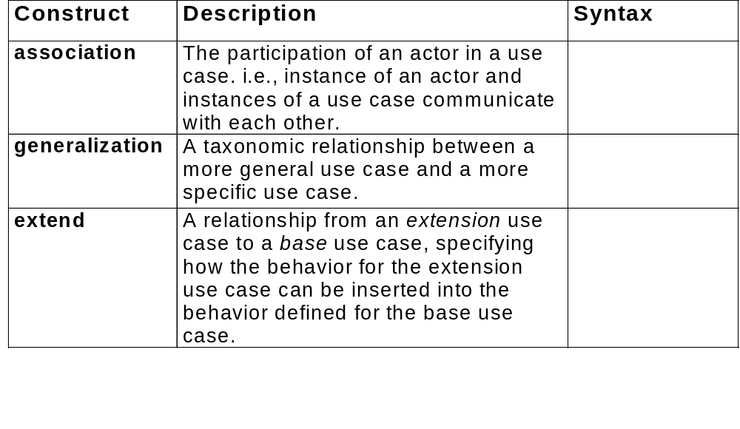



核心关系
<<extend>>

Slide 15
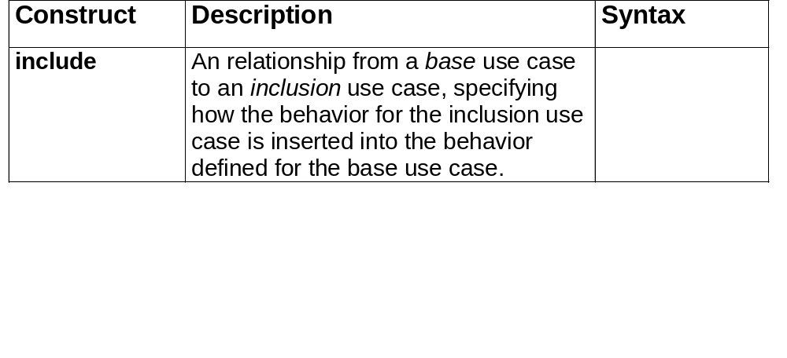
核心关系(续)‏
<<include>>

Slide 16
结构建模
从另一个角度看待系统, 强调对象的结构, 包括分类, 关系, 属性和操作
类图采用象类,包和对象这样一来的设计元素对类的结构和内容进行建模

Slide 17
结构图概述
显示模型的静态关系
  存在的实体 (例如: 类, 接口, 组件, 节点)‏
  内部结构
  和其它实体的关系
而不显示
  随时间变化的信息

Slide 18
静态结构图
显示通过静态关系连接的对象图
种类 -（ Conceptual models ）:
  类图Class diagram: 类
  对象图Object diagram:实例

Slide 19
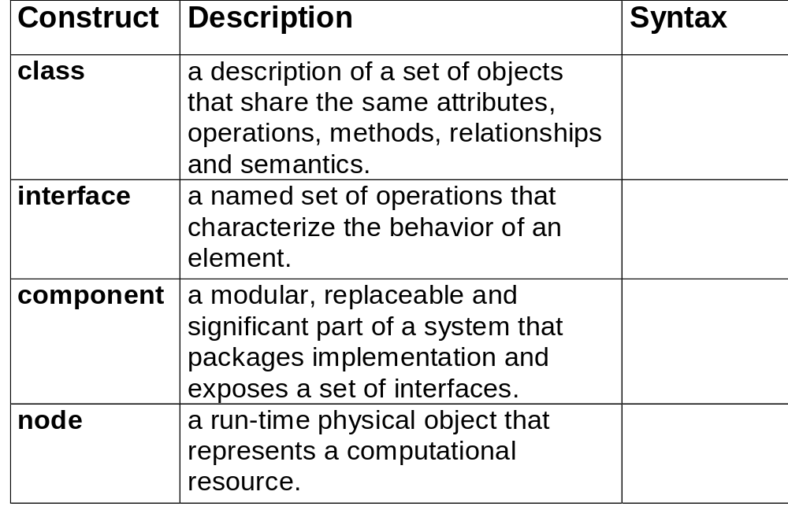
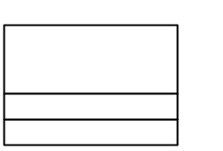

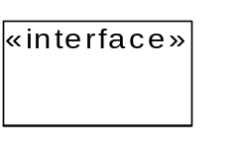
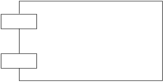
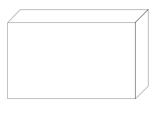
核心元素

Slide 20
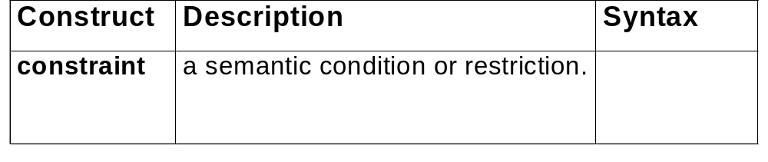
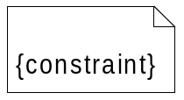
核心元素(续)‏

Slide 21
Conceptual modelling概念模型
One of the most important activities in the development cycle is the creation of a conceptual model
A conceptual model aims to identify the individual concepts (or classes) which exist within a problem domain
It should show:
  Concepts (i.e. fundamental classes);
  Associations between concepts;
  Attributes of concepts.
Conceptual models are described using CLASS DIAGRAMS

Slide 22
Class diagrams 类图
Probably the most important modelling technique used in UML
Class diagrams model static relationships that exist between objects
By static it is meant that the nature of the relationships does not change over time, e.g. a student may borrow zero or many copies of a book (this property should always be true)
Class diagrams also describe the internal structure of objects, i.e. their component attributes and operations

Slide 23
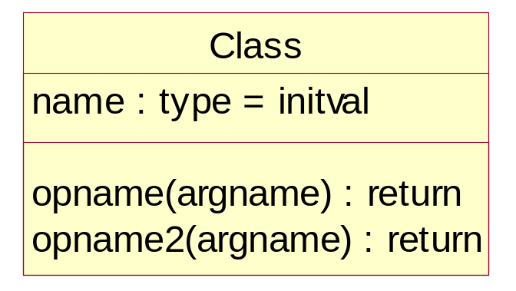
Classes
The UML definition of a class
  “a description of a set of objects that share the same attributes, operations, methods and relationships'' [OMG UML Guide, 1999]
A class is drawn as a 3-part box, with the class name at the top, a list of attributes in the middle, and a list of operations in the bottom

Slide 24

类记号
类由三部分组成: 名字, 属性, 和操作
Class name
Attributes
Operations

Slide 25
Attributes 属性
Attributes are descriptions of a particular data item maintained by each instance of a class.
Every attribute has a name, a type, and if required a default initial value
During analysis attribute types can be abstract; during later design they should have the syntax of the target language.
Enumerated types can be described by a set of separated values: {Academic | Student}

Slide 26
Operations 操作
Operations are abstract specifications of a class's behaviour
They have a name, a set of input parameters, and a return type
Details of the functionality of an operation are specified textually elsewhere (see later)
Methods implement operations:

Slide 27
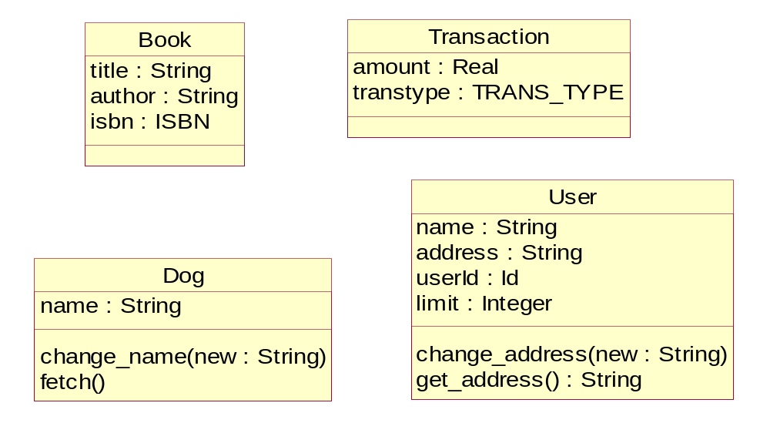
Some Examples of Classes

Slide 28
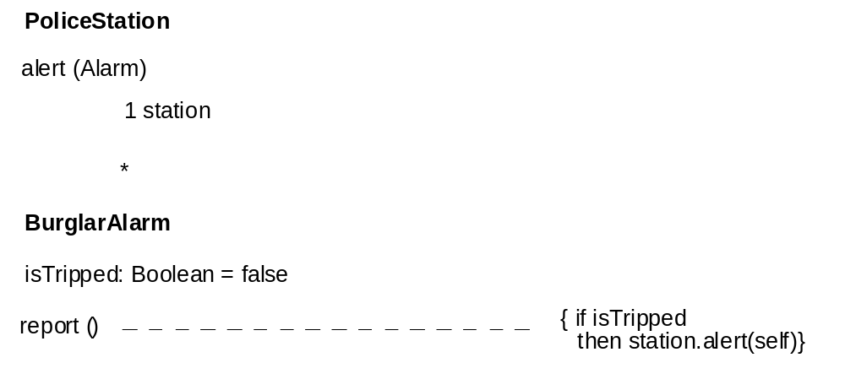
类: 方法体

Slide 29
Objects （对象）
Objects are instances of a class
Objects have a unique identity which will not change over time
Objects have lifecycles:
Create()
Created
Op()
Updated
Kill()
Deleted

Slide 30
Object Notation
In UML, an object is represented by a class box, with the name of the class underlined and (optionally) instantiated:
fred : User
object : Class
name = “fred”
attr1 = value1
address = “unknown”
attr2 = value2

Slide 31
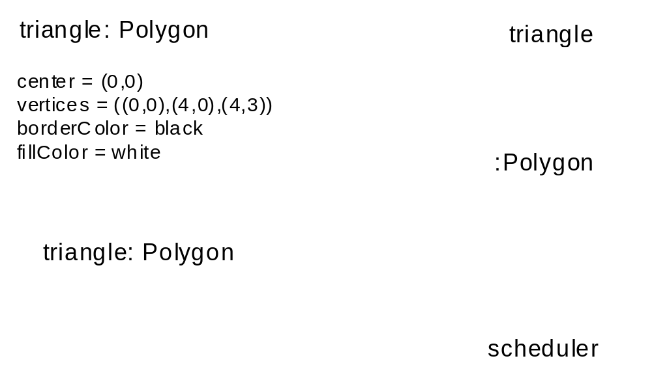
对象

Slide 32
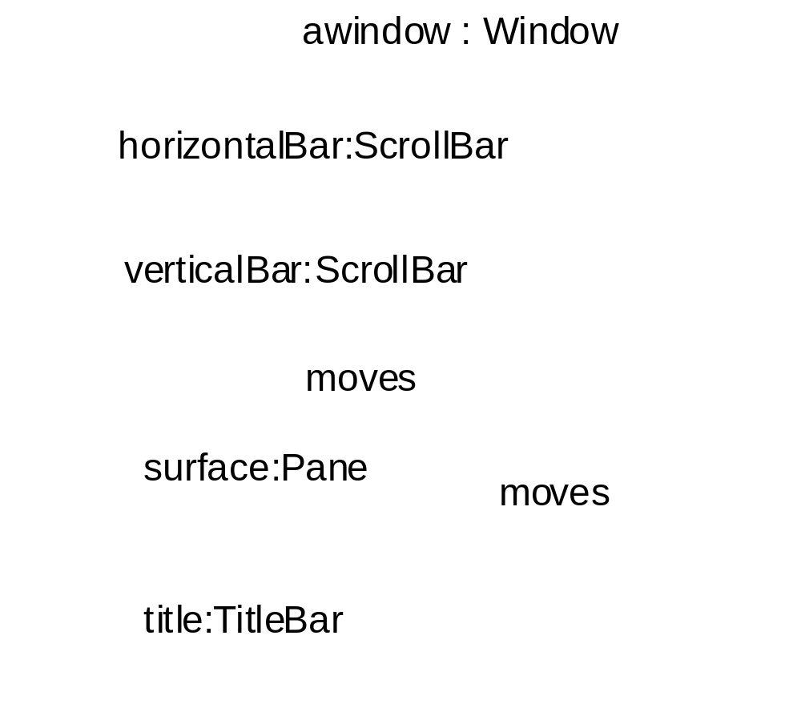
复合对象

Slide 33
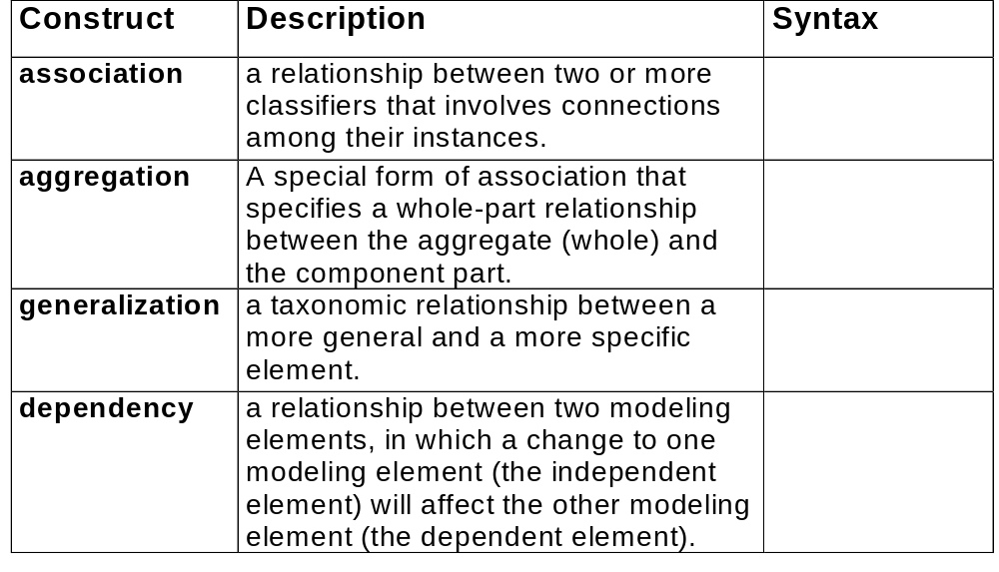



核心关系

Slide 34
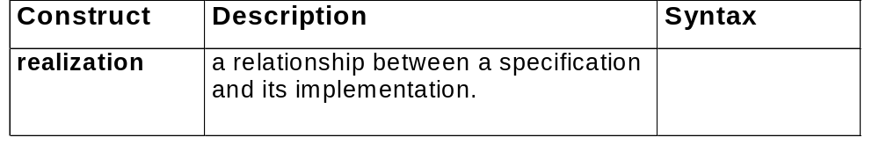

核心关系(续)‏

Slide 35
类图
类图也表示关系: 包含(containment), 继承(inheritance), 关联( associations)‏
关联 (association) 关系是类图中最常见的关系 -关联显示类的实例间的关系

Slide 36
Associations关联
Associations specify relationships between objects of different (or the same) classes. Associations have:
  a name, which is usually read from left to right
  a role, which describes the role the instances of the associated class play in the relationship
  a multiplicity which states how many instances of a class at one role end can be associated with an instance of another class at the other role end

Slide 37
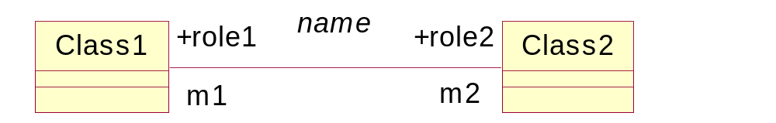
Associations
In UML, multiplicity may be denoted by a number, e.g. ‘1’, a set, e.g. {1 .. 3}, or a ‘*’, which denotes ‘one to many’
Note, 0..* is equivalent to ‘*’

Slide 38
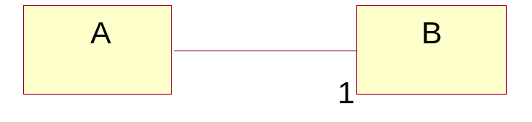
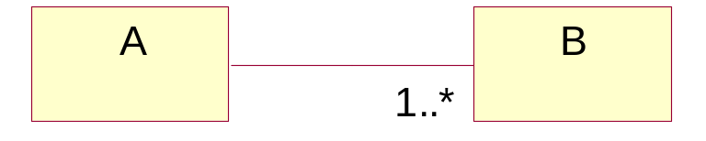
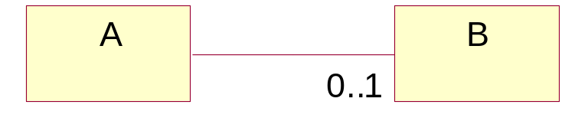
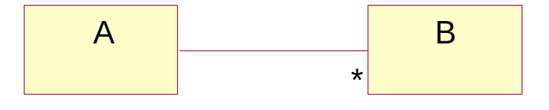
Multiplicity
An A is associated with exactly one B
An A is associated with one or more B
An A is associated with zero or one B
An A is associated with zero or many B

Slide 39
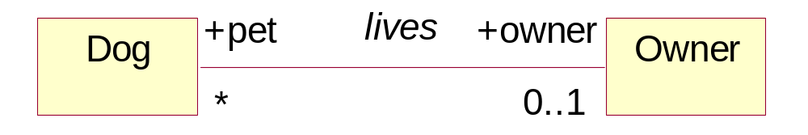
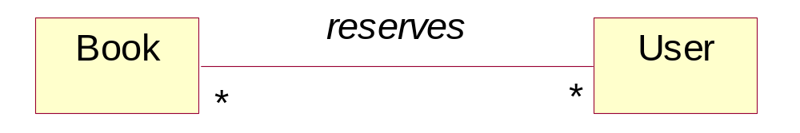
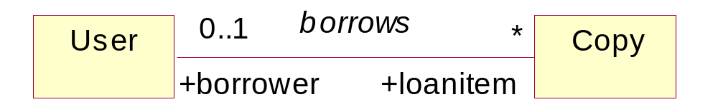
Examples
A ‘zero or many’ to ‘zero or one’ association:
A ‘zero or many’ to ‘zero or many’ association:
A ‘zero or one’ to ‘zero or many’ association:

Slide 40
Association Meaning
An association represents a set of links between objects belonging to the associated classes, e.g. borrows association:
Link
javaGently(1):Copy
bill : User
GreatExpectations:Copy
phil : User
TheZNotation:Copy
jill : User
HowToPassExams:Copy
will : User
WinnieThePooh:Copy
javaGently(2):Copy

Slide 41
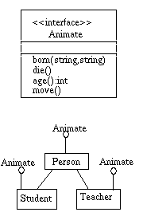
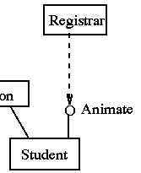
接口: 简略记号

Slide 42
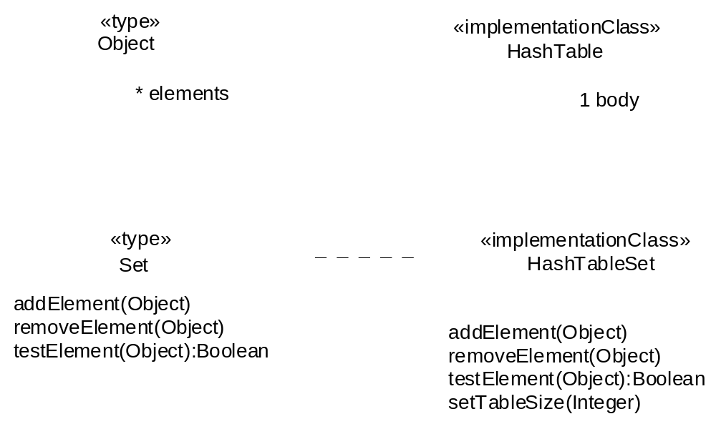
类图关系（实现，组合）

Slide 43
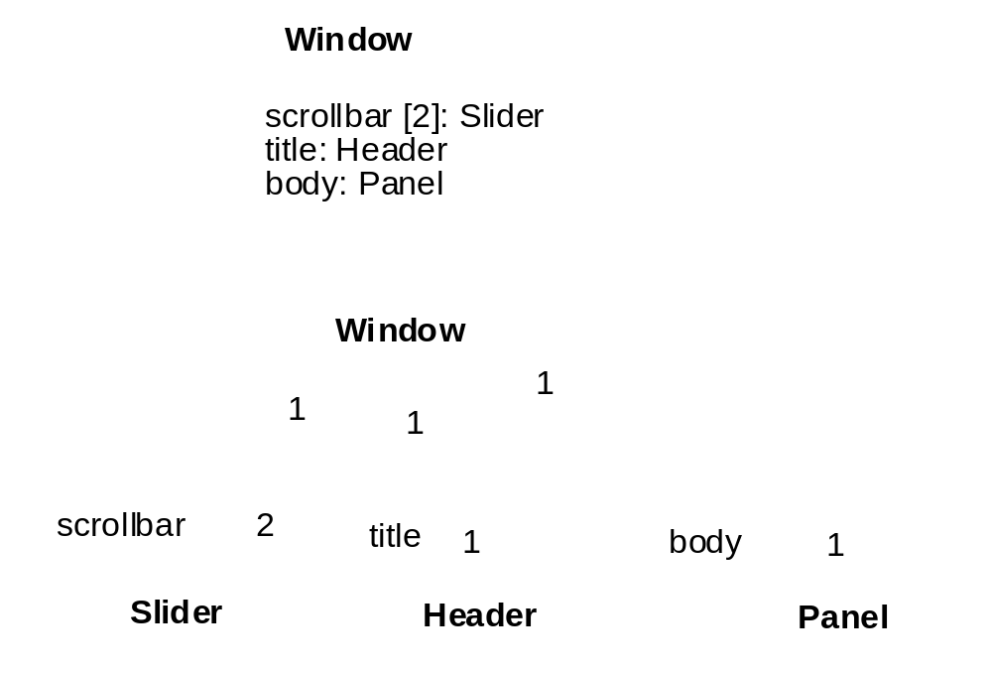
类图关系-组合(Composition)‏

Slide 44
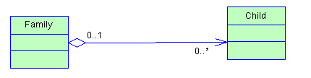
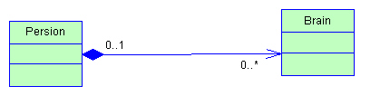
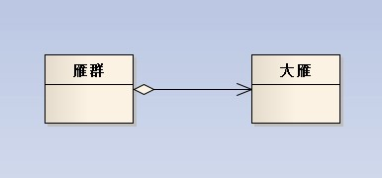
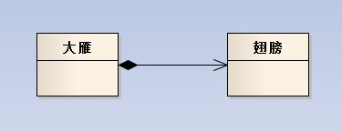
类图关系-（组合，聚合）‏

Slide 45
Generalisation/Specialisation
泛化
Generalisation is a classification relationship between classes in which a number of classes are viewed as being ‘a kind of’ another class
A generalisation relationship is denoted by an un-filled arrow from the specialised class (subclass) to its more general class (superclass)
UML permits generalisation of single and multiple classes

Slide 46
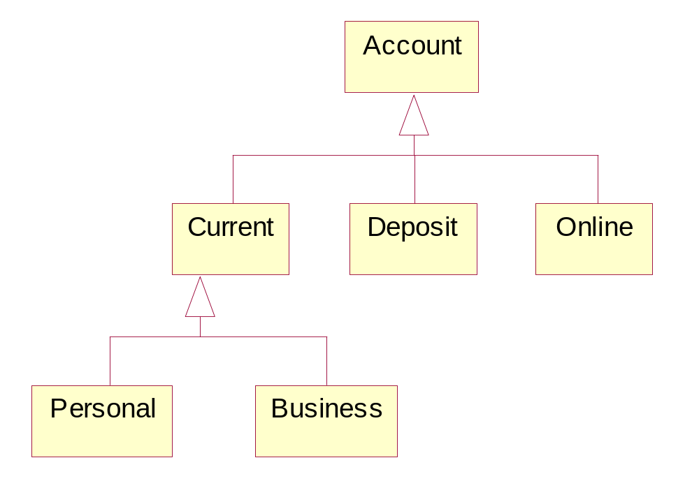
Example

Slide 47
The Meaning of Generalisation
Generalisation implies a property of “substitutability”:
  Substitutability: An instance of a subclass can always be substituted wherever an instance of a superclass is expected or required
In other words, if the system works for instances of a superclass it will also work for its subclasses

Slide 48
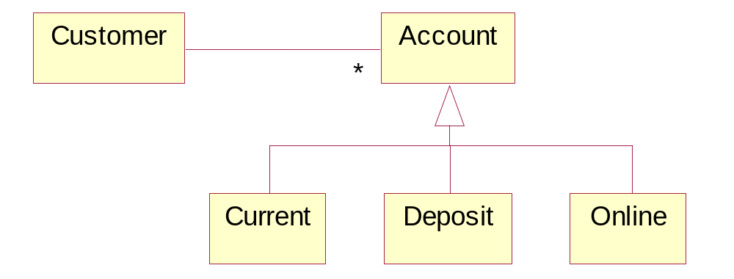
Example
A customer holds accounts objects. By substitutability these account objects can be replaced by instances of any of the account subclasses
This flexibility, also known as polymorphism, is a powerful feature of OO
It allows us to abstract common features of concepts and facilitates high maintainability and reusability

Slide 49
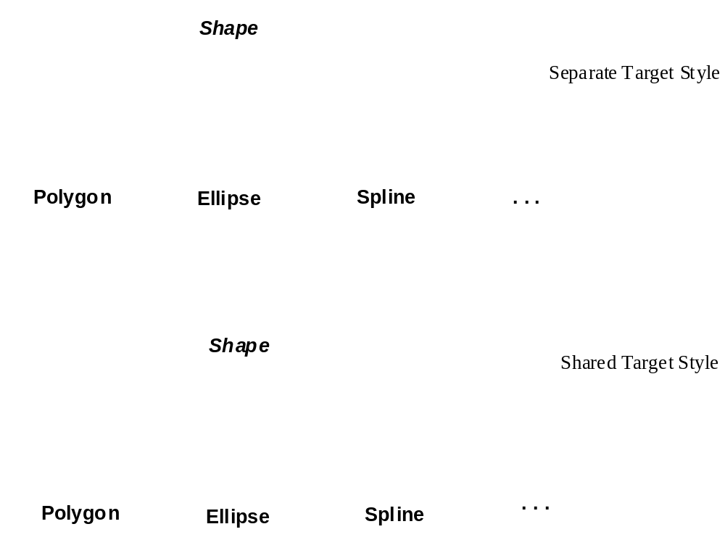
泛化(Generalization)‏

Slide 50
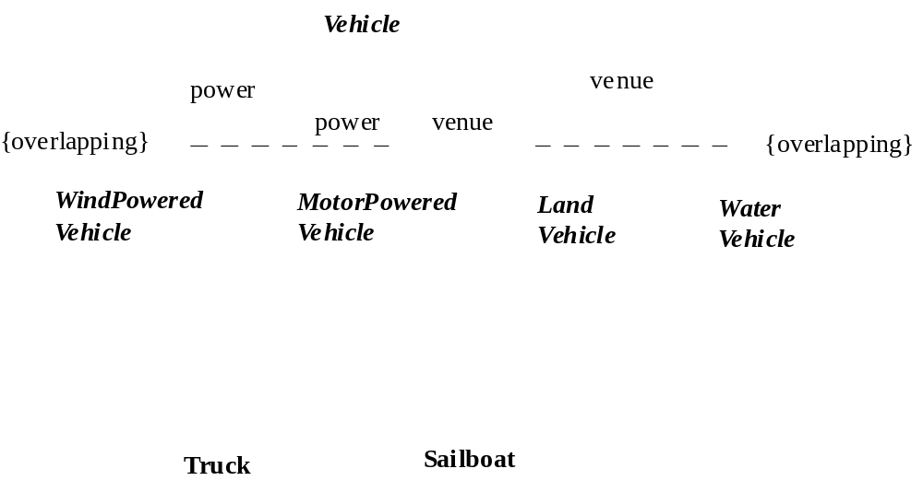
泛化Generalization (续)‏

Slide 51
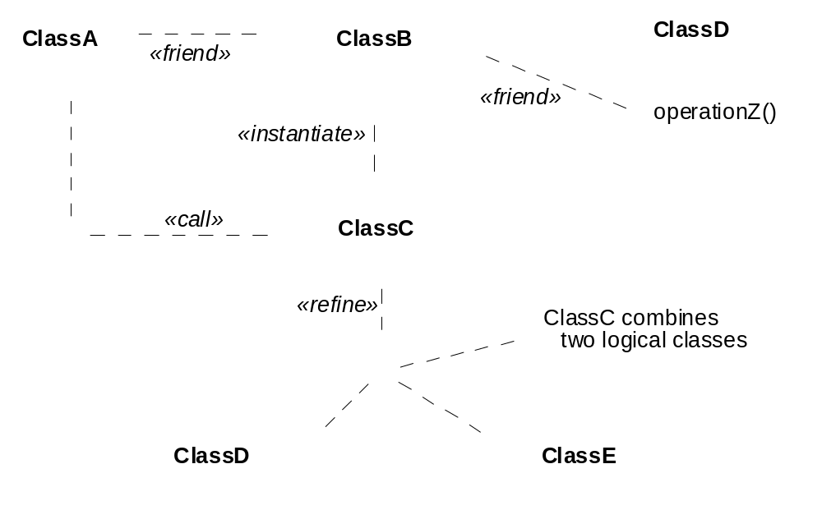
依赖(Dependencies)‏

Slide 52
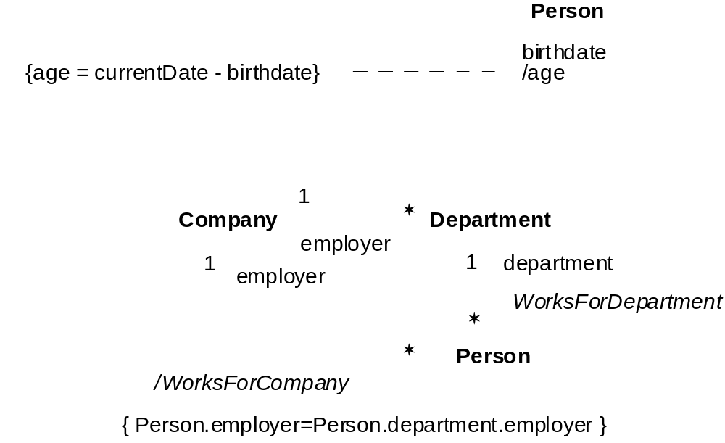
导出属性和关联 attributes derived

Slide 53
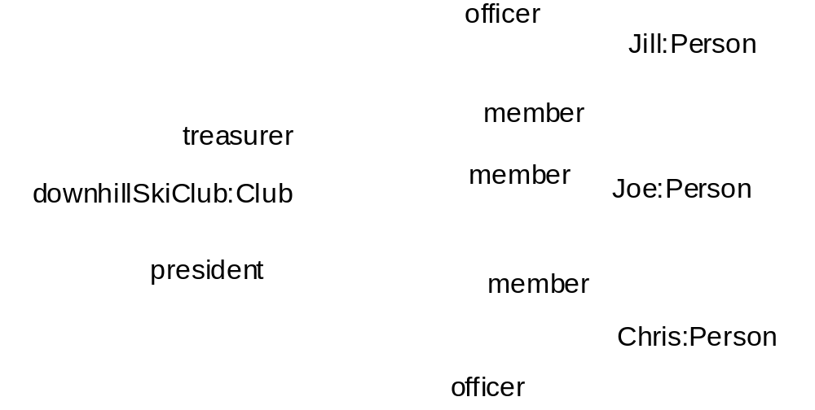
连接(Links)‏

Slide 54
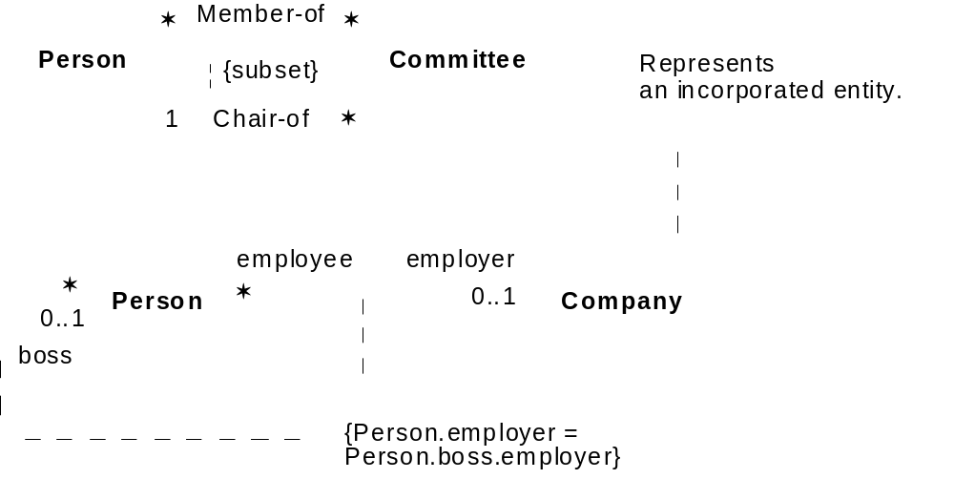
约束和注释

Slide 55
实现图
显示模型的实现方面, 包括源代码结构和运行时实现结构
种类
  组件图Component diagram
  部署图Deployment diagram

Slide 56
组件图
显示软件组件之间的组织和依赖关系
为架构师提供一个开始为解决方案建模的自然形式
小组之间有用的交流工具
组件可以
  用一些类来描述
  用软件制品(e.g., 二进制的, 可执行的, 脚本文件)来实现

Slide 57
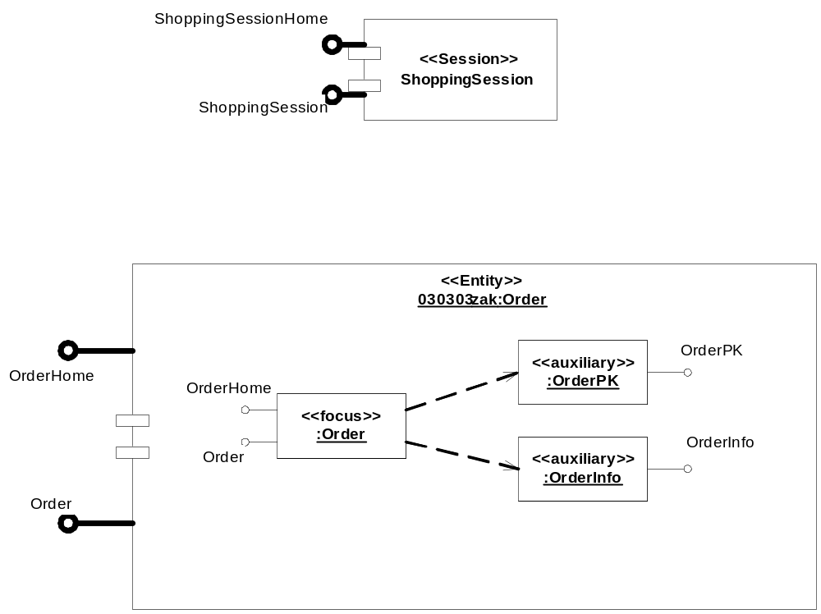
组件(Components)‏

Slide 58
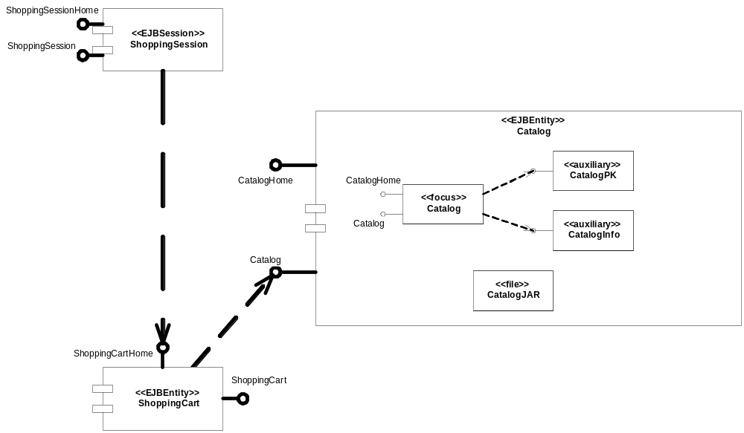
组件图

Slide 59
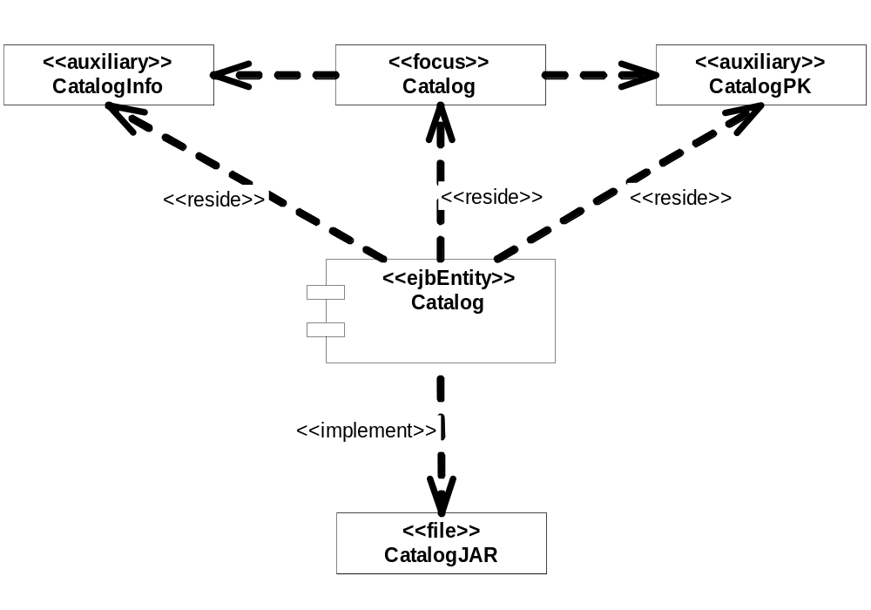
带关系的组件图

Slide 60
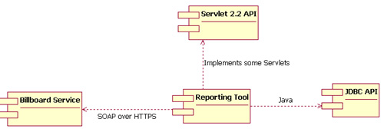

Slide 61
部署图
显示系统在硬件环境中的物理部署
显示系统的各个组件运行的物理位置和他们之间的通信方式
部署图可用来显示哪个组件可以运行在哪个节点(node)上
系统的产品部门人员大量使用该图.

Slide 62
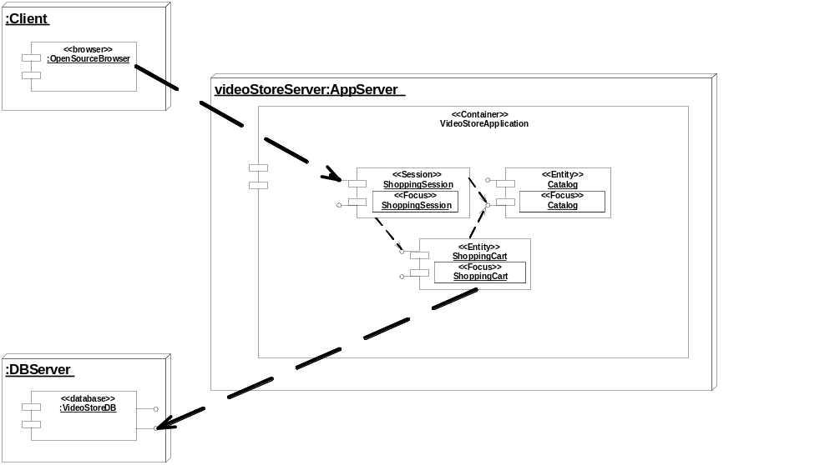
部署图(1/4)‏

Slide 63
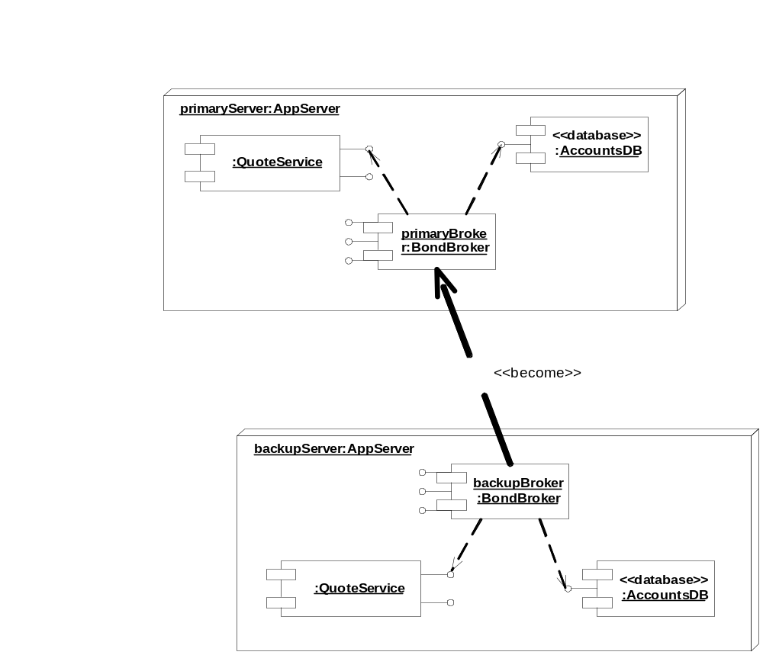
部署图(2/4)‏

Slide 64

部署图(3/4)‏

Slide 65
部署图(4/4)‏
Instance name:
instance type
Nodes
Component
packages
Dependency

Slide 66
什么时候进行结构建模
采用一种自顶向下和自底向上交织的方法对结构建模
  采用”具有架构意义”的类和模型管理元素(包, 模型, 子系统)来描述顶级结构
  随着发现类和关系的细节逐步细化低层结构

Slide 67
用例图
一个用例演示系统提供的一个功能单元
用例图的主要目的是帮助开发者对实现系统的功能需求可视化:
  行为者之间的关系
  不同用例之间的关系

Slide 68


Slide 69
用例图的例子
Relationships
Use Cases
Actors
Actor
Relationship

Slide 70
类图的例子
Class name
Attributes
Operations

Slide 71

例子
Inheritance
One-way
association
Two-way
association

Slide 72
例子 : CD 销售报告
CDSalesReport 类继承Report 类
一个CDSalesReport 关联一个 CD, 但是 CD 类不知道 CDSalesReport 类
CD 和 the Band 类互相知道, 每个类可以和对方一个或多个关联

Slide 73
时序图(Sequence Diagram)‏
时序图表示一个具体用例或者其一部分的详细流程
按时序显示不同对象的调用关系
可以非常详细的显示对不同对象的不同调用

Slide 74


Slide 75
时序图(Sequence Diagram)‏
时序图是二维的:
纵轴按时间顺序显示消息/调用发生的时间
横轴显示被发送消息的对象的实例

Slide 76
例子
Object instances to which the messages are sent
Sequence of messages/calls in time order

Slide 77
时序图(Sequence Diagram)‏
图的顶部, 标识出类的实例(对象), 放进一个方框:
  方框内, 实例名后用空格/冒号/空格( : )隔开写上类名 (例如, myReportGenerator : ReportGenerator)‏
如果一个类的实例向另一个类的实例发送一个消息, 画一条带箭头的线指向接收的实例
  在线的上方写上消息/方法的名称

Slide 78
时序图(Sequence Diagram)‏
可选的, 画一条带箭头的虚线指回引发的类的实例
在虚线上标上返回值

Slide 79
例子
Identify the objects as
class instance name : class name
Draw a line for each message, with an arrowhead pointing to the receiving class instance
Draw a dotted line for each return value, with an arrowhead pointing back to the originating class instance

Slide 80
阅读时序图
从左上方引发序列的类实例开始
沿着图向下每条消息

Slide 81
状态图(Statechart Diagram)‏
状态图对一个类可以处于不同状态以及类在这些状态之间的转换方式进行建模
或许可以说每个类都有一个状态, 但是绝非每个类都应该有一个状态图
只有那些类拥有”有意义”的状态 – 在系统活动中拥有三个以上潜在状态的类 – 才应该对其建模

Slide 82


Slide 83
状态图记号集合
初始点, 用一个实心圆圈表示
状态间的转换用带箭头的线段表示
一个状态, 用圆角矩形表示
一个决策点用一个空心圆圈来表示
终止点用一个圆圈里头套一个实心圆圈来表示

Slide 84
画状态图
从起点开始, 向类的起始状态画一条转移线
在图上任意地方画上状态, 然后用状态转移线连接

Slide 85
活动图(Activity Diagram)‏
活动图显示两个或多个对象在处理一个活动时的规程控制流
活动图可以用来在商业业务单元的层次对高层的业务过程进行建模
或者对低层的内部类的活动建模
相比时序图, 活动图看上去技术成分少, 对于以业务为主的人来说更容易理解

Slide 86


Slide 87
活动图记号
与状态图相似
一个活动图一一个连到初始活动的实心圆圈开始
活动用一个圆边的矩形里面写上名字来表示

Slide 88
活动图记号集合
活动可以用一根转移线连到其他活动
或者连到一个决策点, 根据不同条件再连到不同的活动
终止过程的活动连到终止点
可选的, 可以把活动分组为若干平行”跑道”, 每个”跑道” 表明执行活动的对象

Slide 89
Swimlanes
Initial activity
Transition
lines
Activity = rounded rectangle
Termination
point

Slide 90
小结
UML 可以有效的对大型复杂的软件系统建模
对大多数开发人员来说简单易学, 同时也提供了高级的特性给专家的分析师, 设计师和架构师
能够用一种独立于实现技术的方式描述系统

Slide 91
小节(续)‏
80-90% 的时候只用到10-20% 语法结构
结构建模型描述了一种骨架, 可以通过附加的结构和行为进行细化和扩展
用例建模以面向对象的方式来描述系统的功能需求

Slide 92
http://www.uml.org/ — The official UML Web site
http://www.rational.com/uml/resources/documentation/index.jsp —Offers several different versions of the actual UML specification
http://www-140.ibm.com/developerworks/rational/products/rose —Information on IBM Rational Rose,® A commercial UML modeling tool
http://www-140.ibm.com/developerworks/rational/products/xde —Information on IBM Rational XDE,® a commercial UML modeling tool that is integrated with IBM's Eclipse development platform
http://argouml.tigris.org/ — Information on Argo UML, an .open source UML modeling tool built in Java
http://uml.sourceforge.net/index.php — Information on Umbrello UML Modeller, an open source UML modeling tool for KDE

