Slide 1
Modelling Safety Monitors of Railway Systems by Formal Methods
Dr H. Cai, Dr T.K. Ho, Dr C.D. Zhang
University of Shantou
Shantou, China
Dr W.H. Wu, Dr Z.M. Zhang
Lloyd’s Register Rail (Asia)
Beijing, China

Slide 2
Outlines
The problems of design and implementation of High Integrity Railway Systems
State of the Art
Application of Formal Methods
  Design
  Implementation
  Testing
  Verification and Validation
An Example based on CBI

Slide 3
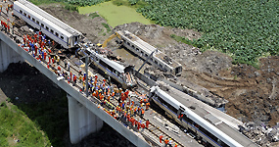
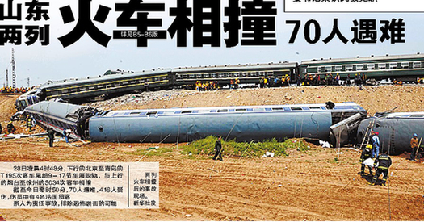
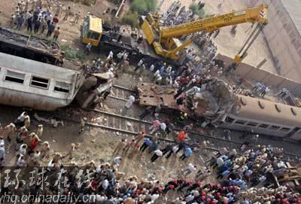
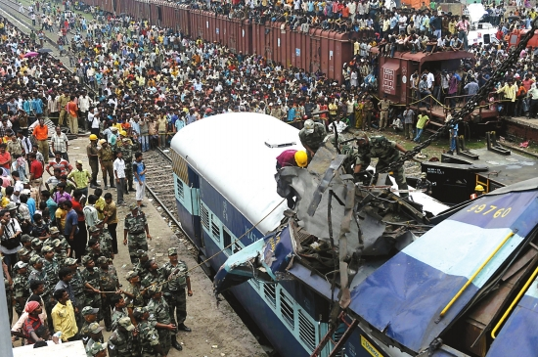
Problems
2011, 70+遇难 温州
Weizhou, China
2008, 70+遇难中国山东
ShanDong, China
2010, 60+遇难, 印度 India
2006, 80+遇难, 埃及 Egypt

Slide 4
Causes
Poor safety management
Human mistakes
Failure of the control system software and ATP, HW
Can they be avoided at all? …. Unlikely
Measures to keep the risk as low as reasonably practicable

Slide 5
Risk Reducations
Object-Oriented Design (OOD) – UML
  “7.23” [NPSSAB, 2013]
Formal Approach
A variety of European Safety Critical Control Systems [Altran Praxis]
French High-Speed Rail Control System [GEC-ALSTHOM ]
Roscoe et al (2010), Woodcock (1991), Hoare (2004), and SCADE (Esterel, 2003)

Slide 6
Application of Formal Methods
Design Phase
The combined descriptions (text, graphic notations and formal notations) are required.
The formal notation is compulsory for the critical part of high integrity transport systems.
The subset of graphic notation is essential to specify the architecture of the systems. It is preferable to use the graphic notations only for essential architecture design and minimize their use for detailed design.
Safety properties need to be considered and specified by formal languages. The formal specifications enable easy verification that the safety properties are solidly held.

Slide 7
Application of Formal Methods
Implementation Phase
The clear mapping between the formal specification and the implementation are required.
It is preferable that the transfer from the formal model to the implementation is carried out manually by an experienced team so that the specification faults and deficiency of the design could be identified, recorded and fixed as early as possible, which will greatly reduce the development cost at the later stage.
During the mapping process, that the implementation matches the design functionally and structurally must be ensured. It should again be accomplished manually by the engineers during implementation.

Slide 8
Application of Formal Methods
Testing Phase
The full coverage of the testing and verification of the formal model including the exception and error handing scenario are required.

Slide 9
Application of Formal Methods
Verification and Validation Phase
Critical safety proprieties of the systems specified in the formal model at design phase should be fully verified.
It is preferable to take the advantage of the certified automatically verifiable toolsets to facilitate the development and enhance the benefits of using formal methods to those safety critical systems. Such as verifiable compiler.

Slide 10
An Example based on a CBI
Design
SRS39 - Under interlocking, the process to release a track section upon fault is put in place with the following exceptions.
  i) all sections occupied and controlled by track circuits
  ii) the section ahead of an entry point
SRS40 - A track section is released when the signal is in 'open' state and a train is approaching the signal. If the signal is in 'closed' state upon fault, the release process only commences after a pre-defined time period after the fault.

Slide 11
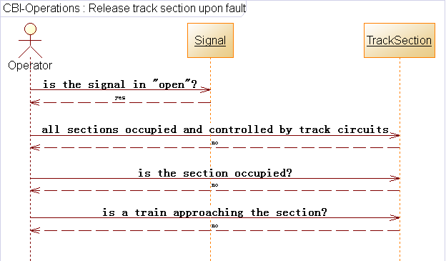
An Example based on a CBI
Design

Slide 12
An Example based on a CBI
Design
ReleaseTrackSectionUponFault
ΔSignalState
s? : Signal; ts : TrackSection; allSections : PTrackSection
s.Status = Open
∃sec :TrackSection| sec∈allSections●sec.Occupied=false
ts.Occupied=false
ts.TrainApproaching=false
S’.Status = Close
Status : {Open, Close}
TrackSection
Occupied : { true, false }
TrainApproaching : { true, false }

Slide 13
An Example based on a CBI
1 ----------------------------------------
2 -- It is the implementation of
3 -- schema ReleaseTrackSectionUponFault
4 ----------------------------------------
5 Procedure Release_Track_Section_Upon_Fault
6 (sec: in Track_Section;
7 all_Secs : in Track_Sections;
8 s: in out Signal)
9 --#pres.Status=Open;
10 is
11 All_Secs_Occupied : Boolean;
12 begin
13 All_Secs_Occupied = True;
14 for i in Integer range 1..all_Secs.Count loop
15 if not all_Secs(i).Occupied then
16 All_Secs_Occupied = False;
17 end if;
18 exit when not All_Secs_Occupied;
19 end loop;
20 -- the condition “S.Status=Open” will be guaranteed by all
21 -- the callers of this procedure (verified by SPARK Tools).
22 if not (All_Secs_Occupied or
23 sec.Occupied or
24 sec.Train_Approaching)
25 then
26 S.Status = Close;
27 end if;
28 end Release_Track_Section_Upon_Fault;
Mapping Design to Implementation
ReleaseTrackSectionUponFault
ΔSignalState
s? : Signal; ts : TrackSection; allSections : PTrackSection
s.Status = Open
∃sec :TrackSection| sec∈allSections●sec.Occupied=false
ts.Occupied=false
ts.TrainApproaching=false
S’.Status = Close
Status : {Open, Close}
TrackSection
Occupied : { true, false }
TrainApproaching : { true, false }

Slide 14
Discussion
Cost vs Benefits
Real-time Train Safety and Collision Prevention System (RTSCPS) – a medium-term cost effective solution to addressing the current safety risk associated with signalling systems. [IRSC2013]
Safety monitor for onboard ATP – continuous monitor of the output of onboard ATP with respect to the predefined safety conditions of the operation environment. [ICRE2014]
PTC [Association of American Railroad]

Slide 15
Future Work
Application of Formal Methods for Safety Monitors
Real-time Train Safety and Collision Prevention System (RTSCPS) – a medium-term cost effective solution to addressing the current safety risk associated with signalling systems. [IRSC2013]
Safety monitor for onboard ATP – continuous monitor of the output of onboard ATP with respect to the predefined safety conditions of the operation environment. [ICRE2014]
PTC [Association of American Railroad]

