Slide 1
Requirements and OO Modelling
蔡浩

Slide 2
课程介绍 Overview
课程要求
软件工程简介
  软件工程概述
  软件开发过程模型
Requirements 需求分析
OO Modelling and UML
  Why OO?
  Brief History of UML
  UML
Patterns & Frameworks
  Reuse Driven Design软件复用
  Patterns
  Frameworks and Templates
Component Based Design软件构件
  Components（CORBA / CCM， EJB，COM）软件构件技术和软件体系结构
  Web 服务
  Middleware
  MDA
Coding编码
Testing 软件测试
  软件测试及自动化
  软件质量模型和质量保证
软件知识产权和自由软件
CMM简介
软件工程工具介绍

Slide 3
需求 Requirements

Slide 4
需求分析概要
需求分析的任务
需求获取技术
需求规格说明书 (Specification)
需求描述技术 (OO, Formal Methods)

Slide 5
需求分析的任务
1. 发现弄清用户（客户）对系统确切要求
通过跟客户(clients)、系统用户、系统管理员和其他相关人员的沟通
通过领域分析
通过对以前的以及相似系统的调查
需求分析人员组成 (SE, Customer-SE, Users etc)
2. 规范的表达需求

Slide 6
识别和请教相关人员
如果没有考虑到那些很可能被这个系统的引入而受影响的人们，就很有可能会丧失很重要的需求。
识别相关人员，跟他们讨论系统的问题，令他们觉得他们也参与到了开发的过程。

Slide 7
使用商业关注去激发需求导出
如果一个系统是有用的，它必须为商业的关注的问题出一份力。
如果识别了商业关注而且用它们作为一个激发需求导出的过程, 那么对这个系统适合客户的要求是很有信心的。

Slide 8
从众多角度中收集需求
如果需求仅从单个的角度中收集，那么它就不大可能会适合其他相关人员的需求。
这些角度有助于组织需求导出和形成需求规范。

Slide 9
重用需求 requirements re-use
节省时间和金钱。
降低风险
重用需求更有可能让所有相关人员容易理解
需求的重用有可能指引生命周期其他活动的附加重用

Slide 10
需求挑战
“不错，但是”的综合症源于用户无法象对物理设备那样去体验软件
“需求爆炸”，你发现的需求越多，你意识到未发现的需求更多。
“用户和开发人员”的综合症反映了一个更深层次的不同，使沟通更加困难了。
“前人的罪过”的综合症是顾客和开发人员基于以前的经历而互不信任，所以顾客所有的东西都想要，但是开发人员什么都不兑现。

Slide 11
“不错，但是”
用户第一次看见系统，第一个反应要不是说“哇，这个很棒”就是说“不错，但是现在我看到了，那么能不能再增加点这个呢…？”
这种反应仅仅是人的天性。
必须把这些“但是”及早去除。
预先设想有“但是”而且多花些时间和资源去根据用户反馈来计划。

Slide 12
“被遗漏的需求”
开发人员为确定他们什么时候完成了需求导出而挣扎
  我们怎么知道我们是否已经导出了所有的需求，或者至少我们已经找出了足够的需求？?
  就好象问一个考古学家“还有多少个没有发现的遗址”
通过定义该软件系统要解决的商业问题来确定要花费多大的努力来导出需求
使用一些技巧有助于发现这些“被遗忘的需求”和得到相关人员去认可需求.

Slide 13
“用户和开发人员”
用户不知道他们要什么或者说他们无法表达.
直到开发人员交付他们他们所说想要的，用户才知道他们想要什么
开发人员认为他们对用户的问题的了解比用户自身要多
要认识到顾客只是其领域的专家
提早提供选择性的导出技巧 ： 图解, 角色，原型等等.
把开发人员置于用户的位置

Slide 14
正视 “前人的罪过”
无论你喜欢与否，你的顾客和开发人员都记得在过去发生了什么
  高质量的达到客户预期的软件产品就是不一样
  上一个项目的需求不着边际或者交付的产品没有达到预期
需要逐渐建立信任: 哪方面都不要承诺太多：功能特性、时间以及预算。
及早交付用户最需要的最高优先级的功能特性。

Slide 15
需求导出技术
面谈以及调查问卷
Brainstorm和精减意见
插图
角色
需求研讨会
原型

Slide 16
技巧: 面谈
简单直接的技巧
一般性的问题关于需要为用户开发什么系统
聚集一些共同的需求将建起“需求知识库”
调查问卷无法代替面谈，但是可以先于或者后于面谈
Notes:
Examples of context-free questions?

Slide 17
面谈: 一般性的问题
目标是为了防止用户对问题的反应有偏见
例如:
  谁是顾客 (Clients)?
  谁是用户 (Users) ?
  谁是用户的顾客?
  他们的需求不同吗?
  还有别的地方能找到解决这个问题的方法吗？
经过询问这些问题以后，一些隐含的答案很容易就发掘出来了。

Slide 18
面谈: 展示时间
建立顾客和用户的概况
评估问题
了解用户环境
概括对问题理解
分析员对顾客问题的意见
评估你的解决方案 (如果适用)
Notes:
Establish Customer or User Profile
Name:
Company:
Industry:
Job Title:
What are your key responsibilities?
What outputs do you produce?
For Whom?
How is success measured?
Which problems interfere with your success?
What, if any, trends make your job easier or more difficult?
Assessing the Problem
For which problems do you lack good solutions?
What are they? (Hint: Keep asking, “Anything else?”)
For each problem ask:
Why does the problem exist?
How do you solve it know?
How would you like to solve it?
Understanding the User Environment
Who are the users?
What is their educational background?
What is their computer background?
Are users experienced with this type of application?
Which platforms are in use?
What are your plans for future platforms?
What are your expectations for usability for this type of product?
What are your expectations for training time?
What kinds of user help do you need?
Recap the Understanding
You have told me:
(List customer described problems in your own words.)
Analyst’s Inputs on Customer’s Problems
(Validate or Invalidate assumptions)
For each problem ask,
Is this a real problem?
What are the reasons for the problem?
How do you currently solve the problem?
How would you like to solve the problem?
How would you rank solving these problems in comparison to others you’ve mentioned?
Assessing Your Solution (if applicable)
What if you could
How would you rank the importance of these?

Slide 19
技巧: Brainstorm(集思广益)
Brainstorm包括想法的产生和想法的精减
最具有创造性的的想法通常是把看似没有关系的想法结合起来而产生的
采用各种投票技巧对产生的想法确定优先级
尽管现场的Brainstorm是首选，但是以网络为基础的Brainstorm也是一个可行的选择

Slide 20
Brainstorm的规则
不要有批评和辩论
让你的想象力飞翔
产生尽可能多的想法
修改和组合想法
想法的精减
  去除那些不值得深入讨论的想法
  把一些相似的想法合并成一个
把剩下的想法区分优先顺序
Notes:
Banning criticism and banning debate is not just an attempt to “be nice”. It is necessary to not squelch creative thinking.

Slide 21
技巧: 图解
按照预定的计划彩排设想的一系列系统活动和 屏幕模拟
辨认参与者，解释一下他们发生了什么事情以及如何发生的
把图解简单化而且易于修改

Slide 22
技巧: 角色表演
角色表演允许开发人员从用户的观点出发亲身体验他们的世界
现场图解或者体验
当你进行的时候将产生系统活动以及屏幕模拟

Slide 23
技巧: 需求研讨会
也许是引出需求的最有力的技巧
把所有的重要的相关人员召集起来一段时间，这段时间是短的而且是高度集中的。
外请一位富有需求管理经验的组织者
可以把面谈、集思、图解和角色表演结合起来。

Slide 24
筹备研讨会
把研讨会的概念介绍给相关人员
确保参与的都是“合适”的相关人员
后勤保障
  设法防止墨菲法则 (Anything that can go wrong will go wrong)
  考虑一下旅行、照明甚至甜食。
热身材料
  具体项目信息
  思想准备

Slide 25
组织者的角色
运用专业的、客观性的语调
准时开始和结束会议
会议纪要
建立和执行会议“规则”
介绍一下目标和议程
确保小组“不跑题”
促成决议和达成一致性意见
确保所有的相关人员都参加了而且听取了他们的想法
抑制破坏性的和没有建设性的行为
研讨会后接下来的任务以及责任到人

Slide 26
研讨会议程
在研讨会前把议程拟订好
权衡: 尽量按照议程,但是不要那么呆板的依照它 – 特别适当一个很好的讨论正在进行的时候
叫外卖,然后吃一个轻松的工作餐

Slide 27
开展研讨会
顾及人们的行为
  不要“攻击”其他的参与者
  不要夸夸其谈
  不要迟到
给每一个参加人员三次机会
    1 是迟到
    1 是夸夸其谈
    1 是过分攻击
  合适的时候组织者也一样

Slide 28
技巧: 原型 prototype
完成软件系统的一部分，是为了有助于开发人员、用户和顾客能更好的了解系统需求
关注一下“模糊”的需求：定义不明确或者理解不准确
有效使用构建原型的工具 (PowerPoint, AppInventor，Axure RP 等等)

Slide 29
其他计划的方法

Slide 30
Gantt图
列出任务
形象地描述了任务中的依赖性
闲适每一个任务的开始和持续时间
极大依赖于对这些的预测:
  涉及的活动
  需要的努力和时间

Slide 31
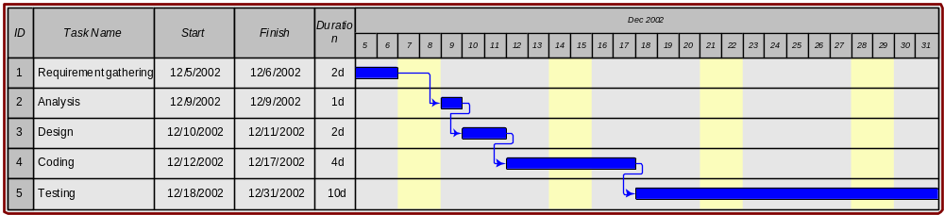
Gantt图例子
程序员正在做一个小软件项目
Explicit start time, end time, and duration (in days )
Explicit calendar bar

Slide 32
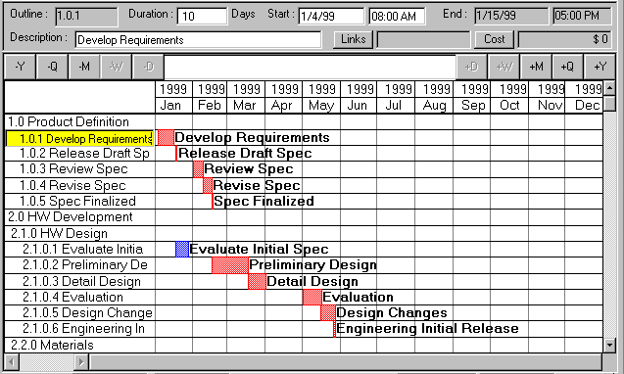
另一幅Gannt图

Slide 33
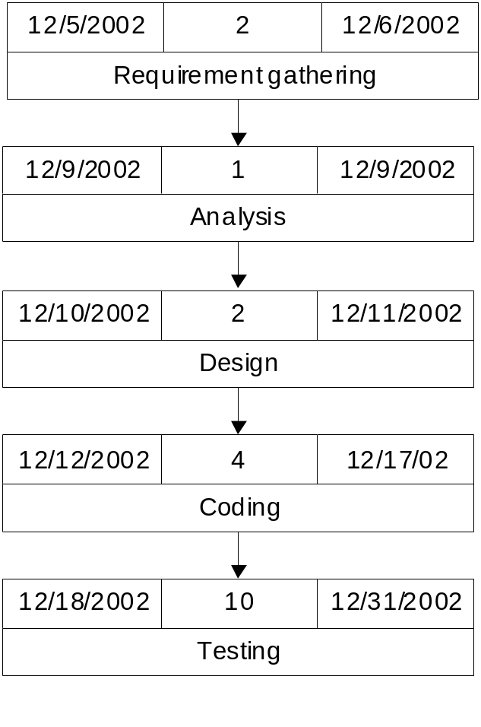
Pert图
Duration
Start time
Task
End time
Gantt图的替代方案
不同的角度
  对于依赖性的关注更甚于时间
没有固定的格式

Slide 34
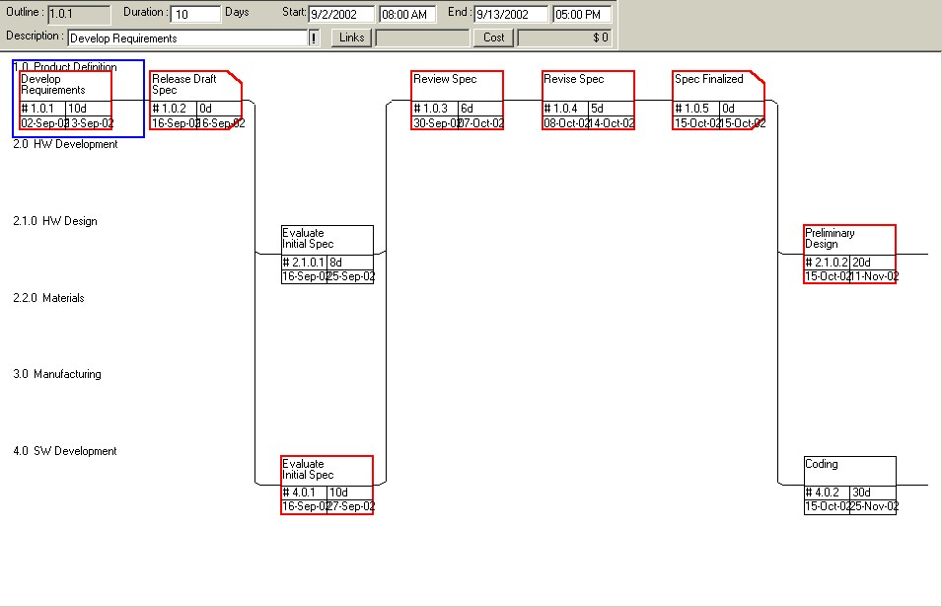
另一幅Pert图

Slide 35
那你是怎么知道一个任务到底需要多长时间呢？

Slide 36
What Business Needs from Software
Function
  Does what is says on the box
  Reliable, secure, robust
Maintainable
  Adaptable and flexible to changing requirements
  Changes have low impact
Reusable
  Each product has many variants
  Readily ported to new domains
  Interoperable
  Platform Independent
Cost Effective
  Getting the requirements right early on saves money

Slide 37
How to Get Flexibility
Build with pluggable parts
  Separate out variability
  Provide conformance rules
  for plug-ins
Banking
System
Account
Type X
B2C
Solution Z
Product
Type Y

Slide 38
How to Get Reusability
Build generic components
  Kits of reusable parts
  Generic templates
  Product line architectures
Generic
Banking System
China
Banking System
US Banking System
Standard UK
Banking System

Slide 39
Getting Cost Effectiveness
Expose gaps and inconsistencies early
Make abstract models accurate not fuzzy
Be precise!
  Enables requirements to be traced through entire development process
  Supports sophisticated analysis tools at the modelling level

Slide 40
OO Modelling
Powerful abstractions are needed to support flexible designs
Objects are one such abstraction, and these are well-supported by programming languages
However, in practice, only modelling languages can support the right level of modularity necessary to support large-scale reuse and maintainability

Slide 41
Other Advantages of Models
Visual: easier to comprehend large system models.
Abstract: abstract away from how the system is to be built. Concentrate on what the problem is about.
Platform independent: not tied to a particular implementation technology.
Approachable to customers.
Can be tailored to specific domains.

Slide 42
Further information
A useful book which presents OO development case studies are:
  Applying UML and Patterns, Craig Larman, Prentice Hall, 1998
The best book for advanced techniques, but 800 pages long!
  Catalysis, Desmond D’Souza and Alan Wills
We will adopt a use-case (用例) driven, iterative development process similar to that used by these books

Slide 43
The Unified Modelling Language
The Unified Modelling Language (UML) was developed jointly by Grady Booch, Ivar Jacobson and James Rumbaugh at Rational Software
A language for “specifying, visualising and documenting software systems”:
  Class and object modelling
  Component modelling
  Business processing modelling with use cases
  Concurrent and real-time system modelling
Encapsulates best practice techniques into a single, standardised language

Slide 44
Background to UML
Prior to UML there were no clearly leading OO modelling languages
Users had to choose from among many similar modelling languages with minor differences in expressive power:
  Commonly accepted concepts were expressed using slightly different notations and terminology (术语 )
  This discouraged new users from entering the OO market
  Tool developers were unsure about which method to support
In 1996, the Object Management Group (composed of industry OO practitioners) put out a call for proposals for object methods suitable for standardisation

Slide 45
History
Booch (Object-Oriented Design), Rational Software, Rumbaugh (OMT), General Electric, Jacobson, and Eriksson joined forces to develop the UML
January 1997, various organisations submitted proposals for a methods standard to the OMG task force
October 1997, UML version 1.0 was accepted for standardisation
To date, UML is the de-facto world wide standard modelling language for software and system modelling
Move towards version 2.0 around 2001-2.

Slide 46
UML 2.0 and the OMG
Major Industrial Stakeholders
Major Milestones
UML 2.0
UML 1.x
60+ Companies signed a letter of intent to implement the OMG UML 1.X/2.0 Standard. These include:
Rational
IBM
Unisys
Sun MicroSystems
Siemens
Telelogic
Iona
Computer Associates
Hewlett Packard
Motorolla
Microsoft
UML 2.0 Call for Proposals
Dec 2000
UML 1.3 Standard Defined
Early 1999
Initial Submissions
Jul 2001
UML 1.4 Standard Released
Mid 2001
Revised Submissions
Aug 2002

Slide 47
Artefacts of UML
The UML offers a number of graphical notations, each of which provide a different view of the system being modelled:
  Use Case diagrams
  Static modelling:
    Class diagrams
    Object diagrams
  Behaviour modelling
    State charts
    Activity diagrams
    Interaction diagrams:
      Sequence diagrams
      Collaboration diagrams
Packages
Implementation diagrams:
  Component diagrams
  Deployment diagrams

Slide 48
Development Processes
The UML provides a standard language for describing object-oriented systems
It does not describe a standard development process
Reasons include:
  The need to ensure separation of concerns;
  Recognising that different development processes will be used in different problem domains and by different people.
However, it is possible to identify a fairly typical view of best practices, basic activities and models, based on an iterative, use-case driven development process

Slide 49
Use Case (用例）Driven Development
Use Cases
Requirements
Requirements Specification
Conceptual
Models
Contracts
Detail
Design
Design Models
Collaborations
Code
Implementation

Slide 50
Iterative Development
An iterative life-cycle is based on successive enlargement and refinement of a system through multiple development cycles of analysis, design, implementation, and testing
Each cycle tackles a relatively small set of requirements, proceeding through the cycle
The system grows incrementally as each cycle is completed
This is in contrast to the classic waterfall life-cycle in which emphasis is placed on completing the whole of each activity before starting the next
Advantages of iterative development are:
  Complexity is minimised;
  Early feedback is generated.

Slide 51
Use Cases (使用例子）
Use cases describe the relationship between the system being modelled and the outside world
They describe the functionality the system has to offer from the perspective of the external participants of the system
Developed by Ivar Jacobson during the 90's, they are now one of the best known approaches to documenting requirements

Slide 52
Use Case Example
外部行为者
系统
OpenAccount
Actor
Deposit Funds
Banker
Customer
Use-case
Withdraw Funds

Slide 53
Use Case Components
Actors: Constitute anything that is external to the system and interact with it. Users may obviously serve as actors, however any other external object can also be an actor, e.g. sensor

Slide 54
Use case components
Use cases: A description of an interaction between an actor and the system.
Associations: relate a use case to an actor
Withdraw Funds
OpenAccount
Banker

Slide 55
Use Case Descriptions
Use Cases can be described in 2 main ways:
  Scenarios
  Goals or contracts
A Scenario describes a typical sequence of events that occur during the interaction
A Goal based approach focuses on what the interaction aims to achieve, and the conditions under which the it can occur
Scenarios are good for discussing requirements with customers, goals are a powerful way of focusing on the essential purpose of the Use Case

Slide 56
Scenario Example
  Name: Withdraw Funds
  Description: The account holder inserts their card in the cash machine. They enter their pin number. They enter the amount of cash to be withdrawn. A check is made to ensure that the amount can be withdrawn.The machine issues them with the amount of money. The amount of money is debited from the account.
  Exceptions
  The card/pin/account is invalid. There are insufficient funds. The machine has run out of cash. Result: An appropriate error message is outputted.
A description of the chain of events in the interaction
Exceptional or alternative courses of events

Slide 57
Goal-oriented Example
  Name: Withdraw Funds
  Inputs: accno, pin, amount
  Outputs: None
  Participants: Account Holder, Bank
  Goal:
  The amount is debited from the account
  The Account Holder receives the money
  Pre-condition:
  The account exists, the PIN is valid, the amount will not exceed the account’s overdraft limit
A Goal is equivalent to a Post-condition
If a pre-condition is false, then the result can also be specified using pre- and post-conditions

Slide 58
Uses and Extends
Use Case Diagrams provide two additional relationships between use cases:
  Extends: A relationship from one use case to another that specifies how the behaviour defined for the first use case can be inserted into the behaviour defined for the other
  Uses: the behaviour defined for one use case employs the behaviour defined for the other
See Larman for examples

Slide 59
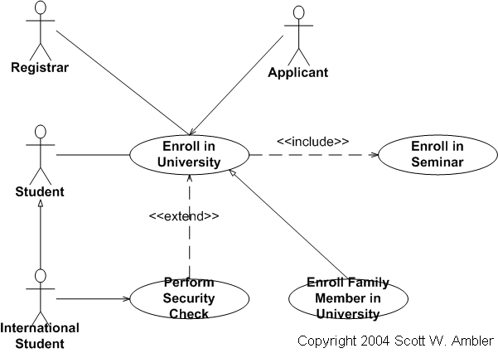
Uses and Extends

Slide 60
Use Cases can be Refined
Use cases can describe behaviour at different levels of abstraction
Top level use case
Buy Petrol
Finer grained use case, or step in a scenario
Start Pump
Fill Tank
Pay at Till

Slide 61
总结 Summary
Requirements 需求分析
OO Modelling and UML
  Why OO?
  Brief History of UML
  UML
Open Source Tool:
http://argouml.tigris.org/
Sommerville
http://www.software-engin.com/
http://www.cs.st-andrews.ac.uk/~ifs/Books/SE9/

