Slide 1
UML Design - Design Models and Pattern 设计模型和模式
屈建勤， 蔡浩

Slide 2
课程介绍 Overview
课程要求
软件工程简介
  软件工程概述
  软件开发过程模型
Requirements 需求分析
OO Modelling and UML
  Why OO?
  Brief History of UML
  UML
Design, Patterns & Frameworks
  Reuse Driven Design
  Patterns
  Frameworks and Templates
Component Based Design软件构件
  Components（CORBA / CCM， EJB，COM）软件构件技术和软件体系结构
  Web 服务
  Middleware
  MDA
Coding编码
Testing 软件测试
  软件测试及自动化
  软件质量模型和质量保证
软件知识产权和自由软件
CMM简介
软件工程工具介绍

Slide 3
UML and Design – Collaborations

Slide 4
Design
Use Cases
Requirements
Requirements Specification
Conceptual
Models
Contracts
Detail
Design
Design Models
Collaborations
Code
Implementation

Slide 5
Design - assigning responsibilities
Contracts (合约) show what the system is required to do without making any assumptions about how the operations are to be implemented
Interaction diagrams (交互图）are the means by which a designer can describe how the contracts are to be implemented in terms of communicating objects
Choices have to be made about the responsibilities that are to be assigned to the objects in a system
Poor choices can lead to system components which are fragile and hard to maintain
A skilful implementation has it roots in the principles of good object-oriented design

Slide 6
Responsibilities 责任
Booch and Rumbaugh define responsibility as a ``contract or obligation of a type or class'‘
The responsibility of an object can broadly be divided into the following [Larman]:
  doing;
  knowing.
Doing includes: doing something itself, initiating action in other objects
Knowing includes: knowing about private encapsulated data, knowing about related objects, knowing about things that it can calculate

Slide 7
Assigning responsibilities
Applying for a job
Thinks – I need a job
10 (later)
thinks: I need a
Software Engineer
1
chris.acceptApplication
(myApplication)
jo: Person
chris: Secretary
pat: Manager
2
: Application
intray: WorkTray

Slide 8
Assigning Responsibilities 责任分配
An appropriate distribution of responsibilities:
  Changes have restricted impact
  Objects can be reused elsewhere
0
thinks: I need a job
10 (later)
thinks: I need a
Software Engineer
1
chris.acceptApplication
(joApplic)
11 chris.nextApplicn()
jo: Person
chris: Secretary
pat: Manager
12 intray.get()
2 intray.put(joApplic)
11 intray.get()
joApplic: Application
intray: WorkTray

Slide 9
Collaboration Diagrams 协作图
Collaboration diagrams are what UML uses to describe the assignment of responsibilities责任分配.
They describe the behaviour of a system in terms of collaborating objects 协同对象
Objects collaborate by sending and receiving messages:
  Messages requesting certain services to be performed
  Messages notifying other objects of changes in the system state
  Messages relating to a thread of control
Collaboration diagrams are primarily used at the design level to describe how the system operations described by use cases are to be realised

Slide 10
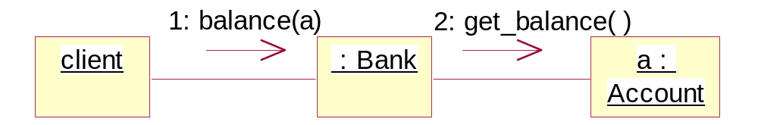
Collaboration diagrams协作图
Collaboration diagrams illustrate object interactions in a graph or network format:

Slide 11
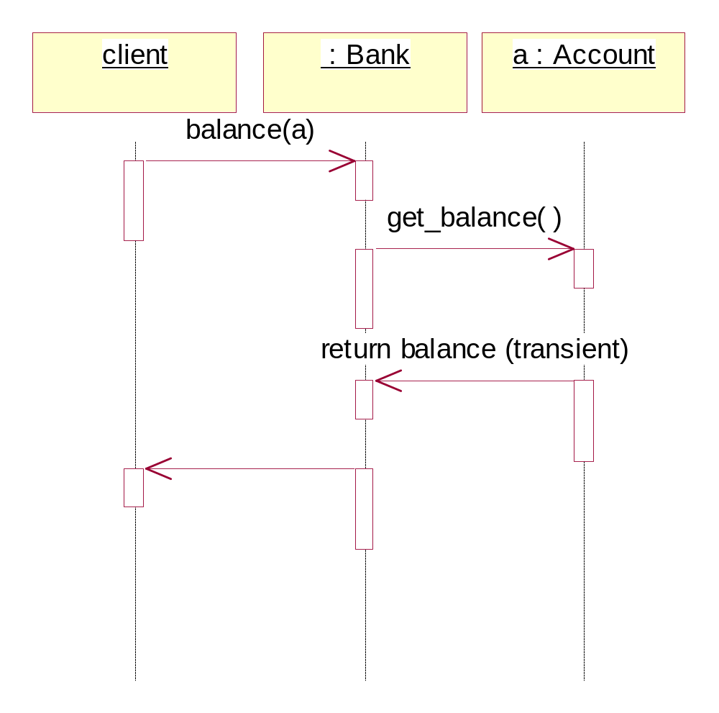
Sequence Diagrams 时序图
Sequence diagrams illustrate interactions in a fence format:

Slide 12
Role of interaction diagrams
Interaction diagrams are a design tool:
  They show how contracts are to be implemented in terms of message passing between objects;
  They illustrate the means by which responsibilities are distributed amongst the objects in a system;
  They are readily implementable in an object-oriented programming language such as Java.

Slide 13
Contracts and Collaborations
  Collaborations are implementations of contracts
  Visually a contract can be viewed as a message to a system level class:

Slide 14
Objects
Interaction diagrams show objects, not classes
a : Account
1: notify()
c : Customer
accno = 123 balance = 0
name = Hao address = STU

Slide 15
Links
A link is a connection point between two instances
On an object diagram, a link represents an instance of an association
On an interaction diagram, a link is the means by which instances send messages to each other
Navigation and message passing are possible because both instances have knowledge of each other

Slide 16
Transient Links 短暂连接
Transient links are short lived links between objects which are not instances (实例）of associations, but which correspond to one object gaining access to another through another route
There are 4 types of transient links:
  Objects passed as a parameter of a message
  Objects declared as local variables
  Global variables
  An object sending a message to itself

Slide 17
Link Example
client
: Bank
a : Account
balance(a)
get_balance( )
Normal Link (Association instance)
return balance (transient)
Transient link (Value passed in parameter)
Normally dotted

Slide 18
Messages
Messages between objects are represented via a labelled arrow on a link line
Any number of messages may flow along this link
UML has a standard syntax for messages:
  return := message(param : paramType) : returnType
Note, types are often suppressed for brevity
Return value – could be an object
Message name – corresponds to method

Slide 19
Iteration 重复
An iterated message denotes that the message is sent to a collection of instances
For example, to calculate the total assets of the bank, the balance of each account must be queried:
The multiobject icon is used to denote a collection of instances, whilst the * means that the message is iteratively sent to all the instances in the collection
1: assets()
2: *get_balance( )
client
: Bank
:
Account

Slide 20
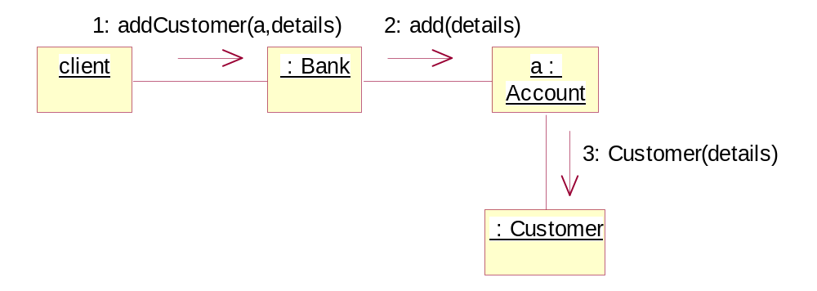
Creation
A creation message to an object is denoted by the object’s class’s constructor
The message may include parameters, indicating the passing of initial values
Create is analogous to new in Java
Constructor for Customer
{created}

Slide 21
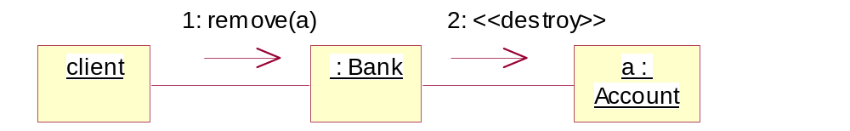
Deletion
Delete is denoted by and appropriate stereotype 固定形式, e.g. <<destroy>>:
{deleted}

Slide 22
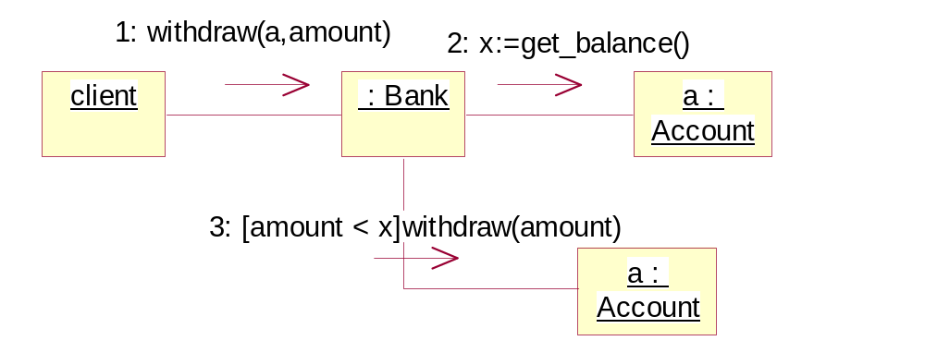
Conditional message
A conditional message is shown by a sequence number with a conditional clause in square brackets
The message is only sent if the clause evaluates to true:
Condition

Slide 23
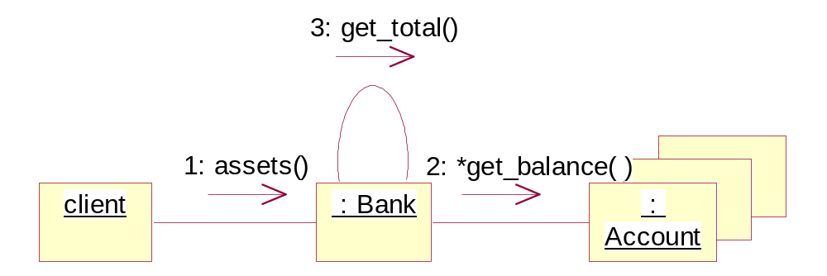
Messages to self
A message can be sent from an object to itself
This is useful when it is important to clarify the internal details of the object’s implementation:

Slide 24
Message Types
There are many types of messages in UML
Some examples:
  Synchronous messages (full arrow head)
    In this situation, the sender waits until the receiving object has finished processing
    Thus, there is a single thread of control, which originates from the first call to the system
  Asynchronous messages (half arrow head)
    This implies that the sender may continue processing once the message has been sent
    Used to describe multiple threads of control
Default

Slide 25
Interaction diagrams and snapshots
An interaction diagram (particularly a collaboration diagram) can be viewed as a pair of snapshots, overlaid with messages:
  Draw a snapshot satisfying the pre-condition of an operation
  Overlay it with a snapshot satisfying the post-condition of the operation
  Add messages to show the sequence of messages that move the system from the pre-condition to the post-condition

Slide 26
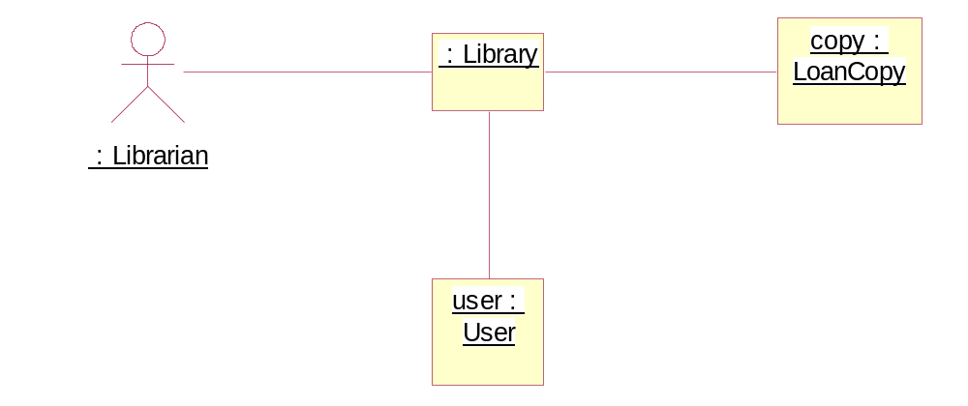
Example – Borrowing a Copy
Pre-condition:

Slide 27
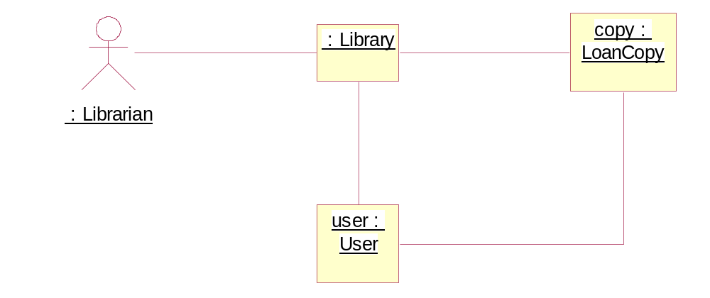
Example – Borrowing a Copy
Post-condition:
Then add messages as shown earlier.
New!

Slide 28
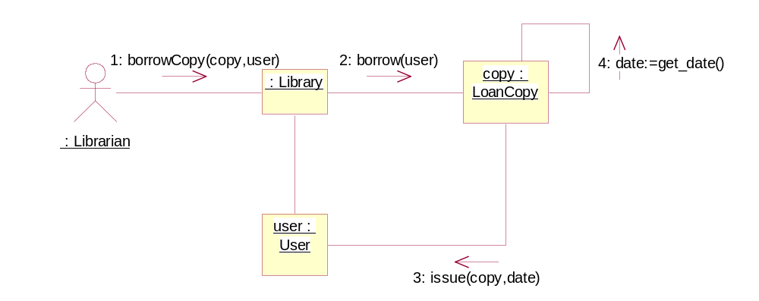
Borrow collaborations

Slide 29
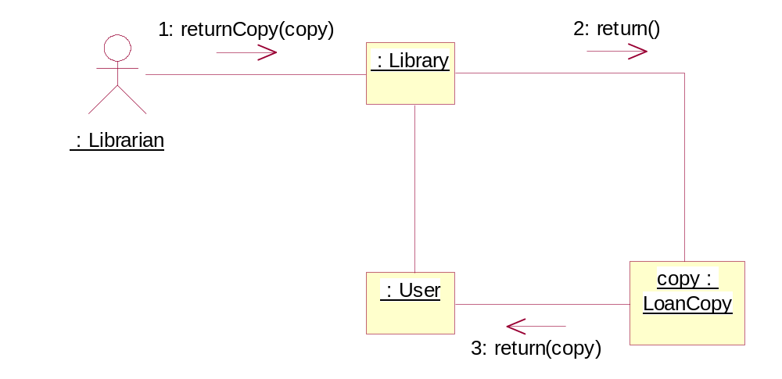
Other Collaborations

Slide 30
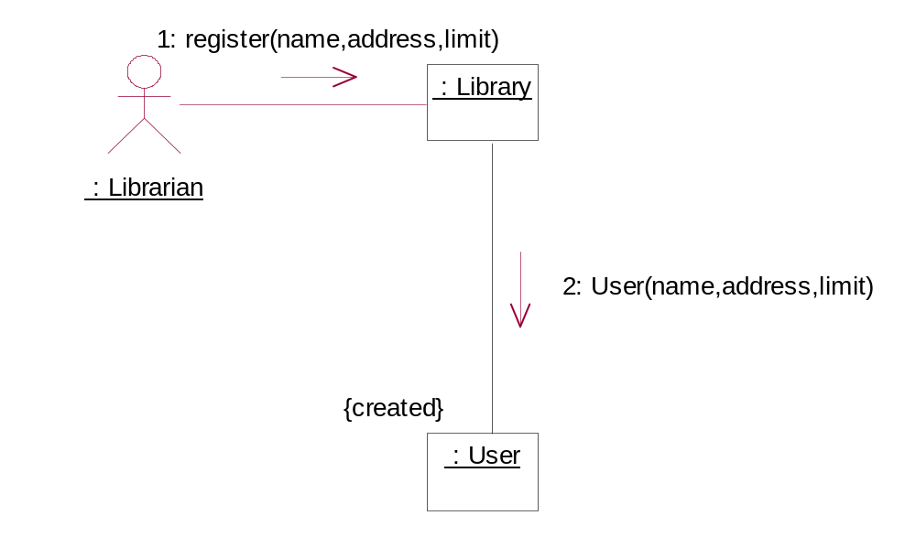
Register

Slide 31
General principles of assigning responsibilities
  The skilful assignment of responsibilities is extremely important in object-oriented design;
  Determining the assignment of responsibilities often occurs during the creation of interaction diagrams;
  A good design will partition the responsibilities cleanly so no object does the work of another object

Slide 32
Guiding principle 1 - low coupling耦合
How to support low dependency and increased reuse?
Solution: Assign a responsibility so that coupling remains low
Coupling is a measure of how strongly one class is connected to, has knowledge of, or relies upon other classes. If coupling is too strong, then the design might suffer from the following problems:
  Poor maintainability -- changes in local classes will require changes in many other classes;
  Opportunities for reuse will be reduced -- dependent classes will also have to be reused.
Design patterns can help (see later)!

Slide 33
Guiding principle 2 - high cohesion内聚
How to keep complexity manageable?
Solution: Assign a responsibility so that cohesion remains high
In terms of object-oriented design, cohesion is a measure of how strongly related and focused the responsibilities of a class are
A class with highly related responsibilities, and which does not do too much work, has high cohesion
A class with low cohesion does many unrelated things or too much work
Such classes are hard to understand and hard to maintain
It is likely that responsibilities will be need to delegated elsewhere

Slide 34
Guiding principle 3 -facade
Who should be responsible for handling a system event?
Solution: Assign the responsibility for handling a system event message to a class representing one of the following:
  The overall ``system'' (facade controller);
  The overall business or organisation (facade controller);
  Something in the real-world which is active (for example a person) that might be involved in the task (role controller);
  An artificial handler of all system events of a use case (use case controller)

Slide 35
Guiding principle 4:Bloated controller
If a controller has too much responsibility it is likely to suffer from low cohesion. Signs include:
  There is only a single controller class receiving all system events, and there are many of them;
  The controller itself performs many of the tasks necessary to fulfil the system event, without delegation;
  A controller maintains significant information about the system or domain, which should be distributed elsewhere.
Bloated Controller
100’s of variables
100’s of methods

Slide 36
There are several cures: add more controllers, design the controller so that it delegates to other controllers.
E.g. a reservation system might have the following controllers: MakeAReservation, ManageSchedules, ManageFares.
How might we apply this to the Library?

Slide 37
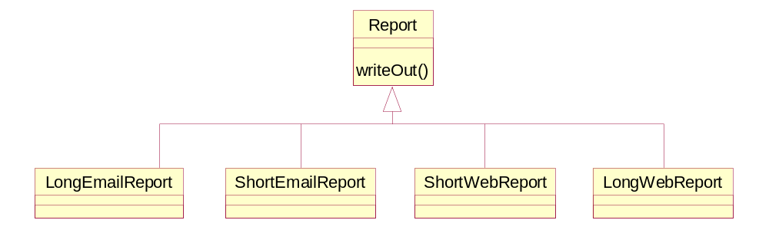
Principle 5: Plug-points & delegation
Variability in an object’s behaviour can be encapsulated with plug-ins
Subclassing can provide variants, but less effective when dealing with more than one dimension or state changes, e.g. a report that can be in two formats (email and web) and can be short and long:

Slide 38
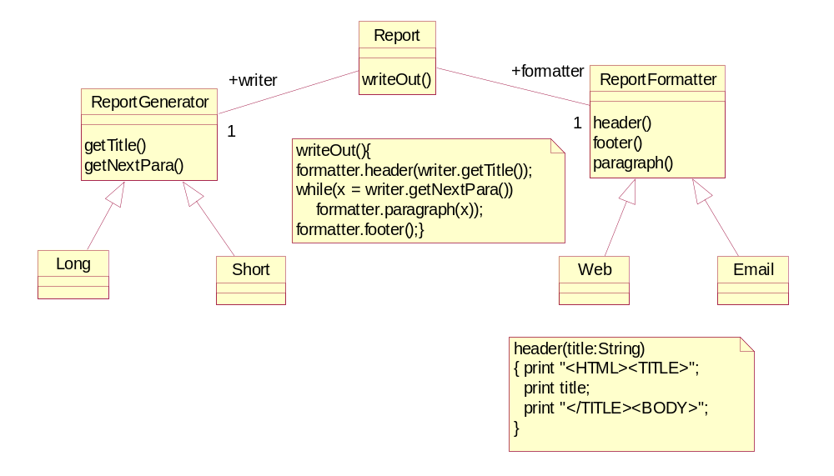
Designing with plug-points
Move variation points into separate classes:

Slide 39
A new loan must be created whenever a loan is made to a user.
There may be many subclasses of loan, depending on the details of the period and the items involved.

Slide 40
LoanCopy
User
+borrower
+issued
return()
+type
userid : Integer
borrow()
LoanType
name : String
0..*
1
1
address : String
1
limit : Integer
1
+status
1
return()
LoanState
Monthly
issue()
Daily
untitled()
Onloan
return
OnShelf
0..*

Slide 41
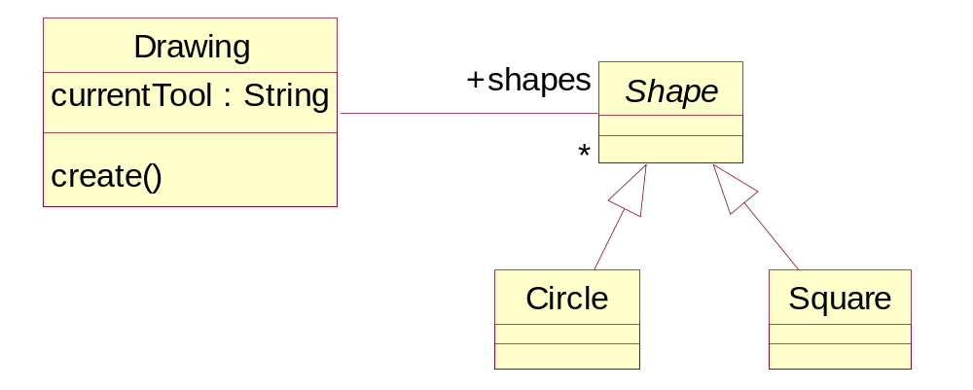
Principle 6: Use Factories
Decoupling from the classes of new objects
    class Drawing
    { …
    { … if (currentTool == circleTool)
    s= new Circle (5);
Problem - Drawing dependent on Circle

Slide 42
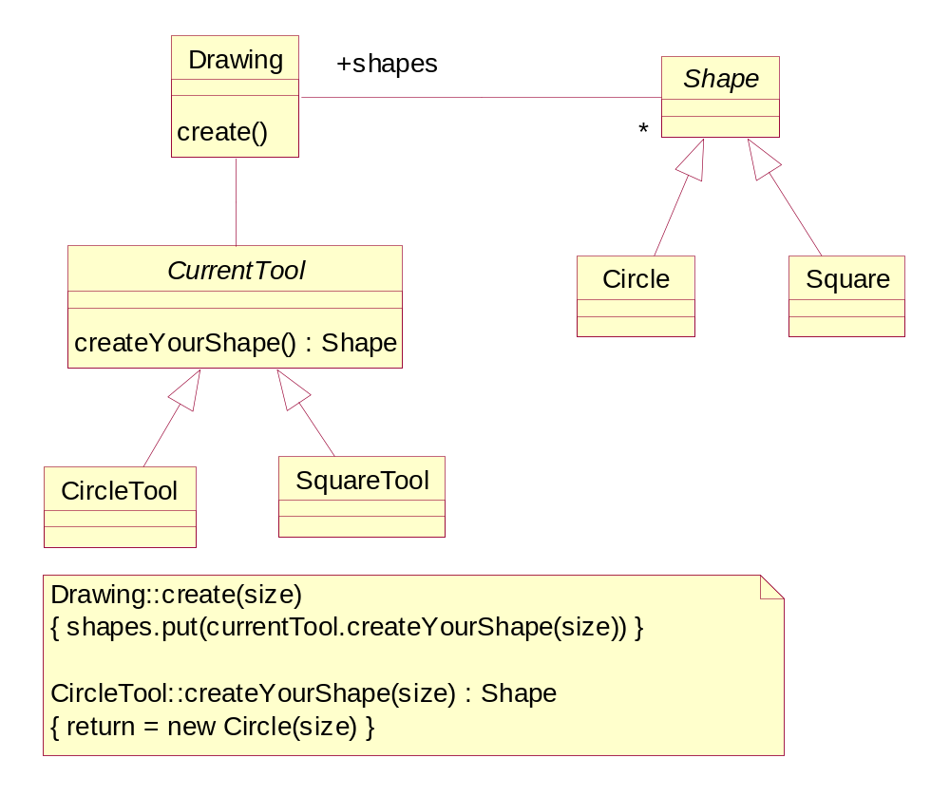
Better
Move object creation all into one ‘factory’ for one supertype
Factory
minimise number of places you have to update when adding a new class

Slide 43
Final comments
Collaboration diagrams are a powerful technique for determining who should have overall control over an operation, and how responsibilities can be shared
Good sharing of responsibility leads to loosely coupled, cohesive designs
Collaboration diagrams may also identify better modelling strategies.

Slide 44
Design Models 设计模型
Use Cases
Requirements
Requirements Specification
Conceptual
Models
Contracts
Detail
Design
Design Models
Collaborations
Code
Implementation

Slide 45
Design class diagrams设计类图
With the completion of interaction diagrams, it is now possible to start developing the design for the software classes and interfaces that will be used to implement the system
This is documented using design class diagrams
Their creation is dependent on the prior creation of:
  Interaction diagrams -- from this, the designer identifies software classes and methods;
  Conceptual model (类图）-- from which it is ensured that the requirements of a contract are implemented correctly.

Slide 46
Features of a design class diagram
Classes, associations and attributes
Interfaces, with their operations and constants
Methods
Attribute type information
Navigability
Dependencies

Slide 47
Steps in making a design class diagram
Identify all the classes participating in the software solution.
Draw them in a class diagram
Duplicate the attributes from the associated concepts in the conceptual model
Add method names by analysing the interaction diagrams
Add type information to the attributes and methods
Add the associations necessary to support the required attributes visibility
Add navigability arrows to the associations to indicate the direction of attribute visibility
Add dependency relationship lines to indicate non-attribute visibility

Slide 48
Library - identify software classes
To find software classes, examine all the interaction diagrams
Identify all those classes which are involved in the interactions
Include all the attributes of the classes previously identified
Substitute concrete types for abstract types

Slide 49
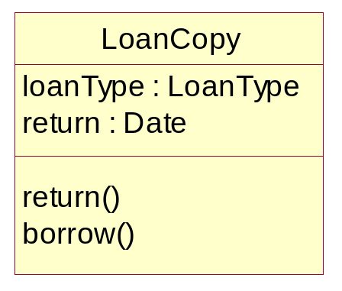
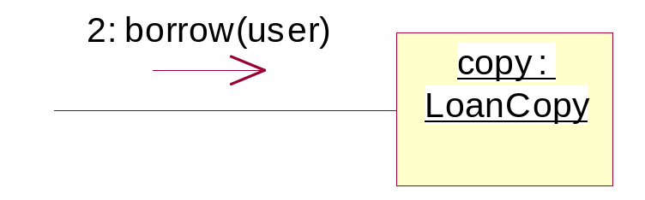
Add method names
The methods of each class can be identified by analysing the collaboration diagrams
In particular, additional methods will have been identified for:
  accessing attributes;
  creating/deleting objects;
  forming/removing association links.

Slide 50
Method names - issues
The following special issues must be considered with respect to method names:
Interpretation of the create() message - the create() message in UML is language dependent. For example, there is no actual create message in Java. Therefore, it is common to omit this from the design class diagram
Accessing methods - are methods which retrieve or modify object attributes. If these methods are used very extensively, it is common to omit them from the diagram (to reduce `noise')
Multiobjects - A message to a multiobject is interpreted as a message to the container object itself. Therefore these messages are not depicted as methods of the multiobject

Slide 51
Adding associations and navigability
In the design class diagram, roles may be decorated with navigability constraints
Navigability is a property of a role which indicates that it is possible to navigate uni-directionally across an association
An important aspect of navigability is that it implies attribute visibility
The usual interpretation of an association with a navigability arrow is attribute visibility from the source to the target
This is usually translated into the source object containing an attribute that refers to the target object/s

Slide 52
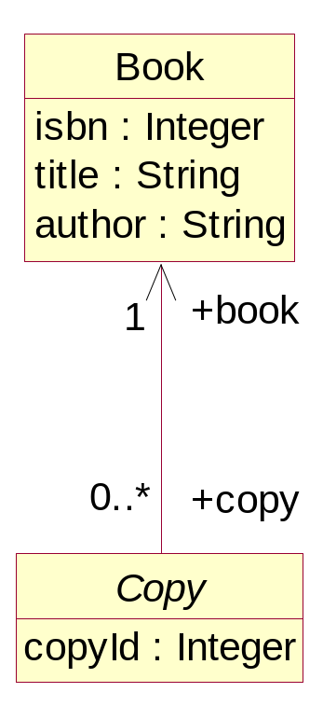
For instance, a Java Copy class will have an attribute that references the associated Book instance:
abstract class Copy {
Book book;
Int copyID;
}

Slide 53
An important rule here is that, if possible, associations in design class diagrams should be adorned with navigability
The most important navigability issue in the library system is that between an LoanCopy and User: should navigation be allowed in both directions?
Answer: only if we remember to maintain the links at both ends!

Slide 54
Design class diagram
Book
isbn : Integer
title : String
author : String
1
+book
1
Library
0..*
date : Date
0..*
+copy
borrowCopy()
+library
+stockitem
Copy
renewCopy()
1
copyId : Integer
1
0..*
0..*
returnCopy()
register()
removeUser.()
1
+library
1
LoanCopy
loanType : LoanType
ReferenceCopy
+user
0..*
return : Date
0..*
User
return()
userid : Integer
borrow()
name : String
+issued
0..*
address : String
+borrower
0..*
limit : Integer
0..1
0..1
return()
issue()
untitled()

Slide 55
Decoupling - Bloated Controller
Book
isbn : Integer
title : String
author : String
1
+book
1
Library
0..*
date : Date
StockManager
0..*
+copy
borrowCopy()
+library
Copy
renewCopy()
1
borrow()
copyId : Integer
1
1
1
renew()
returnCopy()
1
1
return()
register()
+library
1
removeUser.()
1
UserManager
LoanCopy
loanType : LoanType
ReferenceCopy
register()
return : Date
removeUser()
1
1
return()
0..*
borrow()
User
0..*
+issued
0..*
userid : Integer
+user
0..*
name : String
address : String
+borrower
limit : Integer
0..1
0..1
return()
issue()
untitled()

Slide 56
Decoupling – Plug-in
LoanCopy
User
+borrower
+issued
return()
+type
userid : Integer
borrow()
LoanType
name : String
0..*
1
1
address : String
1
limit : Integer
1
+status
1
return()
LoanState
Monthly
issue()
Daily
untitled()
Onloan
return
OnShelf
0..*

Slide 57
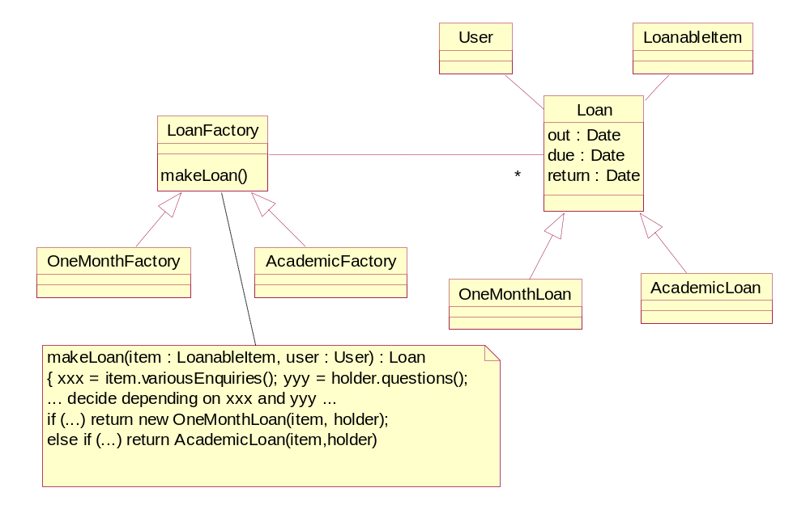
Decoupling - Factory
Add more flexible loan capability

Slide 58
设计模式 Design Patterns
设计模式是一种复用关于某个问题和其解决方案的抽象知识的方法。
模式描述问题及其解决方案的本质
模式应当足够抽象，以便能够用于不同的情形

Slide 59
设计模式的历史
Christopher Alexander
  A Pattern Language (1977)‏
  www.patternlanguage.com
“每个模式描述了一个在我们的环境中反复出现的问题，并且描述了解决该问题的方法的核心，使得你能够将该方法复用一百万次，而没有两次重复的。
Each pattern describes a problem which occurs over and over again in our environment, and then describes the core of the solution to that problem, in such a way that you can use this solution a million times over, without ever doing it the same way twice.

Slide 60
软件开发人员的感慨
“要是软件工程能像 X 一样...”, X 代表 任意一种拥有长期的成功的历史的设计密集型的行业
因而能够发现在 X 出现过的同样的基本的价值观的、方法论的，实用性的问题，这会令人同时感到欣慰（和烦恼）的

Slide 61
Origins of patterns模式的起源
Software patterns first became popular with the wide acceptance of the book: Design Patterns: Elements of Reusable Object-Oriented Software by Erich Gamma, Richard Helm, Ralph Johnson, John Vlissides (Gang of Four四人帮) – 描述了(不是发明了） 23 种模式
This book was developed from work in the 80's on using pattern languages in the development of Smalltalk programs (Cunningham and Beck)
Their use of the term `pattern' was derived from the work of Christopher Alexander
Alexander is famous for the books he has written on the topic as it relates to urban planning and building architecture
许多会议，书籍，文集等

Slide 62
设计模式 Design Patterns
“一个设计模式，对解决一种在面向对象系统中反复出现的设计问题的一种通用的设计方法进行系统的命名，鼓励，解释。不仅描述该问题一种通用的设计，解决方法，还有何时适用该解法以及这样做的效果。同时也给出了实现的参考和例子。该解法是对用来解决问题的对象和类的一种通用的安排。根据具体情形，定制和实现该解决方法。
systematically names, motivates, and explains a general design that addresses a recurring design problem in object-oriented systems. It describes the problem, the solution, when to apply the solution, and its consequences. It also gives implementation hints and examples. The solution is a general arrangement of objects and classes that solve the problem. The solution is customized and implemented to solve the problem in a particular context.”

Slide 63
Patterns模式
Experienced software developers build up a repertoire of both general principles and idiomatic solutions that guide them in the creation of software
These principles, if structured in a common way, can be thought of as patterns
For example, here is a sample pattern:

Slide 64
Example - Singleton
Context/Problem
  Exactly one instance of a class is allowed. Objects need a single point of access
Solution
  Define a class method that returns the singleton
  For example, suppose that a singleton pattern is
  required for the Library class

Slide 65
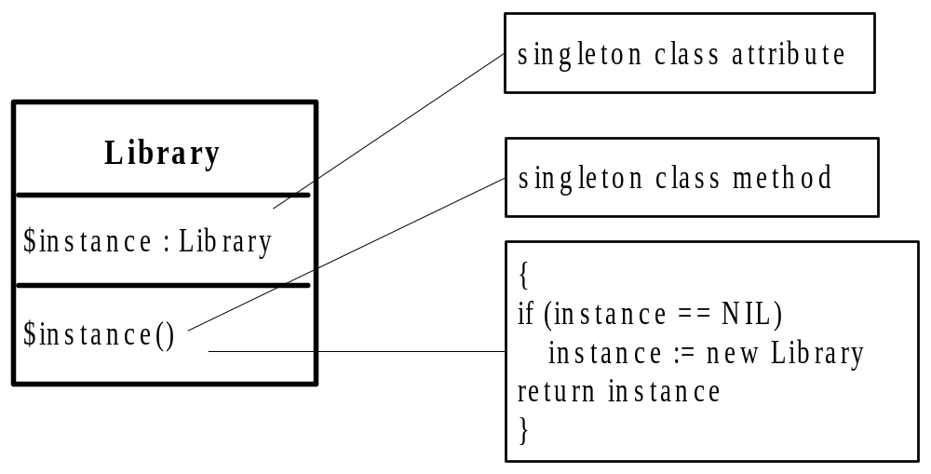
Solution
To gain access to the instance, the singleton class method is invoked first:

Slide 66
Pattern definition
At the most basic level, a pattern is a named description of a problem and a solution
They provide a way of documenting and encapsulating good design practice
Many patterns provide guidance for how responsibilities should be assigned to objects, given a specific category of problem
Patterns support reuse

Slide 67
Software patterns
Software patterns are aimed at improving the quality of software
Good quality software has many of the following features:
  High cohesiveness;
  Low coupling;
  Easy maintainability;
  Reusability;
  Robustness.

Slide 68
Kinds of software patterns
Architectural Patterns:
  An architectural pattern expresses a fundamental structural organisation or schema for software systems. It provides a set of predefined subsystems, specifies their responsibilities, and includes rules and guidelines for organising the relationships between them.
Design Patterns:
  A design pattern provides a scheme for refining the subsystems or components of a software system, or the relationships between them. It describes commonly recurring structure of communicating components that solves a general design problem within a particular context.
Idioms 习语:
  An idiom is a low-level pattern specific to a programming language. An idiom describes how to implement particular aspects of components or the relationships between them using the features of the given language.

Slide 69
What makes a good software pattern? - Coplien
It solves a problem: Patterns capture solutions, not just abstract principles or strategies;
It is a proven concept: Patterns capture solutions with a track record, not theories or speculation;
The solution isn't obvious:
  Many problem-solving techniques (such as software design paradigms or methods) try to derive solutions from first principles. The best patterns generate a solution to a problem indirectly -- a necessary approach for the most difficult problems of design;

Slide 70
Good patterns
It describes a relationship: Patterns don't just describe modules, but describe deeper system structures and mechanisms.
The pattern has a significant human component .... All software serves human comfort or quality of life; the best patterns explicitly appeal to aesthetics and utility.

Slide 71
Whole-part 整体与部分 (递归组合）
Context/Problem
What structure can be used to capture a tree-like relationship between an object and its parts
Solution
The following describes a class structure in which each object can be a leaf object, or an object composed of other objects:

Slide 72
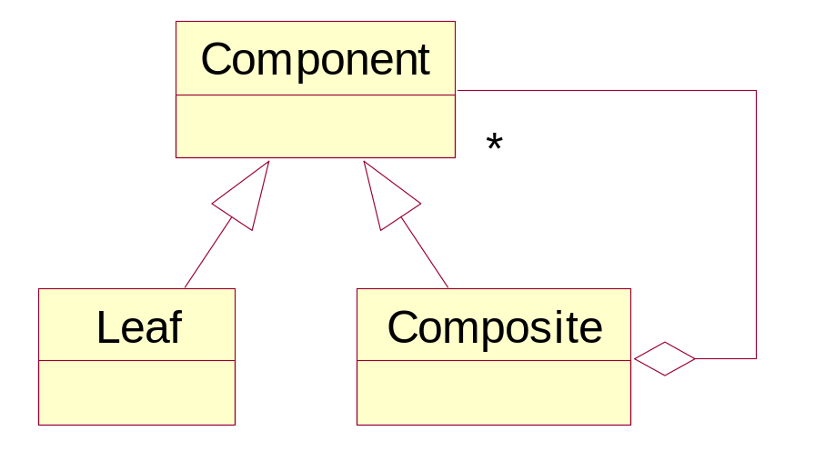
Whole-part整体与部分 (递归组合）
Can you think of a common software structure that would use this pattern?

Slide 73
Façade 模式
结构型Structural
用一个单个的类来代表整个子系统
对一个子系统中的一系列接口提供一个统一的接口
定义一个高层的接口使得子系统容易使用
对现有对象的一种语义包裹

Slide 74
Observer （观察者）
Maintains consistency between related components, e.g. spreadsheet cells, in a way that maximises decoupling.
Usually used when there are several observers for each subject.
Observers register their interest with the subject (dynamically), which will then notify them of any changes.
Low coupling: subject is interface decoupled from observer (observer can be built after subject) as it knows only to call the notify method.

Slide 75
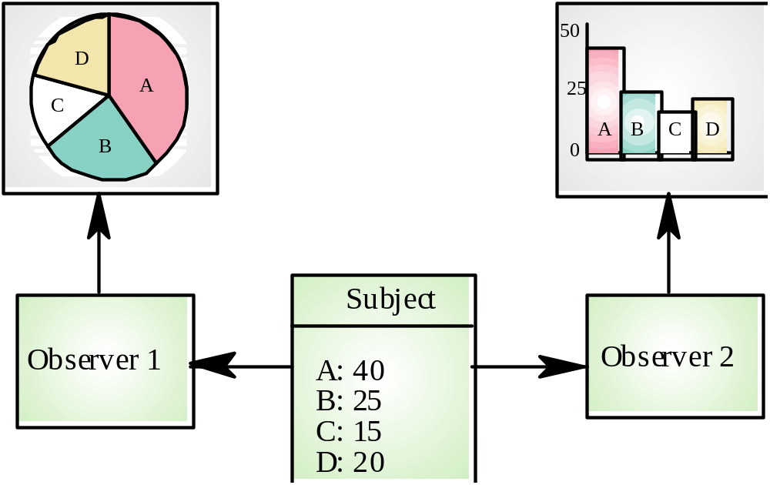
Example

Slide 76
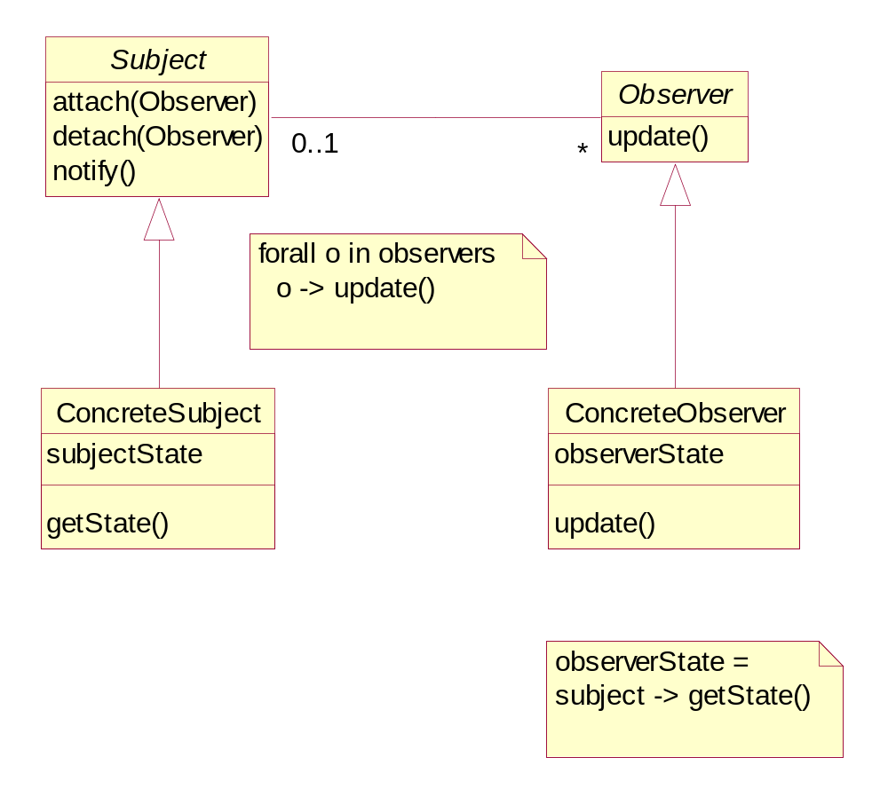
Observer

Slide 77
代理模式的几种类型
虚拟Virtual (or Lazy) – 推迟实例化, 将创建某些资源耗费型的对象的工作一直推迟到真正需要起功能的时候
远程Remote – 隐藏远程对象间的通信机制
存取Access (或保护) – 检查客户的存取权限
智能Smart (or 修饰Decorator) – 提供额外的功能

Slide 78
Proxy Pattern (typical format) 代理
Synopsis
  Provide a surrogate or placeholder for another object which cannot be accessed by normal means 提供一个傀儡或者空缺让其他对象来控制其访问
Context
  You want a normally inaccessible or unavailable object to appear like an ordinary object. For example, the object might be: in a different system, or may be a physical device
Solution
  Make a Proxy object with the same interface as the subject and which holds a reference to the subject. This is usually not a conventional reference, but may be a host/port/object triple file name and offset piece of code for producing the subject

Slide 79
Proxy continued
  The Proxy may forward requests to the subject or simply replace itself by the subject, depending on the Proxy's purpose.
Known Uses
  Proxies are commonly used to make objects appear local in distributed systems. For example, a connection to a remote server, a modem link to an authorisation system
Benefits
  Loose coupling is maintained
  The designer can abstract away from the implementation details of the proxy
  Advantage can be made of the implementation languages support for remote method invocation

Slide 80
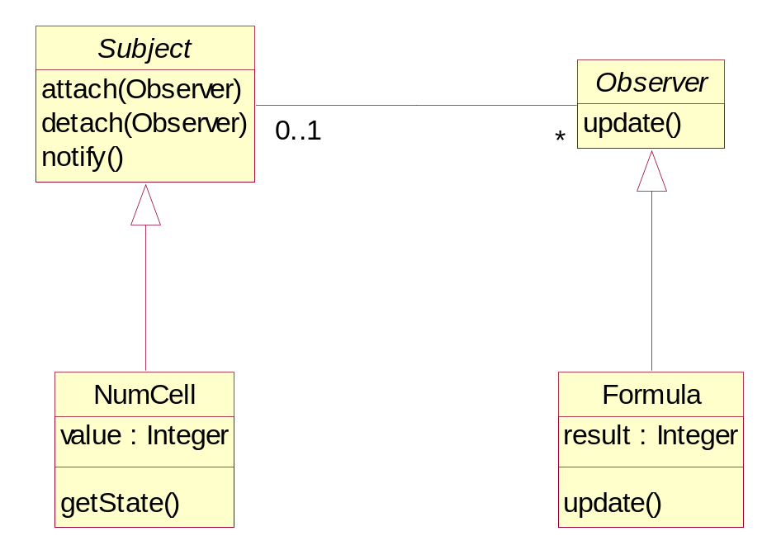
Applying Patterns
Typically involves subclassing appropriate abstract classes (placeholders):
However, this is not practical for large patterns and multiple applications.

Slide 81
Pattern Application
UML doesn’t support a pattern notation (yet), but recent books like Catalysis propose their own:
NumCell
Observer
Formula
value : Integer
result : Integer
getState()
update()
Pattern

Slide 82
Modelling Patterns
Design patterns are just one example of reuse of repeating structures that permeate software development
Catalysis gives lots of examples where patterns can be identified and used at the more general “modelling level” (see attached notes)
These types of patterns can not only encapsulate structural relationships, but constraints on those relationships to

Slide 83
Patterns summary
Patterns provide an excellent way of conveying good design practice
Many patterns, and types of patterns exist, for example:
  Architectural, Design and Implementation
  Analysis patterns
  Anti- patterns (describe examples of bad practice!)
Patterns are important because they are an essential way of encapsulating reusable artefacts.

Slide 84
Information about patterns
Central sources of information on patterns can be found at:
http://st-www.cs.uiuc.edu/users/patterns/
patterns.html (Patterns home page)
And also at:
http://c2.com/ppr/index.html

Slide 85
总结 Summary
课程要求
软件工程简介
  软件工程概述
  软件开发过程模型
Requirements 需求分析
OO Modelling and UML
  Why OO?
  Brief History of UML
  UML
Design, Patterns & Frameworks
  Reuse Driven Design
  Patterns
  Frameworks and Templates
Component Based Design软件构件
  Components（CORBA / CCM， EJB，COM）软件构件技术和软件体系结构
  Web 服务
  Middleware
  MDA
Coding编码
Testing 软件测试
  软件测试及自动化
  软件质量模型和质量保证
软件知识产权和自由软件
CMM简介
软件工程工具介绍

