Slide 1
Real-Time Embedded Systems
实时嵌入式系统
蔡浩 屈建勤

Slide 2
What is a real-time system?
A real-time system is any information processing system which has to respond to externally generated input stimuli within a finite and specified period
  the correctness depends not only on the logical result but also the time it was delivered
  failure to respond is as bad as the wrong response!
The computer is a component in a larger engineering system => EMBEDDED COMPUTER SYSTEM
99% of all processors are for the embedded systems market

Slide 3
Terminology专业术语
Hard real-time — systems where it is absolutely imperative that responses occur within the required deadline. E.g. Flight control systems.
Soft real-time — systems where deadlines are important but which will still function correctly if deadlines are occasionally missed. E.g. Data acquisition system.
Real real-time — systems which are hard real-time and which the response times are very short. E.g. Missile guidance system.
Firm real-time — systems which are soft real-time but in which there is no benefit from late delivery of service.
A single system may have all hard, soft and real real-time subsystems
In reality many systems will have a cost function associated with
missing each deadline

Slide 4
A simple fluid control system
Interface
Pipe
Input flow
reading
Flow meter
Processing
Valve
Output valve
angle
Time
Computer

Slide 5
A Process Control System
Process
Control
Computer
Valve
Temperature
Transducer
Stirrer
Finished
Products
Chemicals
and
Materials
PLANT

Slide 6

A Grain-Roasting Plant
Bin
Furnace
Fuel Tank
grain
Pipe
fuel

Slide 7
A Widget-Packing Station
Computer
Switch
Switch
Assembly line
Bell
Line controller
Box
0 = stop
1 = run

Slide 8
A Production Control System
Production
Control
System
Finished
Products
Parts
Machine Tools
Manipulators
Conveyor Belt

Slide 9
A Command and Control System
Command
Post
Command and Control
Computer
Temperature, Pressure, Power and so on
Terminals
Sensors/Actuators

Slide 10
A Typical Embedded System
Real-Time
Clock
Algorithms for
Digital Control
Interface
Engineering
System
Data Logging
Remote
Monitoring System
Database
Data Retrieval
and Display
Display
Devices
Operator’s
Console
Operator
Interface
Real-Time Computer

Slide 11
Characteristics of a RTES
Large and complex — vary from a few hundred lines of assembler or C to 20 million lines of Ada estimated for the Space Station Freedom
Concurrent control of separate system components — devices operate in parallel in the real-world; better to model this parallelism by concurrent entities in the program
Facilities to interact with special purpose hardware — need to be able to program devices in a reliable and abstract way

Slide 12
Characteristics of a RTES
Extreme reliability and safe — embedded systems typically control the environment in which they operate; failure to control can result in loss of life, damage to environment or economic loss
Guaranteed response times — we need to be able to predict with confidence the worst case response times for systems; efficiency is important but predictability is essential

Slide 13
Embedded software
Computers are used to control a wide range of systems from simple domestic machines, through games controllers, to entire manufacturing plants.
Their software must react to events generated by the hardware and, often, issue control signals in response to these events.
The software in these systems is embedded in system hardware, often in read-only memory, and usually responds, in real time, to events from the system’s environment.
[Sommerville 2014]

Slide 14
Responsiveness
Responsiveness in real-time is the critical difference between embedded systems and other software systems, such as information systems, web-based systems or personal software systems.
For non-real-time systems, correctness can be defined by specifying how system inputs map to corresponding outputs that should be produced by the system.
In a real-time system, the correctness depends both on the response to an input and the time taken to generate that response. If the system takes too long to respond, then the required response may be ineffective.
[Sommerville 2014]

Slide 15
Embedded system characteristics
Embedded systems generally run continuously and do not terminate.
Interactions with the system’s environment are uncontrollable and unpredictable.
There may be physical limitations (e.g. power) that affect the design of a system.
Direct hardware interaction may be necessary.
Issues of safety and reliability may dominate the system design.
[Sommerville 2014]

Slide 16
Embedded system design
The design process for embedded systems is a systems engineering process that has to consider, in detail, the design and performance of the system hardware.
Part of the design process may involve deciding which system capabilities are to be implemented in software and which in hardware.
Low-level decisions on hardware, support software and system timing must be considered early in the process.
These may mean that additional software functionality, such as battery and power management, has to be included in the system.
[Sommerville 2014]

Slide 17
Reactive systems
Given a stimulus, the system must produce a
reaction or response within a specified time.
Periodic stimuli. Stimuli which occur at
predictable time intervals
  For example, a temperature sensor may be polled 10 times per second.
Aperiodic stimuli. Stimuli which occur at
unpredictable times
  For example, a system power failure may trigger an
  interrupt which must be processed by the system.
[Sommerville 2014]

Slide 18
Stimuli and responses for a burglar alarm system
Stimulus | Response
Single sensor positive | Initiate alarm; turn on lights around site of positive sensor.
Two or more sensors positive | Initiate alarm; turn on lights around sites of positive sensors; call police with location of suspected break-in.
Voltage drop of between 10% and 20% | Switch to battery backup; run power supply test.
Voltage drop of more than 20% | Switch to battery backup; initiate alarm; call police; run power supply test.
Power supply failure | Call service technician.
Sensor failure | Call service technician.
Console panic button positive | Initiate alarm; turn on lights around console; call police.
Clear alarms | Switch off all active alarms; switch off all lights that have been switched on.
[Sommerville 2014]

Slide 19
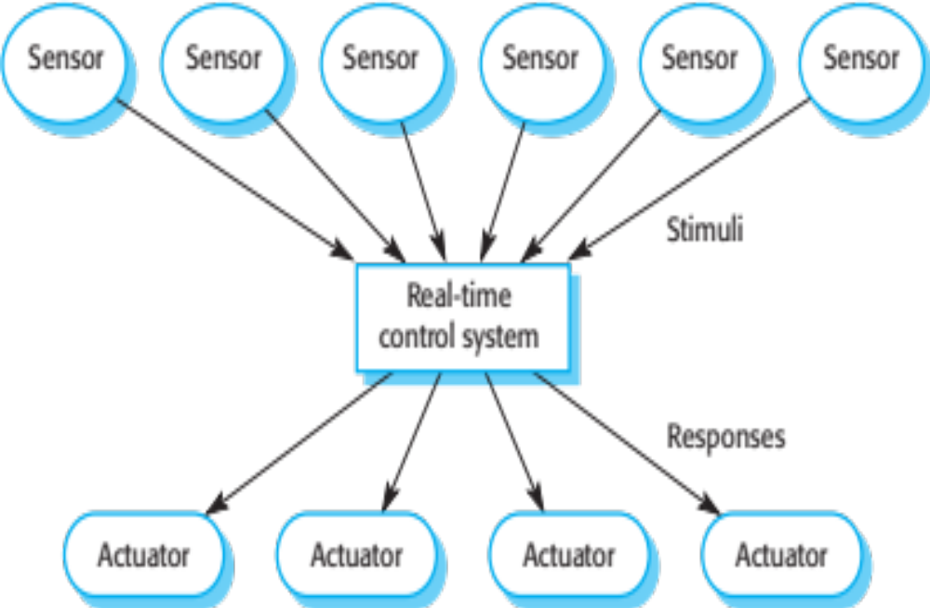
A general model of an embedded real-time system
[Sommerville 2014]

Slide 20
Architectural considerations
Because of the need to respond to timing demands made by different stimuli/responses, the system architecture must allow for fast switching between stimulus handlers.
Timing demands of different stimuli are different so a simple sequential loop is not usually adequate.
Real-time systems are therefore usually designed as cooperating processes with a real-time executive controlling these processes.
[Sommerville 2014]

Slide 21
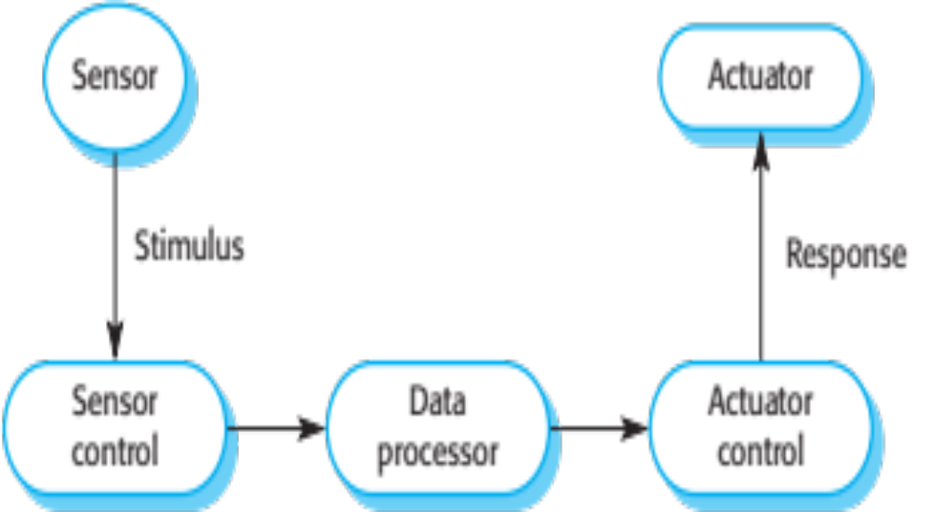
Sensor and actuator processes
[Sommerville 2014]

Slide 22
System elements
Sensor control processes
  Collect information from sensors. May buffer information collected in response to a sensor stimulus.
Data processor
  Carries out processing of collected information and computes the system response.
Actuator control processes
  Generates control signals for the actuators.
[Sommerville 2014]

Slide 23
Design process activities
Platform selection
Stimuli/response identification
Timing analysis
Process design
Algorithm design
Data design
Process scheduling
[Sommerville 2014]

Slide 24
Process coordination
Processes in a real-time system have to be coordinated and share information.
Process coordination mechanisms ensure mutual exclusion to shared resources.
When one process is modifying a shared resource, other processes should not be able to change that resource.
When designing the information exchange between processes, you have to take into account the fact that these processes may be running at different speeds.
[Sommerville 2014]

Slide 25
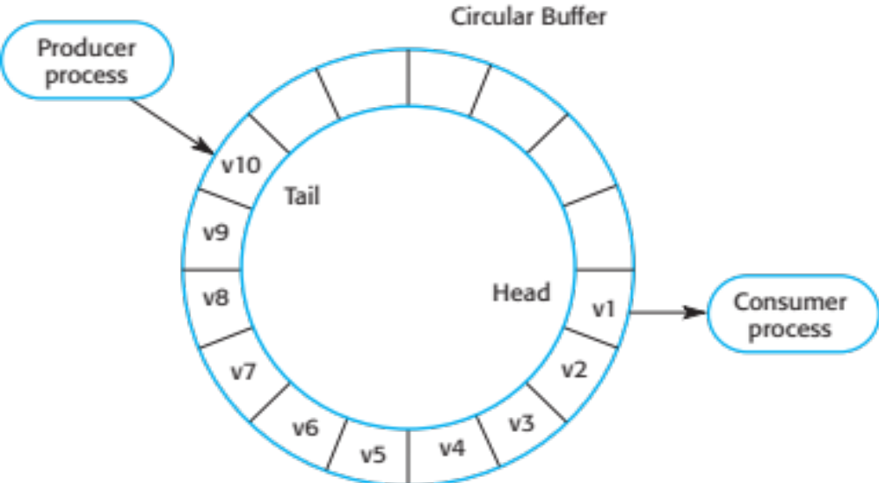
Producer/consumer processes sharing a circular buffer
[Sommerville 2014]

Slide 26
Mutual exclusion
Producer processes collect data and add it to
the buffer. Consumer processes take data from the buffer and make elements available.
Producer and consumer processes must be
mutually excluded from accessing the same
element.
The buffer must stop producer processes
adding information to a full buffer and consumer processes trying to take information from an empty buffer.
[Sommerville 2014]

Slide 27
Real-time system modelling
The effect of a stimulus in a real-time system may trigger a transition from one state to another.
State models are therefore often used to describe embedded real-time systems.
UML state diagrams may be used to show the states and state transitions in a real-time system.
[Sommerville 2014]

Slide 28
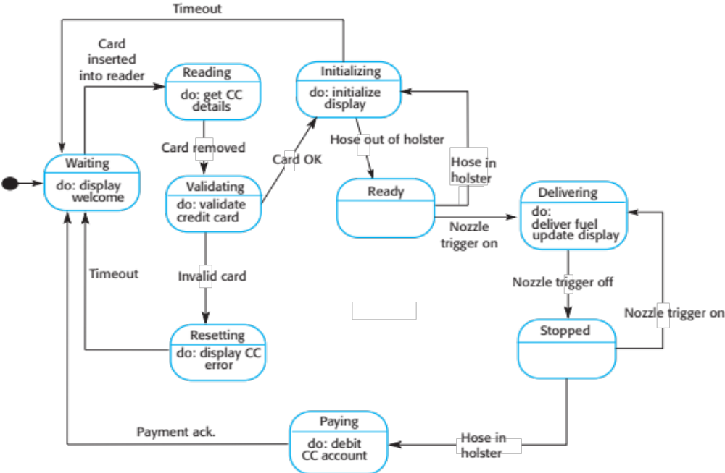
State machine model of a petrol (gas) pump
[Sommerville 2014]

Slide 29
Real-time programming
Programming languages for real-time systems development have to include facilities to access system hardware, and it should be possible to predict the timing of particular operations in these languages.
Systems-level languages, such as C, which allow efficient code to be generated are widely used in preference to languages such as Java.
There is a performance overhead in object-oriented systems because extra code is required to mediate access to attributes and handle calls to operations. The loss of performance may make it impossible to meet real-time deadlines.
[Sommerville 2014]

Slide 30
Architectural patterns for embedded systems
Characteristic system architectures for embedded systems
  Observe and React This pattern is used when a set of sensors are routinely monitored and displayed.
  Environmental Control This pattern is used when a system includes sensors, which provide information about the environment and actuators that can change the environment
  Process Pipeline This pattern is used when data has to be transformed from one representation to another before it can be processed.
[Sommerville 2014]

Slide 31
The Observe and React pattern
Name | Observe and React
Description | The input values of a set of sensors of the same types are collected and analyzed. These values are displayed in some way. If the sensor values indicate that some exceptional condition has arisen, then actions are initiated to draw the operator’s attention to that value and, in certain cases, to take actions in response to the exceptional value.
Stimuli | Values from sensors attached to the system.
Responses | Outputs to display, alarm triggers, signals to reacting systems.
Processes | Observer, Analysis, Display, Alarm, Reactor.
Used in | Monitoring systems, alarm systems.
[Sommerville 2014]

Slide 32
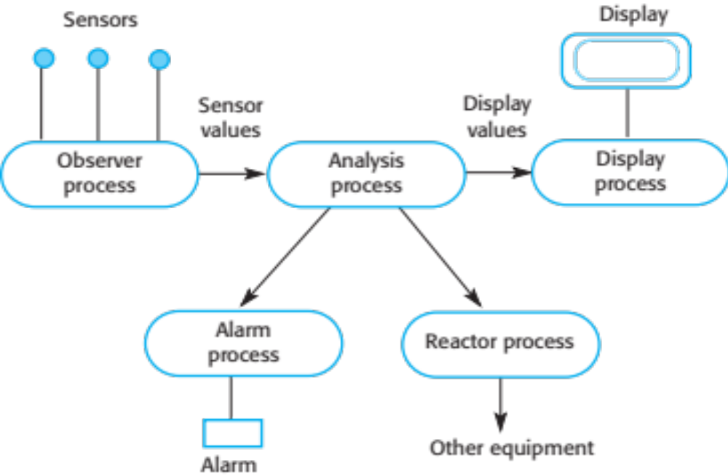
Observe and React process structure
[Sommerville 2014]

Slide 33
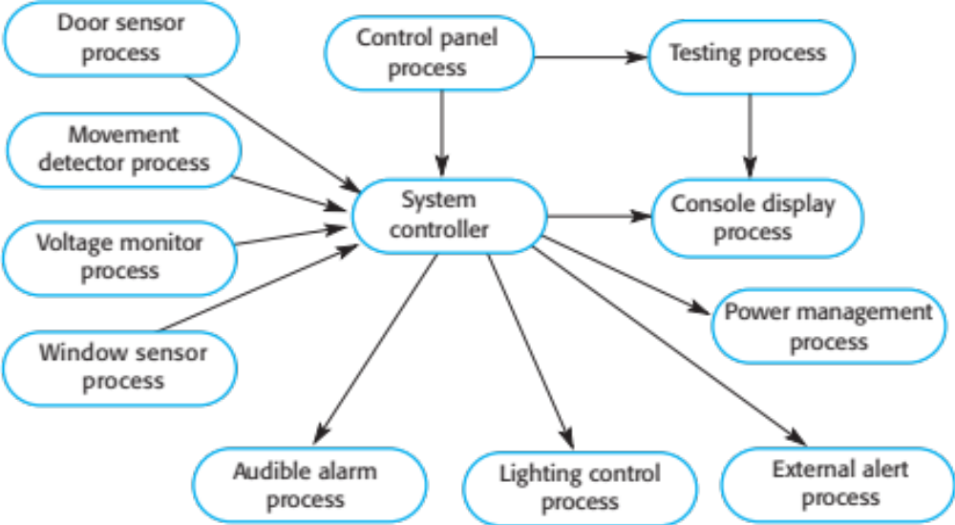
Process structure for a burglar alarm system
[Sommerville 2014]

Slide 34
The Environmental Control pattern
Name | Environmental Control
Description | The system analyzes information from a set of sensors that collect data from the system’s environment. Further information may also be collected on the state of the actuators that are connected to the system. Based on the data from the sensors and actuators, control signals are sent to the actuators that then cause changes to the system’s environment. Information about the sensor values and the state of the actuators may be displayed.
Stimuli | Values from sensors attached to the system and the state of the system actuators.
Responses | Control signals to actuators, display information.
Processes | Monitor, Control, Display, Actuator Driver, Actuator monitor.
Used in | Control systems.
[Sommerville 2014]

Slide 35
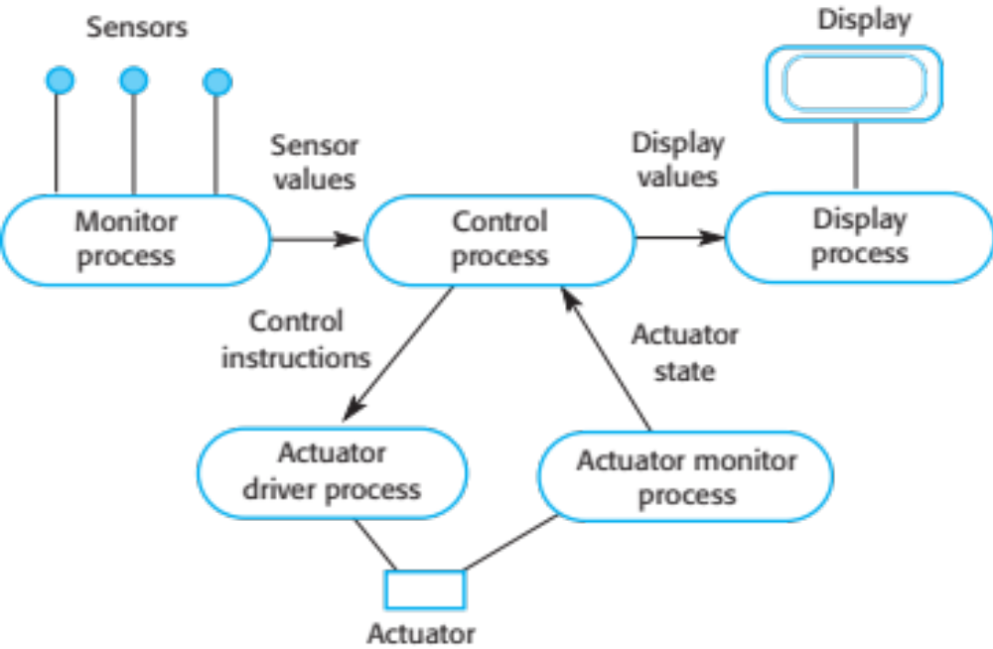
Environmental Control process structure
[Sommerville 2014]

Slide 36
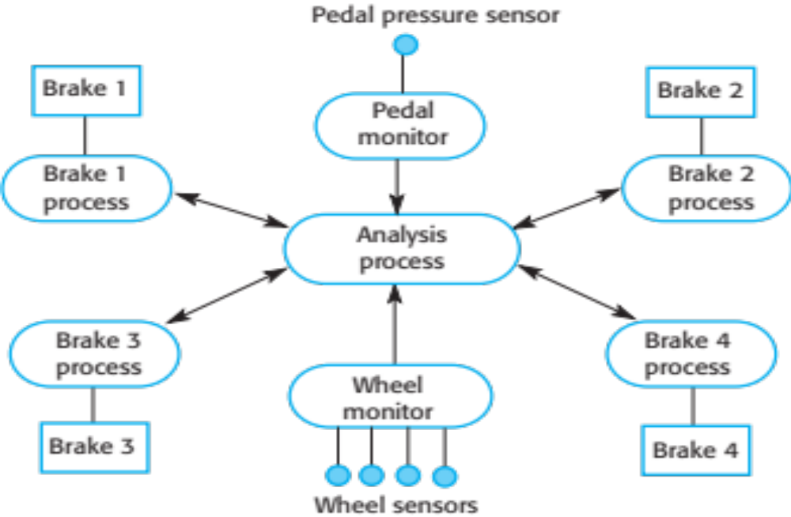
Control system architecture for an anti-skid braking system
[Sommerville 2014]

Slide 37
The Process Pipeline pattern
Name | Process Pipeline
Description | A pipeline of processes is set up with data moving in sequence from one end of the pipeline to another. The processes are often linked by synchronized buffers to allow the producer and consumer processes to run at different speeds. The culmination of a pipeline may be display or data storage or the pipeline may terminate in an actuator.
Stimuli | Input values from the environment or some other process
Responses | Output values to the environment or a shared buffer
Processes | Producer, Buffer, Consumer
Used in | Data acquisition systems, multimedia systems
[Sommerville 2014]

Slide 38
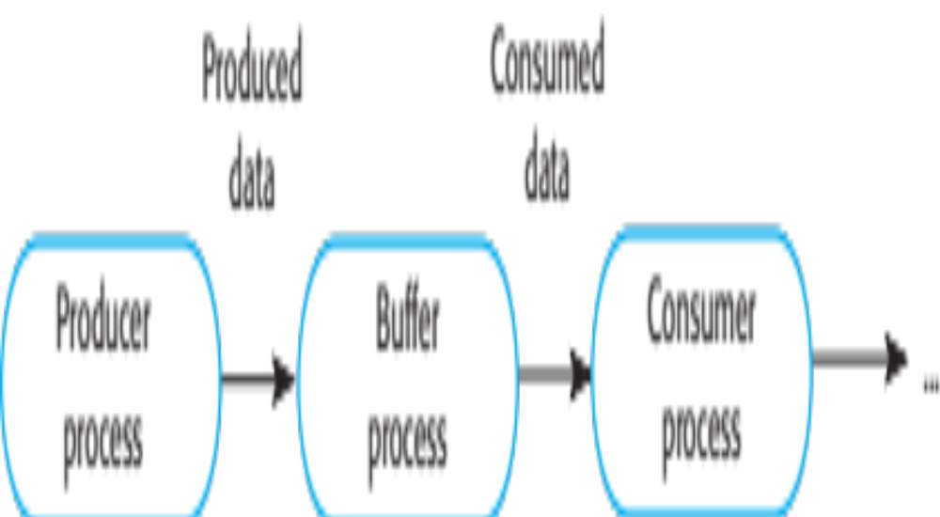
Process Pipeline process structure
[Sommerville 2014]

Slide 39
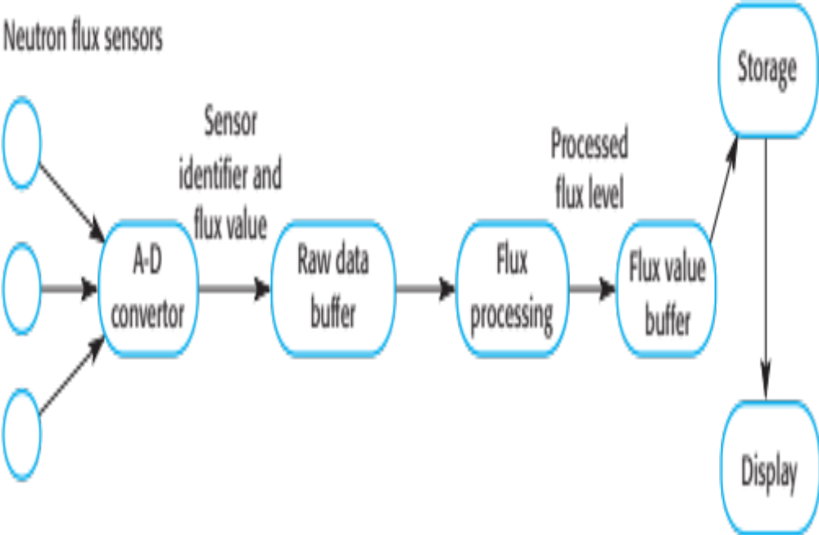
Neutron flux data acquisition
[Sommerville 2014]

Slide 40
Timing analysis
The correctness of a real-time system depends not just on the correctness of its outputs but also on the time at which these outputs were produced.
In a timing analysis, you calculate how often each process in the system must be executed to ensure that all inputs are processed and all system responses produced in a timely way.
The results of the timing analysis are used to decide how frequently each process should execute and how these processes should be scheduled by the real-time operating system.
[Sommerville 2014]

Slide 41
Timing requirements for the burglar alarm system
Stimulus/Response | Timing requirements
Power failure | The switch to backup power must be completed within a deadline of 50 ms.
Door alarm | Each door alarm should be polled twice per second.
Window alarm | Each window alarm should be polled twice per second.
Movement detector | Each movement detector should be polled twice per second.
Audible alarm | The audible alarm should be switched on within half a second of an alarm being raised by a sensor.
Lights switch | The lights should be switched on within half a second of an alarm being raised by a sensor.
Communications | The call to the police should be started within 2 seconds of an alarm being raised by a sensor.
Voice synthesizer | A synthesized message should be available within 2 seconds of an alarm being raised by a sensor.
[Sommerville 2014]

Slide 42
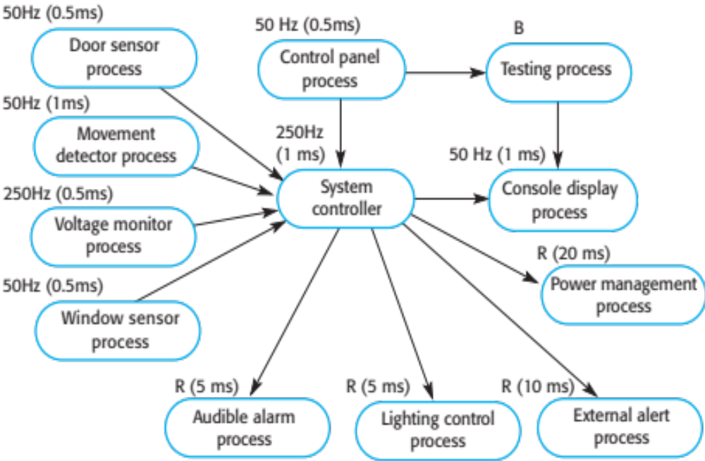
Alarm process timing
[Sommerville 2014]

Slide 43
Real-Time Languages and OSs
User Programs
User Program
Operating
Including Operating
Hardware
Hardware
System
System Components
Typical OS Configuration
Typical Embedded Configuration
[Sommerville 2014]

Slide 44
Real-time operating systems
Real-time operating systems are specialised operating systems which manage the processes in the RTS.
Responsible for process management and
resource (processor and memory) allocation.
May be based on a standard kernel which
is used unchanged or modified for a particular
application.
Do not normally include facilities such as file management.
[Sommerville 2014]

Slide 45
Operating system components
Real-time clock
  Provides information for process scheduling.
Interrupt handler
  Manages aperiodic requests for service.
Scheduler
  Chooses the next process to be run.
Resource manager
  Allocates memory and processor resources.
Dispatcher
  Starts process execution.
[Sommerville 2014]

Slide 46
Non-stop system components
Configuration manager
  Responsible for the dynamic reconfiguration of the system
  software and hardware. Hardware modules may be replaced and software upgraded without stopping the systems.
Fault manager
  Responsible for detecting software and hardware faults and
  taking appropriate actions (e.g. switching to backup disks) to ensure that the system continues in operation.
[Sommerville 2014]

Slide 47
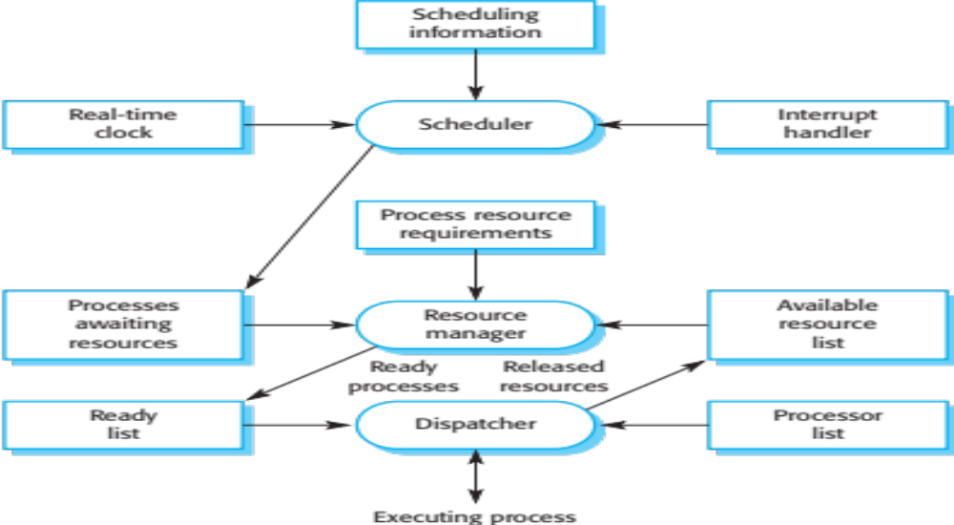
Components of a real-time operating system
[Sommerville 2014]

Slide 48
Process priority
The processing of some types of stimuli must
sometimes take priority.
Interrupt level priority. Highest priority which is
allocated to processes requiring a very fast
response.
Clock level priority. Allocated to periodic
processes.
Within these, further levels of priority may be
assigned.
[Sommerville 2014]

Slide 49
Interrupt servicing
Control is transferred automatically to a
pre-determined memory location.
This location contains an instruction to jump to
an interrupt service routine.
Further interrupts are disabled, the interrupt
serviced and control returned to the interrupted
process.
Interrupt service routines MUST be short,
simple and fast.
[Sommerville 2014]

Slide 50
Periodic process servicing
In most real-time systems, there will be several
classes of periodic process, each with different
periods (the time between executions),
execution times and deadlines (the time by
which processing must be completed).
The real-time clock ticks periodically and each
tick causes an interrupt which schedules the
process manager for periodic processes.
The process manager selects a process which
is ready for execution.
[Sommerville 2014]

Slide 51
Process management
Concerned with managing the set of concurrent processes.
Periodic processes are executed at pre-specified time intervals.
The RTOS uses the real-time clock to determine when to execute a process taking into account:
  Process period - time between executions.
  Process deadline - the time by which processing must be complete.
[Sommerville 2014]

Slide 52
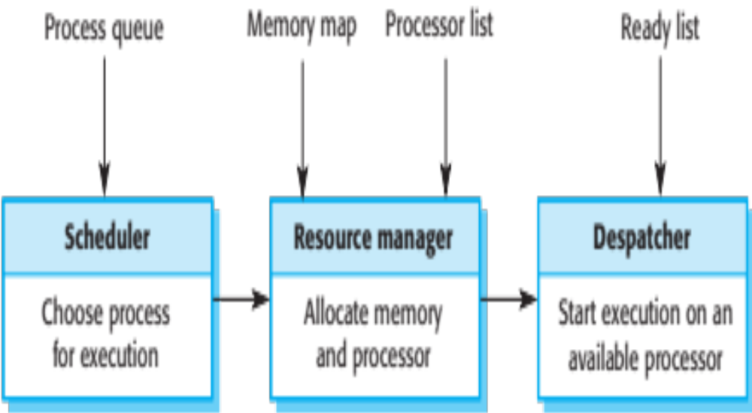
Figure 20.18 RTOS actions required to start a process
[Sommerville 2014]

Slide 53
Process switching
The scheduler chooses the next process to be executed by the processor. This depends on a scheduling strategy which may take the process priority into account.
The resource manager allocates memory and a processor for the process to be executed.
The dispatcher takes the process from ready list, loads it onto a processor and starts execution.
[Sommerville 2014]

Slide 54
Scheduling strategies
Non pre-emptive scheduling
  Once a process has been scheduled for execution, it runs to completion or until it is blocked for some reason (e.g. waiting for I/O).
Pre-emptive scheduling
  The execution of an executing processes may be stopped if a higher priority process requires service.
Scheduling algorithms
  Round-robin;
  Rate monotonic;
  Shortest deadline first.
[Sommerville 2014]

Slide 55
Key points
An embedded software system is part of a hardware/software system that reacts to events in its environment. The software is ‘embedded’ in the hardware. Embedded systems are normally real-time systems.
A real-time system is a software system that must respond to events in real time. System correctness does not just depend on the results it produces, but also on the time when these results are produced.
Real-time systems are usually implemented as a set of communicating processes that react to stimuli to produce responses.
State models are an important design representation for embedded real-time systems. They are used to show how the system reacts to its environment as events trigger changes of state in the system.
[Sommerville 2014]

Slide 56
Key points
There are several standard patterns that can be observed in different types of embedded system. These include a pattern for monitoring the system’s environment for adverse events, a pattern for actuator control and a data-processing pattern.
Designers of real-time systems have to do a timing analysis, which is driven by the deadlines for processing and responding to stimuli. They have to decide how often each process in the system should run and the expected and worst-case execution time for processes.
A real-time operating system is responsible for process and resource management. It always includes a scheduler, which is the component responsible for deciding which process should be scheduled for execution.
[Sommerville 2014]

