Slide 1
Component Based Design and Reuse
屈建勤， 蔡浩

Slide 2
课程介绍 Overview
课程要求
软件工程简介
  软件工程概述
  软件开发过程模型
Requirements 需求分析
OO Modelling and UML
  Why OO?
  Brief History of UML
  UML
Design, Patterns & Frameworks
  Reuse Driven Design
  Patterns
  Frameworks
Component Based Design软件构件
  Components（CORBA / CCM， EJB，COM）软件构件技术和软件体系结构
  Web 服务
  Middleware
  MDA
Coding编码
Testing 软件测试
  软件测试及自动化
  软件质量模型和质量保证
软件知识产权和自由软件
CMM简介
软件工程工具介绍

Slide 3
Components 组件
Many software managers envy hardware engineers because of the ease in which they can construct products from pre-existing components
  For example, electronic systems are built by plugging together chips, boards or boxes that are widely interoperable
  A well-chosen set of components can have many possible configurations, resulting in end products that can be made quickly and reliably
  Over the last few years, the same thing has begun to happen in software: word processors can talk to spreadsheets, and graphs to databases, etc.
  Standards such as COM and CORBA permit components to be `plugged together' in different languages and platforms

Slide 4
Component based development
Component based development (CBD) is a buzz word for the new millennium. However, how do components differ from modules and objects?
Some basic definitions:
Component based development: An approach to software development in which all artefacts can be built by assembling, adapting and "wiring" together existing components in a variety of configurations
Component: A coherent package of software artefacts that can be independently developed and delivered as a unit and that can be composed with other components to build something larger

Slide 5
Examples
All the following conform to the above definitions:
  Using some user interface widgets, such a list boxes, and connecting them to appropriate data sources
  Using a collection class in Java
  Using an off the shelf (COTS) calendar package, word processor and spreadsheet in an assemblage of several components and writing scripts to link them together
  Using a class framework, such as Java's Swing components, to build the user interfaces for many applications
  Using predefined language constructs, e.g. for (...) {...}

Slide 6
Implementation Components 实现组件
Although components can be artefacts at any level of abstraction, it is most common to think of them at the software level.
In this case, a component is viewed as:
  a coherent package of software implementation that:
    can be independently developed and delivered (even sold!)
    has explicit and well-specified interfaces for the services it provides
    has explicit and well-specified interfaces for services it expects from others
    can be composed with other components, perhaps customizing some of their properties, without modifying the components

Slide 7
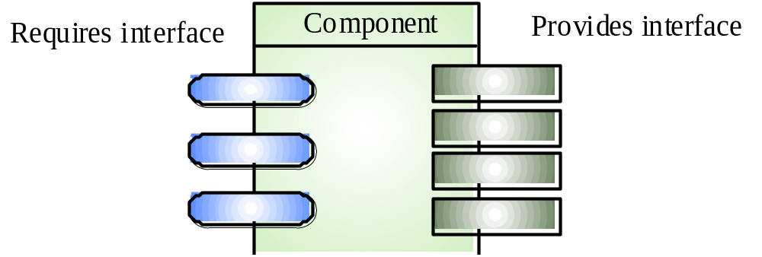
Component Interfaces 组件接口

Slide 8
Component composition 组件组合
To assemble a larger component or application the composer of a component:
  selects which component to compose
  connects required interfaces of one component to provided interfaces of other component to plug them together
  perhaps writes some glue using scripting or adapters between components
  Note that composites often provide standard service to expose their child structure at run-time

Slide 9
Components and binding 绑定
Components are designed and built in one activity, they are composed with other in a separate step.
This can happen at:
  Coding time
  Compile time
  Link time
  Link time using dynamic linking (DLL's)
  Runtime
  Runtime using reflection
The later that binding occurs, the more flexibility there is in allowing composition of components.

Slide 10
Reflection 反射
Reflection is particularly interesting. It allows components to dynamically query other components services and invoke them.
This gives the maximum degree of flexibility in composing components.
Reflection is very well supported by Java and Smalltalk.

Slide 11
Reflection 反射
An example in Java using the Java package java.lang.reflect
// Without reflection
new Foo().hello();
// With reflection
Class<?> clazz = Class.forName("Foo"); clazz.getMethod("hello").invoke(clazz.newInstance());

Slide 12
Components and standards
If we are to build systems by assembling components, we need a set of standards so that components can easily interoperate
Some typical issues are those relating to interaction mechanisms, security, distributed transactions and repositories.
Some common implementation and definitions of such standards include:
  Java Beans - used to build components in Java which permits reflection of Java components
  Enterprise Java Beans - let you implement business functions as Java Beans and then provides standard means of distributed these functions across networks and distributed repositories
  COM/DCOM/COM+ - Microsoft's standard library of interface mechanisms for components
  CORBA (Common Object Request Broker Architecture) – permits open distributed communication between components across a wide variety of platforms and languages. It is particularly widely used in the banking/business sectors
All of these have large books written about them!

Slide 13
CORBA
CORBA is an international standard for an Object Request Broker - middleware to manage communications between distributed objects
CORBA objects can be viewed as components
Several implementations of CORBA are available
DCOM is an alternative approach by Microsoft to object request brokers
CORBA has been defined by the Object Management Group

Slide 14
CORBA Objects
CORBA objects are comparable, in principle, to objects in C++ and Java
They MUST have a separate interface definition that is expressed using a common language (IDL) similar to C++
There is a mapping from this IDL to programming languages (C++, Java, etc.)
Therefore, objects (components) written in different languages can communicate with each other

Slide 15
Object Request Broker
The ORB handles object communications. It knows of all objects in the system and their interfaces
Using an ORB, the calling object binds an IDL stub that defines the interface of the called object
Calling this stub results in calls to the ORB which then calls the required object through a published IDL skeleton that links the interface to the service implementation

Slide 16
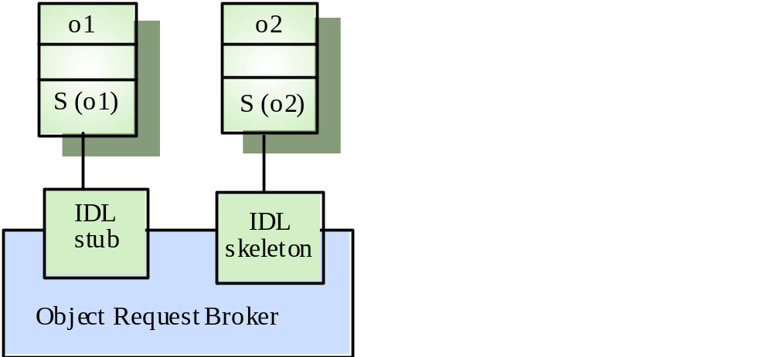
Object Communication 对象通讯

Slide 17
CORBA Services
Naming and trading services
  These allow objects to discover and refer to other objects on the network
Notification services
  These allow objects to notify other objects that an event has occurred
Transaction services
  These support atomic transactions and rollback on failure

Slide 18
Benefits of components
Components form a basic unit for maintenance and upgrading:
  Using components there should no longer be a need to upgrade entire "systems". Instead, components get replaced or added as required.
  Partitioning systems up into components enables parallel development
  Interface-centric design gives scalable and extensible architectures
  Components offer greater scope for standardisation, and this benefits the development of systems (no need to keep re-inventing the wheel as basic services are already built into standards)

Slide 19
Reuse
One of the most compelling reasons for adopting component based development is the promise of reuse
In its broadest sense reuse = any situation in which work done for one project is used to help another
Some questions:
  What can be reused and how?
  Why reuse?
  Why is reuse hard?
  Which components are generally reusable?

Slide 20
What can be reused, and how?
The following are all things that can be reused:
  Specifications
  Architecture
  Code
  Designs
  Documentation
  Tests
Most effort has been geared towards reusing single classes.
For example, class libraries.

Slide 21
Why reuse?

Slide 22
Why reuse?
The bottom line is to save money. Reuse has the benefit of:
  saving developers time.
  making products more reliable (someone else has ironed out the bugs in the component already).
  reducing market cycle time. Faster product development is essential in allowing a company to exploit new areas of work quickly.
  encouraging developers to focus on the design of the system as opposed to how it is to be implemented.
  this in turn can lead to more interesting and rewarding work (not just programming all the time), which is good for employer and employee.
  encouraging the development of more maintainable systems.

Slide 23
Why is reuse difficult?
Imagine you are a developer wishing to reuse components:

Slide 24
Why is reuse difficult?
Imagine you are a developer wishing to reuse components:
  Even if a components exists, can you find it? Large component libraries are hard to search.
  How can you be sure that the component will do what you want? If it does not (highly likely) you will need to adapt it (but how?)
  Do you trust it? How can you be sure it will do what is claimed for it?

Slide 25
Frameworks 框架
Another widely used approach to reuse is the frameworks approach
A framework is a concrete, yet incomplete, design of a system or software architecture
Frameworks provide plug-in points for adding concrete classes

Slide 26
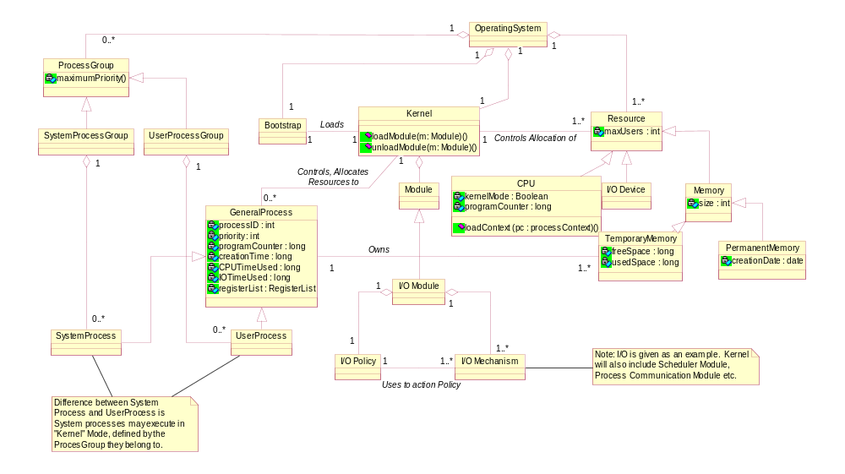
Example – operating system framework
Plug-point

Slide 27
Components and OO
What difference does OO make?
Components need not be implemented using OO, but it helps!
  OO provides facilities for describing interfaces (methods) and plug-ins (subclassing of abstract classes).
  it also emphasises high cohesion/low coupling, which is important in building components.

Slide 28
Future
Components are becoming an increasingly important part of software engineering
In fact they are a whole area of study in themselves
Their use recognises the fact that system are no longer built from scratch, and that reusing existing components can save time and money
While most CBD focuses on program components, it is likely that more and more people will begin looking at the reuse of other artefacts, e.g. specifications, in the future

Slide 29
Bibliography
Some useful books on CBD and reuse are:
Ivar Jacobson: Software Reuse : Architecture Process and Organization for Business Success, Addison-Wesley 1997.
Richard Monson-Haefel, Enterprise JavaBeans. O-Reilly, 1999
A source of online software components:
http://www.componentsource.com/

