Slide 2

Inside Contents
.
Executive Summary | Cashless Vs Reimbursement Analysis | Maternity Analysis | TAT analysis
Demographic Analysis | Relationship Wise Analysis | Disease Analysis
Portfolio Summary | Age Band Wise Analysis | Hospital Wise Analysis
Claim Status and Ratios | Amount Wise Analysis | Claim Value Settlement Ratio
Relation wise Incident Rate | Sum Insured wise Analysis | Rejection Reasons

Slide 3
Particulars
•Incurred Claim Ratio
•Demographic Analysis
•Cashless Vs. Reimbursement
•Claim Value Settlement Ratio
•High Value Claims ( >100K)
•Top 3 Disease

Slide 4
Portfolio Summary

Slide 5
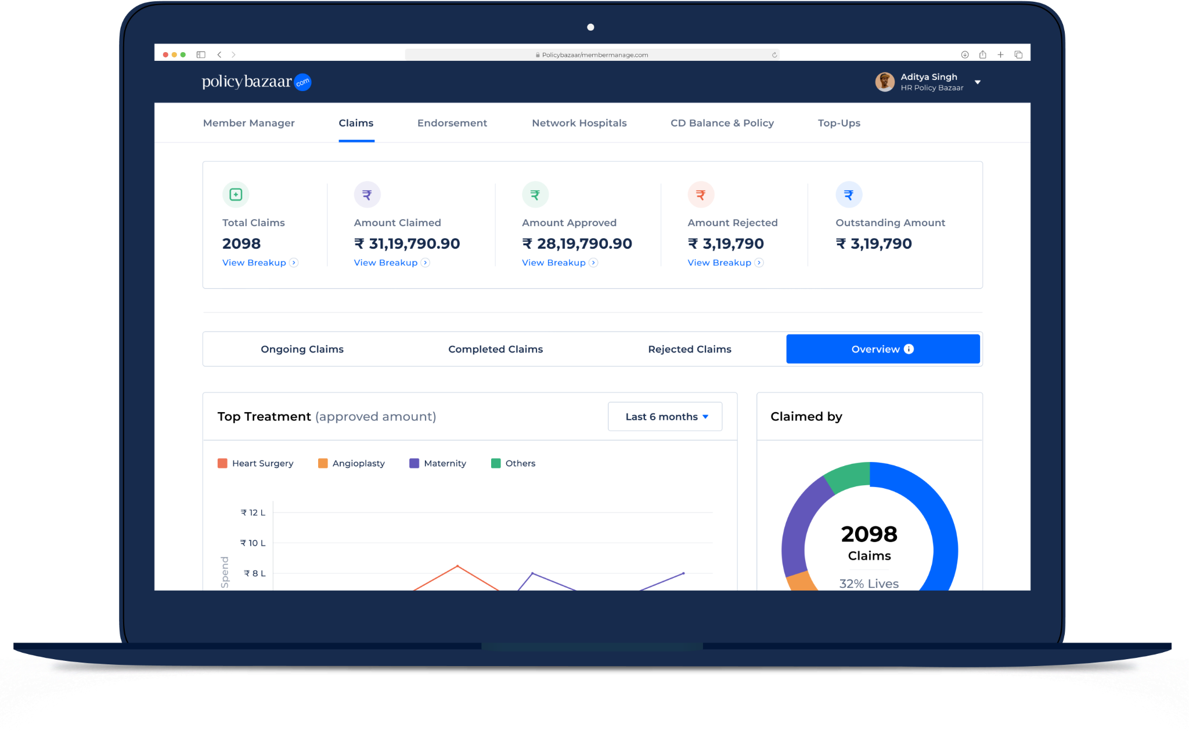

Simplifying Employee Benefits End to End
Demographic Analysis
1
Notes:
Key differentiators this years - 9 years

Slide 6
Demographic Analysis – Relationship Wise
Gender Wise Count

Slide 7
Demographic Analysis ESK Policy – Age Band Analysis

Slide 8
Demographic Analysis ESK Policy – Sum Insured & Household Wise

Slide 9
This is a text box

