Slide 1

Department of Facilities Management
Cook County
Civic Hackathon | 10 October 2015

Slide 2
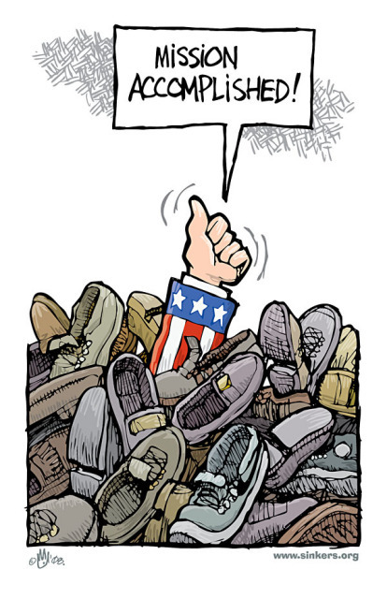
Mission
The Department of Facilities Management exists to ethically maintain and operate Cook County facilities in a cost effective manner for both the general public and various Cook County departments in order to have a safe, reliable and clean environment conducive and support to carrying out the business and services of the County.

Slide 3
The Problem
Resources
Responsibilities
$43M
Yearly Budget
500
Full-time Skilled Laborers
183,000 Work Orders/year
12M sqft of usable space
Day-to-day Maintenance
Big
Projects
How do we efficiently and effectively allocate resources?

Slide 4

The Problem
How many plumbers does it take to change a lightbulb?

Slide 5
Critical Questions
How long should each work order take?
How many people should be assigned to each task?
Narrowing down the scope

Slide 6

The Data
What do we have?

Slide 7
Data Source
Work Order System
Real-Time Data
Future Plans
Work Order Release
Foreman Estimate
Job Assignment
Track Job Status
Job Completion
Data Entry by Handheld Devices
Job Type
Job Location
Job Priority
Assigned Foreman
Assigned Worker(s)
Open Date and Time
Assignment Date and Time
Close Date and Time
Additional Data Points
Estimated Time of Completion
Benchmark
Compare Cook County with Other Counties

Slide 8

The Solution
Alert System

Slide 9


What does this system do?
Foreman
Identify work orders that are taking too long to be assigned based on job type and location
:
Laborers
Identify work orders that are taking too long to be completed based on job type and location

Slide 10
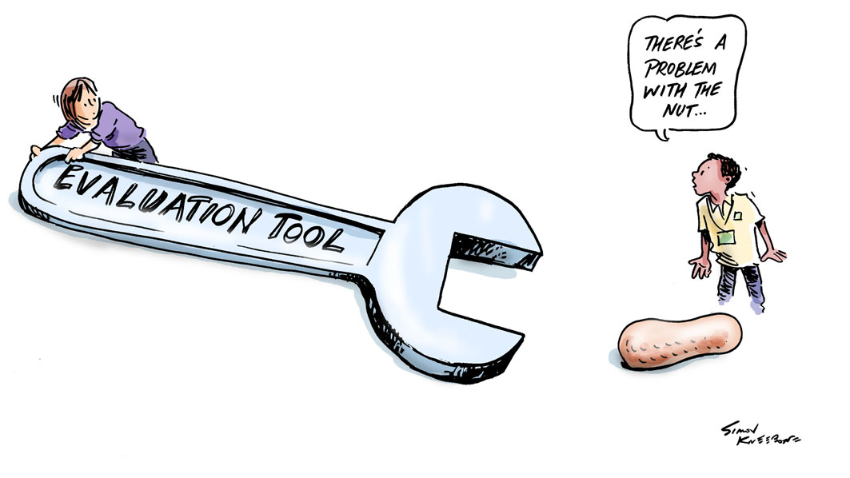
The Solution
Serves as a basis for the evaluation of the laborers and foremen

Slide 11

Theory of Change
Analyze
Alert
Accountability
Use the Data
Establish benchmarks for expected completion time given job and location.
Intervene
Figure out which ones are taking too long in real time and why.
Save Taxpayer Dollars
Incorporate into a performance review process and incentivize efficiency.

Slide 12

Did you like it?

