Slide 1
Rising Inequality Within Countries Under Globalization
Measured through the inequality in pay in manufacturing
APSA
Chicago, September 2004

Slide 2

by
James K. Galbraith
The University of Texas Inequality Project
http://utip.gov.utexas.edu

Slide 3
A Global Coup?
Looking Beyond Technology and Trade at the Causes of Rising Inequality in the Age of Globalization

Slide 4
With the UTIP data, we can review changes in global inequality both across countries and through time. Nothing comparable can be done with the Deininger and Squire data set, for the measurements are too sparse and too inconsistent.

Slide 5
The Scale
Brown: Very large decreases in inequality; more than 8 percent per year.
Red Moderate decreases in inequality.
Pink: Slight Decreases.
Light Blue: No Change or Slight increases
Medium Blue: Large Increases -- Greater than 3 percent per year.
Dark Blue: Very Large Increases -- Greater than 20 percent per year. h

Slide 6
1963 to 1969

Slide 7
1970 to 1976
The oil boom: inequality declines in the producing states, but rises in the industrial oil-consuming countries, led by the United States.

Slide 8
1977 to 1983

Slide 9
1981 to 1987
… the Age of Debt
Note the exceptions to rising inequality are mainly India and China, neither affected by the debt crisis…

Slide 10
1984 to 1990

Slide 11
1988 to 1994
The age of globalization…
Now the largest increases in inequality in are the post-communist states; an exception is in booming Southeast Asia, before 1997…

Slide 12
Simon Kuznets in 1955 argued that while inequality could rise in the early stages of industrialization, in the later stages it should be expected to decline. This is the famous “inverted U” hypothesis.
Recent studies based on Deininger & Squire find almost no support for any relationship between inequality and income levels.
We believe, however, that in the modern developing world the downward sloping relationship should predominate, particularly in data drawn from the industrial sector.

Slide 13
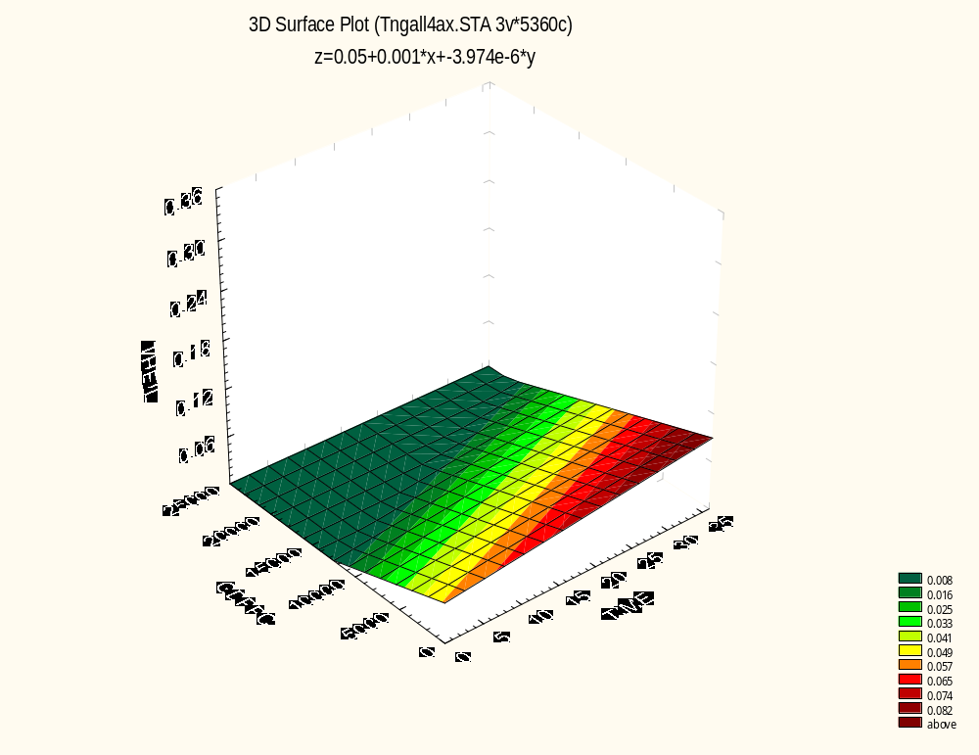
A regression of pay inequality on GDP per capita and time, 1963-1998.
The downward sloping income-inequality relation holds, but with an upward shift over time…

Slide 14
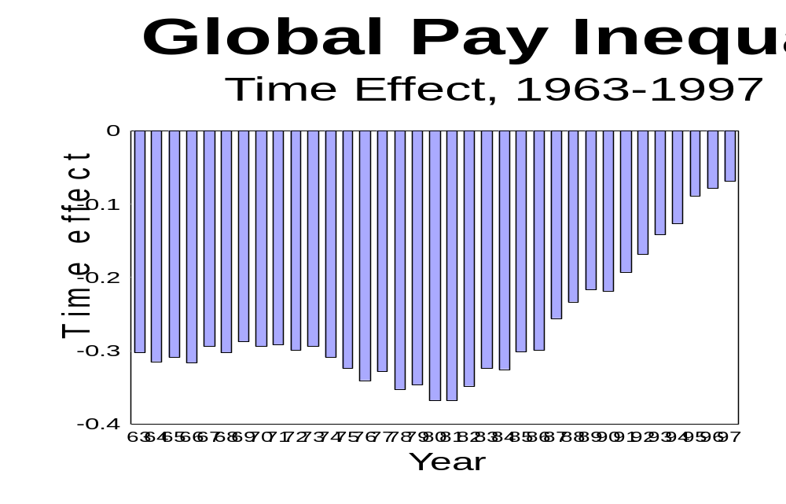
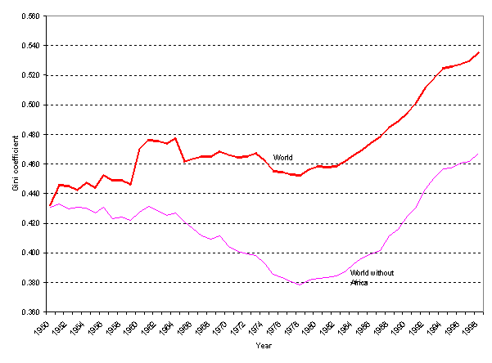
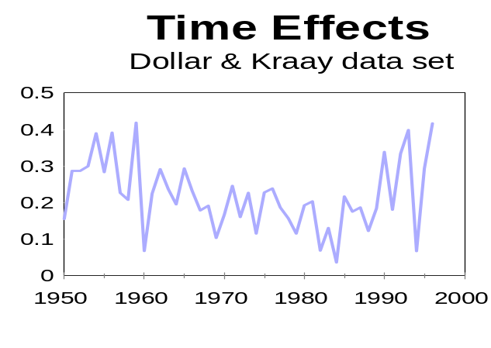
Milanovic Unweighted
Inequality Between Countries
The time effect from a two-way fixed effects panel data analysis of inequality on GDP per capita, with time and country effects.

Slide 15
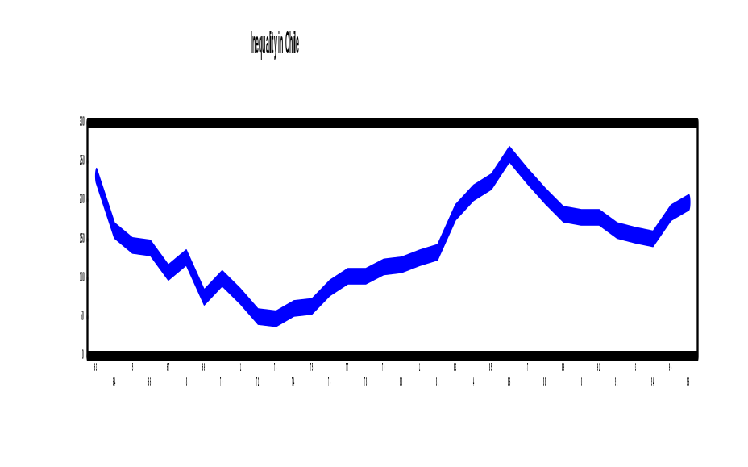
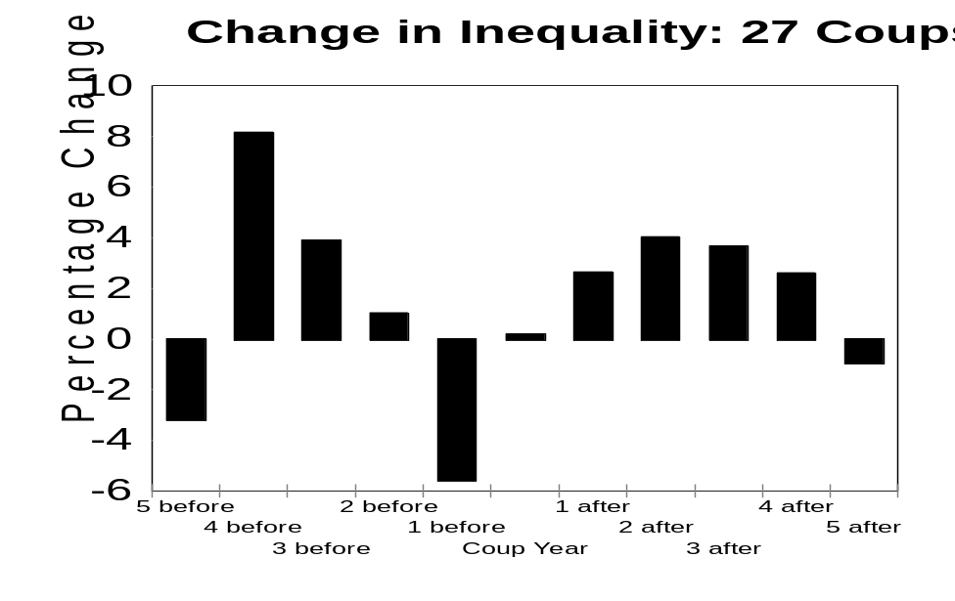
This pattern resembles the general pattern we associate,
within countries, with the coup d’etat:

Slide 16
Main conclusions
Inequality has been rising in the age of globalization.
Kuznets was right: in general, inequality does declines with rising income. A decline in economic growth rates is part of the problem in many countries.
But there is also an important global element to rising inequality, independent of national income growth. This reflects a failing of the world system, particularly in the years since 1980.

Slide 17
Beating the Bank at its Own Game:
Estimating Income Inequality from measures of pay inequality and other economic information

Slide 18
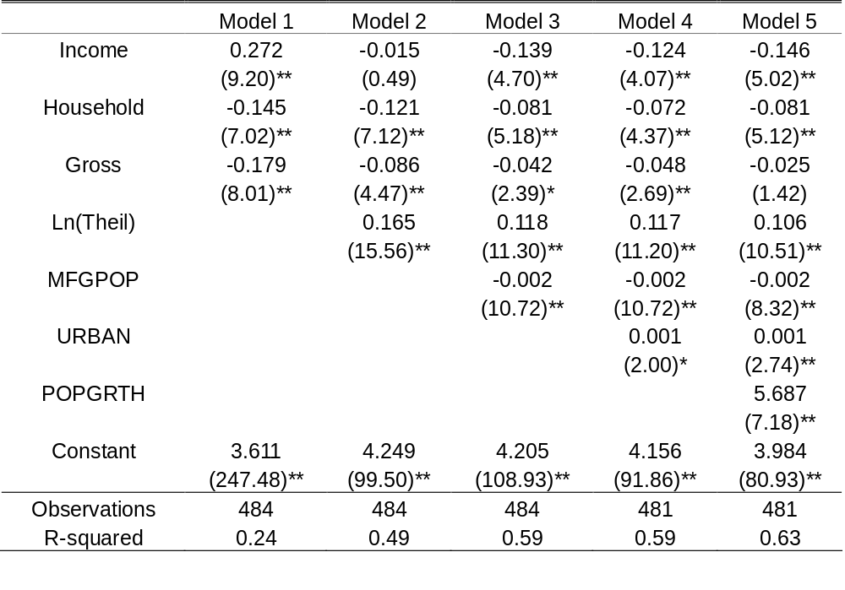
Estimating the DS Gini Coefficients from Pay Inequality and other variables.
Dependent variable is log(DSGini)

Slide 19
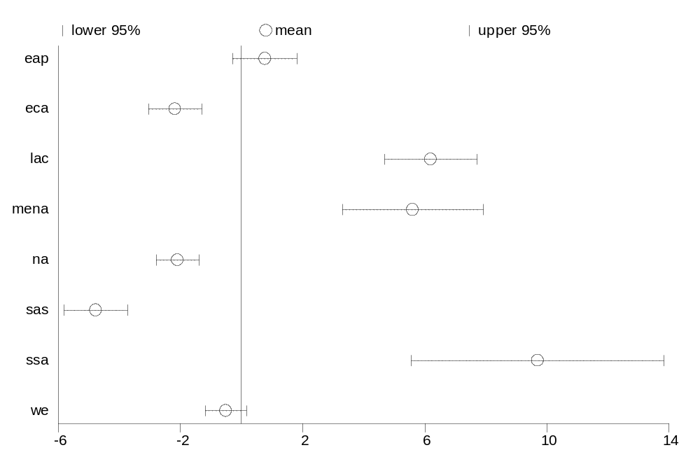
Mean Value and Confidence Interval of Differences
  eap: East Asia and Pacific
  eca: Eastern Europe and Central Asia
  lac: Latin and Central America
  mena: Middle East and North Africa
  na: North America
  sas: South Asia
  ssa: Sub Saharan Africa
  we: Western Europe

Slide 20
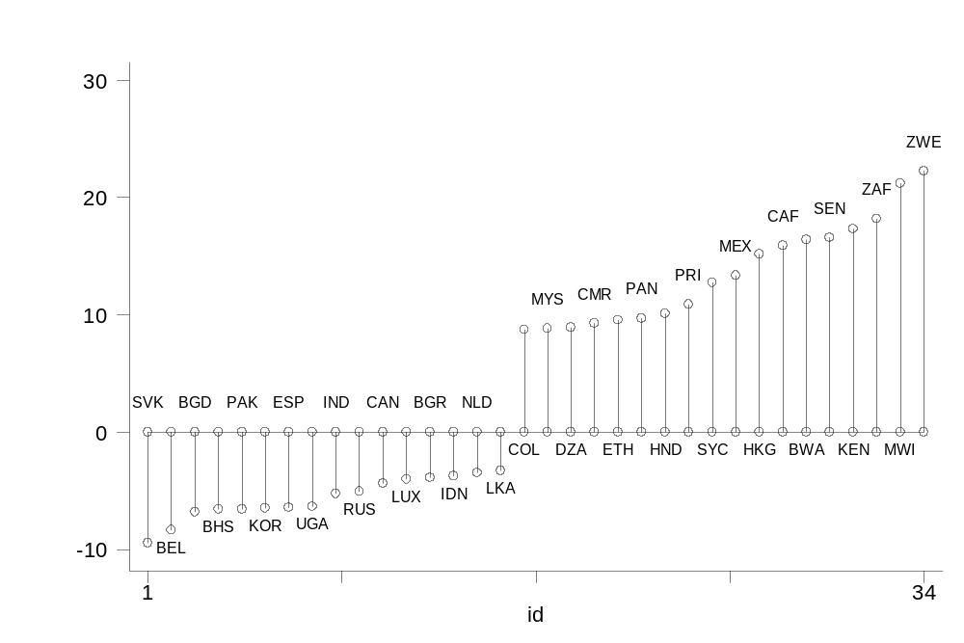
Major Differences Between D&S Gini and EHII Gini

Slide 21
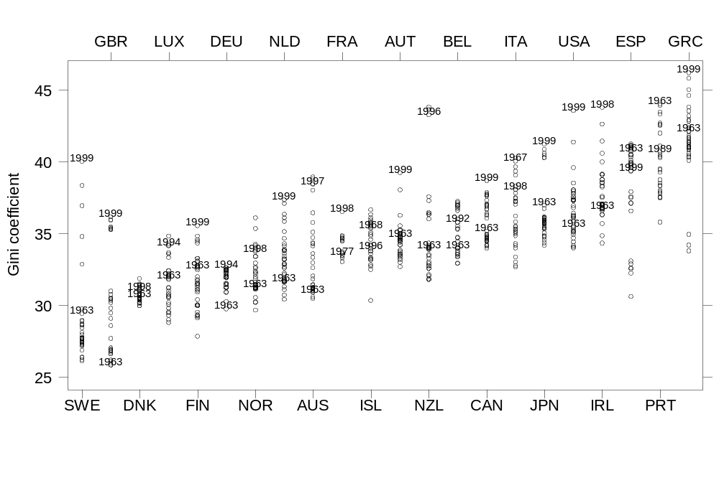
EHII -- Estimated Household Income Inequality for OECD Countries
Low
High

Slide 22
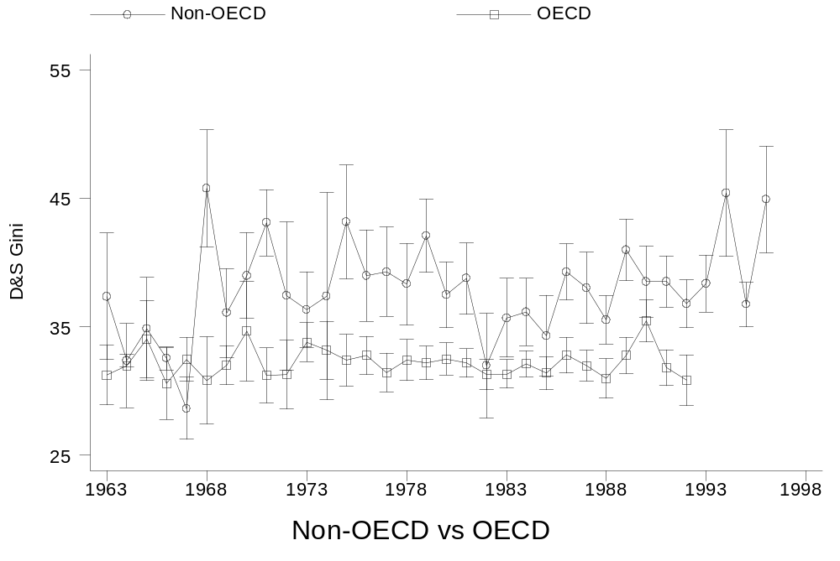
Trends of Inequality in the D&S Data

Slide 23
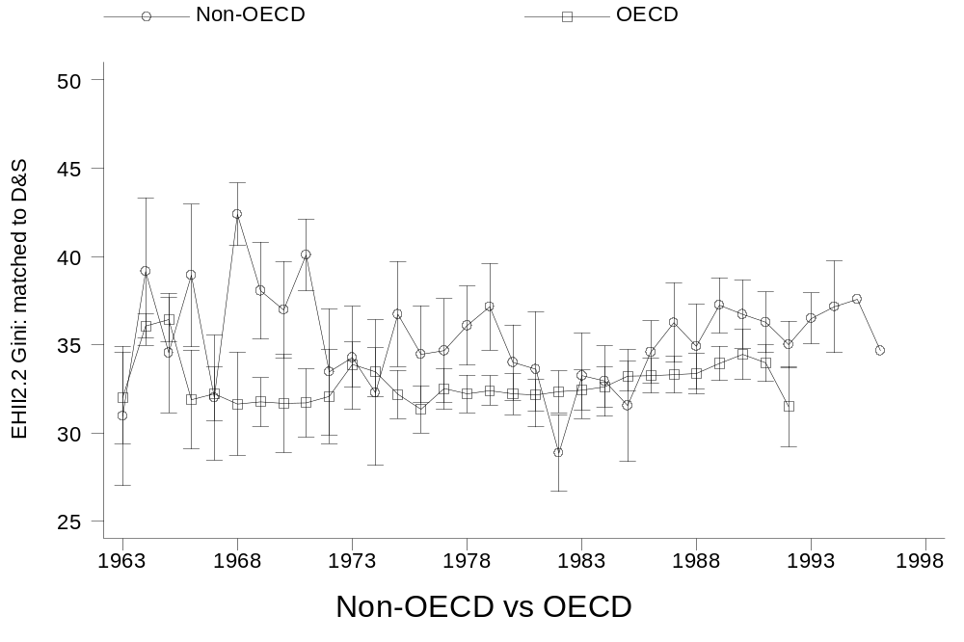
Trends of Inequality in subset of EHII 2.2 Data matched to D&S

Slide 24
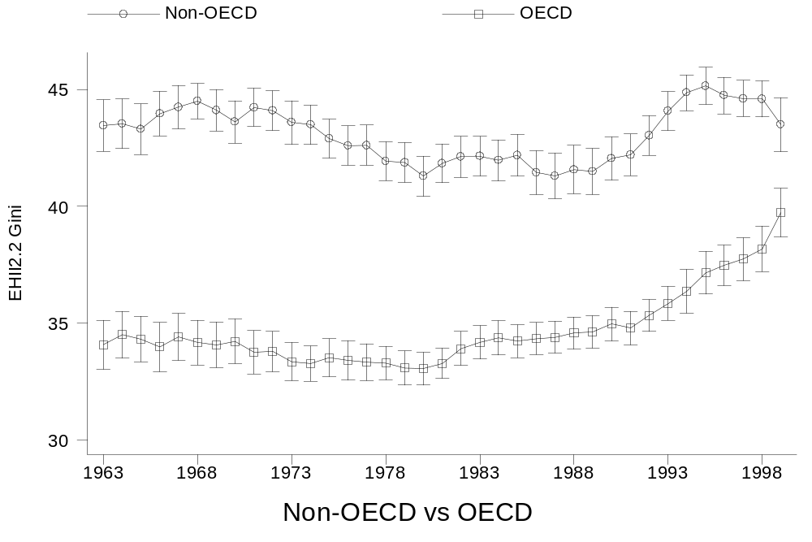
Trends of Inequality in Full EHII 2.2 Dataset (N=3,179)

Slide 25
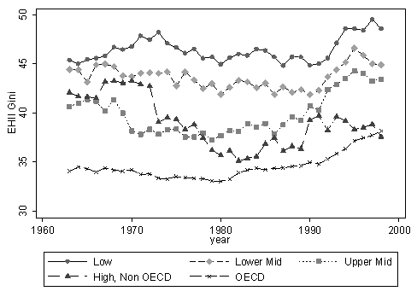
Trends of Inequality in the EHII 2.2 Dataset by Income Level

Slide 26
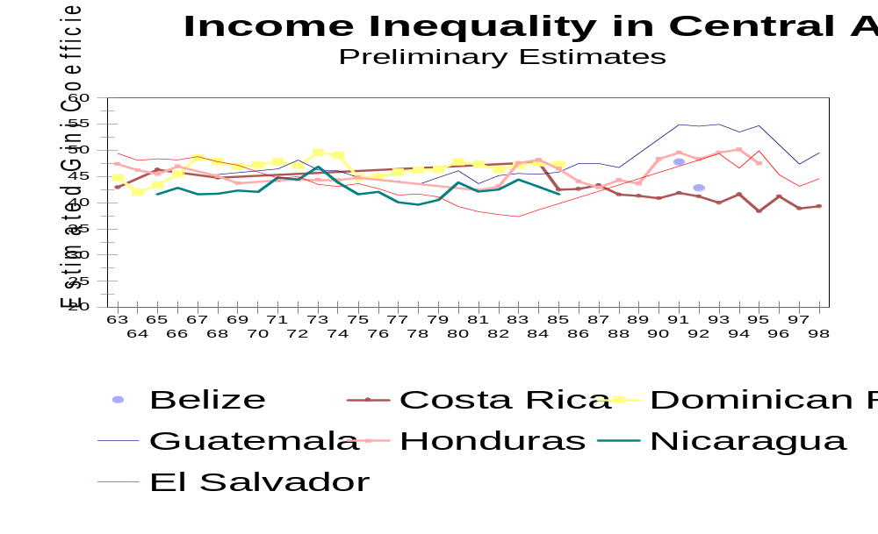

Slide 27
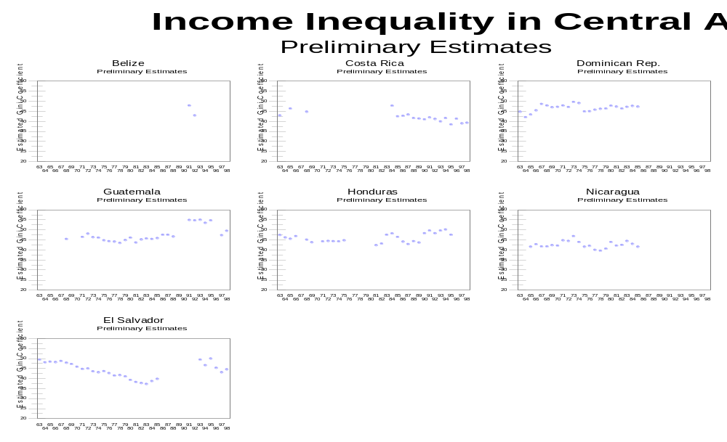

Slide 28
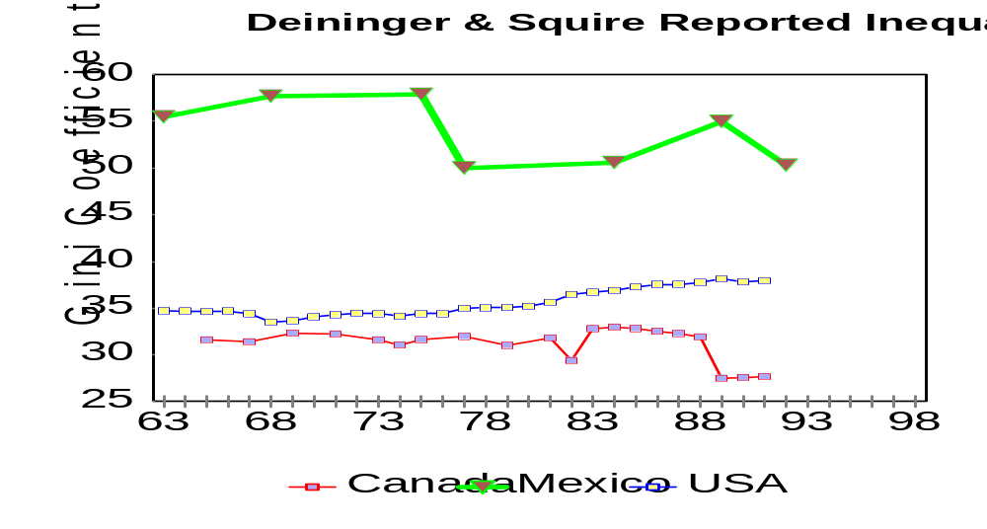
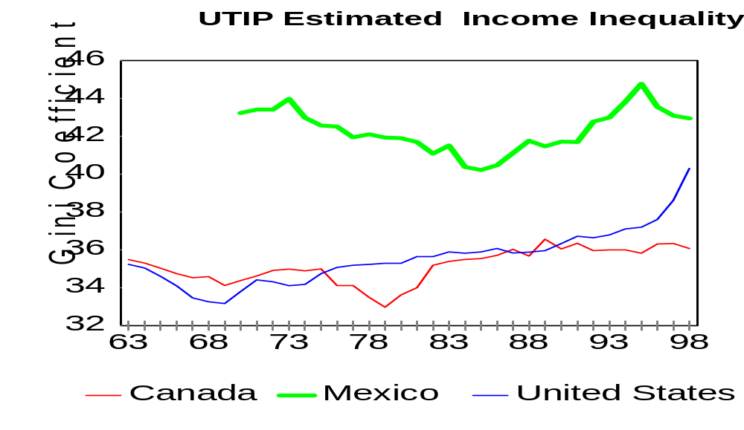
Income Inequality in North America

Slide 29

Type “Inequality” into Google to find us on the Web

