Slide 1

PYTHON FUNDAMENTALS
INFO1 Mission 2 (S3)
Jean-Luc Bibaud

Slide 2
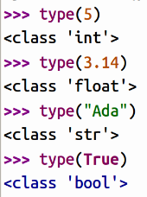
VARIABLES, VALUES & DATA TYPES
Type and Value
type(value) → its type
5
→
int
3.14
→
float
"Ada"
→
str
True
→
bool
INFO1 · Mission 1 (S2)
2 / 9

Slide 3
OPERATORS
Concatenation vs Addition
Addition
Concatenation
1 + 1
"hi " + "world"
= 2 numbers are added
= "hi world" strings are joined
INFO1 · Mission 1 (S2)
3 / 9

Slide 4
CONTROL FLOW
Which branch runs?
if x < y:
In this example, what happens if we have
print("STATEMENTS_A")
elif x > y:
x = 3
print("STATEMENTS_B")
y = 4
else:
print("STATEMENTS_C")
INFO1 · Mission 1 (S2)
4 / 9

Slide 5
TYPES
Explicit vs Implicit type conversion
Explicit
Implicit
A = str(55.55)
A = 2
A = A + 0.14
you ask for the conversion
Python converts for you (int → float)
INFO1 · Mission 1 (S2)
5 / 9

Slide 6
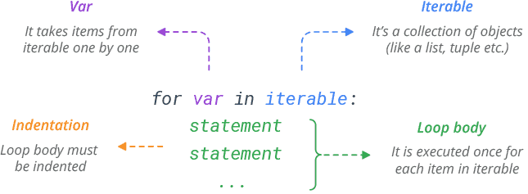
CONTROL FLOW
For loops
INFO1 · Mission 1 (S2)
6 / 9

Slide 7
CONTROL FLOW
Range for making numbers Iterable
range(start, stop, step)
range(stop) is the same as range(0, stop, 1)
INFO1 · Mission 1 (S2)
7 / 9

Slide 8
CONTROL FLOW
Break to get out of a loop
for i in range(5):
A
B
C
print(i)
0
0
0
if i == 3:
1
1
1
break
2
2
2
3
3
4
INFO1 · Mission 1 (S2)
The correct answer is B
8 / 9

Slide 9
CONTROL FLOW
Continue to skip an iteration
for i in range(5):
A
B
C
print(i)
0
0
0
if i == 3:
1
1
1
continue
2
2
2
3
3
4
INFO1 · Mission 1 (S2)
The correct answer is A
9 / 9

