Slide 1

STRINGS, LISTS & MUTABILITY
INFO1 Mission 4 (S5)
Jean-Luc Bibaud

Slide 2
STRINGS
Methods on strings (and other objects)
1
A string is an object
my_str = "hi"
my_str_upper = my_str.upper()
print(my_str_upper)
2
Methods are functions that come with the object
→ HI
"banana".count("a")
3
You apply them with a . object.method()
→ 3
"a,b,c".split(",")
Lists have methods too: nums.append(4)
→ ['a', 'b', 'c']
4
"hi".replace("h", "p")
→ 'pi'
INFO1 · Mission 4 (S5)
2 / 13
Notes:
A method is just a function attached to the object: you call it with a dot. Note that upper() does not change my_str, it gives back a new string — that's why we store it in my_str_upper.

Slide 3
STRINGS & LISTS
Indexing operator
How it works
VARIABLE[INDEX] or VALUE[INDEX] gives a value
VALUE[...] is less common
Indexes start at 0.
What it does depends on the type:
# string
nums = [1, 2, 4]
"hi"[0]
nums[1]
→ 'h' (a str)
→ 2 (an int)
INFO1 · Mission 4 (S5)
3 / 13

Slide 4
LOOPS
What is iterable? How to loop through all elements?
Iterable = something you can go through one element at a time: a string, a list, a range…
What does this do then?
fruit = "banana"
for i in fruit:
list(enumerate(fruit))
print(i)
→ [(0, 'b'), (1, 'a'), (2, 'n'),
(3, 'a'), (4, 'n'), (5, 'a')]
→ b
a
n
a
n
a
list(enumerate(range(0, 5)))
→ [(0, 0), (1, 1), (2, 2), (3, 3), (4, 4)]
INFO1 · Mission 4 (S5)
4 / 13
Notes:
A for loop takes the elements of the iterable one by one. On a string, that's each character — so the loop prints b, a, n, a, n, a on separate lines. (range(fruit) would not work: range needs a number.)

Slide 5
LISTS
Nested lists are possible
mx = [[1, 2, 3],
0
1
2
0
1
2
3
[4, 5, 6],
[7, 8, 9]]
1
4
5
6
row ↓ column →
2
7
8
9
for row in mx:
print(row)
→ [1, 2, 3]
[4, 5, 6]
[7, 8, 9]
mx[1]
→ [4, 5, 6]
mx[1][2]
→ 6
mx[-1][0]
→ 7
INFO1 · Mission 4 (S5)
5 / 13

Slide 6
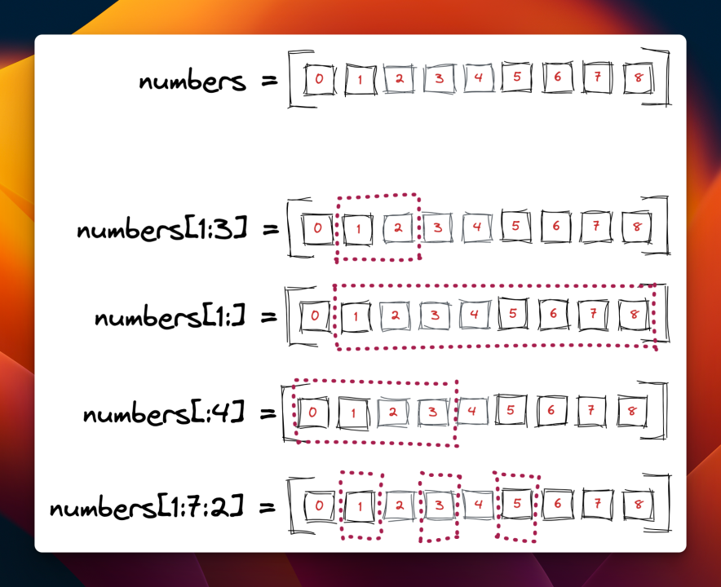
STRINGS & LISTS
Slices and substrings
Using negative indexes?
0
1
2
3
4
5
6
word
a
m
a
z
i
n
g
-7
-6
-5
-4
-3
-2
-1
What does this give?
word[-1]
→ 'g'
word[-3:]
→ 'ing'
word[:-3]
→ 'amaz'
word[-5:-2]
→ 'azi'
word[::-1]
→ 'gnizama'
[start : stop : step] — stop is excluded
INFO1 · Mission 4 (S5)
6 / 13
Notes:
Negative indexes count from the end: -1 is the last character. Slices work the same way, stop is still excluded: word[-5:-2] takes -5, -4, -3 → 'azi'. A step of -1 walks backwards, so word[::-1] reverses the string.

Slide 7
MUTABILITY
Numbers and strings (and tuples) are immutable!
Numbers
Strings
x = 23
x
23
greeting = "Hello, world!"
y = x
y
greeting[0] = "J"
→ TypeError: 'str' object does not
support item assignment
How many distinct values exist?
→ 1
print(greeting)
x
12
→ Hello, world!
x = 12
y
23
Concatenation creates a new string and binds the name to that new value:
x = 12 rebinds the name x to the value 12. It does not change 23 — y still points to it.
greeting = greeting + " Bye!"
print(greeting)
→ Hello, world! Bye!
INFO1 · Mission 4 (S5)
7 / 13

Slide 8
MUTABILITY
Lists are mutable! Looking at a list
after tri = nums
nums = [1, 2, 3]
nums
1
2
3
tri = nums
tri
after nums.append(4)
nums.append(4)
nums
1
2
3
4
tri
print(tri)
Only one list: tri is just a second name for it.
→ [1, 2, 3, 4]
Want a separate list? tri = nums.copy() (or nums[:])
INFO1 · Mission 4 (S5)
8 / 13

Slide 9
FUNCTIONS
Functions reminder
Invoking / calling
def NAME(PARAMETERS):
STATEMENTS
= executing the code of that function
return VALUE # optional
NAME(ARGUMENTS)
Without a return, the function gives back None.
x = myfunction(20) # x is what the function returned
INFO1 · Mission 4 (S5)
9 / 13

Slide 10
FUNCTIONS & MUTABILITY
List in a function
A list is changed in place
A number is not
def add(lst):
def add(num):
lst.append("B")
num += 1
return lst
return num
my_list = ["X"]
my_num = 3
add(my_list)
add(my_num)
print(my_list)
→ returns 4 (not stored!)
→ ['X', 'B']
print(my_num)
→ 3
The function gets the same list, so append changes it. num += 1 makes a new number, only inside.
INFO1 · Mission 4 (S5)
10 / 13
Notes:
I renamed the parameter from list to lst: naming it list hides Python's built-in list() function.

Slide 11
NAMING
Two hard things
“
All of these are assignments
X = ...
with ... as X:
There are 2 hard problems in computer science: cache invalidation, naming things, and off-by-1 errors.
for X in ...
except ... as X:
[... for X in ...]
import X
(... for X in ...)
from ... import X
{... for X in ...}
import ... as X
class X(...):
from ... import ... as X
A joke built on Phil Karlton's quote (his original only had the first two).
def X(...):
def fn(X): ... ; fn(12)
INFO1 · Mission 4 (S5)
11 / 13

Slide 12
COMPARISON
Difference between is and ==?
==
same value?
a = [1, 2, 3]
is
same object (the same list in memory)?
b = [1, 2, 3]
c = a
a
1
2
3
c
a == b
→ True
b
1
2
3
a is b
→ False
same values, but two different lists
a is c
→ True
Use is only for None: if x is None:
INFO1 · Mission 4 (S5)
12 / 13
Notes:
== asks: do they look the same? is asks: are they literally the same object? Don't use is to compare numbers or strings: it sometimes works by accident because Python reuses small values, which makes bugs hard to find.

Slide 13
WATCH OUT
Common beginner mistakes
Storing what append gives
Thinking strings change
Index one too far
nums = [1, 2]
s = "hi"
word = "hi"
nums = nums.append(3)
s.upper()
word[2] # IndexError
# nums is now None
print(s) # hi
append changes the list and returns None.
Strings never change: write s = s.upper().
The last index is len(word) - 1, or just -1.
Forgetting stop is excluded
Copying a list with =
is instead of ==
"amazing"[0:3]
tri = nums
if name is "Ada":
# 'ama', not 'amaz'
tri.append(9)
# works... sometimes
# nums changed too!
[start:stop] stops just before stop.
Use nums.copy() for a real copy.
== for values, is only for None.
INFO1 · Mission 4 (S5)
13 / 13

