Slide 1
Steepest Descent Method (SDM)
A 1D Projection Method for SPD Linear Systems
Student: Адейеми Коладе Дамилола
Course: Numerical Methods of Linear Algebra for Sparse Matrices
Lecturer: Anna Nasedkina, PhD, Assoc. Prof.
Project: SDM • Southern Federal University • July 2026

Slide 2
Motivation
2
▸ Goal: solve A x = b for large SPD systems arising from PDE discretisation (e.g. Poisson).
▸ Direct methods (LU / Cholesky): O(n³) work, O(n²) memory, and fill-in destroys sparsity.
▸ Iterative projection methods use only matrix-vector products (O(nnz)/step) and preserve sparsity.
▸ SDM is the simplest 1D projection method — the conceptual building block for CG and Krylov methods.
▸ Requirement: A must be symmetric positive definite (SPD).

Slide 3
SDM as a 1D Projection Method
3
▸ Projection framework: seek x̃ = x0 + δ, δ ∈ K, with residual r ⊥ L (Petrov–Galerkin).
▸ SDM chooses K = L = span{ r_k } → orthogonal projection (A is SPD).
▸ Equivalent view: minimise the quadratic functional f(x) = ½(A x, x) − (b, x).
▸ Gradient ∇f(x) = A x − b = −r → steepest-descent direction is the residual r.
x_{k+1} = x_k + α_k r_k , α_k = (r_k , r_k) / (A r_k , r_k)

Slide 4
Algorithm — Modified SDM (1 MVP/iteration)
4
Input : A (SPD), b, x0, tol, kmax
r0 = b - A*x0 ; p0 = A*r0
for k = 0,1,2,...
if ||r_k||_2 / ||b||_2 < tol -> stop
alpha_k = (r_k , r_k) / (p_k , r_k) % p_k = A r_k
x_{k+1} = x_k + alpha_k * r_k
r_{k+1} = r_k - alpha_k * p_k % recurrence (saves 1 MVP)
p_{k+1} = A * r_{k+1}
end
▸ Only ONE product A·r per iteration.
▸ Stop on the RELATIVE residual ‖r‖₂/‖b‖₂.
▸ Returns x, r, ‖r‖₂, ‖r‖₂/‖b‖₂, k.
▸ Convergence checked inside the function.

Slide 5
MATLAB Implementation (SDM.m)
5
function [x,r,rnorm,relres,k,rnorm_hist] = SDM(A,b,x0,tol,kmax)
x = x0; r = b - A*x; p = A*r; % p = A r (one MVP)
nb = norm(b,2); if nb==0, nb = 1; end
rnorm = norm(r,2); rnorm_hist(1) = rnorm;
for k = 0:kmax
if rnorm/nb < tol || k==kmax, break; end % rel. residual
Ar = p; alpha = (r'*r)/(r'*Ar);
x = x + alpha*r;
r = r - alpha*Ar; % residual recurrence
p = A*r;
rnorm = norm(r,2); rnorm_hist(k+2) = rnorm;
end
relres = rnorm/nb;
▸ Modified SDM: 1 MVP/iter.
▸ Returns ‖r‖₂ and ‖r‖₂/‖b‖₂.
▸ Norms explicit 2-norm.
▸ SPD checked via chol.

Slide 6
Convergence Theory (Lecture 12, Thm 2)
6
▸ If A is SPD, SDM converges for ANY initial guess x0.
▸ Error decreases monotonically in the A-norm ‖v‖_A = √(A v, v).
||x_{k+1} - x*||_A ≤ (κ - 1)/(κ + 1) · ||x_k - x*||_A , κ = λmax/λmin
▸ Contraction factor (κ−1)/(κ+1): κ = 2.84 → 0.48 (fast); κ = 4.3×10⁴ → 0.99995 (stalls).
▸ Convergence speed depends on the CONDITIONING of A, not its size.

Slide 7
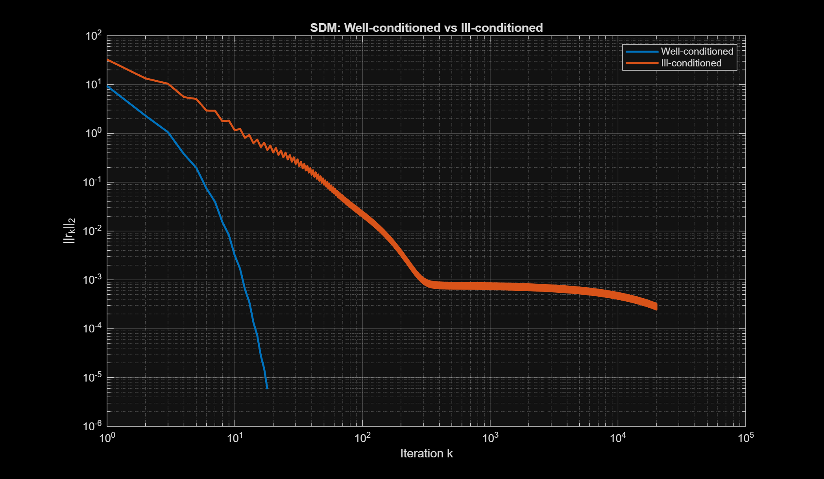
Numerical Results — Accuracy & Scaling
7
Test 1 (3×3): exact solution in 56 iters, error 3.0e-12
n | κ(A) | Iters | CPU (s) | Rel.err
100 | 4.66 | 28 | 0.0012 | 1.3e-6
1000 | 4.97 | 31 | 0.0020 | 1.1e-6
3000 | 4.99 | 30 | 0.0204 | 1.4e-6
Scaling (n = 100/1000/3000): iterations ≈ const (κ fixed ≈ 5),
CPU grows with n → cost is per-iteration MVP, not iteration count.
Confirms SDM depends on conditioning, not size.
Well- vs ill-conditioned: κ decides convergence

Slide 8
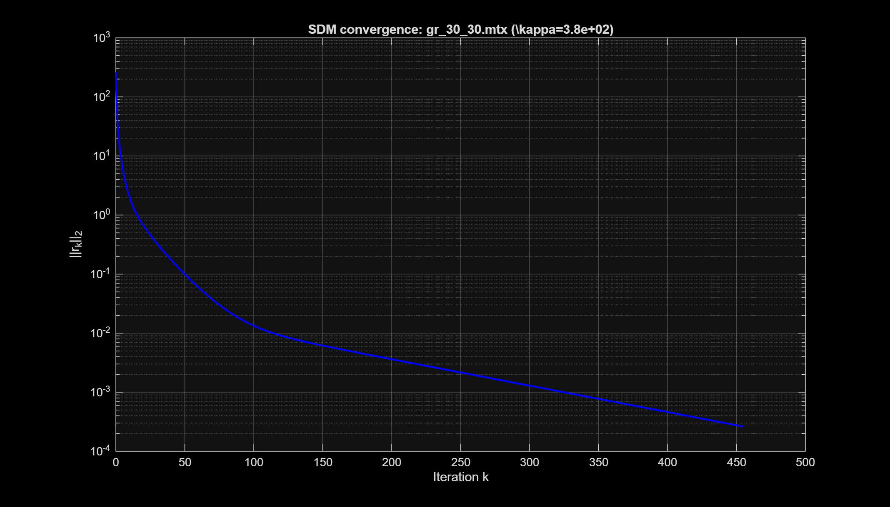
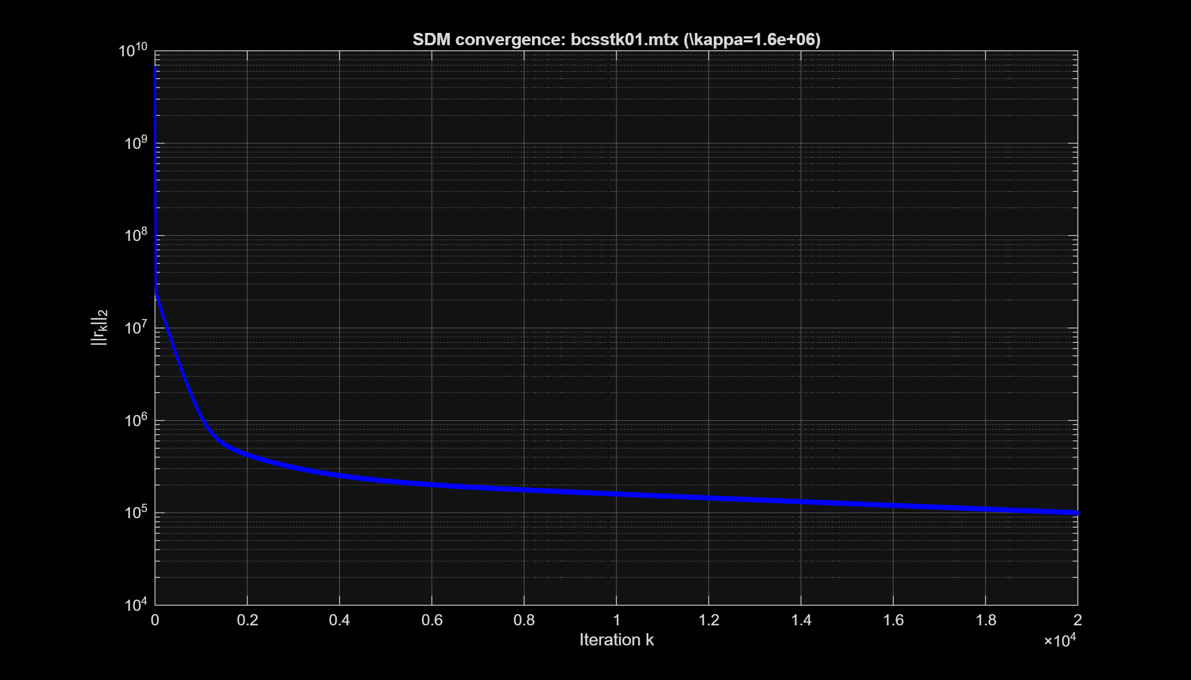
Real Matrix Market Matrices vs CG
8
Real SPD matrices via mmread: gr_30_30 (900×900),
bcsstk01 (48×48). SPD verified: ‖A−Aᵀ‖₁ = 0, chol p = 0.
Matrix | κ | Method | Iters | Conv.
gr_30_30 | 3.8e2 | SDM | 455 | Yes
gr_30_30 | 3.8e2 | CG | 52 | Yes
bcsstk01 | 1.6e6 | SDM | 20000 | No
bcsstk01 | 1.6e6 | CG | 78 | Yes
Well-conditioned gr_30_30: SDM converges (455), CG faster (52).
Ill-conditioned bcsstk01 (κ=1.6e6): SDM STALLS, CG still works.
Real data confirms: SDM collapses as κ grows → use CG.
gr_30_30 converges (top) — bcsstk01 stagnates (bottom)

Slide 9
Conclusions
9
▸ Strengths:
  – Simple; one MVP per step (O(nnz)); guaranteed convergence for any SPD A and any x0.
  – Monotonic error decrease in the A-norm.
▸ Limitations:
  – Rate (κ−1)/(κ+1): very slow for ill-conditioned systems (Test 4).
  – SPD only; zig-zag directions are sub-optimal — CG is strictly better.
▸ Future work: Conjugate Gradient (A-orthogonal directions); GMRES for nonsymmetric systems.

Slide 10
References
10
▸ Y. Saad, Iterative Methods for Sparse Linear Systems, 2nd ed., SIAM, 2003.
  – Ch. 5 — Projection methods (Steepest Descent, MR); Ch. 6–8 — Krylov / CG.
▸ A. Nasedkina, Lecture 12: Projection methods. 1D projection methods. SFU, 2026.
▸ A. Nasedkina, Lecture 10: Direct & iterative methods; general iterative formulation. SFU, 2026.
▸ A. Nasedkina, Lecture 2 (vector & matrix norms); Lecture 6 (positive definite matrices). SFU, 2026.
▸ R. Barrett et al., Templates for the Solution of Linear Systems, SIAM, 1994.
▸ Matrix Market — math.nist.gov/MatrixMarket (test matrices gr_30_30, bcsstk01).

Slide 11
Thank you!
Questions?
Адейеми Коладе Дамилола • SDM • Numerical Methods of Linear Algebra for Sparse Matrices

