Slide 1

Analytics project Salary Insights: Predicting Earnings Learn from the world’s largest community of professional software developers
Data Circle, Fall 2024, Berlin, Germany

Slide 2
Agenda
Introduction
Insights and trends in the developer community
Machine learning models to predict annual salary
Takeaways

Slide 3

Stack Overflow 2023 Developer Survey
Data source: survey.stackoverflow.co
Contains locations, age, employment roles, education level, and annual salaries as well as preferred programming languages and years of professional coding

Slide 4




Developers Community
46% of respondents
specify their salary
~ 90,000 developers
80% of respondents have a Bachelor’s degree or higher
from 185 countries

Slide 5

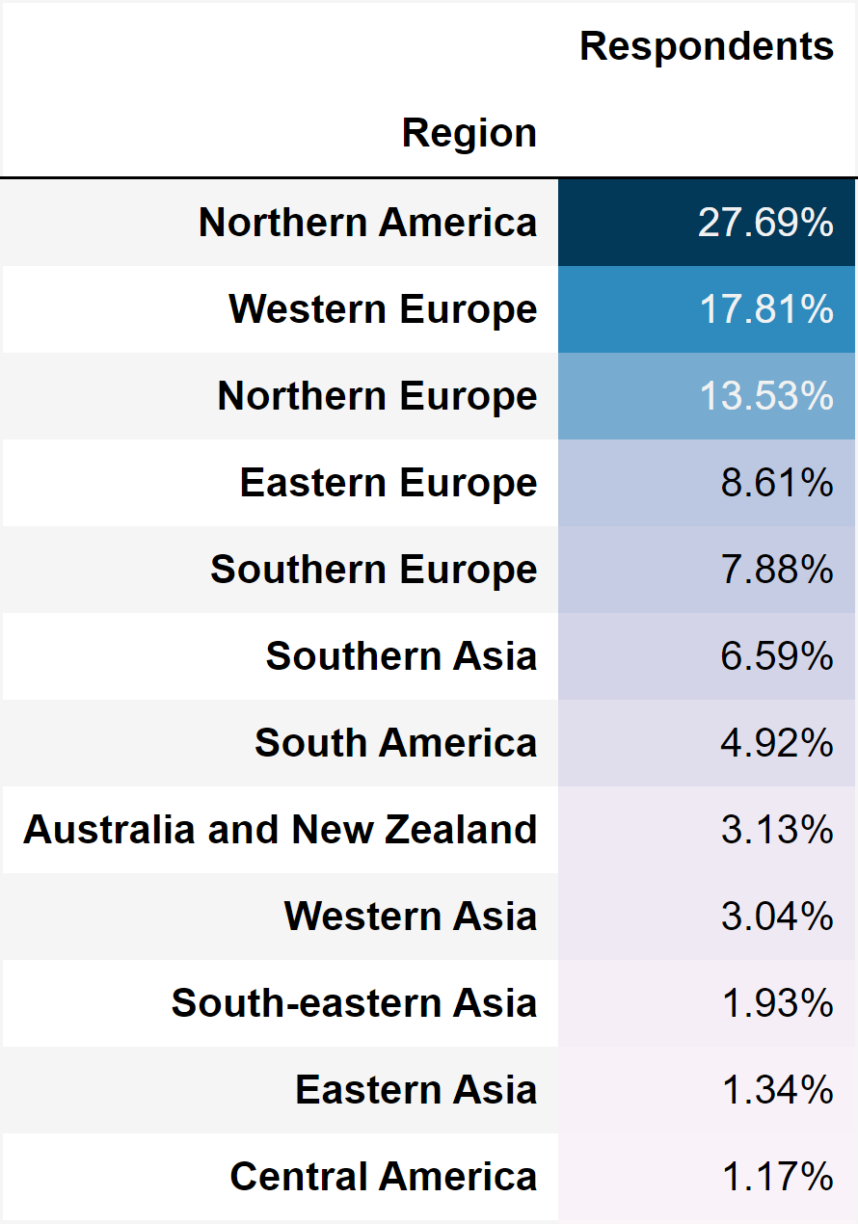
Imbalance in Data
Not all countries have the same representation in data
Most active part of community lives in the USA, Germany, UK, India and Canada
Data from Cuba, Iran, North Korea, and Syria are inaccessible

Slide 6
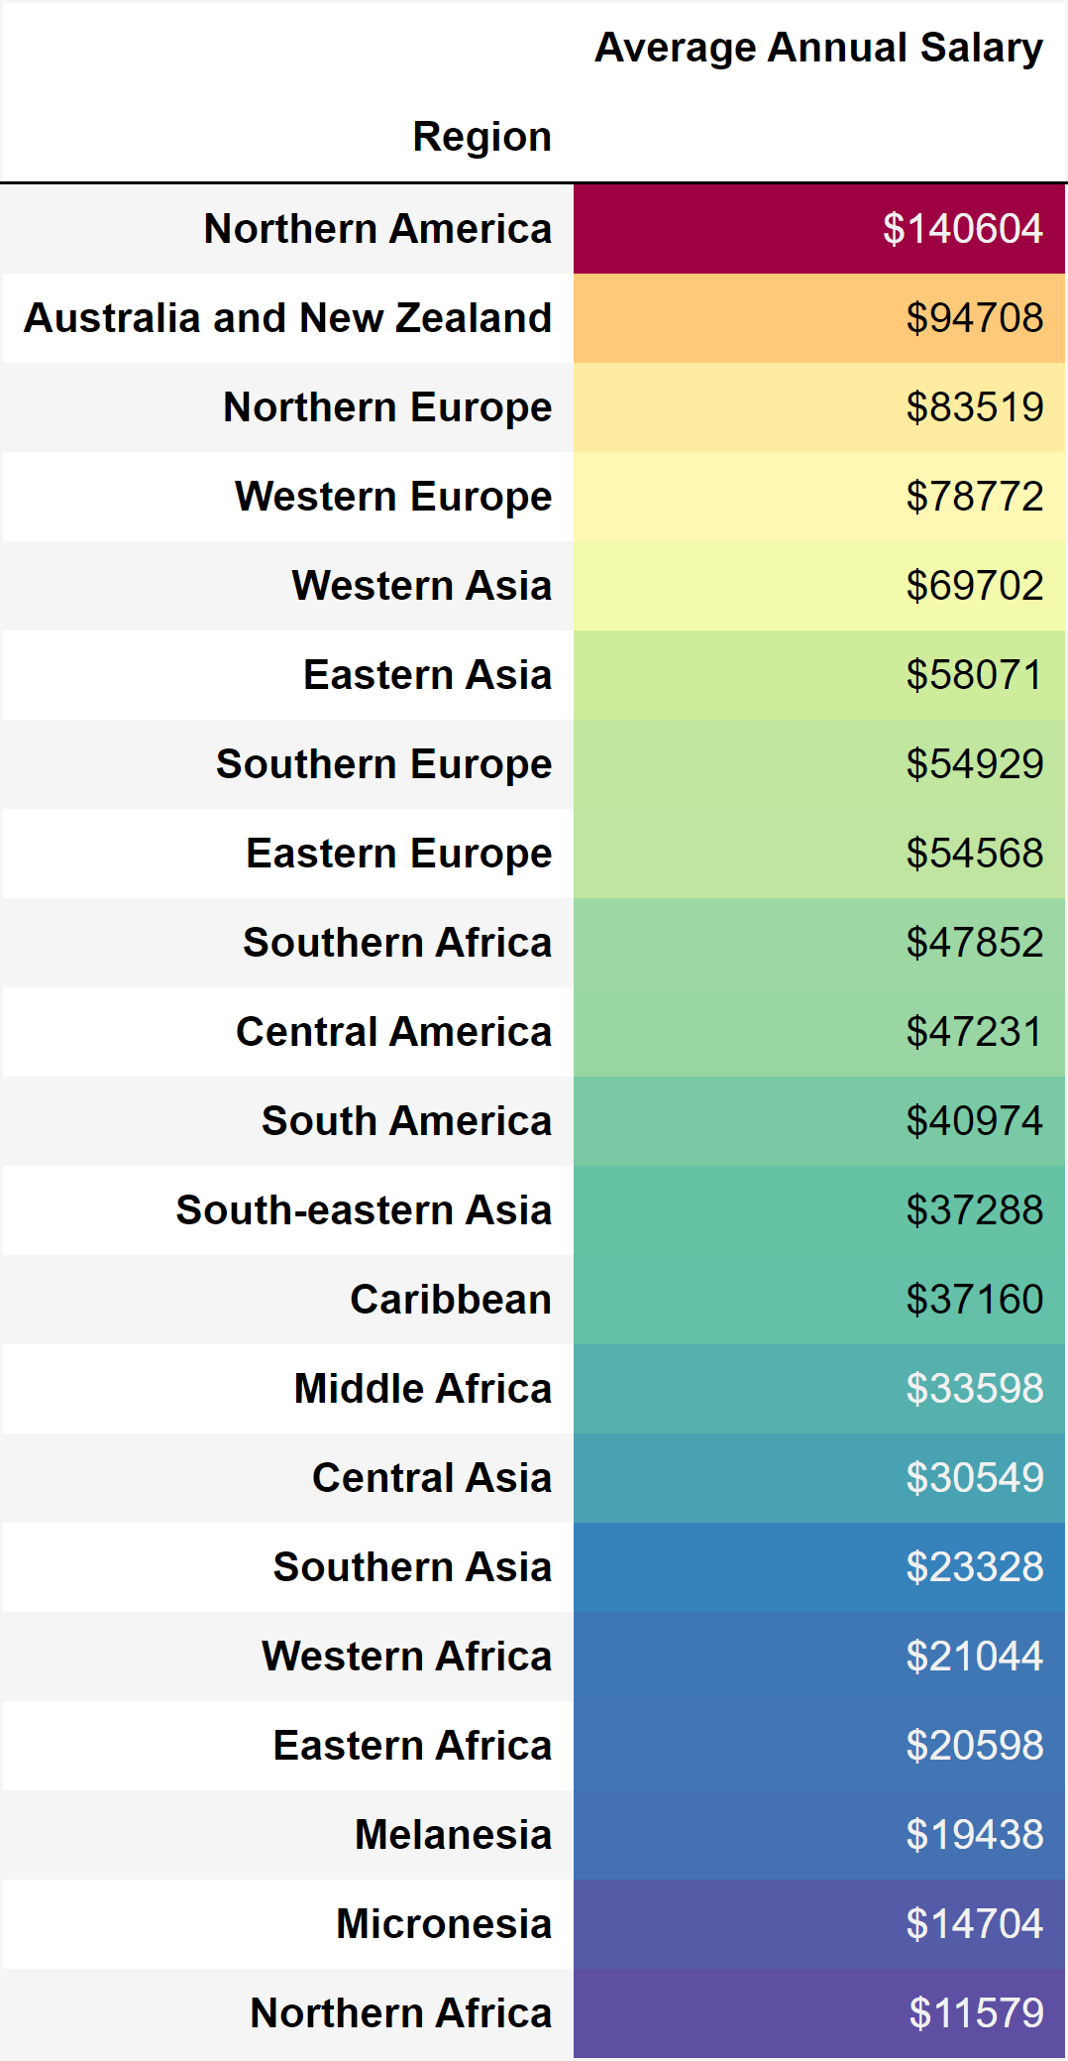
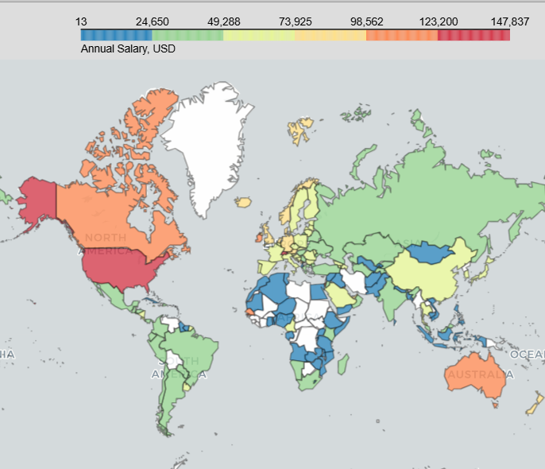
Salary by country and region

Slide 7
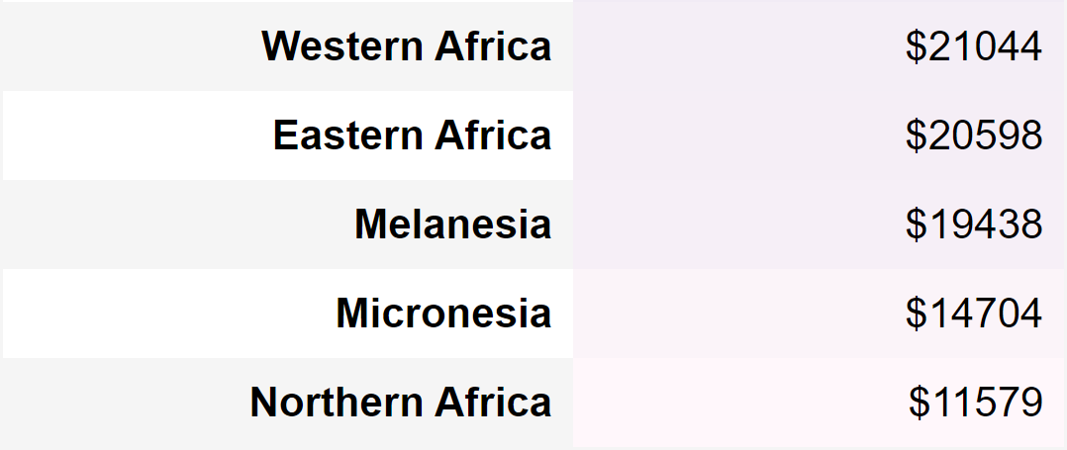
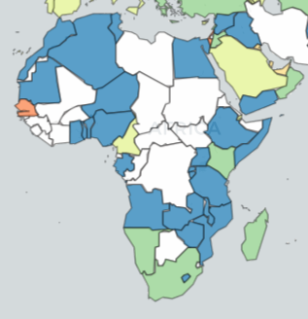
Senegal: outlier

Slide 8
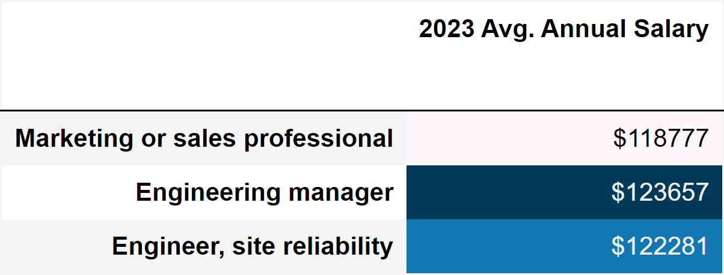


Employment Roles: 34 different roles
Highest Paying

Slide 9
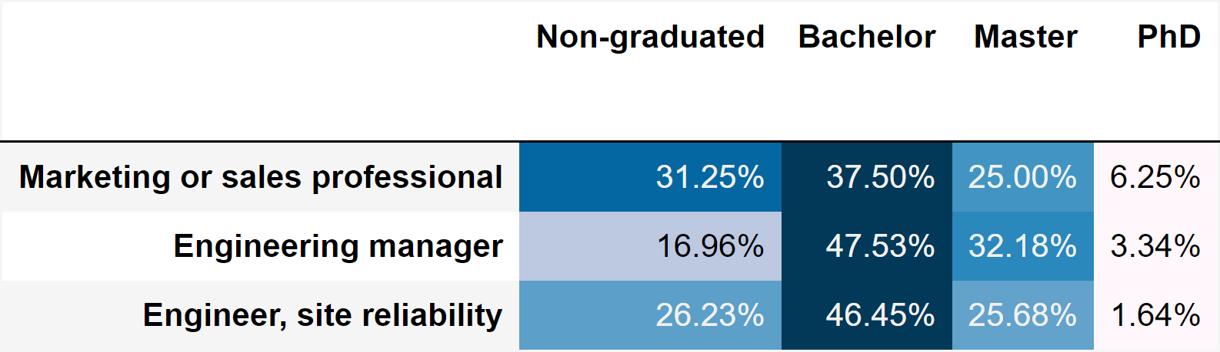
Highest Paying Roles: Education

Slide 10

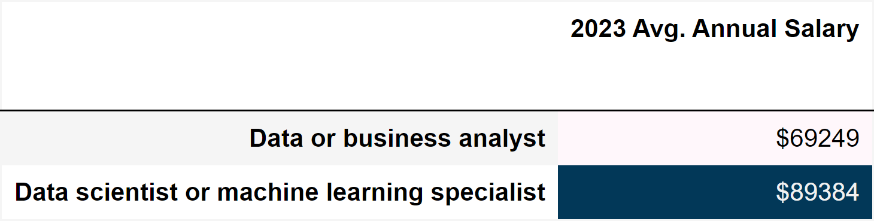
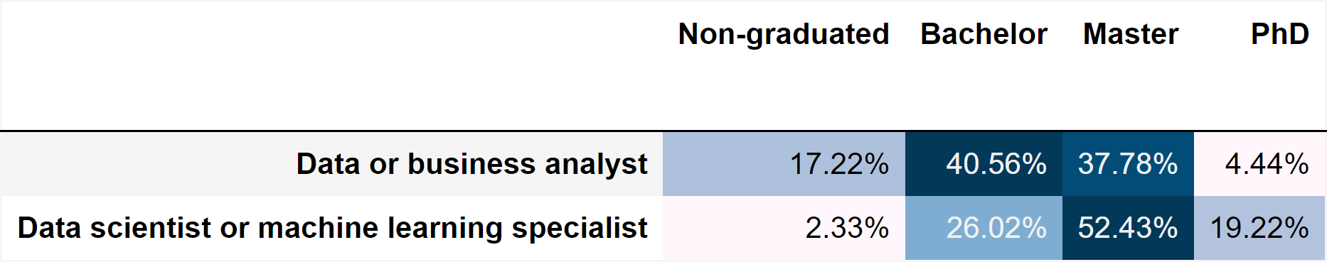

Analytics employment roles
Top10 Programming languages
Python
SQL
Bash/Shell (all shells)
HTML/CSS
JavaScript
R
C++
Java
TypeScript
C#

Slide 11

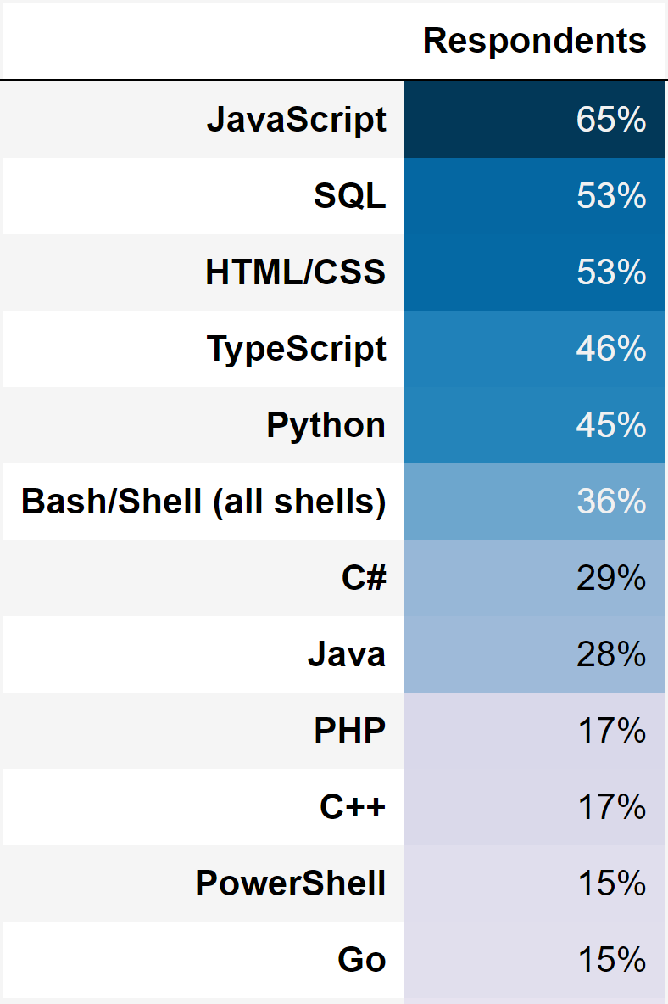
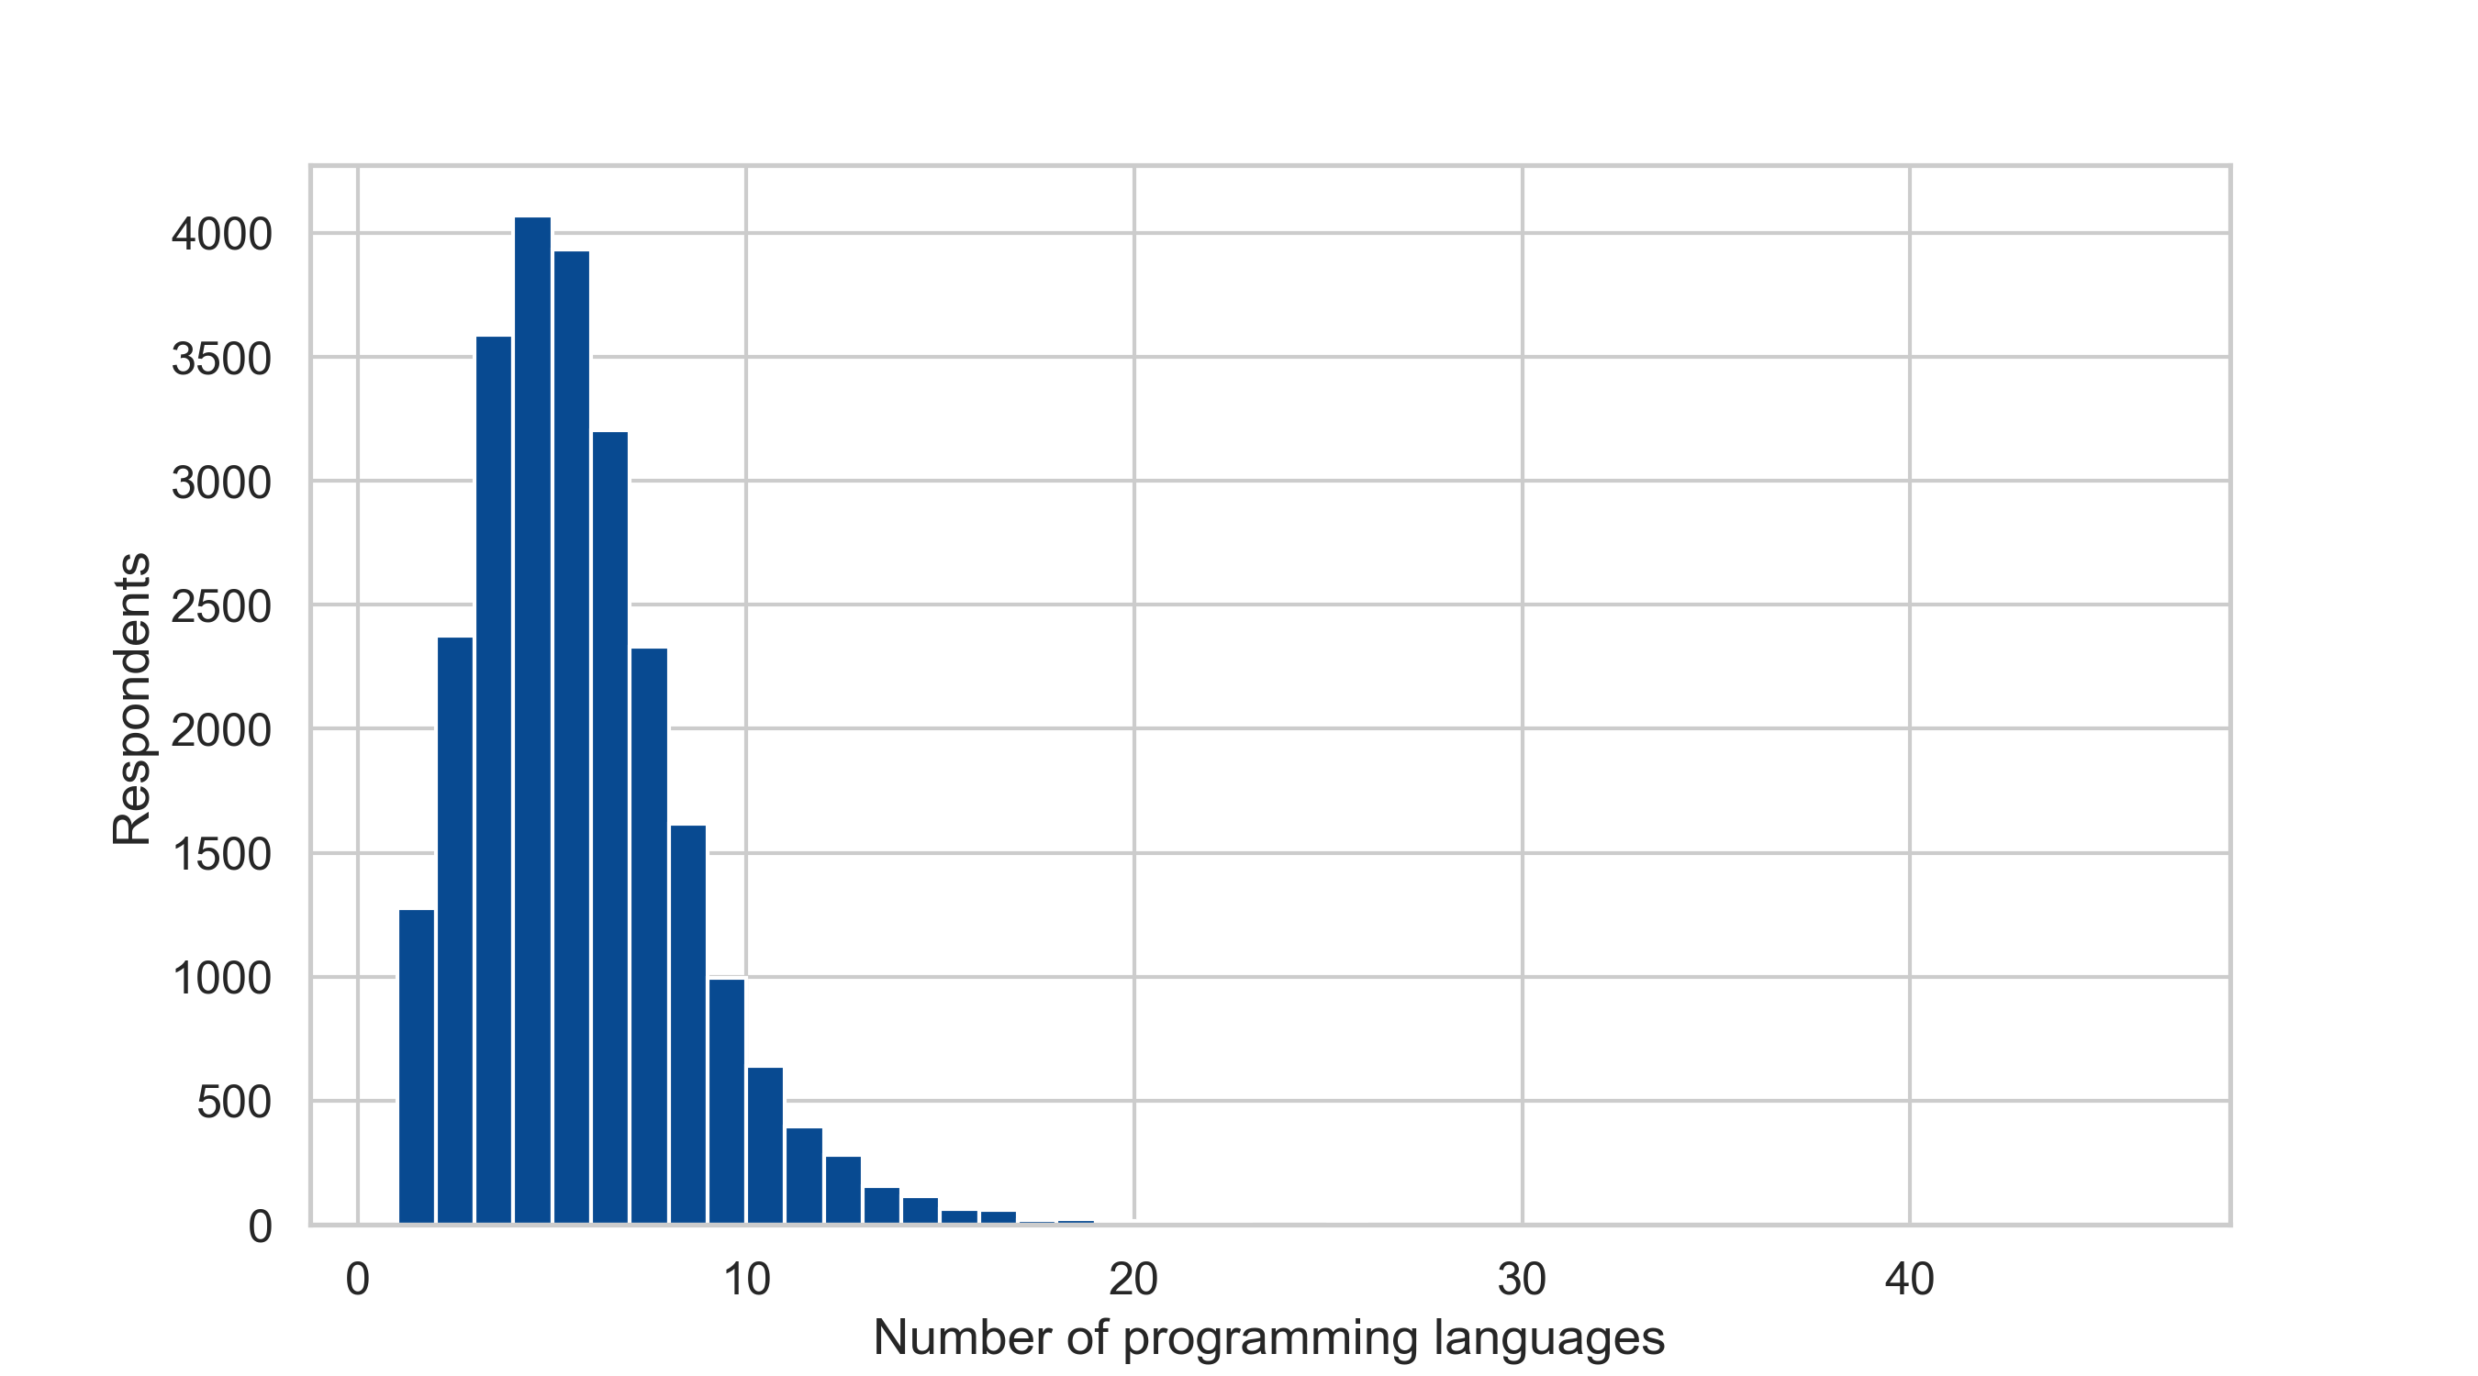
Most commonly-used programming language

Slide 12
Analytics Project: Predicting Salary
Develop a machine-learning model to predict annual salary based on various factors such as:
Country
Employment role
Education level
Years of professional coding
Most used programming languages

Slide 13

Selecting a model to predict salary
Regression
Interpretable
Tree
Model
Flexible
SVR
NN

Slide 14


Selecting a model to predict salary
Linear Regression
Outliers have a strong influence on the regression model
Do not fit well complex patterns
Simple
Computationally efficient
Multicollinearity between independent variables
Regression Tree
Robust to outliers in the input features
Imbalanced classes and high cardinality make the model training process more challenging
Outliers in target variable can affect results
Flexibility and complexity
Good for data with many categorical variables

Slide 15
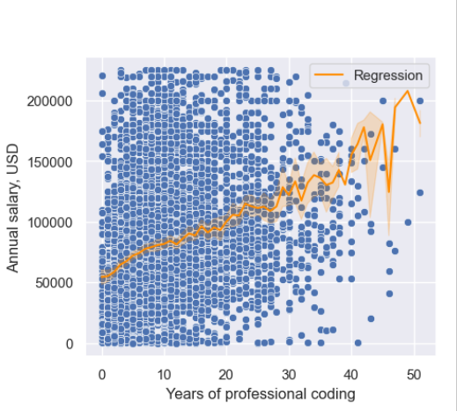
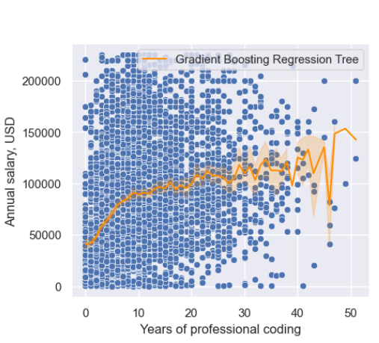
Comparing models
Gradient Boosting Regression Tree with tuned hyperparameters
Linear Regression
Model performance on train data R^2 = 0.635
Model performance on test data R^2 = 0.630
Model performance on train data R^2 = 0.689
Model performance on test data R^2 = 0.660

Slide 16



Salary prediction: example
Education: Master
Coding Experience: 5
Employment Role:
Data scientist or machine learning specialist
Country: Germany
Programming Languages: Python, R, SQL
Predicted Salary
$79255
90% Prediction Interval
[$52443, $93526]

Slide 17

Takeaways
Analytics Project: Predicting Salary
Prediction annual salary is based on location, experience and skills
Choose an algorithm that balances complexity, flexibility, and predictive power
Affordable computational time to fit a model
Further steps: adding new features and improving model accuracy

Slide 18

THANK YOU
Lena Smotrova
www.linkedin.com/in/lena-smotrova/

