Slide 1
Odds Ratio Excluded 1 for the first time
Odds-ratio for death
3
More Evidence accumulating showing no benefit
Worst
Increases deaths
1
Saves lives
Unclear 95%CI include
Better
1/2
Pandemic Day
Big RWS study added
Cumulative N
Cumulative N
and
N of patients
Cumulative N Reached
Cumulative N Reached
Real World Studies
Real World Studies
Height proportional to Cumulative N
Big Step → Big RWS study added
Cumulative N Reached
First big RCT added
Randomized Controlled Trials
Randomized Controlled Trials
Cumulative N Reached
Pandemic Day
RWS results arrive early, effect might be exaggerated
RCTs results arrive later
Combining both can provide early and accurate insights

Slide 2
IL6 Class
Cumulative Estimates of Mortality Odds Ratio and 95% CI weighted by degree of heterogeneity
Odds-ratio for death
3
The benefit could have been determined ~ 5.3 months earlier
IL-6 Worst
1
IL-6 Better
1/2
Day 178, 2146 RWS patients added, the odds ratio 95% CI excludes 1
Day 332, 3924 RWS patients added, no change
Day 444, 4116 RCT patients added, odds ratio and 95% CI stayed below 1
Cumulative N of patients
13380
Real World Studies
10718
10000
Randomized Controlled Trials
166 days
5000
0
200
300
400
500
600
Pandemic Day

Slide 3
IL6 Class
Cumulative Estimates of Mortality Odds Ratio and 95% CI weighted by degree of heterogeneity
Odds-ratio for death
3
The benefit could have been determined ~ 5.3 months earlier
IL-6 Worst
1
IL-6 Better
1/2
Day 178, 2146 RWS patients added, the odds ratio 95% CI excludes 1
Day 332, 3924 RWS patients added, no change
Day 444, 4116 RCT patients added, odds ratio and 95% CI stayed below 1
Cumulative N
and
N of patients
13380
Real World Studies
166 days
10718
Randomized Controlled Trials
Height proportional to Cumulative N
200
300
400
500
600
Pandemic Day

Slide 4
Hydroxychloroquine
Cumulative Estimates of Mortality Odds Ratio and 95% CI weighted by degree of heterogeneity
Odds-ratio for death
3
HCQ never showed any promising effect on mortality before or after Day 236
HCQ Worst
1
HCQ Better
1/2
Day 236, 14798 RWS patients accumulated
and 5744 RCT patients added
Understanding did not change despite adding
> 40 000 RWS patients > 11 000 RCT patients
Cumulative N of patients
40000
40304
30000
Real World Studies
Randomized Controlled Trials
20000
Another RWS patients added
10000
11379
0
200
300
400
500
600
Pandemic Day

Slide 5
Hydroxychloroquine
Cumulative Estimates of Mortality Odds Ratio and 95% CI weighted by degree of heterogeneity
Odds-ratio for death
3
HCQ never showed any promising effect on mortality before or after Day 236
HCQ Worst
1
HCQ Better
1/2
Day 236: 14798 RWS patients +
5744 RCT patients
Understanding did not change despite adding
> 40 000 RWS patients > 11 000 RCT patients
Cumulative N
and
N of patients
40304
Real World Studies
Randomized Controlled Trials
11379
Height proportional to Cumulative N
200
300
400
500
600
Pandemic Day

Slide 6
Cumulative Estimates of Mortality Odds Ratio (blue line) and 95% CI (shaded blue area),
weighted by degree of heterogeneity
antimalarial
corticoid
il6
all
mild and mild/moderate
moderate
critical and severe
all
3
1
Log Odds-ratio for death
1/2
40000
30000
40304
Cumulative N
20000
13380
10000
11379
7037
10718
1477
1652
3986
2741
2369
0
40304
1477
7037
2741
13380
RWS
N and Cumulative N
11379
1652
3986
2369
10718
RCT

Slide 7
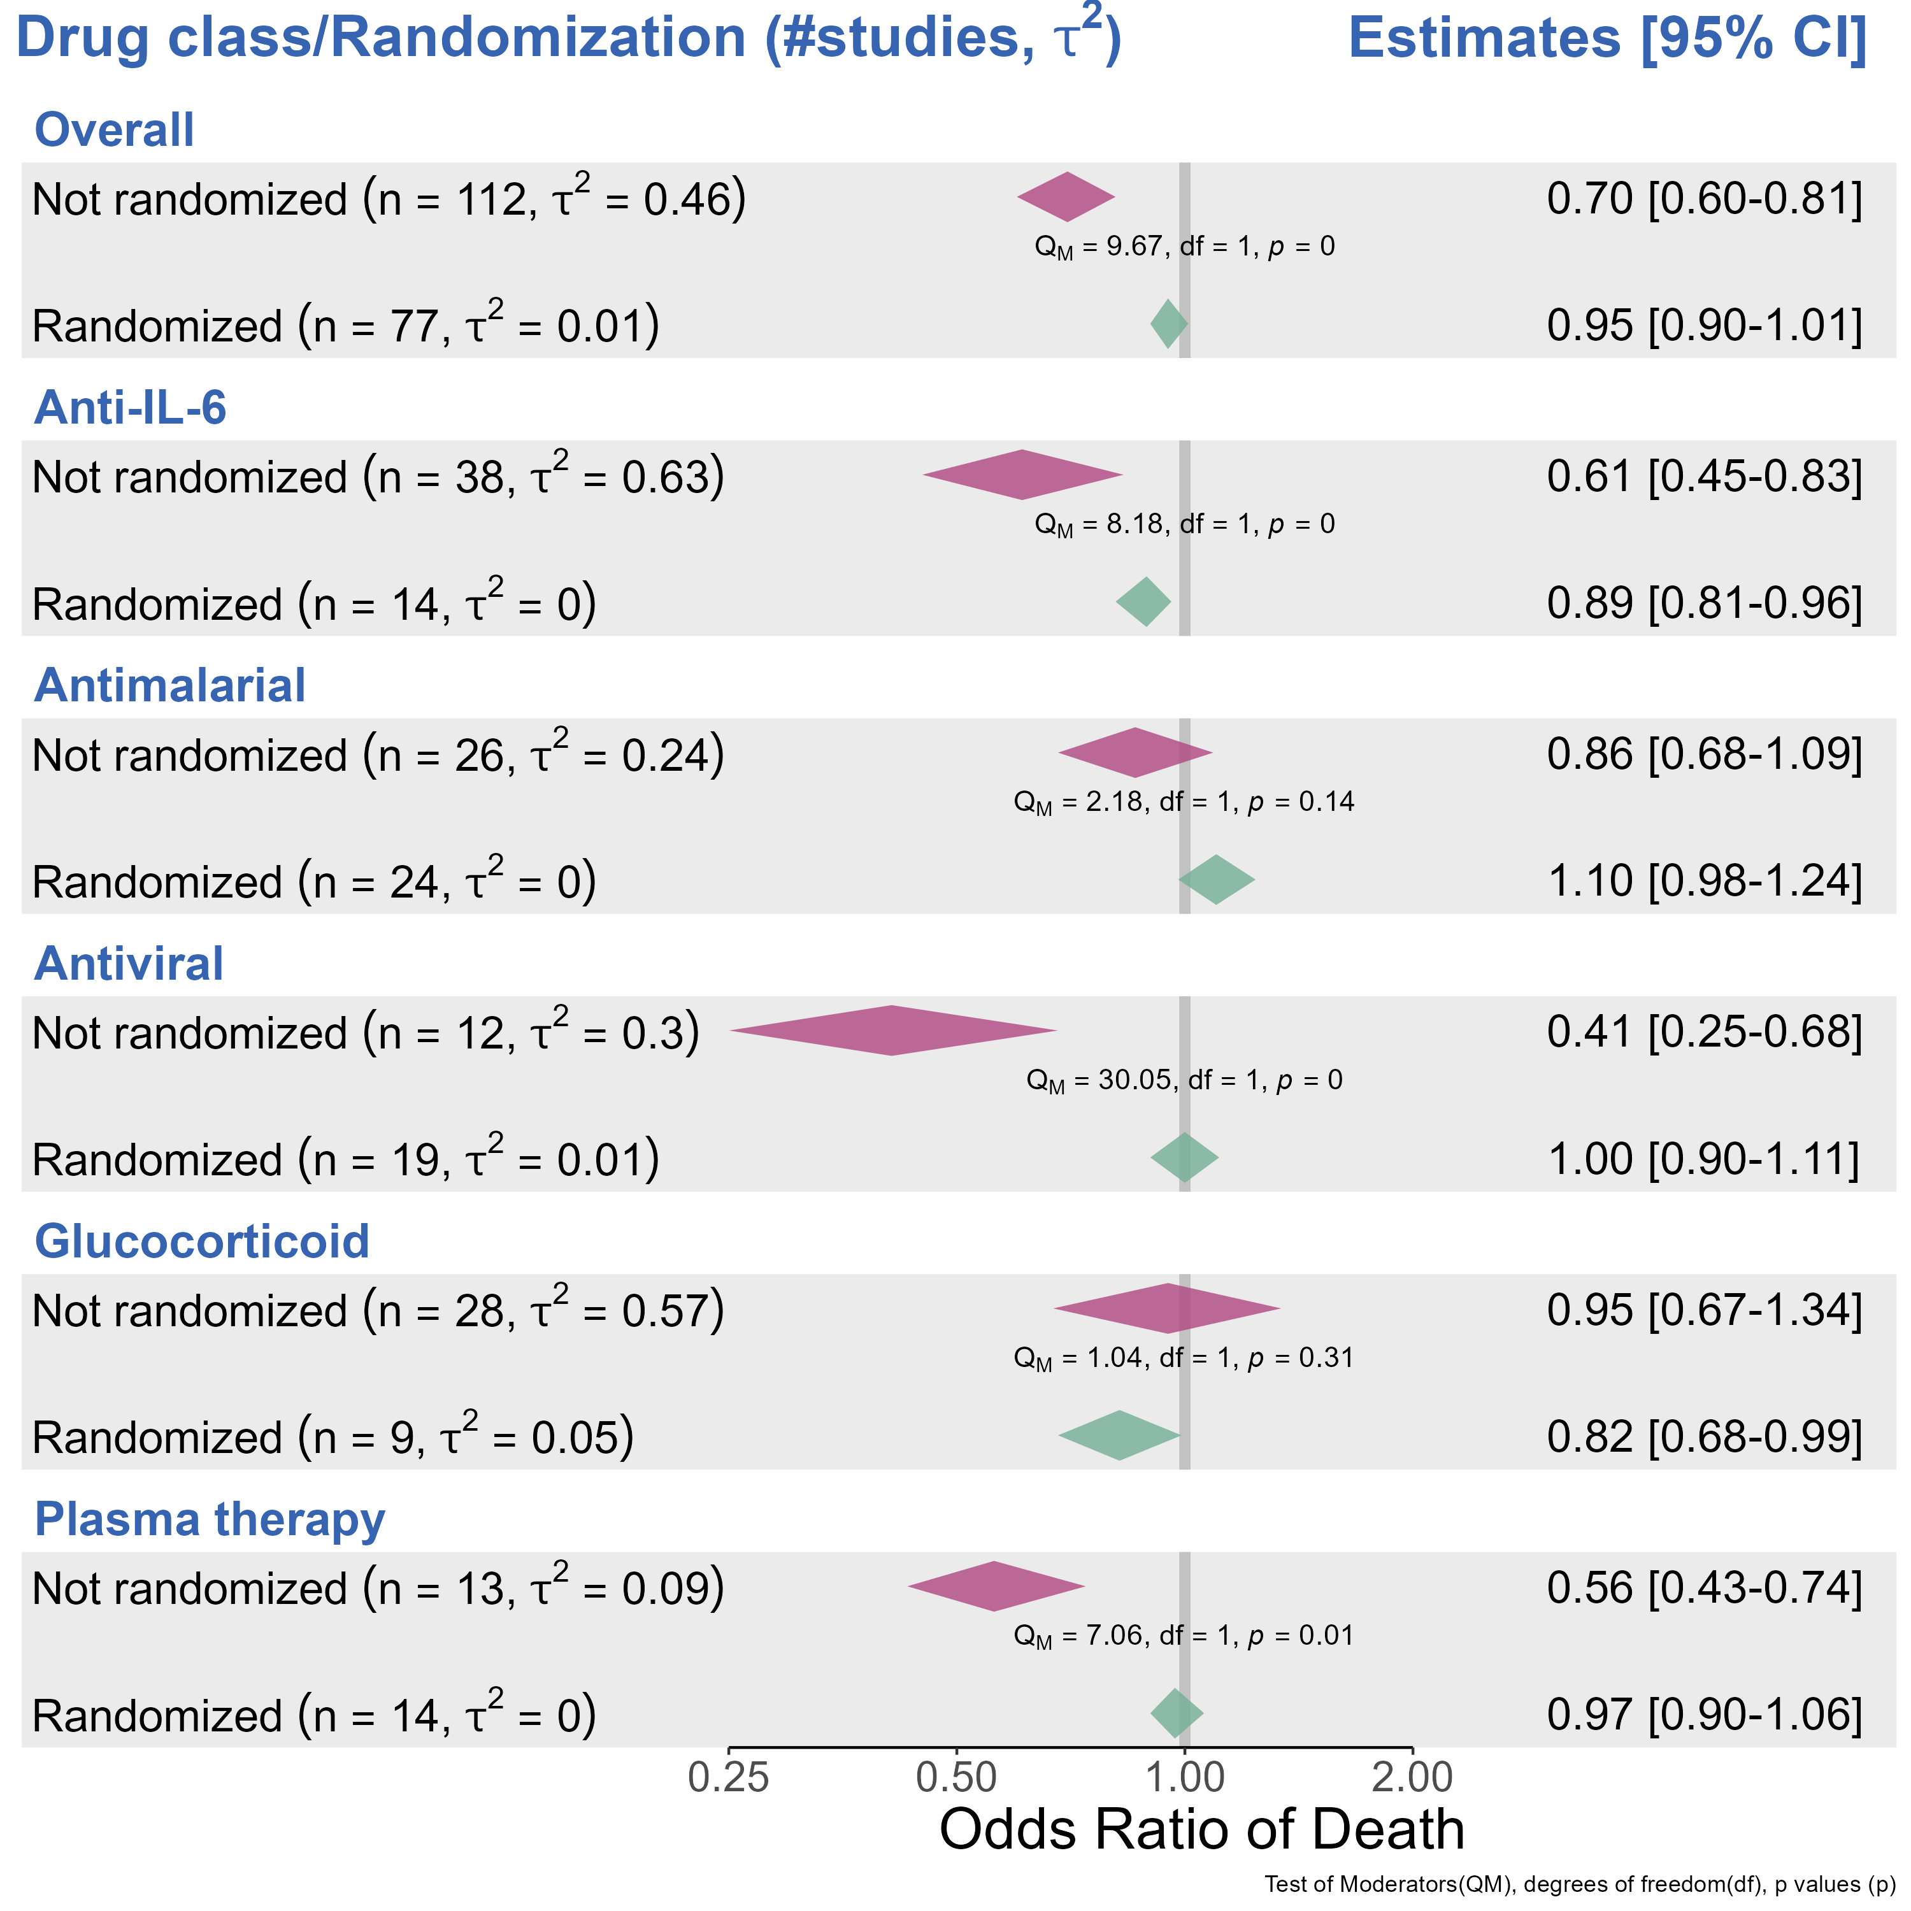

Slide 8
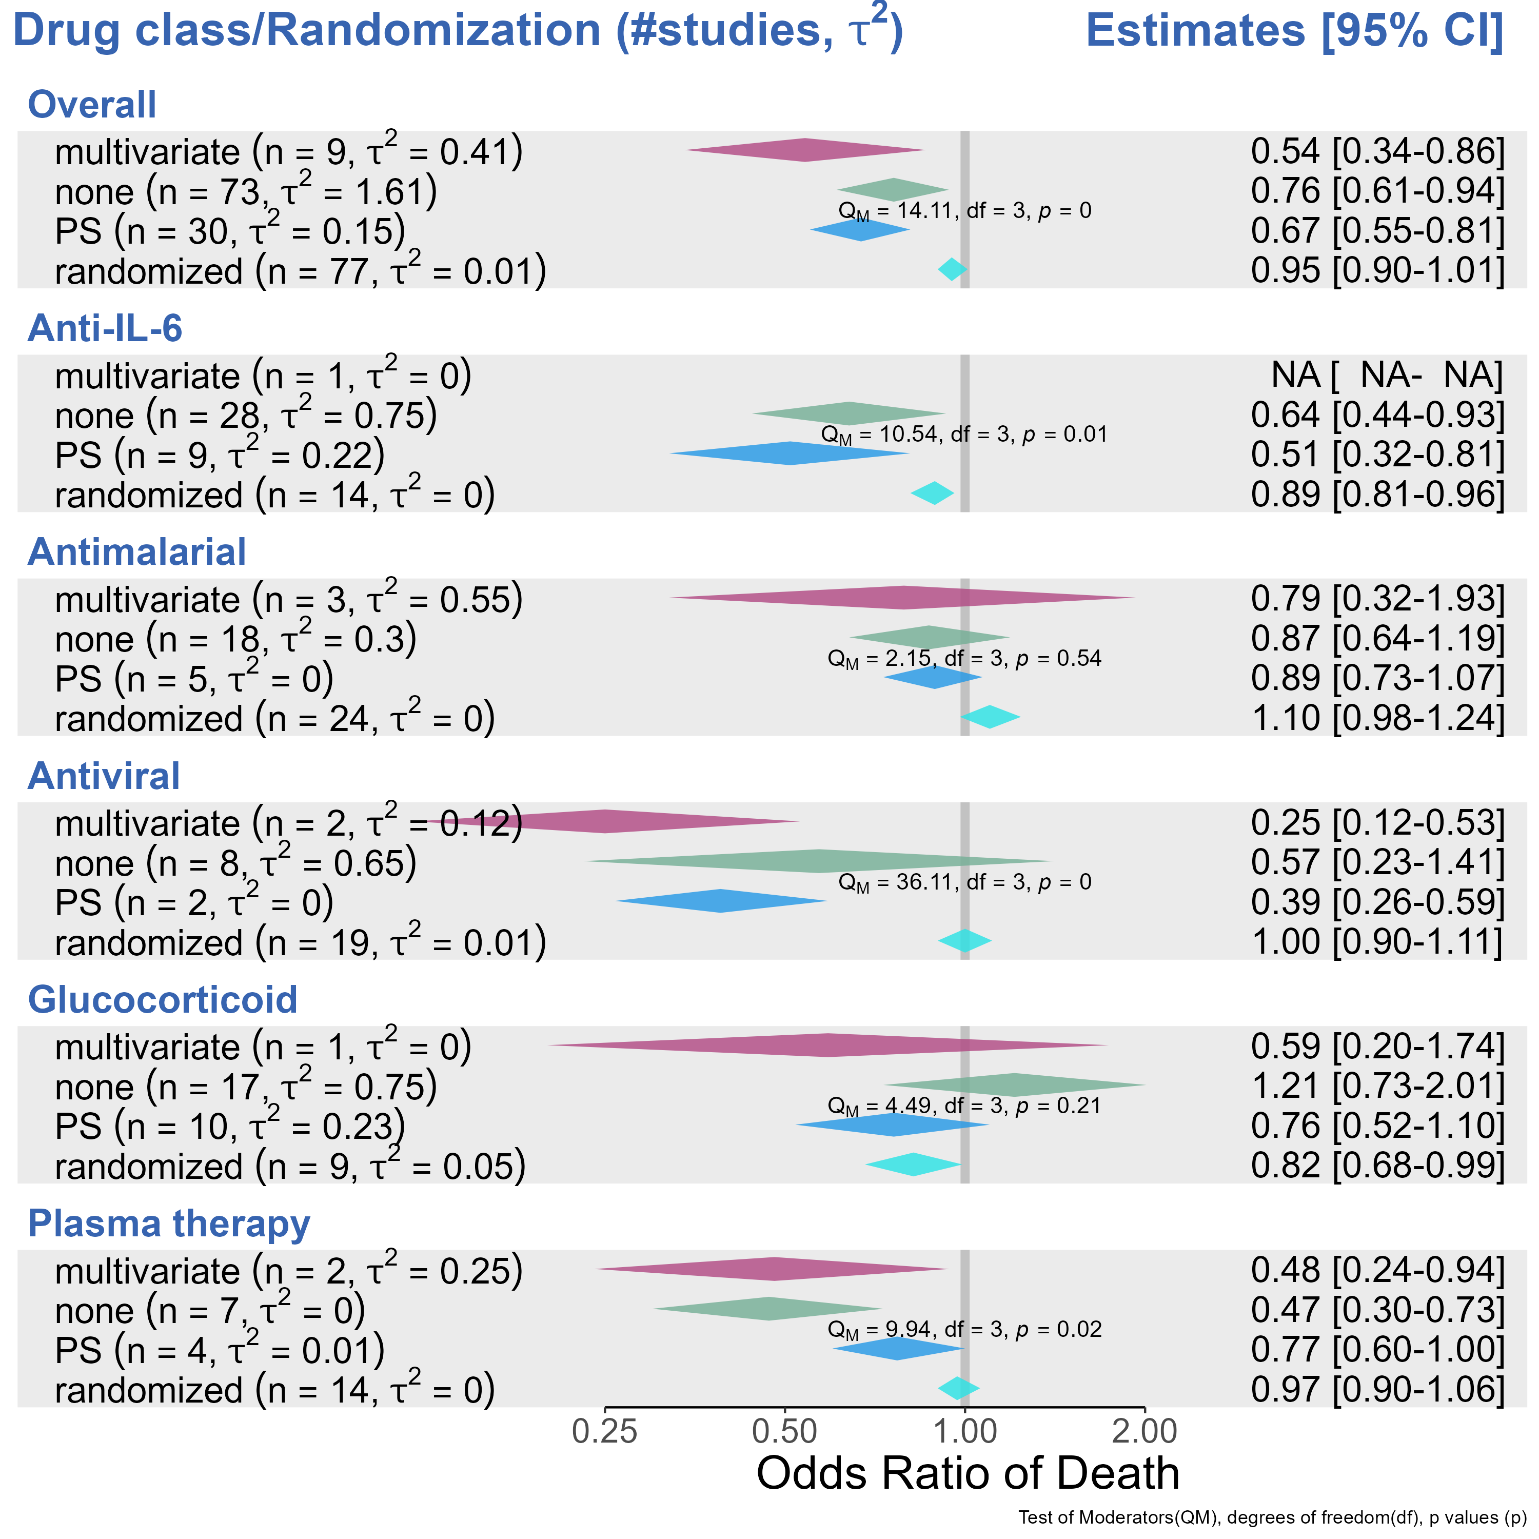

Slide 9
