Slide 1
Analysis of US Power Plant Outages from an Equipment Breakdown Insurance Perspective
Stephen Patti
Springboard Data Science Capstone Project
April 2018 – September 2018

Slide 2
Data Sources
This study will examine the causes of US power plant outages based on the following data from the North American Electrical Reliability Corporation (NERC) Generating Availability Data System (GADS).
CC_GT_2011_2017.csv - Combined Cycle Power Plants
GT_Jet_Engine_2013_2016.csv - Simple Cycle Power Plants
Fossil_steam_2013_2017.csv - Fossil Fuel Fired Boiler Steam Power Plants
Since all equipment found at Simple Cycle Power Plants is found at the others, and my preliminary analysis did not show differences with respect to outage duration (Time_To_Repair), I did not use this data set.

Slide 3
Objectives
As alluded to in the title, I am looking at this from the perspective of my role in commercial property and equipment insurance. I started with the following questions.
What equipment or equipment systems are most responsible for unplanned outages?
We have thresholds for larger losses (outages): PML – Probable Maximal Loss, MFL – Maximum Foreseeable Loss. What equipment is most closely related to these failures?
Will this data, as used in the statistical modeling and analysis methods I’m about to study, provide any predictive value?
How else might this analysis help my company and out customers?

Slide 4
Preliminary Data Wrangling and Cleaning
My initial data wrangling steps included the following.
Cleaned (mutate) column/variable names, removing periods and spaces and replacing with underscores
Combined separate date and time fields to one POSIX.ct formatted field for start and end of outage
Used Select to create data frames with desired fields
c_cycle_worka <- c_cycle_work %>%
select(Util_Unit, start_dt, Type, Cause_Code, end_dt,
Time_To_Repair, TBF_Period_Hrs, IA_PH,
TBF_Service_Hrs, IA_SH, X_Derate)
Filtered the data to exclude planned, maintenance, or reserve outages, i.e. include only force outages or outages due to failures and accidents.
type_filter <- c("D1", "D2", "D3", "D4", "SF", "U1", "U2", "U3")
ff_steam_df <- ff_steam_df %>%
filter(ff_steam_df$Type %in% type_filter)

Slide 5
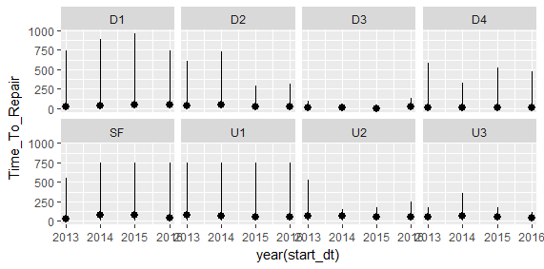
Preliminary Statistics and Plots
I used the following code to calculate mean time to repair for steam turbine and combined cycle plants. # Calculate mean Time_To_Repair for each outage Type ff_steam_df %>% group_by(Type) %>% summarise(Mean_TTR_Type = mean(Time_To_Repair, na.rm = TRUE)) %>% arrange(desc(Mean_TTR_Type)) | I created stat summary plots with the following code. # create a stat summary plot, x = year(start_st), y = time to repair ggplot(data = ff_steam_df) + stat_summary( mapping = aes(x = year(start_dt), y = Time_To_Repair), fun.ymin = min, fun.ymax = max, fun.y = mean ) + facet_wrap(~ Type, nrow = 2)
Type Mean_TTR_Type <chr> <dbl> 1 U1 62.2 2 SF 58.5 3 U2 58.1 4 U3 53.9 5 D1 37.4 6 D2 33.2 7 D4 11.1 8 D3 10.7 This indicates extremely left skewed distributions with the mean near the minimum values.

Slide 6
Categorizing Cause Codes
The NERC GADS Cause Codes tell us what caused the outage. Since there are hundreds of them, I created a System variable for each type of plant based on the attached files.
The following is the coding for Combined Cycle plants. cc_dfb <- cc_df cc_dfb <- cc_dfb %>% mutate(Cause_Code = as.numeric(Cause_Code)) %>% mutate(System = if_else((Cause_Code>=111 & Cause_Code<=1999 | Cause_Code>=6000 & Cause_Code<=6183), "HRSG", if_else((Cause_Code>=3110 & Cause_Code<=3549 | Cause_Code>=3800 & Cause_Code<=3899 | Cause_Code>=3950 & Cause_Code<=3999 | Cause_Code==6299 | Cause_Code==6399), "Balance_of_Plant", if_else(Cause_Code>=3600 & Cause_Code<=3730, "Electrical", if_else(Cause_Code>=4000 & Cause_Code<=4499, "Steam_Turbine", if_else(Cause_Code>=4500 & Cause_Code<=4750, "Generator", if_else(Cause_Code>=5000 & Cause_Code<=5299, "Gas_Turbine", if_else(Cause_Code>=5400 & Cause_Code<=5699, "Jet_Engine", if_else(Cause_Code==6200, "Miscellaneous", if_else(Cause_Code>=7800 & Cause_Code<=7960, "Expander_Turbine", if_else(Cause_Code>=8700 & Cause_Code<=8845, "PCE", if_else((Cause_Code>=9000 & Cause_Code<=9340 | Cause_Code==0), "External", if_else(Cause_Code>=9504 & Cause_Code<=9720, "Regulatory", if_else(Cause_Code>=9900 & Cause_Code<=9960, "Personnel", if_else((Cause_Code>=9990 & Cause_Code<=9991 | Cause_Code==2), "Inactive", "Performance")))))))))))))))

Slide 7
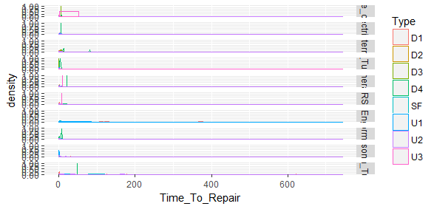
Setting thresholds for probable maximal loss (PML) and maximum foreseeable loss (MFL).
In order to look a larger losses (longer down times), we look at the PML and MFL. Based on the distribution plots (eample below), I set the following thresholds.
PML: 10 days < Time_To_Repair <= 30 days
MFL: Time_To_Repair > 30 days

Slide 8
Logistic Regression for PML Events.
Logistic Regression Code ff_steam_dfb <- ff_steam_dfb[complete.cases(ff_steam_dfb),] ff_steam_dfb <- ff_steam_dfb %>% mutate(PML = factor(PML, levels = c("0","1"))) %>% mutate(MFL = factor(MFL, levels = c("0","1"))) ff_steam_dfb$System <- as.factor(ff_steam_dfb$System) fit_ffs <- glm(PML ~ System, data = ff_steam_dfb, family = "binomial")
summary(fit_ffs) | exp(coef(fit_ffs))
While this doesn’t provide much predictive value, the coefficients may be helpful as factors in determining equipment breakdown insurance pricing for power plants. For example, if we determine that a particular plant is deficient in the area of what is reported to NERC GADS as Performance, we could apply a risk modifying factor to the rate.

Slide 9
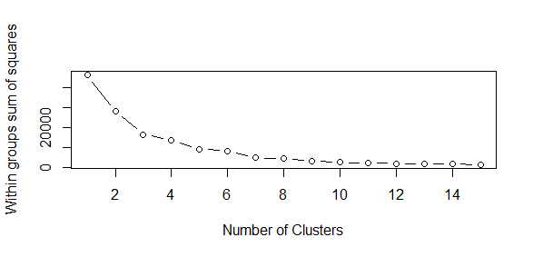
K-means Clustering
The next few slide show the use of K-means Clustering in examining the data.
#First select the variables of importance ClData_ffs <- ff_steam_dfb %>% select(System, Time_To_Repair, TBF_Period_Hrs) ClData_ffs <- ClData_ffs[complete.cases(ClData_ffs),] ffs_df <- scale(ClData_ffs[-1]) wssplot <- function(data, nc=15, seed=144){ wss <- (nrow(data)-1)*sum(apply(data,2,var)) for (i in 2:nc){ set.seed(seed) wss[i] <- sum(kmeans(data, centers=i)$withinss)} plot(1:nc, wss, type="b", xlab="Number of Clusters", ylab="Within groups sum of squares")} wssplot(ffs_df) #Indicates use of 7 Clusters

Slide 10
K-means Clustering
library(NbClust) ncF <- NbClust(ffs_df, min.nc=2, max.nc=15, method="kmeans") fit.kmF <- kmeans(ffs_df, 7, nstart=25) fit.kmF$size fit.kmF$centers | fit.kmF$size [1] 6 2284 18323 1194 616 538 108

Slide 11
K-means Clustering
aggregate(ClData_ffs[-1], by=list(cluster=fit.kmF$cluster), mean) ct.kmF <- table(ClData_ffs$System, fit.kmF$cluster) print(ct.kmF) library(flexclust) randIndex(ct.kmF) > randIndex(ct.kmF) ARI 0.004410025 This index as well as the systems being concentrated in two clusters show a relatively week model

Slide 12
Summary
As previously stated in the logistic regression section, there is not much predictive value here with respect to reducing outages and mitigating time to repair.
There would be some predictive value if this data could be augmented with the following
Age of Equipment
Hours running prior to failure
Number of starts and stops in the years prior to and between failure
Plant maintenance expenditures
Plant overhaul and maintenance schedules: number of daily, weekly, monthly maintenance items, number of major overhauls performed, etc.
Also as mentioned previously there is some useful information gained from logistic regression on systems associated with longer tailed outages. I could work with our actuarial and analytics department to leverage this information.

