Slide 1


Different ways to provision AWS Lambda functions
Sergii Pavlenko
Smaato Inc.
November 1, 2018

Slide 2


Who am I, who is Smaato
Sergii Pavlenko
Senior Software Developer
Serverless Advocate
Smaato
Smaato is the leading global mobile RTB ad exchange (SMX) helping mobile app developers and publishers increase ad revenues worldwide.

Slide 3
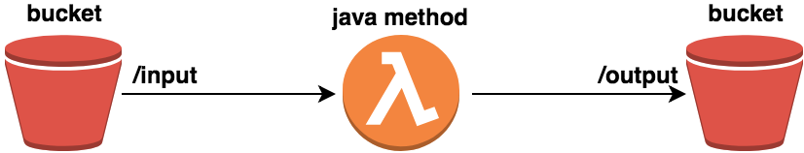
Motivation
put log file into bucket (input folder)
parse log file and keep necessary info
put output file back to bucket (output folder)

Slide 4
Agenda
AWS Cloudformation
AWS SAM & SAM Local
Serverless
Terraform

Slide 5

AWS Cloudformation

Slide 6
AWS Cloudformation
CloudFormation is an Infrastructure as Code tool that can help automate and manage AWS deployments
Template - a JSON or YAML formatted text file
Stack - allows to manage related resources as a single unit
Change Set - a summary of your proposed changes

Slide 7
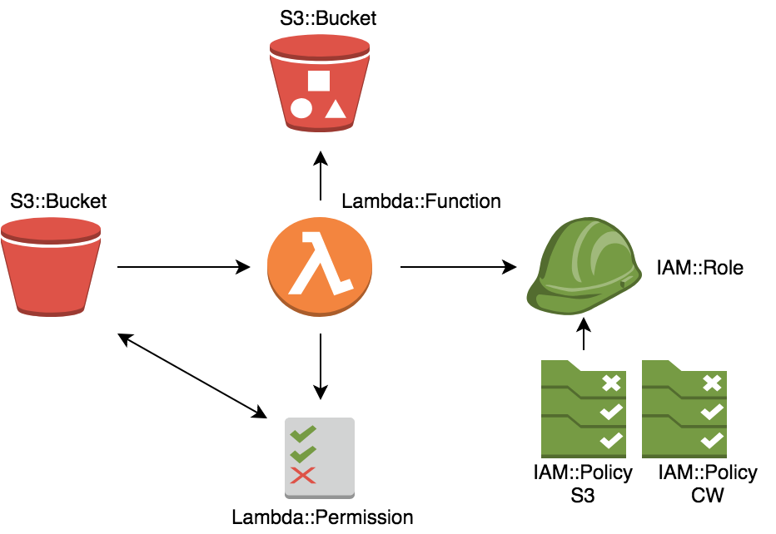
Resources needed

Slide 8
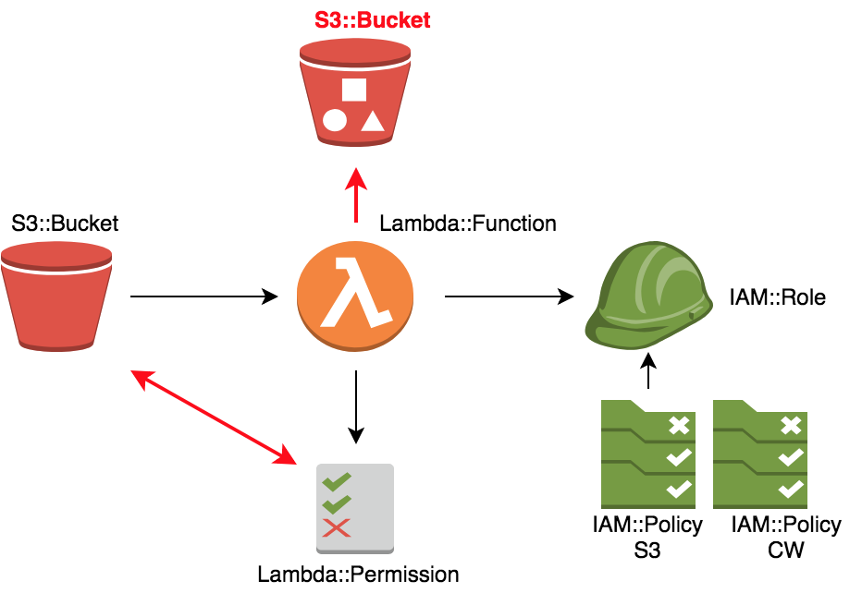

Slide 9
AWS Cloudformation
official AWS tool
good documentation
has UI
too complex
need manually upload jar to src bucket
can't update stack if infrastructure not updated
number of stacks are limited

Slide 10

Serverless Application Model

Slide 11
AWS SAM
AWS SAM adds three new resource types:
AWS::Serverless::Function
AWS::Serverless::Api
AWS::Serverless::SimpleTable
None of the above are new AWS primitives but rather wrappers around existing CloudFormation resources.

Slide 12


Slide 13
AWS SAM
official AWS tool
extensions for easier working with Lambda
easier packaging and deployment
ability to invoke function locally
still in beta
poor documentation and CLI
still need S3 Bucket for sources
inconvenient work with variables

Slide 14

Serverless

Slide 15
Serverless
Serverless framework is a broker which allows to connect and execute apis of different serverless platforms
Serverless is a Node.js CLI tool on top of CloudFormation
Helps to develop and deploy AWS Lambda functions
None of the above are new AWS primitives but rather wrappers around existing CloudFormation resources.

Slide 16
Serverless
creates functions in the most declarative way
works with different Cloud providers
automatically creates necessary bucket, role, permission
ability to invoke function locally
can export templates to SAM using serverless-sam plugin
not everything out of the box
good only for serverless services
doesn’t rollback changes automatically in case of error

Slide 17

Terraform

Slide 18
Terraform
Terraform is an infrastructure-as-code software developed by HashiCorp
Multi-cloud and multi-framework infrastructure tool
Use concept of reconciliation state file with the real world infrastructure
Tool for developing, changing and versioning infrastructure
HCL - own high-level configuration language

Slide 19
Terraform
open source, extendable
universal, provider agnostic
integration with IDE
good documentation
need to track state file manually
working with environments is tricky
doesn’t rollback changes automatically in case of error
too verbose

Slide 20
Links
Links
https://aws.amazon.com/cloudformation/
https://github.com/awslabs/serverless-application-model
https://serverless.com/
https://www.terraform.io/
Code
https://github.com/smpavlenko/aws-lambda-provisioning-methods

Slide 21
Thanks

