Slide 1
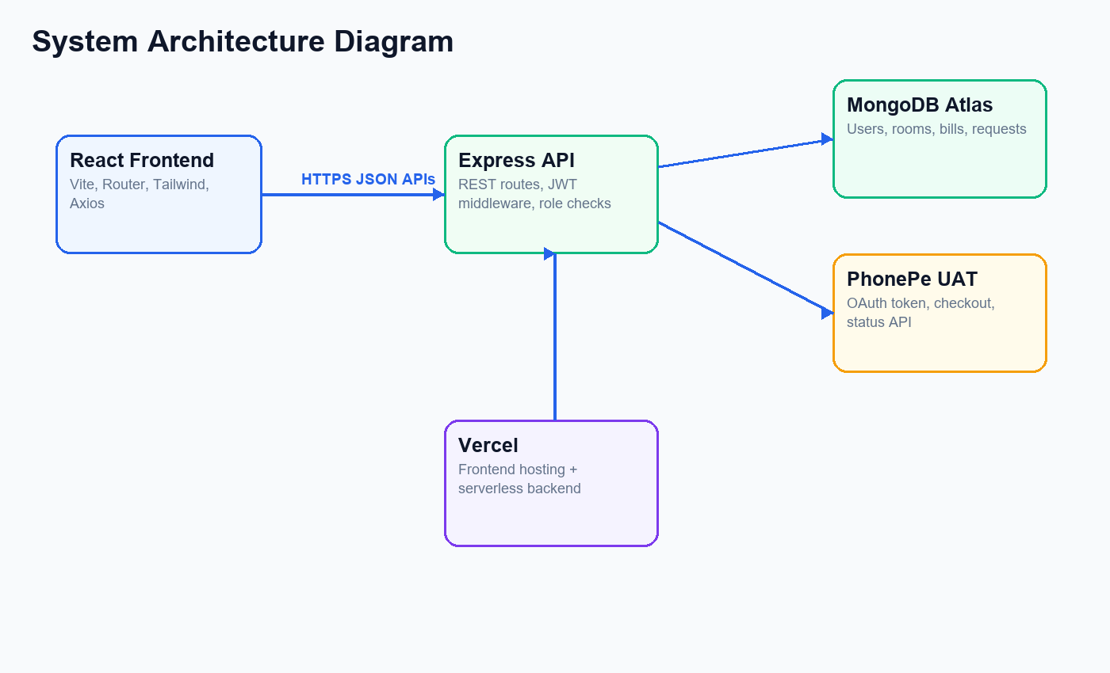
Hostel Management System
MERN stack college project
Role-based dashboards for admin, staff, and resident
PhonePe UAT payment integration
Cloud deployment ready

Slide 2
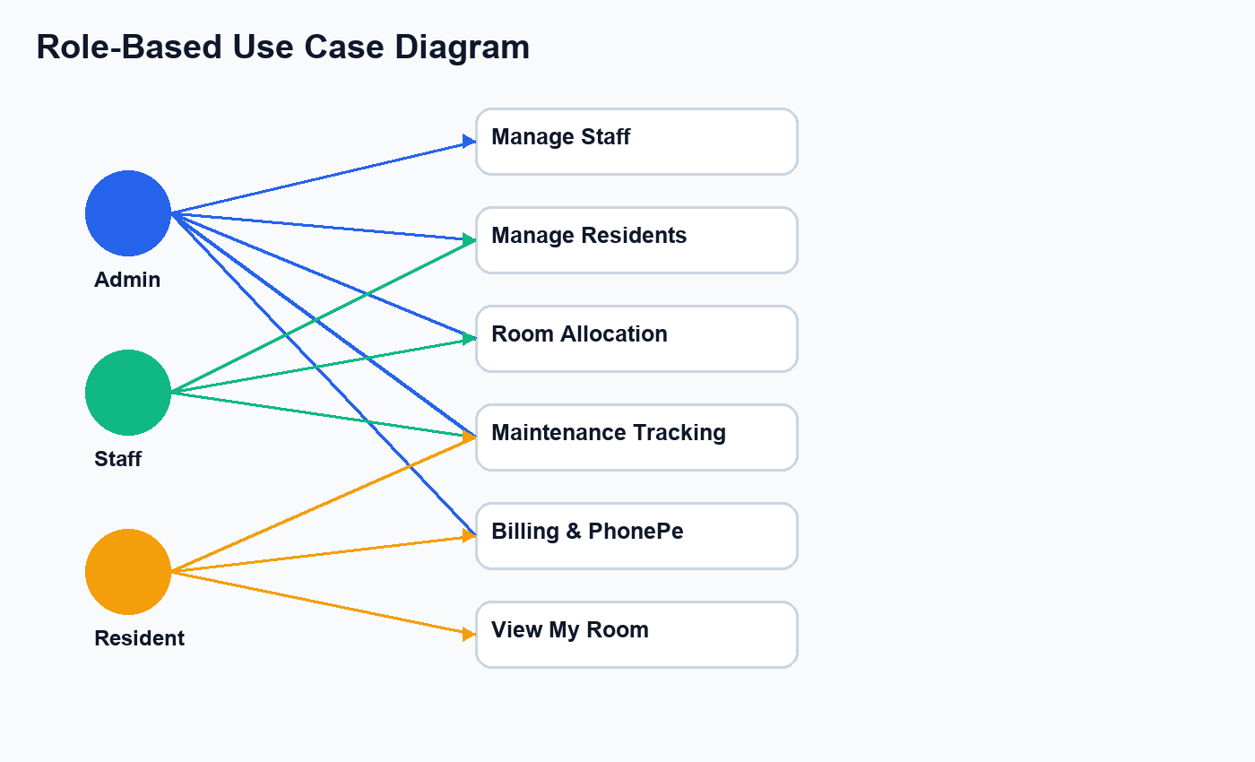
Problem Statement
Manual records are slow and difficult to audit
Room allocation and billing need transparency
Maintenance complaints need status tracking
Residents need self-service access

Slide 3
Proposed System
Centralized hostel management platform
Secure login and role-based access
Digital rooms, bills, maintenance, and notifications
Responsive frontend and REST backend

Slide 4
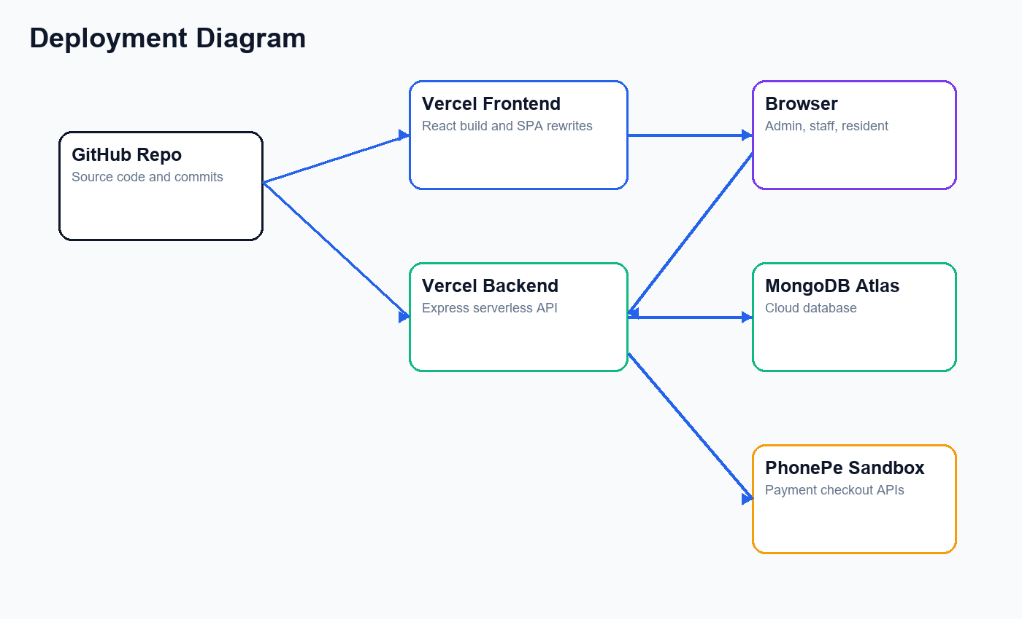
Technology Stack
React, Vite, Tailwind CSS
Node.js, Express.js, Mongoose
MongoDB Atlas database
JWT and bcrypt security
Vercel deployment

Slide 5
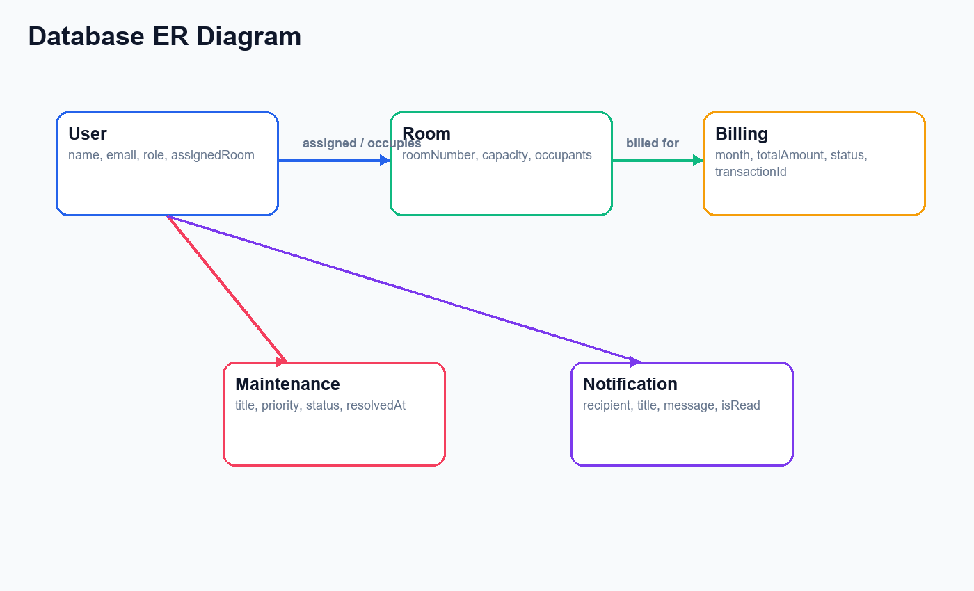
Database Design
Users, Rooms, Billing, Maintenance, Notifications
References connect residents, rooms, and bills
Billing stores PhonePe transaction information
Maintenance stores priority and status

Slide 6
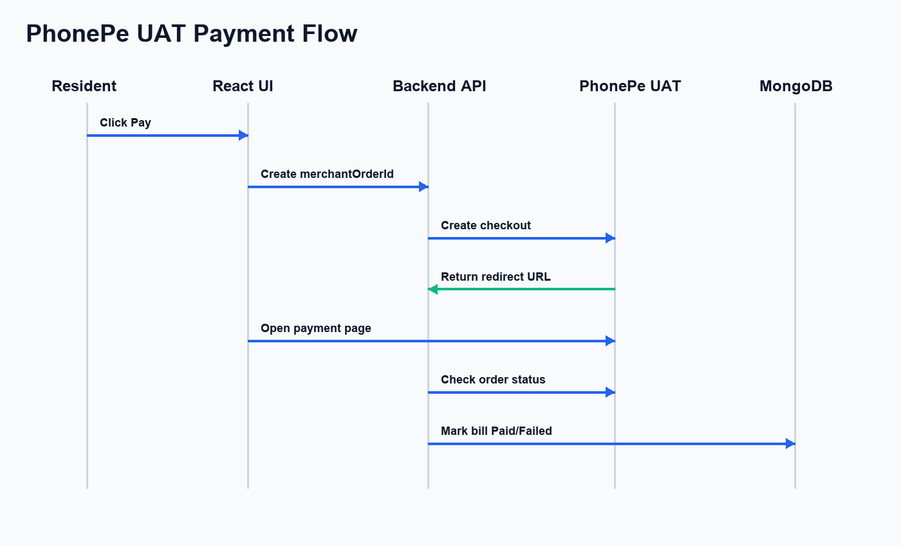
Payment Integration
Resident starts PhonePe checkout
Backend creates merchant order
PhonePe returns checkout URL
Backend verifies order status
Invoice becomes Paid after completion

Slide 7
Dashboard and UI
Light professional theme
Sharp rectangular cards
Pie, bar, and area-style charts
Role-specific data presentation

Slide 8
Performance Improvements
Parallel billing/resident fetches
Dedicated my-room endpoint
Lean MongoDB queries
Local maintenance state update
Clear database error handling

Slide 9
Testing and Deployment
Frontend build verified
Backend routes verified
Vercel frontend and backend configs
MongoDB Atlas network access
Environment variables for production

Slide 10
Conclusion
Digital solution for hostel administration
Improves speed and transparency
Demonstrates full-stack engineering
Future scope: PDF invoices, SMS/email, analytics

