Slide 1





Market Analysis Presentation
Customer Segmentation & Performance
RFM-COHORT
ANALYSIS
Compare, Evaluate

Slide 2

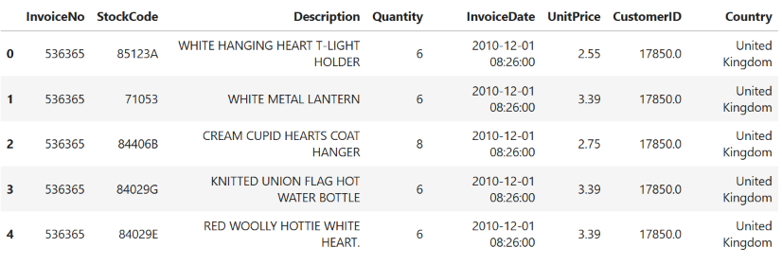
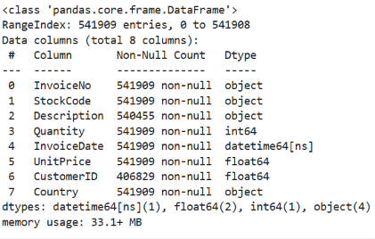
Problem statement
Develop a RFM (Recency, Frequency, Monetary) and Cohort Analysis system to segment customers and analyze retention trends. helps businesses understand customer value, purchase behavior, and retention patterns.
DATA
Data →

Slide 3
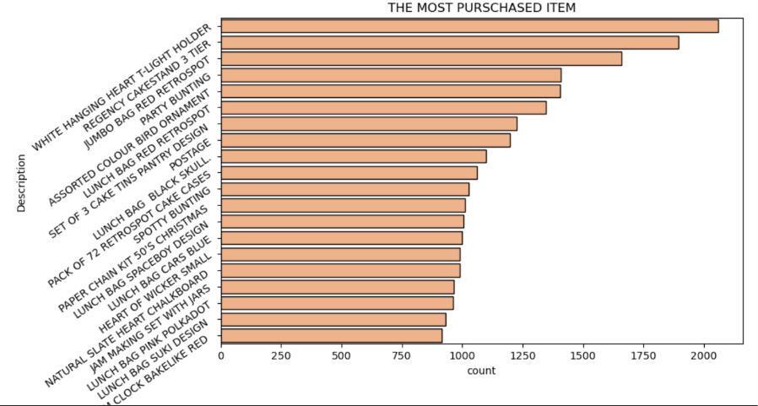
Eda :
EDA
The White Hanging Heart T-Light Holder is the most frequently purchased product.
Several home-decor and gift-related products dominate the top-selling list.
Products such as Jumbo Bag Red Retrospot, Regency Cakestand 3 Tier, and Rose Cottage Tea Cup & Saucer also have high purchase frequencies.
The concentration of purchases around a few products indicates the presence of strong best-selling products.
These products can be prioritized for inventory management, promotions, and cross-selling.

Slide 4
STEPS INVOLVED :
DataCleaning
EDA
RFM SCORE CALCULATION
Model building
Model Evalaution and solution

Slide 5
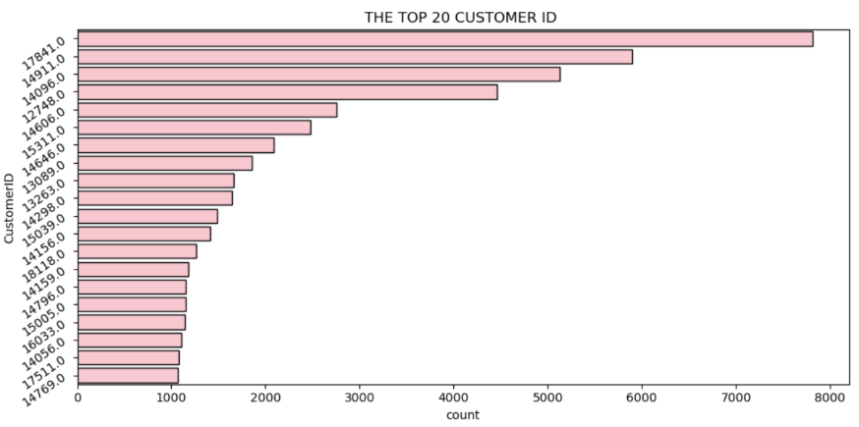
A small group of customers generates a very large number of transactions compared with other customers.
Customer 17841 is the most frequent customer in the chart.
The difference between the top customer and the remaining customers indicates unequal purchasing frequency.
These high-frequency customers are potentially loyal or high-value customers.
The business can create VIP programs, personalized offers, and loyalty rewards for these customers.

Slide 6
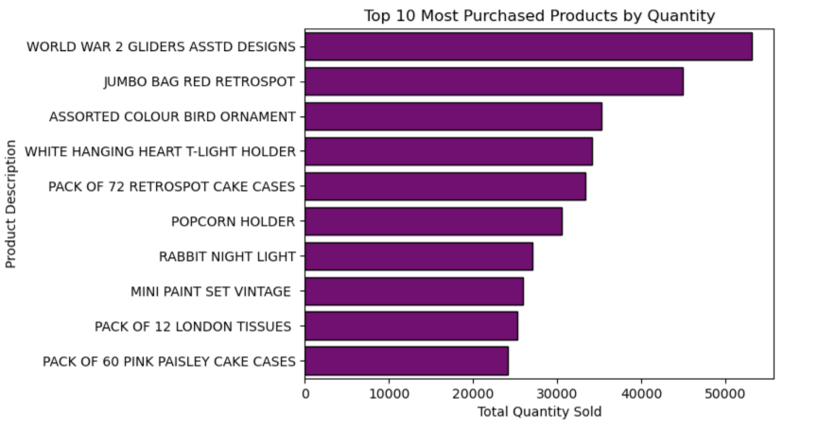
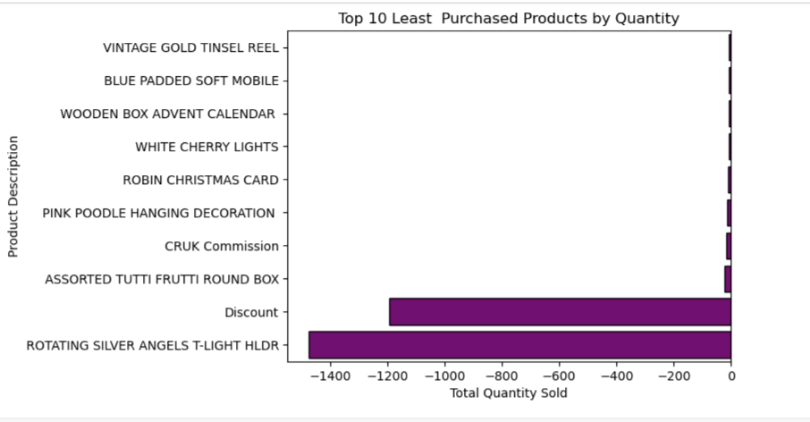
World War 2 Gliders Asstd Designs has the highest total quantity sold.
Jumbo Bag Red Retrospot and Assorted Colour Bird Ornament are also among the strongest products.
The difference between the first product and lower-ranked products shows that demand is concentrated among a few products.
These products should be closely monitored to avoid stock-outs.
High-volume products can also be used for bundle offers and cross-selling.

Slide 7
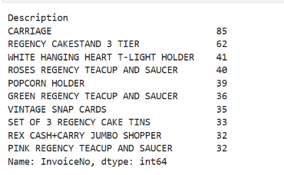
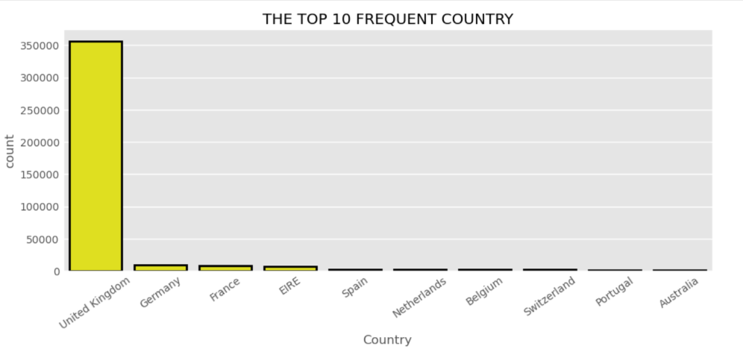
Several products have very low sales quantities.
Some products show negative quantities, indicating product returns or cancellations.
Rotating Silver Angels T-Light Holder has a particularly large negative quantity.
Products with consistently low demand may need reduced inventory or promotional support.
Products with high negative quantities should be investigated for return-related issues.

Slide 8
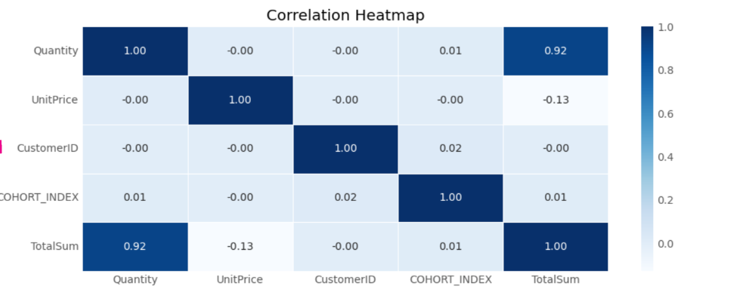
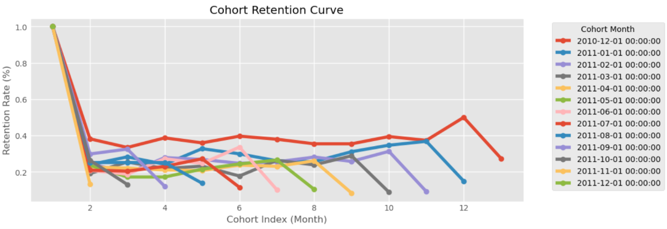

Slide 9
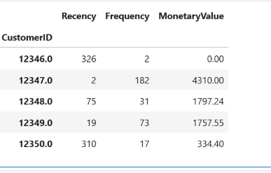
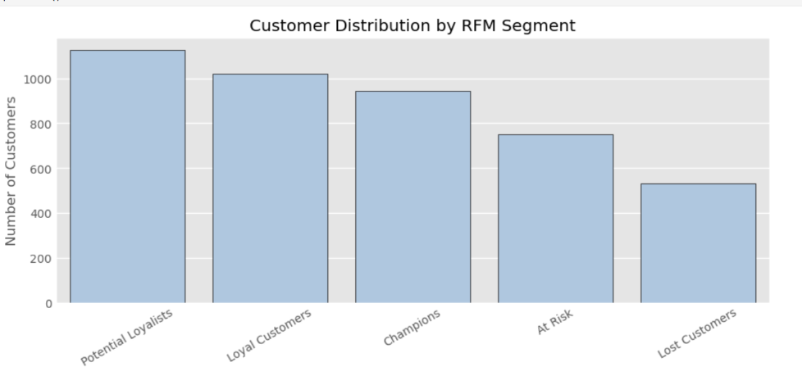
.
Several products have very low sales quantities.
Some products show negative quantities, indicating product returns or cancellations.
Rotating Silver Angels T-Light Holder has a particularly large negative quantity.
Products with consistently low demand may need reduced inventory or promotional support.
Products with high negative quantities should be investigated for return-related issues

Slide 10
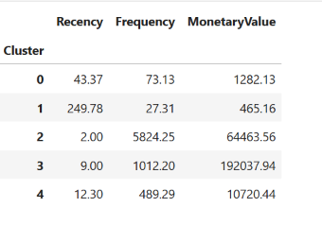
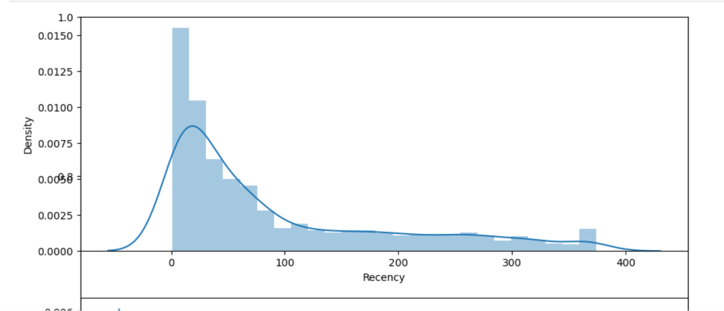
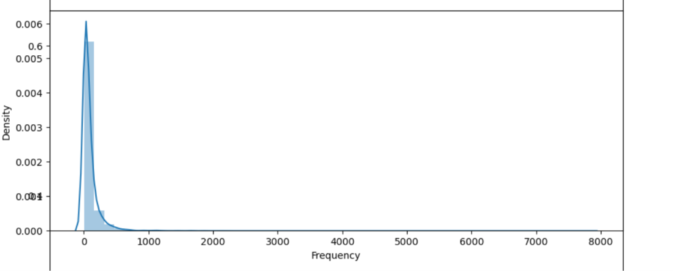
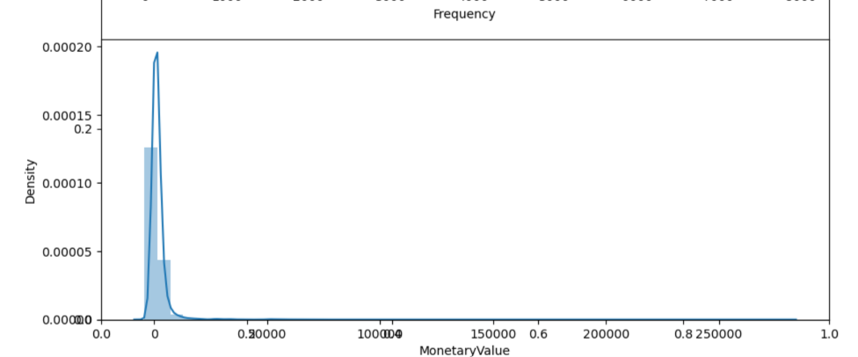

Slide 11
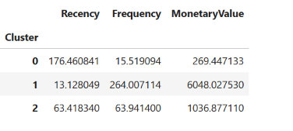
conclusion
"The analysis shows that customer value is highly concentrated among a smaller group of highly engaged customers. RFM and clustering help identify these high-value customers, while cohort analysis reveals a significant retention challenge after the initial purchase. Therefore, the business should focus on retaining high-value customers, reactivating at-risk customers, improving early customer engagement, and optimizing inventory around best-selling products."

Slide 12
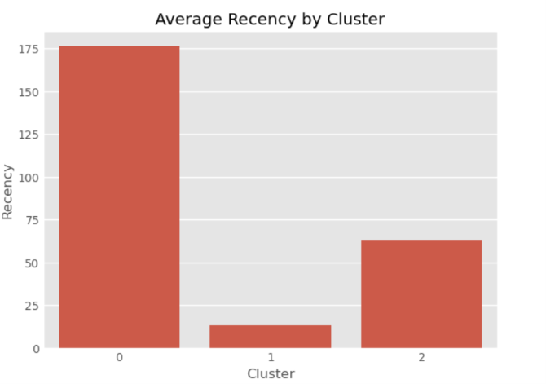
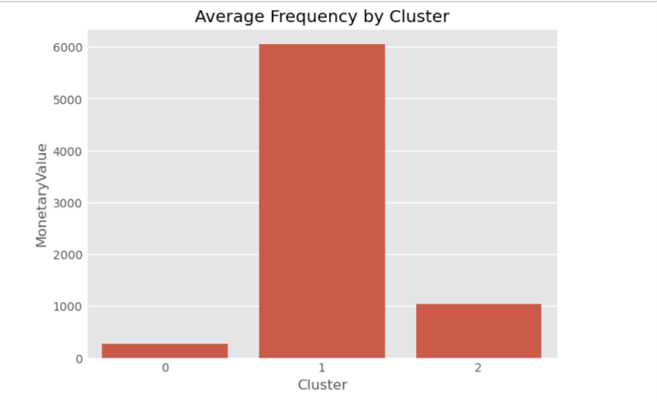
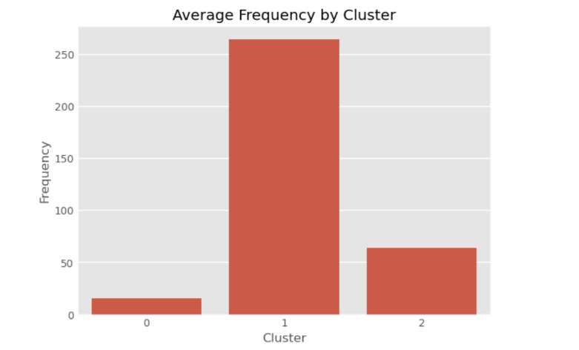

Slide 13
Key Insights & Recommendations
Key Insights
Recommendations
Revenue is concentrated in a small "Champions" segment (Recency ~14 days, Frequency ~272) – average spend $6,197 vs just $127 for Lost Customers
Retention drops sharply after month 1 across almost every cohort, falling from 100% to roughly 20–40% by month 2
K-Means clustering confirms 3 natural customer groups: low-value/inactive (1,545), mid-value (1,843), and high-value/loyal (984)
A handful of outlier customers (9 total) each carry six-figure lifetime spend, far above the typical customer
The UK accounts for the large majority of transactions, but retention quality varies meaningfully across cohort months
Launch a loyalty/VIP program for Champions and the high-value cluster to protect and grow the ~$6K average spenders
Trigger automated win-back campaigns for At Risk and Lost customers (Recency beyond 150 days)
Strengthen post-first-purchase onboarding to soften the steep month-1 to month-2 retention drop-off
Assign dedicated account management to top outlier spenders (9 customers, $190K+ lifetime value)
Test upsell/cross-sell offers on Potential Loyalists and the mid-value cluster before they drift toward churn

Slide 14



Thank you
+123-456-7890
@reallygreatsite
123 Anywhere St., Any City
Try to translate benchmarking findings into strategic actions, prioritize improvements, reinforce strengths, and guide decisions to enhance competitive positioning effectively and efficiently.

