Slide 1
✈
MACHINE LEARNING PROJECT
Travel Insurance
Prediction
Predicting customer purchase behavior with classification models — Random Forest, Logistic Regression, KNN & Decision Tree
Dataset: TravelInsurancePrediction.csv | 1,987 records | 9 features

Slide 2
PROJECT OVERVIEW
Objective & Workflow
Predict whether a customer will purchase travel insurance based on demographic, financial, and travel-history attributes, then compare four classification models to find the best performer.
1
2
3
Data Cleaning
Exploratory Analysis
Feature Engineering
Remove index column, check nulls & duplicates
Visualize distributions & relationships
Encode categories, build new ratio features
4
5
6
Model Training
Evaluation
Prediction
Random Forest, Logistic Regression, KNN, Decision Tree
Accuracy, Precision, Recall, F1 comparison
Score new, unseen customer profiles
Travel Insurance Prediction • 2

Slide 3
DATA PREPROCESSING & CLEANING
Dataset Snapshot
1,987
9
0
9
Total Records
Original Features
Missing Values
Columns after dropping index
Cleaning Steps
Numeric Summary (describe)
✓
Dropped the redundant 'Unnamed: 0' index column
Metric | Age | Annual Income | Family Members
Mean | 29.65 | ₹9,32,763 | 4.75
Std Dev | 2.91 | ₹3,76,856 | 1.61
Min | 25 | ₹3,00,000 | 2
Max | 35 | ₹18,00,000 | 9
✓
Confirmed zero null values across all 9 columns
✓
Checked for duplicate rows using .duplicated()
✓
Verified data types: 5 numeric, 4 categorical
Travel Insurance Prediction • 3

Slide 4
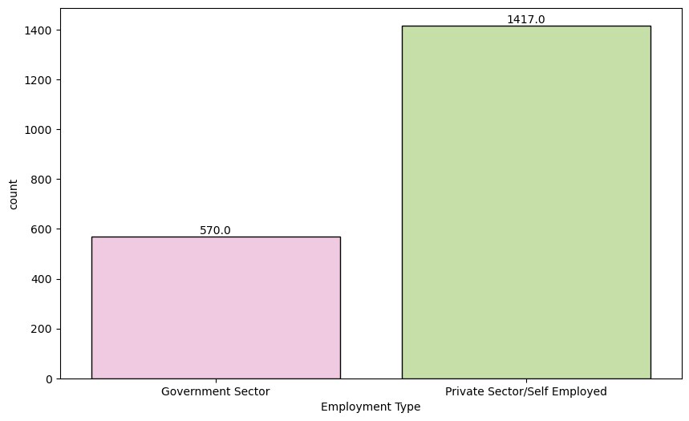
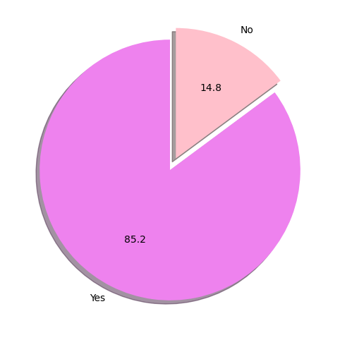
EXPLORATORY DATA ANALYSIS
Employment Type & Education
Count of customers by Employment Type
Graduate vs Non-Graduate split
Most customers work in the Private Sector, and the vast majority are graduates — a strongly imbalanced education split.
Travel Insurance Prediction • 4

Slide 5
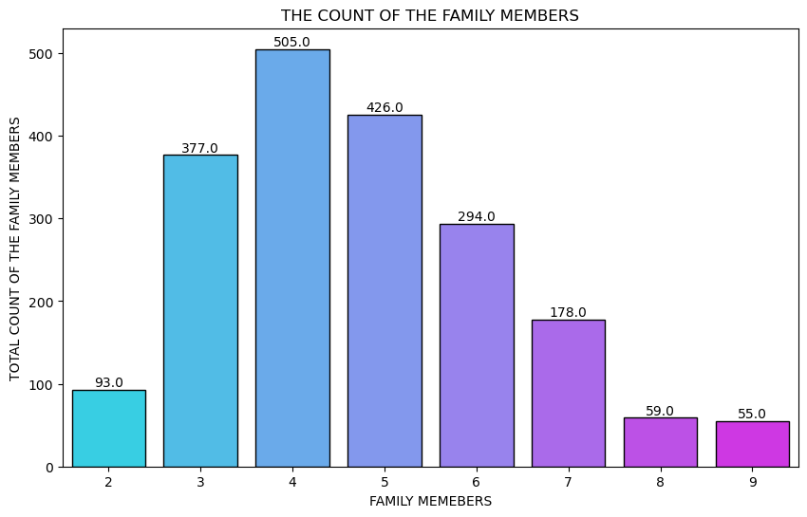
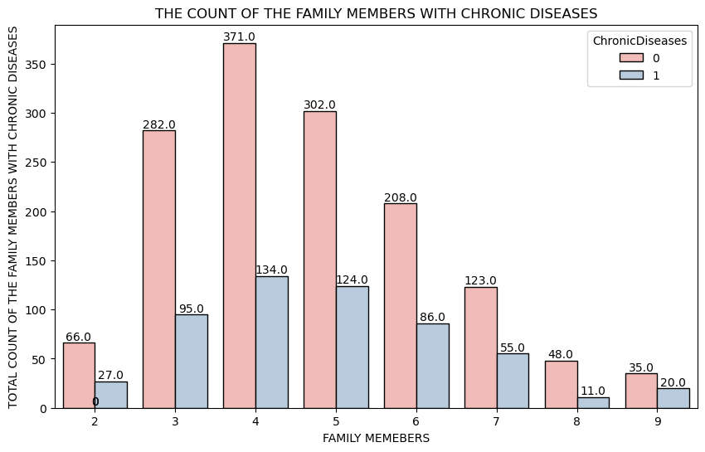
EXPLORATORY DATA ANALYSIS
Family Size & Chronic Disease
Distribution of Family Members
Family Members split by Chronic Disease
Families of 4-6 members dominate the dataset; chronic disease presence is spread fairly evenly across family sizes.
Travel Insurance Prediction • 5

Slide 6
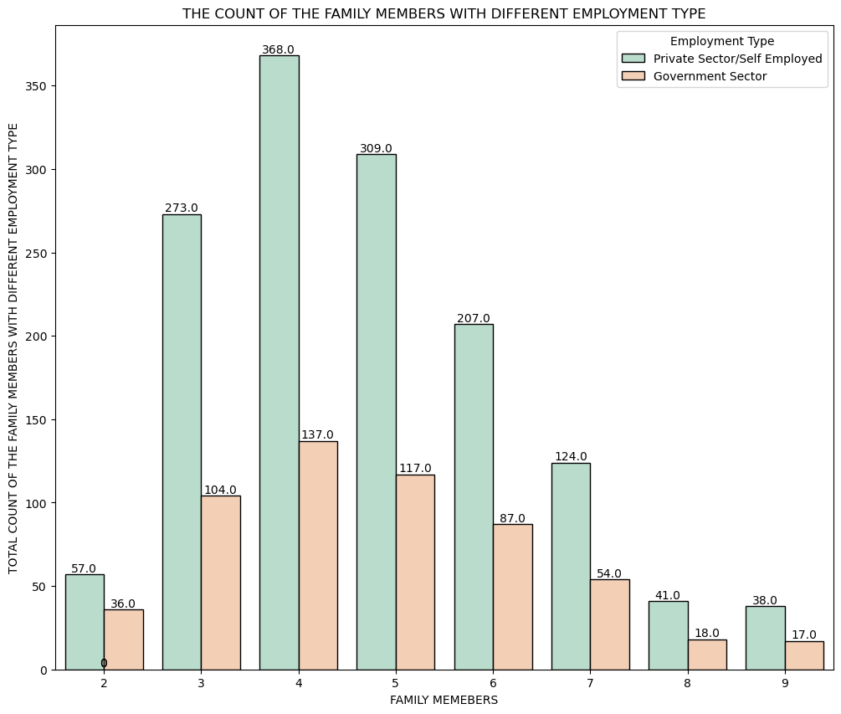
EXPLORATORY DATA ANALYSIS
Family Size by Employment Type
Family Members count, split by Employment Type
Travel Insurance Prediction • 6

Slide 7
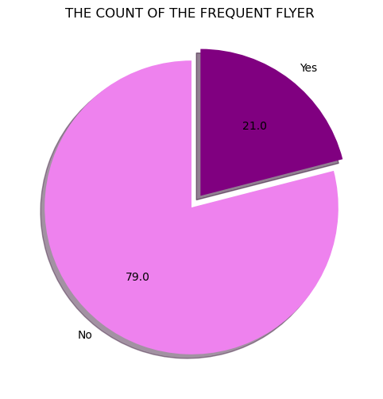
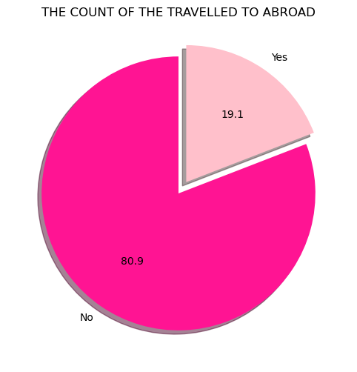
EXPLORATORY DATA ANALYSIS
Travel Habits
Frequent Flyer status
Ever Travelled Abroad status
Only a minority of customers are frequent flyers or have travelled abroad — these behaviors turn out to be strong purchase signals.
Travel Insurance Prediction • 7

Slide 8
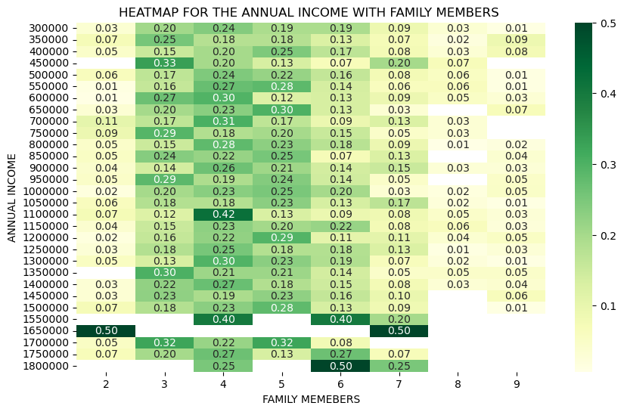
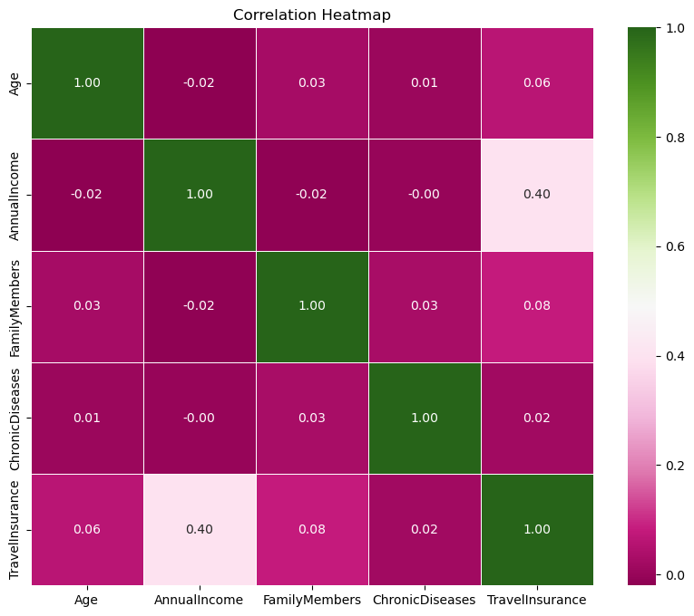
EXPLORATORY DATA ANALYSIS
Relationships & Correlation
Annual Income vs Family Members (row-normalized)
Correlation heatmap of numeric features
No single feature dominates the correlation with the target — the signal is distributed across income, travel history, and family size.
Travel Insurance Prediction • 8

Slide 9
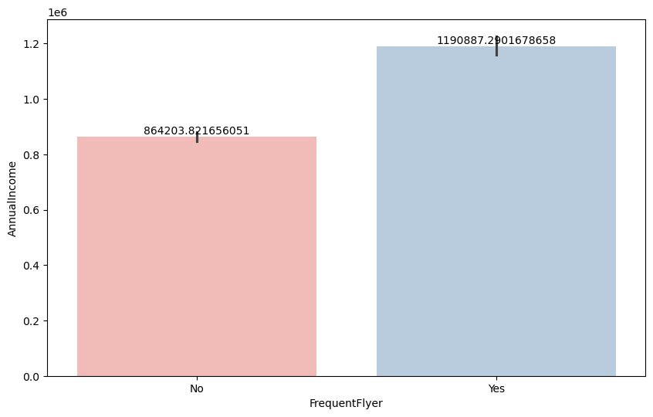
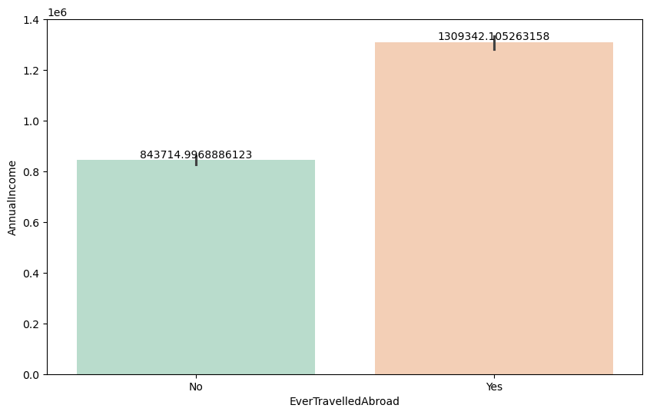
EXPLORATORY DATA ANALYSIS
Income vs Travel Behavior
Annual Income by Frequent Flyer status
Annual Income by Ever Travelled Abroad status
Customers with higher annual income are more likely to be frequent flyers and to have travelled abroad.
Travel Insurance Prediction • 9

Slide 10
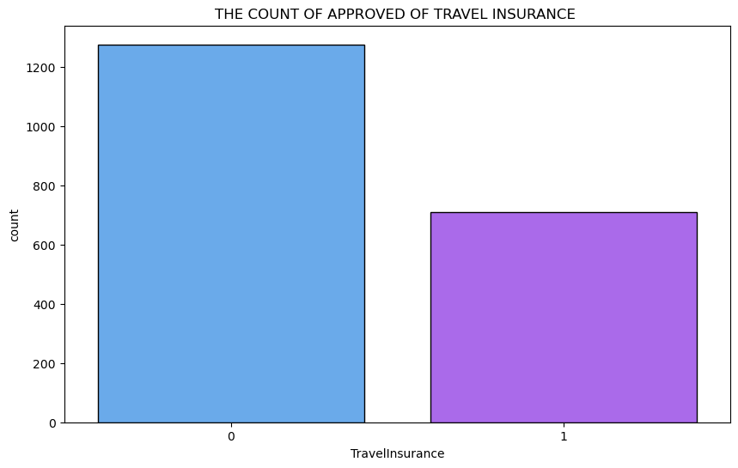
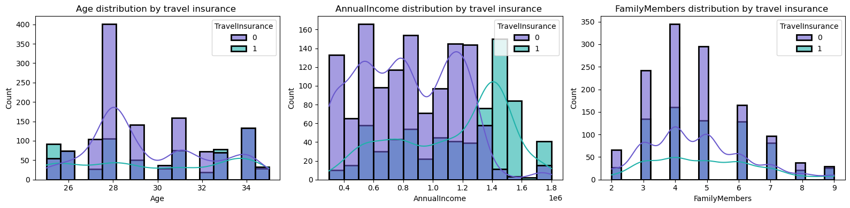
EXPLORATORY DATA ANALYSIS
Target Variable & Distributions
Age, Annual Income & Family Members by target
Class Balance
Around 64% of customers did not purchase insurance, 36% did — a mild imbalance the models must handle.
Travel Insurance purchase count
Group | Avg Age | Avg Income | Avg Family
No Insurance (0) | 29.5 | ₹8,21,300 | 4.7
Purchased (1) | 29.9 | ₹11,33,239 | 4.9
Travel Insurance Prediction • 10

Slide 11
FEATURE ENGINEERING
Encoding & New Features
Categorical Encoding
Engineered Features
FrequentFlyer
Yes → 1, No → 0
÷
IncomePerFamilyMember
= AnnualIncome / FamilyMembers
EverTravelledAbroad
Yes → 1, No → 0
+
TravelScore
= FrequentFlyer + EverTravelledAbroad
GraduateOrNot
Yes → 1, No → 0
Why it matters
Employment Type
Government → 1, Private/Self → 0
These ratio and combined features capture per-person affordability and cumulative travel exposure — signals that raw columns don't express directly.
Travel Insurance Prediction • 11

Slide 12
DATA TRAINING & SPLITTING
Train / Test Split
80 / 20 split using train_test_split(random_state=42)
Train — 1,589 rows (80%)
Test
398 (20%)
1,589
398
42
Training Rows
Testing Rows
Random State (seed)
Feature set (data_x): Age, Employment Type, GraduateOrNot, AnnualIncome, FamilyMembers, ChronicDiseases, FrequentFlyer, EverTravelledAbroad, IncomePerFamilyMember, TravelScore → Target (data_y): TravelInsurance
Travel Insurance Prediction • 12

Slide 13
MODEL TRAINING & EVALUATION METRICS
Four Models, Head to Head
Model | Accuracy | Precision | Recall | F1 Score
Random Forest | 82.41% | 81.42% | 65.25% | 72.44%
Logistic Regression | 74.87% | 71.58% | 48.23% | 57.63%
KNN | 79.90% | 78.50% | 59.57% | 67.74%
Decision Tree | 80.40% | 75.20% | 66.67% | 70.68%
★
Random Forest leads on every metric
Highest accuracy (82.4%), precision (81.4%), and F1 score (72.4%) — ensembling many decision trees captures the non-linear interactions between income, travel history, and family size better than a single model.
Travel Insurance Prediction • 13

Slide 14
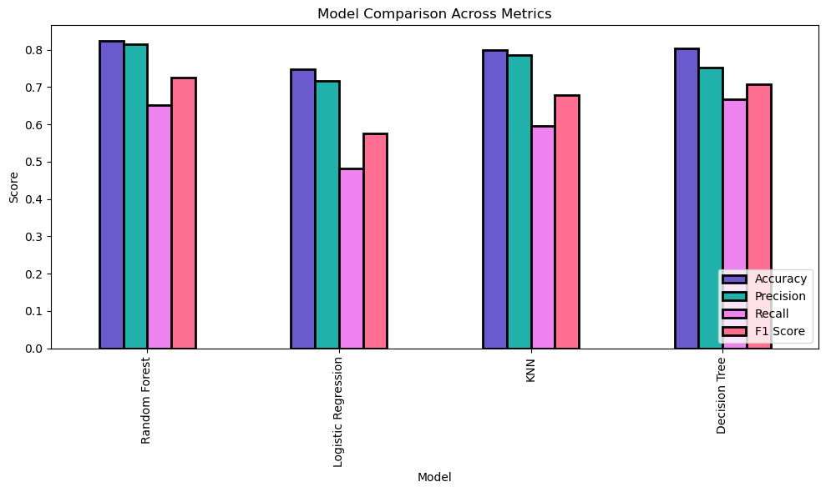
MODEL TRAINING & EVALUATION METRICS
Model Comparison Across Metrics
Accuracy, Precision, Recall & F1 Score by model
Travel Insurance Prediction • 14

Slide 15
CONCLUSION
Random Forest Wins
Across all four models, Random Forest delivers the strongest, most balanced performance for predicting travel-insurance purchases.
BEST MODEL
Random
Forest
✓
Highest overall accuracy at 82.4%, ~2 points above the next-best model
✓
Best precision (81.4%) — fewer false positives when predicting a purchase
82.4%
✓
Best F1 score (72.4%), the strongest balance of precision and recall
Accuracy on held-out test set
✓
Handles non-linear feature interactions (income × travel history × family size) that Logistic Regression misses
F1 Score: 72.4% • Precision: 81.4%
Recall: 65.3%
Travel Insurance Prediction • 15

Slide 16
PREDICTION ON UNSEEN DATA
Scoring New Customers
Three unseen customer profiles were passed through the trained Random Forest model to validate real-world behavior.
C1
Customer 1
C2
Customer 2
C3
Customer 3
Age
29
Age
45
Age
24
Employment
Private/Self
Employment
Government
Employment
Private/Self
Graduate
Yes
Graduate
Yes
Graduate
No
Annual Income
₹14,00,000
Annual Income
₹4,50,000
Annual Income
₹6,50,000
Family Members
3
Family Members
5
Family Members
2
Frequent Flyer
Yes
Frequent Flyer
No
Frequent Flyer
No
Travelled Abroad
Yes
Travelled Abroad
No
Travelled Abroad
Yes
Will Purchase
Will Not Purchase
Will Not Purchase
Probability: 89.0%
Probability: 12.8%
Probability: 31.6%
Travel Insurance Prediction • 16

Slide 17
✈
Thank You
Travel Insurance Prediction — Machine Learning Project

