Slide 1
Expense Sharing

Slide 2




Problem Statement
When friends share expenses, tracking who owes whom becomes complex and error-prone.
Multiple People
Manual Tracking
Expenses split among many participants with varying shares
Manual calculation leads to mistakes and confusion
Uneven Splits
Settlement Chaos
Different amounts for different participants cause complexity
Hard to determine who pays whom to settle all debts

Slide 3
Solution
A complete Python OOP-based expense sharing system
Group Setup
Expense Logging
Balance Engine
Add any number of friends
Record payer, amount, desc
Auto-calculates net balances
Flexible participant input
Multi-participant splitting
Greedy settlement algo
Console-driven interface
Per-expense breakdown
Minimizes transactions

Slide 4
Class Architecture: ExpenseSharing
ExpenseSharing
Data Storage
friends → list of dicts
Friends list with name/email/phone
Expenses dict per payer
expenses → dict by payer
balances → dict by friend
Core Methods
Add expenses & track participants
Compute net balances
__init__(friends)
add_expense(payer, amt, desc, parts)
Settlement
calculate_balances()
Greedy algorithm minimizes
number of transactions
calculate_settlements()
refund(payer, amount, desc, to)
Reporting
generate_expense_df()
Pandas DataFrame with
per-person cost breakdown

Slide 5
How It Works
1
2
3
4
5
Input Friends
Log Expenses
Calculate Balances
Settle Up
View Report
User enters comma-separated friend names to initialise the group
Enter payer, amount, description & participants until 'done'
Each payer is credited; each participant is debited their share
Greedy algorithm pairs debtors & creditors; prints minimal transactions
Pandas DataFrame shows full expense table with per-person cost

Slide 6
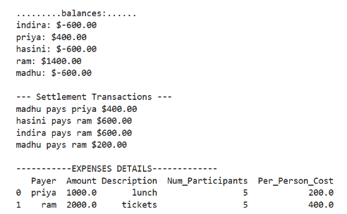
Settlement Algorithm
Algorithm (Greedy)
Example — 4 Friends
Separate into:
Friend
Owes
creditors (balance > 0)
debtors (balance < 0)
Sort both by amount (desc)
WHILE debtors AND creditors:
pop smallest debtor
pop smallest creditor
settle = min(debt, credit)
record transaction
if remainder > 0:
push back with new amount

Slide 7



Key Features
Dynamic Group Management
Expense Tracking
Balance Calculation
Add unlimited friends
Log payer, amount, description
Automatic net balance per person
Flexible participant input per expense
Supports partial participation
Handles payers who also participate
Greedy Settlement
Pandas Reporting
Refund Support
Minimises number of transactions
DataFrame with per-person cost
Record refunds with timestamps
Clear pay-to instructions
Ready for further data analysis
Status tracking (pending/done)

Slide 8
Technology Stack
Language
Python 3
Object-oriented design with classes & methods
Library
Pandas
DataFrame generation for tabular expense reports
Paradigm
OOP
Encapsulated ExpenseSharing class with clear API
Algorithm
Greedy
Optimal debt settlement with sorted creditor/debtor queues
I/O
Console
Interactive input loop with user prompts and guards

Slide 9

Summary & Future Scope
What is Built
Future Enhancements
Fully working Python expense tracker
→
Web or mobile UI (Flask / React)
OOP design with clear class structure
→
Database persistence (SQL)
Greedy settlement minimises transactions
→
Email / SMS payment reminders
Pandas integration for expense reports
→
Currency conversion support
Interactive console interface
→
Recurring expense subscriptions
Thank you

