Slide 1
What is still unsolved, and how to solve it
Go 3 · Research
The research landscape from max-pressure to language-model traffic agents, the eleven gaps that keep them off real streets, five small SUMO experiments that make those gaps visible, and the designs and questions that look most promising.
smrahmanbd.github.io/agentic-atsc-lab
Notes:
This guide is for beginners who have met the earlier parts of the course (or are happy to learn the words as they go). You need only school maths. Go 3 is about research: what has been tried, how to judge it fairly, what is still missing, and what our own small experiments show. Every paper cited here is in the course's list of 40 checked references, and every lab number comes from this repository's SUMO runs. There are six ideas. Each builds on the one before.

Slide 2
6 ideas, each building on the last
1
The research landscape: six waves
2
How to evaluate a new idea fairly
3
The eleven gaps
0 of 9 LLM controller papers reporting a field deployment
0.66 s R1 talking benefit, no bigger than the 0.67 s noise
53 → 22 s R4 longest wait with fairness weight 0.15
4
Our five experiments, R1-R5
5
Future solution: a layered agentic controller
6
Open research questions
223 vs 0 unsafe commands reaching the signal, R2 at 40 % bad answers
1.81 M decisions per hour for 2,510 lights deciding every 5 s
+26.3 % R5 delay at H = 8 s, for 8.7 % fewer stops
Notes:
Outcomes for today:
- Name the six waves of signal-control research and say, in plain words, what reinforcement learning (RL) and a large language model (LLM) do.
- List the rules of a fair comparison and decide whether a difference is bigger than the noise.
- Explain at least six of the eleven gaps (sim-to-real, safety, hallucination, explainability, robustness, equity...) with one piece of evidence each.
- Read the results of experiments R1-R5 and compute relative changes from them.
- Sketch the layered agentic controller and say what each layer protects against.
- Turn a gap into a testable research question with a method, setting and metric.

Slide 3
Three surprises to start
Not one LLM traffic controller is on a real street.
Breaking the rules looks faster.
A promise can cost more than it saves.
The nine language-model controllers in our reviewed literature were all tested in simulation only; none reports a field deployment. Their headline gains, about 17.5-20.4 % in waiting or travel time, are as reported by their authors.
In our experiment R2, a perfectly reliable model with no safety shield had less delay (9.0 s) than the shielded one (10.6 s). It got there by issuing 112 rule-breaking commands. A fair comparison makes everyone obey the same rules.
In R5, making the signal commit to its next change 8 s ahead gave connected cars usable speed advice and the fewest stops, but raised delay from 16.7 to 21.1 s and CO2 from 229.5 to 241.4 g per vehicle.

Slide 4
Words you will meet
Reinforcement learning (RL) | A program that learns by trial and error, rewarded with a score, like a dog trained with treats.
Large language model (LLM) | A text-predicting AI, as in chatbots. It can answer 'switch to north-south' and give a reason.
Agent | A program that observes, decides and acts on its own. Here, a signal controller.
Hallucination | An LLM answer that is confident but wrong, such as a phase that does not exist.
Safety shield | A strict rule-checker that blocks any command breaking minimum green or other safety rules.
Sim-to-real gap | Everything that changes when a controller moves from a simulator (SUMO, CityFlow) to real streets.
Seed | The starting number for simulated random arrivals: a different seed is a different, equally likely day.
CAV / V2X | Connected and automated vehicle; V2X is the radio link between vehicles and the signal.
GLOSA | Green Light Optimal Speed Advisory: the speed that arrives on green, so the driver need not stop.
Notes:
You do not need to memorise these now; each is explained again when it first matters.

Slide 5
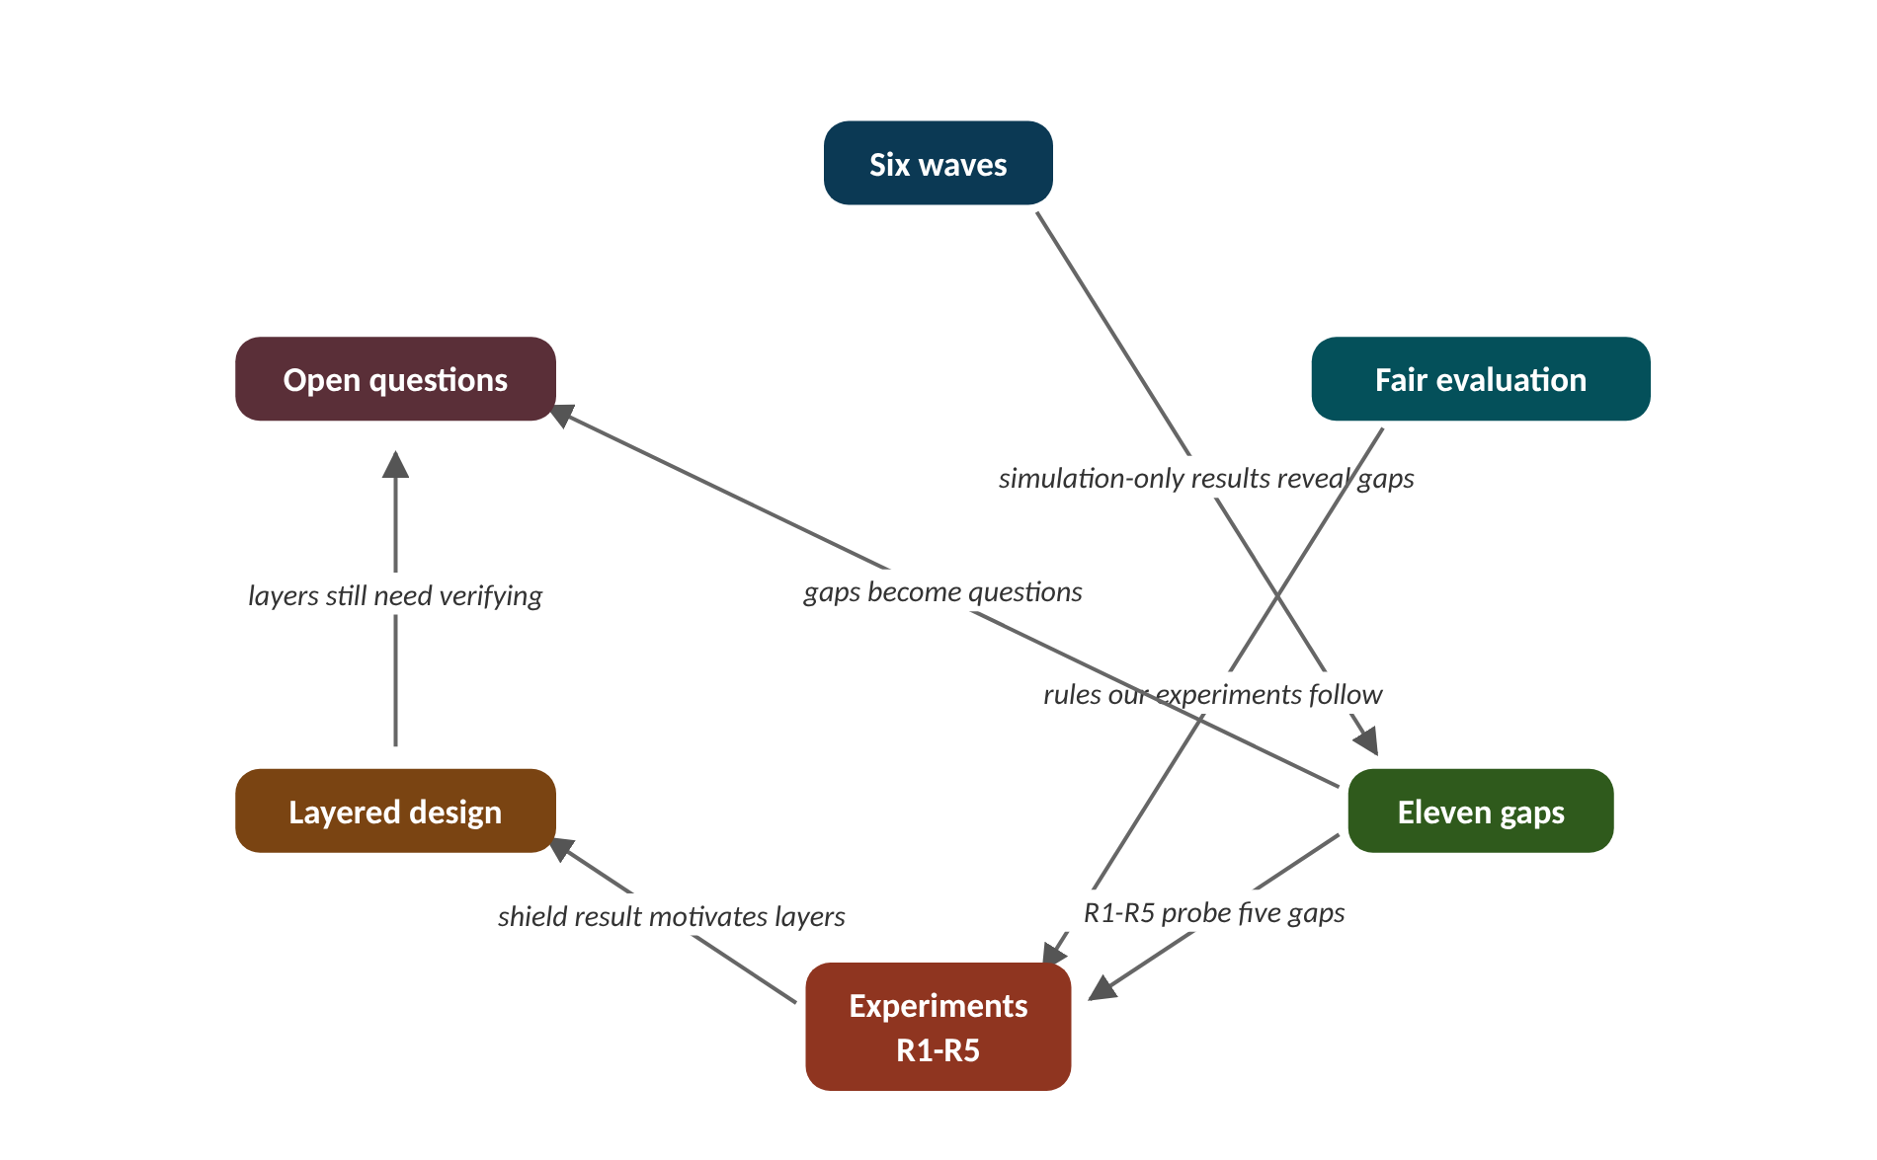
The map of today's ideas
Notes:
Each box is one idea; arrows say how one feeds the next. simulation-only results reveal gaps; rules our experiments follow; R1-R5 probe five gaps; shield result motivates layers; gaps become questions; layers still need verifying.

Slide 6
1 The research landscape: six waves
IN PLAIN WORDS
Think of how phones grew up: landline, mobile, smartphone, voice assistant. Each new wave kept the old one inside it: a voice assistant still makes plain phone calls. Newer signal controllers likewise use older controllers as tools or as the yardstick.
Adaptive, max-pressure, deep RL
LLM: tool user, controller, hybrid
Each wave keeps the last as baseline
Reported LLM gains: about 17.5-20.4 %
All LLM controllers: simulation only
0 of 9
LLM controller papers reporting a field deployment
Notes:
Traffic lights have been 'smart' since the 1980s. So why are language-model controllers news, and why has none reached a real street?
Adaptive systems (1980s on, SCOOT and SCATS) measure traffic and re-tune cycle, split and offset. Max-pressure (2013) gives green to the movement with the biggest 'queue in minus queue out'; it needs only local queues and has a mathematical proof of maximum throughput (Varaiya, 2013). Hardware-in-the-loop tests on real signal hardware move it toward the field (Stern et al., 2024).
Deep RL and multi-agent RL (MARL), from about 2019: a neural network learns which phase to pick by trial and error in a simulator, rewarded for less queueing. PressLight, CoLight, FRAP, AttendLight and MPLight are the standard set; MPLight ran on a simulated network of 2,510 lights.
LLM waves, from 2023. As a tool user, an LLM chats with an operator and calls simulators (TrafficGPT, Open-TI). As a controller, it reads the traffic state and picks the phase with a reason (LLMLight, LA-Light, CoLLMLight). Hybrids let fast RL or rules handle routine cases and send hard ones to LLM reasoning or critique (iLLM-TSC, VLMLight, HeraldLight). Reported gains: about 17.5-20.4 % against RL, in the authors' simulations; none of the nine reports a field deployment.
Presenter tip: Start with the phone analogy. Define RL (trial and error with a score) and LLM (text predictor that can explain itself) before naming papers. Do the 20.4 % example on the board and stress that percentages from different papers are not comparable.

Slide 7
Worked example: What does '20.4 % less waiting' mean?
new value = old value × (1 − gain ÷ 100)
relative change = (new − old) ÷ old × 100 %
LA-Light reports 20.4 % less waiting than RL under sensor outages. Suppose (invented) RL waited 50 s.
1. Turn the percentage into a fraction: 20.4 ÷ 100 = 0.204.
2. Seconds saved: 50 × 0.204 = 10.2 s.
3. New waiting time: 50 − 10.2 = 39.8 s (or 50 × 0.796).
4. Check backwards: (39.8 − 50) ÷ 50 × 100 = −20.4 %.
5. iLLM-TSC reports 17.5 % under degraded communication: 50 × 0.825 = 41.25 s.
The two gains differ by 1.45 s here, and their setups differ: do not rank them.
Notes:
Headline gains reported by three LLM papers (authors' simulations). What to notice: all about one fifth, all in simulation, different setups.
Try it with the audience: VLMLight reports up to 65 % less emergency-vehicle waiting than RL alone. If (invented) an ambulance waited 40 s, how long after a 65 % cut?
Answer: 40 × (1 − 0.65) = 40 × 0.35 = 14 s, a saving of 26 s. Remember 'up to': this is the best case the authors report.

Slide 8
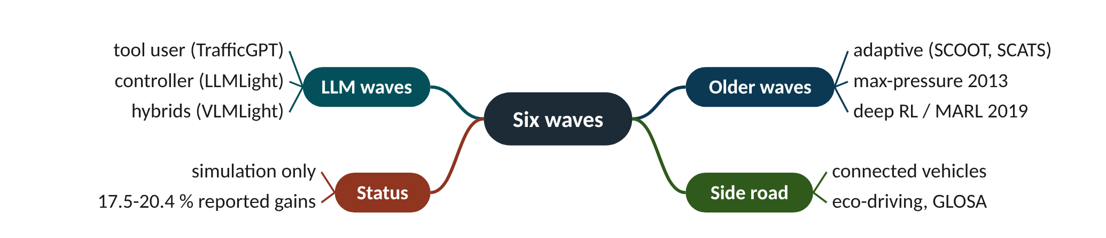
Remember it: Six waves
PICTURE THIS · STOP 1: MUSEUM OF WAVES
TRAP
Six bone-dry surfboards: an old wooden SCOOT board, a pressure-gauge board, a neural-network board, a talking board, a board with a brain, a board split in two.
A reported percentage holds only for the authors' simulator, data and baseline. Two papers' percentages compare only if the setups match, which is rare.
Notes:
What the scene encodes: Adaptive → max-pressure → deep RL → LLM tool users → LLM controllers → hybrids; dry = simulation only.
Recap: Six waves: adaptive → max-pressure → deep RL → LLM tool user → LLM controller → hybrids; LLM gains of about 17.5-20.4 % are reported in simulation only.

Slide 9
2 How to evaluate a new idea fairly
IN PLAIN WORDS
A fair race gives every runner the same shoes and track, runs more than one heat, and also checks who was left behind. One heat on a windy day proves little: the winner may just have had the wind at their back.
Beat strong baselines, not just fixed time
Same rules for every controller
Three or more seeds: mean and spread
Report fairness, CO2 and violations
Publish the negative results too
0.66 s
R1 talking benefit, no bigger than the 0.67 s noise
Notes:
Your new controller cuts delay by 0.66 s. Is that a discovery, or just a lucky day of random traffic?
Strong baselines. Always compare with well-tuned actuated control and max-pressure, not only fixed time, which is easy to beat. Same everything else: same network, demand, seeds, yellow and all-red, minimum green. In our code every controller drives the same Junction class, so results differ only by decisions.
Several seeds. A seed is the random starting number for arrivals; each seed is a different but equally likely day. Report the mean and the spread over at least 3 seeds. If a gain is smaller than the spread, you have not shown it. In R1 talking agents beat silent ones by 0.66 s, but the runs with messages wobble over a 0.67 s range: the effect is within single-seed noise.
More than delay. Report stops, CO2, the 95th-percentile and the longest wait (fairness), and safety violations. Stress tests (faults, latency, odd demand, bad model outputs) and ablations (switch one part off at a time) show what really helps. And publish negative results: several of ours are. Rules matter too: in R2 the unshielded perfect model looked faster (9.02 s vs 10.62 s) only because it broke minimum green 112 times.
Presenter tip: Use the race analogy. Show the R1 chart and point at the y-axis first. Then reveal the R2 'cheating is faster' result to show why identical rules matter.

Slide 10
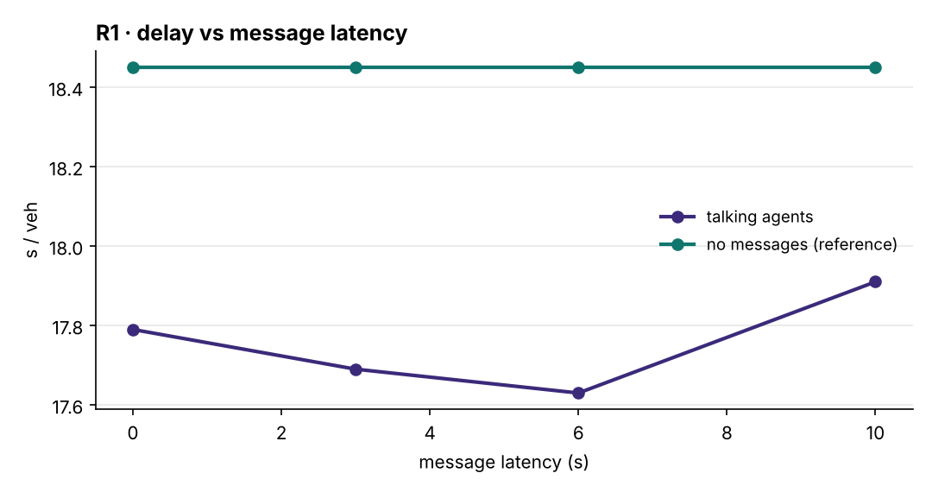
Worked example: R1: is the gain bigger than the wobble?
mean = sum of results ÷ number of runs
range = largest − smallest
R1, four-junction corridor, one seed. No messages: 18.45 s. Six runs with messages (latency 0, 3, 6, 10 s; loss 30 %, 60 %): 17.79, 17.69, 17.63, 17.91, 18.30, 17.86 s. Latency and loss can only hurt, so up-and-down changes behave like noise.
1. Sum: 17.79 + 17.69 + 17.63 + 17.91 + 18.30 + 17.86 = 107.18 s.
2. Mean: 107.18 ÷ 6 = 17.86 s.
3. Range: 18.30 − 17.63 = 0.67 s (standard deviation about 0.24 s).
4. Benefit of talking at 0 s latency: 18.45 − 17.79 = 0.66 s, that is 3.6 %.
5. Compare: the benefit (0.66 s) is no bigger than the wobble (0.67 s).
With one seed we cannot claim that messages help, or that latency hurts. The honest next step is more seeds, longer corridors and heavier demand.
Notes:
R1: corridor delay against message latency (one seed). What to notice: the vertical axis spans only 17.6-18.4 s. Delay goes down then up as latency grows, which no theory predicts: it is noise. All talking runs sit under the no-message line by less than 1 s.
Try it with the audience: Practice numbers (invented): a new controller gives 10, 11 and 12 s delay over three seeds; the old one gives 11.5, 12 and 12.5 s. Find both means and ranges. Is the gain convincing?
Answer: New: mean 33 ÷ 3 = 11 s, range 2 s. Old: mean 36 ÷ 3 = 12 s, range 1 s. The 1 s gain is smaller than the new controller's 2 s spread: promising, but run more seeds before claiming it.

Slide 11
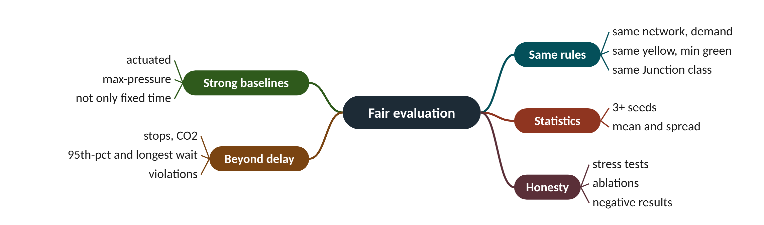
Remember it: Fair evaluation
PICTURE THIS · STOP 2: RACE TRACK
TRAP
Referees make every runner use the same shoes, run three races, and time not just speed but also who was left behind.
Do not zoom into a chart and read every wiggle as an effect. Check the axis: R1's whole chart covers less than 1 s. A difference smaller than the run-to-run spread is not a result, however neat the line looks.
Notes:
What the scene encodes: Same shoes = same rules; three races = seeds; left behind = fairness metrics.
Recap: Fair evaluation: strong baselines, same rules, 3+ seeds with mean and spread, metrics beyond delay, stress tests, ablations, honest negatives.

Slide 12
3 The eleven gaps
IN PLAIN WORDS
A new car that wins on a test track still needs crash tests, rain tests, cheap fuel, a driver who understands the dashboard and a road-safety licence. Speed on the track is only the first step.
Sim-to-real, safety, hallucination, explainability
Faults, scale, equity, mixed autonomy
Predictability, benchmarks, human factors
R4: fairness weight 0.15 nearly free
53 → 22 s
R4 longest wait with fairness weight 0.15
Notes:
If LLM and RL controllers report 20 % gains, why is no city using them? Because eleven potholes lie between a good simulation result and a safe street.
Sim-to-real: almost every controller is tested only in simulators; Sim2Signal finds direct transfer always degrades and no fix wins everywhere. Safety: minimum greens and conflict rules are non-negotiable, but learning and language models do not respect them by default. Hallucination: an LLM can name an invalid phase or give a confident, wrong reason, and its response time is unbounded. Explainability: operators must understand why a phase was chosen.
Sensor faults and communication delay: detectors fail and radio links drop messages, yet most benchmarks assume perfect data. Scalability and latency: cities have thousands of signals deciding every few seconds. Fairness and equity: throughput-optimal control can starve side streets, pedestrians and bus riders. Data and benchmarks: results rest on a few data sets (Jinan, Hangzhou, New York).
Mixed autonomy: connected-vehicle benefits depend on how many vehicles are connected; Feng et al. (2015) report up to 16.33 % less delay than actuated control at high penetration but about the same at low. Adaptivity vs predictability: eco-driving needs to know when the light changes. Human factors and regulation: trust, advice compliance and certification decide deployment, and are under-researched. Our R4 measures the equity gap on one junction.
Presenter tip: Walk the pothole road; give each gap one plain sentence. Explain hallucination with an example: a confident answer naming a phase that does not exist. Then do the R4 calculation to show one gap measured.

Slide 13
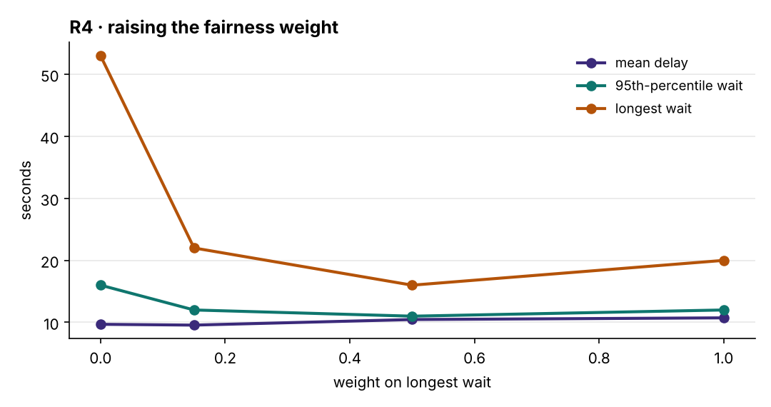
Worked example: R4: what does fairness cost?
fairness-weighted score = efficiency term + w × longest wait
relative change = (new − old) ÷ old × 100 %
One junction, heavy main road, one seed. Weight w = 0: mean delay 9.69 s, longest wait 53 s. w = 0.15: 9.56 s, 22 s. w = 0.5: 10.46 s, 16 s.
1. Longest wait, w 0 → 0.15: (22 − 53) ÷ 53 × 100 = −58.5 %.
2. Mean delay, w 0 → 0.15: (9.56 − 9.69) ÷ 9.69 × 100 = −1.3 % (no cost at all).
3. Longest wait, w 0.15 → 0.5: (16 − 22) ÷ 22 × 100 = −27.3 %.
4. Mean delay, w 0.15 → 0.5: (10.46 − 9.56) ÷ 9.56 × 100 = +9.4 %.
5. Max-pressure (ignores waits): longest wait 150 s, about 150 ÷ 22 = 6.8 times the w = 0.15 agent.
A small fairness weight was free in this run; larger weights buy a little more fairness for extra delay. One seed only, so treat the 'free' part as a hint, not a proof.
Notes:
R4: raising the fairness weight (one junction, one seed). What to notice: the longest wait (top line) falls from 53 s to 22 s at w = 0.15 while mean delay (bottom line) barely moves. After that, mean delay creeps up and the longest wait no longer improves much (20 s at w = 1).
Try it with the audience: Jayawardana and Wu report up to 25 % less CO2 from RL eco-driving at full CAV penetration, and that 25 % penetration delivers at least half of the benefit. What CO2 cut does that imply at 25 % penetration, at least?
Answer: Half of 25 % = at least 12.5 % (in the authors' simulation). The gap: below 25 % penetration the benefit is much less certain.

Slide 14
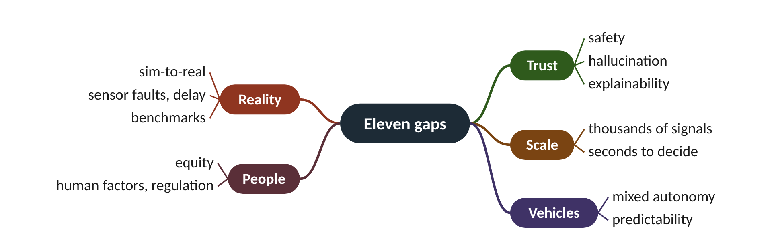
Remember it: Eleven gaps
PICTURE THIS · STOP 3: POTHOLE ROAD
TRAP
Eleven potholes, each with a sign: a simulator screen, a broken guardrail, a parrot, a question mark, a cut cable, a crowd, a seesaw, blue cars, a broken promise, a single dataset, a judge's gavel.
A low mean delay can hide one driver waiting a very long time. Max-pressure had more mean delay here (15.52 s), but the bigger warning is its 150 s longest wait. Always report the tail (95th percentile and maximum), not just the average.
Notes:
What the scene encodes: Sim-to-real, safety, hallucination, explainability, robustness, scale and latency, equity, mixed autonomy, predictability, benchmarks, human factors and regulation.
Recap: Eleven gaps: sim-to-real, safety, hallucination, explainability, robustness, scale and latency, equity, mixed autonomy, predictability, benchmarks, human factors. R4: w = 0.15 cut the longest wait 53 → 22 s for no delay cost.

Slide 15
4 Our five experiments, R1-R5
IN PLAIN WORDS
A seat belt slightly annoys you on every trip and does nothing on most of them. On the day of a crash it is the only thing that matters. The safety shield is the seat belt between an LLM and the lights.
R1: messages help under one second
R2: shield holds delay at 12.1 s
R2: no shield, 223 unsafe commands
R3: CAV-only weaker at 10 %
R4 and R5: fairness, commitment
223 vs 0
unsafe commands reaching the signal, R2 at 40 % bad answers
Notes:
What happens when the AI that runs the lights gives a bad answer four times in ten? We can test it safely in SUMO, and the answer depends entirely on one guard.
R1, latency and loss (four-junction corridor): talking agents with messages delayed 0-10 s or 30-60 % lost. Delay 17.6-18.3 s against 18.45 s without messages: under 1 s benefit, and latency and loss effects within single-seed noise. R2, hallucination and shield (one junction): a mock LLM gives a bad answer with probability h. With the shield, bad answers are caught and replaced.
In R2 at h = 40 %, the shielded agent keeps delay at 12.14 s (longest wait 39 s, 0 violations); without the shield, delay is 31.49 s, the longest wait 132 s, and 223 unsafe commands reach the signal. R3, CAV-only sensing: the agent sees only connected vehicles and scales up by the penetration. At 10 % delay is 9.94 s vs 9.01 s with loops; at 100 % both are 6.6 s.
R4, fairness: a small weight on the longest wait (0.15) cut it from 53 to 22 s and slightly lowered mean delay. R5, predictability (corridor, 50 % CAVs with GLOSA): committing H seconds ahead gives the fewest stops at H = 8 s (0.86) but raises delay and CO2. Every run is one seed in a small synthetic scenario: illustrations, not proofs.
Presenter tip: Spend most time on R2: it is the clearest result. Say clearly that the LLM is a mock. Use the seat-belt analogy for the shield. Mention each other room in one sentence and point to the website to rerun the scripts in sumo/go3/.

Slide 16
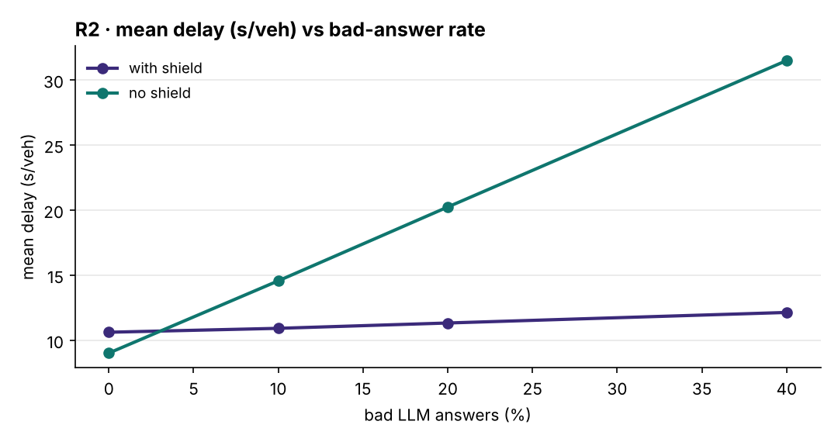
Worked example: R2: the shield at 40 % bad answers
relative change = (with − without) ÷ without × 100 %
times worse = unshielded ÷ shielded
One junction, mock LLM, 40 % bad answers, one seed. With shield: delay 12.14 s, longest wait 39 s. Without: delay 31.49 s, longest wait 132 s.
1. Delay saved: 31.49 − 12.14 = 19.35 s per vehicle.
2. As a share of the unshielded delay: 19.35 ÷ 31.49 × 100 = 61.4 % less.
3. Ratio: 31.49 ÷ 12.14 = 2.59: without the shield, delay is about 2.6 times higher.
4. Longest wait: 132 − 39 = 93 s shorter with the shield.
5. Shielded agent, 0 % → 40 % bad: (12.14 − 10.62) ÷ 10.62 × 100 = +14.3 % only.
With the shield, a model that is wrong 40 % of the time costs only 14 % more delay and breaks no rules. Without it, the junction degrades badly and 223 unsafe commands get through.
Notes:
R2: mean delay against the share of bad LLM answers (mock LLM, one seed). What to notice: the shielded line is almost flat (10.6 → 12.1 s); the unshielded line climbs steeply (9.0 → 31.5 s). At 0 % the unshielded agent looks faster, but only because it breaks minimum green.
Try it with the audience: In R3 at 10 % connected vehicles, the CAV-only agent had 9.94 s delay and the loop-detector agent 9.01 s. What is the relative change? At 100 % both had 6.6 s: what is it then?
Answer: (9.94 − 9.01) ÷ 9.01 × 100 = +10.3 % worse at 10 %; 0 % at 100 %. Low penetration is where estimating unequipped vehicles matters most.

Slide 17
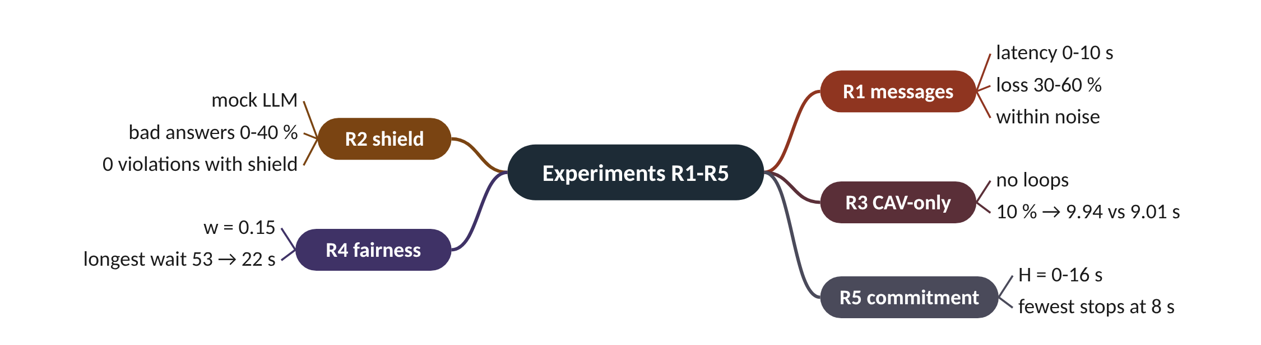
Remember it: Experiments R1-R5
PICTURE THIS · STOP 4: FIVE LAB ROOMS
TRAP
Room 1: tin-can phones with cut strings. Room 2: the parrot without its guard wrecks the junction. Room 3: half-blind goggles. Room 4: a seesaw between speed and fairness. Room 5: a clock that keeps promises.
R2 tests the shield, not any real language model: the 'LLM' is a mock that is wrong with a set probability. Do not quote these numbers as how ChatGPT-like models behave at junctions.
Notes:
What the scene encodes: R1 latency/loss, R2 shield vs hallucination, R3 CAV-only sensing, R4 fairness weight, R5 commitment horizon for eco-driving.
Recap: Experiments R1-R5: messages help under 1 s (noise); the shield holds delay at 12.1 s vs 31.5 s with 40 % bad answers; CAV-only works but degrades at low penetration; a little fairness is free; commitment trades stops for delay.

Slide 18
5 Future solution: a layered agentic controller
IN PLAIN WORDS
A hospital does not send every patient to the top surgeon. Nurses handle routine cases fast; hard cases go to a specialist; a second doctor checks risky decisions; strict rules forbid dangerous doses; the hospital board sets the goals.
Fast base policy for routine cases
Slow LLM only for hard cases
Critic checks, shield enforces
Digital twin tests in shadow mode
People set goals and read reasons
1.81 M
decisions per hour for 2,510 lights deciding every 5 s
Notes:
Should one giant AI model run every traffic light in a city? The evidence says no: the most promising designs look like a layer cake.
Fast base policy: max-pressure, actuated logic or a small RL policy decides every few seconds. Cheap, stable and already proven. Slow reasoning agent: an LLM is consulted only for unusual cases (incidents, emergency vehicles, special events) or to audit the base policy. VLMLight does this and reports under 1 % degradation in normal conditions; iLLM-TSC lets an LLM correct RL actions.
Critic and verifier: a second model or a rule checker reviews every proposal for invalid or hallucinated actions (HeraldLight's LLM-Critic). Formal safety shield: hard constraints in the signal cabinet (minimum green, intergreen, pedestrian times, conflict monitor), never bypassed. Our R2 shows why: it held delay at 12.14 s with 40 % bad answers.
Digital twin: a calibrated simulation of the corridor where new policies run in shadow mode (deciding, but not controlling) before going live, and where sim-to-real gaps are measured. V2X and CAVs: signal timing broadcasts with commitment windows for eco-driving, and CAV trajectories as a sensor. Operator in the loop: engineers state goals in plain language, approve autonomy levels and read the agents' explanations.
Presenter tip: Draw the cake from the bottom up. Use the hospital analogy. Do the 2,510-lights calculation to show why the slow layer must be rare. Stress the critic-versus-shield difference.

Slide 19
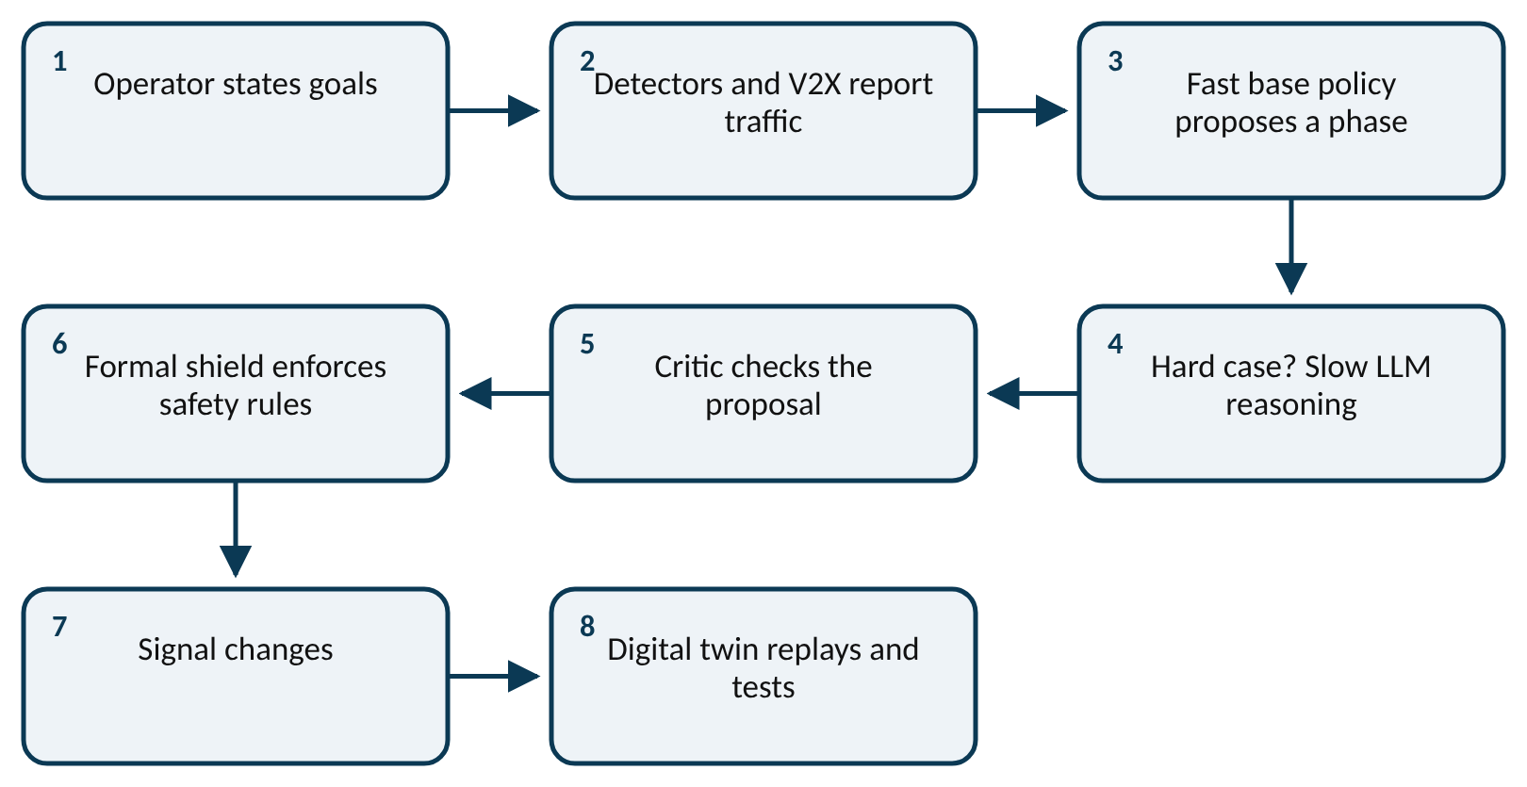
Worked example: Why not ask the LLM every time?
decisions per hour = signals × (3600 ÷ seconds between decisions)
LLM calls per hour = decisions per hour × share sent to the slow layer
MPLight was demonstrated on 2,510 simulated lights. Suppose (invented settings) each decides every 5 s, and only 1 % of decisions are escalated to the LLM.
1. Decisions per light per hour: 3600 ÷ 5 = 720.
2. Whole network: 2,510 × 720 = 1,807,200 decisions per hour.
3. Per second: 1,807,200 ÷ 3600 = 502 decisions every second.
4. Escalate only 1 %: 1,807,200 × 0.01 = 18,072 LLM calls per hour.
5. That is about 18,072 ÷ 3600 = 5 LLM calls per second instead of 502.
The fast layer handles 99 % of the work; the slow layer gets 100 times fewer calls. A learned 'when to escalate' rule is an open research question.
Notes:
The layered agentic controller. What to notice: the fast base policy makes routine decisions; the LLM is consulted only for hard cases; every proposal passes the critic and then the shield before reaching the lights. The digital twin tests changes first, and people set the goals.
Try it with the audience: A city has 400 signals deciding every 4 s. How many decisions per hour? If 2 % are escalated to an LLM, how many LLM calls per hour?
Answer: 3600 ÷ 4 = 900 per signal; 400 × 900 = 360,000 decisions per hour; 360,000 × 0.02 = 7,200 LLM calls per hour (2 per second).

Slide 20
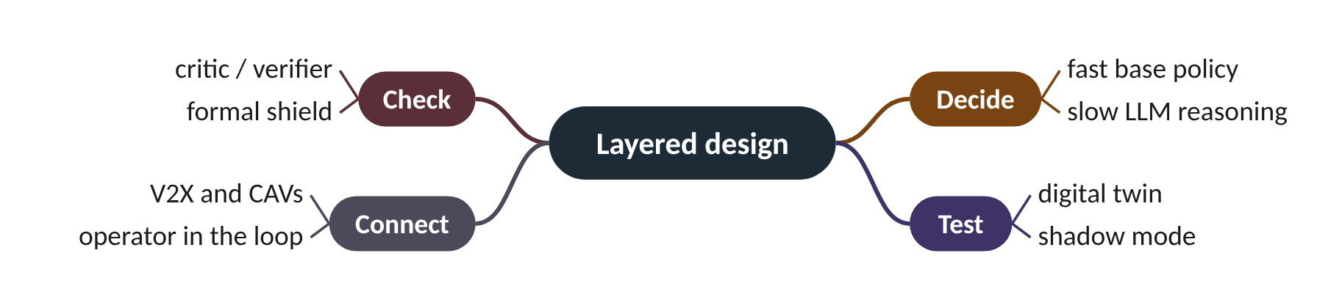
Remember it: Layered design
PICTURE THIS · STOP 5: LAYER-CAKE CAFÉ
TRAP
A seven-layer cake: a fast sponge base, a slow thinking cream, a taster who checks every slice, an iron plate underneath, a mirror cake (digital twin) beside it, radio candles on top, and the chef watching.
The shield is not the critic. The critic is a model or checker that can be wrong and gives advice; the shield is fixed, hard-coded rules in the signal cabinet that can never be bypassed. A safe design needs the shield even if the critic is excellent.
Notes:
What the scene encodes: Fast base policy, slow LLM reasoning, critic, formal shield, digital twin, V2X, operator in the loop.
Recap: Layered design: fast base policy, slow LLM for rare hard cases, critic, formal shield, digital twin (shadow mode), V2X, operator in the loop.

Slide 21
6 Open research questions
IN PLAIN WORDS
A lighthouse does not show you the island; it shows where the rocks are so you can sail toward it. A good research question works the same way: it marks clearly what is not known, so a study can head straight for it.
Can LLM supervision be verified safe?
Are LLM explanations faithful?
Which sim-to-real gap dominates?
Beat actuated below 25 % CAVs?
R5: fewer stops, more delay, CO2
+26.3 %
R5 delay at H = 8 s, for 8.7 % fewer stops
Notes:
R5 gave drivers a promise about the next light change and got fewer stops, but more delay and more CO2. Nobody yet knows how to get predictability without losing adaptivity. That is what an open question looks like.
Eight open questions. (1) Verified LLM supervision: can an LLM supervising max-pressure or RL be guaranteed never to break minimum green or a maximum pedestrian wait, and at what cost? (2) Faithful explanations: do an LLM's stated reasons match what really drove the decision? (3) Which sim-to-real gap dominates (observation, action, transition or reward) for LLM vs RL controllers? (4) Combined faults: detector outages, V2X latency and noisy prompts in one stress test.
(5) Scalable escalation: when should a cheap local policy call expensive reasoning under a fixed compute budget? (6) Equity from plain language: can operators state people-centric goals in words and compile them safely into constraints? (7) Low-penetration CAVs: below about 25 % connected vehicles, can joint signal and eco-driving control beat actuated control? (8) Certification: what evidence would a road authority need?
Our R5 shows why (7) and predictability are hard. With 50 % CAVs and GLOSA on the corridor, committing H seconds ahead gives the fewest stops at H = 8 s (0.86 vs 0.94), because more connected cars get usable advice, but delay rises from 16.72 to 21.12 s and CO2 from 229.5 to 241.4 g. In our implementation the lost adaptivity costs more than eco-driving saves. A recipe for a question: gap + method + setting + metric, compared with actuated control and max-pressure, over 3+ seeds.
Presenter tip: Present R5 as a worked example of an open problem. Then show the recipe gap + method + setting + metric and let students build a question with the website's builder.

Slide 22
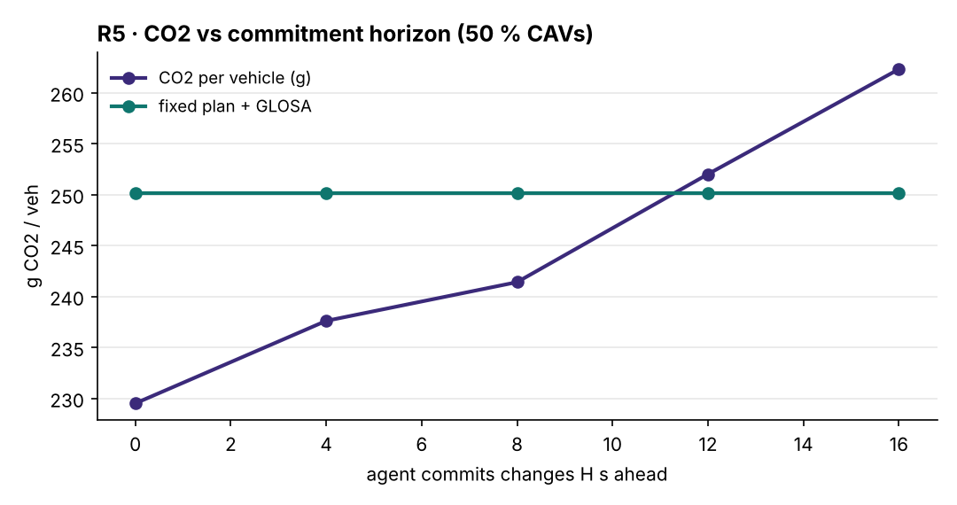
Worked example: R5: the price of a promise
research question = gap + method + setting + metric
relative change = (H value − H 0 value) ÷ H 0 value × 100 %
Corridor, 50 % CAVs with GLOSA, one seed. H = 0 (fully adaptive): delay 16.72 s, CO₂ 229.5 g, 0.942 stops. H = 8 s: 21.12 s, 241.4 g, 0.860 stops. H = 16 s: 30.10 s, 262.3 g.
1. Stops, H 0 → 8: (0.860 − 0.942) ÷ 0.942 × 100 = −8.7 % (the gain).
2. Delay, H 0 → 8: 21.12 − 16.72 = 4.40 s; 4.40 ÷ 16.72 × 100 = +26.3 %.
3. CO₂, H 0 → 8: 241.4 − 229.5 = 11.9 g; 11.9 ÷ 229.5 × 100 = +5.2 %.
4. CO₂, H 0 → 16: (262.3 − 229.5) ÷ 229.5 × 100 = +14.3 %.
5. Delay, H 0 → 16: (30.10 − 16.72) ÷ 16.72 × 100 = +80.0 %.
An 8.7 % cut in stops cost 26 % more delay and 5 % more CO₂. Longer promises are worse on every count. Predictability without losing adaptivity remains open.
Notes:
R5: CO2 per vehicle against the commitment horizon H (50 % CAVs, one seed). What to notice: CO2 rises steadily as the agent commits further ahead (229.5 g at H = 0 to 262.3 g at H = 16 s), and passes the fixed plan with GLOSA (250.1 g) at about H = 12 s.
Try it with the audience: Build one research question for the 'low CAV penetration' gap: choose a method, a setting and a metric. Then compute R5's H = 4 s delay change: delay 18.87 s vs 16.72 s at H = 0.
Answer: Example: 'Can probabilistic SPaT with commitment windows beat actuated control on a corridor with 10-50 % CAVs, measured by CO2 per vehicle, over 3 seeds?' Delay change: (18.87 − 16.72) ÷ 16.72 × 100 = +12.9 %.

Slide 23
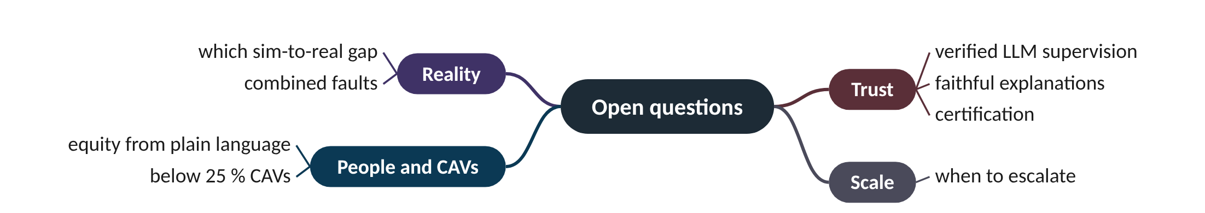
Remember it: Open questions
PICTURE THIS · STOP 6: LIGHTHOUSE
TRAP
A lighthouse sends eight beams into the fog, each lighting a different unexplored island. On the nearest, a promise-keeping clock stands by a car puffing grey smoke.
Fewer stops does not mean less CO2 or less delay. In R5 the 8 s promise gave the fewest agent stops, yet both delay and CO2 went up. Judge eco-driving by every metric, not the one it was designed to improve.
Notes:
What the scene encodes: Eight beams = eight open questions; clock and smoke = R5's commitment raising CO2.
Recap: Open questions: verified supervision, faithful explanations, dominant sim-to-real gap, combined faults, scalable escalation, equity, low-penetration CAVs, certification. R5: commitment cut stops 8.7 % but added 26 % delay.

Slide 24
Four families of signal controller
 | Max-pressure | Deep RL | LLM controller | Hybrid
Decides with | local queues in minus out | a policy learned from reward | a prompt describing traffic | fast policy + LLM for hard cases
Explains itself? | rule is simple | usually no | yes, a stated reason | yes, for escalated cases
Main worry | starving side streets | sim-to-real transfer | hallucination, latency | when to escalate
Strongest evidence | proof of max throughput; hardware-in-the-loop | simulation, up to 2,510 lights | simulation only | simulation only

Slide 25
Things beginners mix up
This… | …is not this | The fact that tells them apart
RL | LLM | RL learns from reward by trial and error; an LLM predicts text and is prompted, not trained per junction.
Critic | Shield | A critic is a model giving advice and can be wrong; a shield is fixed rules that are never bypassed.
Seed | Scenario | A seed is another random day of the same traffic; a scenario is a different network or demand.
Mean delay | Longest wait | R4: mean delay barely moved while the longest wait fell 53 → 22 s.
Fewer stops | Less CO2 | R5 at H = 8 s: fewest stops, but CO2 rose 229.5 → 241.4 g.
Reported gain | Field result | 17.5-20.4 % LLM gains are authors' simulation results; none is from a real street.

Slide 26
Check yourself (1 of 2)
LA-Light reports 20.4 % less waiting than RL. If (invented) RL waiting were 60 s, what would LA-Light's be?
Which experiment probes the mixed-autonomy gap?
A. 39.6 s
B. 47.8 s
C. 48.0 s
D. 72.2 s
A. R1
B. R2
C. R3
D. R4
Answers are in the speaker notes and in the study guide's answer key.
Notes:
Answer: B. 60 × (1 − 0.204) = 60 × 0.796 = 47.76 ≈ 47.8 s. 72.2 s adds instead of subtracting.
Answer: C. R3 controls with connected-vehicle data only, at 10-100 % penetration.

Slide 27
Check yourself (2 of 2)
In the layered design, what is the digital twin used for?
Three seeds give a new controller 10, 11, 12 s and the old one 11.5, 12, 12.5 s (invented). What should you report?
A. Replacing detectors
B. Running new policies in shadow mode and measuring sim-to-real gaps
C. Talking to drivers
D. Enforcing minimum green
A. 'The new one is 1 s better', nothing more
B. Means 11 and 12 s with ranges 2 and 1 s: promising but not shown; run more seeds
C. The old one is better
D. Only the best seed
Answers are in the speaker notes and in the study guide's answer key.
Notes:
Answer: B. A calibrated simulation where policies are tested before going live.
Answer: B. The 1 s gain is smaller than the new controller's 2 s spread. Report mean and spread, and be cautious.

Slide 28
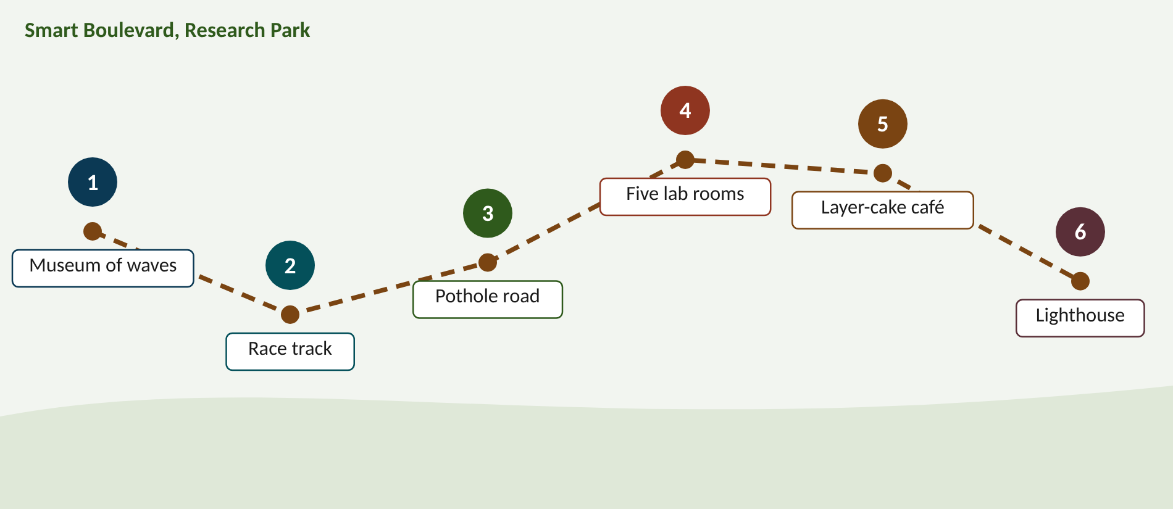
Walk the memory route
1 Museum of waves = Six waves · 2 Race track = Fair evaluation · 3 Pothole road = Eleven gaps · 4 Five lab rooms = Experiments R1-R5 · 5 Layer-cake café = Layered design · 6 Lighthouse = Open questions
Notes:
Stop 1, Museum of waves: Six bone-dry surfboards: an old wooden SCOOT board, a pressure-gauge board, a neural-network board, a talking board, a board with a brain, a board split in two. (Adaptive → max-pressure → deep RL → LLM tool users → LLM controllers → hybrids; dry = simulation only.)
Stop 2, Race track: Referees make every runner use the same shoes, run three races, and time not just speed but also who was left behind. (Same shoes = same rules; three races = seeds; left behind = fairness metrics.)
Stop 3, Pothole road: Eleven potholes, each with a sign: a simulator screen, a broken guardrail, a parrot, a question mark, a cut cable, a crowd, a seesaw, blue cars, a broken promise, a single dataset, a judge's gavel. (Sim-to-real, safety, hallucination, explainability, robustness, scale and latency, equity, mixed autonomy, predictability, benchmarks, human factors and regulation.)
Stop 4, Five lab rooms: Room 1: tin-can phones with cut strings. Room 2: the parrot without its guard wrecks the junction. Room 3: half-blind goggles. Room 4: a seesaw between speed and fairness. Room 5: a clock that keeps promises. (R1 latency/loss, R2 shield vs hallucination, R3 CAV-only sensing, R4 fairness weight, R5 commitment horizon for eco-driving.)
Stop 5, Layer-cake café: A seven-layer cake: a fast sponge base, a slow thinking cream, a taster who checks every slice, an iron plate underneath, a mirror cake (digital twin) beside it, radio candles on top, and the chef watching. (Fast base policy, slow LLM reasoning, critic, formal shield, digital twin, V2X, operator in the loop.)
Stop 6, Lighthouse: A lighthouse sends eight beams into the fog, each lighting a different unexplored island. On the nearest, a promise-keeping clock stands by a car puffing grey smoke. (Eight beams = eight open questions; clock and smoke = R5's commitment raising CO2.)

Slide 29
Numbers to remember
› LLM gains reported: 17.5 % (iLLM-TSC), 20.4 % (LA-Light), 20.03 % (HeraldLight); 0 of 9 in the field
› MPLight: 2,510 lights; Feng 2015: −16.33 % at high CV penetration
› R1: 18.45 s silent vs 17.79 s talking; runs range 0.67 s (noise)
› R2 at 40 % bad: 12.14 vs 31.49 s; 0 vs 223 violations
› R3 at 10 %: CAV-only 9.94 s vs loops 9.01 s; 100 %: 6.6 s
› R4: w = 0.15 → longest wait 53 → 22 s; max-pressure 150 s
› R5: H = 8 s fewest stops 0.86; delay 16.72 → 21.12 s, CO₂ 229.5 → 241.4 g

Slide 30
Keep going
References, experiments and interactive website: smrahmanbd.github.io/agentic-atsc-lab
Notes:
Point learners to the study guide for the full worked examples, quiz and revision plan, and to the website for the simulators.

