Slide 1
Build traffic-signal agents in SUMO, one lab at a time
Go 2 · Build in SUMO
Six short Python labs: a first agent, talking agents, a learning agent, eco-driving connected cars, priority for buses and ambulances, and a language-model agent behind a safety shield.
smrahmanbd.github.io/agentic-atsc-lab
Notes:
This guide is for beginners who have read Go 1 or know what a traffic-signal agent is. You need a little Python and school arithmetic. You will run six labs in the SUMO traffic simulator and learn to read the code behind each one: what the agent sees, how it decides, and what the results really show, including where it does not win. There are seven ideas: the set-up, then one per lab. Each builds on the one before.

Slide 2
7 ideas, each building on the last
1
Set-up and the Junction class
2
Lab 1: your first agent
3
Lab 2: many agents on a corridor
4 s lost to yellow plus all-red at every stage change
20 s agent's longest wait in Lab 1 (max-pressure: 301 s)
−7% stops per vehicle when agents talk (0.95 → 0.88)
4
Lab 3: a learning agent (Q-learning)
5
Lab 4: eco-driving with SPaT and GLOSA
6
Lab 5: tools for priority
31 distinct states the learner visited in 30 episodes
−55% stops per vehicle, fixed plan, 0 → 100% CAVs
−77% bus delay with the priority tool vs actuated (33.4 → 7.8 s)
7
Lab 6: an LLM agent behind a safety shield
165 bad answers from the mock model; no unsafe one reached the signal
Notes:
Outcomes for today:
- Install the lab, run a SUMO simulation from Python and explain why all controllers share one Junction class.
- Compute an agent's keep-or-switch decision from an observation, goal weights and hysteresis.
- Explain how platoon messages between neighbouring agents work and why they cut stops but not delay in Lab 2.
- Carry out a Q-learning update by hand and say why the learner did not yet beat the rules.
- Work out a GLOSA speed advice and explain why an adaptive signal must commit to give one.
- Show how a priority tool and one weight change decisions, and read the bus, ambulance and general delay trade-off.
- Trace an LLM answer through the safety shield and say what the shield can and cannot catch.

Slide 3
Three surprises to start
The cleverest-sounding controller left a car waiting 301 s.
Several results here are honest losses.
The language model is a mock, on purpose.
In Lab 1 max-pressure, a well-known efficient rule, ignored how long the side street had waited. One car waited 301 s before SUMO removed it. The agent, with a small weight on waiting time and a 90 s cap, never let anyone wait more than 20 s.
Talking agents did not beat actuated control on delay; the learning agent did not beat the rules; a promise made for connected cars cost the signal delay. Knowing where a method does not win is part of learning it.
Lab 6 runs offline with a pretend model that gives bad answers 20% of the time. That makes the lab repeatable and lets you watch the safety shield do its job. A real model can be plugged in with one flag.

Slide 4
Words you will meet
SUMO | A free traffic simulator that moves every vehicle second by second.
TraCI | SUMO's remote control: Python reads the traffic and sets the lights through it.
Stage | A set of movements green together. Here: EW (main road) and NS (side street).
Agent | A controller that perceives, reasons and acts toward goals, and explains itself.
Observation | What the agent sees at one moment: queues, waits, arrivals, messages.
Delay | Time a trip lost compared with driving freely, averaged per vehicle.
Platoon | A bunch of cars travelling together, usually released by the previous green.
CAV | Connected (and automated) vehicle: a car that can receive signal timing and advice.
LLM | Large language model: software that reads and writes text, such as a chatbot.
Notes:
You do not need to memorise these now; each is explained again when it first matters.

Slide 5
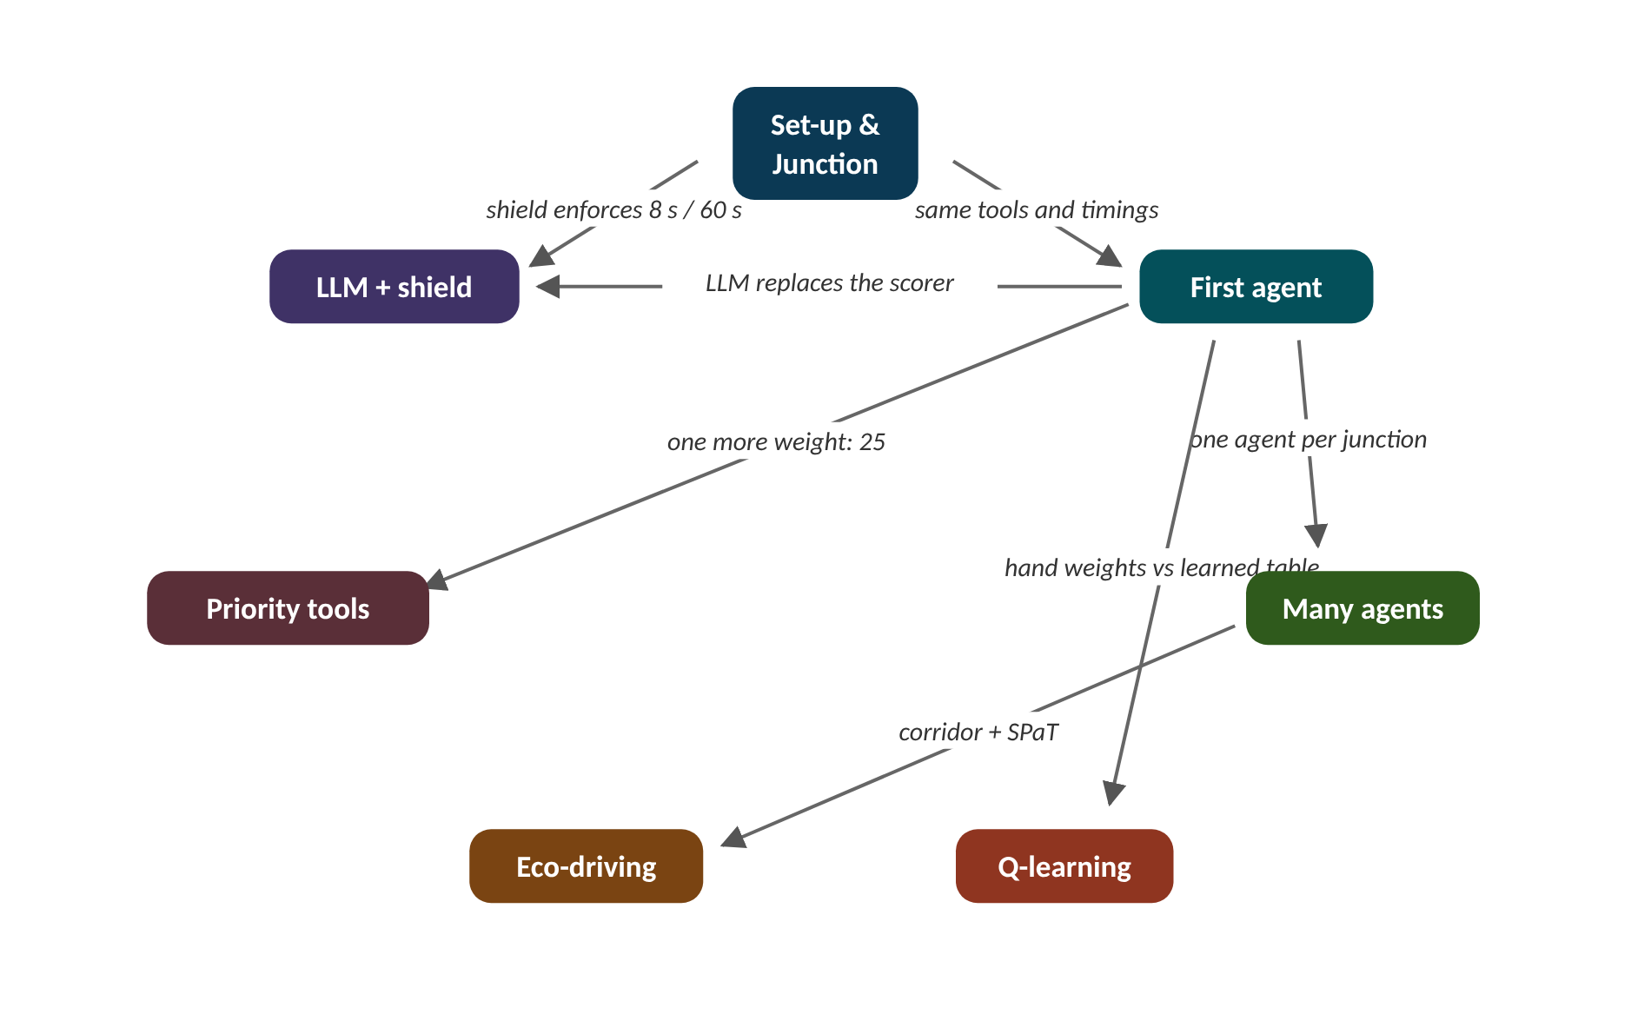
The map of today's ideas
Notes:
Each box is one idea; arrows say how one feeds the next. same tools and timings; one agent per junction; hand weights vs learned table; corridor + SPaT; one more weight: 25; LLM replaces the scorer; shield enforces 8 s / 60 s.

Slide 6
1 Set-up and the Junction class
IN PLAIN WORDS
Think of a cooking contest where every chef gets the same oven, the same knives and the same timer. Whatever dish wins, you know it won on the recipe, not because one chef had a better stove.
SUMO simulates, TraCI is the remote control
One Junction class for every controller
Yellow 3 s, all-red 1 s
Min green 8 s, max green 60 s
Seven shared perception tools
4 s
lost to yellow plus all-red at every stage change
Notes:
Six labs compare fixed plans, actuated signals, rule agents, a learner and a language model. How can such different controllers be compared fairly? By forcing every one of them through the same small door.
How to run. git clone https://github.com/smrahmanbd/agentic-atsc-lab.git, then in sumo: python -m pip install -r requirements.txt (SUMO comes from pip). python -m pytest tests -q checks the code; python go2/01_first_agent.py --gui shows Lab 1 in sumo-gui.
SUMO simulates every vehicle; TraCI is the remote control Python uses to read it and set the lights. runner.py steps SUMO once a second, calls the controller, and turns trip records into delay, stops, CO2 and longest wait.
The key code idea. Each junction is one Junction with two stages, EW (main road) and NS (side street). Controllers change lights only through Junction.request(stage): yellow 3 s, all-red 1 s, then green. It also offers the perception tools queue(), max_wait(), approaching(), downstream_occupancy(), pressure(), priority_requests(), cav_estimate(). Minimum green 8 s and maximum 60 s live in controllers.py. Shared timings mean results differ only by decisions.
Presenter tip: Do the install live if you can; the first lab runs an hour in under a minute. Stress the fairness point: all controllers go through Junction.request, so the comparisons in later labs are about decisions only.

Slide 7
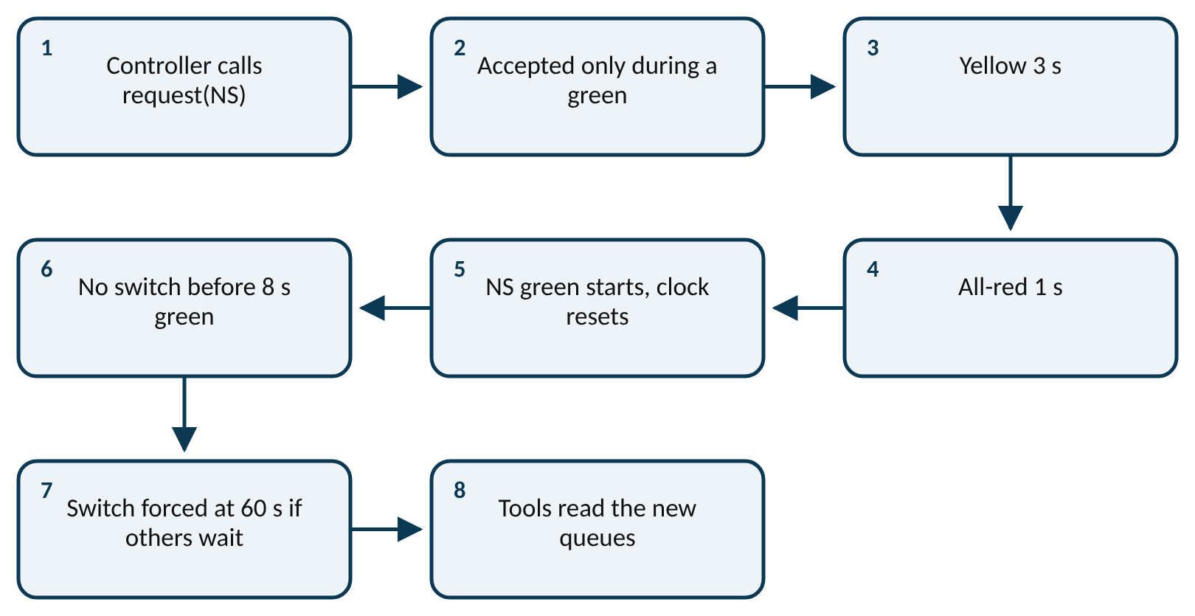
Worked example: What do stage changes cost?
lost time per stage change = yellow 3 s + all-red 1 s = 4 s
shortest possible cycle = 2 × (min green 8 s + 4 s) = 24 s
Lab 1's agent made 234 stage changes in its run.
1. Lost time per change = 3 s yellow + 1 s all-red = 4 s.
2. Total lost = 234 × 4 = 936 s.
3. As a share of one hour: 936 ÷ 3600 = 0.26, about a quarter.
4. Shortest cycle: 2 × (8 + 4) = 24 s.
5. Longest cycle (both at max green): 2 × (60 + 4) = 128 s.
About a quarter of the hour went on changeovers, so switch only when it clearly pays.
Notes:
How every controller changes the lights. What to notice: the controller only asks; the Junction class runs the same safe sequence for everyone. Read it left to right, then down.
Try it with the audience: Fixed time made 122 stage changes in Lab 1 and actuated control made 254. How much time did each lose to yellow and all-red?
Answer: Fixed: 122 × 4 = 488 s. Actuated: 254 × 4 = 1016 s, about 17 minutes.

Slide 8
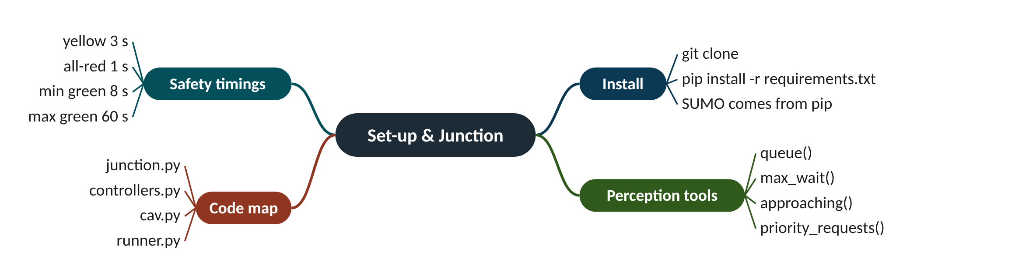
Remember it: Set-up & Junction
PICTURE THIS · STOP 1: TOOLBOX SHOP
TRAP
A shop sells one toolbox to every robot: inside are a queue ruler, a waiting stopwatch, an arrivals radar, an exit gauge, a VIP detector and blue-car goggles. The shop sign says "pip install".
The safety timings are not part of any controller's cleverness: nobody can win by skipping yellow.
Notes:
What the scene encodes: Sign = pip install; the identical toolbox = the shared Junction tools and safety timings.
Recap: Set-up: one Junction class for all: same tools; yellow 3, all-red 1, green 8-60 s.

Slide 9
2 Lab 1: your first agent
IN PLAIN WORDS
Think of a parent with two children asking for help. They weigh who has been waiting longest, who has the most to do and who is about to arrive, and only stop helping one child when the other clearly needs it more.
Perceive, reason, act every 2 s
Score = weighted queue, arrivals, wait
Switch only if ahead by 2
Every decision logs a reason
Agent 9.6 s, actuated 9.8 s
20 s
agent's longest wait in Lab 1 (max-pressure: 301 s)
Notes:
Your first agent is a few lines of arithmetic: add up what each stage needs, compare, and say why. Can something that simple beat a fixed plan and match a well-tuned actuated signal?
How to run. python go2/01_first_agent.py (add --gui to watch). Fixed time, actuated, max-pressure and the agent run on the same one-hour arrivals with a peak.
The key code idea. Every 2 s: perceive → reason → act. reason scores each stage: 1 × queuing + 0.7 × arriving within 50 m + 0.15 × longest wait (s), plus extras used in later labs. It switches only if the other stage leads by more than the hysteresis of 2, and writes its reason. act passes the choice through the safety shield.
What we got (seed 1): mean delay fixed 14.1 s, actuated 9.8 s, max-pressure 15.0 s, agent 9.6 s. Longest wait: 36, 26, 301 and 20 s. Max-pressure starved the side street (SUMO removed the car after 301 s): it has no notion of fairness. The agent's wait weight and 90 s cap prevent that.
Presenter tip: Work the score example on the board before showing code. Then show the decision inspector on the website. Suggested exercise from the page: set w_wait to 0 and compare the longest wait; raise hysteresis to 6 and count switches.

Slide 10
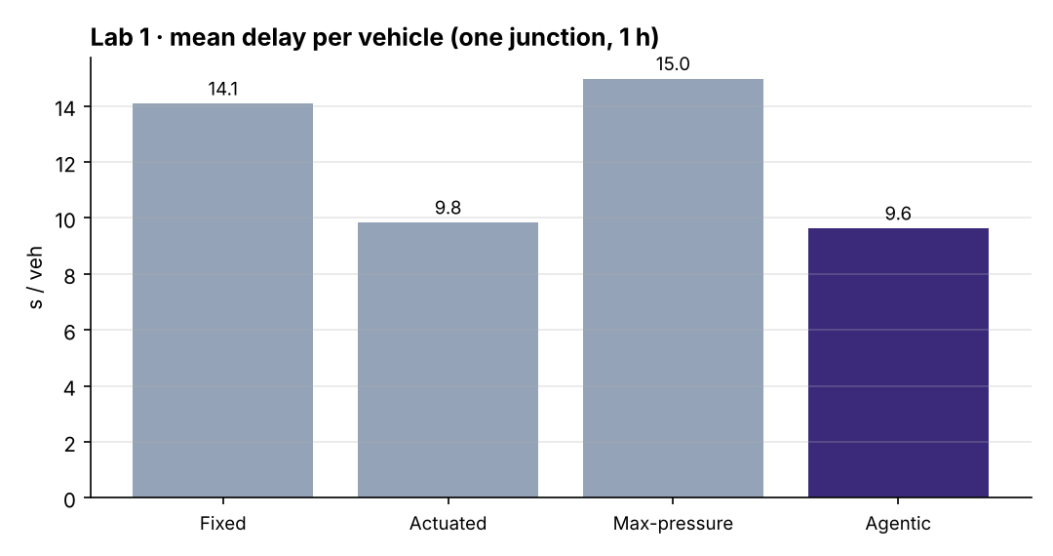
Worked example: One decision by the agent
score(stage) = 1 × queue + 0.7 × arriving + 0.15 × longest wait
switch if score(other) > score(current) + 2
EW green 14 s. EW: 3 queuing, 2 arriving, wait 4 s. NS: 7 queuing, 1 arriving, wait 24 s.
1. EW score = 1 × 3 + 0.7 × 2 + 0.15 × 4 = 3 + 1.4 + 0.6 = 5.0.
2. NS score = 1 × 7 + 0.7 × 1 + 0.15 × 24 = 7 + 0.7 + 3.6 = 11.3.
3. Bar to beat = current + hysteresis = 5.0 + 2 = 7.0.
4. 11.3 > 7.0, so the agent proposes switch.
5. Shield: green has run 14 s ≥ 8 s minimum, so the switch is allowed.
Log: "switch to NS: score 11.3 vs 5.0 (queue 7, longest wait 24 s)".
Notes:
Lab 1: mean delay per vehicle (one junction, one hour). What to notice: the agent (9.6 s) edges actuated control (9.8 s) and cuts a third off fixed time (14.1 s). Max-pressure is worst here because it ignores how long the side street has waited.
Try it with the audience: EW green. EW: 5 queuing, 3 arriving, longest wait 2 s. NS: 6 queuing, 0 arriving, longest wait 30 s. Does the agent switch? What if hysteresis were 6?
Answer: EW = 5 + 2.1 + 0.3 = 7.4; NS = 6 + 0 + 4.5 = 10.5. With hysteresis 2: 10.5 > 9.4, switch. With hysteresis 6: 10.5 < 13.4, keep.

Slide 11
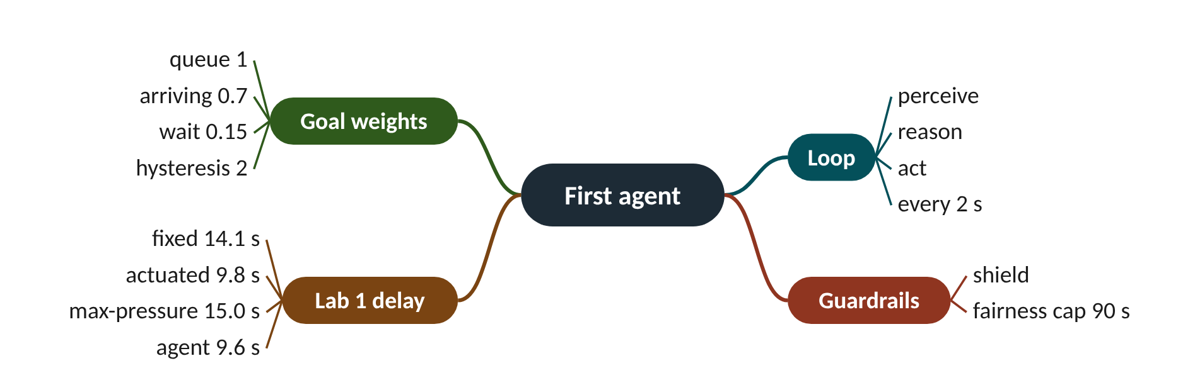
Remember it: First agent
PICTURE THIS · STOP 2: FIRST JUNCTION
TRAP
The robot weighs two baskets on a scale every 2 seconds: cars waiting, cars arriving and how long the oldest has waited. A sticky note on the scale reads "9.6".
Lowest mean delay is not the whole story: max-pressure's 15.0 s hid a 301 s wait.
Notes:
What the scene encodes: Scale = scoring each stage with goal weights every 2 s; sticky note = 9.6 s delay.
Recap: Lab 1: score = 1·queue + 0.7·arriving + 0.15·wait; switch if ahead by 2; 9.6 s.

Slide 12
3 Lab 2: many agents on a corridor
IN PLAIN WORDS
Think of a relay of neighbours along a street. The first sees a group of children leave school and texts the next house: "six kids, there in twenty seconds". The next one opens the gate just in time instead of guessing.
Neighbours share platoon size and ETA
+0.8 per car due within 12 s
Talking: stops 0.95 to 0.88
Actuated still lowest delay here
Short corridor limits coordination gains
−7%
stops per vehicle when agents talk (0.95 → 0.88)
Notes:
On a row of four junctions, each agent can see cars leaving its own stop line long before the next junction can. What if it simply told its neighbour?
How to run. python go2/02_multi_agent.py --seeds 3 (about 10 minutes): fixed green wave, actuated, max-pressure, silent agents and talking agents on four junctions 300 m apart.
The key code idea. In communicate() each agent looks at cars heading to its downstream neighbour, estimates arrival as now + distance ÷ 12 m/s, and sends a "platoon" Message with size and ETA. The receiver adds 0.8 × size to its EW score when the platoon is due within 12 s.
What we got (mean of 3 seeds): delay 26.5, 17.5, 24.3, 18.4 and 18.2 s; stops 1.11, 0.89, 0.80, 0.95 and 0.88. Talking cut stops by about 7% and CO2 slightly (232 → 229 g), but actuation still had the lowest delay on this short corridor. Coordination should pay more on longer, denser networks (Go 3).
Presenter tip: Present the negative result plainly: actuated has the lowest delay. Ask the class why coordination might pay more on a longer corridor. Exercise from the page: raise w_platoon to 1.5 or make the corridor six junctions long.

Slide 13
Worked example: A platoon message, start to finish
ETA = now + remaining distance ÷ 12 m/s
EW score += 0.8 × platoon size, if ETA ≤ now + 12 s
J1 sees 6 cars 240 m from J2's stop line; travel speed 12 m/s.
1. Travel time = 240 ÷ 12 = 20 s, so ETA = now + 20 s.
2. 20 s > 12 s window, so J2 stores the message but adds nothing yet.
3. 8 s later the platoon is 12 s away: inside the window.
4. Bonus to J2's EW score = 0.8 × 6 = 4.8 points.
5. Lab 2 stops: (0.95 − 0.88) ÷ 0.95 = 0.074, about 7% fewer.
A 4.8-point boost holds EW green for the platoon unless NS clearly leads.
Notes:
Lab 2: stops per vehicle on the corridor (mean of 3 seeds). What to notice: talking agents stop less often than silent ones (0.88 vs 0.95). Max-pressure has the fewest stops but long waits and high delay. Wave = fixed green wave.
Try it with the audience: A platoon of 4 cars is 180 m from the next stop line. When is it due, and what bonus does it add once inside the window?
Answer: 180 ÷ 12 = 15 s, so ETA = now + 15 s, just outside the 12 s window. About 3 s later it adds 0.8 × 4 = 3.2 points to EW.

Slide 14
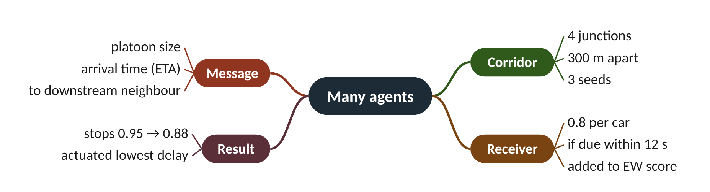
Remember it: Many agents
PICTURE THIS · STOP 3: FOUR HOUSES
TRAP
Four houses in a row pass paper aeroplanes downstream with a number and a time written on each wing.
Talking agents did not win on everything: actuated still had the lowest delay (17.5 vs 18.2 s).
Notes:
What the scene encodes: Houses = four junctions; aeroplanes = platoon messages (size, ETA) sent downstream.
Recap: Lab 2: platoon size + ETA sent downstream; stops 0.95 → 0.88; actuated lowest delay.

Slide 15
4 Lab 3: a learning agent (Q-learning)
IN PLAIN WORDS
Think of training a puppy. It tries sitting or jumping; a treat follows good choices. Over many sessions it learns which choice works in which situation. Early on it tries random things on purpose, to discover what earns treats.
State: stage, queue bins, green time
Reward: minus the waiting cars
Alpha 0.2, gamma 0.9
31 states learned in 30 episodes
11.7 s: not yet beating rules
31
distinct states the learner visited in 30 episodes
Notes:
Instead of writing the weights by hand, could the signal learn when to switch just by trying things and noticing when the queue shrinks?
How to run. python go2/03_learning_agent.py --episodes 30: 30 training episodes of 30 minutes with fresh arrivals, then a greedy test hour against actuated and the rule agent.
The key code idea. State = current stage, EW and NS queues in bins of 3 cars, and a green-time bin. Every 5 s the agent picks keep or switch, gets reward −(cars waiting), and updates Q ← Q + α (r + γ · max Q(next) − Q), α 0.2, γ 0.9. With probability ε (30% → 2%) it explores at random.
What we got. 31 states visited; 11.7 s on the test hour vs 9.8 s actuated and 9.6 s rules. The training curve is noisy (11.0 to 12.8 s) with no clear downward trend. Tabular learning needs more training, a richer state and reward shaping to beat good rules.
Presenter tip: Do the update on the board one line at a time. Then show the noisy training curve honestly. Exercise from the page: change the reward to pressure, or add the longest wait to the state.

Slide 16
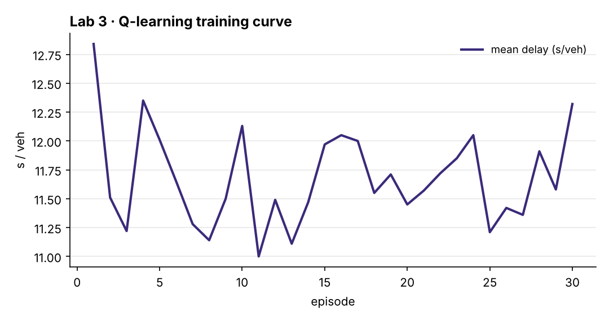
Worked example: One Q-learning update
Q(s, a) ← Q(s, a) + α [ r + γ · max_{a′} Q(s′, a′) − Q(s, a) ]
r = −(queue EW + queue NS)
Q(s, keep) = −10. Next, 6 cars wait; best Q in the new state is −12.
1. Reward r = −6.
2. Target = r + γ × best next = −6 + 0.9 × (−12) = −6 − 10.8 = −16.8.
3. Error = target − old = −16.8 − (−10) = −6.8.
4. Step = α × error = 0.2 × (−6.8) = −1.36.
5. New Q(s, keep) = −10 − 1.36 = −11.36.
Keep now looks a little worse; only 20% of each surprise is absorbed.
Notes:
Lab 3: Q-learning training curve (mean delay per episode). What to notice: the curve jumps around 11 to 12.8 s and does not fall steadily. Each episode has new random arrivals and exploration falls from 30% to 2%, so a single episode is a noisy signal of progress.
Try it with the audience: Q(s, switch) = 0. After switching, 4 cars are waiting and the best Q in the next state is −5. What is the new Q(s, switch)?
Answer: Target = −4 + 0.9 × (−5) = −8.5; error = −8.5 − 0 = −8.5; step = 0.2 × (−8.5) = −1.7; new Q = −1.7.

Slide 17
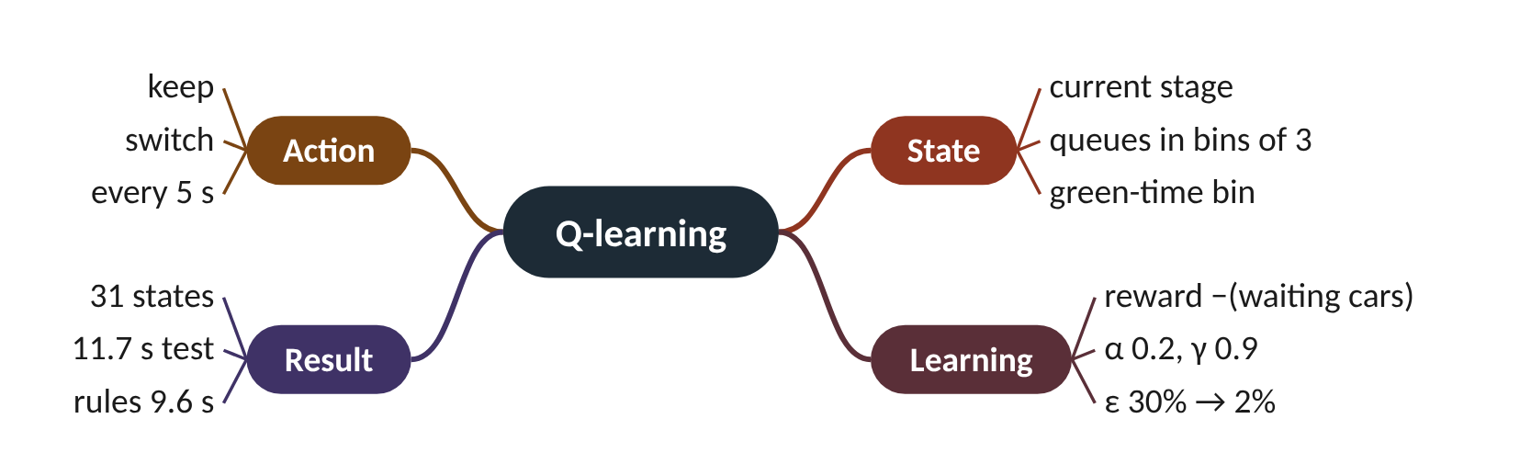
Remember it: Q-learning
PICTURE THIS · STOP 4: DOG SCHOOL
TRAP
A puppy learns to press "keep" or "switch" and gets a treat each time the queue shrinks; its notebook has 31 pages.
"It learns" does not mean "it beats the rules": 11.7 s vs 9.6 s (rules) and 9.8 s (actuated).
Notes:
What the scene encodes: Keep / switch = actions; treat = reward; 31-page notebook = Q-table with 31 states.
Recap: Lab 3: Q-learning, reward −waiting, α 0.2, γ 0.9; 31 states; 11.7 s, not yet beating rules.

Slide 18
5 Lab 4: eco-driving with SPaT and GLOSA
IN PLAIN WORDS
Think of a ferry that announces "leaving in 5 minutes". You walk calmly instead of sprinting and then waiting. If the ferry never announced its time, you would have to rush and hope.
SPaT: stage and seconds to change
GLOSA: distance divided by time
Adaptive agent must commit 8 s
Fixed plan stops: 1.12 to 0.50
Commitment costs adaptivity
−55%
stops per vehicle, fixed plan, 0 → 100% CAVs
Notes:
A connected car told "green in 14 seconds" can ease off and glide through instead of braking to a stop. But an adaptive signal does not know its own future. What must it promise?
How to run. python go2/04_eco_driving.py: a fixed plan and the agent committing 8 s ahead, each with 0, 25, 50 and 100% connected vehicles (CAVs).
The key code idea. The signal publishes SPaT: green stage and, if known, seconds to change. In cav.py a CAV within 300 m computes the next green (remaining + yellow + all-red) and drives at distance ÷ time, between 5 m/s and the limit: GLOSA. A fixed plan always knows its time; the agent knows it only once it commits (commit_horizon=8).
What we got (seed 1): fixed plan, 0 → 100% CAVs: stops 1.12 → 0.50, CO2 254.4 → 244.3 g. Committed agent: delay 24.0 → 20.0 s, stops 1.00 → 0.85; CO2 245.8 → 244.0 g, but 248.1 g at 25%. The price: the same agent without commitment had 18.4 s on this corridor and seed (Lab 2 run).
Presenter tip: Do the GLOSA arithmetic, then ask: what if the signal does not know when it will change? That leads to commitment. Exercise from the page: set commit_horizon to 0 or 16; Go 3 experiment R5 sweeps it.

Slide 19
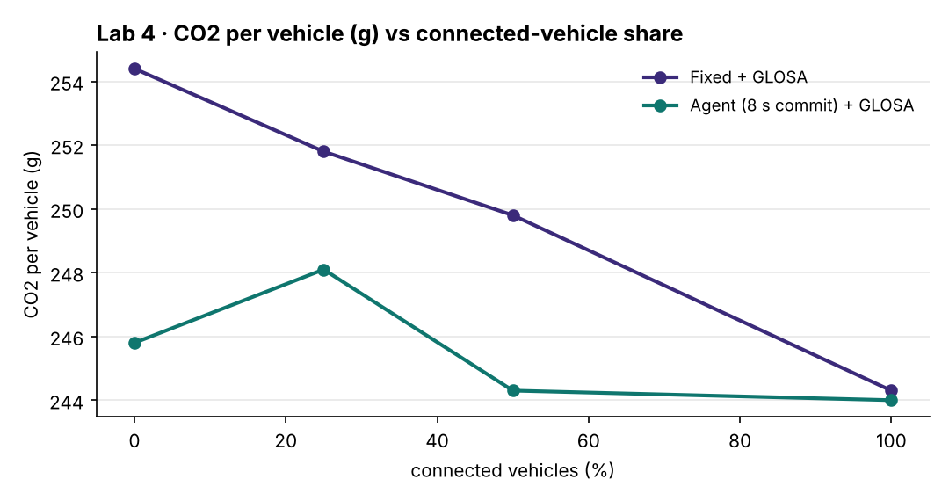
Worked example: A GLOSA speed advice
time to next green = remaining + yellow 3 s + all-red 1 s
advised speed = max(5 m/s, min(limit, distance ÷ time to next green))
CAV 150 m away, limit 13.89 m/s; NS green, committed to change in 10 s.
1. At the limit it would arrive in 150 ÷ 13.89 = 10.8 s.
2. EW turns green in 10 + 3 + 1 = 14 s.
3. 10.8 s < 14 s, so at full speed it would reach a red and stop.
4. Advised speed = 150 ÷ 14 = 10.7 m/s (about 38.6 km/h).
5. Check: between 5 and 13.89 m/s, so the advice stands.
It eases to about 39 km/h and glides in on green. With no committed time, no advice.
Notes:
Lab 4: CO2 per vehicle against the share of connected vehicles. What to notice: with the fixed plan, CO2 falls steadily as CAVs increase. The committed agent starts lower but is not monotonic (it rises at 25%). At 100% the two meet near 244 g. One seed only.
Try it with the audience: A CAV is 250 m away (limit 13.89 m/s). The other stage is green with 20 s left. What speed is advised?
Answer: At the limit: 250 ÷ 13.89 = 18.0 s. Next green in 20 + 4 = 24 s. 18 < 24, so advise 250 ÷ 24 = 10.4 m/s (37.5 km/h).

Slide 20
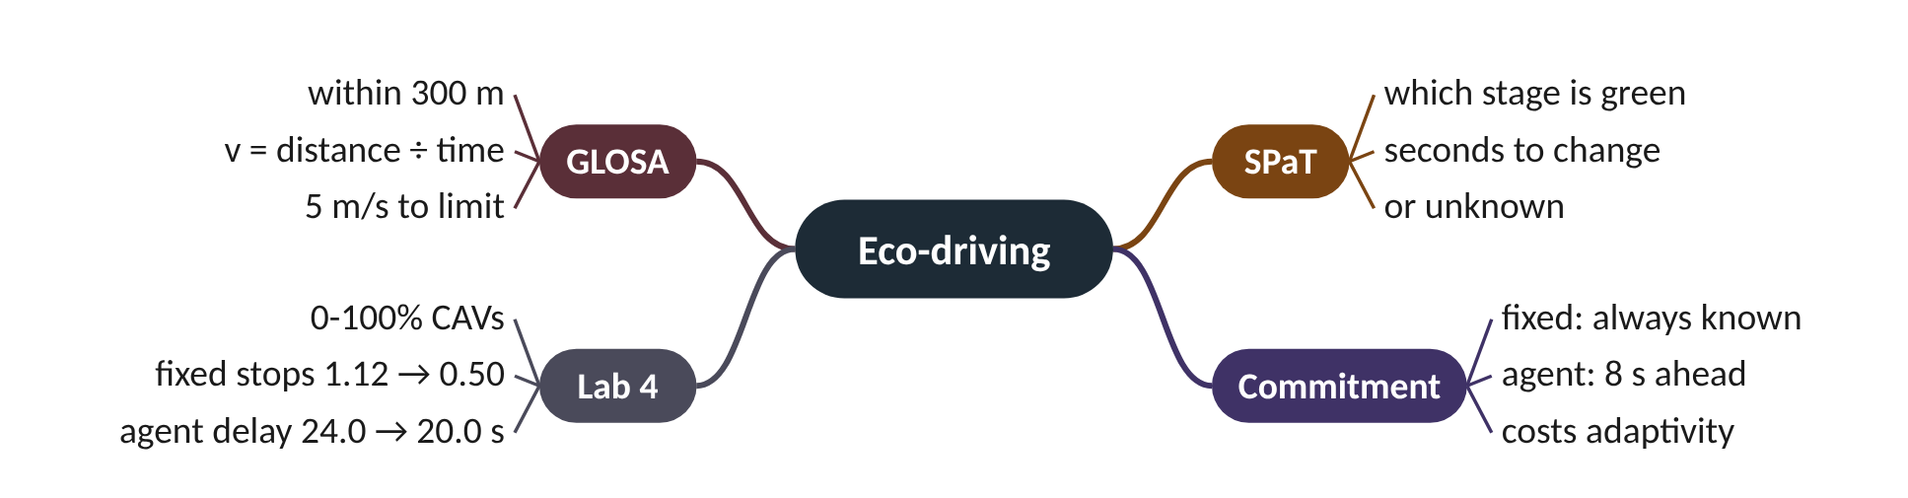
Remember it: Eco-driving
PICTURE THIS · STOP 5: SWAN PARADE
TRAP
The traffic light holds up a promise card "change in 8 s" and a parade of blue swans slows to glide through.
SPaT is not free for an adaptive signal: to announce a time it must commit, and then cannot react.
Notes:
What the scene encodes: Promise card = SPaT with an 8 s commitment; gliding swans = CAVs following GLOSA.
Recap: Lab 4: SPaT + GLOSA, v = d ÷ (remaining + 4 s); agent must commit 8 s, which costs delay.

Slide 21
6 Lab 5: tools for priority
IN PLAIN WORDS
Think of a supermarket that opens a till the moment a customer with a priority card appears. Others barely notice, because it happens rarely, but the card holder walks straight through.
New tool: priority_requests() within 200 m
Weight 25 outweighs normal queues
Bus delay 33.4 to 7.8 s
Ambulance 17.3 to 3.0 s
Everyone else pays about 0.2 s
−77%
bus delay with the priority tool vs actuated (33.4 → 7.8 s)
Notes:
A full bus or an ambulance should not wait behind a queue of cars. One new tool and one large weight change the agent's mind. What does it cost everyone else?
How to run. python go2/05_priority.py: corridor, eastbound bus every 3 min, ambulance every 5 min; actuated vs agent without priority (Goals(w_priority=0)) vs agent with its tool.
The key code idea. Junction.priority_requests(stage) lists buses and ambulances within 200 m. If any, the agent adds w_priority = 25 to that stage's score, more than a typical queue, so it switches or holds for the vehicle and names it in its reason. The shield still applies.
What we got: bus delay 33.4, 29.1 and 7.8 s; ambulance 17.3, 17.8 and 3.0 s; everyone 17.8, 18.2 and 18.4 s. Bus delay fell by about three-quarters, at about 0.2 s for everyone else.
Presenter tip: Show how adding one tool and one weight changes behaviour without retraining anything. Discuss the fairness of the trade: who pays 0.2 s, and is it worth it?

Slide 22
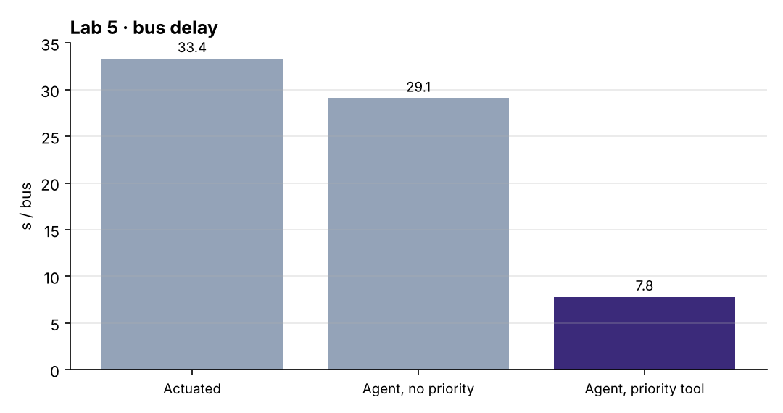
Worked example: The VIP pass beats the queue
score(stage) += 25 if a bus or ambulance is within 200 m
relative reduction = (before − after) ÷ before
NS green 20 s: 12 queuing, 3 arriving. EW: 2 queuing, wait 10 s. A bus appears on EW.
1. NS = 12 + 0.7 × 3 = 14.1; EW = 2 + 0.15 × 10 = 3.5: keep.
2. EW with the bus = 3.5 + 25 = 28.5.
3. 28.5 > 14.1 + 2 = 16.1, so switch (20 s ≥ 8 s, shield allows).
4. Bus delay vs actuated: (33.35 − 7.82) ÷ 33.35 = 0.77.
One weight turns keep into switch. Vs the agent without priority the cut is (29.11 − 7.82) ÷ 29.11 = 0.73.
Notes:
Lab 5: mean bus delay. What to notice: removing the priority tool leaves the agent close to actuated control; switching it on cuts bus delay from about 30 s to 7.8 s. Everyone else paid about 0.2 s.
Try it with the audience: Ambulance delay: 17.28 s actuated, 3.0 s with the priority tool. What fraction was removed?
Answer: (17.28 − 3.0) ÷ 17.28 = 14.28 ÷ 17.28 = 0.83, about 83%.

Slide 23
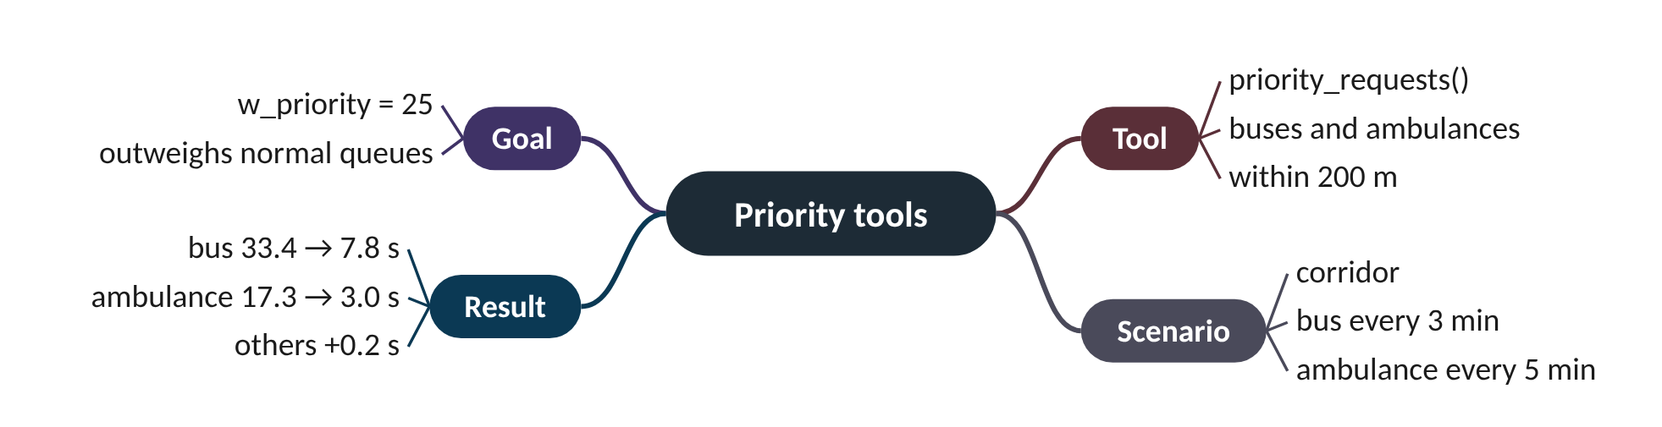
Remember it: Priority tools
PICTURE THIS · STOP 6: HOSPITAL ROAD
TRAP
A yellow bus and an ambulance flash a golden VIP pass worth 25 points; the lights part like a red carpet.
Priority is not free: everyone else +0.2 s, and the shield still blocks a switch before 8 s green.
Notes:
What the scene encodes: VIP pass = priority_requests() plus w_priority 25; red carpet = bus 33 → 8 s, ambulance 17 → 3 s.
Recap: Lab 5: priority within 200 m adds 25; bus 33.4 → 7.8 s; everyone else +0.2 s.

Slide 24
7 Lab 6: an LLM agent behind a safety shield
IN PLAIN WORDS
Think of a talkative parrot giving orders on a ship, with a calm officer who checks each order against the rulebook. Sensible orders pass; dangerous ones are replaced with "hold course".
Observation, prompt, JSON, shield, signal
Mock model by default, repeatable
Shield checks every single answer
20% bad answers: 11.6 s delay
No unsafe order reached the signal
165
bad answers from the mock model; no unsafe one reached the signal
Notes:
A language model can read the junction's situation and answer in plain words. It can also answer nonsense with total confidence. How do you let it near a traffic light?
How to run. python go2/06_llm_agent.py uses an offline mock model (repeatable). With pip install anthropic and an API key, add --backend anthropic --minutes 10 for a real model.
The key code idea. Every 5 s: observation → prompt (plus goals) → JSON {"action": "keep" | "switch", "reason"} → shield → Junction.request. The mock acts like the rule agent but, with probability hallucination, answers badly: switching too early, never switching, inventing a stage ("green_NE") or holding all-red. The shield turns unknown actions into keep, blocks switches before 8 s, and forces a switch at 60 s green or a 90 s wait.
What we got: actuated 9.8 s; reliable mock 10.7 s; 20% bad answers + shield 11.6 s. 165 of 735 answers were bad; no invented stage or all-red reached the signal. Even the reliable run had 97 blocks: the rules do not check minimum green, the shield does. Go 3 R2 removes the shield.
Presenter tip: Use the prompt and shield playground on the Go 2 page: let students type a bad answer and see the shield's response. Stress that the default model is a mock, so the numbers describe the shield, not any real LLM.

Slide 25
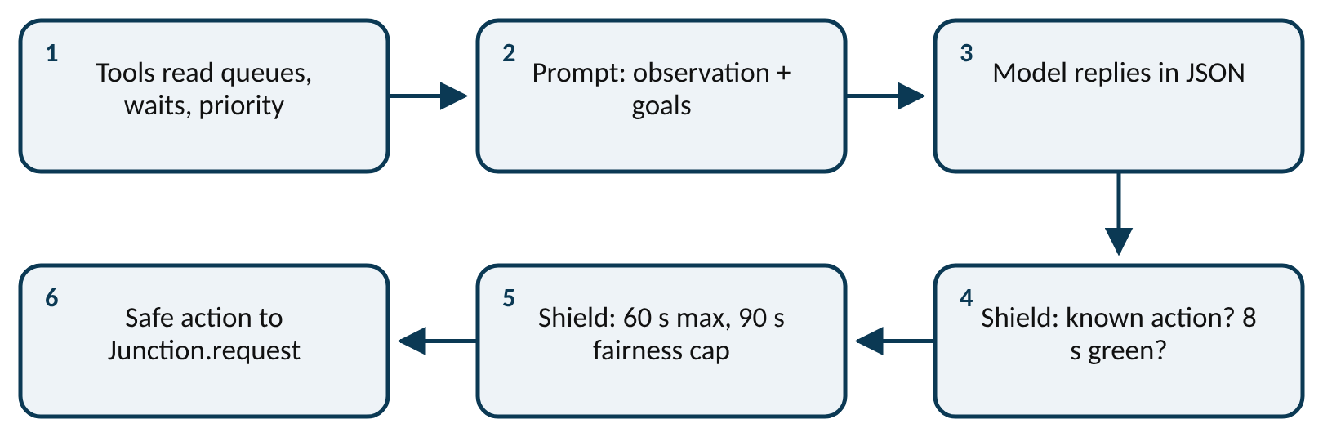
Worked example: What did the shield cost and catch?
observation → prompt → JSON answer → shield → Junction.request
unknown action → keep; switch with green < 8 s → keep
Actuated 9.84 s; reliable mock 10.73 s; 20% bad + shield 11.58 s; 165 bad of 735 calls.
1. Share of bad answers = 165 ÷ 735 = 0.224, about 22% (set to 20%, drawn at random).
2. Reliable mock vs actuated: 10.73 − 9.84 = 0.89 s more (+9%).
3. Bad answers + shield vs actuated: 11.58 − 9.84 = 1.74 s more (+18%).
4. Bad answers cost a further 11.58 − 10.73 = 0.85 s.
5. Unsafe orders reaching the signal: 0.
One bad answer in five: still safe, and under a second of extra delay.
Notes:
From model answer to traffic light. What to notice: the shield sits between the model and the signal, outside the model, and checks every answer. Read it left to right, then down.
Try it with the audience: EW has been green for 6 s. The model answers {"action": "switch"}. Then, at 30 s of green, it answers {"action": "green_NE"}. What does the shield do each time?
Answer: At 6 s: 6 < 8 s minimum green, so keep. At 30 s: "green_NE" is not a known action, so keep (unless someone has waited over 90 s, which forces a switch).

Slide 26
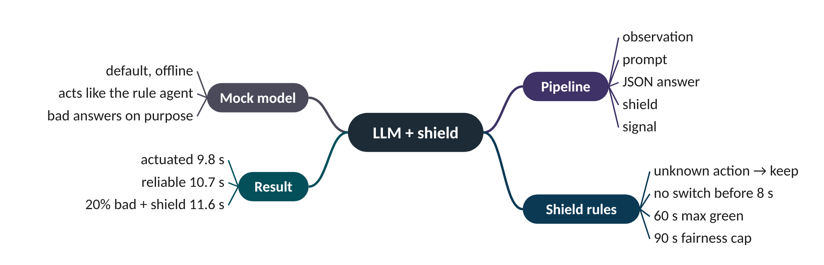
Remember it: LLM + shield
PICTURE THIS · STOP 7: PARROT CAGE
TRAP
A talkative parrot shouts orders, some of them nonsense ("green to the north-east!"); a guard reads every order against the rulebook before passing it on.
The shield does not make a bad model good: legal but poor answers pass and cost delay.
Notes:
What the scene encodes: Parrot = the LLM; nonsense = bad answers; guard = the shield checking every answer.
Recap: Lab 6: prompt → JSON → shield → signal; mock LLM; 20% bad answers, 11.6 s, none unsafe.

Slide 27
The controllers you build in Go 2
 | Actuated | Rule agent | Q-learning | LLM + shield
Decides with | gaps between vehicles | goal weights and hysteresis | a learned table of keep/switch values | a model's JSON answer
How often | every second | every 2 s | every 5 s | every 5 s
Explains itself? | no | yes, a reason per decision | no | yes, the model's reason
Safety | min / max green | shield | min green only | shield
One-junction delay | 9.8 s | 9.6 s | 11.7 s | 10.7 s (11.6 s with 20% bad)

Slide 28
Things beginners mix up
This… | …is not this | The fact that tells them apart
Hysteresis | Minimum green | Hysteresis (2 points) is a judgement margin; minimum green (8 s) is a hard rule the shield enforces.
Green wave | Platoon messages | A green wave fixes offsets in advance; messages tell the neighbour live what is coming.
SPaT | GLOSA | SPaT is what the signal broadcasts; GLOSA is the speed the car works out from it.
Bad answer | Unsafe action | The shield blocks rule-breaking answers; legal but poor answers pass and cost delay.
Mock LLM | Real LLM | Lab 6 numbers come from a mock that imitates failures; a real model needs the anthropic backend option.

Slide 29
Check yourself (1 of 2)
Why does every controller change the lights only through Junction.request?
Q = −4, reward −2, best next Q = −5, α = 0.2, γ = 0.9. What is the new Q?
A. It is faster than TraCI
B. So all share the same safety timings and comparisons are fair
C. Because SUMO allows only one call per second
D. To save CO2
A. −4.5
B. −5.0
C. −6.5
D. −3.5
Answers are in the speaker notes and in the study guide's answer key.
Notes:
Answer: B. Same yellow, all-red and minimum green for everyone, so differences in results come from the decisions.
Answer: A. Target = −2 + 0.9 × (−5) = −6.5; error = −6.5 − (−4) = −2.5; step = 0.2 × (−2.5) = −0.5; new Q = −4.5.

Slide 30
Check yourself (2 of 2)
The model answers {"action": "green_NE"}. What does the shield do?
In Lab 6 the reliable mock (no bad answers) still had 97 answers blocked. Why?
A. Turns NE green
B. Holds all-red
C. Replaces it with keep
D. Stops the simulation
A. The shield is faulty
B. The rule reasoning can propose a switch before 8 s of green; the shield enforces it
C. The model invented stages
D. The fairness cap was set to 10 s
Answers are in the speaker notes and in the study guide's answer key.
Notes:
Answer: C. Any action other than keep or switch is unknown and becomes keep (unless the 60 s or 90 s rules force a switch).
Answer: B. The score rule does not check minimum green itself; that rule lives in the shield, which blocked such switches.

Slide 31
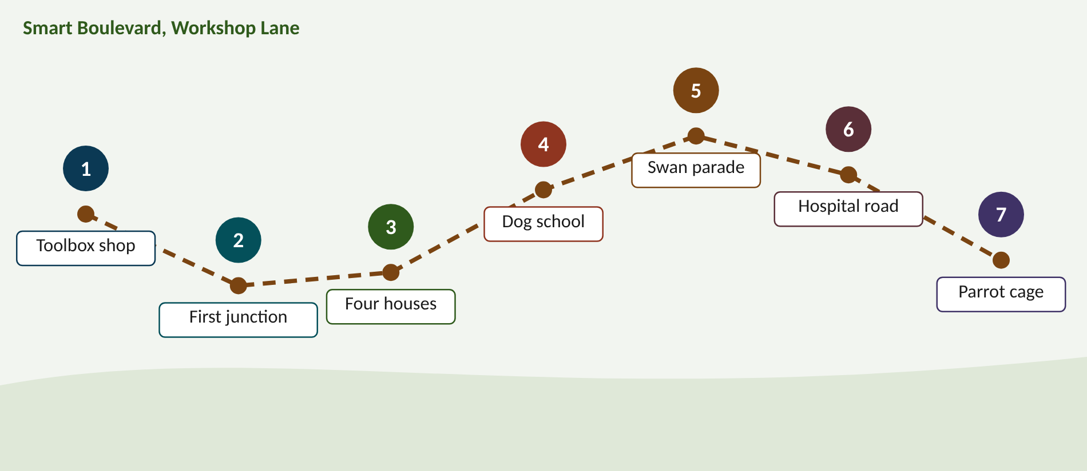
Walk the memory route
1 Toolbox shop = Set-up & Junction · 2 First junction = First agent · 3 Four houses = Many agents · 4 Dog school = Q-learning · 5 Swan parade = Eco-driving · 6 Hospital road = Priority tools · 7 Parrot cage = LLM + shield
Notes:
Stop 1, Toolbox shop: A shop sells one toolbox to every robot: inside are a queue ruler, a waiting stopwatch, an arrivals radar, an exit gauge, a VIP detector and blue-car goggles. The shop sign says "pip install". (Sign = pip install; the identical toolbox = the shared Junction tools and safety timings.)
Stop 2, First junction: The robot weighs two baskets on a scale every 2 seconds: cars waiting, cars arriving and how long the oldest has waited. A sticky note on the scale reads "9.6". (Scale = scoring each stage with goal weights every 2 s; sticky note = 9.6 s delay.)
Stop 3, Four houses: Four houses in a row pass paper aeroplanes downstream with a number and a time written on each wing. (Houses = four junctions; aeroplanes = platoon messages (size, ETA) sent downstream.)
Stop 4, Dog school: A puppy learns to press "keep" or "switch" and gets a treat each time the queue shrinks; its notebook has 31 pages. (Keep / switch = actions; treat = reward; 31-page notebook = Q-table with 31 states.)
Stop 5, Swan parade: The traffic light holds up a promise card "change in 8 s" and a parade of blue swans slows to glide through. (Promise card = SPaT with an 8 s commitment; gliding swans = CAVs following GLOSA.)
Stop 6, Hospital road: A yellow bus and an ambulance flash a golden VIP pass worth 25 points; the lights part like a red carpet. (VIP pass = priority_requests() plus w_priority 25; red carpet = bus 33 → 8 s, ambulance 17 → 3 s.)
Stop 7, Parrot cage: A talkative parrot shouts orders, some of them nonsense ("green to the north-east!"); a guard reads every order against the rulebook before passing it on. (Parrot = the LLM; nonsense = bad answers; guard = the shield checking every answer.)

Slide 32
Numbers to remember
› Yellow 3 s, all-red 1 s, min green 8 s, max green 60 s
› Score = 1·queue + 0.7·arriving + 0.15·wait; switch if ahead by 2
› Lab 1 delay: 14.1 / 9.8 / 15.0 / 9.6 s; longest wait 301 s (MP) vs 20 s
› Lab 2: stops 0.95 → 0.88 with talking; actuated 17.5 s lowest
› Lab 3: α 0.2, γ 0.9; 31 states; 11.7 s vs 9.6 s rules
› Lab 4: v = d ÷ (remaining + 4 s); fixed stops 1.12 → 0.50
› Lab 5: w_priority 25; bus 33.4 → 7.8 s. Lab 6: 165 bad answers, 11.6 s

Slide 33
Keep going
Code, labs and interactive website: smrahmanbd.github.io/agentic-atsc-lab
Notes:
Point learners to the study guide for the full worked examples, quiz and revision plan, and to the website for the simulators.

