Slide 1
Eight mechanisms, one corridor, and the votes that keep them calm
SCATS · Level 2 · Advanced
How SCATS turns stop-line counts into cycle lengths, split plans, offsets and linked subsystems, then keeps every green honest second by second.
smrahmanbd.github.io/scats-learning-lab
Notes:
This guide assumes you have read the Foundation level, or at least know what a cycle, a phase, a split and an offset are, and that SCATS measures each green with the degree of saturation (DS). Everything else is built from scratch with small numbers. There are eight ideas: the first five are strategic (decided once per cycle for groups of junctions), the last three are about tactical control, priority and the system as a whole.

Slide 2
8 ideas, each building on the last
1
Subsystems and the critical intersection
2
Cycle length: bounded steps towards a target DS
3
Split plans: equalise DS, then vote
1 to 10 signals in a typical subsystem
+6 / +9 s largest cycle increase per cycle
2 of 3 wins a split plan needs before it runs
4
Offsets and green waves
5
Marriage and divorce
6
Tactical control: gap-out, skipping, holding
21.6 s offset step for 300 m at 50 km/h
18 / 10 link VK to marry / to divorce
62.0 s corridor delay with tactical control off (36.9 s on)
7
Public transport priority
8
Operating modes and the full system on SUMO
29.7 s SCATS bus delay in Lab A1 (fixed 110.8 s)
−52% delay cut versus fixed time on the corridor
Notes:
Outcomes for today:
- Find the critical intersection of a subsystem from its DS values and explain why it sets the cycle.
- Compute the next cycle length from C, DS and the target, using the step limits and LMIN/LMAX.
- Predict each phase's DS under a different split plan and pick the plan that balances them.
- Work out offsets for an eastbound or westbound green wave and explain offset voting.
- Trace marriage and divorce of two subsystems through a run of link volumes.
- Decide when a green gaps out, when a phase is skipped, and why the main road is held.
- Compare high, medium and low transit priority for a bus that just missed its green.
- Name the operating modes and read the SUMO ablation: which mechanism matters most.

Slide 3
Three surprises to start
SCATS refuses to obey a single good result.
Junctions get married.
Switching off cycle adaptation made our corridor slightly better.
Even when a new split plan is clearly better this cycle, SCATS waits until it wins 2 of the last 3 cycles. For offsets it waits for 4 of 5. Patience is designed in, because a plan that flips every cycle disturbs drivers more than it helps them.
Two neighbouring groups of signals can 'marry' to share one cycle and one clock, and 'divorce' when the traffic between them fades. The thresholds for marrying and divorcing are deliberately different, so they do not argue all day.
In the SUMO ablation, freezing the cycle at 80 s gave 34.4 s of delay instead of 36.9 s, because 80 s happened to suit that demand. Switching off tactical control, by contrast, raised delay to 62.0 s. Not every mechanism matters equally on every road.

Slide 4
Words you will meet
Subsystem | A group of one to ten signals that share one cycle length so they can be coordinated.
Critical intersection (CI) | The busiest junction in a subsystem. Its DS decides the subsystem's cycle.
DS | Degree of saturation: how much of a green was really used by traffic. 0.9 means 90%.
VK | Reconstituted flow: SCATS's estimate of how many vehicles a green could have carried, from DS.
Split plan | A stored way of sharing the cycle between phases, for example 50% / 20% / 30%.
Offset plan | A stored pattern of start times along a road, for example 'green wave eastbound'.
Strategic control | Decisions made once per cycle by the regional computer: cycle, splits, offsets, linking.
Tactical control | Decisions made every second by the local controller: end a green early, skip a phase.
Hysteresis | Using a higher threshold to switch on than to switch off, so a decision does not flicker.
Notes:
You do not need to memorise these now; each is explained again when it first matters.

Slide 5
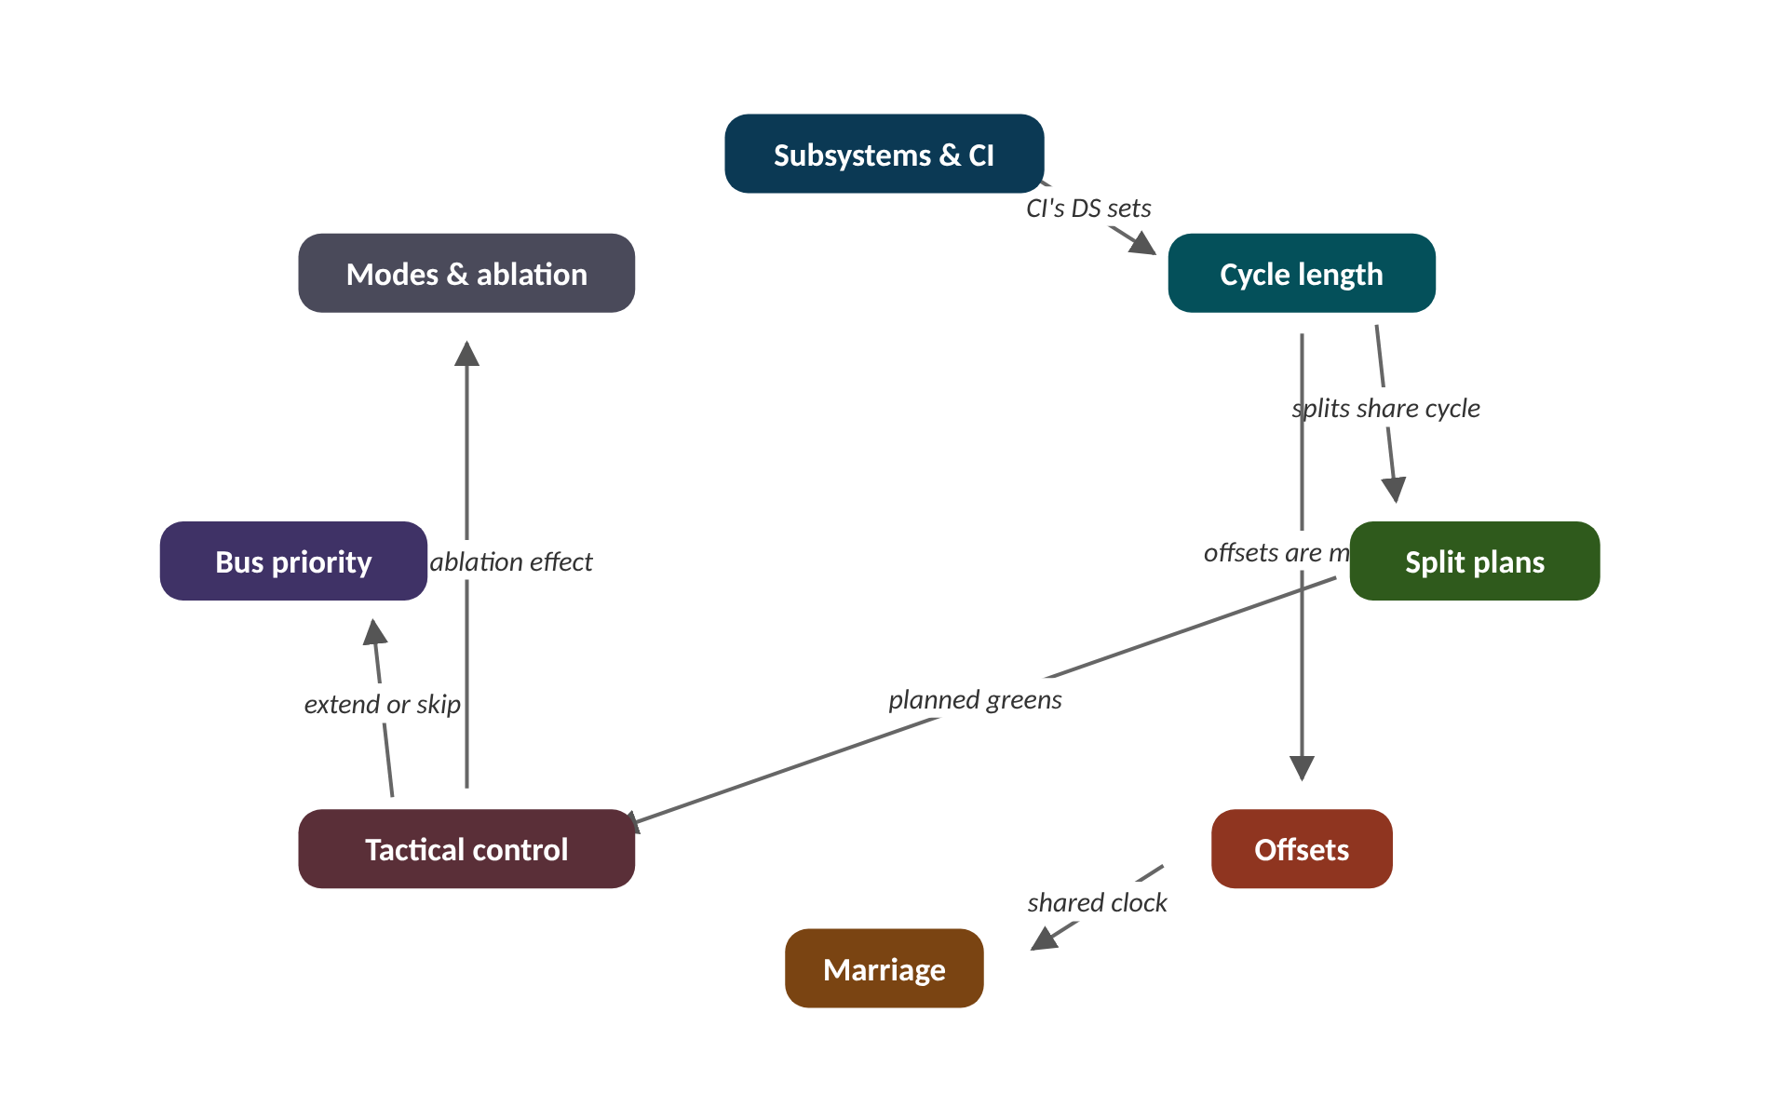
The map of today's ideas
Notes:
Each box is one idea; arrows say how one feeds the next. CI's DS sets; splits share cycle; offsets are mod C; shared clock; planned greens; extend or skip; biggest ablation effect.

Slide 6
1 Subsystems and the critical intersection
IN PLAIN WORDS
A rowing crew rows to one rhythm, and the stroke rower at the back sets it. If the stroke tires, the whole boat slows. The other rowers keep the same rhythm but each pulls with their own strength.
Signals grouped into small subsystems
Critical intersection: the busiest one
CI's DS sets the shared cycle
Others keep own splits and offsets
1 to 10
signals in a typical subsystem
Notes:
A city may have thousands of signals. SCATS does not try to give them one cycle; it splits them into small teams. Each team has a captain. Who should the captain be?
SCATS groups signals into subsystems, usually one to ten junctions that must share a cycle length to be coordinated. Each subsystem has one critical intersection (CI), normally the busiest. The CI's DS decides the subsystem's cycle length.
The other junctions follow that cycle, but each has its own split plan (how it shares the cycle among its phases) and an offset (when its cycle starts compared with the CI).
Once per cycle the regional computer runs the same strategic loop: collect DS and VK from every strategic loop detector; move the cycle length; vote on split plans; vote on offset plans; decide whether neighbouring subsystems should marry or divorce.
Presenter tip: Use the rowing analogy. Work the DS example: it reminds learners of the Foundation formula before the cycle controller uses it.

Slide 7
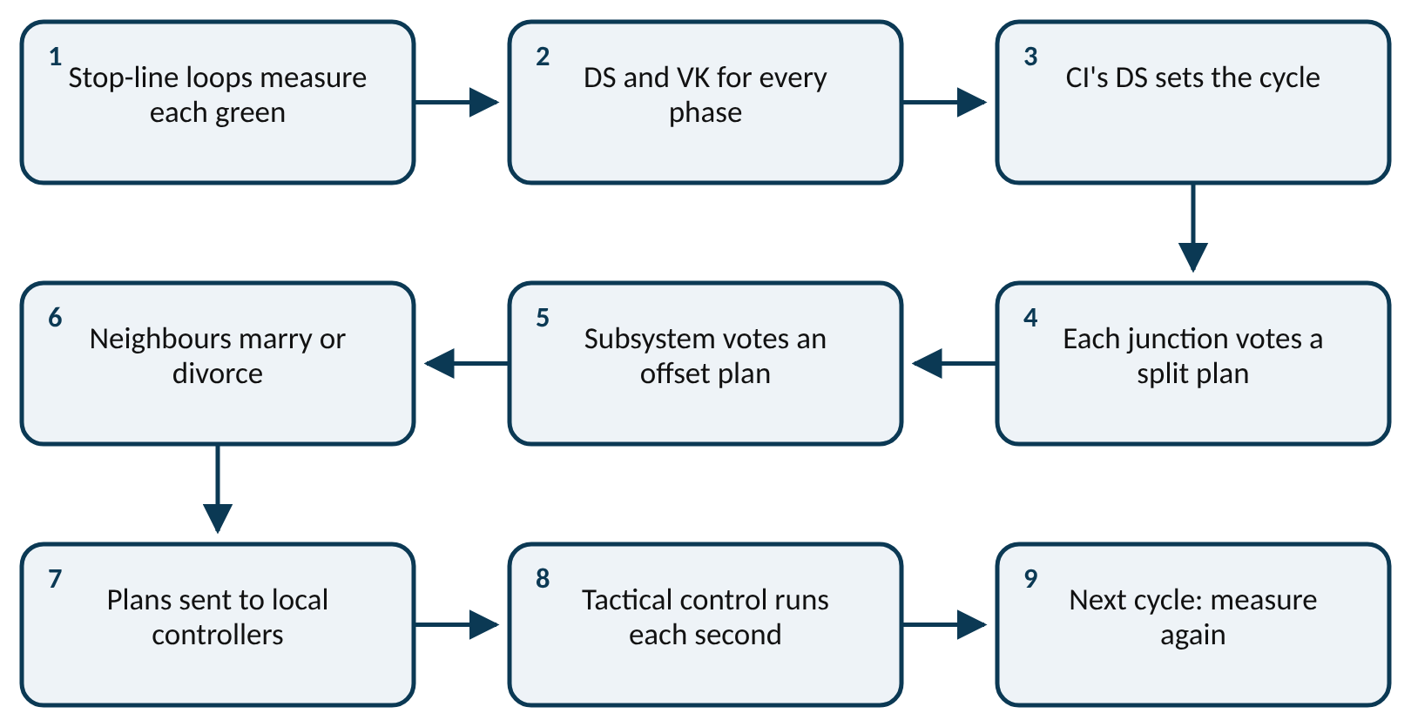
Worked example: Which junction is critical?
DS = (g − (T − n × h)) ÷ g
Subsystem J1-J2-J3. At J2 the main phase had 30 s of green, the loop was empty for 22 s in total, 12 vehicles crossed, h = 1.6 s. J1 has DS 0.78 and J3 has DS 0.66.
1. Space a busy stream needs: n × h = 12 × 1.6 = 19.2 s.
2. Wasted green: T − n × h = 22 − 19.2 = 2.8 s.
3. Used green: 30 − 2.8 = 27.2 s.
4. DS at J2 = 27.2 ÷ 30 = 0.91.
5. Compare: J1 0.78, J2 0.91, J3 0.66. The highest is J2.
J2 is the busiest and is the natural CI. Its 0.91 will drive the subsystem's next cycle length.
Notes:
The strategic loop, once per cycle. What to notice: everything starts from DS and VK measured at stop-line loops; the cycle is decided first, because splits and offsets are fractions of it. Read left to right, then down.
Try it with the audience: A junction had 40 s of green, 18 s of unoccupied loop time and 20 vehicles (h = 1.6 s). What is its DS?
Answer: n × h = 32 s. Wasted = 18 − 32 = −14 s. Used = 40 + 14 = 54 s. DS = 54 ÷ 40 = 1.35. DS can exceed 1 when vehicles pass with gaps shorter than h: this junction is very busy.

Slide 8
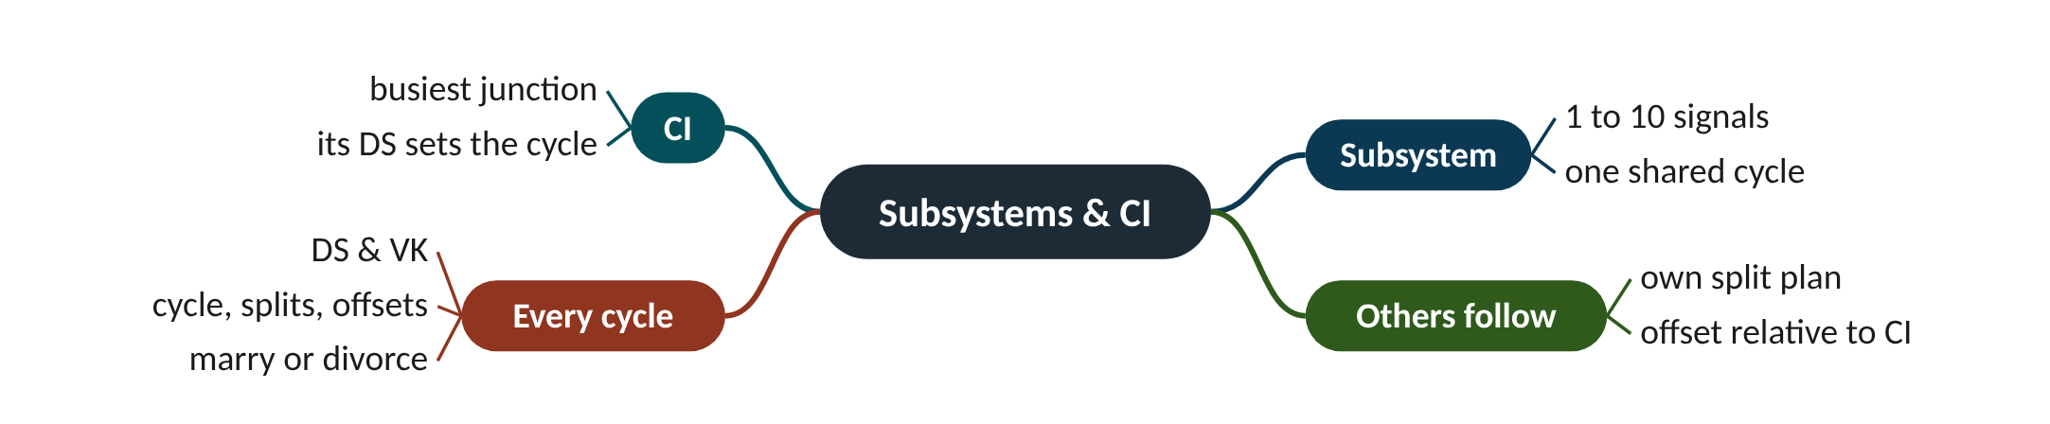
Remember it: Subsystems & CI
PICTURE THIS · STOP 1: FERRY WHARF
TRAP
At the wharf, a team of up to ten little ferries is tied together with one rope. The biggest, puffing ferry at the front wears a captain's hat and bangs a drum; all the others row to its beat.
The CI is not 'the junction in the middle' or 'the first one'. It is the one whose demand limits the cycle, usually the busiest. Picking a quiet CI makes the whole subsystem's cycle too short.
Notes:
What the scene encodes: The roped ferries are a subsystem (1 to 10 signals); the captain is the critical intersection; the drumbeat is the shared cycle.
Recap: Subsystems and CI: 1-10 signals share a cycle; the busiest (critical) intersection's DS sets it; others keep their own splits and offsets.

Slide 9
2 Cycle length: bounded steps towards a target DS
IN PLAIN WORDS
Steering a big ship: you see the harbour entrance, but you turn the wheel a little each minute rather than spinning it. A small, steady correction is safer than one big turn based on one reading.
Desired cycle = C × DS ÷ 0.9
Move at most 6 s (9 if overloaded)
Stay between 40 and 140 s
Above 110 s, extra goes to main road
+6 / +9 s
largest cycle increase per cycle
Notes:
If the CI is overloaded, why not double the cycle straight away? SCATS deliberately refuses. It walks towards the right cycle a few seconds at a time.
If the CI ran at DS with cycle C, the cycle that would have given the target DS (0.9 here) is roughly C × DS ÷ 0.9. That is the desired cycle.
SCATS never jumps there. It moves at most 6 s up per cycle (9 s when DS is 1 or more, because the junction is overloaded) and at most 6 s down. The result is kept between LMIN (40 s) and LMAX (140 s).
Above the stretch cycle (110 s here) extra time is not shared by the split plan; it all goes to one nominated phase, usually the main road, because long cycles are mainly for the heaviest movement.
Presenter tip: Do the 80 to 89 to 95 example on the board. Then show the figure: the staircase shape is the signature of bounded steps.

Slide 10
Worked example: Two cycles of a rising peak
desired = C × DS ÷ DS_{target}
C_{next} = C + clamp(desired − C, −6, +6 or +9)
The CI runs an 80 s cycle and measures DS = 1.05. Target 0.9.
1. Desired = 80 × 1.05 ÷ 0.9 = 93.3 s.
2. Gap = 93.3 − 80 = 13.3 s. DS ≥ 1, so the step limit is 9 s.
3. Next cycle = 80 + 9 = 89 s.
4. Next DS = 0.97: desired = 89 × 0.97 ÷ 0.9 = 95.9 s; gap 6.9 s; limit 6 s (DS < 1).
5. Next cycle = 89 + 6 = 95 s.
In two cycles SCATS moved from 80 s to 95 s, never by more than its step limit.
Notes:
A simulated rush hour at the CI. What to notice: the cycle (top) climbs in steps of 6 or 9 s while DS is high, peaks at 112 s, then steps down by 6 s per cycle as DS falls. DS rises above 1 only briefly. Computed with this lab's next_cycle_length() on an invented demand pattern.
Try it with the audience: The cycle is 120 s and the CI's DS is 0.80. What is the next cycle? How much of it is 'stretch' time?
Answer: Desired = 120 × 0.80 ÷ 0.9 = 106.7 s. Gap −13.3 s, limit −6 s, so Cnext = 114 s. Stretch above 110 s = 4 s, which all goes to the main-road phase.

Slide 11
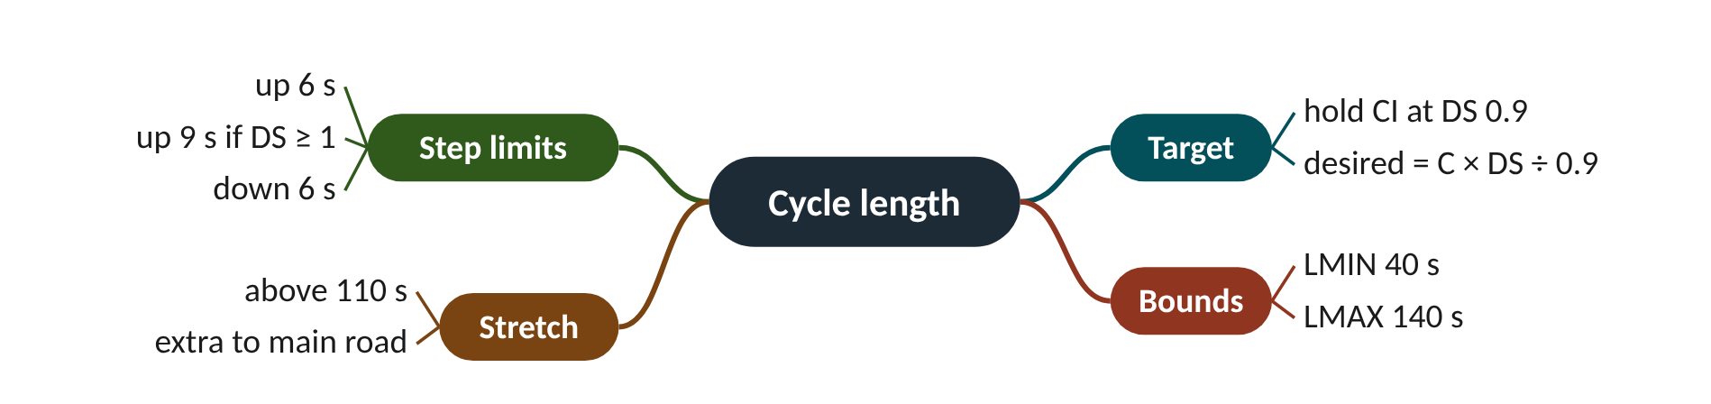
Remember it: Cycle length
PICTURE THIS · STOP 2: OPERA HOUSE
TRAP
Inside the opera house a conductor speeds up the orchestra, but a rope on his baton lets him move it only six beats faster at a time, nine if the audience is stampeding. The tempo dial runs from 40 to 140, and a big '0.9' glows above the stage.
The step limit is applied to the change, not to the cycle. 'Up 6 s' means Cnext = C + 6 at most, not Cnext = 6. And a low DS does not crash the cycle to LMIN; it walks down 6 s at a time.
Notes:
What the scene encodes: Tempo = cycle length; the rope = step limits 6 s (9 s if DS ≥ 1); the dial = LMIN 40 s and LMAX 140 s; 0.9 = target DS.
Recap: Cycle length: desired = C × DS ÷ 0.9; move at most +6 (+9 if DS ≥ 1) or −6 s per cycle, within 40-140 s; above 110 s extra goes to the main road.

Slide 12
3 Split plans: equalise DS, then vote
IN PLAIN WORDS
Sharing pizzas at a party: you look at which table emptied its plate fastest and which left slices, then pick the seating plan that leaves every table equally full. You only move people if the same plan looks best twice out of three times.
Predict each phase's DS under each plan
Pick plan with lowest worst-phase DS
Adopt only after 2 of 3 wins
Plans are stored, not invented
2 of 3
wins a split plan needs before it runs
Notes:
A junction has three phases. One is overloaded, one is half-empty. SCATS fixes this not by inventing new timings but by choosing among a few stored plans, and only after a vote.
Each junction stores a few split plans, each a share of the cycle for every phase. To compare them, SCATS asks: if this phase had had green gplan instead of gnow, what would its DS have been? The traffic used DS × gnow seconds of green, so the predicted DS is that divided by gplan.
The best plan is the one whose highest predicted DS is lowest. That choice equalises the phases: no phase is left badly overloaded while another has spare green.
A plan is only put into service after it wins consistently, here in 2 of the last 3 cycles. This voting smooths out one-off surges.
Presenter tip: Stress 'minimise the worst phase'. Ask the audience which plan wins before showing the bar chart.

Slide 13
Worked example: Choosing among three plans
DS_{plan} = DS × g_{now} ÷ g_{plan}
best plan = the one with the smallest max(DS_{plan})
Greens now (plan SP1): A 40 s, B 15 s, C 20 s. Measured DS: A 0.95, B 0.50, C 0.70. SP2 gives 45/12/18 s, SP3 gives 35/15/25 s.
1. SP1 (no change): 0.95, 0.50, 0.70. Highest 0.95.
2. SP2: A 0.95 × 40 ÷ 45 = 0.84; B 0.50 × 15 ÷ 12 = 0.63; C 0.70 × 20 ÷ 18 = 0.78. Highest 0.84.
3. SP3: A 0.95 × 40 ÷ 35 = 1.09; B 0.50; C 0.70 × 20 ÷ 25 = 0.56. Highest 1.09.
4. Smallest 'highest' is SP2 (0.84). SP2 gets this cycle's vote.
5. If SP2 also wins one of the next two cycles, it goes into service.
SP2 takes 5 s from the quiet side road and turn and gives them to the overloaded main road, bringing the worst DS down from 0.95 to 0.84.
Notes:
Highest predicted DS under each plan. What to notice: the winning plan is the shortest bar, because it leaves the worst phase least overloaded. Values from the worked example.
Try it with the audience: Two-phase junction, greens now A 30 s and B 30 s, DS A 0.98 and B 0.60. Plan P gives A 36 s, B 24 s. What are the predicted DS values? Is P better?
Answer: A: 0.98 × 30 ÷ 36 = 0.82. B: 0.60 × 30 ÷ 24 = 0.75. Highest 0.82 < 0.98, so P is better (it would still need to win the vote).

Slide 14
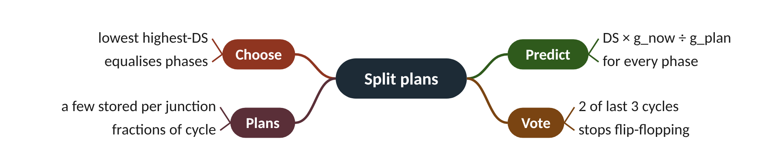
Remember it: Split plans
PICTURE THIS · STOP 3: FISH MARKET
TRAP
At the fish market a stallholder balances three trays of fish on a giant see-saw scale, swapping fish until no tray sags. Before she nails the trays down, three seagulls vote; she needs two squawks for the same tray layout.
Do not pick the plan with the lowest average DS. SP3 has a fine average but pushes phase A above 1. SCATS minimises the worst phase.
Notes:
What the scene encodes: The trays are phases; balancing = minimising the highest DS; the three seagulls and two squawks = 2-of-3 voting.
Recap: Split plans: predict DS × gnow/gplan per phase; choose the plan with the lowest worst DS; adopt it after 2 of 3 wins.

Slide 15
4 Offsets and green waves
IN PLAIN WORDS
A Mexican wave in a stadium: each section stands up a moment after its neighbour, timed so the wave travels at a steady speed. Time the lights the same way, and a platoon of cars rides the wave of greens.
Offset = travel time from reference
Wrap round the cycle (mod C)
Heavier direction gets the wave
Adopt after 4 of 5 votes
21.6 s
offset step for 300 m at 50 km/h
Notes:
Drive along a well-timed road and every light turns green just as you arrive. That 'green wave' is just arithmetic: distance, speed and one subtraction.
An offset is when a junction's green starts compared with the reference junction (the CI). For an eastbound green wave, each junction starts its green later by the travel time from the reference: distance ÷ progression speed. The result is taken mod the cycle (wrapped round, like a clock).
SCATS keeps a few offset plans: OP1 eastbound wave, OP2 westbound wave, OP3 all start together, OP4 alternate (every second junction shifted by half a cycle). It picks one from the directional flows: the clearly heavier direction (here, more than 1.3 times the other) gets the wave; balanced traffic gets OP3 or OP4.
Changing offsets disturbs traffic while the junctions shift, so offset plans need stronger agreement than splits: 4 of the last 5 cycles.
Presenter tip: Sketch a time-space diagram with four junctions. Show why a perfect eastbound wave hurts westbound traffic, and why OP4 can serve both when travel time is about half a cycle.

Slide 16
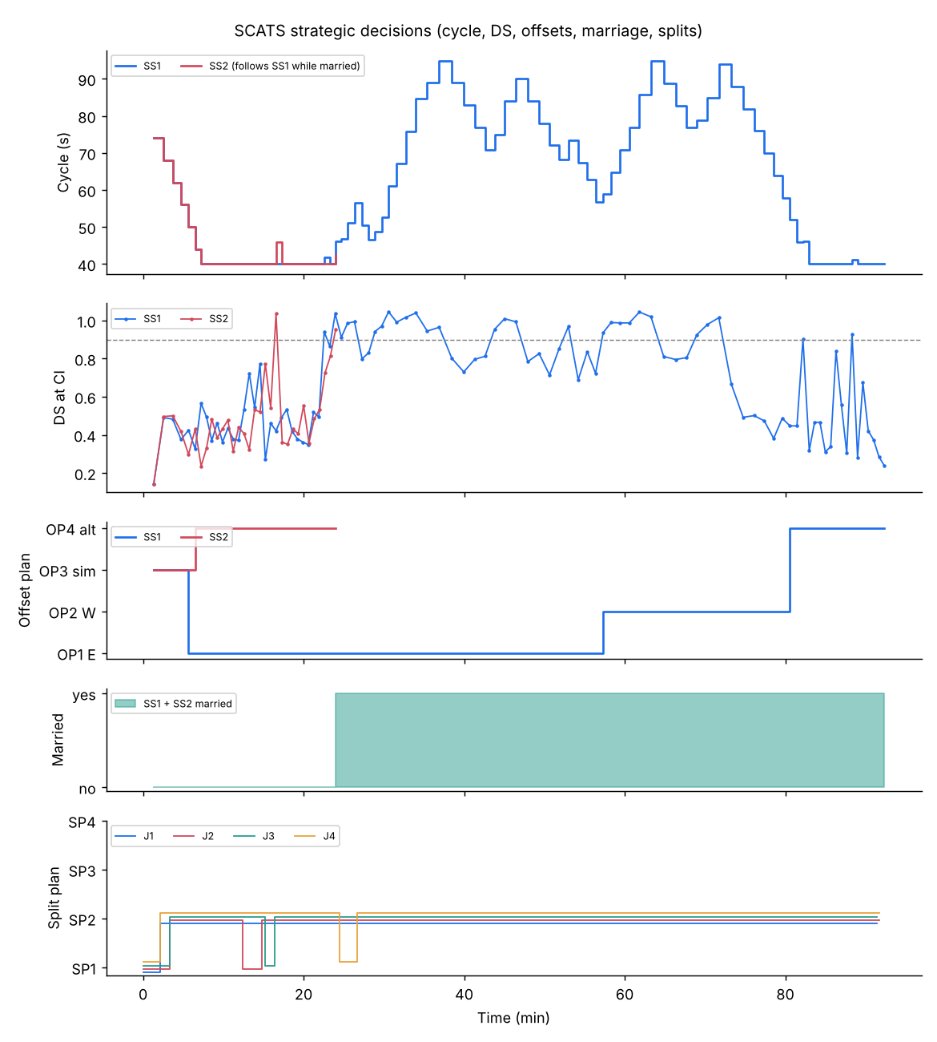
Worked example: An eastbound wave on four junctions
OP1: offset_{i} = (x_{i} − x_{ref}) ÷ v (mod C)
OP4: offset = C ÷ 2 at every second junction
Junctions every 300 m, progression speed 13.9 m/s (50 km/h), cycle 80 s. VK eastbound 20, westbound 12.
1. Travel time per link: 300 ÷ 13.9 = 21.6 s.
2. OP1 offsets: 0, 21.6, 43.2, 64.7 s (all under 80, no wrapping).
3. OP2 offsets: 0, −21.6, −43.2, −64.7 → mod 80 = 0, 58.4, 36.8, 15.3 s.
4. Is east clearly heavier? 1.3 × 12 = 15.6, and 20 > 15.6, so yes.
5. This cycle votes OP1; it is adopted once it wins 4 of the last 5 votes.
Eastbound drivers at 50 km/h now meet green at every junction; westbound drivers get whatever is left.
Notes:
Strategic decisions on the SUMO corridor (Lab A1). What to notice: the cycle rises with each peak, the offset plan switches from eastbound (OP1) to westbound (OP2) progression and then to alternate (OP4) as traffic balances, and the two subsystems marry as the first peak builds.
Try it with the audience: Same corridor, but the cycle is 60 s. What are the OP1 offsets for junctions 1 to 4?
Answer: 0, 21.6, 43.2, 64.7 s; the last wraps: 64.7 − 60 = 4.7 s. So 0, 21.6, 43.2, 4.7 s.

Slide 17
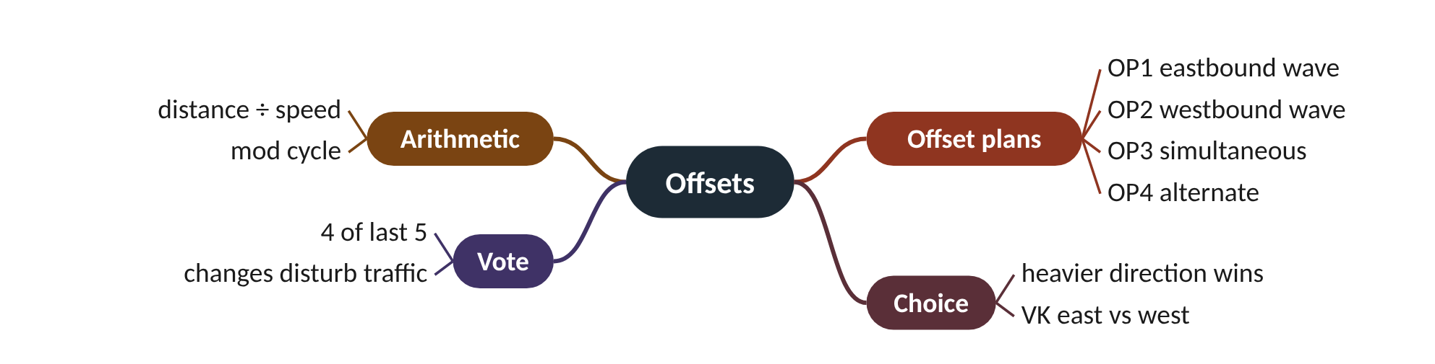
Remember it: Offsets
PICTURE THIS · STOP 4: HARBOUR BRIDGE
TRAP
Along the harbour bridge, giant flags pop up one after another, left to right, exactly as a speeding red car passes each one. A stern referee holds up five cards and needs four to agree before the flags may change direction.
Offsets wrap round the cycle. A westbound offset of −21.6 s on an 80 s cycle is the same as +58.4 s. Forgetting 'mod C' gives negative start times that a controller cannot use.
Notes:
What the scene encodes: Flags popping in sequence = offsets making a green wave; the car's speed = progression speed; four of five cards = 4-of-5 offset voting.
Recap: Offsets: offset = distance ÷ speed (mod C); OP1/OP2 waves, OP3 together, OP4 alternate; heavier direction (>1.3×) wins; adopt after 4 of 5 votes.

Slide 18
5 Marriage and divorce
IN PLAIN WORDS
A thermostat that turns heating on at 18 °C and off at 21 °C, not at the same temperature. The gap stops the boiler clicking on and off. SCATS uses a similar gap, plus three agreeing readings in a row.
Married: shared larger cycle and clock
Marry at VK 18, divorce below 10
Three votes in a row to change
Hysteresis stops flip-flopping
18 / 10
link VK to marry / to divorce
Notes:
Two neighbouring subsystems each run their own cycle. When lots of traffic flows between them, they would do better as one. When it fades, they would do better apart. How do you stop them changing their minds every minute?
Two adjacent subsystems can be married: they run on a common cycle (the larger of the two they each need) and share a master clock, so the offset between them means something. When the traffic between them drops, coordination no longer pays for the extra cycle time, and they divorce.
The decision uses the link flow (VK) between them. In this lab they marry when link VK is at least 18 and the two cycles are within 25 s of each other; once married they stay married until VK falls below 10. Different thresholds for on and off are called hysteresis.
A change also needs 3 consecutive votes. One busy cycle cannot marry them, and one quiet cycle cannot divorce them.
Presenter tip: Walk the VK sequence on the board, counting votes aloud. Ask what would happen with a single threshold of 15.

Slide 19
Worked example: Tracing link VK cycle by cycle
marry if VK ≥ 18 (and |C_{A} − C_{B}| ≤ 25 s) for 3 cycles in a row
divorce if VK < 10 for 3 cycles in a row
Divorced subsystems with cycles 80 s and 90 s. Link VK per cycle: 12, 15, 19, 20, 17, 21, 22, 23, 16, 12, 9, 11, 8, 7, 6.
1. Cycles 3-4 (19, 20) vote 'marry'; cycle 5 (17) breaks the run, count back to 0.
2. Cycles 6, 7, 8 (21, 22, 23): three in a row. Married at cycle 8, common cycle 90 s.
3. Cycles 9-10 (16, 12) are above 10: stay married.
4. Cycle 11 (9) votes 'divorce'; cycle 12 (11) breaks the run.
5. Cycles 13, 14, 15 (8, 7, 6): three in a row. Divorced at cycle 15.
Two state changes in fifteen noisy cycles, instead of the many flips a single threshold would give.
Notes:
Link VK and the marriage state. What to notice: the state (married = 25 on this scale) switches on only after three cycles at or above 18, and off only after three below 10. Readings between the dashed lines never change anything. Computed with this lab's MarriageLogic.
Try it with the audience: Divorced, cycles 70 s and 100 s, link VK 25, 26, 27. Do they marry?
Answer: No. VK is high, but the cycles differ by 30 s, more than the 25 s allowed, so the votes do not count.

Slide 20
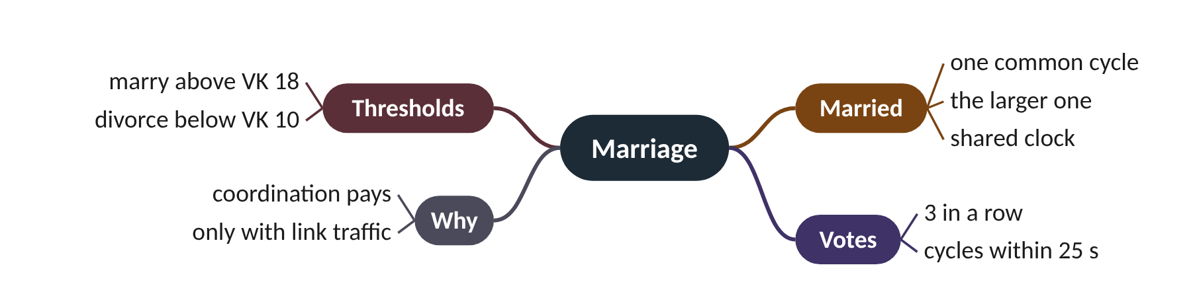
Remember it: Marriage
PICTURE THIS · STOP 5: WEDDING CHAPEL
TRAP
On the rocks above the harbour, two ferries get married in a tiny chapel. The priest needs 18 roses to start the wedding but only takes the rings back if fewer than 10 remain, and three bells must ring in a row each time. The couple share the bigger of their two clocks.
Married subsystems do not average their cycles; they both take the larger one, so the busier subsystem is not starved. That is also the cost of marriage: the quieter one runs a longer cycle than it needs.
Notes:
What the scene encodes: Marry at VK 18, divorce below 10 (hysteresis); three bells = 3 consecutive votes; the bigger clock = the larger cycle.
Recap: Marriage: neighbours share the larger cycle when link VK ≥ 18 for 3 cycles (cycles within 25 s); divorce when VK < 10 for 3 cycles.

Slide 21
6 Tactical control: gap-out, skipping, holding
IN PLAIN WORDS
A lift door: it stays open while people keep walking in, and closes once nobody has come through for a few seconds. If nobody pressed the button on a floor, the lift does not stop there at all.
Gap timer ends a green early
Never before the minimum green
Empty phases are skipped
Main road held to keep the wave
62.0 s
corridor delay with tactical control off (36.9 s on)
Notes:
The regional computer plans greens once per cycle. But what if the side road empties after 8 seconds of a planned 25? Something has to notice, every second.
Strategic control gives each phase a planned green. The local controller then checks, every second, whether that green is still useful. After the minimum green, a gap timer restarts each time a vehicle crosses the loop. If it reaches the gap setting (3 s here), the phase gaps out and its unused time passes to the next phase.
Demand-dependent phases, such as a protected right-turn arrow, are skipped when nobody is waiting.
The coordinated phase (the main road) is normally held rather than gapped out, because ending it early would break the green wave. Spare time from the other phases returns to it.
Presenter tip: Act out the gap timer with a clap for each car. Then link to the ablation: tactical control was the single most valuable mechanism on this corridor.

Slide 22
Worked example: Does this side-road green gap out?
end green when t ≥ g_{min} and (t − last vehicle) ≥ gap setting
Planned green 25 s, minimum green 8 s, gap setting 3 s. Vehicles cross the loop at 1.0, 2.5, 4.0 and 5.5 s, then the next one would come at 9.5 s.
1. Before 8 s the green cannot end (minimum green).
2. At 8.0 s the gap since the last car (5.5 s) is 2.5 s, below 3 s: keep going.
3. At 8.5 s the gap is 3.0 s: gap-out. The green ends at 8.5 s.
4. Unused time: 25 − 8.5 = 16.5 s, passed on to the next phase.
5. The car arriving at 9.5 s waits for the next cycle.
Instead of 16.5 s of empty green, the main road gets that time. This is why switching off tactical control hurt most in the SUMO ablation.
Notes:
The gap timer during one green. What to notice: the timer resets to 0 at every vehicle; the green may end only after the minimum green, the first time the timer reaches the 3 s line (8.5 s). Values from the worked example.
Try it with the audience: Minimum green 6 s, gap 3 s, vehicles at 0.5, 2.0 and 6.5 s, then none. When does the green end?
Answer: At 5.0 s the gap is 3.0 s, but that is before the 6 s minimum. At 6.0 s the gap is 4 s, so the green would end at 6.0 s; the car at 6.5 s just misses. (If it had come at 5.5 s, the timer would have reset and the green would end at 8.5 s.)

Slide 23
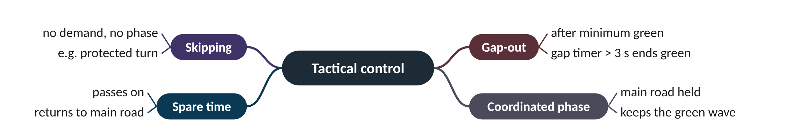
Remember it: Tactical control
PICTURE THIS · STOP 6: LIGHTHOUSE
TRAP
In the lighthouse, a lift door stays open while tourists stream in, then slams after three silent seconds, but never before an eight-second bell. The lift skips floors where nobody pressed a button. On the main-road floor a guard props the door open with a giant anchor.
Gap-out does not apply to every phase. The coordinated main-road phase is held so the green wave survives, and no phase can gap out before its minimum green.
Notes:
What the scene encodes: Three silent seconds = gap setting 3 s; eight-second bell = minimum green; skipped floors = phase skipping; anchor = the held coordinated phase.
Recap: Tactical: after minimum green a 3 s gap ends a green early; empty demand phases are skipped; the main road is held; spare time passes on.

Slide 24
7 Public transport priority
IN PLAIN WORDS
At a busy shop counter, a customer in a wheelchair (high priority) is served next, someone with one item may be squeezed in early (medium), and everyone else waits their turn (low).
High: hurry call, serve at once
Medium: extend or start early
Low: wait in normal sequence
Every priority second costs someone
29.7 s
SCATS bus delay in Lab A1 (fixed 110.8 s)
Notes:
A bus with 60 people arrives a second after its green ends. Should 60 people wait for the next cycle so that 5 cars on the side road get their turn?
SCATS can receive priority requests from buses and trams, for example from a transponder or a detector in a bus lane. Three levels are commonly described.
High priority is a 'hurry call': the transit phase is served as soon as it is safe, skipping other phases if needed. It is typical for trams and emergency vehicles. Medium priority is a flexible window: the current green is extended, or other phases are shortened, so the transit phase comes sooner. It is typical for buses. Low priority means the vehicle waits in normal sequence.
In Lab A1 buses ran every 4 minutes each way. Mean bus delay was 110.8 s with fixed time, 51.8 s actuated and 29.7 s with SCATS and bus priority.
Presenter tip: Ask the audience which level they would give a city bus. Then show the cost: the side road loses the time.

Slide 25
Worked example: A bus that just missed its green
Cycle 80 s: phase A (bus) green 0-40 s, intergreen 5 s, phase B green 45-75 s, intergreen 5 s. The bus arrives at 42 s. Phase B has a 10 s minimum green.
1. Low: wait for the next A green at 80 s. Delay = 80 − 42 = 38 s.
2. Medium: cut B to its 10 s minimum: B ends at 55 s, intergreen to 60 s. Delay = 60 − 42 = 18 s.
3. High: skip B entirely; A returns after the intergreen at 45 s. Delay = 45 − 42 = 3 s.
4. Cost: medium takes 20 s from B; high takes all 30 s.
Higher priority saves the bus more time but costs the side road more. That is why buses usually get medium, not high.
Notes:
Bus delay at each priority level (worked example). What to notice: each step up in priority cuts the bus delay sharply, but the time comes from phase B. Illustrative timings from the calculation, not SUMO.
Try it with the audience: Same junction, but the bus arrives at 38 s, before A's green ends. Under medium priority, what happens and what is the bus delay?
Answer: Medium can extend the current A green by a few seconds so the bus passes. Bus delay ≈ 0 s; B starts a little later and is shortened by the same few seconds.

Slide 26
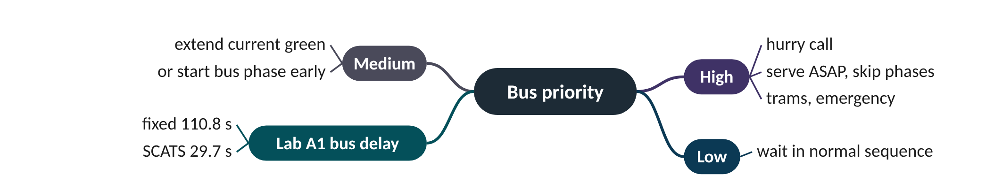
Remember it: Bus priority
PICTURE THIS · STOP 7: TRAM STOP
TRAP
At the tram stop three vehicles queue for a magic gate. A fire-red tram blasts a hurry horn and the gate flies open at once. A yellow bus waves a ticket and the gate swings early. A grey van just waits its turn, tapping the wheel.
Priority is not free. In the ablation, switching bus priority off raised bus delay from 29.7 to 46.4 s but also raised mean delay for everyone from 36.9 to 42.5 s here, because buses ran on the main road with the green wave. On another corridor, aggressive priority can raise general delay instead.
Notes:
What the scene encodes: Hurry horn = high priority (serve at once); waved ticket = medium (extend or start early); waiting van = low (normal sequence).
Recap: Bus priority: high = hurry call, medium = extend or start early, low = wait; Lab A1 bus delay 110.8 / 51.8 / 29.7 s.

Slide 27
8 Operating modes and the full system on SUMO
IN PLAIN WORDS
An orchestra with a conductor (Masterlink); the same orchestra following printed sheet music and a shared metronome when the conductor leaves (Flexilink); musicians each playing by ear alone (Isolated).
Masterlink, Flexilink, Isolated, flashing
Lab A1: 77.2 vs 40.9 vs 36.9 s
Tactical control matters most here
Ablation results depend on the corridor
−52%
delay cut versus fixed time on the corridor
Notes:
What happens to a city's signals when the cable to the control centre is cut? And if you remove one SCATS mechanism at a time, which one does the corridor miss most?
Masterlink is full adaptive operation: strategic plans from the regional computer, tactical control locally. Flexilink is the fallback: time-of-day plans with synchronised clocks, so offsets still hold, with local actuation inside them. Isolated means local vehicle actuation only, with no coordination. Last comes flashing or off, for faults and power loss.
SCATS also raises alarms for implausible loops (no counts for many cycles, or the loop stuck 'on'), and engineers configure substitutes. The Mastery level tests this.
Lab A1 ran everything on four 3-phase junctions 300 m apart, in two subsystems that may marry, for 90 minutes with tidal peaks and buses every 4 minutes. Lab A2, the ablation, switched one mechanism off at a time.
Presenter tip: Show the ablation chart and ask the audience to rank mechanisms before revealing it. Be honest about the 'no cycle' result.

Slide 28
Worked example: Reading the ablation
change = (delay without mechanism − delay with all) ÷ delay with all
Full SCATS: 36.94 s mean delay. With one mechanism off: no tactical 62.04, no marriage 50.33, no offset 45.22, no bus priority 42.49, no split 37.50, no cycle 34.42 s.
1. No tactical: (62.04 − 36.94) ÷ 36.94 = +68%.
2. No marriage: 13.39 ÷ 36.94 = +36%. No offset: 8.28 ÷ 36.94 = +22%.
3. No bus priority: 5.55 ÷ 36.94 = +15%. No split: 0.56 ÷ 36.94 = +1.5%.
4. No cycle adaptation: −2.52 ÷ 36.94 = −6.8% (slightly better).
5. Versus fixed time (77.2 s): SCATS cuts delay by 52%; versus actuated (40.9 s) by 10%.
On this corridor, second-by-second tactical control and coordination (marriage, offsets) carry most of the benefit. An 80 s fixed cycle happened to suit this demand, so cycle adaptation did not pay here.
Notes:
Lab A2 ablation: mean delay with one mechanism switched off (SUMO, seed 1). What to notice: the tallest bar shows the mechanism the corridor misses most. 'No cycle' is below 'Full': a fixed 80 s cycle happened to suit this demand.
Try it with the audience: Lab A1 stops per vehicle were 1.82 (fixed), 1.57 (actuated) and 1.30 (SCATS). By what percentage did SCATS cut stops compared with fixed time?
Answer: (1.82 − 1.30) ÷ 1.82 = 0.52 ÷ 1.82 = 29% fewer stops.

Slide 29
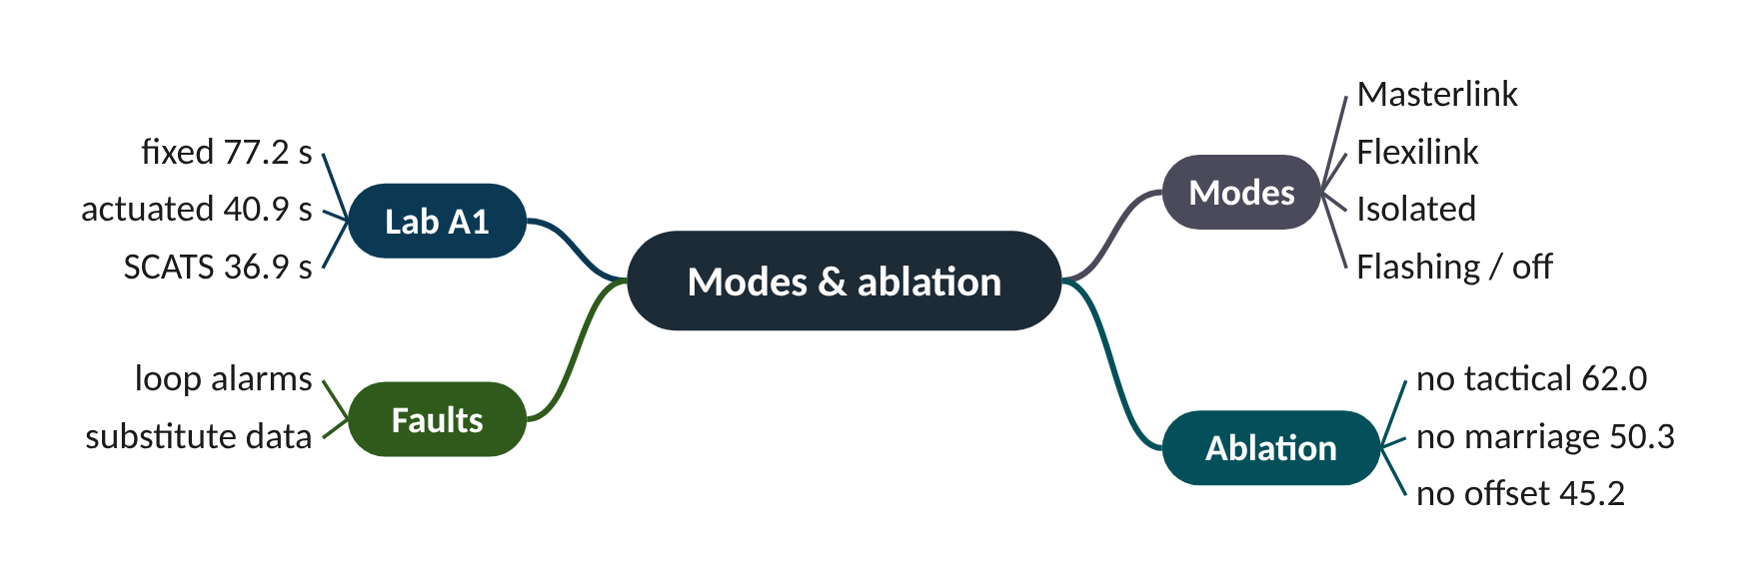
Remember it: Modes & ablation
PICTURE THIS · STOP 8: CONTROL TOWER
TRAP
In the control tower a conductor leads an orchestra of traffic lights. When she trips over the cable, the lights pick up sheet music and a ticking metronome. Behind her a scoreboard shows seven pillars; the tallest, 62, is labelled 'tactical'.
An ablation result is about this corridor and this demand. 'No cycle adaptation was better' does not mean cycle adaptation is useless; it pays off when demand swings far from the fixed value.
Notes:
What the scene encodes: Conductor = Masterlink; sheet music + metronome = Flexilink; the scoreboard = ablation, no tactical 62.0 s versus 36.9 s full.
Recap: Modes and ablation: Masterlink → Flexilink → Isolated → flashing; Lab A1 delay 77.2 / 40.9 / 36.9 s; ablation: tactical matters most (62.0 s off).

Slide 30
Strategic versus tactical control
 | Strategic | Tactical
Where it runs | regional computer | local controller at the junction
How often | once per cycle | every second
Decides | cycle, split plan, offset plan, marriage | gap-out, skipping, holding, priority
Damping | step limits, 2-of-3 and 4-of-5 votes, hysteresis | minimum green, gap setting
Ablation (delay when off) | marriage 50.3, offset 45.2, split 37.5, cycle 34.4 s | 62.0 s

Slide 31
Things beginners mix up
This… | …is not this | The fact that tells them apart
Split voting (2 of 3) | Offset voting (4 of 5) | Offset changes disturb traffic more, so they need stronger agreement.
Married cycle | Average of the two cycles | Married subsystems both take the larger cycle.
Lowest worst-phase DS | Lowest average DS | SCATS picks the split plan that minimises the highest phase DS.
Gap-out | Phase skipping | Gap-out ends a green that started; skipping never starts a phase with no demand.
Flexilink | Isolated | Flexilink keeps synchronised clocks, so offsets still hold; Isolated has no coordination.

Slide 32
Check yourself (1 of 2)
C = 100 s and the CI's DS = 1.20 (target 0.9). What is the next cycle?
Junctions 400 m apart, progression 16 m/s, cycle 90 s. OP1 offset of the third junction (800 m from the reference)?
A. 106 s
B. 109 s
C. 133 s
D. 140 s
A. 25 s
B. 40 s
C. 50 s
D. 65 s
Answers are in the speaker notes and in the study guide's answer key.
Notes:
Answer: B. Desired 133.3 s; DS ≥ 1 allows +9, so 109 s. 106 s uses the normal +6 limit.
Answer: C. 800 ÷ 16 = 50 s, below 90 so no wrap. 25 s is one link only.

Slide 33
Check yourself (2 of 2)
Why is the main-road (coordinated) phase normally not allowed to gap out?
Which pair of mechanisms carried most of SCATS's benefit on the Lab A2 corridor?
A. It has no detector
B. Ending it early would break the green wave
C. It always has demand
D. Rules forbid it
A. Split and cycle adaptation
B. Tactical control and marriage
C. Bus priority and cycle adaptation
D. Offset and split adaptation
Answers are in the speaker notes and in the study guide's answer key.
Notes:
Answer: B. Holding it keeps progression; spare time returns to it.
Answer: B. Switching them off raised delay to 62.0 and 50.3 s, the two largest increases.

Slide 34
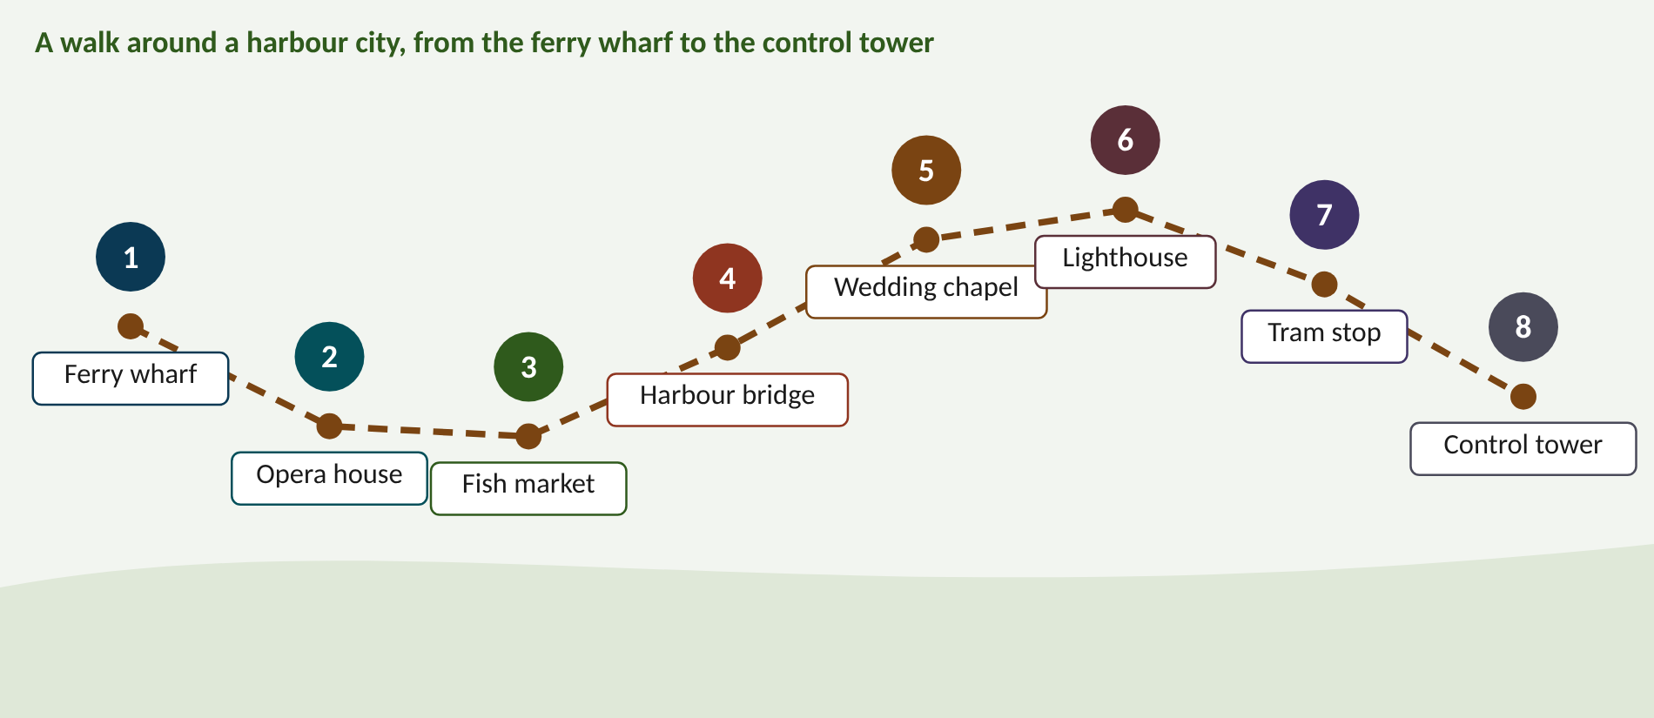
Walk the memory route
1 Ferry wharf = Subsystems & CI · 2 Opera house = Cycle length · 3 Fish market = Split plans · 4 Harbour bridge = Offsets · 5 Wedding chapel = Marriage · 6 Lighthouse = Tactical control · 7 Tram stop = Bus priority · 8 Control tower = Modes & ablation
Notes:
Stop 1, Ferry wharf: At the wharf, a team of up to ten little ferries is tied together with one rope. The biggest, puffing ferry at the front wears a captain's hat and bangs a drum; all the others row to its beat. (The roped ferries are a subsystem (1 to 10 signals); the captain is the critical intersection; the drumbeat is the shared cycle.)
Stop 2, Opera house: Inside the opera house a conductor speeds up the orchestra, but a rope on his baton lets him move it only six beats faster at a time, nine if the audience is stampeding. The tempo dial runs from 40 to 140, and a big '0.9' glows above the stage. (Tempo = cycle length; the rope = step limits 6 s (9 s if DS ≥ 1); the dial = LMIN 40 s and LMAX 140 s; 0.9 = target DS.)
Stop 3, Fish market: At the fish market a stallholder balances three trays of fish on a giant see-saw scale, swapping fish until no tray sags. Before she nails the trays down, three seagulls vote; she needs two squawks for the same tray layout. (The trays are phases; balancing = minimising the highest DS; the three seagulls and two squawks = 2-of-3 voting.)
Stop 4, Harbour bridge: Along the harbour bridge, giant flags pop up one after another, left to right, exactly as a speeding red car passes each one. A stern referee holds up five cards and needs four to agree before the flags may change direction. (Flags popping in sequence = offsets making a green wave; the car's speed = progression speed; four of five cards = 4-of-5 offset voting.)
Stop 5, Wedding chapel: On the rocks above the harbour, two ferries get married in a tiny chapel. The priest needs 18 roses to start the wedding but only takes the rings back if fewer than 10 remain, and three bells must ring in a row each time. The couple share the bigger of their two clocks. (Marry at VK 18, divorce below 10 (hysteresis); three bells = 3 consecutive votes; the bigger clock = the larger cycle.)
Stop 6, Lighthouse: In the lighthouse, a lift door stays open while tourists stream in, then slams after three silent seconds, but never before an eight-second bell. The lift skips floors where nobody pressed a button. On the main-road floor a guard props the door open with a giant anchor. (Three silent seconds = gap setting 3 s; eight-second bell = minimum green; skipped floors = phase skipping; anchor = the held coordinated phase.)
Stop 7, Tram stop: At the tram stop three vehicles queue for a magic gate. A fire-red tram blasts a hurry horn and the gate flies open at once. A yellow bus waves a ticket and the gate swings early. A grey van just waits its turn, tapping the wheel. (Hurry horn = high priority (serve at once); waved ticket = medium (extend or start early); waiting van = low (normal sequence).)
Stop 8, Control tower: In the control tower a conductor leads an orchestra of traffic lights. When she trips over the cable, the lights pick up sheet music and a ticking metronome. Behind her a scoreboard shows seven pillars; the tallest, 62, is labelled 'tactical'. (Conductor = Masterlink; sheet music + metronome = Flexilink; the scoreboard = ablation, no tactical 62.0 s versus 36.9 s full.)

Slide 35
Numbers to remember
› Target DS 0.9; h = 1.6 s
› Cycle steps +6 (+9 if DS ≥ 1), −6; LMIN 40, LMAX 140, stretch 110 s
› Split vote 2 of 3; offset vote 4 of 5
› Marry VK ≥ 18, divorce < 10, 3 votes, cycles within 25 s
› Gap setting 3 s; main road held
› Lab A1 delay 77.2 / 40.9 / 36.9 s; bus 110.8 / 51.8 / 29.7 s
› Ablation off: tactical 62.0, marriage 50.3, offset 45.2 s

Slide 36
Keep going
Study guide: SCATS_Advanced_Study_Guide.pdf · Interactive labs and SUMO code: smrahmanbd.github.io/scats-learning-lab
Notes:
Point learners to the study guide for the full worked examples, quiz and revision plan, and to the website for the simulators.

