Slide 1
The traffic light that grades its own green time
SCATS · Level 1 · Foundation
How SCATS watches one loop per lane, measures how much of each green was really used, and adjusts the next cycle.
smrahmanbd.github.io/scats-learning-lab
Notes:
This guide is for complete beginners. You need no traffic engineering and only school maths. By the end you will understand how SCATS, one of the most widely used adaptive traffic systems in the world, measures traffic with a loop at the stop line and turns one number, the degree of saturation, into new signal timings. There are six ideas. Each builds on the one before.

Slide 2
6 ideas, each building on the last
1
What SCATS is
2
Two levels of control
3
The timing vocabulary
60,000+ intersections reported to run SCATS worldwide
±6 s largest normal cycle change per cycle (this lab)
48 / 32 s greens of a 90 s cycle split 60/40
4
Measuring demand: the degree of saturation
5
Fixed time, actuated and SCATS
6
Where fixed-time plans come from
DS 0.90 g 40 s, T 20 s, 10 cars, h 1.6 s
−30% SCATS delay vs fixed time in Lab F3
h = 1.62 s calibrated standard space time (Lab F2)
Notes:
Outcomes for today:
- Explain what 'adaptive, coordinated and plan-based' mean for SCATS.
- Say which decisions are tactical (every second) and which are strategic (every cycle).
- Use cycle, phase, split, intergreen and offset correctly, and work out the greens of a cycle.
- Compute the degree of saturation (DS) and VK from a loop record by hand.
- Explain why SCATS beat fixed time and roughly tied with actuation at one junction in the SUMO lab.
- Design a fixed plan with Webster's formula and say why SCATS re-solves it every cycle.

Slide 3
Three surprises to start
SCATS measures empty road.
It runs on a huge scale.
A truck is handled fairly without being recognised.
Instead of counting cars, SCATS adds up the moments when nothing is over the loop during green. Wasted green is easy to see; used green is whatever is left.
SCATS was developed in Sydney from the 1970s and is owned today by Transport for NSW. It is reported to run more than 60,000 intersections in over 200 cities.
A truck covers the loop for longer, so it leaves less empty time, exactly as it uses more green. SCATS never needs to know it was a truck.

Slide 4
Words you will meet
Intersection | A place where roads meet and traffic lights take turns.
Phase | A set of movements that get green together, for example 'main road both ways' (phase A).
Cycle | One full turn through all phases, including the changeover times, for example 90 s.
Split | How the green time is shared between phases, for example 60% to A and 40% to B.
Intergreen | Amber plus all-red between two phases. Nobody moves much, so it is 'lost' time.
Offset | When one intersection's cycle starts compared with its neighbour, so a green wave can form.
Stop-line loop | A wire loop in the road just before the stop line that knows when a vehicle is over it.
Degree of saturation (DS) | How much of a green was really used: 1 means fully used, 0.4 means mostly empty road.
Subsystem | A small group of intersections that share one cycle length.
Notes:
You do not need to memorise these now; each is explained again when it first matters.

Slide 5
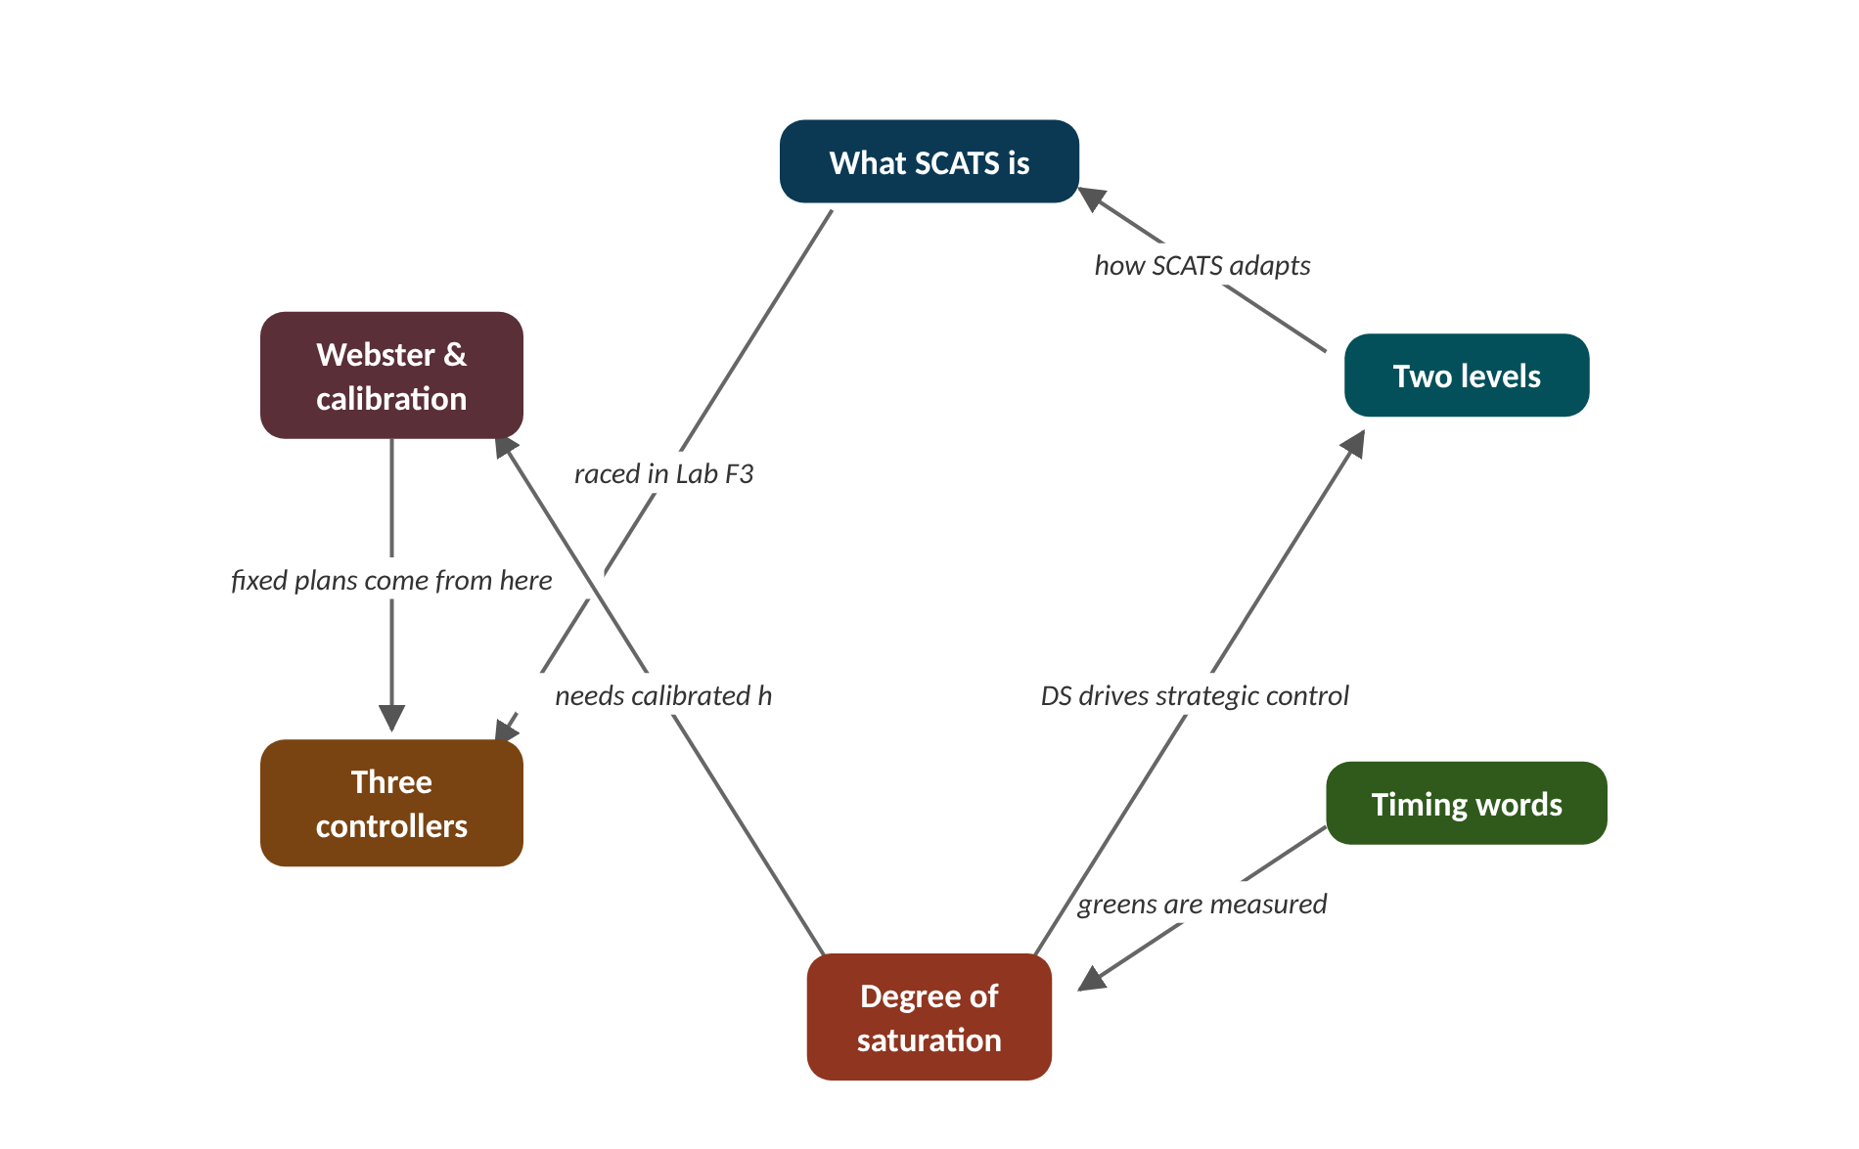
The map of today's ideas
Notes:
Each box is one idea; arrows say how one feeds the next. greens are measured; DS drives strategic control; how SCATS adapts; raced in Lab F3; fixed plans come from here; needs calibrated h.

Slide 6
1 What SCATS is
IN PLAIN WORDS
SCATS is like a teacher marking homework every day instead of once a year. Each day she sees what went wrong and adjusts tomorrow's lesson a little. Small daily fixes keep the class on track.
Adaptive: timings change every cycle
Coordinated: neighbours share a cycle
Plan-based: chooses from approved plans
Grades each green, nudges the next
60,000+
intersections reported to run SCATS worldwide
Notes:
A timing plan written months ago knows nothing about today's crash, concert or rainstorm. SCATS grades every green it just gave, and corrects the next cycle. How can such small corrections keep a whole city moving?
SCATS stands for the Sydney Coordinated Adaptive Traffic System. It was developed by the New South Wales Department of Main Roads from the 1970s and is owned and run today by Transport for NSW.
Three words describe it. Adaptive: timings change automatically from detector data, cycle by cycle. Coordinated: neighbouring signals share a cycle and are offset so platoons (bunches of cars) meet green lights. Plan-based: SCATS does not invent arbitrary timings; it chooses and blends from a library of split and offset plans approved by engineers.
The core idea is simple. At the end of each cycle SCATS asks: how well was each green used? Then it nudges the cycle length and the split for the next cycle. Many small corrections keep the signals in step with real traffic.
Presenter tip: Open with the homework-marking analogy. Stress the three words and that SCATS chooses from approved plans rather than inventing timings.

Slide 7
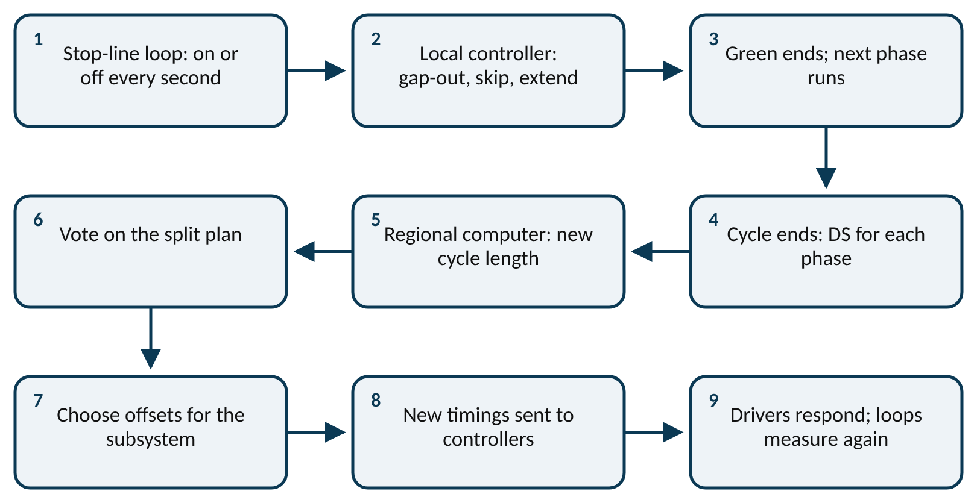
Worked example: How often does SCATS think?
One intersection running a 90 s cycle for one hour.
1. Cycles per hour = 3600 ÷ 90 = 40.
2. Strategic decisions (cycle length, split, offset) happen once per cycle: 40 per hour.
3. Tactical checks (should this green end now?) happen every second: 3600 per hour.
4. So for every strategic decision there are 3600 ÷ 40 = 90 tactical checks.
Forty careful decisions an hour, each backed by ninety quick checks. Each correction can be small because another one is coming within two minutes.
Notes:
From the loop to the next cycle. What to notice: the loop reports every second, the local controller reacts at once, and the regional computer grades the whole cycle before choosing the next timings. Read left to right, then down.
Try it with the audience: An intersection runs a 120 s cycle. How many strategic decisions does SCATS make there in one hour?
Answer: 3600 ÷ 120 = 30 cycles, so 30 strategic decisions (one per cycle).

Slide 8
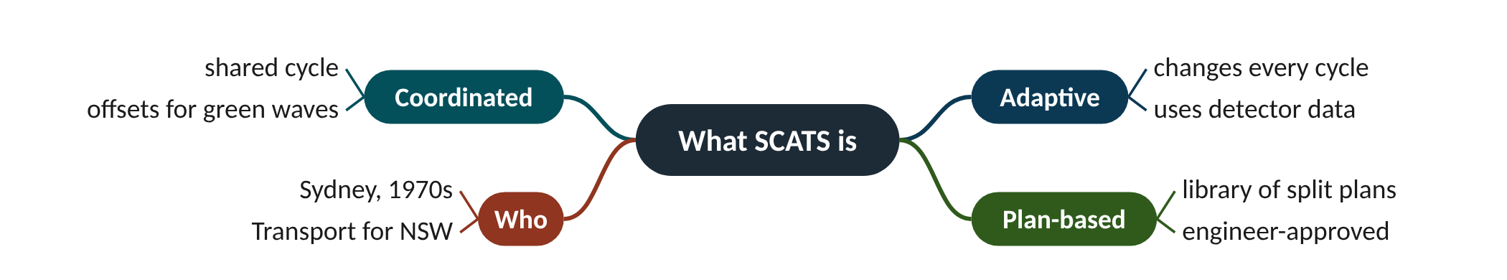
Remember it: What SCATS is
PICTURE THIS · STOP 1: BRIDGE ENTRANCE
TRAP
At the start of the bridge a conductor in a huge coat waves a baton at the traffic lights. Instead of one score she flips between four thick music books, and after every bar she scribbles a red mark on the page she just played.
Adaptive does not mean 'anything goes'. SCATS keeps the cycle between a minimum and a maximum, changes it by a few seconds at a time, and picks splits from a small library of approved plans.
Notes:
What the scene encodes: Conductor = coordinated; red marks after every bar = adaptive grading of each cycle; four music books = the library of split plans (plan-based).
Recap: What SCATS is: adaptive (every cycle), coordinated (shared cycle, offsets) and plan-based (approved plans); it grades each green and nudges the next cycle.

Slide 9
2 Two levels of control
IN PLAIN WORDS
A restaurant has waiters and a manager. Waiters react every second: this table is empty, serve the next one. The manager looks at the whole evening and decides how many tables and staff tonight needs.
Tactical: every second, in the controller
Gap-out ends empty greens early
Strategic: every cycle, regional computer
Cycle steered towards DS 0.9
±6 s
largest normal cycle change per cycle (this lab)
Notes:
Some decisions must be made in a split second (the road just emptied). Others need the whole picture (traffic is building across the area). SCATS gives each kind of decision its own brain.
Tactical control runs in the roadside controller, every second. Its main tool is gap-out: if no vehicle has crossed the loop for a few seconds (the gap setting, 3 s in this lab), the green ends early. It also skips a phase nobody is waiting for, and responds to buses and emergency vehicles.
Strategic control runs in a regional computer, once per cycle. It measures the degree of saturation (DS) of each phase, then sets the cycle length, the split plan and the offsets for a group of intersections called a subsystem. The cycle is steered so the busiest phase sits near a target DS of 0.9, moving only a few seconds per cycle.
If communications fail, each intersection has a fallback. Full adaptive control is Masterlink. Flexilink runs time-of-day plans with clocks kept in step. Isolated runs local vehicle actuation.
Presenter tip: Use the waiter and manager analogy. Work both cycle cases on the board. Show the Lab F3 curve: cycle falls in light traffic and rises in the peak.

Slide 10
Worked example: Two cycle-length decisions
desired cycle = current cycle × DS ÷ 0.9
The cycle is 80 s. Case 1: the busiest phase had DS 0.99. Case 2: it had DS 0.60.
1. Case 1 desired: 80 × 0.99 ÷ 0.9 = 88 s, which is 8 s longer.
2. DS is below 1, so the step limit is +6 s: new cycle = 80 + 6 = 86 s.
3. Case 2 desired: 80 × 0.60 ÷ 0.9 = 53.3 s, which is 26.7 s shorter.
4. The step limit is −6 s: new cycle = 80 − 6 = 74 s.
SCATS moves towards the cycle that would give DS 0.9, but only a few seconds per cycle, so one odd cycle cannot swing the timings.
Notes:
SCATS cycle length over one hour in Lab F3 (SUMO). What to notice: in light traffic the cycle falls to the 40 s minimum; as the peak builds and DS nears 1 it climbs to about 70-80 s; after the peak it falls back. Sampled every 2 minutes from the repository run.
Try it with the audience: The cycle is 60 s and the busiest phase had DS 1.05. What new cycle does this lab's rule give?
Answer: Desired = 60 × 1.05 ÷ 0.9 = 70 s, 10 s longer. DS ≥ 1, so the step limit is +9 s: new cycle = 69 s.

Slide 11
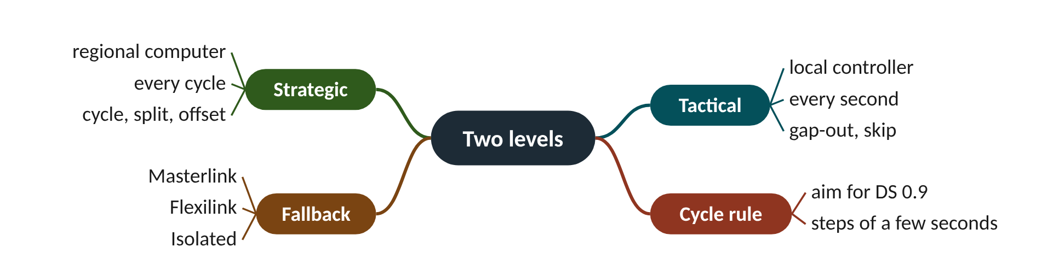
Remember it: Two levels
PICTURE THIS · STOP 2: DOUBLE-DECKER TRAM
TRAP
Halfway across the bridge a double-decker tram rattles by. Downstairs a driver slaps a big button every single second, shouting 'empty, next!'. Upstairs a captain with a clipboard looks through a telescope and, once a lap, turns a dial by exactly six clicks.
Gap-out is tactical, not strategic. Ending a green early because the road emptied happens in the local controller within seconds; it is not a decision of the regional computer.
Notes:
What the scene encodes: Downstairs driver = tactical control every second (gap-out, skip); upstairs captain = strategic control once per cycle; six clicks = the ±6 s cycle step.
Recap: Two levels: tactical control every second in the local controller (gap-out, skip); strategic control every cycle in the regional computer (cycle towards DS 0.9, splits, offsets).

Slide 12
3 The timing vocabulary
IN PLAIN WORDS
A cycle is a pizza. Each phase gets a slice; the split says how big each slice is. The crust between slices is the intergreen: it comes with every slice and nobody really eats it.
Phase: movements that run together
Cycle: all phases, intergreens included
Split: how green is shared
Intergreen: amber plus all-red, lost
48 / 32 s
greens of a 90 s cycle split 60/40
Notes:
Every signal plan in the world is described with the same five words. Learn them once and every traffic engineering conversation becomes readable.
A phase is a set of movements that may run together; here A is the main road and B the side road. The cycle (SCATS calls its length RL) is the time for every phase to run once, including the changeovers.
Between two phases comes the intergreen: amber plus all-red. Traffic barely moves, so it is lost time. Whatever is left of the cycle is green, shared between phases by the split. SCATS keeps a small library of split plans (SP1 to SP4 in this lab).
The offset is when a cycle starts at one intersection compared with a reference one. Good offsets make green waves; the Advanced level covers them.
Presenter tip: The pizza analogy works well drawn on the board. Make sure everyone subtracts the intergreens before sharing the green.

Slide 13
Worked example: Building a 90 s cycle
total green = cycle − (number of phases × intergreen)
green_{i} = total green × split share_{i}
Two phases, 5 s intergreen each, split 60% to A and 40% to B.
1. Lost time = 2 × 5 = 10 s.
2. Total green = 90 − 10 = 80 s.
3. Phase A green = 80 × 0.60 = 48 s; phase B green = 80 × 0.40 = 32 s.
4. Share of the cycle lost = 10 ÷ 90 = 11.1%. With a 60 s cycle it would be 10 ÷ 60 = 16.7%.
Longer cycles waste a smaller share of time, but make drivers wait longer at red. Choosing the cycle is a balance.
Notes:
Share of the cycle lost to intergreens (2 phases × 5 s). What to notice: the same 10 s of intergreen is a quarter of a 40 s cycle but under a tenth of a 120 s cycle. Computed as 10 ÷ cycle.
Try it with the audience: A 120 s cycle has three phases with 5 s intergreen each and a split of 50% / 30% / 20%. Find each green and the share of the cycle lost.
Answer: Lost = 3 × 5 = 15 s; green = 105 s. Greens: 52.5 s, 31.5 s, 21 s. Lost share = 15 ÷ 120 = 12.5%.

Slide 14
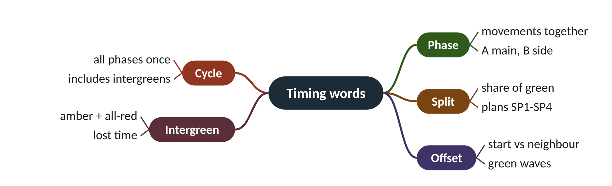
Remember it: Timing words
PICTURE THIS · STOP 3: PIZZA CLOCK TOWER
TRAP
On a tower above the bridge, the clock face is a giant pizza. The hand sweeps round once per cycle. Two slices, one big and one small, are painted A and B, and a thick burnt crust between them crunches loudly every time the hand passes.
The cycle includes the intergreens. A 90 s cycle with two 5 s intergreens has only 80 s of green to share, not 90.
Notes:
What the scene encodes: Whole pizza = cycle; slices = phases; slice sizes = split; burnt crust = intergreen (lost time); the hand's start time vs the next tower = offset.
Recap: Timing words: phase = movements together; cycle = all phases plus intergreens; split = share of green; intergreen = amber + all-red (lost); offset = start time vs neighbour.

Slide 15
4 Measuring demand: the degree of saturation
IN PLAIN WORDS
Think of a supermarket checkout. Even when the queue is endless there is a short pause between customers. Any pause longer than that normal pause is the cashier waiting for nobody: wasted time.
Loop measures gap time during green
Wasted green = T − n·h
DS = used green ÷ green
VK turns DS into car-equivalents
DS 0.90
g 40 s, T 20 s, 10 cars, h 1.6 s
Notes:
How do you know how busy a green was, without counting cars? Measure the empty road. Whatever was not empty was used.
During each green SCATS watches the stop-line loop and adds up the gap time T: every moment when nothing is over the loop. It also counts the vehicles n.
Even a perfectly packed stream of cars leaves a small gap between each pair, the standard space time h. So n vehicles 'should' leave n × h of gap. Any gap beyond that, T − n·h, is wasted green. The rest is used green g′, and the degree of saturation is the share of the green that was used.
SCATS also turns DS into VK, a car-equivalent volume, using MF, the maximum flow the lane can carry (learned automatically). Because DS is measured in time, a truck that covers the loop longer counts for more, just as it uses more green.
Presenter tip: Work the five steps on the board. Then ask what happens to DS if h is too small, and show the chart.

Slide 16
Worked example: DS and VK from one green
g′ = g − (T − n·h)
DS = g′ ÷ g
VK = DS × g × MF ÷ 3600
Green g = 40 s. The loop was empty for T = 20 s. n = 10 vehicles crossed. h = 1.6 s, MF = 1800 veh/h.
1. Expected gaps: n × h = 10 × 1.6 = 16 s.
2. Wasted green: T − n·h = 20 − 16 = 4 s.
3. Used green: g′ = 40 − 4 = 36 s.
4. DS = 36 ÷ 40 = 0.90.
5. VK = 0.90 × 40 × 1800 ÷ 3600 = 18 car-equivalents.
90% of the green was used: right at the usual target. If h were set wrongly, DS would be wrong too, which is why h is calibrated.
Notes:
Measured DS against true arrival flow, for a correct and a wrong h. What to notice: with the true h (1.55 s here: one car every 2 s, each covering the loop 0.45 s) DS rises in a straight line to 1 at 1800 veh/h. With h set too small (1.0 s) DS is under-estimated by about a quarter, so SCATS would give too little green. Computed for g = 40 s.
Try it with the audience: Green g = 30 s, gap time T = 15 s, n = 8 vehicles, h = 1.6 s, MF = 1730 veh/h. Find DS and VK.
Answer: n·h = 12.8 s; wasted = 15 − 12.8 = 2.2 s; g′ = 27.8 s; DS = 27.8 ÷ 30 = 0.927. VK = 0.927 × 30 × 1730 ÷ 3600 = 13.4.

Slide 17
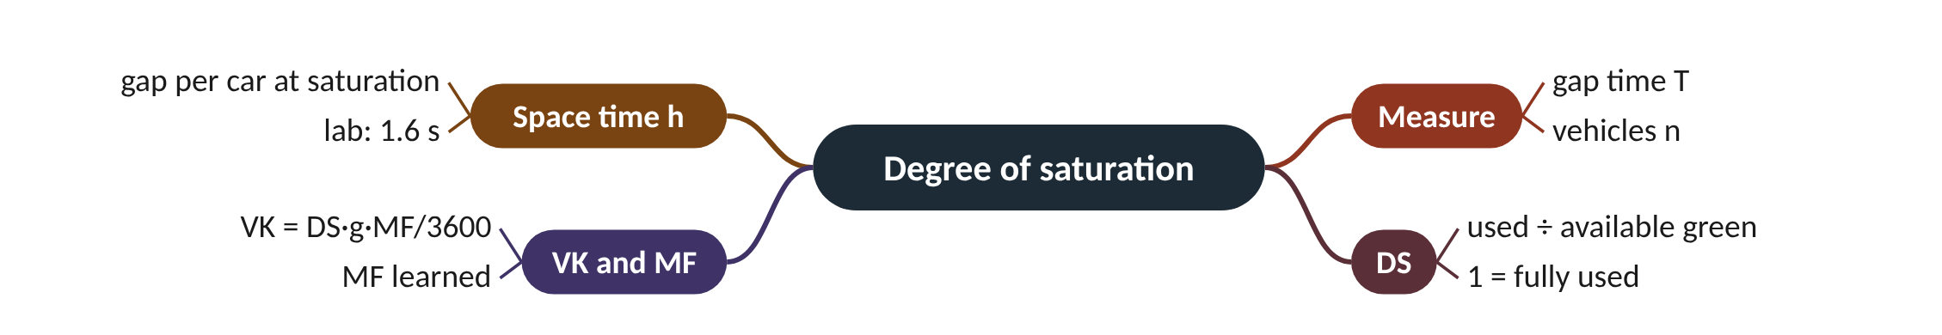
Remember it: Degree of saturation
PICTURE THIS · STOP 4: ICE-CREAM CART
TRAP
By the bridge's far pylon an ice-cream seller serves a queue. Between customers she holds up a ruler 1.6 long; any gap longer than the ruler, she drops a cone in a bin labelled WASTED. A scoreboard shows 'used ÷ open time'.
DS is not 'number of cars ÷ capacity' counted in vehicles. It is measured in time from the loop's gaps, and it depends on h. A wrong h gives a wrong DS for every cycle.
Notes:
What the scene encodes: Ruler = h (1.6 s); cones in the bin = wasted green T − n·h; the scoreboard = DS = g′ ÷ g.
Recap: Degree of saturation: wasted = T − n·h, used g′ = g − wasted, DS = g′/g, VK = DS·g·MF/3600; h must be calibrated.

Slide 18
5 Fixed time, actuated and SCATS
IN PLAIN WORDS
Fixed time is a lift that stops at every floor whether anyone is waiting or not. Actuated is a lift that skips empty floors. SCATS also skips empty floors, and every few minutes rethinks its whole timetable from how busy it was.
Fixed: one plan, ignores traffic
Actuated: ends empty greens early
SCATS: also re-plans every cycle
Lab F3: 20.4 vs 15.0 vs 14.3 s
−30%
SCATS delay vs fixed time in Lab F3
Notes:
Put three controllers on the same junction with the same cars. The plain timer loses badly. But the race between the other two is much closer than you might expect.
Fixed time runs one plan (here a 90 s cycle) whatever the traffic. Actuated control uses the loops to end greens early by gap-out but keeps fixed maximum greens. SCATS adds the strategic layer: after every cycle it computes DS, moves the cycle length towards DS 0.9 and votes on the best of four split plans.
In Lab F3 (one intersection in SUMO, one hour with a peak in the middle, identical arrivals) the mean delay was 20.44 s for fixed time, 14.96 s for actuated and 14.27 s for SCATS. Stops per vehicle were 0.64, 0.62 and 0.565.
At one isolated intersection SCATS and good actuation finish close together: both end greens when traffic clears. SCATS earns its keep through coordinating many intersections.
Presenter tip: Be honest that actuation is strong at one intersection. Use it to motivate the Advanced level's corridor.

Slide 19
Worked example: How big are the differences?
improvement = (old − new) ÷ old × 100%
Lab F3 mean delays: fixed 20.44 s, actuated 14.96 s, SCATS 14.27 s.
1. SCATS vs fixed: (20.44 − 14.27) ÷ 20.44 = 6.17 ÷ 20.44 = 30.2% less delay.
2. SCATS vs actuated: (14.96 − 14.27) ÷ 14.96 = 0.69 ÷ 14.96 = 4.6% less delay.
3. Actuated vs fixed: (20.44 − 14.96) ÷ 20.44 = 26.8% less delay.
Most of the gain over fixed time comes from reacting to gaps; SCATS's strategic layer adds a little more at a single intersection.
Notes:
Mean delay per vehicle in Lab F3 (SUMO, one intersection, one hour). What to notice: fixed time is clearly worst; actuated and SCATS are close, with SCATS slightly ahead. Results from the repository's SUMO run (seed 1).
Try it with the audience: Stops per vehicle in Lab F3 were 0.64 (fixed) and 0.565 (SCATS). By what percentage did SCATS cut stops?
Answer: (0.64 − 0.565) ÷ 0.64 = 0.075 ÷ 0.64 = 11.7% fewer stops.

Slide 20
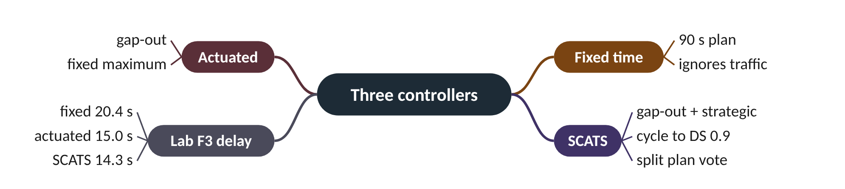
Remember it: Three controllers
PICTURE THIS · STOP 5: FERRY RACE
TRAP
Below the bridge three ferries race to the quay. A rusty clockwork ferry chugs in at twenty and a half. A jumpy speedboat arrives at fifteen, and just ahead of it, at fourteen and a quarter, glides a ferry whose captain studies a chart after every lap.
Do not conclude 'SCATS is only 5% better than actuation'. This test is one isolated intersection. Coordination across a corridor, which actuation cannot do, is where the bigger gains appear.
Notes:
What the scene encodes: Finish times are Lab F3 delays: fixed 20.4 s, actuated 15.0 s, SCATS 14.3 s; the chart-reading captain = SCATS's strategic layer.
Recap: Three controllers: fixed ignores traffic, actuated gaps out, SCATS gaps out and re-plans each cycle. Lab F3 delay: 20.4 / 15.0 / 14.3 s.

Slide 21
6 Where fixed-time plans come from
IN PLAIN WORDS
Webster is a tailor who measures you once and sews a perfect suit. It fits beautifully on that day. If you gain weight or wear a coat underneath, the suit no longer fits, and nobody re-measures you.
Webster designs one fixed plan
C0 = (1.5L + 5) ÷ (1 − Y)
Cycle explodes as Y nears 1
SCATS needs calibrated h and MF
h = 1.62 s
calibrated standard space time (Lab F2)
Notes:
A fixed plan is a suit tailored for one day's traffic. Webster's formula is the tailor. SCATS, in effect, re-measures the customer every cycle.
Fixed-time plans are usually designed with Webster's formula (1958). It balances lost time against queueing for one assumed demand. Each phase's flow ratio y is its flow q divided by its saturation flow s; Y adds up the critical ones; L is the total lost time per cycle.
The formula gives the cycle with the least delay, and shares the effective green in proportion to the flow ratios. As Y approaches 1 the cycle grows without limit: the intersection is near capacity.
SCATS needs no design day, but it does need calibration. Lab F2 overloaded the main road and measured h = 1.62 s and a maximum flow MF ≈ 1730 veh/h, the values the controller uses.
Presenter tip: Compute the Webster example together. Then explain that SCATS replaces the design day with measurement, which is why calibration of h matters.

Slide 22
Worked example: Webster for a two-phase intersection
C₀ = (1.5 L + 5) ÷ (1 − Y)
g_{i} = (C₀ − L) × y_{i} ÷ Y
Lost time L = 10 s. Main road y_{A} = 0.40, side road y_{B} = 0.20.
1. Y = 0.40 + 0.20 = 0.60.
2. C₀ = (1.5 × 10 + 5) ÷ (1 − 0.60) = 20 ÷ 0.40 = 50 s.
3. Green to share = 50 − 10 = 40 s.
4. Main road: 40 × 0.40 ÷ 0.60 = 26.7 s. Side road: 40 × 0.20 ÷ 0.60 = 13.3 s.
A good fixed plan for exactly these flows: 50 s cycle, 26.7 s and 13.3 s of effective green.
Notes:
Webster's optimum cycle as demand grows (L = 10 s). What to notice: the cycle grows slowly at first, then shoots up as Y nears 1. At Y = 0.85 it is already 133 s. Computed from C0 = 20 ÷ (1 − Y).
Try it with the audience: Use Webster with L = 12 s, yA = 0.45, yB = 0.25. Find C0 and both greens.
Answer: Y = 0.70. C0 = (18 + 5) ÷ 0.30 = 76.7 s. Green to share = 64.7 s. Main 64.7 × 0.45/0.70 = 41.6 s; side 64.7 × 0.25/0.70 = 23.1 s.

Slide 23
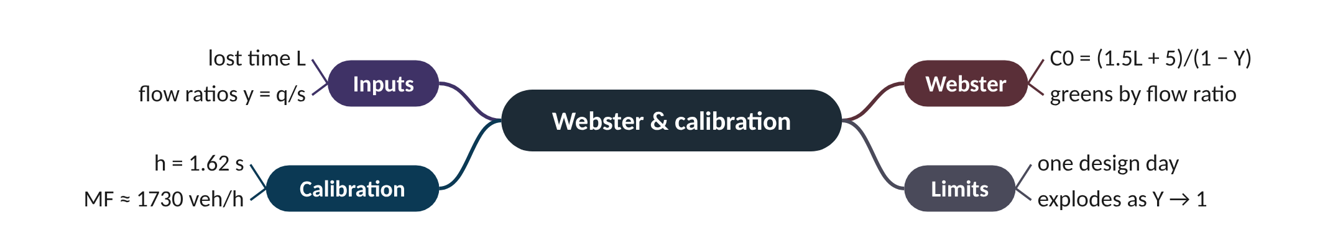
Remember it: Webster & calibration
PICTURE THIS · STOP 6: TAILOR AT THE OPERA HOUSE
TRAP
On the opera house steps a tailor stitches a suit onto a dancer. His tape measure is printed '1.5 L + 5', and the suit fits perfectly until the dancer eats a giant pie and the buttons fly off. Next door an assistant re-measures a second dancer after every pirouette, holding a ruler marked 1.62.
If Y ≥ 1 no cycle length works: demand exceeds capacity. A huge cycle from Webster is a warning that the intersection is near capacity, not a plan to use.
Notes:
What the scene encodes: Tailor = Webster's formula C0 = (1.5L + 5)/(1 − Y) for one design day; popping buttons = demand changing; the re-measuring assistant = SCATS re-solving every cycle; 1.62 = calibrated h.
Recap: Webster and calibration: C0 = (1.5L + 5)/(1 − Y) designs one fixed plan; SCATS re-solves every cycle but needs calibrated h (1.62 s) and MF (≈ 1730 veh/h).

Slide 24
Three ways to run a traffic light
 | Fixed time | Actuated | SCATS
Detectors | none needed | stop-line loops | stop-line loops in every lane
Ends a green early? | no | yes, by gap-out | yes, by gap-out
Changes the cycle? | no | no (fixed maximum) | every cycle, towards DS 0.9
Coordinates neighbours? | if designed so | no | yes: subsystems, offsets
Lab F3 delay | 20.44 s | 14.96 s | 14.27 s

Slide 25
Things beginners mix up
This… | …is not this | The fact that tells them apart
Tactical | Strategic | Tactical decides every second in the local controller; strategic decides once per cycle in the regional computer.
Cycle | Total green | The cycle includes the intergreens; total green is what is left after them.
Gap time T | Wasted green | Wasted green is T minus the normal gaps n·h.
DS | Vehicle count ÷ capacity | DS is measured in time from loop gaps, so trucks count for more automatically.
Adaptive | Unlimited | SCATS changes timings in small steps and from approved plans.

Slide 26
Check yourself (1 of 2)
A 90 s cycle has two phases with 5 s intergreen each, split 70/30. What is phase A's green?
The cycle is 100 s and the busiest phase had DS 0.72. Using this lab's rule, what is the next cycle?
A. 63 s
B. 56 s
C. 59.5 s
D. 45 s
A. 80 s
B. 94 s
C. 106 s
D. 100 s
Answers are in the speaker notes and in the study guide's answer key.
Notes:
Answer: B. Green = 90 − 10 = 80 s; 80 × 0.70 = 56 s. 63 s forgets to remove the intergreens.
Answer: B. Desired = 100 × 0.72 ÷ 0.9 = 80 s, but the step is limited to −6 s, giving 94 s.

Slide 27
Check yourself (2 of 2)
In Lab F3, which controller had the lowest mean delay?
A truck and a car pass the loop during a saturated green. How does DS treat the truck?
A. Fixed time
B. Actuated
C. SCATS
D. All equal
A. Ignores it
B. Counts it as one car
C. It leaves less empty time, so it raises DS as it uses more green
D. It lowers DS
Answers are in the speaker notes and in the study guide's answer key.
Notes:
Answer: C. SCATS 14.27 s, actuated 14.96 s, fixed 20.44 s.
Answer: C. DS is measured in time: a long vehicle covers the loop longer, leaving less gap time.

Slide 28
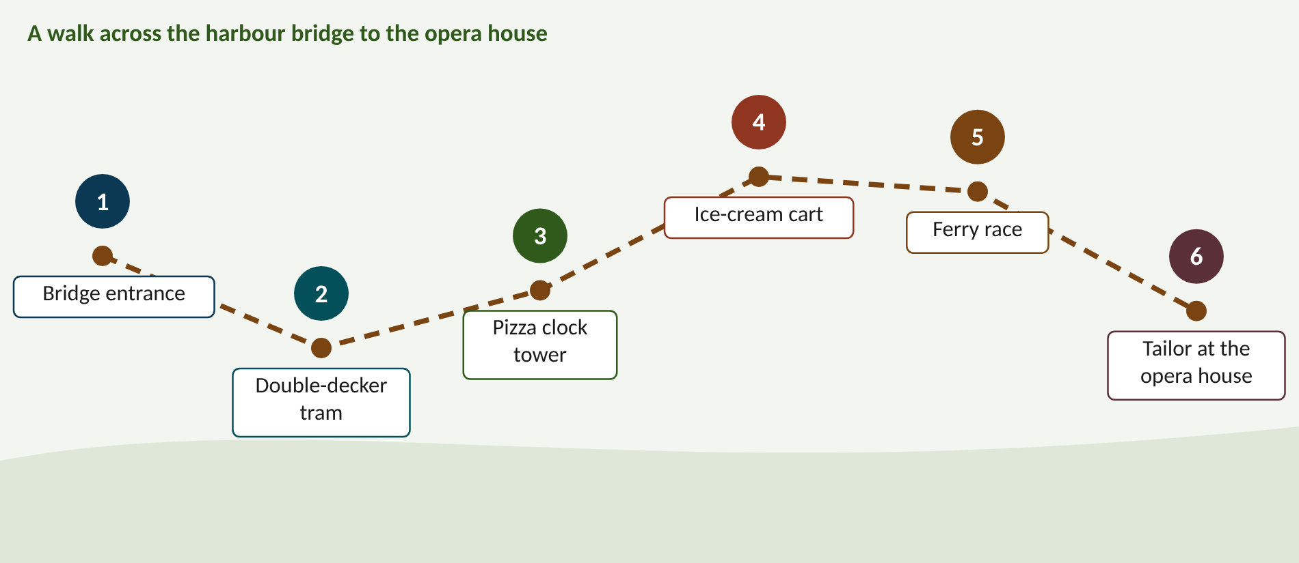
Walk the memory route
1 Bridge entrance = What SCATS is · 2 Double-decker tram = Two levels · 3 Pizza clock tower = Timing words · 4 Ice-cream cart = Degree of saturation · 5 Ferry race = Three controllers · 6 Tailor at the opera house = Webster & calibration
Notes:
Stop 1, Bridge entrance: At the start of the bridge a conductor in a huge coat waves a baton at the traffic lights. Instead of one score she flips between four thick music books, and after every bar she scribbles a red mark on the page she just played. (Conductor = coordinated; red marks after every bar = adaptive grading of each cycle; four music books = the library of split plans (plan-based).)
Stop 2, Double-decker tram: Halfway across the bridge a double-decker tram rattles by. Downstairs a driver slaps a big button every single second, shouting 'empty, next!'. Upstairs a captain with a clipboard looks through a telescope and, once a lap, turns a dial by exactly six clicks. (Downstairs driver = tactical control every second (gap-out, skip); upstairs captain = strategic control once per cycle; six clicks = the ±6 s cycle step.)
Stop 3, Pizza clock tower: On a tower above the bridge, the clock face is a giant pizza. The hand sweeps round once per cycle. Two slices, one big and one small, are painted A and B, and a thick burnt crust between them crunches loudly every time the hand passes. (Whole pizza = cycle; slices = phases; slice sizes = split; burnt crust = intergreen (lost time); the hand's start time vs the next tower = offset.)
Stop 4, Ice-cream cart: By the bridge's far pylon an ice-cream seller serves a queue. Between customers she holds up a ruler 1.6 long; any gap longer than the ruler, she drops a cone in a bin labelled WASTED. A scoreboard shows 'used ÷ open time'. (Ruler = h (1.6 s); cones in the bin = wasted green T − n·h; the scoreboard = DS = g′ ÷ g.)
Stop 5, Ferry race: Below the bridge three ferries race to the quay. A rusty clockwork ferry chugs in at twenty and a half. A jumpy speedboat arrives at fifteen, and just ahead of it, at fourteen and a quarter, glides a ferry whose captain studies a chart after every lap. (Finish times are Lab F3 delays: fixed 20.4 s, actuated 15.0 s, SCATS 14.3 s; the chart-reading captain = SCATS's strategic layer.)
Stop 6, Tailor at the opera house: On the opera house steps a tailor stitches a suit onto a dancer. His tape measure is printed '1.5 L + 5', and the suit fits perfectly until the dancer eats a giant pie and the buttons fly off. Next door an assistant re-measures a second dancer after every pirouette, holding a ruler marked 1.62. (Tailor = Webster's formula C0 = (1.5L + 5)/(1 − Y) for one design day; popping buttons = demand changing; the re-measuring assistant = SCATS re-solving every cycle; 1.62 = calibrated h.)

Slide 29
Numbers to remember
› Target DS ≈ 0.9
› Cycle 40-140 s, step +6 (+9 if DS ≥ 1) / −6 s
› Gap-out setting 3 s; intergreen 5 s
› h = 1.62 s, MF ≈ 1730 veh/h (Lab F2)
› g 40, T 20, n 10, h 1.6 → DS 0.90, VK 18
› Lab F3 delay: 20.44 / 14.96 / 14.27 s
› Webster: L 10, Y 0.6 → C₀ = 50 s

Slide 30
Keep going
Study guide: SCATS_Foundation_Study_Guide.pdf · Interactive labs and SUMO code: smrahmanbd.github.io/scats-learning-lab
Notes:
Point learners to the study guide for the full worked examples, quiz and revision plan, and to the website for the simulators.

